Slide 1


GAINS 101
Grants Program Administration Office
1
Notes:
Mandy – slides 1 - 10
Megan – slides 11 - infinity

Slide 2

Agenda
What is GAINS?
Who is in GAINS?
Roles and Permissions
Logging In
IdM vs Native Login
GAINS Navigation
Associated Organizations
Funding Applications
Left Side Bar
Workflow
Supplemental Applications
Fund Requests
Resources
Small Bites
Help Desk Tickets
GAINS Inbox
GAINS 101
2

Slide 3

What is GAINS?
Grants Administration Implementation and Navigation System (GAINS) is CDE's grants management system for formula and competitive grants administered by the department
Adopted in September 2023
GAINS 101
3

Slide 4
Who’s Using GAINS?
All Colorado School Districts
Boards of Cooperative Education Services (BOCES)
Administrative Units
Charter Schools
Community Based Organizations
Institutions of Higher Education
Award Applicants (Schools, Teachers, Students, etc.)
GAINS 101
4

Slide 5
Roles And Permissions (Overview)
GAINS is a roles-based system, and at least one role associated with an organization must be assigned to a user’s profile before they can utilize much of the system’s functionalities.
A user role is a set of permissions that allows a person to start and edit grant applications, view grant data, complete monitoring and reporting requirements, submit revisions, approve various workflow steps, and more.
Roles are assigned by an organization’s User Access Administrator.
There are exceptions where CDE will create and/or manage users for these organization types.
Charter Schools
Award Applicants
Community Based Organizations
Institutions of Higher Education
GAINS 101
5

Slide 6
Roles And Permissions (Overview) cont.
Keep in mind the following aspects of user roles:
A role grants a set of permissions in the system,
A user can have more than one role,
A role can be assigned to more than one user, and
Every organization MUST have a LEA Fiscal Representative and LEA Authorized Representative assigned to submit applications and create Fund Requests.
Visit the GAINS Roles Webpage for specific role titles and associated permissions.
GAINS 101
6

Slide 7
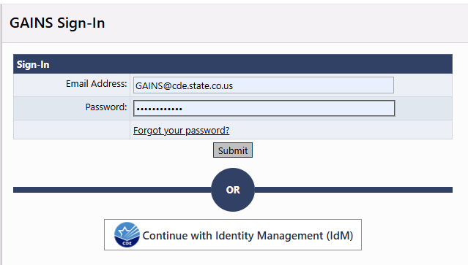
Logging Into GAINS
School district, BOCES, and Administrative Unit personnel will log in with their CDE Identity Management (IdM) user profile.
Charter school, community-based organizations, libraries, institutions of higher education personnel, and award applicants will log in using the GAINS system sign in box.
GAINS 101
7

Slide 8
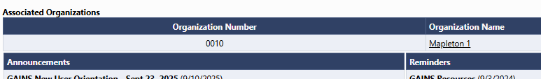
GAINS Navigation – Associated Organizations
Once logged in, users will see the organizations with which their profile is associated on the GAINS Home page. Most users will likely only have a single organization tied to their profile. Clicking on the Organization Name will access applications and information for that organization. This will also expand the left navigation menu with additional options for that organization.
GAINS 101
8

Slide 9
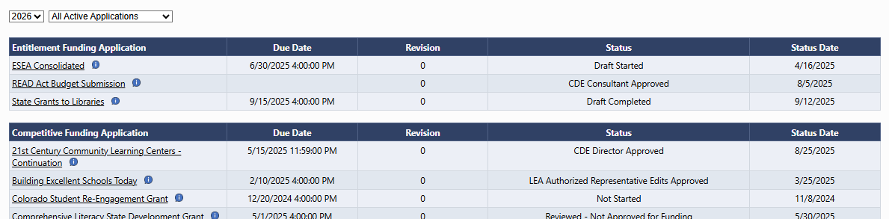
GAINS Navigation – Funding Applications
After selecting the Organization Name, the user will be taken to the Funding Applications page. Here, they will be able to access all active Entitlement (Formula) and Competitive applications by fiscal year. To enter any application, click on the name of the program.
GAINS 101
9

Slide 10
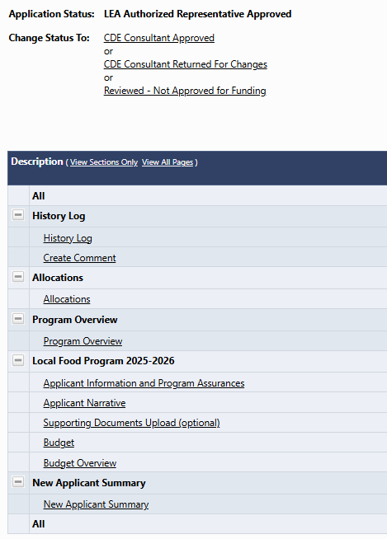
GAINS Navigation – Sections Page
Once the user selects a program application, they will be taken to the Sections page of the application. Here, you’ll be able to access any narrative or budget elements of the grant, view its current status, and see the history of the application in the system.
GAINS 101
10

Slide 11
GAINS Navigation – Left Side Bar
GAINS Home: Use this to return to the main home page at any time.
Search: Use this feature to search for organizations, grants, or application supplements.
Inbox: Use this feature to locate all emailed communications through GAINS.
Monitoring: Use this feature to access any monitoring instruments assigned to the organization.
Application Supplement: Use this feature to access any Application Supplements assigned to the organization.
Funding: Use this feature to access your organization’s Funding Application page list, locate the Budget Summary page, and download a Budget Revenue File from the Budget Download page.
Fund Request: Use this feature to locate a summary of all fund requests, click to view fund requests by grant, and search fund requests.
GAINS 101
11

Slide 12
GAINS Navigation – Left Side Bar (Cont.)
Project Overview: Use this feature to see an overview of payments against approved budgets by funding application. This feature is useful to get a broad overview of what has been paid for a specific awarded grant and what has yet to be drawn down.
LEA Document Library: Use this to find organization specific grant and related documentation from CDE such as Grant Award Letters (GALs).
Address Book: Use this to view members of your organization by role in GAINS. This is particularly useful in identifying and finding contact information for LEA User Access Administrators who can assign and remove roles of users in your organization.
CDE Resources: Use this feature to locate general CDE GAINS Resources.
Help for Current Page: User this feature to view resources specific to the page you are on. A number next to the link indicates that a resource is available to view.
Contact CDE: Use this feature to send general GAINS support and technical questions to the CDE GAINS teams.
GAINS 101
12

Slide 13
GAINS Navigation – Workflow
In general, funding applications in GAINS follow the following approval workflow in the system:
Draft Started
Draft Completed
LEA Fiscal Representative Approved
LEA Authorized Representative Approved
CDE Consultant Approved
CDE Director Approved
CDE Fiscal Analyst Approved
CDE Fiscal Manager Approved
Note: Once an application is moved to Authorized Representative Approved, it is officially submitted to CDE.
GAINS 101
13

Slide 14
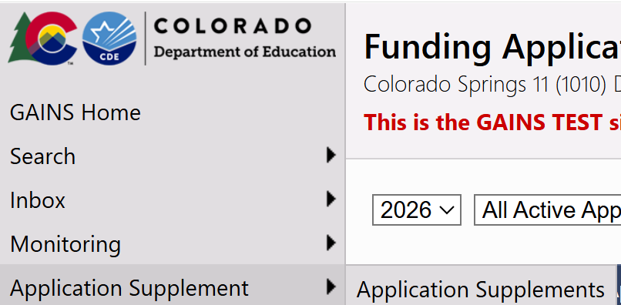
GAINS Navigation - Supplements
Application Supplements are application submissions that do not contain a budget.
Award applications
Intent to Apply requests
Reporting requirements
GAINS 101
14

Slide 15
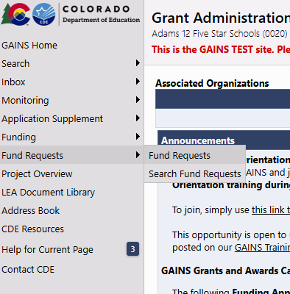
Fund Requests
Fund requests will be completed in GAINS.
Fund requests can be filtered by funding year or by individual funding applications.
Or all fund requests can be viewed at once by selecting "All" as the fiscal year.
The Fund Request page shows the available budget amount, total available amount, received amount, net available amount, and pending request amount.
GAINS 101
15

Slide 16
Resources
Small Bites
Help Desk Tickets
GAINS Inbox (GAINS@cde.state.co.us)
GAINS 101
16

