Slide 1
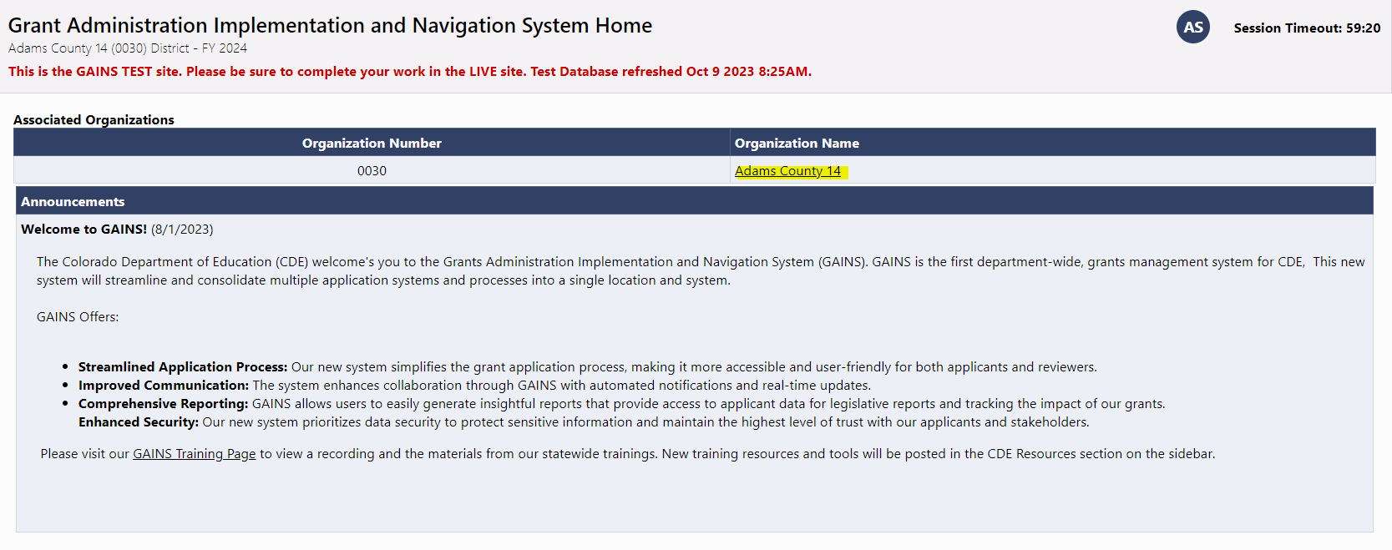
Navigate to Funding Applications
Login and Select your Organization's name:
Note: Using the Search option on the sidebar will NOT result in viewing your organization’s specific grants.

Slide 2
Finding 2025 Grants
Select 2025 from the dropdown

Slide 3
Open the Grant for Editing
Tip: Once inside, be sure to change the application status to “DRAFT STARTED”

