Slide 1

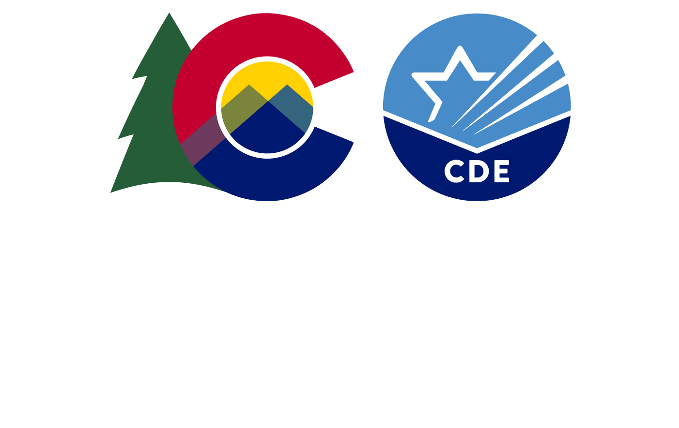
Annual Financial Management Certification and Assurances
Grants Program Administration Office
in collaboration with
Grants Fiscal Management Unit
1

Slide 2

Agenda
What is the Financial Certification?
Who must complete it and how often?
GAINS Navigation for the Certification
2

Slide 3

What is the Financial Management Certification and Assurances form?
Every entity that receives federal funds must comply with applicable federal regulations, statutes and other compliance requirements.
Annual completion of this form serves several purposes:
Functions as your entity’s annual certification of compliance
Enables CDE to target technical assistance needs to best serve the population
Documents CDE’s compliance with our requirement to assess the “risk of noncompliance” for our universe of LEAs
3

Slide 4
Who must complete the form and how often?
Every entity receiving federal funds through CDE
Must be signed off by the Authorized Representative within GAINS
Starting in January, you will receive an email from GAINS indicating it is ready to complete.
Once complete, internal CDE staff will review and reach out if anything additional is needed
The form must be completed every January and is “effective” for the coming fiscal year (e.g., completion in January 2026 is for FY27)
Every entity receiving any federal awards through CDE is expected to have a current document on file each fiscal year starting with FY27
4

Slide 5
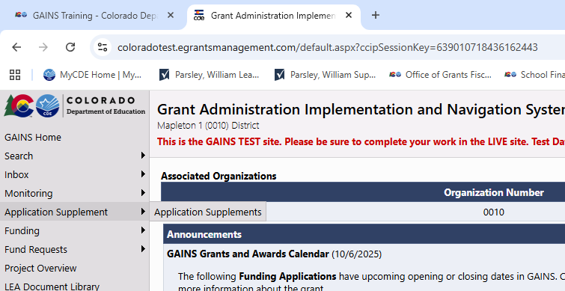
Where to find the form?
Once logged into your GAINS dashboard, navigate to the Application Supplements
5

Slide 6
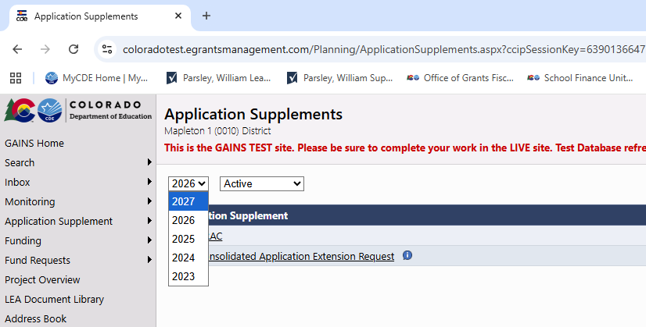
Where to find the form? (cont)
Within the Application Supplements, choose the correct fiscal year (for this first submission in January 2026, it will be FY27)
6

Slide 7
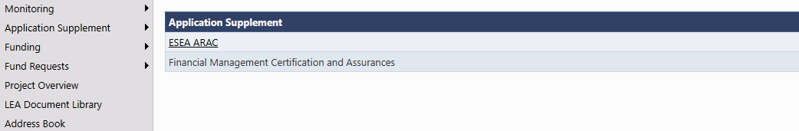
Where to find the form? (cont.)
Select the Financial Management Certification and Assurances link and then change the status to “Draft Started”
7

Slide 8
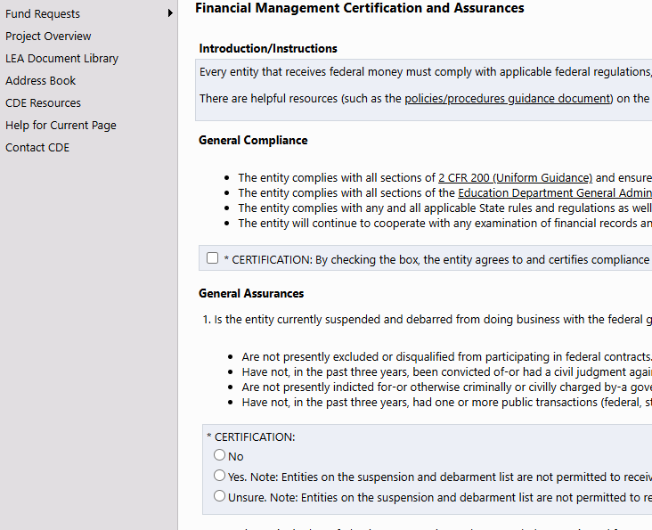
How to complete the form?
Answer the questions as complete as possible. First question is a single check box to certify your LEA will comply with all applicable rules required of every recipient of federal funds. The rest are Y/N responses specific to the situation at your LEA.
For GAINS, there are no right or wrong answers. Only checking for completeness. CDE internal staff will review responses for any potential areas for technical assistance.
8

Slide 9
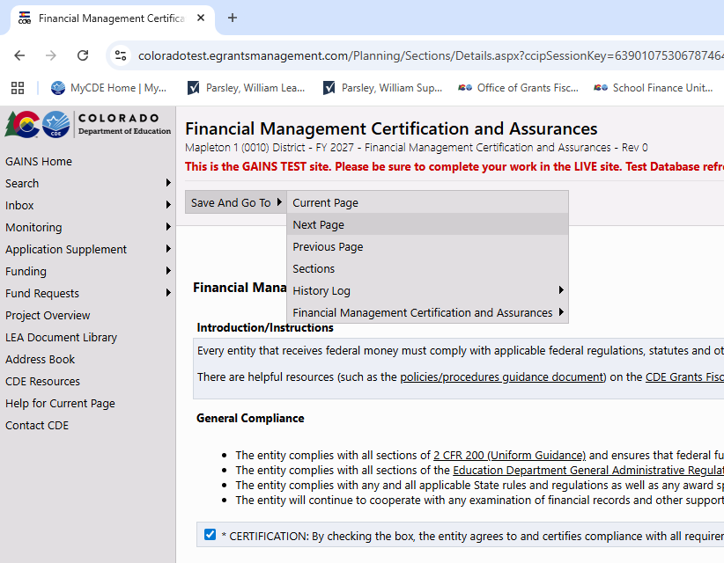
How to complete the form? (cont)
Once all questions have been answered, click Save and Go To Next Page.
Change status to “Draft Completed” then it follows the standard LEA Approvals to submit within GAINS to CDE.
As mentioned, the document is reviewed internally. Any concerns will be brought to your LEA from CDE staff. No word means we have your form, and you are good until next January.
9

Slide 10
Resources
Small Bites
Help Desk Tickets
GAINS Inbox (GAINS@cde.state.co.us)
GFMU Inbox (Grants_Fiscal@cde.state.co.us)
10

