Slide 1
EL Identification: Parent/Family Notification Requirement
November 15, 2018

Slide 2
Purpose and Agenda:
To support LEA’s in understanding 2018 Monitoring indicators associated with Title I and III English Learner (EL) Parent Notification Requirements
EL Identification Parent Notification Monitoring Procedure
Sample EL Identification Parent Notification Letter
Considerations for Effective Parent Notification
Demonstrating Evidence in Monitoring Process

Slide 3

ESSA: Title III Sec. 3116(b) – Slide 1
EL Identification Parent Notifications Requirements:
Under Every Student Succeeds Act (ESSA), parent notification requirements are found in section §§1112(e) and Title III section 3116(b).
LEAs must notify parents of their child’s enrollment in an ELD program no later than 30 days after the beginning of the school year, or within two weeks if identification occurs after the school year begins.
Notifications must be in an understandable and uniform format, and to the extent practicable, in a language that parents can understand.

Slide 4
ESSA: Title III Sec. 3116(b) – Slide 2
Notifications must include the:
  Reason why the child was identified as EL;
  Level of English proficiency and how the child was assessed;
  Method of instruction used in programs (if more than one, include all);
  Exit requirements for the programs and graduation rates for secondary students; and,
  Parents right to opt out of program services.
Notifications must also include how the program:
  Meets the needs of children with a disability/IEP (if applicable);
  Will meet the educational strengths of the child; and,
  Will help the child learn English.

Slide 5
State Requirements
English Language Proficiency Act (ELPA), CRS 22-24-101
Requires all Colorado districts, Charter School Institute, and facility schools to identify ELs

Slide 6
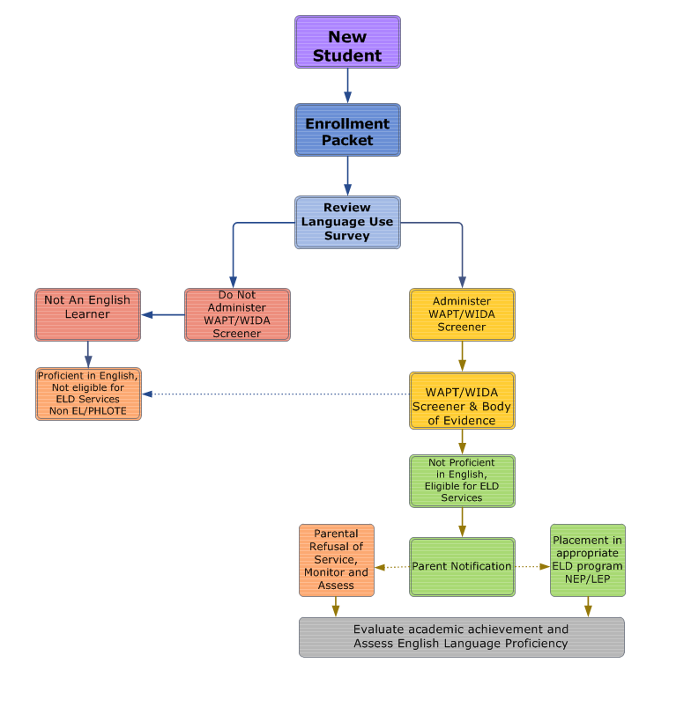
Colorado Identification Process
*Deliver Parent Notification
Notes:
Adapted from CLDE Identification Webinar
The parent notification is the outcome of student’s identification as an English learner. The notification is here on the continuum after screening and determining if a student is eligible for students
There are some key components of EL Identification that we are not discussing in this monitoring webinar
For more resources on effective identification and tools, please consult the CLDE website has identification and redesignation guidance and the CLDE team contacts
If you have questions about your identification process, please let us know

Slide 7
Monitoring
Notes:
We are going to go ahead and move onto monitoring. We will be discussing the Stakeholder Engagement indicator 9.8

Slide 8
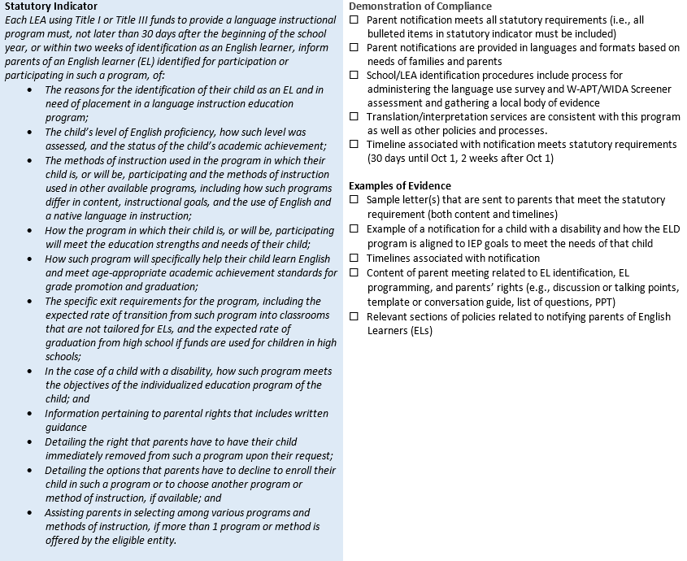
Stakeholder Engagement 9.8 Slide 1
Notes:
This is the language we have included to support you on the monitoring document.
1st Box
Use pointer for this. As outlined earlier, here are the statutory requirements such as reason for identification, level of English proficiency, method of instruction in the program the child is participating, how the program will help the student meet academic achievement, exit requirements, if/how a student’s disability accommodations are being met, opt out, or other programming options if available. Naturally, the statutes are aligned with the demonstration indicators which should all be met. This is the minimum practice or information that must be included in parent notifications
2nd box
We will outline what this looks like using the sample letter to follow and discuss other avenues for communicating with your parent/family communities. This part is more detail of the items necessary for notification.
3rd box
The evidence is submitted to meet the indicators in January. We will have a webinar at the end of November to support you in how to submit this evidence
You have 30 days after enrollment at the beginning of the school year
If a student enrolls after October count, you have two weeks after student is identified to notify parents
One resource that CDE offers to support LEA’s in meeting this requirement is the sample parent notification letter

Slide 9
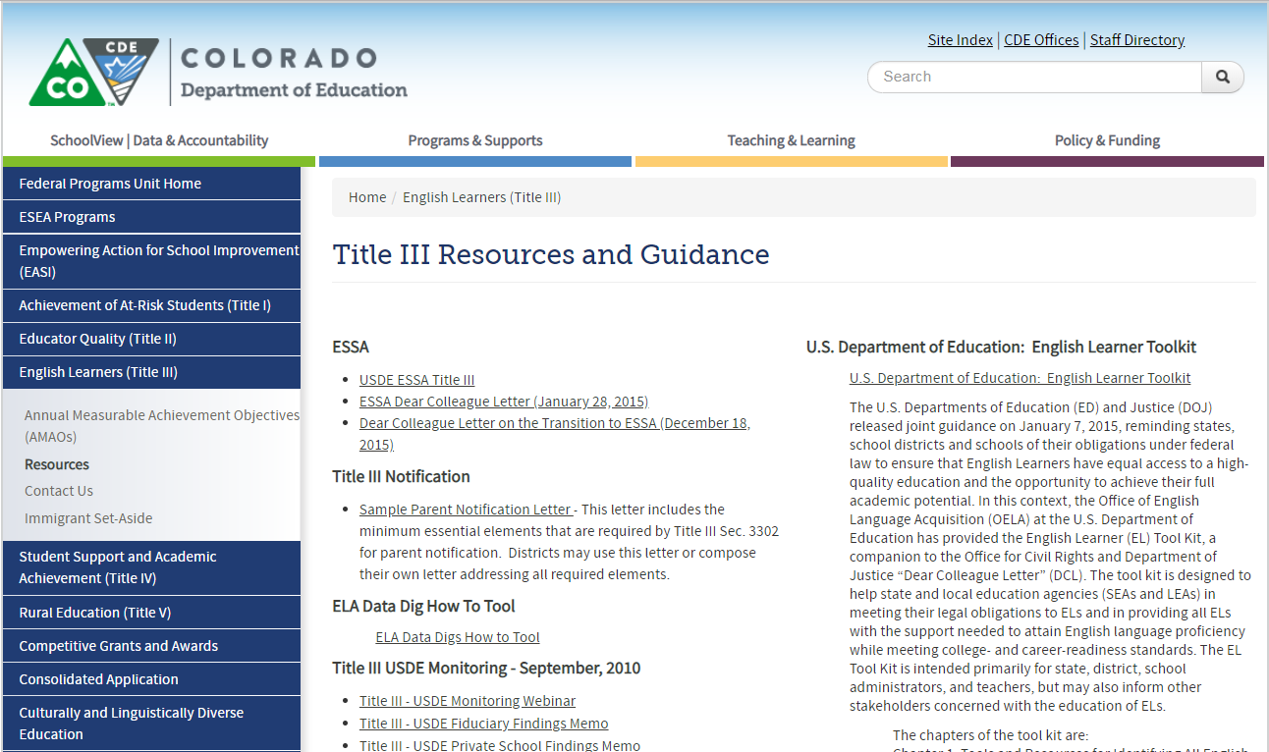
Sample Letter
Sample Letter
Notes:
Webquest!
One example of evidence is on the title III Resources and Guidance page which can be found in the Resources section of these slides or if you navigate to:
Go to www.cde.state.co.us → policy and funding → Federal Programming under School and District Info →
http://www.cde.state.co.us/fedprograms/titleiii-resources
This can also be found in the EL Guidebook on page 219 under Appendix Q next to a suggested home language survey

Slide 10
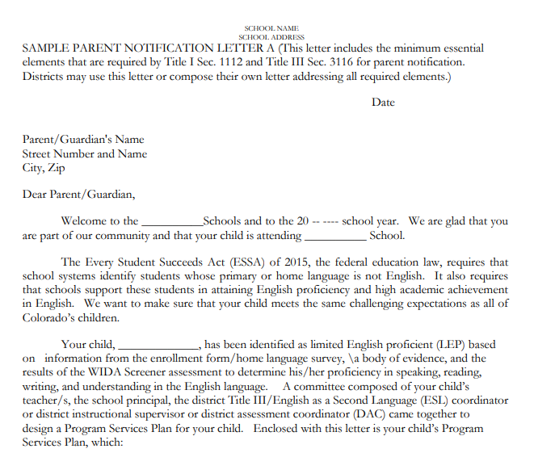
Sample Parent Notification Letter Page 1
Notified of child’s enrollment
ESSA Statute
Reason why child was identified
Meet needs of child
Notes:
This letter incorporates all of the key pieces of statutory requirements and as the name implies, it is a sample for utilizing a letter format in the notification process.
STARE AT SLIDE
Each section meets the statutory requirement by…
In the introduction, you can see how the notification of enrollment is included.
LEAs must notify parents of their child’s enrollment in an ELD program no later than 30 days after the beginning of the school year, or within two weeks if identification occurs after the school year begins.
ESSA Statute
Two primary goals of Title III are the acquisition of English and academic success. Part of acquisition is identification.
REASON
Reason why the child was identified and how the child was assessed
4. Last highlighted section outlines how the ELD program meets the educational strengths of the child and will help the child learn English in the following sections of the letter.

Slide 11
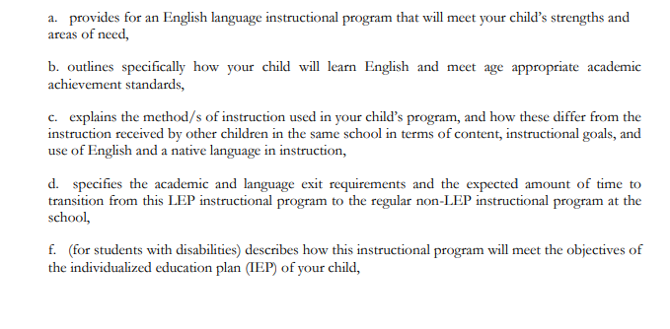
Sample Parent Notification Letter Page 1 continued
Educational Strengths of child
Will help the child learn English
Method of Instruction
Exit Requirements
Meets the needs of a child with a disability
Notes:
This section is where the LEA incorporates the unique specifics of the child’s needs and how the program will meet the unique needs of the student. These sections are part of the requirements from statute that the language include the
Click to show the arrow
Say what the arrows say

Slide 12
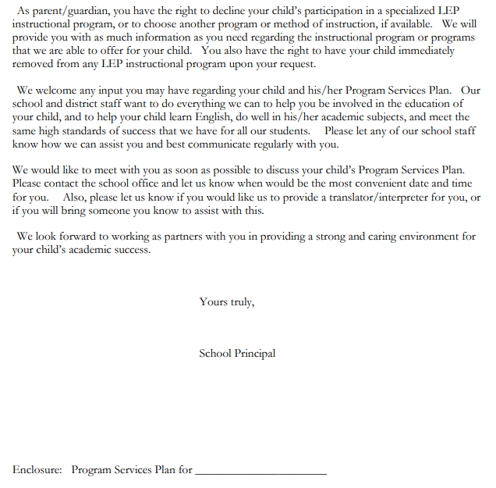
Sample Parent Notification Letter Page 2
Parents right to opt out
Notes:
The second page of the letter rents right to opt out of program services
If a parent opts out, ensure that parents are well-informed of the implications of the decision to opt out and the school’s responsibility to continue to ensure that Els have access to academic content and are acquiring English per the OCR and DOJ. Additionally, if parent opts out, the student must be tested annually on ACCESS 2.0 until resignation.

Slide 13
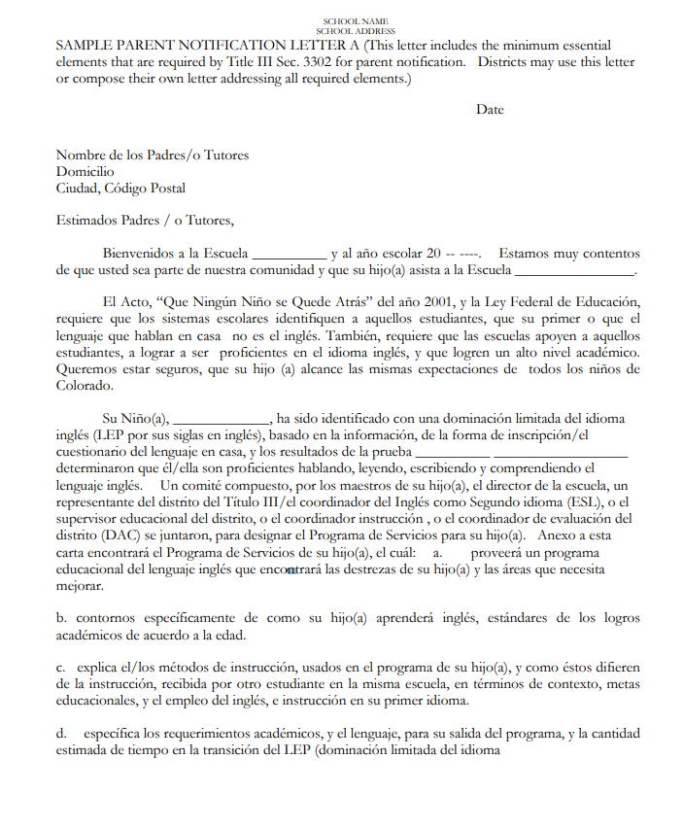
Sample Parent Notification Letter: Translated
Notes:
Notifications must be in an understandable and uniform format, and to the extent practicable, in a language that parents can understand.
The website also includes with the sample letter, a translated version of the sample letter

Slide 14
Considerations for Effective Notifications
Notifications must be in an understandable and uniform format, and to the extent practicable, in a language that parents can understand.
Considerations for translation:
  Use a needs assessment in your district
  Look at your demographics and what makes sense for the families that you serve.
Look at:
  Who are our families?
  What is our experience with them?
  Where have we had prior success with communication protocols?
  What is the most powerful way to communicate this information in the language and format that can be understood?
Notes:
Notifications whether they be through a face to face meeting with parents, through a notification letter, or a phone conversation must be presented and communicated to parents in their spoken language. Parents are entitled to opt out of language services if they choose, and should fully understand the identification of their students in order to make an informed decision on their students education.
Some considerations to implement effective communication practices overall are to utilize a needs assessment to address the demographics of your schools and languages spoken. Look at the various families in the schools/districts, what district or school staff has developed a relationship with them, what has been the most successful communication practices, these may not be the most convenient methods, but look for a method that has had success connecting and providing critical information to families.

Slide 15
LEA Input
Notes:
Build a survey into this?
Best practices: Consider what are some things that your district is doing or evidence you might submit to show that you are demonstrating effectiveness.
Our goal is to go beyond compliance to effectiveness and to identify excellent practices around the state

Slide 16
LEA Input on Local Practices
Statute
Requirements
Evidence
Notes:
The sample letter, when utilized in the recommended format has the potential to incorporate the specifics of the district context.
We are going to build in a question now and we are leaving this up for your reference. The question is….
What are some items you are considering to submit as evidence of meeting parent notification requirements?
How can CDE support your district in implementing effective notification practices for Title III
It does not have anything to do with parent notification

Slide 17
Resources and Contacts
For more information on Monitoring
  Visit: www.cde.state.co.us/fedprograms/monit/index
  Contact: Nazie Mohajeri-Nelson at Mohajeri-Nelson_n@cde.state.co.us
  Contact: Joey Willett at Willett_J@cde.state.co.us
  Contact: Robert Thompson at Thompson_R@cde.state.co.us
For more information on CLDE
  Visit: www.cde.state.co.us/cde_english
  Contact: Morgan Cox at cox_m@cde.state.co.us
  Contact: Lindsay Swanton at Swanton_l@cde.state.co.us
  Contact: Doris Nguyen at brock-Nguyen_d@cde.state.co.us
For more information on EL Identification
  Visit: www.cde.state.co.us/cde_english/identification-placement
Notes:
This link is resources, programming, and effective practices for supporting English learners and the next link is specific guidance for identification

Slide 18
Resources
For more information on Parent Notification
  Sample Letter: www.cde.state.co.us/parentnotificationrequirements
  Visit: www.cde.state.co.us/fedprograms/titleiii-resources
For more information on Title III Resources
  Visit: www.cde.state.co.us/fedprograms/titleiii-resources
For more information on Opt Out Resources
  Visit: www2.ed.gov/about/offices/list/oela/english-learner-toolkit/chap7.pdf

Slide 19

Questions? Comments?

