Slide 1








Every Student Succeeds Act (ESSA)
Standards Spoke Committee Meeting #4
November 3, 2016
1

Slide 2





Agenda
Welcome and introductions
Quick review of ESSA plan development process
Discuss upcoming Hub and State Board of Education presentations
Family-School-Community Partnering Considerations
Q & A
Wrap-up
2

Slide 3
Welcome and Introductions
3

Slide 4
CDE Staff
Melissa Colsman, Ph.D, Teaching and Learning Executive Director
Karol Gates, Standards and Instructional Support Director
Raymond Johnson, Mathematics Content Specialist

Slide 5
Standards Spoke Committee Work Plan and Process
5

Slide 6
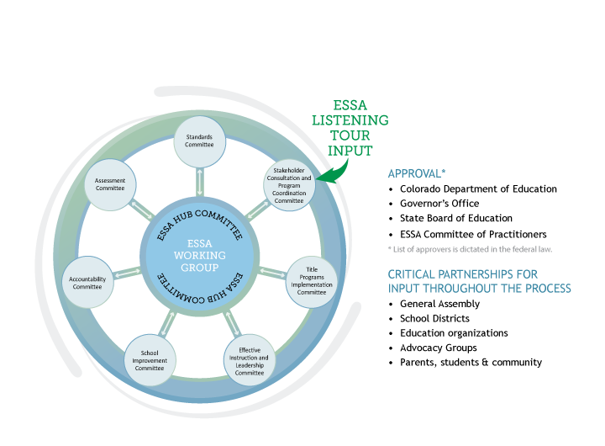
ESSA State Plan Development
6

Slide 7
Process for ESSA State Plan
Development: Standards Section
Committee input for draft outline
CDE drafts outline from input
Committee provides feedback on outline
CDE drafts narrative from outline
Public draft narrative shared with Hub Committee and State Board of Education
Committee provided with public version of draft narrative
CDE revises narrative based on committee feedback
Committee provides feedback on draft narrative
Public draft narrative shared with the public for feedback
Proposed revisions are shared with committee
Final draft narrative completed
7

Slide 8

How and When Will the Standards Spoke Committee Meetings Be Conducted?
Timeline | Tasks
August 18, 3:30 – 4:30 | Informational webinar about the Standards Spoke Committee
August 22 | Sign-up deadline for committee
August 24 | Committee members are announced and have access to draft outline
August 29; 3:30 – 4:30 | Virtual committee meeting to discuss draft outline
September 1 | Input due for section outline
September 8; 3:00 – 4:30 | Virtual committee meeting to review draft outline
September 15 | Committee members have access to the first draft of the section
September 22; 3:00 – 4:30 | Virtual committee meeting to review first draft of the section
September 29 | Feedback due for first draft of the section
October 6 | Committee members have access to second draft of the section
November 3 | Virtual committee meeting to review Hub and SBE update and discuss draft standards section
November 7 and 9 | Standards Spoke Committee presentation to Hub Committee and SBE
8

Slide 9
Preview of Hub and State Board of Education
Standards Spoke Committee Presentation
Hub Committee Meeting
Monday, November 7, presentation scheduled for 12: 15 – 1: 15 State Board of Education Room, 201 E. Colfax
State Board of Education Meeting
Thursday, November 10, presentation scheduled for 9: 30 – 11: 00 State Board of Education Room, 201 E. Colfax
9

Slide 10
Standards Spoke Committee
Report to the ESSA Hub Committee
November 7, 2016

Slide 11
About the
Standards Spoke Committee

Slide 12
ESSA Standards Spoke Committee Membership
Professional development provider
Professional educator organization
3%
Institution of higher education
6%
1%
Retired 3%
Graduate student 1%
CDE 7%
Education advocacy organization
3%
Business 4%
Educator 31%
Community organization 3%
Parent 3%
Early childhood 2%
School administrator 3%
School district administrator 30%

Slide 13
Standards Spoke Committee Process
Timeline | Tasks
August | Recruit committee members
August 18 | Informational webinar about the Standards Spoke Committee
August 22 | Sign-up deadline for committee
August 24 | Committee members are announced Committee members have access to “empty” draft outline
August 29 | Virtual committee meeting to discuss “empty” draft outline
September 1 | Input due for section outline
September 8 | Virtual committee meeting to review draft outline
September 15 | Committee members have access to the first draft of the section
September 22 | Virtual committee meeting to review first draft of the section
September 29 | Feedback due for first draft of the section
October 6 | Committee members have access to second draft of the section
November 3 | Virtual committee meeting to review Hub and SBE update and discuss draft standards section
13

Slide 14
ESSA Requirements and Decision Points
14

Slide 15
ESSA Standards Requirements
Provide assurance that the state has adopted “challenging” statewide standards in math, reading or language arts, and science
Alternate achievement standards for students with the most significant cognitive disabilities
Standards for English language proficiency

Slide 16
ESSA Restrictions on U.S. Department of Education Related to Standards
States shall not be required to submit standards to the Secretary of Education
The Secretary shall not have the authority to mandate, direct, control, coerce, or exercise any direction or supervision over any of the challenging State academic standards adopted or implemented by a State

Slide 17
Key Conversations of the Standards Spoke Committee
17

Slide 18
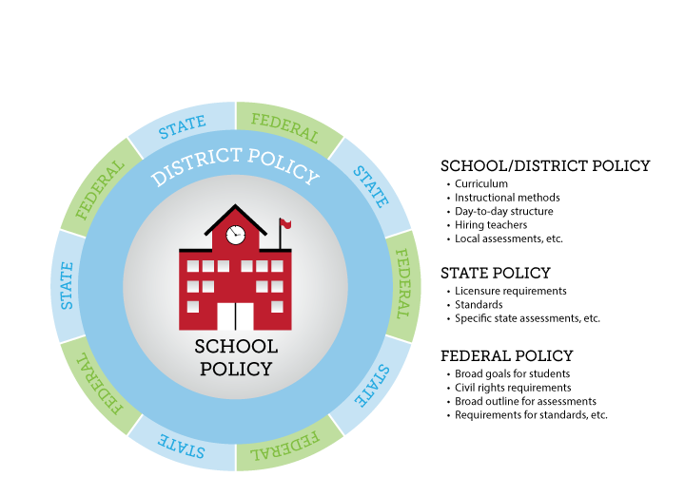
Differentiating Between Federal, State and Local Policies
Existing Colorado Education Law

Slide 19










The Relationship to Standards to Classroom Instruction
Broad goals articulating what students should know, understand, and be able to do over a given time period.
Standards
State
An organized plan of instruction: a sequence of instructional units.
Local Districts
Curriculum
Learning experiences designed to meet the needs of students.
Instruction

Slide 20
History of Academic Standards in Colorado: The Colorado Model Content Standards
House Bill 1313 (passed in 1993) initiated standards based education Colorado
  Created standards in reading, writing, mathematics, science, history, civics, geography, economics, art, music, and physical education
  Initiated the Colorado Student Assessment Program (CSAP) in 1996
Why standards?
  Standards define what students should know and be able to do at the end of a grade level or grade span
  Standards advance equity of outcomes for students
  Standards reinforce school and district accountability

Slide 21
History of Academic Standards in Colorado: Colorado’s Achievement Plan for Kids (CAP4K)
Standards Timeline
Senate Bill 08-212, Officially called the Preschool to Postsecondary Education Alignment Act
2008: CAP4K passes
2009: Standards revision process conducted; new standards adopted in all ten content areas (called the Colorado Academic Standards)
2010: Common Core State Standards in mathematics and English/language arts adopted; standards in these two content areas reissued
2011-2013: Transition process to the Colorado Academic Standards
2013-14: Full implementation of the Colorado Academic Standards
July 1, 2018: The first review and revision cycle for the Colorado Academic Standards is set to conclude (and every six years thereafter)

Slide 22
History of Academic Standards in Colorado: Colorado’s Achievement Plan for Kids (CAP4K)
Requirements for the Colorado Academic Standards:
Minimally include reading, writing, mathematics, science, history, geography, visual arts, performing arts, physical education, world languages, English language competency, economics, civics, and financial literacy
  HB 16-1198 requires addition of optional, secondary computer science standards by July 2018
Be comparable in scope, relevance, and rigor to the highest national and international standards
Require the development of creativity and innovation skills; critical-thinking and problem-solving skills; communication and collaboration skills; social and cultural awareness; civic engagement; initiative and self-direction; flexibility; productivity and accountability; character and leadership; and information technology application skills
Be aligned with career and technical education standards, as practicable
Be aligned with the state’s postsecondary and workforce description
Lead to postsecondary and workforce readiness

Slide 23
Overview of Draft ESSA Standards Section

Slide 24
Federal and State Requirements: Challenging Academic Standards
ESSA Requirements | State Requirements
Assurance that the state has adopted challenging standards | CAP4K required the State Board of Education to adopt postsecondary aligned standards by December 2009; the standards must be comparable in scope, relevance, and rigor to the highest national and international standards
The standards apply to all public schools | CAP4K requires each local education provider to adopt local standards that meet or exceed state standards; districts may adopt the state’s standards
The standards include at minimum the subject areas of mathematics, reading or language arts, and science | CAP4K requires standards in reading, writing, mathematics, science, history, geography, visual arts, performing arts, physical education, world languages, economics, civics, financial literacy, computer science*
The standards are aligned with credit-bearing coursework and state career and technical education standards | CAP4K requires the academic standards to (1) align with the postsecondary and workforce readiness description co- adopted by the State Board of Education and the Colorado Commission on Higher Education and (2) lead to postsecondary readiness

Slide 25
Federal and State Requirements: Alternate Achievement Standards
ESSA Requirements The alternate achievement standards must be: | State Requirements
Aligned with the state academic standards | The Colorado Exceptional Children’s Education Act (ECEA) corresponds to federal guidance of IDEA Part B statute and regulation addressing the alignment of challenging academic standards. Sec. 300.160(c)(2)(i) and (ii) (I) and the adoption of alternate achievement standards for students with the most significant cognitive disabilities. Sec.200.300.160(c)(2) (iii)
Promote access to the general education curriculum
Reflect professional judgment as to the highest possible standards achievable by students with the most significant cognitive disabilities
Designated in the individualized education program for each such student as the academic achievement standards that will be used for the student
Aligned to ensure that a student who meets the alternate academic achievement standards is on track to pursue postsecondary education or employment
25

Slide 26
Federal and State Requirements:
English Language Proficiency Standards
ESSA Requirements The English language proficiency standards must: | State Requirements The Colorado English language proficiency standards meet all ESSA requirements:
Be derived from the four recognized domains of speaking, listening, reading, and writing | CAP4K requires Colorado’s standards to include standards for English language proficiency. Adopted in 2009, the Colorado English language proficiency standards, through WIDA*, incorporate the four recognized domains.
Address the different proficiency levels of English learners | The Colorado English language proficiency standards address the following six levels of English language proficiency: 1—Entering, 2—Emerging, 3—Developing, 4—Expanding, 5—Bridging, and 6—Reaching.
Align with the State’s challenging academic standards | The Colorado English language proficiency standards provide English learners with the social and instructional language necessary for school and access to grade level academic content standards.
*WIDA: World-class Instructional Design and Assessment

Slide 27
Next Steps
The Standards section of the ESSA state plan has been drafted and is posted on the CDE website for review.
The Standards Spoke Committee will make any needed revisions based on feedback/comments received.
The Standards Spoke Committee is requesting the approval of the draft Standards section by the Hub Committee.

Slide 28
Family-School-Community Partnering Considerations for
ESSA Spoke Committees
https://enetlearning.adobeconnect.com/p5u98tag6zv/

Slide 29


Comprehensive, Sustainable Structure Components
Implementing the Framework of National Standards for Family-School Partnerships
  Welcoming All Families into the School Community
  Communicating Effectively
  Supporting Student Success
  Speaking Up for Every Child
  Sharing Power
  Collaborating with the Community
Sharing Leadership
Action Planning
Evaluating
http://www.cde.state.co.us/sacpie/nationalstandardsgoalsandindicators2l

Slide 30
Four Core Beliefs
Are you ready for FSCP?
All parents have dreams for their children and want the best for them.
All parents have the capacity to support their children’s learning.
Parents and school staff should be equal partners.
The responsibility for building partnerships between school and home rests primarily with school staff, especially school leaders.
30
Henderson, A.T. et al. (2007) Beyond the bake sale: The essential guide to family-school partnerships.

Slide 31

Our Perspective on Relative Impact of Family Engagement Strategies on Student Learning
Lower impact
Higher impact
Celebrations
Parent help on administrative tasks
Goal-setting
Parent training
talks
events
 | Weekly data- sharing folders
Regular, personalized communication | Home visits
Parent resource rooms
Fundraisers
Back to school night
Family support services
Parent-teacher conferences
Positive phone calls home
Modeling of learning support strategies
Potlucks
Performances and showcases
Generic school newsletters
Interactive homework
Classroom observations
Parent help on learning projects
Flamboyan Foundation defines family engagement as collaboration between families and educators that accelerates student learning.

Slide 32
CDE Resources
Family/Parent Resources: http://www.cde.state.co.us/resourcesforparents
Training Resources: http://www.cde.state.co.us/uip/familyengagement
Promising Partnership Practices: http://www.cde.state.co.us/uip/promising
Survey:
http://www.cde.state.co.us/uip/school_family_community_partn ership_survey
Colorado Academic Standards Parent Guides: https://www.cde.state.co.us/standardsandinstruction/guidestost andards
32

Slide 33
For More Information
Darcy Hutchins, Ph.D.
CDE Family Partnership Director SACPIE Staffer
303-866-5921
hutchins_d@cde.state.co.us
SACPIE
http://www.cde.state.co.us/SACPIE/
33

Slide 34
Wrap Up
Q & A

