Slide 1
Leveraging Funds to Address Impact of COVID-19
January 14, 2020

Slide 2
Welcome & Introductions

Slide 3
Purpose:
Desired Outcome for participants
Comprehensive needs assessment and needs that have arisen due to COVID 19. Feedback from field that growing need of social, emotional and mental health needs and sharing practices with districts and each other on how they are leveraging ESEA funds to support the work they are doing.
CDE shares out-Andrea Pulskamp, Krista Klabo and Bill Brown share resources and effective practices to implement.
2nd half devoted to discussion and conversations on SEL needs, how they are using ESEA funds to address needs, and strategies being implemented.
Notes:
Kristen

Slide 4
Agenda January 14, 2021:
9:00 am-9:15 am: CDE Introductions and Agenda Overview
9:15 am-10:00 am: CDE resources available for Social, Emotional, and Mental Health Supports
Social Emotional and School Climate Supports
Student Mental Health Supports
Staff Mental Health and Self-Care
10:05 am-10:40 am: Networking with participants on shared practices
Breakout Groups
Share out
10:40 am- 11:00 am: Leveraging Title II
11:00 am-11:20 am: Leveraging Title IV
11:20 am – 12:00 pm: Questions for CDE staff
Notes:
Kristen

Slide 5
Social, Emotional, and Mental Health Supports Andrea Pulskamp, State Transformation Specialist Krista Klabo, School Psychology and Special Education Evaluation Specialist William Brown, Serious Emotional Disability Specialist
Notes:
Andrea Pulskamp, State Transformation Specialist Krista Klabo, School Psychology and Special Education Evaluation Specialist William Brown, Serious Emotional Disability Specialist

Slide 6
Social Emotional and School Climate Supports
Notes:
Andrea Pulskamp, State Transformation Specialist Krista Klabo, School Psychology and Special Education Evaluation Specialist William Brown, Serious Emotional Disability Specialist

Slide 7
Whole Child as a Focus:
The needs of the Whole Child must be at the cornerstone of a school’s design to ensure:
Each student enters school healthy and learns about and practices a healthy lifestyle.
Each student learns in an environment that is physically and emotionally safe for students and adults.
Each student is actively engaged in learning and is connected to the school and broader community.
Each student has access to personalized learning and is supported by qualified, caring adults.
Each student is challenged academically and prepared for success in college or further study and for employment and participation in a global environment.
http://www.ascd.org/whole-child.aspx
https://learningpolicyinstitute.org/sites/default/files/product-files/Educating_Whole_Child_REPORT.pdf
Notes:
Andrea Pulskamp, State Transformation Specialist Krista Klabo, School Psychology and Special Education Evaluation Specialist William Brown, Serious Emotional Disability Specialist

Slide 8
Positive School Climate
A positive school climate is foundational to the academic promise of the school and refers to the work of a school community to create a quality experience for all students, staff, and families. This is done by collectively fostering social, emotional, physical, academic and identity safety and promoting a supportive academic environment that encourages and maintains respectful, empathetic, and trusting, relationships; resulting in a sense of belonging for all.
For more information on school climate improvement: http://www.cde.state.co.us/schoolclimate
Notes:
Andrea Pulskamp, State Transformation Specialist Krista Klabo, School Psychology and Special Education Evaluation Specialist William Brown, Serious Emotional Disability Specialist

Slide 9
Social Emotional Skills
Self-awareness involves identifying emotions and accurate self-perceptions.
Self-management includes managing stress and controlling impulses, which includes aspects of executive function and draws on mindsets.
Social awareness entails perspective taking, empathy, and appreciation for diversity.
Relationship skills involve communication and cooperation to establish and maintain healthy relationships.
Responsible decision making focuses on skills such as identifying problems, evaluating, reflecting, and acting with consideration for the well-being of oneself and others.
https://casel.org/covid-resources/
Notes:
Andrea Pulskamp, State Transformation Specialist Krista Klabo, School Psychology and Special Education Evaluation Specialist William Brown, Serious Emotional Disability Specialist

Slide 10
The Role of Relationships and Behavior
Relationships that are caring, supportive and culturally responsive which are proven to:
Increase attachment and connectedness to school
Improve school performance and engagement
Building Developmental Relationships During the COVID-19 Crisis
21 Questions to Check-in on Your Student’s Well-Being
In addition to positive relationships, positive behaviors in schools are shaped by:
Use of student-centered, inclusionary and restorative approaches to discipline
Warm, caring and inclusive environments that are predictable and set explicit expectations for mindsets and behaviors. https://www.pbis.org/
Notes:
Andrea Pulskamp, State Transformation Specialist Krista Klabo, School Psychology and Special Education Evaluation Specialist William Brown, Serious Emotional Disability Specialist

Slide 11
Multi-Tiered System of Supports
An effective Multi-Tiered System of Supports (MTSS) ensures all student needs are met and include:
Universal practices that emphasize prevention, buffer stress, and build resilience
Identifying and addressing each child’s needs including physical, social, emotional, mental health, and academic needs
Providing appropriate interventions that assess individual needs, coordinate care, engage families, and if needed provide wrap around services.
http://www.cde.state.co.us/mtss
Notes:
Andrea Pulskamp, State Transformation Specialist Krista Klabo, School Psychology and Special Education Evaluation Specialist William Brown, Serious Emotional Disability Specialist

Slide 12
How to Make Improvements
Notes:
Andrea Pulskamp, State Transformation Specialist Krista Klabo, School Psychology and Special Education Evaluation Specialist William Brown, Serious Emotional Disability Specialist

Slide 13
Ideas for Utilizing Funds for Social Emotional Supports
Contract/Hire/Pay for Services
Assess needs/perceptions as well as policies and practices and analyze data to drive action planning
Coordination of whole child, school climate, family engagement, and/or prevention efforts
Staff professional development on: integrating social emotional skill building; trauma responsiveness; positive behavior supports; student engagement/relationship building
Pay for substitutes to cover PD
Notes:
Andrea Pulskamp, State Transformation Specialist Krista Klabo, School Psychology and Special Education Evaluation Specialist William Brown, Serious Emotional Disability Specialist

Slide 14
Resources
School Climate and Perception Surveys:
US Department of Education School Climate Surveys
Positive Behavior Interventions and Supports Surveys
National School Climate Center
Resource Hubs with Policy and Practice Inventories (completed by school teams):
School Health Assessment and Performance Evaluation (SHAPE) System
Resilience in School Environments (RISE)
Colorado Healthy Schools Smart Source (Smart Source)
For more information about possible professional development ideas, contact Andrea Pulskamp: pulskamp@cde.state.co.us
Notes:
Andrea Pulskamp, State Transformation Specialist Krista Klabo, School Psychology and Special Education Evaluation Specialist William Brown, Serious Emotional Disability Specialist

Slide 15
Student Mental Health Supports
Notes:
Andrea Pulskamp, State Transformation Specialist Krista Klabo, School Psychology and Special Education Evaluation Specialist William Brown, Serious Emotional Disability Specialist

Slide 16
Tips to Help Teens Cope during COVID-19
Notes:
Andrea Pulskamp, State Transformation Specialist Krista Klabo, School Psychology and Special Education Evaluation Specialist William Brown, Serious Emotional Disability Specialist

Slide 17
Direct Mental Health Intervention
Therapeutic Model
Social Skills
Dialectical Behavior Therapy (DBT)
Cognitive Behavioral Therapy (CBT)
Solution Focused Therapy
Professionals
School Social Worker
Counselors
School Psychologists
Style
Individual Counseling
Group Counseling
Notes:
Andrea Pulskamp, State Transformation Specialist Krista Klabo, School Psychology and Special Education Evaluation Specialist William Brown, Serious Emotional Disability Specialist

Slide 18
Promising Interventions that Support Mental Health
Office Hours
Visual Schedules
Embedded links
Simple and Clear Expectations and Websites
Streamlined Communication
Social Stories
I Can Wear A Mask Social Story
Structured Virtual Social Activities
Kahoot
Show and Tell
Check In / Check Out
Guidance on Adapting Check-in Check-out (CICO) for Distance Learning
Adapting Check-In Check-Out (CICO) for Distance Learning
Notes:
Andrea Pulskamp, State Transformation Specialist Krista Klabo, School Psychology and Special Education Evaluation Specialist William Brown, Serious Emotional Disability Specialist

Slide 19
Mental Health Resources for Families and Students
Helping Children Cope during an COVID-19 Outbreak
Telehealth: Virtual Service Delivery Updated Recommendations
A Successful Launch of the 2020-2021 School Year for Students with Disabilities
COVID-19: Special Education and Service Delivery
Planning for Virtual/Distance School Counseling During an Emergency Shutdown
Helping Children Cope with Emergencies
Coping After a Disaster
Teen Depression
Parents: Care for Yourself
Family Caregivers: Care for Yourself
Students: Care for Yourself
Working Adults: Care for Yourself
Critical Workers: Care for Yourself
Teachers: Encourage Your Students to Care for Themselves
Tips to Help Teens Cope During COVID-19
Notes:
Andrea Pulskamp, State Transformation Specialist Krista Klabo, School Psychology and Special Education Evaluation Specialist William Brown, Serious Emotional Disability Specialist

Slide 20
CDE Mental Health Resources
Resources for Families of Students with Disabilities During COVID-19
COVID-19 and Special Education
COVID-19 Resources for Schools
Resources for Learning at Home
Best Practices for Educators Learning at Home
Best Practices for Families Learning at Home
Promising Partnerships Practices during COVID-19
Notes:
Andrea Pulskamp, State Transformation Specialist Krista Klabo, School Psychology and Special Education Evaluation Specialist William Brown, Serious Emotional Disability Specialist

Slide 21
On Demand Webinars
COVID-19: Schools are Shut Down. Providing School Mental Health Supports Online
Supporting Our Kids from a Distance: Tools & Strategies to Provide SEL and Special Education Services
Notes:
Andrea Pulskamp, State Transformation Specialist Krista Klabo, School Psychology and Special Education Evaluation Specialist William Brown, Serious Emotional Disability Specialist

Slide 22
Evidence-Based and Promising Practices
Resources And Strategies To Support Children With Disabilities And Their Families During Covid-19
Teachers: Evidence-Based and Promising Practices to Support Continuity of Learning for Students With Disabilities
SSP: Evidence-Based and Promising Practices to Support Continuity of Learning for Students With Disabilities
Practices and Resources to Support Parents and Families
FAQs: Virtual School Counseling Ethics
Notes:
Andrea Pulskamp, State Transformation Specialist Krista Klabo, School Psychology and Special Education Evaluation Specialist William Brown, Serious Emotional Disability Specialist

Slide 23
Ideas for Utilizing Funds for Mental Health Support
Contract/Hire to provide intervention and support
Paraprofessionals or teachers
Implement executive functioning and organizational interventions
Support teachers with additional demands
School-Based Mental Health Professionals
Wrap around services
Direct intervention
Evaluations or Private Contractors
Reduce load on school team to focus on intervention and support
Conduct mental health screenings to determine need and guide service and intervention
Notes:
Andrea Pulskamp, State Transformation Specialist Krista Klabo, School Psychology and Special Education Evaluation Specialist William Brown, Serious Emotional Disability Specialist

Slide 24
Staff Self-Care and Mental Health
Notes:
Andrea Pulskamp, State Transformation Specialist Krista Klabo, School Psychology and Special Education Evaluation Specialist William Brown, Serious Emotional Disability Specialist

Slide 25
Self-Care May Sound Like a Luxury, but Science Proves It’s Actually a Non-negotiable
Self-care helps you be kinder to yourself
Self-care enables you to respond better to difficult situations
Self-care restores your energy resources
Self-care boosts your patience and efficiency
Self-care has real short- and long-term effects
https://bumble.com/en/the-buzz/5-reasons-self-care-is-good-for-you-science
Notes:
Andrea Pulskamp, State Transformation Specialist Krista Klabo, School Psychology and Special Education Evaluation Specialist William Brown, Serious Emotional Disability Specialist

Slide 26
Self-Care Starter Kit ℠
The Self-Care Starter Kit℠ was initially developed for UB Social Work students, but it is our hope that these resources will be useful for students and professionals alike. Although the information does not address all that goes into developing the skills of self-care, it does begin the journey.
We recommend you start with Introduction to Self-Care, followed by Developing Your Self-Care Plan.
Resources:
University at Buffalo School of Social Work
https://gtlcenter.org/sites/default/files/Educator-Resilience-Trauma-Informed-Self-Care-Self-Assessment.pdf
https://istss.org/clinical-resources/assessing-trauma/ucla-ptsd-assessment-tools
https://www.stress.org/holmes-rahe-stress-inventory
Notes:
Andrea Pulskamp, State Transformation Specialist Krista Klabo, School Psychology and Special Education Evaluation Specialist William Brown, Serious Emotional Disability Specialist

Slide 27
Self care to We Care
Set up a self-care buddy system
Notes:
Andrea Pulskamp, State Transformation Specialist Krista Klabo, School Psychology and Special Education Evaluation Specialist William Brown, Serious Emotional Disability Specialist

Slide 28
Organizational Care, Bruce Perry
Open communication
Coaching, mentoring and reflective supervision
Adequate dosing & spacing of breaks
Front-line work in teams if possible
Synchrony of mission, message and practice
Child and Family Leave policy
Integrated professional development
Flexible work schedules
Clear expectations
Regulated, respectful leadership
https://www.neurosequential.com/covid-19-resources
Notes:
Andrea Pulskamp, State Transformation Specialist Krista Klabo, School Psychology and Special Education Evaluation Specialist William Brown, Serious Emotional Disability Specialist

Slide 29
The Cost of Caring, Bruce Perry
Systems are not traditionally structured to provide for adequate regulation, respect and relational supports
Micro-management results in bad decision making and dysregulation
Create a digital Social Fabric for relationships and connections
Challenge ---- Challenge----Challenge----Challenge
Regulation-----Regulation----Regulation
Have to intentionally build this into your day.
https://www.neurosequential.com/covid-19-resources
Notes:
Andrea Pulskamp, State Transformation Specialist Krista Klabo, School Psychology and Special Education Evaluation Specialist William Brown, Serious Emotional Disability Specialist

Slide 30
Regulatory Breaks
Breathing (4x4, Start, 478)
60 sec walk
Bilateral tapping
Relational – 2 minute check in with someone on your contact list
Create a contact tree for We-Care
Mindfulness
Compartmentalize
https://www.neurosequential.com/covid-19-resources
Notes:
Andrea Pulskamp, State Transformation Specialist Krista Klabo, School Psychology and Special Education Evaluation Specialist William Brown, Serious Emotional Disability Specialist

Slide 31
6 R’s, Bruce Perry
Educational Setting
Relevant (developmentally)
Rhythmic (resonate with neural patterns)
Repetitive (patterns)
Relational (Safe)
Rewarding (pleasurable)
Respectful (child, family, culture)
Workplace
Match to skill level
Resonate with neural patterns
Predictable routines and rituals
Consistent predictable leadership communicates safety
Meaningful and fairly compensated
Individual, Team and Culture
https://www.neurosequential.com/covid-19-resources
Notes:
Andrea Pulskamp, State Transformation Specialist Krista Klabo, School Psychology and Special Education Evaluation Specialist William Brown, Serious Emotional Disability Specialist

Slide 32
Ideas for Utilizing Funds for Staff Health Care
Contract/Hire/Pay for Services on the following:
Assess needs/perceptions of staff
Self-care trainings/resources
Counseling services for staff
Staff professional development on: Neurosequential Model in Education, chronic stress, social emotional skill building, etc.
Pay for substitutes to cover PD
Notes:
Andrea Pulskamp, State Transformation Specialist Krista Klabo, School Psychology and Special Education Evaluation Specialist William Brown, Serious Emotional Disability Specialist

Slide 33
Resources
SELF-REG How to Help Your Child (and You) Break the Stress Cycle and Successfully Engage with Life, by Dr. Stuart Shanker with Teresa Barker, Penguin Books, New York, New York. 2016
John Gottman PHD, Emotional Coaching Raising an Emotionally Intelligent Child, the Heart of Parenting
Classroom 180 A Framework for Creating, Sustaining, and Accessing the Trauma-Informed Classroom, Heather T Fornes, LCSW, Beyond Consequences Institute
Help for Billy, a beyond consequences approach to helping challenging children in the classroom, Heather T Forbes, LCSW, Beyond Consequences institute 2012.
Neuro-sequential Model, Bruce D. Perry: Social & Emotional Development in Early Childhood, Youtube webinar December 11th 2014, https://www.youtube.com/watch?v=vkJwFRAwDNE
Help Guide: https://www.helpguide.org/articles/stress/stress-symptoms-signs-and-causes.htm
https://www.youtube.com/watch?v=1Evwgu369Jw
Notes:
Andrea Pulskamp, State Transformation Specialist Krista Klabo, School Psychology and Special Education Evaluation Specialist William Brown, Serious Emotional Disability Specialist

Slide 34
Resources
https://www.neurosequential.com/covid-19-resources
https://brenebrown.com/
https://www.beyondconsequences.com/
https://www.livesinthebalance.org/
https://casel.org/
https://www.besselvanderkolk.com/
https://www.marcbrackett.com/
https://ifs-institute.com/about-us/richard-c-schwartz-phd
https://www.apa.org/gradpsych/2014/04/corner
https://www.psychologytoday.com/us/blog/the-couch/201905/self-care-is-important-why-is-it-so-hard-practice
https://hbr.org/2018/08/how-self-care-became-so-much-work
https://bumble.com/en/the-buzz/5-reasons-self-care-is-good-for-you-science
https://www.wright.edu/student-affairs/health-and-wellness/counseling-and-wellness/workshops-and-self-help/self-care
https://ugs.utexas.edu/news/self-care
https://www.psycom.net/self-care-101
https://www.psychreg.org/self-care-vital-mental-health/
https://isfglobal.org/isf-self-care-research/
https://www.stress.org/holmes-rahe-stress-inventory
Notes:
Andrea Pulskamp, State Transformation Specialist Krista Klabo, School Psychology and Special Education Evaluation Specialist William Brown, Serious Emotional Disability Specialist

Slide 35
Breakout Activity
Notes:
Nazie and DeLilah

Slide 36
Discussion Questions
https://tinyurl.com/y227o5l7
Notes:
Nazie and DeLilah

Slide 37
Flexible uses of Title II, Part A funds to Meet Human Capital Challenges During COVID-19 Jeremy Meredith, Senior Consultant, Title II Specialist
Notes:
Jeremy

Slide 38
Colorado School District Needs Inventory Results Related to Staffing and Supports for Educators Needs Inventory Results
Notes:
Jeremy

Slide 39
Overview of Challenges Identified by Survey Respondents
Districts are concerned about imminent staff mental health issues, fatigue, burnout, and turnover as a result of increased demands and stress.
The cumulative pressures of conducting COVID-19 procedures, transitioning from one instructional model to another (e.g., in-person to virtual) and closing the learning curve to do so successfully are primary drivers of stress and separations.
Districts expressed concern with teachers fulfilling existing professional development requirements on top of all the new learning they need to do to meet the moment during this pandemic (e.g., READ Act PD).
The bottom line: Districts are looking for ways for how to address staff mental health needs, support them in leading virtual instruction, and fill vacancies driven by retirements and resignations.
Notes:
Jeremy

Slide 40
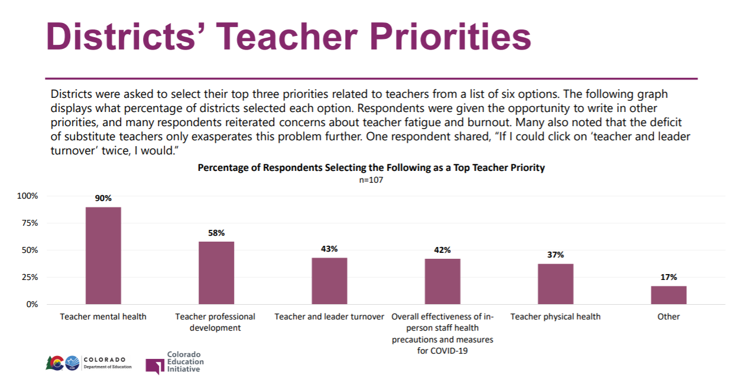
Districts’ Teacher Priorities
Notes:
Jeremy

Slide 41
Districts’ Teacher Priorities by Rural Status
Notes:
Jeremy

Slide 42
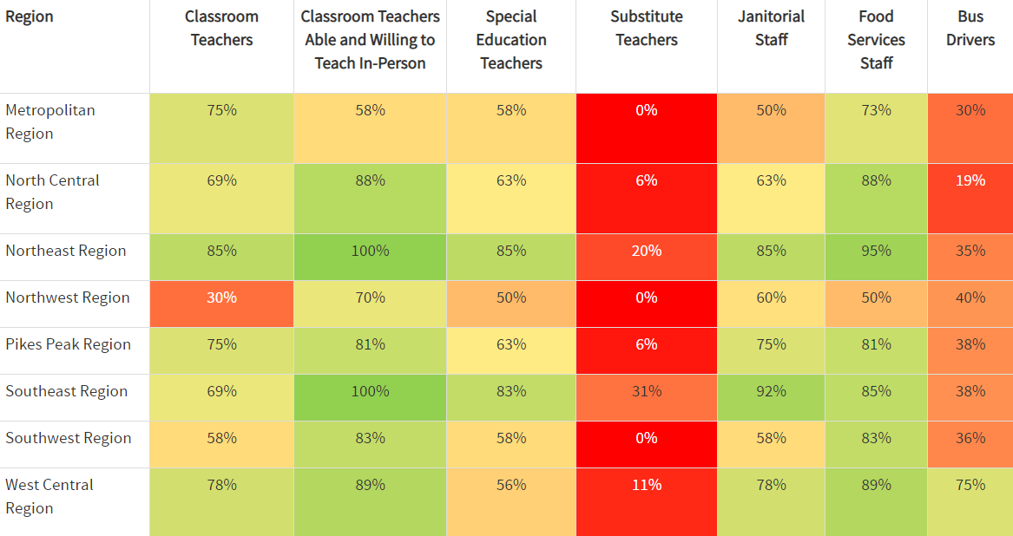
Staffing Shortages Reported by Region
Notes:
Jeremy

Slide 43
Purpose of Title II in ESSA
To increase student academic achievement by improving teacher and principal quality. This includes increasing all students --especially historically underserved students’--access to experienced, in-field, and effective teachers in classrooms. Also, improving skills of school leaders, and implementing quality professional development.
Allowable Title II activities:
Recruiting, hiring, and retaining quality teachers and principals
Programs and activities designed to improve the quality of the teaching force
Teacher development initiatives promoting career progression and differential pay
Professional development activities that improve the knowledge of teachers, principals and superintendents
Addressing disparities in student access to in-field, effective, and experienced teachers
Notes:
Jeremy

Slide 44
Reminder: Title II Requirements
Use of Title II, A funds must be informed by a comprehensive needs assessment that includes robust stakeholder engagement. LEAs must also conduct ongoing consultation with those stakeholders to update and improve activities supported with Title II funds.
Activities supported with Title II funds must be consistent with Title II’s purpose, and address the learning needs of all students, including children with disabilities, English learners, and gifted and talented students.
LEAs must prioritize Title II, Part A funds to schools that are implementing comprehensive support and improvement activities and targeted support and improvement activities and have the highest percentage of low-income (and other disadvantaged) students.
Notes:
Jeremy

Slide 45
Possible Allowable Uses of TIIA To Meet Pandemic Challenges
Notes:
Jeremy

Slide 46
Supporting Educators to Effectively Support Students
Title IIA can be used for teacher in-service training (remote or in-person) for school personnel in:
Techniques to understand when and how to refer students affected by trauma, and children with, or at risk of, mental illness,
The use of referral mechanisms that effectively link such children to appropriate treatment and intervention services in the school and in the community, where appropriate,
Forming partnerships between school-based mental health programs and public or private mental health organizations, and
Addressing issues related to school conditions for student learning, such as safety, peer interaction, drug and alcohol abuse, and chronic absenteeism.
Notes:
Jeremy

Slide 47
Supporting Educators Mental Health
Title II funds may be leveraged in service of providing supports to teachers to address stresses of teaching during COVID. Such uses can include:
Mentoring for novice or educators in need of support, which could include early “release” time (either remotely or in-person) for mentoring, compensation for mentors, and evidence-based professional development for novice educators and mentors.
Innovative trainings on managing stress, organizing time for planning and/or collaboration, positive habits to promote healthy, sustainable teaching.
Notes:
Jeremy

Slide 48
Reducing Class Size
LEAs may use Title II funds to reduce class size to a level that is evidence-based.
A study done for the US Department of Education analyzed the achievement levels of students in 2,561 schools, as measured by performance on the NAEP (national) exams. After controlling for student background, the only objective factor found to be positively correlated with student performance was class size. Student achievement was even more strongly linked to smaller classes in the upper grades.
“Class size reduction most benefits minority and disadvantaged students, and would be expected to narrow the racial achievement gap by about one-third.”
See this research synopsis for evidence-basis: https://nepc.colorado.edu/sites/default/files/publications/Mathis%20RBOPM-9%20Class%20Size.pdf.
Using Title II funds to enable smaller class sizes for purposes of mitigating virus transmission is, if supported by identified needs, a possible use of funds.
Notes:
Jeremy

Slide 49
Protecting time for Planning and Collaboration
LEAs may structure “teacher time banks” --i.e., protected time for planning and/or collaboration-- to enable teachers and leaders to consult with one another, engage in learning, and plan for disruptive pivots in learning models.
Cover costs of additional responsibilities for teacher leaders, use of common planning time, use of teacher-led developmental experiences, and other professional learning opportunities.
Offering differential pay for teachers taking on additional duties related to COVID-19.
Notes:
Jeremy

Slide 50
Professional Development to Teach Effectively Via Virtual and Hybrid Learning Models
Professional development in light of COVID-19, which could include things like:
Adapting materials to remote or hybrid instruction
Effective integration of technology into curricula and instruction (also consider Title IV for this)
Use data to improve student achievement and understand how to ensure individual student privacy is protected
Methods and practices to engage all students during remote or hybrid instruction
Strategies for family engagement and partnership
Methods to identify and address learning gaps without over-remediation
Notes:
Jeremy

Slide 51
Human Capital System Enhancements
Title II funds may be used to strengthen systems for recruiting, selecting, and onboarding instructional staff, including:
Posting advertisements for instructional positions to improve quality of applicant pool.
Supporting human resources staff/systems to work with schools to screen and select quality applicants in a timely manner.
Improve onboarding to bring new instructional staff up-to-date on policies and procedures, especially those related to quality instruction and health and safety of students.
Implementing any and all strategies related to improving low-income and minority students’ access to in-field, effective, and experienced teachers.
Differential pay for hard-to-staff instructional positions to attract/retain staff.
Notes:
Jeremy

Slide 52
Questions? Technical Assistance Needed?
Jeremy Meredith
Senior Consultant, ESEA Programs
Title II, Part A Specialist
Meredith_J@cde.state.co.us
720-696-5113
Notes:
Jeremy

Slide 53
Flexible Uses of Title IV, Part A Funds to Meet Social Emotional Needs during COVID-19 Tammy Giessinger Michelle Prael
Notes:
Tammy & Michelle

Slide 54
Challenges during COVID-19 Pandemic
Identifying mental health needs
Implementation of mental health supports
Virtual relationships
Support for students and teachers
Uncertainty of the future
Lack of routine
Notes:
Tammy & Michelle

Slide 55
District Priorities - Student Needs
Notes:
Tammy & Michelle

Slide 56
District Priorities - Teacher Needs
Notes:
Tammy & Michelle

Slide 57
Purpose of Title IV in ESSA
To improve academic achievement by increasing the capacity of states, LEAs, schools, and communities to:
Provide all students with access to a well-rounded education;
Improve school conditions for student learning; and
Improve the use of technology in order to improve the academic achievement and digital literacy of all students.
Notes:
Tammy & Michelle

Slide 58
Title IV-A Focuses on School Mental Health
Activities to Support Safe and Healthy Students
foster safe, healthy, supportive, and drug-free environments;
drug and violence prevention activities and programs that are evidence-based;
school-based mental health services, including early identification of mental health symptoms, drug use, and violence;
appropriate referrals to direct individual or group counseling services, may be provided by school-based mental health services providers; or in partnership with a public or private entity;
provide comprehensive school-based mental health services and supports;
staff development for school and community personnel in—
(i) suicide prevention;
(ii) trauma-informed practices in classroom management;
(iii) crisis management and conflict resolution techniques;
(iv) human trafficking;
(v) school-based violence prevention strategies;
(vi) drug abuse prevention, and
(vii) bullying and harassment prevention…
Every Student Succeeds Act: Section 4108
Notes:
Tammy & Michelle

Slide 59
Title IV-A Allowable Mental Health Expenses
Salaries
Nurses
Psychologists
Social Workers
Counselors
Community Resource Coordinators
Curriculum
Professional development
Instructional materials
Contracted services with outside organizations
Notes:
Tammy & Michelle

Slide 60
Uses of Title IV-A Funds to Support Safe and Healthy Students Around the State
Suicide prevention
Social emotional curriculum
Mental health counselors
Online safety training
Bullying prevention
Truancy prevention
Mentor training
Conflict resolution
Restorative Justice
Community partnership coordinator
PBIS
Trauma-informed care
Guest speakers
Mindfulness training
Contracts with community-based mental health providers
Notes:
Tammy & Michelle

Slide 61
Analyzing Safe and Healthy Students Needs
What are the individual, community, and environmental factors currently impacting the safety and well-being of students in your district? What are staff and students saying that they need?
What practices, policies, or resources may be missing and need to be added?
What programs and interventions need to be added to reach students? Staff?
How are Title IV-A funds currently supporting these needs? Are there additional ways that they can be used?
Notes:
Tammy & Michelle

Slide 62
Questions? Technical Assistance Needed?
Tammy Giessinger
ESEA Monitoring & Title IV Specialist
giessinger_t@cde.state.co.us
720-827-5291 (cell)
Michelle Prael
ESEA Consultant, Title ID
prael_m@cde.state.co.us
303-866-6998
Notes:
Tammy & Michelle

Slide 63
Thank you!

