Slide 1
ESEA November Virtual Training
Understanding How HR Data is Used to Inform Title I, Part A Comparability and Equitable Distribution of Teachers Analyses
November 2021

Slide 2
Agenda
Alignment to Staff Interchange and Human Resources Snapshot
Data Fields of Interest
Calculations for Comparability
Calculations for Equitable Distribution of Teachers (EDT)
Key Takeaways
Questions

Slide 3
Training Focus
This training is intended to provide a brief overview of the HR data reported by local education agencies (LEAs) to CDE, and to discuss how that data is used to inform calculations for Title I, Part Comparability and Equitable Distribution of Teachers (EDT) analyses.
This training will focus on the data “inputs” for these analyses, but future trainings/workshops will be held to discuss the “outputs” (e.g., interpreting results, developing plans to address disparities, etc.).
Increasing accuracy of the data can further invest key stakeholders in using the data to address comparability and EDT in actionable ways.

Slide 4
Staff Interchange and Human Resources Snapshot

Slide 5
Staff Interchange - Brief Overview
For complete details regarding the Staff Interchange, including timelines, file layouts and definitions, and trainings, please visit CDE’s Data Pipeline Interchanges - Staff webpage (http://www.cde.state.co.us/datapipeline/inter_staff)
The Staff Interchange consists of a set of two files which contain all staff data for a school year:
  Staff Profile - Includes general information for staff (e.g., demographics and background); one record per staff
  Staff Assignment - Includes specifics regarding actual duties/assignments and locations; multiple records per staff are allowed
LEAs report full-time and part-time staff, general education and special education staff, contracted/purchased services staff, charter school staff, and district-level as well as school-level staff

Slide 6
Human Resources Snapshot
The Human Resources Snapshot pulls records from both the Staff Assignment and Staff Profile files, matching on EDID within the reporting district
  Note: Snapshots are not automatically updated when interchange files are uploaded - a new snapshot must be created to pull in updated records
Reflects an official count date of December 1st

Slide 7
Data Fields of Interest

Slide 8
Data Fields of Interest - Staff Assignment
For the file layout and a complete list of definitions: http://www.cde.state.co.us/datapipeline/2021-2022staffassignmentfilelayout
Job Classification Code - Description of the specific group of duties and responsibilities of an assignment (e.g., 201 - Teacher, Regular)
Employment Status Code - Status of a staff member’s employment for the assignment at the time of data file upload (e.g., 11 - Active employment)
Number of Contract Days - Total number of days an individual is employed to perform an assignment (not split among multiple assignments)
Hours Worked per Day - Number of hours scheduled to work in the work day (split for multiple assignments)
Teaching Subject Area - Description of an area course for which an individual has the responsibility to teach (e.g., 0010 - General Elementary Education)
Grant/Project Funding Source - Funding source for each assignment (e.g., 4010 - Title I, Part A)
Grade Level (K through 12th) - Indicator if the staff instructed grade as part of assignment
Demonstrates In-Field Status - Provide method for demonstrating in-field status in the teaching subject area (e.g., 01 - Subject area endorsement on teaching license)

Slide 9
Data Fields of Interest - Staff Profile
For the file layout and a complete list of definitions: http://www.cde.state.co.us/datapipeline/2021-2022staffprofilefilelayout
Years of Prior Pre/K-12 Teaching Experience - Total number of years that an individual has previously held a teaching position in and outside of Colorado
Teacher Overall Performance Evaluation Rating - Final evaluation rating provided in the teacher’s written evaluation report from the prior academic school year (e.g., 11 - Highly Effective)

Slide 10
Data Fields of Interest - Human Resources Snapshot
For the file layout and a complete list of definitions: http://www.cde.state.co.us/datapipeline/2021-2022humanresourcesfilelayoutanddefinitions
FTE (Full Time Equivalency) - Calculated field based on the job class code, hours per day and contract days reported in the Staff Assigment data file. The FTE is calculated per snapshot record. Each job class code is first grouped into 22 job categories which are then used to calculate the mode hours and mode days for the district/BOCES. The mode hours and mode days for each of the job categories may be viewed in the COGNOS report “Mode Contract Days/Hours Per Day by Job Class Category” in the Human Resources data folder.
(Contract Days) x (Hours per Day)
------------------------------------------------------------
(Mode Contract Days) x (Mode Hours Per Day)

Slide 11
Calculations for Comparability

Slide 12
Purpose
The Every Student Succeeds Act (ESSA) requires local education agencies (LEAs) to provide state- and locally-funded services in schools receiving support under Title I, Part A that, taken as a whole, are at least comparable to services provided in schools that do not receive support under Title I, Part A.
Title I, Part A funds are intended to provide additional resources for low-performing students from high-poverty neighborhoods, beyond what is provided with State and local funds.
The comparability requirements seeks to ensure that Title I, Part A funds are not used to provide services that would otherwise be paid for with State and local funds, thus undermining the supplemental nature of Title I, Part A funds.

Slide 13
Staff FTE Included from HR Snapshot
Records with a job class code of
  201 - Teacher, Regular
  202 - Teacher, Special Education
  222 - Reading Interventionist
  223 - Math Interventionist
  415 - Teaching Assistant, Regular Education
  416 - Teaching Assistant, Special Education
Records with a grant/project funding code less than 4000
  0001-2999 - Local and Intermediate Project/Grants
  3000-3999 - State Projects/Grants
Please note that a small number of records may be excluded if the grade level is not reported or is misreported (outside the applicable grade ranges for the school)

Slide 14
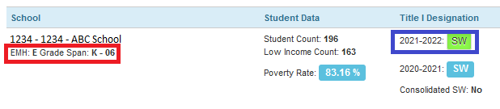
Grade Span Designation and Title I Status
Grade span designation (elementary, middle, high) is determined based on the low and high grades reported by each LEA, for each school in the School Profiles Section of the Consolidated Application
Title I Status is determined based on the LEA’s selection for each school in the School Profiles Section of the Consolidated Application

Slide 15
Aggregations
HR Snapshot records are aggregated by school code and grade span to determine the total state/local funded FTE for each school, separately by grade span
Student enrollment records (K-12) are aggregated by school code and grade span to determine the total number of students enrolled for each school, separately by grade span
For each school and grade span, student enrollment counts are divided by the total state/local funded FTE to determine student-teacher ratios
Example: 350 Students / 17.5 FTE = Student-Teacher Ratio of 20.0
Process is repeated at the district-level, aggregating by district code and grade span, separately for Title I and non-Title I schools

Slide 16
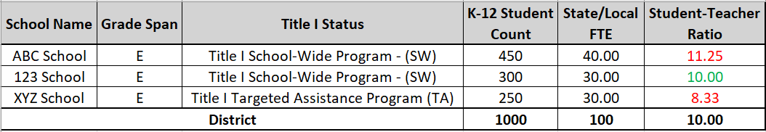
Final Calculations - All Schools in Grade Span Served with Title I
If a district serves all schools within a grade span with Title I funds, then each Title I school will be compared to the district’s student-teacher ratio for all schools in that grade span
In order for a school to meet comparability requirements, the school’s student-teacher ratio must be within 10% of the district’s student-teacher ratio
  For example, if a district’s student-teacher ratio is 20.0, each Title I school must have a student-teacher ratio between 18.0 (20.0 - [20 * 0.1]) and 22.0 (20 + [20 * 0.1])
Within 10% = 9.0 to 11.0

Slide 17
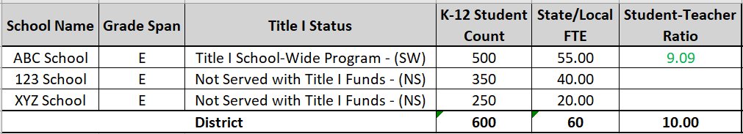
Final Calculations - Some Schools in Grade Span Served with Title I
If a district only serves some schools within a grade span with Title I funds, then each Title I school will be compared to the district’s student-teacher ratio for all non-Title I schools in that grade span
In order for a school to meet comparability requirements, the school’s student-teacher ratio cannot exceed the district’s student-teacher ratio by more than 10%
  For example, if a district’s student-teacher ratio is 15.0, each Title I school must have a student-teacher of 16.5 (15.0 + [15.0 * 0.1]) (20.0 - [20 * 0.1]) or less
No more than 10% = 11.0 or less

Slide 18
Next Steps
Visit the Title I Comparability Webpage (http://www.cde.state.co.us/fedprograms/ti/a_comp) for more information regarding:
  Availability of alternative calculators
  Corrective action plans
  Additional trainings

Slide 19
What are your thoughts?
Check for understanding Poll
What future topics would you like to see around comparability?
Who in your district needs a better understanding of this topic?
How can this check inform your staffing and budgeting conversations?

Slide 20
Calculations for Equitable Distribution of Teachers (EDT)

Slide 21
Pulsecheck
How comfortable are you in your understanding of how the CDE collects and calculates the annual EDT data analysis?
  1 = uncomfortable; no knowledge
  5 = very comfortable; could lead this training
Who in your LEA maintains the accuracy of HR data used for EDT calculations?
Who in your LEA reviews EDT data?
How is EDT data being reviewed/used, proactively or reactively?
Are there district mechanisms in place to review and address EDT data?

Slide 22
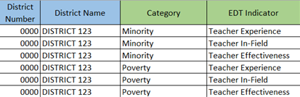
Purpose
The Every Student Succeeds Act (ESSA) requires state education agencies (SEAs) to evaluate annually whether low-income and minority students are taught disproportionately by ineffective, out-of-field, or inexperienced teachers compared to their higher-income, non-minority peers.
NOTE: Teacher Effectiveness Indicators were not included in 20-21 EDT data.

Slide 23
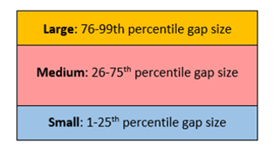
Purpose, Cont.
Local education agencies (LEAs) accepting Title I, Part funds must submit plans to address any “gaps”.
  Future workshops will be held on how to address gaps and write plans.
  For more information now, review the Resources on our EDT webpage.
Submit plan to CDE in Consolidated Application
Maintain local plan; subject to monitoring

Slide 24
Staff FTE Included from HR Snapshot
Records associated with grades K-12
Records with the following teaching subject areas (core classes)
  0010 - General elementary education
  0015 - General 7th/8th grade
  0070 - Co-Alt exclusively (for special education teachers)
  0200s - Art
  0500s - English language arts
  0600s - Foreign languages
  1100s - Math
  1200s - Music
  1300s - Natural sciences
  1500s - Social sciences
  1700s - Special education, except codes 1791 (developmental delay) and 1792 (infant-toddler with a disability) which are used for PK
Records with a job class code of
  201 - Teacher, Regular
  202 - Teacher, Special Education
  206 - Teacher, Title I
Records with an employment status code of
  11 - Active employment
  12 - Active employment in different position at school
  13 - Active employment within the district

Slide 25
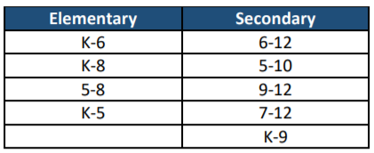
Elementary vs. Secondary Designation
Elementary vs. secondary classifications are necessary for determining the Equitable Distribution of Teachers (EDT) analyses.
School-Level
  If a school’s highest grade is between K through 5, the school is considered elementary.
  If a school’s highest grade is between 9 through 12, the school is considered secondary.
  If a school’s highest grade is between 6 through 8
    The school is considered elementary if the lowest grade is K through 5.
    The school is considered secondary if the lowest grade is 6 or higher.
Staff-level
  Elementary vs. secondary classification should match school-level designation, except:
    If the school is flagged as secondary, but the staff record is only associated with grades K-5, recode staff-level designation as elementary.

Slide 26
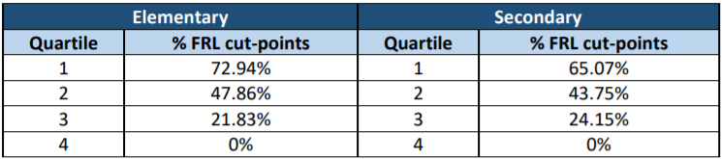
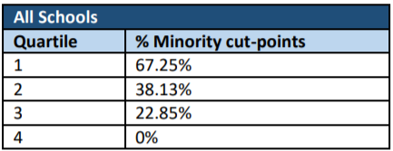
Poverty and Minority Quartiles
Student enrollment records (K-12) are aggregated by school code to determine the poverty and minority percentages for each school.
All Colorado K-12 public schools are ranked highest to lowest based on their poverty and minority percentages.
  Poverty quartiles are calculated separately for elementary and secondary schools.
Schools are then divided into quartiles.
  Schools with poverty or minority percentages in the top 25% fall into the highest quartile.
  Schools with poverty or minority percentages in the bottom 25% fall into the lowest quartile.
Poverty Quartiles*
Minority Quartiles*
*17-18 EDT quartile cut-points shown as an example.

Slide 27
Statewide vs. Local Quartiles
If a district does not have both Q1 and Q4 schools based on the statewide distribution, then a local quartile framework is used (teacher effectiveness only).
  All schools within a district are ranked based on the percentages of low-income and minority students enrolled, and divided into quartiles.

Slide 28
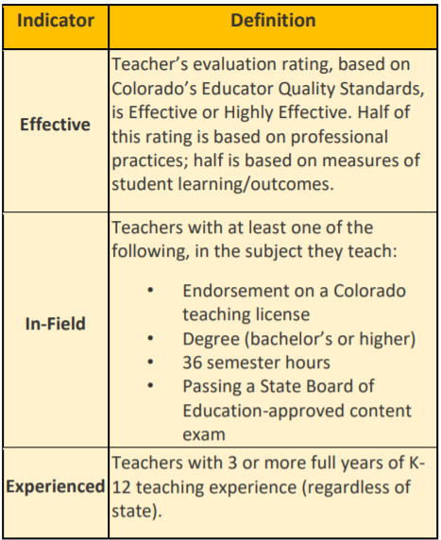
Aggregations
HR Snapshot records are aggregated by school code to determine the total FTE for each school, and separately for each of the following categories:
  Experience
  In-Field
  Effectiveness
Additional indicator guidance can be found here.
In-Field Status may be different for each staff assignment line a teacher has in HR reporting.

Slide 29
Aggregations
Percentages are calculated for each school, separately for each category.
  Experienced FTE and In-Field FTE are divided by the total FTE for the school, to calculate the experienced and in-field percentages.
  Effective FTE are divided by the total FTE with an effectiveness rating for the school, to calculate the effective percentage.
Example: 35.5 In-Field FTE / 50.0 Total FTE = In-Field Percentage of 71.0%
Process is repeated at the district-level, aggregating by district code, separately for the lowest and highest poverty/minority quartile schools.

Slide 30
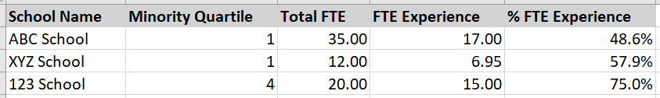
Example Aggregations
Each district receives a school-level data file (Syncplicity), identifying which schools are in the lowest and highest quartiles, and showing the FTE included in each calculation.
Each district also receives a district-level data file, displaying the FTE and percentages for each EDT indicator, across the lowest and highest quartile schools.

Slide 31
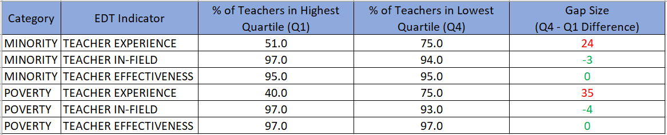
Final Calculations - District With Both Highest and Lowest Quartile Schools
If a district has both highest and lowest quartile schools, then the FTE percentages in the highest quartile schools are compared to the FTE percentages in the lowest quartile schools.
A disparity/gap exists if the FTE percentage in the highest quartile (Q1) schools is less than the FTE percentage in the lowest quartile (Q4) schools.
GAP
GAP
To learn how to address gaps in EDT, like the above example, be on the lookout for upcoming EDT trainings/workshops or visit our website.

Slide 32
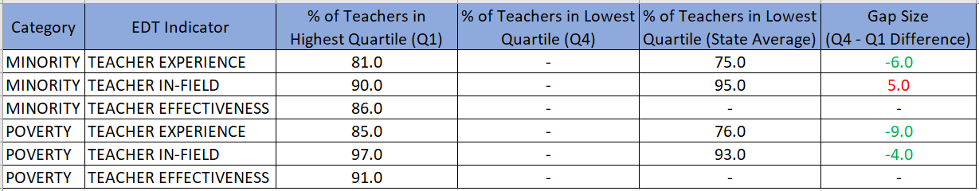
Final Calculations - District With Only Highest Quartile Schools
If a district only has highest quartile (Q1) schools, then the FTE percentages in the highest quartile schools are compared to state averages (for all lowest quartile schools).
A disparity/gap exists if the FTE percentage in the highest quartile (Q1) schools is less than the state average.
GAP

Slide 33
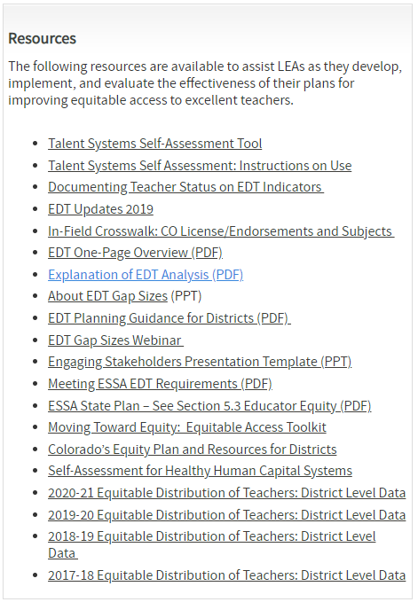
Next Steps
Visit the Equitable Distribution of Teachers (EDT) Webpage (http://www.cde.state.co.us/fedprograms/equitabledistributionofteachers) for more information regarding:
  EDT Gap Sizes
  EDT Planning Guidance
  Additional recorded trainings
Future EDT related Workshops/Trainings

Slide 34
Next Steps
In thinking about the systems your LEA has in place, where is there room for improvements that may increase the accuracy of EDT data? What are you doing well?
What are some topics of conversations that need to take place in your LEA? Who needs to be involved?
Do you feel more comfortable with how EDT is calculated after this training?

Slide 35
Key Takeaways
Comparability data relies on fields in the Staff Interchange (Staff Profile & Staff Assignment) files and the Consolidated Application School Profiles.
EDT data relies on fields in the Staff Interchange (Staff Profile & Staff Assignment) files.
EDT analyses are run for 3 different indicators by both poverty and minority quartiles to identify any gaps.
Comparability and EDT data is only as useful as the information you report is accurate.
Involving HR, finance, and programmatic staff in Comparability and EDT conversations throughout the process results in more actionable data.

Slide 36
Questions

Slide 37
What do you need from us?
What support to you need going forward?
What topics would you like from future trainings? Please submit ideas HERE.

Slide 38
Contact Information
For data or analyses related questions:
  Tina Negley
  Data, Accountability, Reporting, and Evaluation (DARE) Coordinator
  negley_t@cde.state.co.us
  Mary Shen
  ESEA Research Analyst
  shen_m@cde.state.co.us
For additional information regarding Comparability:
  Kathryn Wisner
  ESEA Programs Specialist
  wisner_k@cde.state.co.us
For additional information regarding EDT:
  Niko Kaloudis
  ESEA Titles I and II Specialist
  kaloudis_n@cde.state.co.us

