Slide 1
ESEA - February Virtual Training
February 15, 2022

Slide 2
Agenda
We will start each session on time
We may take short breaks in between if time allows
Feel free to stay on for all three or leave and come back
Type questions in the chat or come off mute to interact
All recordings and slides will be sent out and posted on the RNM webpage after the meeting
9:00- 10:00 am | Consolidating Funds Schoolwide
10:00 - 11:00 am | Title III
11:00 am - 12:00 pm | Monitoring

Slide 3
Consolidating Funds Schoolwide
Notes:
Laura kicks us off

Slide 4
Introductions
Laura Meushaw - Title I School Improvement Coordinator
Kathryn Wisner - ESEA Title I & III Specialist
Niko Kaloudis - ESEA Title I & II Specialist
Steven Kaleda - Grants Fiscal
Robert Hawkins - Grants Fiscal
Enter any questions into the chat.
Please change your name to your preferred name by right clicking your image. Consider including your LEA and any preferred pronouns.
Notes:
Hello and thanks for joining today to discuss Consolidated Schoolwide. My name is Laura Meushaw. I am joined by Kathryn Wisner AND Niko Kaloudis from the ESEA office as well as Steven Kaleda and Robert Hawkins. from Grants Fiscal. They will be jumping in throughout the presentation as CSW is joint effort between programming and fiscal at CDE. Kathryn will be monitoring the chat to feel free to type in any questions and we will address them throughout the presentation.

Slide 5
Objectives
Participants will be able to
articulate what it means to consolidate funds schoolwide.
explain the different levels of consolidating funds.
identify which funds can be consolidated.
understand the planning requirements for consolidating funds.
understand the flexibility provided from consolidating funds.
properly code and account for consolidated funds.
properly indicate consolidation of funds in the Consolidated Application portal.
We will address programmatic and fiscal aspects of consolidating funds schoolwide. Share this with your wider team.
Notes:
I’d like to start with why we wanted to discuss Consolidated Schoolwide today. Each year when districts start working on their Consolidated Application, we start to get the question “On the School Profiles page, my schools are SW do I click on the Consolidated Schoolwide button too? or “What does Consolidated Schoolwide mean? When we explain that “Schoolwide is a programming function while Consolidated Schoolwide is more of an accounting function, the questions and sometimes confusion really starts to flow. Although we have discussed this topic in the past, with so many new staff members and the need for flexibility given the diverse needs of districts and schools, we wanted to partner with our experts in Grants Fiscal to READ bullets
Just as we have partnered for this presentation, if a district determines that CSW is the best for addressing student need, we urge you to partner with your fiscal counterparts.

Slide 6
Targeted Assistance vs Schoolwide Programs
 | Targeted Assistance | Schoolwide
School Eligibility | Any school that receives a Title I allocation is eligible. May serve all grades or only some grades; all subjects or only certain subjects. | Must meet required poverty threshold of 40%. EdFlex waiver available
Student Eligibility | Provide supplemental educational services only to those “failing, or most at risk of failing, to meet the state’s challenging student academic achievement standards.” Must use multiple educationally related objective criteria to select students. | Comprehensive reform strategy to upgrade entire educational program of a Title I school. All students eligible for services.
Option to Consolidated Funds?
Notes:
As you likely know, there are two types of programming in Title I, Targeted Assistance and Schoolwide. A targeted assistance program is just like it suggests, targeted. Students are identified as at risk of not meeting state standards and provided supplemental, intervention type services by a teacher funded by Title I. Schoolwide programming are schools who have a poverty level higher than 40% and have created a schoolwide plan that is based on a comprehensive needs assessment. The needs assessment determined that given the needs at the school, it would be better to have more flexibility in using funds and flexibility when serving students. More specifically, given the needs at the school, the needs could not be adequately addressed if only one teacher was available to serve identified students. When I was a teacher, my school was more than 90% free and reduced and on Improvement, given the large number of students performing below grade level, one interventionist would not have addressed the need. It was key that all teachers were able to provide Tier 2 intervention in the classroom on a daily basis. Flexibility in funding professional development and staffing was critical. We wanted to start with this slide because a school can only Consolidate funds if it has a schoolwide program. This is not a flexibility available to targeted assistance programs. So Step 1 for CSW: must be running schoolwide programs.
Note: if your school is below 40%, a schoolwide waiver available.

Slide 7
What Is Consolidated Schoolwide?
A Title I school that is implementing a schoolwide program may choose to consolidate federal, state, and local funds to design and implement a comprehensive plan for the purpose of upgrading the school’s entire educational program based on the school's comprehensive needs assessment [ESEA, Section 1114(a)(1), (ESEA, Section 1111(c)(9)].
Can only be enacted in schools that are served schoolwide and whose schoolwide plans reflect consolidation.
Notes:
Although we are going to unpack this definition throughout our presentation, we wanted to provide a simple grounding statement for CSW. READ.
This definition spotlights one of the key difference between Schoolwide programming and Consolidated Schoolwide. As we discussed on the previous slide, SW classification allows a school to flexibly use their Title I funds to meet the needs of all of the students in the school. CSW is taking that consolidation further by pooling additional federal, state and/or local to meet the needs of students.

Slide 8
Advantages of Consolidating Funds Schoolwide
From USDE Guidance
Flexibility to allocate all available resources effectively and efficiently.
A school is not required to meet most of the statutory and regulatory requirements of the specific Federal programs included in the consolidation, provided it meets the intent and purposes of those programs.
A school is not required to maintain separate fiscal accounting records by Federal program that identify the specific activities supported by each program’s funds.
Additional Advantages
LEA can choose the funds that they consolidate.
Like schoolwide, consolidation is considered a single cost objective and Time & Effort can be reported semiannually.
Notes:
Our response to the “What’s CSW?” question is normally followed up with “Why do you consolidate” “Are there benefits?” . Well there are a couple of flexibilities provided with CSW that many may consider advantageous READ bullets
We do want you to keep in mind that advantages for one might not be an advantage for another.. It is essential that a district and its schools learn the ins and outs of CSW to determine what makes most sense for them. We have some resources at the end of the presentation that will provide more detail. We are also always available to have one on one conversations with districts to

Slide 9
Becoming a Consolidated Schoolwide Program
Step 1: Receive a Title I allocation in the Consolidated Application.
Served according to the rank order established on the LEA and School Profiles.
Step 2: Meet poverty threshold of 40%.
Ed-Flex waiver available.
Step 3: Planning Year
Complete a Comprehensive Needs Assessment and write a Schoolwide Plan.
Schoolwide Plan must include list of programs that will be consolidated. (Review annually; Revise as necessary.)
The Consolidated Application platform reflects consolidation of funds.
Schoolwide
Consolidated
Schoolwide
Notes:
Niko
In order for your school or schools to consolidate funds, a few steps must be taken. Most of these steps are the same as establishing a SW program such as:
1st a school must receive funds through rank order based off the method of serving your LEA selects in the ConsApp.
2nd, to be a schoolwide program of any kind, school must have a 40% or greater poverty rate (waiver available).
3rd the school, with LEA support, should engage in a planning year in which they leverage a CNA to write a Schoolwide Plan.
All of those steps happen even if a school running a SW program isn’t consolidating funds.
If consolidating funds then:

Slide 10
Importance of the Schoolwide Plan
Comprehensive Needs Assessment (CNA) identifies the need to consolidate funds.
Needs from the CNA are incorporated into the schoolwide plan.
Provides information to auditors and monitors about which programs are included if there is a consolidation.
CDE will use the schoolwide plan to determine whether:
The plan’s activities meet the intent and purposes of the consolidated federal programs;
The school is implementing the activities detailed in the plan.
LEA may attribute expenditures to particular fund sources without regard to whether they actually support particular fund source as long as the expenditures support the schoolwide plan.
Use of funds also affected by level of consolidation.
Notes:
Niko - move quickly through
Ultimately, the Plan and CNA are how LEAs are held accountable for consolidation. The need for consolidation of funds is identified from completing a CNA.
Those needs must be included in the SW Plan. Auditors and monitors use the plan to guide their review of consolidation.
-read through starting bullet 4
-switching over to Laura to breakdown a few ways that consolidation can be implemented.

Slide 11
Multiple Schoolwide Paths
 | Funds Consolidated | Level of Flexibility to Address Student Needs | Notes
Option #1 | No Funds Are Consolidated | Least | Only Title I funds support the schoolwide plan.
Option #2 | Consolidates Only Federal Funds* | Moderate | Wide range of which federal funds you can select. (see next slide)
Option #3 | Consolidates Federal, State, & Local Funds* | Most
*LEA may choose to support CSW with a portion of Title II, III, and IV funds while still allocating funds to non-Title I schools.
Notes:
As I mentioned in a previous slide, within CSW, there are options regarding which funds the school consolidates. Option 1 is your run of the mill SW program. As we discussed SW in and of itself provides a lot of flexibility to upgrade the educational program of the entire school, with special attention to providing services to students identified as at-risk. If the school falls into Option 1, then this is just SW and CSW would not be selected in the Consolidated Application. Option 2 illustrates that the district and its SW schools may choose to only consolidate its federal funds. Keep in mind, all of these funds are still being award to the school but we mention the district because the funds are awarded to the district by CDE and of course need to be apart of this decision. There is a sub-option to Option 2. A district may choose to consolidate some of its Title II, III and IV funds within the Title I SW schools and keep some at the district level or award to non-Title I schools. We will discuss some of the considerations in making that decision.
Then there is Option 3 which is consolidating federal, state and local. With each Option the amount of flexibility increases in that the more funds are pooled together and potentially more statutory requirements are lifted.

Slide 12
Schoolwide Program (Option #1)
Title I
Other Federal
State
Local
II
III
IV
V
Allowable Uses of Title I
Allowable Uses of Title II
Allowable Uses of Title III
Allowable Uses of Title IV
Allowable Uses of Title V
Allowable Uses of Grant
Allowable Uses of Grant
Allowable Uses

Slide 13
Consolidated Schoolwide Program (Options #2)
Option #2
Title I
Other Federal
State
Local
II
III
IV
V
Remember: Not all funds must be used in consolidation.
Consolidated Funds
Allowable Uses of Grant
Allowable Uses
Allowable Uses of ANY Program Included in the Consolidation SW Plan

Slide 14
Consolidated Schoolwide Program (Option #3)
Option #3
Title I
Other Federal
State
Local
II
III
IV
V
Remember: Not all funds must be used in consolidation.
Consolidated Funds
Allowable Uses of ANY Program Included in the Consolidation SW Plan

Slide 15
Which Funds CAN Be Consolidated?
Federal (USDE Programs)
Formula Grants: Can consolidate funds from nearly every noncompetitive, formula grant.
Title I, Part A
Migrant Education Program (Title I, Part C)
Title II, Part A
Title III, Part A
Title IV, Part A
Perkins
IDEA
Discretionary Grants
21st CCLC & Adult Education (WIOA)
Must still carry out activities described in the application under which the funds were awarded.
State
Can consolidate state funds except for special allotments.
Individual grants might restrict.
Local
This is not an exhaustive list.
Notes:
This slide provides a list of USDE funds that are commonly consolidated however this list is not exhaustive. I can’t say this enough, if the district is interested in pursuing consolidation at any of the levels we discussed,, you will want to better understand the funds that can be consolidated as well as any limitations. And of course we are happy to help..

Slide 16
Which Funds CAN Be Consolidated?
Special Restrictions in the following areas:
Migrant Education Program
Indian Education Program
IDEA
Programmatic Responsibilities
IDEA funds can be consolidated but all programmatic protections must apply, including the provision of FAPE.
In other words, IDEA services must be provided, but not necessary to track IDEA dollar to IDEA service.
Restrictions on Consolidation
Amount of funds cannot exceed the number of students with disabilities multiplied by per‐disabled‐child amount of Part B funds received by LEA
What about the non‐consolidated funds?
Any non‐consolidated funds can be spent to ensure that programmatic requirements are met and all children with disabilities are served.
But must track those separately.
Notes:
Speaking of limitations, this slide details some of the funds that have special restrictions. Similar to the previous slide, this list is not exhaustive and does not go into the nitty gritty but does highlight some of the more significant look fors. Again happy to help you sort the rules out as it pertains to your district and the funds you’d be interesting in consolidating.

Slide 17
Consolidated Schoolwide Coding
SRE 95
This Special Reporting Element (SRE) code identifies Consolidated Schoolwide Programs.
Used in conjunction with a unique location code and/or school code if used for each schoolwide plan site and Object Code 0855.
Object Code 0855 identifies the Schoolwide Plan Distribution, as an option to detailed object coding.
SRE 95 should be used for the coding of all expenditure activities related to a specific school’s schoolwide plan.
SRE should also be used in all General Fund (10) Abatement Accounts and all Governmental Grants Fund (22) or General Fund (10) Grant Accounts for the grant programs that have been included in the specific schoolwide plan.
See Appendix T, “Consolidated Schoolwide Programs” for additional information.
Object Code 0855 Schoolwide Plan Distribution (Consolidated Schoolwide plans only)
Notes:
Robert/Steven

Slide 18
Chart of Accounts
Periodically, the allowable expenditure activities will be distributed to the various sources that contributed to the total school wide budget. This distribution may be in the same budget detail as is captured in the SRE code 95 structure or the object code of 0855 may be used as an option to the detailed object coding.
Example
Let us assume that one half of the total school wide budget has been expended to date or $625,000 and that such expenditures have been captured in the same accounts as identified above. Of the $625,000 total expenditures to date, the General Fund share is 80% or $500,000, the Title I, Part A grant share is 16% or $100,000 and the Title III, Part A grant share is 4% or $25,000.
Notes:
Robert/Steven

Slide 19
Chart of Accounts
An example of the use of the 0855 object code is as follows:
Fund Location SRE Program Object Code Job Class Grant Code Amount
10 101 95 0010 0855 000 0000 ($125,000.00)
22 101 95 0010 0855 000 4010 $100,000.00
22 101 95 0010 0855 000 4365 $25,000.00
Notes:
Robert/Steven

Slide 20
Cautions of Consolidating Funds
LEAs must:
serve schools in Rank Order.
provide equitable services to Non-Public Schools.
meet any pending Office of Civil Rights (OCR) requirements.
LEAs are still required to meet mandatory set aside requirements.
Title I Homeless Set Aside
Title I Parent Engagement Set Aside (if more than $500k)
Title IV 20% Safe and Healthy/20% Well Rounded/a portion for Effective Use of Technology (if total allocation is over $30k) when providing funds to non-Title I schools.
LEAs that consolidate funds are still able to use, if they choose:
District Managed Activities (DMA)
Family Literacy Set Aside
Preschool Set Aside
Neglected Institution Set Aside
Notes:
Although there are many flexibilities afforded with CSW, there continue to be some requirements. Regardless of TA, SW or CSW, districts

Slide 21
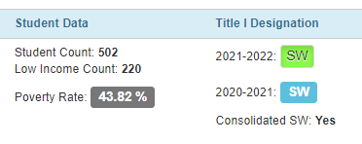
Consolidated Application
Note that you will consolidate funds schoolwide on the School Profiles page.
Must be SW
Notes:
Niko

Slide 22
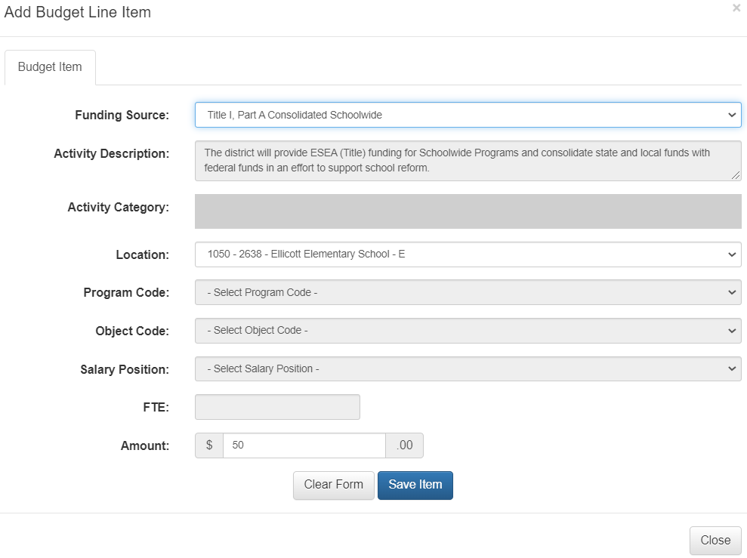
Consolidated Application
Select the Consolidated Schoolwide Funding Source for budget lines.
Activity Category, Program Code, Object Code, Salary Position, and FTE will gray out.
Notes:
Niko

Slide 23
Consolidated Application
Select the Consolidated Schoolwide Funding Source for budget lines. (Activity Category, Program Code, Object Code, Salary Position, and FTE will gray out.)
Notes:
Niko

Slide 24
Advice from an LEA’s Perspective
Quick Intro
Your Role
LEA Name
Urban, Suburban, or Rural
How long has your LEA consolidated funds?
How did your LEA make the decision to consolidate?
What funds do you consolidate? Why have you selected those to consolidate?
What do you wish you knew before you began consolidating funds?
Several LEAs in the state consolidate funds, to various levels. We can connect you!
Notes:
Laura
make point about hosting a panel of LEAs that consolidate
We wanted to take some time to hear from districts that have chosen to consolidate their funds.
This was a great idea that we had a little too late given everyone’s busy schedules.

Slide 25
Questions?

Slide 26
Resources & Contacts
Brustein & Manasevit Consolidated Schoolwide PPT
USDE Guidance (start pg 49)
Chart of Accounts (Appendix T)
CDE Schoolwide Website
Laws & Regulations
ESEA § 1114, 34 C.F.R. 200.25‐200.29
Describes the legal foundation of the schoolwide program
67 Fed. Reg. 40360‐64 (July 2, 2004)
Lists programs that can be consolidated
Programmatic
Meushaw_L@cde.state.co.us
Wisner_K@cde.state.co.us
Kaloudis_N@cde.state.co.us
Fiscal
Hawkins_R@cde.state.co.us
Kaleda_S@cde.state.co.us
District Representatives
swilson@bigsandy100j.org
cjohnson@bigsandy100j.org
Notes:
Laura
If you’d like more information about consolidating funds, please review these resources and email us to set up a meeting.

