Slide 1
Monitoring-Stakeholder Engagement
October 29, 2018
Notes:
Monitoring-Stakeholder Engagement

Slide 2

Introductions
Our Team
Structure of webinar
Being recorded for future viewing
Will go through slides and respond to questions at the end
Please feel free to type in questions into chat box
Or at the end, we will open up microphones
Notes:
Intro

Slide 3
Purpose and Agenda
To provide LEA’s with a deeper level of understanding in regards to CDE expectations on meeting Federal Requirements under the Every Student Succeeds Act during the 2018-2019 Monitoring process and identifying examples of practices in Colorado
CDE existing sources of LEA information (1st look)
CDE Review of LEA Implementation
Examples of Compliance
Considerations for Effective Practices

Slide 4
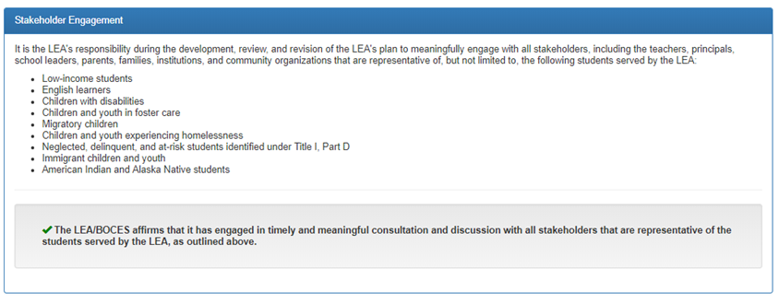
Stakeholder Engagement-Consolidated Application
Module A- Assurance: Tied to SE 9.1 Stakeholder Engagement in the Consolidated Application for ESEA Funds
Notes:
During review, CDE will look at existing sources of information that LEAs have already submitted to us. For example, in order to determine if LEAs are in compliance for SE 9.1 Stakeholder Engagement in the Consolidated Application for ESEA Funds, we will first review the 2018-2019 Consolidated Application for ESEA funds. In the Consolidated Application LEAs are required to submit an assurance that the LEA has meaningfully engaged with all stakeholders, including teachers, principals, school leaders, parents, families, institutions, and community organizations that are representative of the student served by the LEA such as; low-income students, English learners, Children with disabilities, children and youth in foster care, migrant children, youth experiencing homelessness, neglected, delinquent and at risk-students, immigrant youth, and Native American, Alaskin Native students. (Click to next slide)

Slide 5
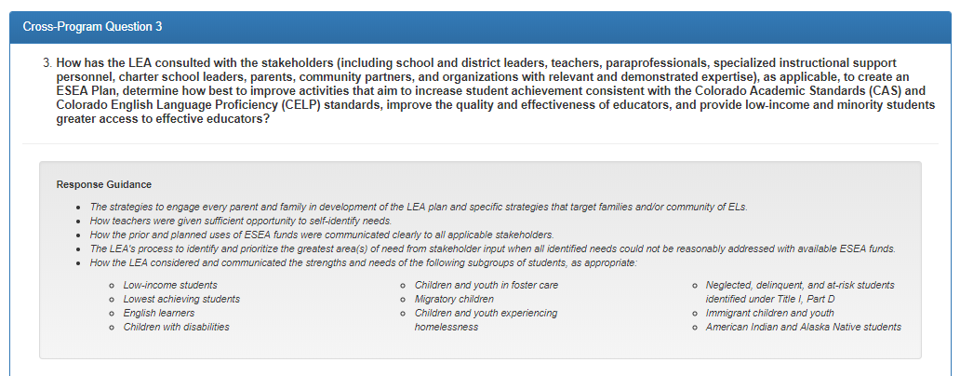
Stakeholder Cross-Program Question
Cross-Program Question 3:Tied to SE 9.1 Stakeholder Engagement in the Consolidated Application for ESEA Funds
Notes:
The narrative response provided by LEA’s in Cross-Program Question #3 informs CDE of the process the LEA has implemented to meaningfully engage stakeholders in the development of the ESEA plan. The narrative response provided will inform CDE on the evidence to collect to determine if the implementation of stakeholder involvement in the development of the ESEA plan meets federal requirements.

Slide 6
Cross Program Question #3: Example Response
CP Q #3 Example Narrative Response:
The LEA utilizes the UIP process to engage stakeholders in developing the ESEA Plan. Parents, teachers, and community members that sit on the District Accountability Committee (DAC) meet quarterly. The DAC reviews disaggregated academic achievement data and develops an action plan for decreasing trend lines. The district also utilizes Teacher Leader Committees (TLC) to review student data weekly and modifies intervention strategies to address students not showing academic growth or at risk of not meeting grade level expectations on CAS or CELP. The DAC and TLC identify priority areas of need and evaluate how ESEA funds can be leveraged to improve student academic outcomes. The ESEA plan is brought to DAC and TLC for final feedback and recommendations then the district incorporates feedback and recommendations into the plan.
Notes:
READ Example

Slide 7
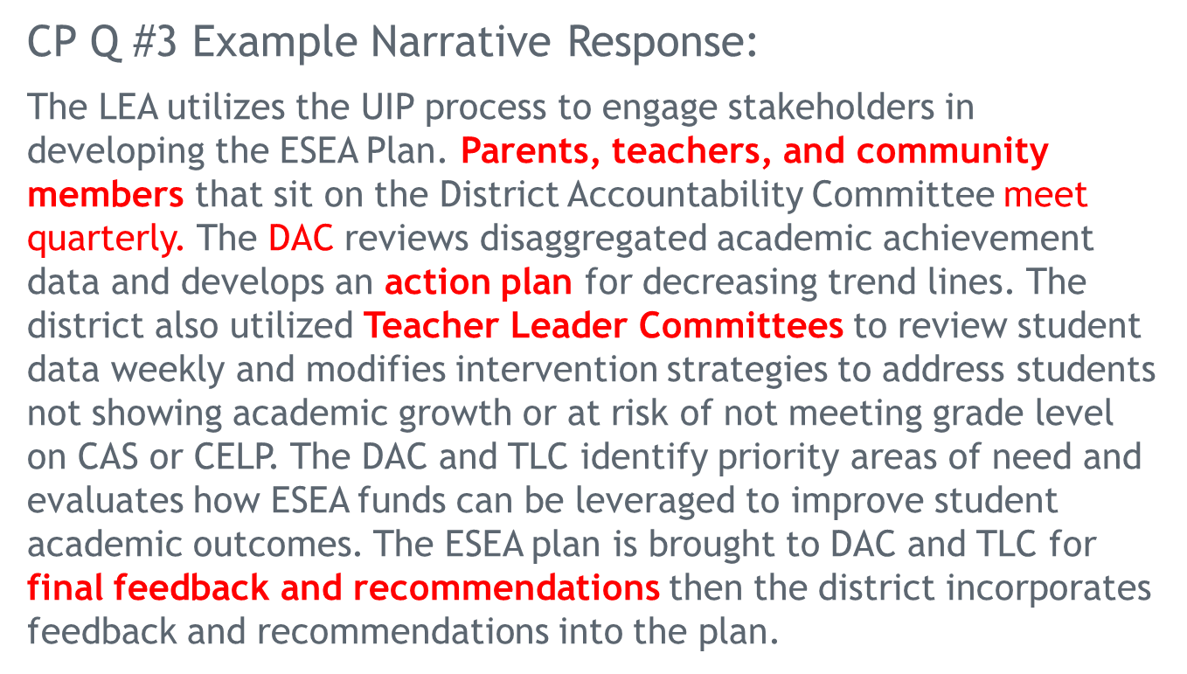
Potential Examples of Evidence:
Notes:
Highlight the Key pieces of information identified from narrative response. Like the ‘stakeholder groups’ listed, the ‘action plan’ that was developed, quarterly meetings, TLC’s etc. The narrative walks us through a high level process that the district has implemented to engage stakeholders in developing the ESEA plan, and what engagement looks like.

Slide 8
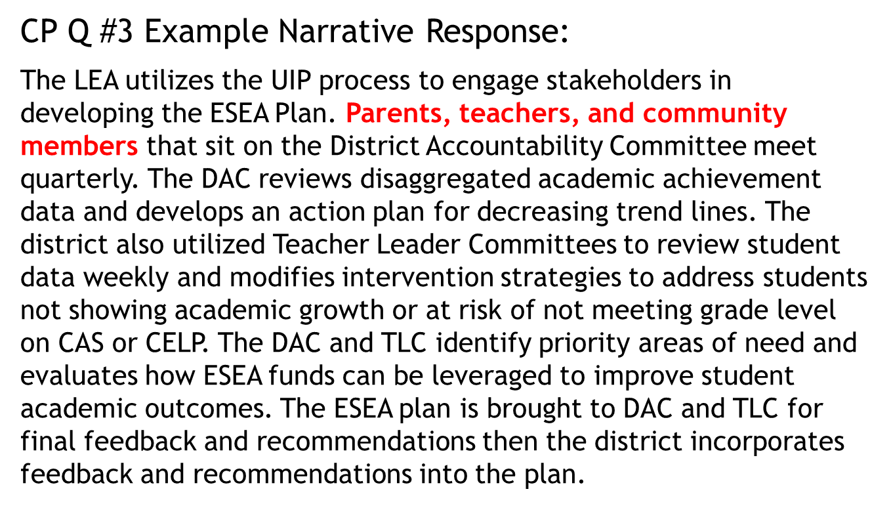
Potential Examples of Evidence: Parents, Teachers, and Community Members
List of DAC members with description of their role and group representation

Slide 9
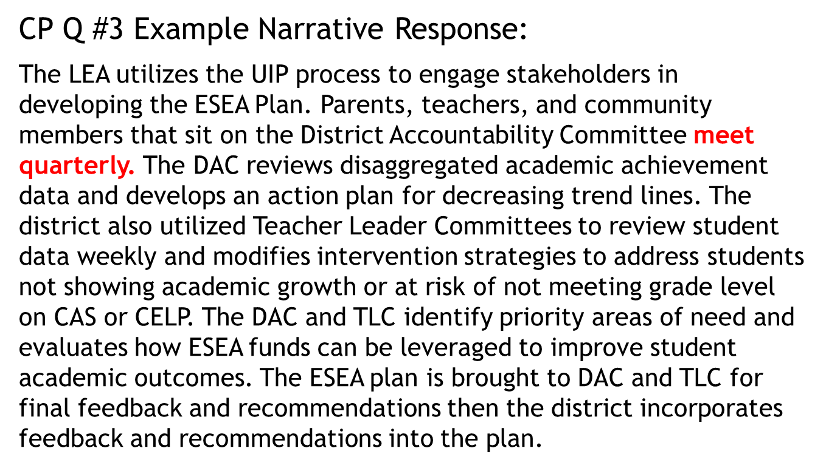
Potential Examples of Evidence: Meet Quarterly
Agenda from meetings, content discussed, decisions or actionable items that developed from meetings, minutes, attendees etc.

Slide 10
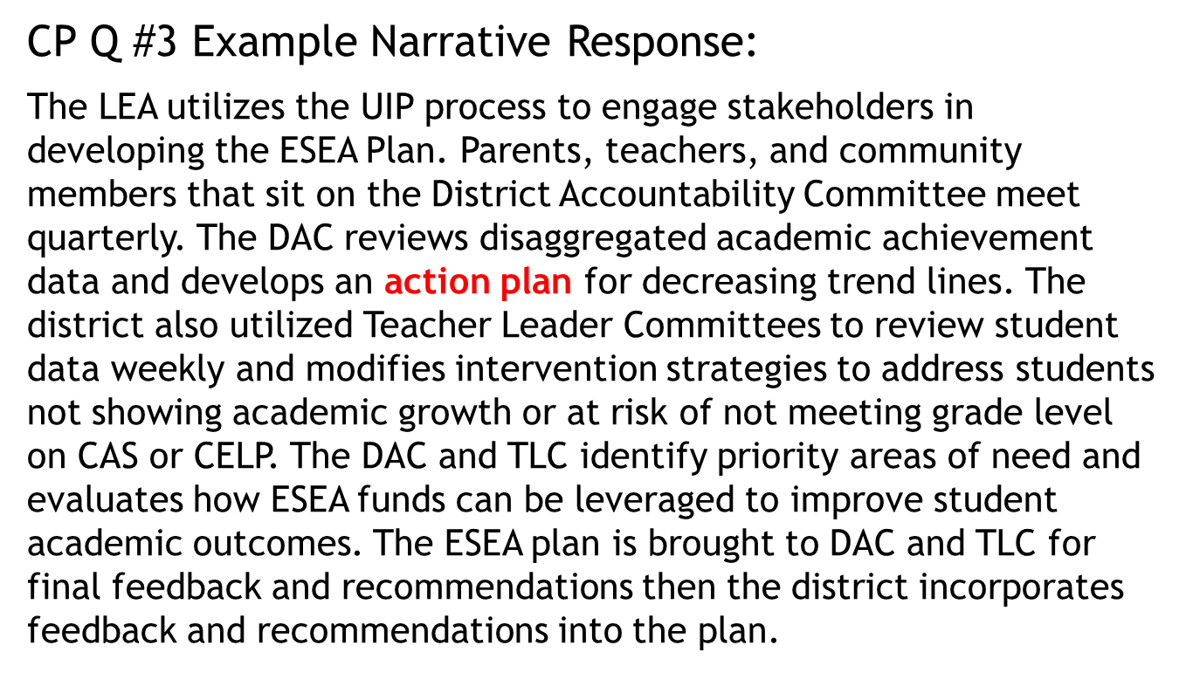
Potential Examples of Evidence: Action Plan
Copy of the action plan and rationale for priorities developed

Slide 11
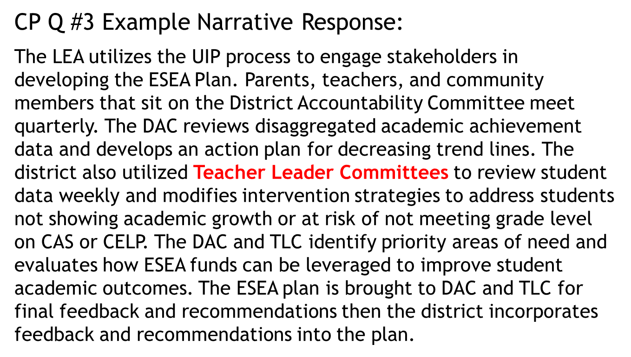
Potential Examples of Evidence: Teacher Leader Committees
List of TLC members with description of their role and group representation

Slide 12
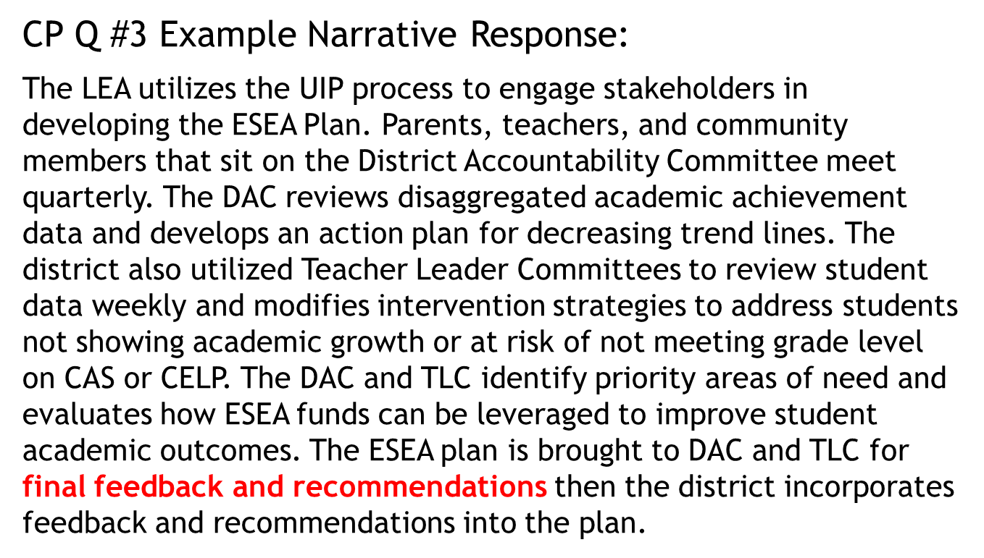
Potential Examples of Evidence: Final Feedback and Recommendations
Summary of feedback provided, before and after drafts of ESEA plan

Slide 13
Considerations for Effective Implementation:
How are representatives selected to reflect the student population?
Were there multiple opportunities for stakeholders to participate in development and review of ESEA plan (Online platform to share information and collect feedback)?
Do stakeholders have background knowledge and skills to meaningfully engage in the development of the ESEA Plan?
Has the LEA provided educational opportunities to increase stakeholder knowledge and skills to meaningfully participate in ESEA Plan?

Slide 14
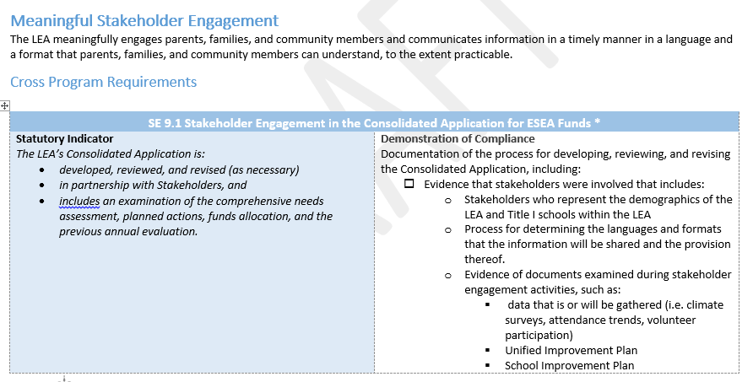
Tied to SE 9.1 Stakeholder Engagement in the Consolidated Application for ESEA Funds

Slide 15
Compliant Practices and Effective Practices: Outreach and Communication
Compliant Practices:
Develop and disseminate critical school and district information to families
In their home language
In a time frame that reasonably allows for family follow-up or response
Effective Implementation Practices:
Provide specific and targeted outreach to parents, including the use of technology, which creates meaningful, two-way communication opportunities.
Specific communication and outreach that is targeted for all stakeholders, and uses multiple methods of outreach to foster collaborative decision making
Stakeholders have multiple opportunities to provide input on various parts of the planning process, included but not limited to:
reviewing data
identifying priorities
giving input on the planned activities
giving input on the plan after it has been organized/developed
Communicate the outcome of involvement and feedback incorporated into plan and updates on rationale for feedback or suggestions not incorporated

Slide 16
Compliant Practices and Effective Practices: Existing Groups and Committees
Compliant Practices:
Utilizing groups or committees similar to SACs or DACs to provide opportunities for students with representation of parents with students that are:
economically disadvantaged
have limited English proficiency
have disabilities
are migratory
and have children with disabilities
Effective Implementation Practices:
Focus on empowering parents, building parent leadership, and developing capacity for families to act as partners in decision making with schools.
Provide opportunities for parents to work together, learn from each other, network, and build social capital.
Offer multiple ways for families to be involved at school that are linked to learning and program improvements

Slide 17

Q & A
Questions?

Slide 18
Contacts
MONITORING:
Joey Willett
Willett_j@cde.state.co.us
(303) 866-6700
DeLilah Collins
Collins_d@cde.state.co.us
(303) 866-6850
Nazie Mohajeri-Nelson
mohajeri-nelson_n@cde.state.co.us
(303) 866-6205
FAMILY AND PARENT ENGAGEMENT:
Kristen Collins
Collins_k@cde.state.co.us
(303) 866-6705
Joey Willett
Willett_j@cde.state.co.us
(303) 866-6700
Darcy Hutchins
Hutchins_d@cde.state.co.us
(303) 866-5921

Slide 19
Reminders:
Webinar Name | Date | Time | Link for Participants | Call-in Number
Monitoring Overview | 10/15/18 | 1:00-3:30pm | https://enetlearning.adobeconnect.com/monitoring-overview/ | 1-866-684-8605
Existing Resources | 10/24/18 | 1:00-3:30pm | https://enetlearning.adobeconnect.com/exisiting-resources/ | 1-866-684-8605
Stakeholder Engagement | 10/29/18 | 1:00-3:30pm | https://enetlearning.adobeconnect.com/stakeholder-engagement/ | 1-866-684-8605
District & School Reporting | 11/6/18 | 1:00-3:00pm | https://enetlearning.adobeconnect.com/district-school-reporting/ | 1-866-684-8605
Title III Parent Notification | 11/15/18 | 1:00-3:30pm | https://enetlearning.adobeconnect.com/titleiii-parentnotification/ | 1-866-684-8605
DMS System | 11/27/18 | 1:00-3:30pm | https://enetlearning.adobeconnect.com/dms-system/ | 1-866-684-8605
Title I & III Parent Involvement | 12/4/18 | 1:00-3:30pm | https://enetlearning.adobeconnect.com/parent-involvement/ | 1-866-684-8605
Monitoring Office Hours | 12/11/18 | 1:00-4:00pm | https://enetlearning.adobeconnect.com/monitoring-office-hours/ | 1-866-684-8605

