Slide 1
Federal Programs Monitoring
Overview

Slide 2
Agenda
New Monitoring Website
Important Documents
How to Upload Evidence
Next Steps

Slide 3
Monitoring Website Structure
Federal Programs Monitoring Home
  Contains the process for both ESEA and ESSER Monitoring
ESEA Monitoring
ESSER Monitoring
Monitoring Follow-Up
ESEA & ESSER
(2 Districts)
ESEA Only
(2 Districts)
ESSER Only
(48 Districts)
Notes:
[walkthrough of website]

Slide 4
Important Documents
ESEA and ESSER Monitoring Schedule
  This schedule reflects the next couple of years in monitoring
21-22 ESEA-ESSER Program Requirements
  This document contains all of the indicators for ESEA and ESSER
  21-22 ESSER Only Indicators
Notes:
[walkthrough]

Slide 5
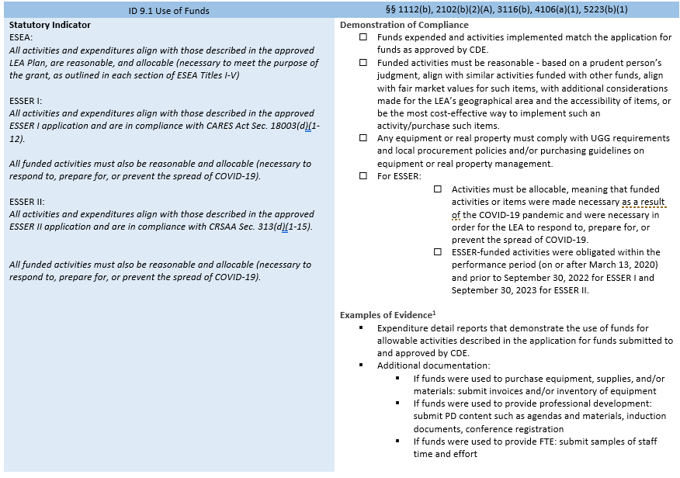
How to Read Each Indicator

Slide 6
Syncplicity
CDE will utilize the Syncplicity Platform for all evidence upload
Syncplicity is a secure file synchronization system that enables you to access files remotely from multiple computers and mobile devices.

Slide 7
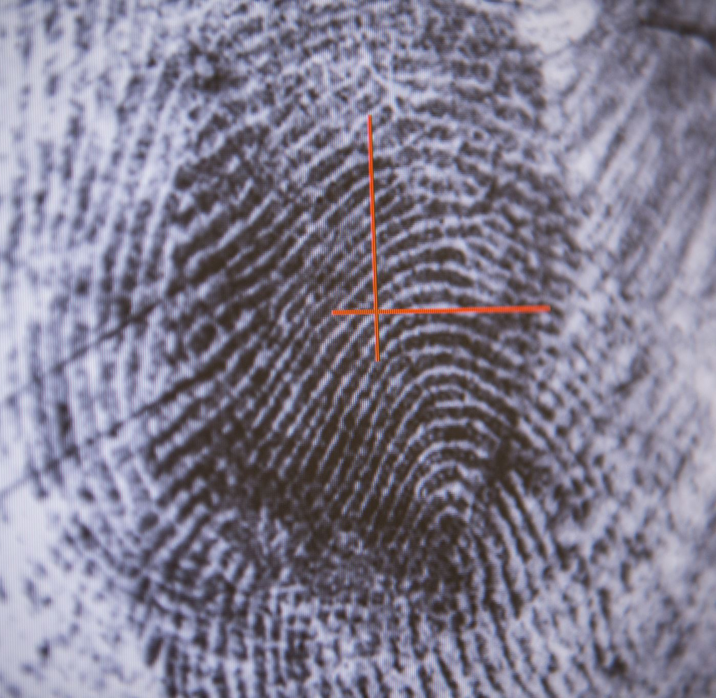
How to Upload Evidence

Slide 8
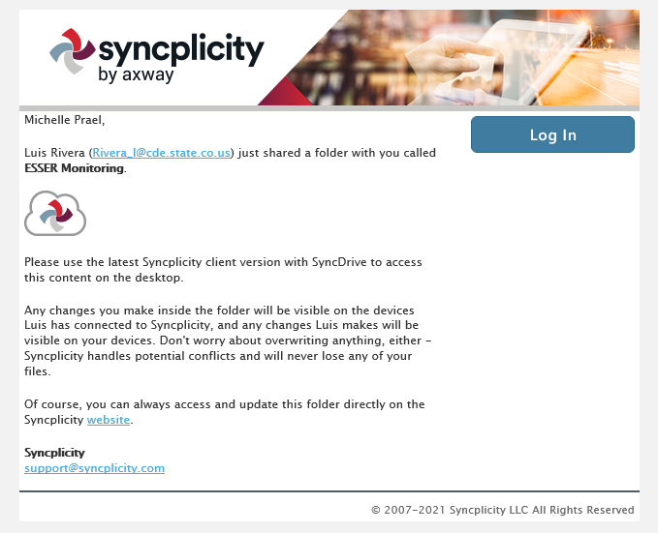
Step 1: Receiving Access
An email will be sent to Authorized Representative from Syncplicity
Email Description Example:
  "ESSER Monitoring" has been shared with you by Luis Rivera (Rivera_l@cde.state.co.us)”
  Be sure to check your SPAM folder
  Please Note: Luis was a summer intern and is no longer at CDE.
This email can’t be shared with others, it will not allow them to access the folder
If you need access, email Kristin Crumley at Crumley_k@cde.state.co.us
Notes:
Once a Syncplicity folder has been shared with the Authorized Representative

Slide 9
Step 2: Login to Syncplicity
Login to your Syncplicity account to access your district’s folder by either clicking on the Syncplicity email or going to my.Syncplicity.com
You may need to create an account to access your folder
If you have accessed Syncplicity before, but can’t remember your password, utilize the Reset Password link

Slide 10
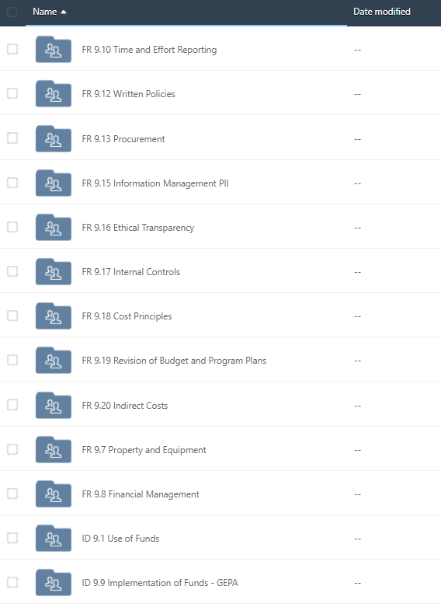

Step 3: Locating your Folder
Your folder will have your district number, name, and “Fed Program Monitoring”
  This is where you will upload evidence
Once you are in your folder, you will see subfolders of each indicator

Slide 11
Step 4: Begin to Upload Evidence
Upload evidence that corresponds with each indicator
As needed, provide a narrative description of evidence or processes that will help reviewers evaluate submitted evidence. This can be done by including a Word document in your evidence folder.
Please use the following naming convention:
  District Number_Indicator Number_Document Name
  Example: 0880_FR1.4_Narrative

Slide 12
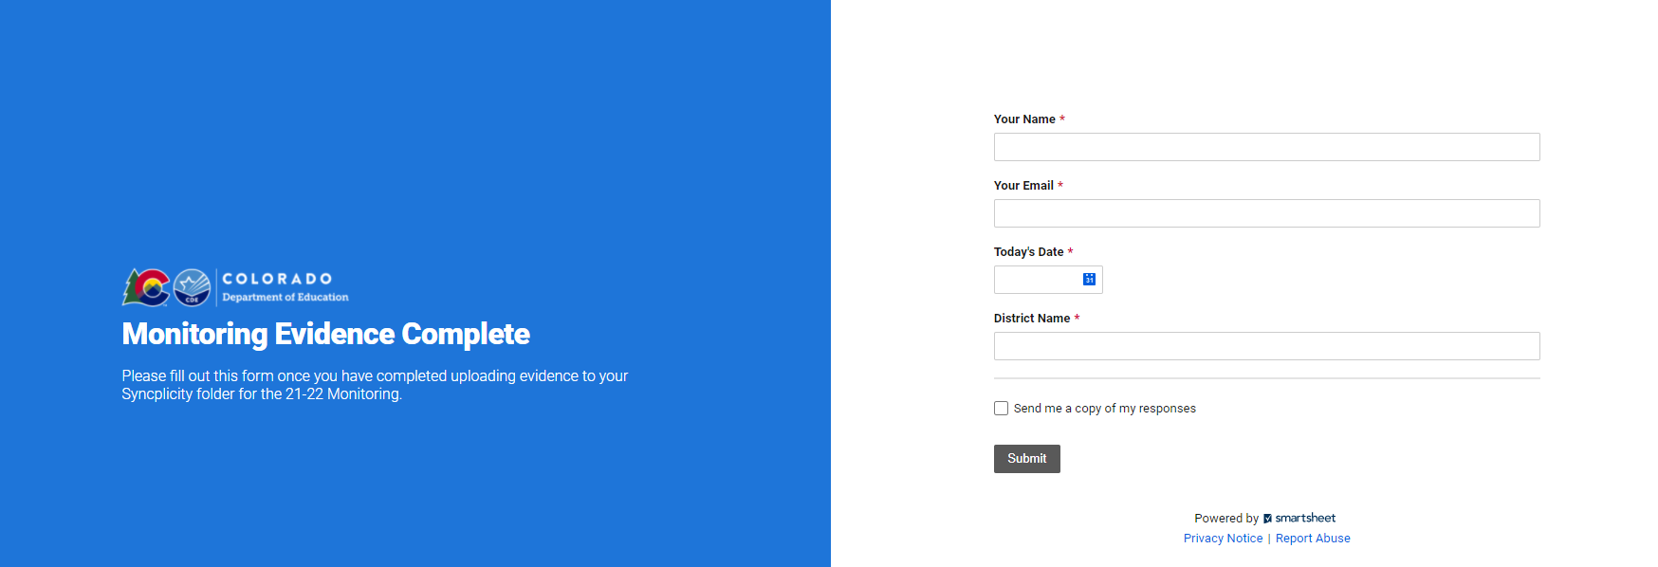
Step 5: Inform CDE
Once all evidence has been uploaded, please notify CDE that you have complete your evidence upload by filling out this form

Slide 13

Timelines and Next Steps
Begin to upload evidence!
LEAs can upload evidence prior to an LEA audit
We won’t begin reviewing evidence until after October 1st and will only do so before the December 31st due date by LEA request!
All evidence must be submitted no later than December 31st
Reminders!
Although you may submit evidence beginning immediately and as you have evidence ready, you are allowed to wait to submit evidence at a later time.
CDE will be providing trainings on each indicator between September and December. You are allowed to wait until after the trainings to submit any evidence. The files are only made available for anyone that wants to start submitting now.

Slide 14
Questions?

Slide 15
Contact Us
ESEA Monitoring
Tammy Giessinger
ESEA Senior Consultant: Title IV
720-827-5291 (c)
giessinger_t@cde.state.co.us
Michelle Prael
ESEA Consultant: Title I, D & Title IV
720-545-7368 (c)
prael_m@cde.state.co.us
ESSER Monitoring
Kristin Crumley
ESEA Monitoring and Reporting Specialist
720-660-1369 (c)
crumley_k@cde.state.co.us
Jonathan Schelke
ESSER Monitoring and Report Specialist
720-388-0842 (c)
schelke_j@cde.state.co.us

