Slide 1
Consolidated Application – Calculations

Slide 2
Agenda
We will go over how numbers are calculated in the Consolidated Application, including:
Non-Public School – Proportionate Share
Budget Summary – Direct and Indirect Caps
Set Asides and Content Category Calculations – Parental Engagement Table, Title IV Content Categories
Budget Locations – PPA

Slide 3
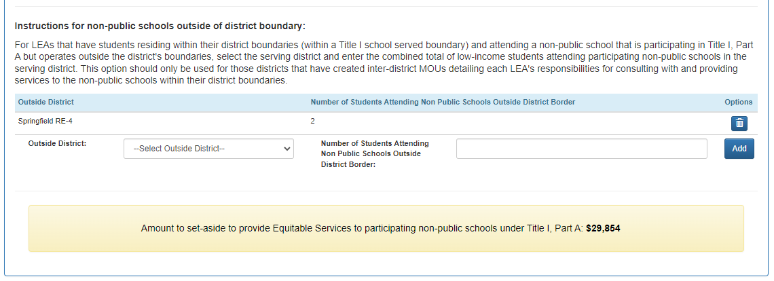
Non-Public Schools: Proportionate Share
We are going to review how the application is calculating the proportionate share for non-public schools.
This is for schools who are participating in Title I Services and can be found on the Non-public Schools page of the menu, in a yellow box:

Slide 4
Proportionate Share: Calculation
((Aggregate Attending Non-public) / (Attending Public + Aggregate Attending Non-public)) * Total Title I, Part A Allocation before admin or set-asides = Proportionate Share
Aggregate Attending Non-public: This number is pulled from the sum of data entered in the ‘# of low-income students residing in a title I school boundary and attending private school’ from the Edit Non-public school table. If the application has added an Outside District with Number of Students Attending non public schools outside district border, those counts should be included in the Aggregate Attending Non-Public.
Attending Public: This number is pulled from the number entered in the ‘Number of low income students residing within Title I school boundaries in the district attending a public school.
Total Title I, Part A Allocation before admin or set-asides: This number is the Total Title I, Part A funds allocated to the district before admin costs, indirect costs or set-asides are taken out.

Slide 5
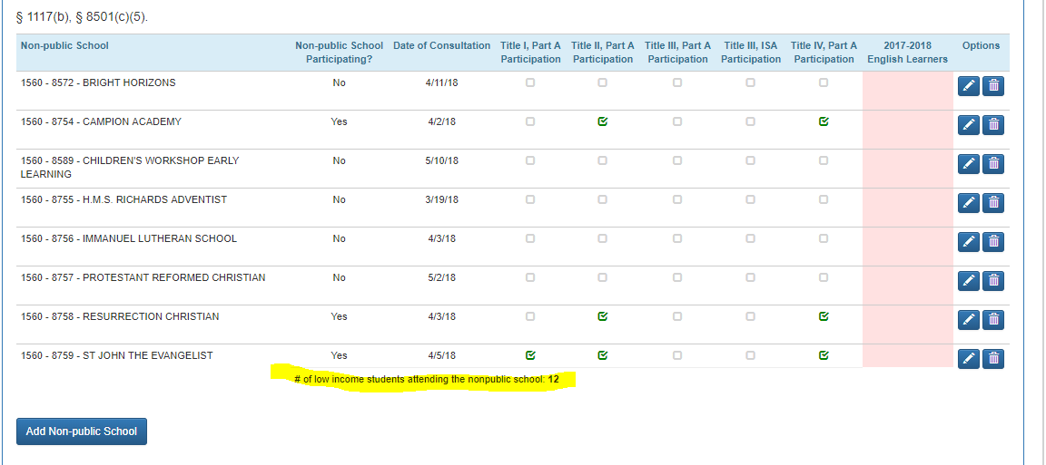
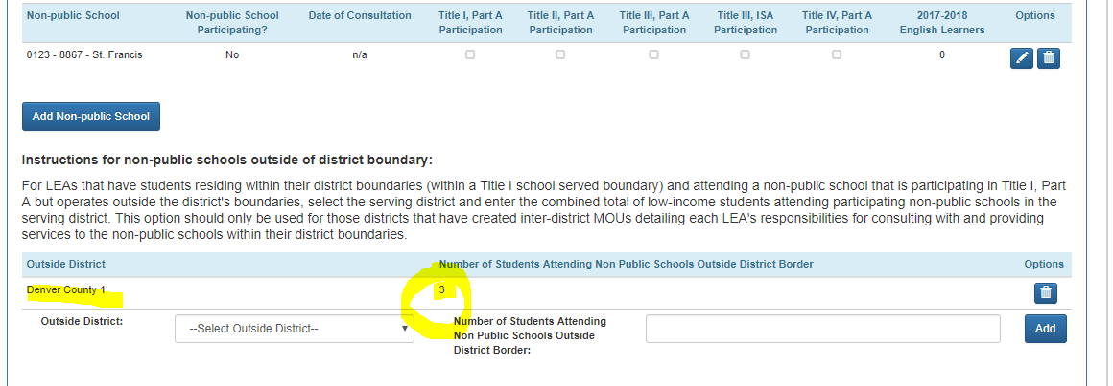
Proportionate Share: Aggregate Attending Non-public
Aggregate Attending Non-public: 12+3 = 15

Slide 6
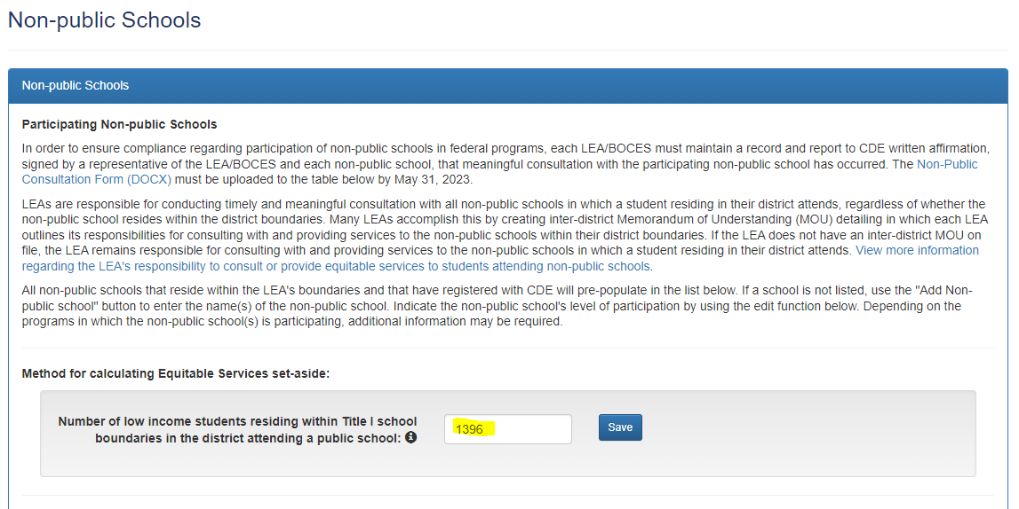
Proportionate Share: Attending Public
Attending Public: 1396

Slide 7
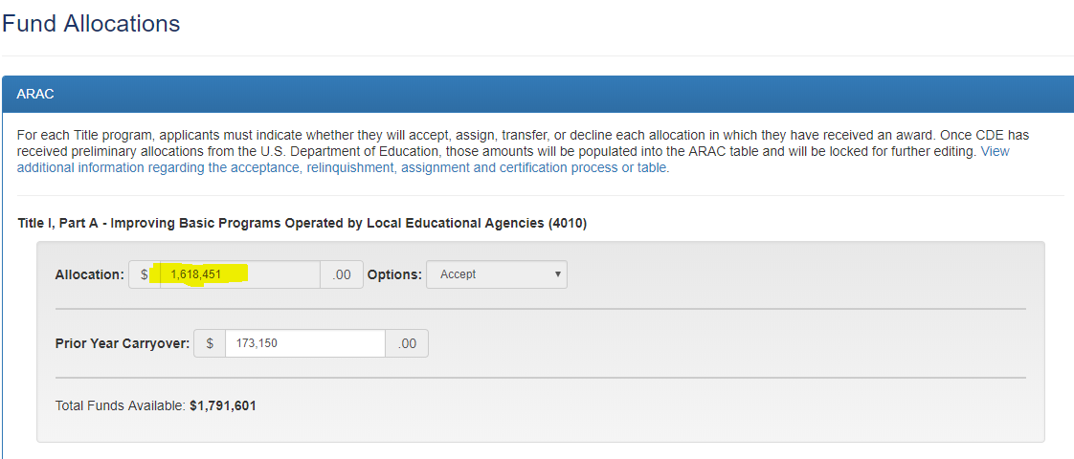
Proportionate Share: Total Title I, Part A Allocation before admin or set-asides
Total Title I, Part A Allocation before admin or set-asides: 1,618,451

Slide 8
Proportionate Share: Example Calculation
((Aggregate Attending Non-public) / (Attending Public + Aggregate Attending Non-public)) * Total Title I, Part A Allocation before admin or set-asides = Proportionate Share
Aggregate Attending Non-public = 15
Attending Public = 1396
Total Title I, Part A Allocation before admin or set-asides = 1,618,451
((15) / (1396 + 15)) *1,618,451 = Proportionate Share
((15) / 1411) *1,618,451 = Proportionate Share
(0.01063076) *1,618,451 = Proportionate Share
17,205 = Proportionate Share

Slide 9
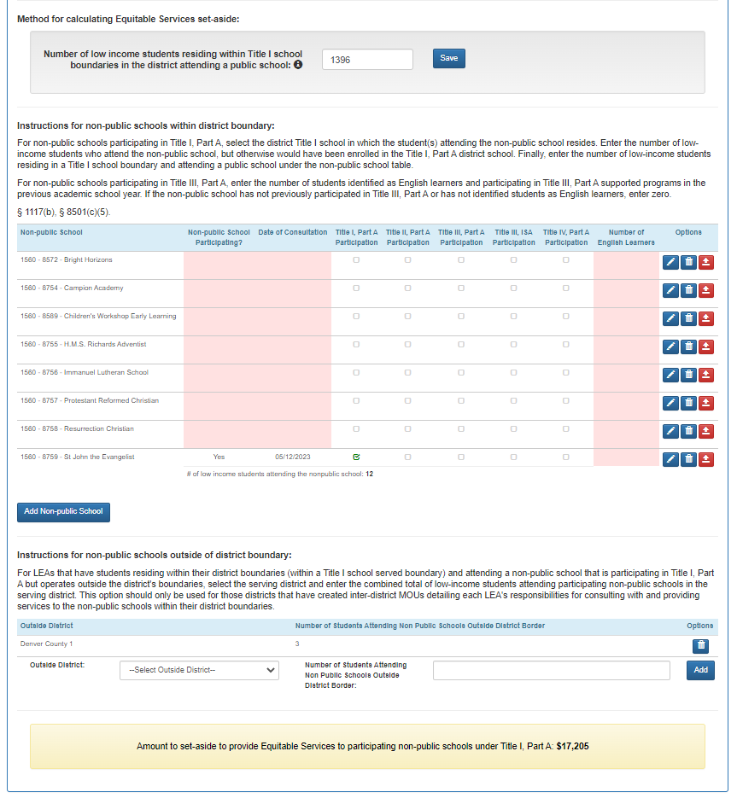
Proportionate Share: Example Screenshot

Slide 10
Title I 10% Cap Calculation
On the Budget Summary page, the application is checking to see that your Title I Administrative Cost and the Title I Indirect Cost is below 10% of total funds available.
Title I Administration + Title I Indirect Cost ≤ 10%
If the combined total is above 10% of your allocation, the Subtotal Administration amount will turn red. This will not prevent submission of your application but will prompt your reviewer to send a comment back for you to fix it.

Slide 11
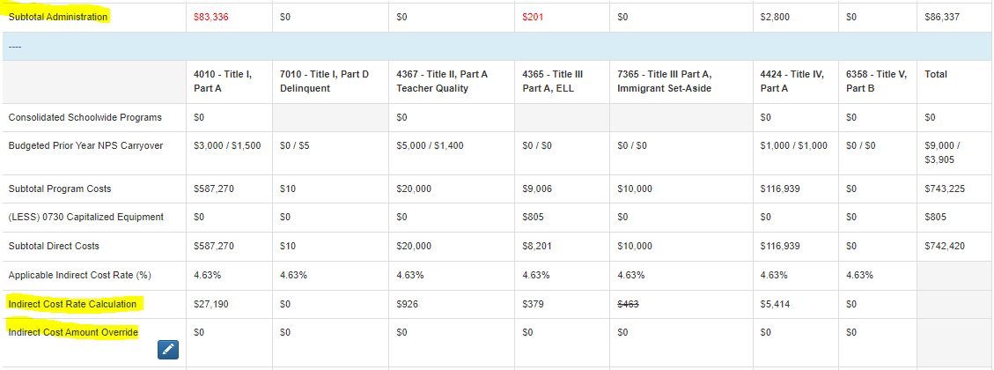
Title I 10% Cap Calculation: Example
Title I Administration + Title I Indirect Cost ≤ 10%
83,336 + 27,190 = 110,526
10% of Total Funds Available = 587,270 *.10 = 57,827
110,526 > 10%

Slide 12
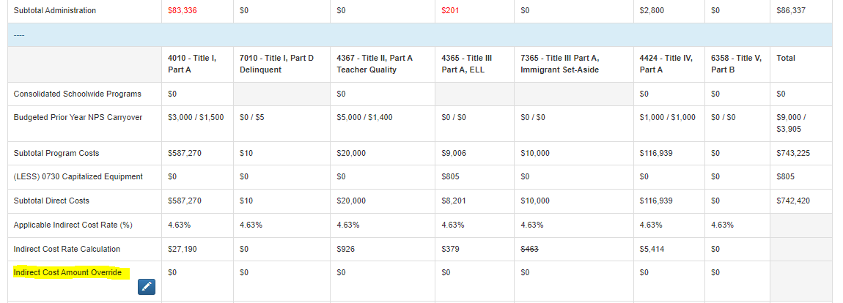
Title I 10% Cap Calculation: Example – IDC Override
To fix the error, you will either need to reduce your administration cost in Title I through your Title I budget or, reduce the amount of indirect by using the Indirect Cost Amount Override:

Slide 13
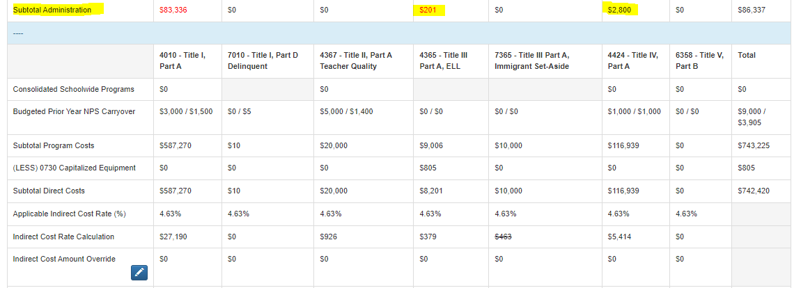
Title III & Title IV 2% Admin Cap
The 2% administration cap for Title III and Title IV is only looking at the administrative amount and not the indirect like Title I.
If the administration is above 2% of the total allocation, it will turn red. Similar to TIA, it will still let you submit, but you will receive a comment back from your reviewer to lower your administration.

Slide 14
Title III & Title IV 2% Admin Cap: Title III Example
Title III Allocation = $10,000
2% of allocation = $200
Administration Cost = $201, above 2% cap
To fix, lower your administration in the Title III budget:
Title IV works the same exact way.

Slide 15
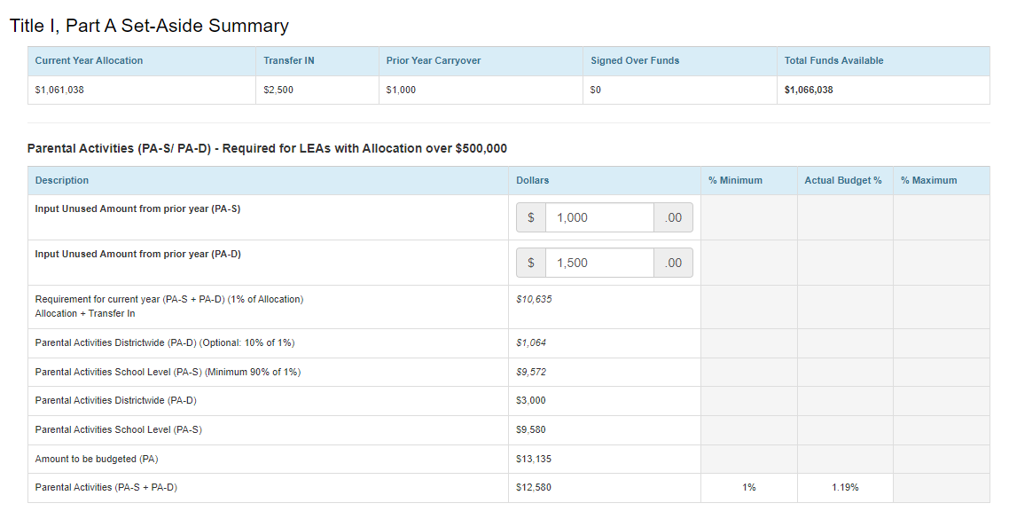
Parental Set-Aside Summary Table: Calculations
(Allocation + Transfer In)*1%
$10,635*.10
$10,635*.90
District Amount budgeted on Title I Funds page
School Amount budgeted on Title I Funds page
$10,635 + Unused Amounts Listed Above
Total budgeted on Title I Funds page
Districts that receive over $500,000 must budget at least 1% to parental activities.

Slide 16
Parental Set-Aside Summary Table: Quick Note
If you budget more than 1%, the table doesn’t take that into consideration with the calculations but LEAs will need to ensure that 90% of the total amount goes to the school level.

Slide 17
Title IV – Content Category Calculations

Slide 18
Budget Locations – Per Pupil Allocation Example
Per Pupil Allocation or PPA is calculated off the amount budgeted at each school on the Title I Funds page.
The Title I, Part A column includes all funds allocated to the school. This includes any set-asides.
But the PPA is calculated with the total amount allocated to each school, minus set-asides (including administration), divided by the low income student count found on the School Profile page.
School A
School B
School C

Slide 19
Budget Locations – Per Pupil Allocation Example Walkthrough
School A has a $60,000 allocation, $0 set-asides, low income is 7 so…
60,000/7 = $8571.43
School B has a $1,000 allocation, $5,580 in parental set-asides, low income is 86 so….
(6,580-5,580)/86 = $11.63
School A
School B
School C

Slide 20
Contact us with Questions!
If reviewing this slide deck after the live presentation, feel free to contact your Regional Contact, the Grants Program Administration Office, or the Grants Fiscal Office. Questions can also be sent to consolidatedapplications@cde.state.co.us

