Slide 1
Use of Funds Program Requirement
Notes:
In this training, we will explain the monitoring process for the use of federal funds. This training is part of a series detailing the monitoring process for individual indicators. For a full list of indicators, see the Program Requirements document on the Federal Programs monitoring page of the CDE website. Additional information regarding the specific indicators that your LEA will be monitored for will be provided upon your LEA's notification for monitoring. For a general overview of how the monitoring process works, see the Monitoring Overview presentation, which is also included on the Federal Programs Monitoring website.

Slide 2
Training Overview
Federal Statute
Demonstration of Compliance
Examples of Evidence

Slide 3
ID 9.1 Use of Funds
ID 9.1 Use of Funds | ESEA §1112(b), 2102(b)(2)(A), 3116(b), 4106(a)(1), 5223(b)(1) ESSER I, II, and III §18003(d)(1-12); 313(d)(1-15); 2001(e)(1), 2001(e)(2)(A-J)
Statutory Indicator ESEA: All activities and expenditures align with those described in the approved LEA Plan, are reasonable, and allocable (necessary to meet the purpose of the grant, as outlined in each section of ESEA Titles I-V). ESSER I: All activities and expenditures align with those described in the approved ESSER I application and are in compliance with CARES Act Sec. 18003(d)(1-12). ESSER II: All activities and expenditures align with those described in the approved ESSER II application and are in compliance with CRSAA Sec. 313(d)(1-15). ESSER III: All activities and expenditures align with those described in the approved ARP-ESSER III application and are in compliance with ARP Act Sec. 2001(e)(1) and 2001(e)(2)(A-J). All ESSER-funded activities must also be reasonable and allocable (necessary to respond to, prepare for, or prevent the spread of COVID-19. | Demonstration of Compliance Funds expended and activities implemented match the application for funds as approved by CDE. Funded activities must be reasonable - based on a prudent person’s judgment, align with similar activities funded with other funds, align with fair market values for such items, with additional considerations made for the LEA’s geographical area and the accessibility of items, or be the most cost-effective way to implement such an activity/purchase such items. For ESSER: Activities must be allocable, meaning that funded activities or items were made necessary as a result of the COVID-19 pandemic and were necessary in order for the LEA to respond to, prepare for, or prevent the spread of COVID-19. ESSER-funded activities were obligated within the performance period (on or after March 13, 2020) and prior to September 30, 2022 for ESSER I, prior to September 30, 2023 for ESSER II, and prior to September 30, 2024 for ARP-ESSER III. Examples of Evidence Expenditure detail reports that demonstrate the use of funds for allowable activities described in the application for funds submitted to and approved by CDE. Prior to submitting additional evidence, please wait for CDE to identify the line items selected for monitoring based on the expenditure detail report. [1] For reasonableness, documentation of any process used for researching or identifying a vendor, provider, or supplier that provides fair market value or cost-effective supplies, materials, or other purchased items, including any bids, requests for purchases, or procurements. For larger items that exceed the LEA’s procurement thresholds, evidence can also include requests for proposals or other bidding processes used by the LEA. Local written protocols/procedures document or narrative summarizing the process used by the LEA to determine reasonableness, including how employees research items needed for purchase. Additional documentation: If funds were used to purchase equipment, supplies, and/or materials: submit invoices and/or inventory of equipment If funds were used to provide professional development: submit PD content such as agendas and materials, induction documents, conference registration If funds were used to provide FTE: submit samples of staff time and effort
[1] CDE will select a list of budgeted items from the approved budget which will total a minimum of 30% of the LEA's allocation (could range up to 100% of the allocation). The LEA will submit evidence to demonstrate that the expenditures match the selected approved budget items.

Slide 4
Federal Statute

Slide 5
Statutory References
ESEA:
All activities and expenditures align with those described in the approved LEA Plan, are reasonable, and allocable (necessary to meet the purpose of the grant, as outlined in each section of ESEA Titles I-V).
ESSER I:
All activities and expenditures align with those described in the approved ESSER I application and are in compliance with CARES Act Sec. 18003(d)(1-12).
ESSER II:
All activities and expenditures align with those described in the approved ESSER II application and are in compliance with CRSAA Sec. 313(d)(1-15).
ESSER III:
All activities and expenditures align with those described in the approved ARP-ESSER III application and are in compliance with ARP Act Sec. 2001(e)(1) and 2001(e)(2)(A-J).
All ESSER-funded activities must also be reasonable and allocable (necessary to respond to, prepare for, or prevent the spread of COVID-19).

Slide 6
Demonstration of Compliance

Slide 7
Demonstration of Compliance
Funds expended and activities implemented match the application for funds as approved by CDE.
Funded activities must be reasonable - based on a prudent person’s judgment, align with similar activities funded with other funds, align with fair market values for such items, with additional considerations made for the LEA’s geographical area and the accessibility of items, or be the most cost-effective way to implement such an activity/purchase such items.
For ESSER:
Activities must be allocable, meaning that funded activities or items were made necessary as a result of the COVID-19 pandemic and were necessary in order for the LEA to respond to, prepare for, or prevent the spread of COVID-19.
ESSER-funded activities were obligated within the performance period (on or after March 13, 2020) and prior to September 30, 2022 for ESSER I, prior to September 30, 2023 for ESSER II, and prior to September 30, 2024 for ARP-ESSER III.

Slide 8
Examples of Evidence
Notes:
Activities match what is written in the grant
Process to identify students in need
Process to determine appropriate intervention
Document parent involvement

Slide 9
Examples of Evidence
Expenditure detail reports that demonstrate the use of funds for allowable activities described in the application for funds submitted to and approved by CDE.
Additional documentation that may be requested:
If funds were used to purchase equipment, supplies, and/or materials: submit invoices and/or inventory of equipment
If funds were used to provide professional development: submit PD content such as agendas and materials, induction documents, conference registration
If funds were used to provide FTE: submit samples of staff time and effort

Slide 10
Will CDE Review Every Budget Line?
CDE will select a list of budgeted items from the approved budget which will total a minimum of 30% of the LEA's allocation (could range up to 100% of the allocation). The LEA will submit evidence to demonstrate that the expenditures match the selected approved budget items.

Slide 11
Will CDE Review Every Budget Line?
LEAs will submit expenditure reports as part of their initial evidence submission. (Note: This type of report might be named differently across LEAs. The requirement is to provide an itemization or details of expenditures for funds expended to date.)
CDE will review each expenditure report and compare it to the budget submitted as part of the application. CDE will include the following:
Budgets that have final approval
Funds that have been expended during fiscal years prior to the time of monitoring
CDE will identify specific activities from the reported expenditures for further review.
A minimum of 30% of each allocation is subject to monitoring based on the types of activities/items listed on expenditure reports. Within types of activities, budget line items will be randomly selected.
CDE will work with the LEA to determine the plans and timeline for submitting evidence under each grant.
Notes:
Regarding the first bullet:
For ESEA monitoring, this might include Title I, Title II, Title III, Title IV, and/or Title V.
For ESSER monitoring, this might include ESSER I, II, or III depending on the point in time of monitoring.
For LEAs that allocate federal funds to schools, including non-public, charter, or traditional schools, an itemization of the school-level expenditures must be included. For charters, expenditure details should include items coded to 0594. Note: the narrative description for each expenditure should align with the activity description provided in the application budget.
Additional note: For LEAs with large ESSER allocations (over $5 million), monitoring might continue into the subsequent year if the LEA has not yet submitted their ESSER II or III application.

Slide 12
Evidence Needed
What CDE already has (LEA will not have to submit again):
Approved budget that meets grant requirements
What LEAs need to submit:
Expenditure reports that match the submitted budget
Based upon review of the expenditure report, the LEA may be asked to submit the following:
Invoices or inventory, PD agendas or conference registrations, time and effort reports,contracts, P.O.s, etc.
Documentation of research conducted to show cost-effectiveness or that similar expenses were paid within the same price range
Documentation or narrative demonstrating that local policies were followed

Slide 13
Evidence Needed to Determine Reasonableness
Documentation of any process used for researching or identifying a vendor, provider, or supplier that provides fair market value or cost-effective supplies, materials, or other purchased items, including any bids, requests for purchases, or procurements. For larger items that exceed the LEA’s procurement thresholds, evidence can also include requests for proposals or other bidding processes used by the LEA.
Local written protocols/procedures document or narrative summarizing the process used by the LEA to determine reasonableness, including how employees research items needed for purchase.

Slide 14
Determining Reasonableness
Examples of evidence:
Cost comparisons from various vendors or websites
Cost comparisons to same items purchased in previous years
Research conducted on various vendors/providers
Assessment of market prices for comparable goods for the geographic area. Another way would be to determine whether the cost is a type generally recognized as ordinary and necessary for the operation of the federal award.

Slide 15
Examples of Additional Evidence

Slide 16
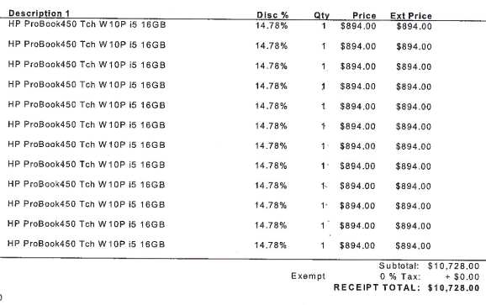
Use of Funds for Technology

Slide 17
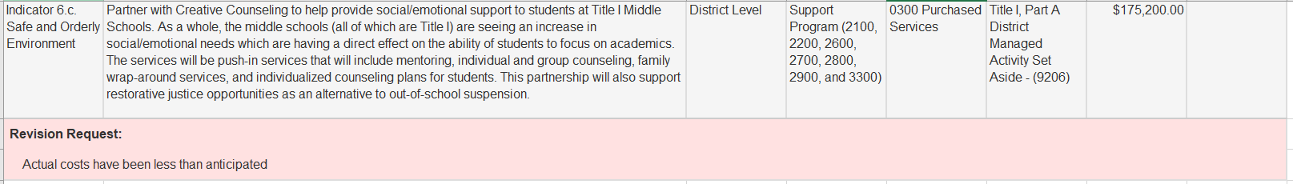
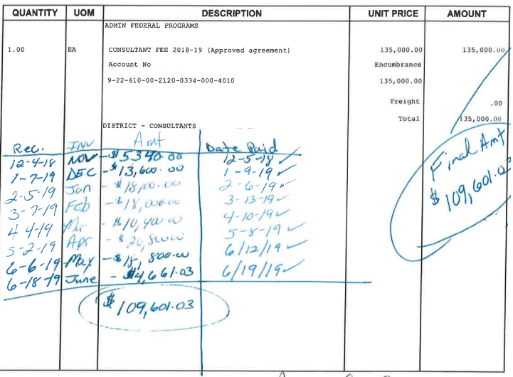
Use of Funds for Purchased Services

Slide 18
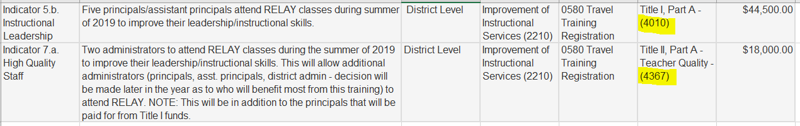
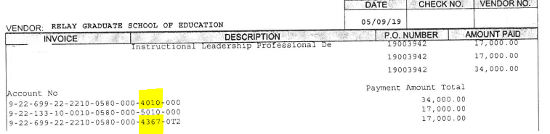
Use of Funds for Professional Development

Slide 19
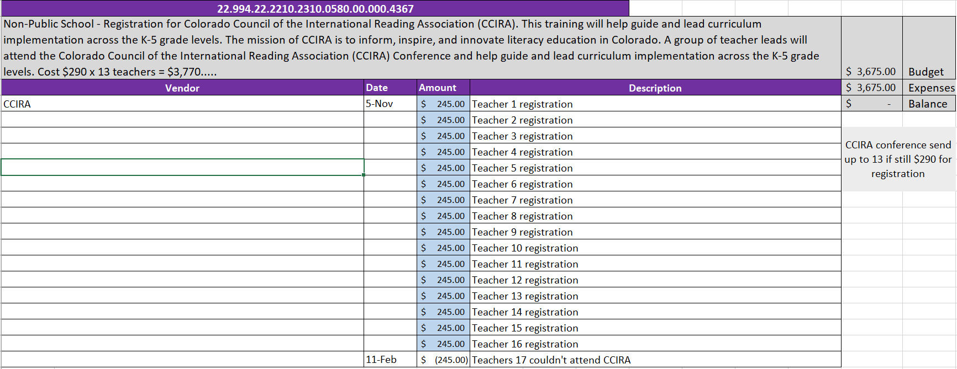
Example of Internal Tracking for Use of Funds

Slide 20
Additional Resources

Slide 21
Monitoring Resources
Federal Programs Monitoring Webpage
Trainings Page
Monitoring Schedule
Programs Requirement Document

Slide 22
If you have any questions, contact:
Your Regional Contact
ESEA Monitoring Leads
ESSER Monitoring Leads

