Slide 1
ESEA Fall Regional Network Meeting
November 15, 2022

Slide 2
Post Award Revision Process and Requirements
Notes:
Presenter: Evita
So… The PAR window is open. Now what?

Slide 3
Introduction
Presenter: Evita Byrd, ESEA Title I Specialist
Purpose:
This training is for new and experienced LEA staff to review when and how to submit a post award revision (PAR).
There are also tips on how to format the request to assist CDE staff with reviewing the PAR as quickly as possible.
Notes:
At this point in the application process, all activities have been reviewed and approved. Revisions to the activities listed in the budget are necessary to ensure that the budget activities align with what is approved by CDE.

Slide 4
Purpose of the Post-Award Revision
The Post-Award Revision (PAR) process is an opportunity for LEAs and BOCES to:
revise the activities and budget that were approved in the initial consolidated application or ESSER application review process.
include additional activities that require pre-approval based on local context and funding availability.
Notes:
At this point in the application process, all activities have been reviewed and approved. Revisions to the activities listed in the budget are necessary to ensure that the budget activities align with what is approved by CDE.

Slide 5
The Life Cycle of ESEA
Consolidated and ESSER Applications
Notes:
So… The PAR window is open. Now what?

Slide 6
Substantial Approval and Final Approval
CDE grants Substantial Approval upon the submission of the ESEA Consolidated application.
LEAs can obligate funds for proposed activities in the budget.
LEAs cannot request reimbursement yet.
Final Approval is granted after the application is reviewed by CDE and the LEA addresses CDE’s comments.
LEAs can now request reimbursement.
Post-Award Revisions (PAR) can be submitted after Final Approval has been granted.
Note: If CDE determines an activity is not allowable, the LEA will be asked to reallocate the funds to an allowable activity.
Notes:
At this point in the application process, all activities have been reviewed and approved. Revisions to the activities listed in the budget are necessary to ensure that the budget activities align with what is approved by CDE.
Internal note: RCs might want to remind LEAs that their application is open for PAR as some LEAs aren’t aware PAR is open.

Slide 7
When Do LEAs Submit Post-Award Revisions (PAR)?
Any changes to equipment purchases require program approval.
To update indirect costs if the LEA:
Overrode the indirect amount allocated, or
Will now take the full indirect cost rate.
To reflect changes in the project/program scope or objective, such as:
PD activities to purchasing Instructional materials.
PD activities to hiring an Interventionist.
Changes among direct cost programs (Instructional, Support, Improvement of Instructional Services, or Administrative) or object categories (Salaries, Benefits, etc.) that exceed, or are expected to exceed, 10% of the total budget for that category as last approved.
All PARs need to be approved by CDE prior to obligating funds and before the end of the grant.
NOTE: The budget line item must provide the rationale in the activity description, just as when the district initially submitted its proposed budget through the Consolidated or ESSER Applications.
Notes:
The information on this slide provides an overview of the types of revision requests that need to be submitted through the PAR process.
The first situation is when changes to the cost of any equipment purchases from the budget as it was last approved.
Another consideration LEAs should make during the PAR window is if you need to update your indirect costs. If the LEA overrode the indirect amount allocated, or if the LEA will now take the amount that was previously reduced, a PAR request should be submitted.
LEAs should also submit PAR requests when there is a change in the scope or objective for the use of the Title funds. If you had initially submitted a plan to use funds for Professional Development and has now decided to use the same funds to support Instructional materials, approval needs to be obtained. This would also apply to a change in the use of funds from Professional Development to supporting a salaried position for an Interventionist.
If an LEA is making changes among direct cost programs or within object categories, such as Salaries or Benefits, and these changes will exceed 10% of the total budget as last approved, you are also required to submit a PAR request.
When submitting the request, the PAR system will ask for a rationale for the changes, just as when the initial Consolidated Application was submitted. These rationale statements will be reviewed by CDE Program staff and feedback will be provided.
Equipment purchases: more in score rather than amount
Talking point from ESSER: Tell what was the original amount and give rationale

Slide 8
Exceptions to Post-Award Revisions
Minor changes may not need to be captured through the PAR process.
Minor adjustments do not alter the overall scope or goals of the approved application. For example:
Reading intervention training for new teachers changed from 2 to 3 days.
Increased number of days for teachers to observe master teachers’ classrooms.
Changes to reflect actual costs and updates to line items to reflect final allocations.
If these types of revisions change the scope of the activity, then a Post-Award Revision must be submitted through the online platform.
Remember
Notes:
There are a few possible exceptions to the PAR process.
Minor changes that do not alter the overall scope or goals of the pre-approved application do not need to be submitted. For example, a revision request might not need to be submitted if a reading intervention training for new teachers was increased from 2 days to 3 days or if the number of days for new teachers to observe in master teachers’ classrooms increased from the initial plan.
The PAR system also does not need to be used to reflect actual costs when they differ from projected costs. LEAs will submit the changes for actual costs through their End-of-Year financial reports.
If these types of revisions change the scope of the activity or fall under the guidance on the previous slide, then a PAR request must be submitted.
Free stock image from Pixabay

Slide 9
Post-Award Revision Window
The PAR system will be open until June 30th of the fiscal year.
LEAs may submit revision requests, as necessary.
Please do not submit any requests to revise your ESEA Consolidated/ESSER Application before the system is open for PAR.
The narrative questions and the school profile page will be locked and cannot be updated during the PAR process.
Notes:
The PAR system becomes available after all districts have received final approval. Once open, the revision system will remain open through June 30th. We would ask that you do not submit any revision requests to us until the system is available in December.
Ongoing basis…may submit PAR
We encourage you to submit changes for all ESEA Title programs with each revision request submitted. We understand that some changes will continue to be made throughout the window, so you have the opportunity for multiple submissions if needed.
We would like to point out that we do not grant approval for activities outside of the Consolidated Application. We can provide input on whether activities are allowable uses of Title funds. We also want to remind you that pre-approval is not required in order to obligate funds; however, all activities must be approved in the online application platform or Post-Award Revision system before an LEA may seek reimbursement for the activity.
During the Post-Award Revision window, the Cross Program and Narrative responses will be locked. You will need to wait until the next application opens to make revisions to plans and processes. The focus of the Post-Award Revision process is to make adjustments to budget line items. If you want to discuss possible program changes, please contact your ESEA Regional Contact.

Slide 10
The PAR window is now open…Now what?
Notes:
So… The PAR window is open. Now what?

Slide 11
Review Contact Information and Final Allocations
Final allocations will be pre-populated in the PAR system for the Consolidated Application.
Allocations are posted on the Grants Fiscal website.
Update any necessary district contact information.
CDE uses the Consolidated/ESSER Application contact lists to communicate important information related to the application, school improvement requirements, and accountability.
Balance the budget to adjust for allocation changes from preliminary to final.
Notes:
When you first enter the Post-Award Revision system, you should plan to review your final allocations that will be prepopulated in the system. You will want to review your final allocations to determine whether revisions to the budget are necessary.
For your reference, the final allocations will also be posted on the Grants Fiscal website
We also ask that you take this opportunity to review your district contact information and make any necessary changes necessary. This will help facilitate communication between LEAS, BOCES, and CDE.

Slide 12
Consider the Following Questions
Is your final allocation different from your preliminary allocation?
Have you changed the scope of how Title program funds will be spent?
Are the costs associated with a budgeted activity different by more than 10%?
Have the allocations impacted your Indirect Costs?
If the answer to any of these questions is “yes,” you may need to submit revisions through the PAR system.
Notes:
After reviewing your final allocations, you will want to consider several questions to determine if you need to submit revisions.
Is your final allocation different from your initial allocation?
Have you changed the scope of how you will spend Title program funds?
Have the final allocations impacted your Indirect Costs?
If your answer “yes” to any of these questions, you may need to submit revisions through the Post-Award Revision system.
Let’s consider some examples.

Slide 13
Is a PAR Submission Needed?
Notes:
The following slides will provide several examples to help differentiate between revisions that need to be submitted through the Post-Award Revision system and those that do not.

Slide 14
Scenario 1
The LEA will not spend Title IV funds as initially planned. The LEA wants to exercise the Alternative Use of Funds Authority (AUFA) from Title IV into Title I. The funds will be used to support the salary of the Title I teacher.
Should this change be submitted through the PAR system?
Notes:
In the first scenario, an LEA has determined that it will not spend Title IV funds as initially planned. They are REAP-eligible and would like to REAP the funds from Title IV into Title I. The funds will be used to support the salary of the Title I teacher.
Should this change be submitted through the PAR system?
Note for presenter: We used to say REAP but the updated language is AFUA – Alternative Fund Use Authority. Please note that USDE uses AFUA instead of AUFA. Hoping we can change to match but that is for another day.

Slide 15
Scenario 1: Answer
Yes. The LEA is exercising their flexibility to move funds between programs and will need to submit a Post-Award Revision (PAR) request.
Notes:
The answer is yes. (Assuming they are REAP eligible…) The LEA is exercising their flexibility to use funds to meet the intent and purpose of other programs. This revision request will need to be submitted through the PAR system.
free stock image from Pixabay.com

Slide 16
Scenario 2
The LEA has decided to adjust the amount budgeted to reflect the final cost of an activity; transportation costs are $40 less than the budgeted $1000.
Should this change be submitted through the PAR system?
Notes:
In the second scenario, an LEA has determined that the transportation costs for an activity within their initial application is $40 less than they budgeted. They want to adjust the line item budget to reflect the final cost of the activity. This change does not exceed 10% for the program category or object code.
Should this change be submitted through the PAR system?

Slide 17
Scenario 2: Answer
No. Since the amount of the change is not more than 10% of the program category or object code, a request to revise the budget is not necessary.
Notes:
No. The LEA does not need to submit a PAR request to adjust the amount of the line item since the change from budgeted to actual will not exceed 10% for the program category or object code from the total budget as it was last approved.
free stock image from Pixabay.com

Slide 18
Scenario 3
The LEA has been unable to fill an interventionist position. It has decided to reallocate the funds to sending several teachers to the National ESEA Conference. The budgeted salary and benefits of the interventionist position are within 10% of the expenses (including registration, travel, etc.) of sending several teachers to the conference.
Should this change be submitted through the PAR system?
Notes:
In our final scenario, the LEA is considering a revision due to being unable to fill an interventionist position. The LEA would like to reallocate the funds and send several teachers to the National ESEA Conference.
Should this change be submitted through the PAR system?

Slide 19
Scenario 3: Answer
Yes. The LEA is changing the scope of the activity and the intent of the funds which requires approval through the PAR system.
Notes:
Yes. The LEA is changing the overall scope of the activity and is changing the intent of the funds. These changes require approval, and therefore, need to be submitted through the PAR system.

Slide 20
How to Enter a PAR Request
Notes:
In this next section, we will be reviewing the technical aspects of how to enter a PAR request.

Slide 21
Accessing the PAR System
The application access is through the Identity Management (IdM) system, the same login and password system used for Data Pipeline and UIP.
A good first step, if you have used IdM before, is to check with your District Local Assess Management (LAM) Group to grant you access to the CONSAPP application.
If you haven't used the IdM system before or are having trouble logging in with it, please use this access assistance form to find your district's LAM Group.
If you have used IdM before and have confirmed you have access to the CONSAPP application, please contact us at consolidatedapplications@cde.state.co.us for additional technical assistance.
Notes:
The Consolidated Application is on the identity management system. If you do not have access to the most recent application, you will have to reach out to your local access manager (LAM). The LAM will then need to assign your credentials to “CONSAPP.” Once “CONSAPP” is assigned, you will be able to access the application.
If you need additional support with logging in, please send an email to consolidatedapplications@cde.state.co.us.

Slide 22
Making Changes in the PAR System
Narratives - Each program narrative represents the LEA’s plans to implement the program requirements.
The narratives are locked after Final Approval. If narrative changes are needed, use the General Comment box at the end of the program Funds page in the budget.
Budget
Select the “Funds” tab for the Title program within which changes will be submitted.
Click on the “edit” tool at the end of the budget line item.
Provide the information requested, including a brief narrative description of the changes requested, to include the original approved amount, date of change requested to provide clarification for reviewers.
All highlighted cells must include the rationale for change.
Notes:
Once you have entered the application, select the “Funds” tab for each Title program. You will use the edit tool which appears as a pencil icon to make updates to the activity description, dollar amount, or any other changes. There will also be a comment box available for each budget line item. This comment box will be located below the “Amount” field and should be used to provide a brief narrative description of the requested change.
The following slide shows the window that will appear after clicking on the edit tool.
Emphasize the 3rd bullet under budget to ensure the field has clarity about the information that is needed when submitting a PAR.

Slide 23
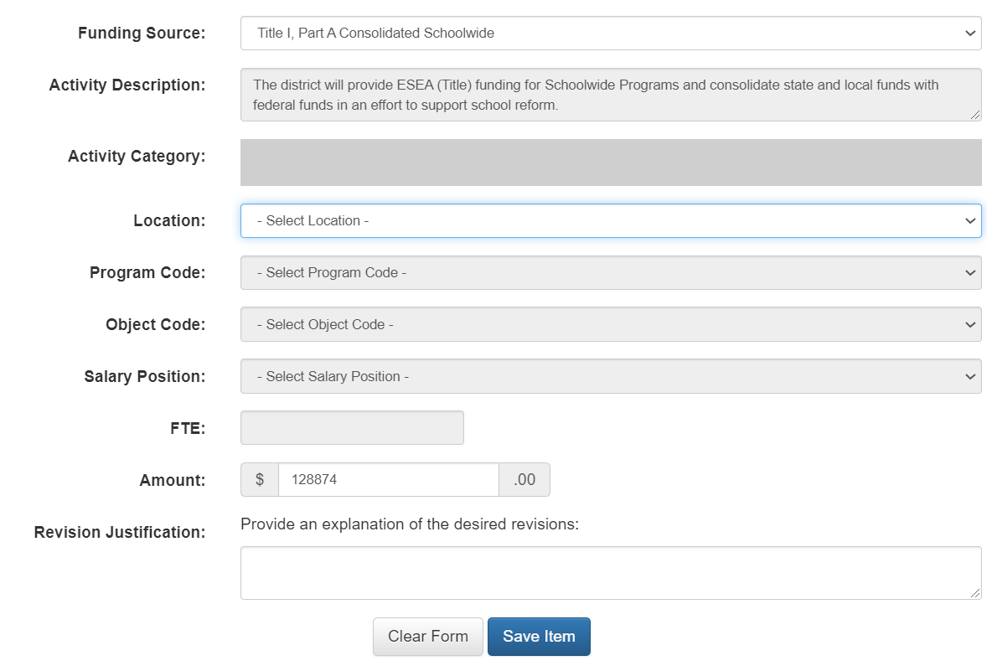
Revision Request Format
For the justification, please include the date of revision request, the change, and the reason for making the change.
Example:
01/31/23 The total amount was changed from $130,000 to $108,874 to update the amount to the actual amount spent.
Notes:
This is an example of what you will see after clicking on the edit tool. To note, your line item edit screen will not be blank.
You will use this format to make revision requests to previously submitted budget line items within each Title program. Once the information has been entered, save your changes.
As mentioned before, the rationale and narrative description of the change will be located below the “Amount” field on the Funds tab.

Slide 24
Review Rank Order (If applicable in Consolidated Application)
Any changes to allocations or activities may disrupt rank order in Title I, Part A:
Review the Locations Total page for any discrepancies in rank order and adjust budget if necessary.
LEA will be unable to submit the application until rank order issues are addressed.
Rank order does not apply to LEAs that choose district less than 1000 as the method of serving Title I funds in Module-A of the Consolidated Application.
Notes:
This does not apply to districts that choose method of serving: district less than a 1000.

Slide 25
Specific to ESSER III PARs
When submitting a PAR request for ESSER III funded activities, please ensure that the revisions will not impact the 20% set aside for addressing the impact of lost instructional time.
In other words, always make sure that a minimum of 20% is being used to address the impact of lost instructional time.
This may require revisions to other activities through the PAR process, if the activities earmarked for the 20% now total less than 20%.
Also ESSER specific - if an activity year has been changed or needs to be changed, consider submitting a PAR.

Slide 26
Final Steps in PAR Submission Process
Before submitting PAR Requests to CDE for review:
Confirm that all Title programs have been reviewed and included in the ESEA Consolidated Application.
Carefully review and ensure that the budget summary in Module-C is balanced in the ESEA Consolidated Application.
While a new signature authorization is not required for PAR requests, LEAs/BOCES should be continually informing their board members and any relevant parties such as fiscal and program departments of their plan changes related to ESSER and the ESEA Consolidated Applications.
Notes:
Prior to submitting your PAR requests to CDE, you should confirm that all Title programs have been reviewed.
Make sure that all set-asides and Title IV are balanced.
A new signature authorization is not required, however, LEAs and BOCES should be continually apprising Board members of changes to initial plans.
Balanced budget for ESSER
And, again, multiple submissions can be made until the Post-Award Revision window closes on Tuesday, April 30, 2019.

Slide 27
PARs are submitted … Now what?
Notes:
In the last few slides, we want to let you know what will happen once you have submitted your Post-Award Revision requests.

Slide 28
PAR Review and Approval
CDE program staff will review revision requests on a continuous basis.
You can anticipate a response within two weeks of submission.
For program specific questions, contact your ESEA Regional Contact or ESSER Contact.
For general Post-Award Revision (PAR) request questions, contact consolidatedapplications@cde.state.co.us.
Notes:
CDE Program staff will review Post-Award Revision requests on a continuous basis until April 30th.
You should anticipate a response with approval or a request for additional information no later than two weeks after submitting a revision request.
As always, please feel free to reach out to your ESEA Regional Contact with questions. Our contact information is included on the this slide. Please note that the ESSER Contact link downloads an Excel file with a list of all the ESSER contacts by LEA. You can also send general questions to consolidatedapplications@cde.state.co.us.
We are here to help! Please call us if you need support or have any questions.
We look forward to working with you during the Post-Award Revision process.
Thank you for your time!

Slide 29
Questions?

