Slide 1
ESEA Fall Regional Network Meeting

Slide 2
Agenda
New LEA staff orientation | 9:00
Post Award Revision Process and Requirements | 10:00
Break | 15 MINUTES
ESEA and ESSER Monitoring Work Group | 11:00
Notes:
Do not move ahead on the agenda. If there is extra time, add a break. Start the next section as scheduled.

Slide 3
An Introduction to
The Federal Programs and Supports Unit

Slide 4
Introductions
Please put in the chat:
Name
LEA or BOCES

Slide 5
Outline
Introduction to Federal Programs and Supports Unit
Brief overview of Title Programs and ESSER
What Should New Directors/LEAs be Focused on at this Time?
Important Dates
Resources and Contacts
Networking Time

Slide 6
Every Student Succeeds (ESSA) Act - Overview
Colorado Receives ~ over $225 million in Elementary and Secondary Education Act (ESEA) currently reauthorized as ESSA.
CDE reserves no more than 5% for administration and oversight of the programs
Percentage caps are set in statute (e.g., Title I is capped at 1%)
CDE requests for permission to retain additional funds for school improvement efforts
Funding period ~ generally 27 months to obligate funds
ESSA provides some flexibilities and opportunities to meet program requirements:
Flexibility in the use of funds
Consolidation of funds
Rural flexibilities (such as Alternative Fund Use Authority)
Reducing the requirements for districts that have less than 1,000 students or only 1 school per grade span (examples)

Slide 7
ESSA - SEA Responsibilities

Slide 8
ESSER Overview
Elementary and Secondary School Emergency Relief (ESSER) Funds under the CARES, CRSSA, and ARP Acts – Funds for the purpose of responding to, preparing for, or preventing the spread of COVID-19 and addressing the impact it has had on education
ESSER I – Crisis Response: To provide schools, staff and students with the technology and infrastructure to accommodate remote learning environments caused by COVID-19.
ESSER II – Resuming/Sustaining In-Person Instruction: To provide schools staff and students with the resources and equipment to safely return to in-person learning environments for students.
ESSER III – Recovery from the Pandemic: To support schools, educators and students with resources and programming that address learning loss caused by COVID-19 and remote learning environments.
Examples of allowable uses
Coordination with public health
Purchasing educational technology
Training and supplies for sanitation
Mental health support
Summer school and after school programs
other activities to continue school operations and employment of existing staff

Slide 9
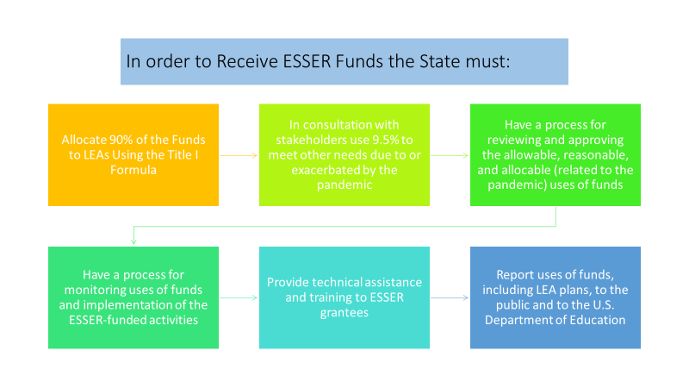
ESSER - SEA Responsibilities

Slide 10
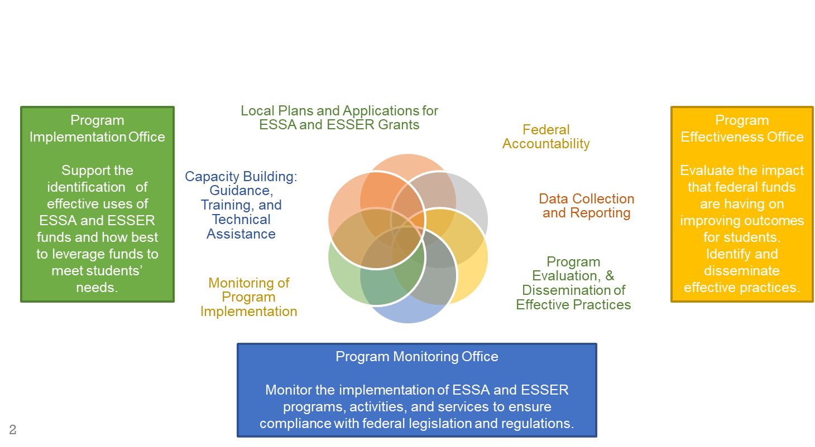
What We Do
Federal Programs & Supports Unit
Notes:
School Quality and Support Division

Slide 11
Regional Contact (RC) Role
The role of the regional contact is to be the main point of contact for questions about ESEA programs, including the Consolidated Application and monitoring questions.
When the RC does not know the answer, they can connect you with a content area expert who does.
Regional Contacts for your LEA/BOCES
If you have questions about ESSER contact your lead reviewer.

Slide 12
Regional Contacts
Metro Region: See RC webpage
North Central and Northeast: Evita Byrd and Nathan Hickman
Northwest and West Central: Karen Bixler and Rachel Temple
Pikes Peak: Tammy Giessinger and Laura Meushaw
Southeast and Southwest: Shannon Wilson

Slide 13
Key Resource for New Staff

Slide 14
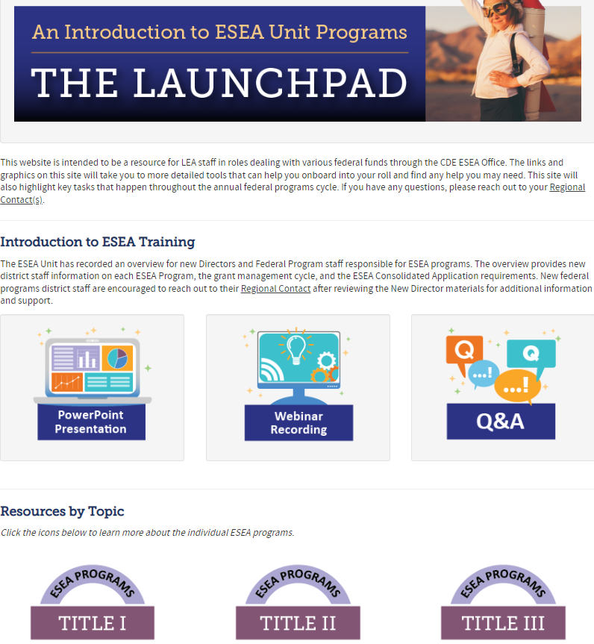
What is the Launchpad?
Starting point for new and current LEA staff to learn about ESEA Programs.
Highly encouraged to share this resource with new teammates in your LEAs.
Notes:
Shannon The Launchpad is a “one stop shop” geared towards LEA staff that may be new to ESEA programs or just wanting to learn about programs/processes in our office.
We are hoping that it becomes an intuitive first step in learning about our programs.

Slide 15
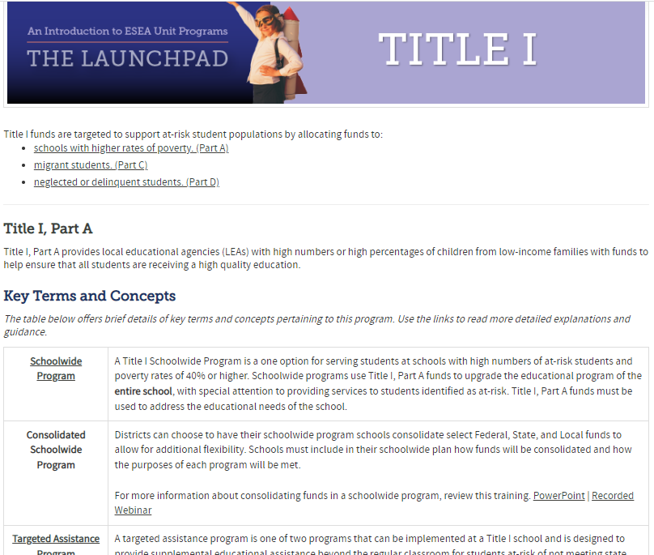
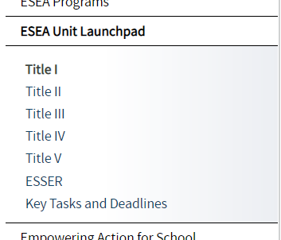
Program Introductions
All ESEA Title Programs & ESSER have independent Training Pages containing:
Key Terms & Concepts
Program Eligibility
Allowable Uses of Funds
Key Tasks & Deadlines
Resources
Use the links on the pages for a more detailed explanation of topics/terms.
Notes:
Shannon

Slide 16
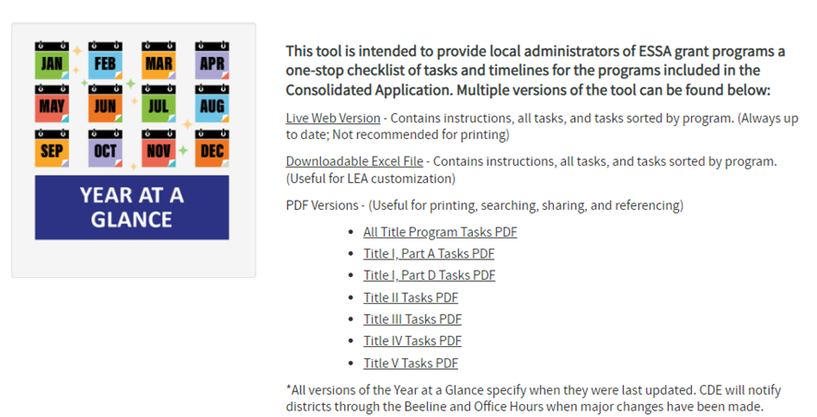
Year at a Glance
The Year at a Glance is a timeline for managing federal programs
Include dates and resources for tasks throughout the year
Sortable by program
Available as a live web version, editable Excel file, and printable PDF
Notes:
Shannon

Slide 17
The Elementary and Secondary Education Act (ESEA), reauthorized as the Every Student Succeeds Act (ESSA)
Notes:
Rachel through slide 28

Slide 18
Your Roles and Responsibilities under ESSA
For ESEA formula funds (Includes Titles IA, ID, IIA, IIIA, IV, and V)
Conduct a needs assessment to identify and prioritize schools and student needs
Develop an LEA plan to address identified needs (every 3 years; submitted via Consolidated Application)
Stakeholder engagement in reviewing needs assessment, identifying priorities, and developing plans
Annually develop and submit an application for funds (Consolidated Application)
Ensure funds are supplemental to state and local funds
Ensure equitable distribution of state and local funds
Implement program as approved and in a manner that improves school outcomes, particularly for schools identified for support and improvement under ESSA
Revise and update application for funds if necessary (Post-Award Revisions)
Provide oversight of programs implemented by schools to ensure they meet ESSA requirements
Develop and implement written procedures and protocols for consistently managing the fiscal aspects of the grant
Evaluate the effectiveness of the programs in improving outcomes for students
Develop and disseminate school and LEA report cards (or reference CDE’s LEA report cards) and meet other reporting requirements

Slide 19
Consolidated Application
June 30th | Consolidated Application due Allocations
July - September | Finalize application with LEAs.
October | Submit Annual Financial Report Grants Fiscal determines carryover
October - May | Revise budget during Post Award Revision Process
February - April | Conduct a needs assessment to identify and prioritize schools and student needs. Stakeholder engagement in reviewing needs assessment, identifying priorities, and developing plans

Slide 20
LEAs with Schools Identified for ESSA Support and Improvement
August | CDE identifies and notifies LEA of ESSA identified schools as part of the Accountability Letters
August/ September | LEA notifies schools and supports them with understanding results, accountability, and improvement planning requirements: School and district create/update an improvement plan that addresses reasons for ESSA identification CS Schools & ATS must identify and address any resource inequities CS Schools - District and CDE review and approve TS and ATS schools - School and district review and approve [review and approval process must be described in the Consolidated Application]
September | Empowering Action for School Improvement (EASI) available to schools on Improvement
October | Review and approve improvement plans (UIP) for Comprehensive Support and Improvement (CS), Targeted Support and Improvement (TS), and Additional Targeted Support and Improvement (ATS). Determine if adjustments need to be made to Consolidated Application based on updated performance frameworks and ESSA identifications
Throughout the year | Oversee implementation of improvement plans to ensure addressing reasons for identification and working towards meeting exit criteria
Notes:
LEA is responsible for approving TS and ATS schools.

Slide 21
Title I, Part A: Improving the Academic Achievement of the Disadvantaged
Purpose: To ensure that all children have a fair, equitable, and significant opportunity to obtain a high-quality education and close educational achievement gaps.
On the Horizon | Resources
October Count - LEAs prepare and submit October Count data through Data Pipeline. The school designation will affect which students are counted for Title I programming. | School Designation Schoolwide Targeted Assistance Collected on Cons App School Profiles page
Title I Parent and Family Engagement Policy - The district and each Title I school should develop and disseminate the district and school level Title I Parent and Family Engagement Policy, including the Title I school-parent compact. Annual meeting - Schools receiving funds must host an annual meeting at a convenient time to inform parents of their school’s participation in Title I, Part A services, programs or activities. | ESEA Parent, Family and Community Engagement resources
Comparability - If notified by CDE, LEAs submit demonstration of Comparability using alternative calculators. LEAs that are not required to submit demonstration: Less than 1000 students, Only one school per grade span, or Two or more schools in the same grade span, but any Title I school(s) has less than 100 students. | Comparability
Notes:
Comparability notes: The comparability requirement within the ESSA seeks to ensure that Title I, Part A funds are not used to provide services that would otherwise be paid for with State and local funds, thus undermining the supplemental nature of Title I, Part A funds.
Comparability requires that State and local funds are used to provide services that, taken as a whole, are comparable between Title I and non-Title I schools. SNS requires LEAs to distribute State and local funds to schools without taking into account a school’s participation in the Title I program. Though the source of funds for both fiscal tests are similar (i.e. State and local), situations may occur where the LEA satisfies the requirements within one while failing those of the other. For this purpose, CDE will not use comparability results to meet the SNS demonstration requirement.

Slide 22
Title I, Part D: Prevention and Intervention Programs for Children and Youth who are Neglected, Delinquent, or At-Risk
Purpose:
Improve educational services for children and youth who are neglected (N) or delinquent (D), provide support in transition from institutionalization, prevent youth from dropping out/returning to correctional facilities.
On the Horizon | Resources
Annual count information survey distributed to currently identified LEAs in the fall. If there is an institution that you feel could be eligible, please reach out to Nathan Hickman (hickman_n@cde.state.co.us) for more information. | Resources & Guidance for Title ID
Review and update ESEA personnel lists by building, in order to establish Time and Effort logs that will need to be completed. (Pertains to all ESEA funds) | Sample timesheet and Certifications related to Employee Time and Effort for Federal Grant Programs
If there has been a change in staff relevant to Title I, Part D funding, make sure all contacts are up to date on the Consolidated Application contacts page. | 2022-2023 Consolidated Application

Slide 23
Title II, Part A: Preparing, Training, and Recruiting, High-Quality Teachers, Principals and other School Leaders
Purpose:
Increase student achievement consistent with the challenging State academic standards and improve the quality and effectiveness of teachers, principals, and other school leaders
On the Horizon | Resources
CDE disseminates Equitable Distribution of Teachers (EDT) results. Districts with identified gaps in equitable access to educators work to develop a plan with stakeholders. Districts with medium or large EDT gaps submit an educator equity plan in Consolidated Application. Districts must consider how Title II funds can address EDT gaps. | Title I Requirement Aligns to the use of funds for Title II, Part A

Slide 24
Title III, Part A: Supplemental Supports for English Learners (ELs)
Purpose:
Ensure ELs and immigrant children and youth attain English proficiency and develop high levels of academic achievement
Assist all ELs in meeting Colorado Academic Standards (CAS)
Establish, implement, and sustain effective English language development (ELD) programs designed to assist in teaching ELs
On the Horizon | Resources
Identification of English learners must be made within 30 days of the beginning of the school year, including Home Language Survey, applicable WIDA Screener, and a body of evidence to confirm language proficiency; after October 1, must be made within 15 days of enrollment | English Learner Identification & Placement
LEAs are required to provide informed parental notification as to why their child is in need of placement in a specialized language instruction program. Parents have the right to choose among instruction programs if more than one type of program is offered and have the right to immediately remove their child from a program for LEP children. H.R. 1 also requires LEAs to implement effective means of parental outreach to encourage parents to become informed and active participants in their child's participation in a language instruction educational program. | Parent Notification Sample Letter
ACCESS for ELs Assessment Window - All students designated as NEP/LEP, including students with parent refusals for services, must be assessed. | Testing window: January 9, 2023 - February 10, 2023. English Language Proficiency Assessments
Notes:
Colorado’s Title III allocation is based on the number of ELs reported through the American Community Survey and U.S. Census data. CDE reserves 5% of its Title III allocation for the Immigrant Set-Aside grant (see corresponding guidance). Annual local education agency (LEA), including district or consortia, allocations are based on the number of English learners reported through the annual Student October Count. The previous Student October count informs the subsequent school year Title III allocation. An LEA or consortium allocation must meet or exceed $10,000 in order to apply for a Title III grant.

Slide 25
Title III Immigrant Set-Aside
Purpose:
The Title III Immigrant Set-Aside grant is designed to support school districts that have experienced a significant increase in immigrant students over the past two years. This program provides enhanced instructional and supplemental support opportunities for immigrant students and their families.
CDE determines local allocations based on the number and average number of immigrant students reported through the annual Student October Count in three school years prior to the current school year.
Immigrant Children and Youth:
Are 3 through 21, Were not born in the U.S. or any U.S. Territory, and Have not attended U.S. schools for more than three full academic years.
Allowable Activities Focused on Immigrant Children and Youth:
Family literacy, parent outreach, and training activities to help parents to participate actively in their children’s education. Support for personnel, including teacher aides, specifically trained to serve immigrant children. Tutoring, mentoring, and academic or career counseling. Identification and acquisition of supplemental curricular materials, and educational software and technologies. Basic instruction services directly attributable to their enrollment; classroom supplies, costs of transportation, etc. Other instruction services to assist immigrant students: civics education, introduction to educational system, etc. Activities coordinated with community-based organizations, institutes of higher education, and private sector entities to assist parents by offering comprehensive services.

Slide 26
Title IV, Part A: Student Support and Academic Enrichment Grants
Purpose:
To improve academic achievement by increasing the capacity of states, LEAs, schools, and communities to:
Provide all students with access to a well-rounded education;
Improve school conditions for student learning; and
Improve the use of technology in order to improve the academic achievement and digital literacy of all students.
On the Horizon | Resources
LEAs need to submit final 21-22 Title IV activity expenditures by content area in the Annual Financial Report in the Cons App. This information was due September 30th and will be used for the Consolidated State Performance Report (CSPR). | 21-22 Cons App
If you are an LEA that receives $30,000 or greater, a comprehensive needs assessment needs to be conducted every three years. | Needs Assessment resources

Slide 27
Title V: Rural Education Achievement Program (REAP)
Purpose:
To address the unique needs of rural school districts that frequently lack personnel and resources needed to compete effectively for federal competitive grants
To support LEAs that receive formula grant allocations in amounts too small to be effective in meeting their intended purposes
On the Horizon | Resources
RLIS Allocations have been populated into the Consolidation Application. Complete in final review or PAR. | Allowable Uses of Funds
Notes:
LEAs can be eligible for both SRSA and RLIS and must choose one grant under which to receive funds in any given fiscal year.
List of eligible districts (Title V - Guidance Page) https://www.cde.state.co.us/fedprograms/ov/tvb#:~:text=Title%20V%2C%20Part%20B%20of,small%20to%20be%20effective%20in

Slide 28
Elementary and Secondary School Emergency Relief (ESSER)
Notes:
Shannon

Slide 29
ESSER Related Responsibilities
September 30th | End of ESSER grant performance period and ability to obligate funds: ESSER I = 2022; Know your LEA’s Allocations and Supplemental Awards ESSER II = 2023; Know your LEA’s Allocations and Supplemental Awards ESSER III = 2024; Know your LEA’s Allocations and Supplemental Awards
Throughout the Year | Review your LEA’s online application to ensure that activities are being implemented as approved by CDE [See links below to the online app]
Throughout the Year | Changes to approved activities must be submitted to CDE for review and approval through the Post Award Revision (PAR) process before implementation (links to online application) ESSER I = Performance period has ended; no other revisions permitted ESSER II = June 30, 2023 ESSER III = June 30, 2024
Throughout the Year | Submit a request for reimbursement (RFF) as funds are spent Final date to submit RFF: ESSER I = November 15, 2022 (extended deadline) ESSER II = October 31, 2023 ESSER III = October 31, 2024
Every 6 months | Review Safe In-Person Plans and make any necessary changes
Throughout the Year | Notify CDE if the LEA’s Use of Funds Plans has been updated or revised; ensure that at least 20% is set aside for addressing learning loss
Each Spring | Submit data to CDE about program implementation for reporting to the U.S. Department of Education
Notes:
Shannon

Slide 30
Networking Time- Breakout Rooms
Share your contact information with your group in the chat
Everyone share:
Describe your role at your LEA
What are your strengths and areas for growth within managing federal programs?
Ask the CDE staff member in your group any questions you have.
Notes:
Shannon

Slide 31
Questions
Notes:
Rachel through slide 37

Slide 32
Additional Resources
ESEA Regional Contacts
New Directors’ Launchpad
Year-At-A-Glance
Monthly Newsletter – The Beeline
Email Emily Owen to be added to the listserv
Bi-weekly Office Hours
Opportunity to hear latest news, upcoming requirements, engage with other LEAs, and ask CDE staff questions
Every other Thursday, from 2:00 to 3:30 [Next Office Hours, November 17, 2022]
Register in advance
Email Emily Owen with any questions or topics for upcoming meetings

Slide 33
Federal Programs and Supports Unit (FPSU) Administration
FPSU Admin | Position | Phone | E-mail
Nazanin (Nazie) Mohajeri-Nelson | Executive Director of FPSU | 720-626-3895 | mohajeri-nelson_n@cde.state.co.us
Tammy Giessinger | Supervisor of Program Monitoring and Title IV Coordinator | 720-827-5291 | giessinger_t@cde.state.co.us
Laura Meushaw | Supervisor of Program Implementation and Title I Coordinator | 720-728-9023 | meushaw_l@cde.state.co.us
Tina Negley | Supervisor of Program Effectiveness | 720-766-2793 | negley_t@cde.state.co.us
Emily Owen | Program Support II | 720-661-9065 | owen_e@cde.state.co.us

Slide 34
Federal Programs and Supports Unit (FPSU) ESEA Program Specialists
ESEA Contacts | Position | Phone | E-mail
Evita Byrd | ESEA Title I Specialist | 720-347-5667 | byrd_e@cde.state.co.us
Nathan Hickman | ESEA Titles I, Part D and IV-A | 720-833-8194 | hickman_n@cde.state.co.us
Karen Bixler | ESEA Title II Specialist | 720-357-4864 | bixler_k@cde.state.co.us
Rachel Temple | ESEA Title III Specialist | 720-202-6135 | temple_r@cde.state.co.us
Shannon Wilson | ESEA/ESSER Grants Administration Coordinator | 720-456-9701 | wilson_s@cde.state.co.us

Slide 35
Federal Programs and Supports Unit (FPSU) ESSER Program Specialists
ESSER Contacts | Position | Phone | E-mail
Kim Boylan | ESSER Monitoring Specialist | 720-354-7031 | boylan_k@cde.state.co.us
Kristin Crumley | ESSER Monitoring Specialist | 720-660-1369 | crumley_k@cde.state.co.us
Mackenzie Owens | ESSER Monitoring and Report Specialist | 720-601-7112 | owens_m@cde.state.co.us
Jonathan Schelke | ESSER Monitoring Specialist | 720-388-0842 | schelke_j@cde.state.co.us
Shannon Wilson | ESEA/ESSER Grants Administration Coordinator | 720-456-9701 | wilson_s@cde.state.co.us

Slide 36
Federal Accountability, Program Evaluation, and Reporting Specialists
DARE Contacts | Position | Phone | E-mail
Tina Negley | Program Effectiveness Supervisor | 720-766-2793 | negley_t@cde.state.co.us
Mackenzie Owens | ESSER Monitoring and Report Specialist | 720-601-7112 | owens_m@cde.state.co.us
Mary Shen | ESEA Research Analyst | 720-766-8723 | shen_m@cde.state.co.us

