Slide 1
Every Student Succeeds Act (ESSA) Hub Committee
October 10, 2016

Slide 2
Agenda
Welcome and Introductions
  Hub Member Updates
  CDE Updates
  Review and Approval of Meeting Minutes
Deep Dive- Assessment
Deep Dive- Effective Instruction and Leadership
Overview – Title Programs
Wrap-Up

Slide 3
Assessment Spoke Committee
Report to ESSA Hub Committee

Slide 4
Assessment Agenda
Required Assessments
Participation Trend
Key ESSA Changes from NCLB
Proposed Regulations: Innovative Assessment Demonstration Authority

Slide 5
Required Assessments

Slide 6
Required Assessments
ESSA Requirements:
  High quality, valid, reliable and fair annual assessments that are the same for all students in the State approved through Peer Review
  Assessments aligned to the full breadth and depth of the standards
  Math and English language arts in grades 3-8 and once in high school (9-12)
  Science once each in elementary, middle and high school (10-12)
  Alternate assessments
  English language proficiency assessments

Slide 7
Required Assessments
Differing Colorado Requirements:
  Three high school assessments: (9th grade ELA/math, PSAT 10 and SAT)
  Social studies assessments once each in elementary, middle and high school on a sampling basis
  Consortium membership
  Parent Excusal
Additional consideration for Colorado:
  Standards revision process

Slide 8
Participation Trend

Slide 9
Background:
Parent Excusal Trend

Slide 10
Background:
Parent Excusal Trend

Slide 11
Participation Rates and Parent Excusals – English Language Arts
ELA10
Participation Rate
Other Non-Participants Parent Excusal Rate

Slide 12
Participation by Grade Level
 | ELA |  | Math |  | Science
Grade | 2015 | 2016 | 2015 | 2016 | 2015 | 2016
3 | 95.0% | 95.6% | 95.2% | 96.0% | -- | --
4 | 94.9% | 95.0% | 94.8% | 95.2% | -- | --
5 | 94.6% | 94.2% | 94.6% | 94.3% | 96.5% | 94.2%
6 | 92.4% | 91.6% | 92.3% | 91.9% | -- | --
7 | 88.7% | 88.0% | 88.5% | 88.1% | -- | --
8 | 85.0% | 83.5% | 84.9% | 83.3% | 90.8% | 83.5%
9 | 70.4% | 73.9% | 69.8% | 73.3% | -- | --
10 | 61.7% | 88.3% (PSAT) | 60.3% | 88.3% (PSAT) | -- | --
11 | -- | -- | -- | -- | -- | 58.1%

Slide 13
Key ESSA Changes from NCLB

Slide 14
Key ESSA Changes from NCLB
  Exception for advanced 8th grade mathematics
  Student must take another more advanced math assessment in high school
    That assessment must pass Peer Review
  State must describe the strategies to provide all students in the state the opportunity to be prepared for and to take advanced mathematical coursework in middle school
First Year in US English Learners: Testing in English Language Arts

Slide 15
ESSA Changes from NCLB
Format of the assessments: single summative or multiple, interim assessments administered statewide that result in a single summative score
Adaptive assessments: must include determination of student’s academic proficiency for the grade in which the student is enrolled

Slide 16
ESSA Changes from NCLB
  LEA selected, nationally recognized high school assessments
  Recognized for the purposes of entrance or placement into courses in postsecondary education or training programs
  Reviewed by state for technical quality and alignment to state standards and equivalent or greater rigor compared with the statewide assessment
  Peer reviewed by U.S. Department of Education

Slide 17
Proposed Regulations:
Innovative Assessment Demonstration Authority

Slide 18
Proposed Regulations:
Innovative Assessment Demonstration Authority
New opportunity for states or consortia of states to pilot innovative approaches to assessments (limited to 7 states)
Gives states time and space to try out, and learn from the implementation of novel testing approaches as they scale the innovative assessment system statewide
Innovative assessment demonstration authority is only needed if a state is seeking to:
  Develop a new approach for assessing students against the standards
  Start small, piloting in a limited number of representative districts and schools before implementing statewide
  Use the approach for accountability and reporting during the piloting phase

Slide 19
Proposed Regulations:
Innovative Assessment Demonstration Authority
Variety of models, including:
  Performance tasks and simulations
  Competency-based assessments
  Multiple assessments
  All models must produce an annual summative determination of grade-level achievement aligned to state standards

Slide 20
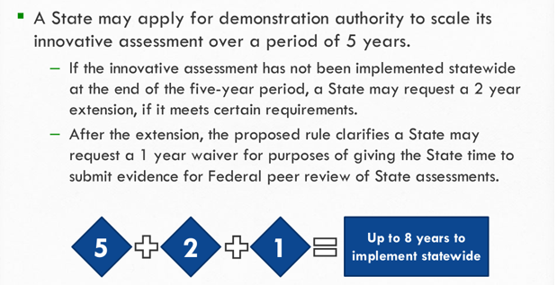
Proposed Regulations:
Innovative Assessment Demonstration Authority
Time to Thoughtfully Scale

Slide 21
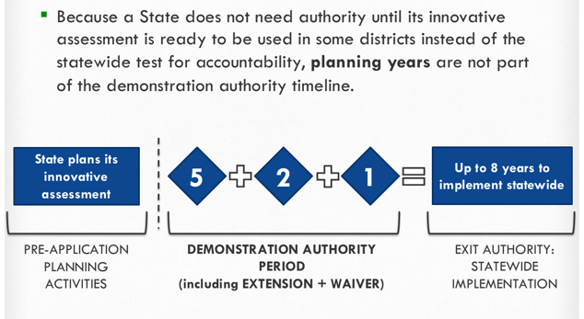
Proposed Regulations:
Innovative Assessment Demonstration Authority
Time to Thoughtfully Scale

Slide 22
Proposed Regulations:
Innovative Assessment Demonstration Authority Comparability
ESSA requires that the innovative and statewide assessments generate results during the authority period that are valid, reliable, and comparable for all students and subgroups of students.
The proposed regulations include options for states regarding how they can annually demonstrate comparability:
  Assessing all students using the statewide tests at least once in each grade span for which there is an innovative assessment.
  Assessing a representative sample of students in the same school year on both the innovative and corresponding statewide test at least once in each span.
  Incorporating, as a significant portion of the assessment, common items across both statewide and innovative tests.
  Another state-determined method that will provide an equally rigorous, statistically valid comparison for all students and subgroups.

Slide 23
Proposed Regulations:
Innovative Assessment Demonstration Authority Application Requirements
A demonstration that the innovative assessment system meets statutory requirements for assessments: alignment, quality, fairness, comparability between the innovative and statewide assessment (depth and breadth of content, academic achievement standards and results) to maintain consistent and unbiased annual accountability and reporting
Provide for the participation and be accessible to all students (95% participation of all students and all subgroups)
Provide disaggregated results for all students and subgroups

Slide 24
Assessment Priorities
What can we prioritize and do without demonstration authority?
  Move to single new assessment that meet state and federal requirements
What can we prioritize and do with demonstration authority?
  Have 2 comparable assessments being administered at the same time while scaling up to a single system
What doesn’t appear to be allowed?
  Multiple assessments long term, outside of high school
  Off-grade level without a grade level determination

Slide 25
What are we hearing?
Options that don’t require demonstration authority
Options that don’t require demonstration authority:
Is there a way to increase perceived student relevance of 9th grade assessments?
Is there a way to shorten current CMAS assessments?
Social studies? (especially high school)

Slide 26
:
What are we hearing?
Options that require demonstration authority… or more
Options
Allow for waivers from CMAS high school science assessments for students taking AP/IB/Cambridge/SAT Content tests (violates proposed regulations)
Move to a single statewide administered series of interim/benchmark assessments
  Advantages: reduction in testing
  Challenges: potential intrusion on local control
Develop common performance-based assessments that can be used by themselves at some grade levels and in conjunction with administration of current assessment at other grade levels
  Fits also with graduation guidelines work
Increase flexibility of off-grade level use of current assessments

Slide 27
Effective Instruction and Leadership Spoke Committee
Report to ESSA Hub Committee

Slide 28
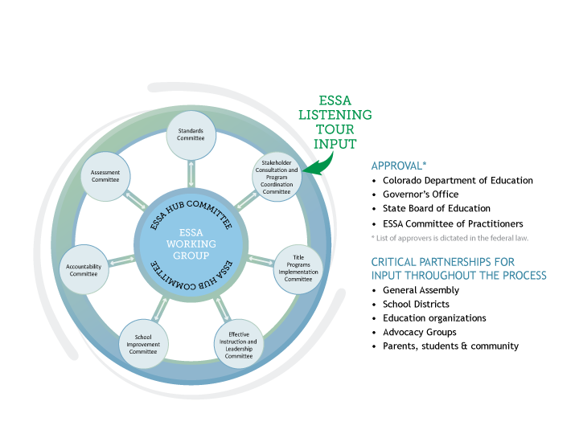
ESSA State Plan Development
Notes:
Under the guidance of the State Board of Education, the Colorado Department of Education (CDE) will utilize a Hub/Spoke Committee structure for ESSA state plan development.
A formal, central Hub Committee that will have an oversight role in the development of a draft of our state plan to be submitted to the State Board in early 2017.
ESSA topical spoke committees will be responsible for developing and appropriately vetting sections of the state plan.
Spoke committees
Standards Committee
Assessment Committee
Accountability Committee
Effective Instruction and Leadership Committee
School Improvement Committee
Title Program Plans/Assurances Committee
Stakeholder Consultation/Program Coordination Committee

Slide 29
Charge for Spoke Committees
Draft, review, and revise sections of Colorado’s ESSA State Plan;
Provide recommendations on content specific decision points
Identify possible areas for additional flexibility in state legislation
Propose responses to and provide justifications for decisions made concerning stakeholder feedback; and,
Present and submit draft sections, recommendations , and summaries of the ESSA state plan work to the Hub committee.

Slide 30
Effective Instruction & Leadership Spoke Participants
Newly formed group of stakeholders from across the state
  School Districts
    District Leaders
    Educators
  BOCES
  Institutes of Higher Education
  Education Partners
    ASCD (formerly the Assoc. for Supervision and Curriculum Development)
    Center for Teaching Quality
    Colorado Education Association
    Colorado Education Initiative
    KIPP Colorado Schools
    Public Education Business Coalition (PEBC)
Notes:
How did we engage our committee members and how they engage their own stakeholders (ie. Ty with CASPA, Kerrie/Randal with CEA, Heidi w/C-CODE)

Slide 31
Effective Instruction & Leadership Spoke Meetings
Effective Instruction and Leadership Spoke Meetings:
August 4, 2016, 1:00 – 4:00 p.m.
  Equity Working Group: August 22, 2016, 1:00 – 4:00 p.m.
  Support Working Group: August 22, 2016, 1:00 – 4:00 p.m.
September 7, 2016, 10:00 a.m. – 2:00 p.m.
  October 10, 2016 – Hub Committee
  October 12th or 13th, 2016 – State Board of Education
October 14, 2016, 10:00 a.m. – noon
November 2, 2016, 10:00 a.m. – 2:00 p.m.

Slide 32
ESSA Requirements and Decision Points

Slide 33
Effective Instruction & Leadership
Key Decision Points
Identify educator definitions for:
  Experienced/inexperienced
  In-field/out-of-field
  Effective/ineffective
CDE’s identified use of Title I and II funds in support of districts
CDE’s support to improve preparation programs and strengthen teachers, principals and leaders ability to identify and support students with specific learning needs
CDE’s support of local districts’ implementation of educator evaluation systems
Definition of para-professional standards and demonstration of meeting those standards
Notes:
Spoke will bring hub recommendations/feedback on each of these decision points. Want to make sure you understand the decision points, have an opportunity to share thoughts, ask questions with spoke before we finalize our work.

Slide 34
Recommendations
Define ‘inexperienced’ as teachers with 0-2 years of experience teaching in any educational setting.
Define ‘in-field’ as holding a license with an endorsement in the subject area in which the teacher is assigned to teach.
Continue to use the definition of effective/ineffective contained in SB 10-191.
Keep references to State model educator evaluation system broad and do not include any details that are not required.
Maintain paraprofessional requirements aligned to former highly-qualified rules in NCLB
Notes:
How can we take advantage of the added endorsement option (24 hrs or equivalent, including the 6 semester hours via PD or work experience, etc.)

Slide 35
Potential Unintended Consequences
Definition | Potential Unintended Consequence | Discussion Question(s)
In-field: endorsed | Teachers in schools with waivers from licensure (charter schools) would largely be counted as ‘out-of-field’. | Should we identify a unique definition for waiver (including public and charter) schools? If so, what should it include?
In-field: endorsed | Teachers who were considered ‘highly qualified’ under NCLB without the endorsement may be then counted as ‘out-of-field’ until they apply for and meet endorsement standards. | Can we live with this unintended consequence in the short-term while we flesh out additional pathways to add endorsements?
Inexperienced | Is there truly an equitable application of experience for all educators. | What criteria counts as 0-2 years of experience? Does part time or .25 time count for two full years just as a full time 100% teacher?
Notes:
distribution of license types among charter school teachers
Frequency Percent
5-YR Substitute Authorization 14 0.294
Adjunct Teacher 1 0.021
Alternative Teacher License 131 2.750
Initial 1244 26.113
Interim Authorization 31 0.650
Professional Teacher License 2012 42.200
Waiver 1331 27.939
Total 4764

Slide 36
Discussion Questions
Feedback for the Spoke Committee
If we define in-field as an educator who holds an endorsement in that content, what could this mean in different contexts for our districts?
If we use the definition of experienced to include all educators with 2 or more years of teaching, then how could this impact retention and recruitment?
If we keep current paraprofessional requirements, what are the implications for the field?
What is needed to have an experienced, effective and in-field educator in front of students?
Notes:
Develop note catcher for Hub feedback to our Spoke group.

Slide 37
Thank You and
Contact Information
Thank you for your time and insight today!
For more information, contact the Effective Instruction and Leadership Spoke Committee leads:
  Colleen O'Neil
  (303) 866-6945 | Oneil_C@cde.state.co.us
  Jennifer Simons
  (303) 866-3905 | Simons_J@cde.state.co.us

Slide 38
Title Programs Spoke Committee
Overview

Slide 39
Introduction to ESSA Title Programs
A brief introduction to the programs for which we are applying as part of our ESSA state plan
  The purposes of the programs.
  How much money does the state and do local school districts receive under the programs?
  How does funding flow – competitive v. formula?

Slide 40
Title Programs
    Title I, Part A: Improving Basic Programs Operated by State and Local Educational Agencies
    Title I, Part B, Section 1201: Grants for State Assessments and Related Activities
    Title I, Part C: Education of Migratory Children
    Title I, Part D: Prevention and Intervention Programs for Children and Youth Who Are Neglected, Delinquent, or At-Risk
    Title II, Part A: Supporting Effective Instruction
    Title III, Part A: Language Instruction for English Learners and Immigrant Students
    Title IV, Part A: Student Support and Academic Enrichment Grants
    Title IV, Part B: 21st Century Community Learning Centers
    Title V, Part B, Subpart 2: Rural and Low-Income School Program
    Title VII, Subpart B of the McKinney Vento-Homeless Assistance Act: Education for Homeless Children and Youths

Slide 41
Formula Programs
Title I, Part A: Improving Basic Programs Operated by State and Local Educational Agencies
  CDE Coordinator – Brad Bylsma
  To provide all children significant opportunity to receive a fair, equitable, and high quality education and to close achievement gaps.
  CDE administrative and state level funds = $1,379,020
  Distribution funds = $142,202,423

Slide 42
Formula Programs
Title I, Part D: Prevention and Intervention Programs for Children and Youth Who Are Neglected, Delinquent, or At-Risk
  CDE Coordinator - Brad Bylsma
  To improve educational services for children and youth in state and local institutions for neglected or delinquent children
  CDE state level and administrative funds = $0 (use regular Title I administrative funds)
  Distribution funds = $1,132,009

Slide 43
Formula Programs
Title II, Part A: Preparing, Training, and Recruiting High Quality Teachers, Principals, and Other School Leaders
  CDE Coordinator – Jennifer Simons
  To improve the quality and effectiveness of teachers, principals, and other school leaders
  CDE state level and administrative funds = $864,579
  Distribution funds = $23,399,610

Slide 44
Formula Programs
Title III, Part A: Language Instruction for English Learners and Immigrant Students
  CDE Coordinator – Morgan Cox
  To help ensure that English learners, including immigrant children, attain English proficiency and develop high levels of academic achievement in English
  CDE state level and administrative funds = $447,258
  Distribution funds = $8,050,653

Slide 45
Formula Programs
Title IV, Part A: Student Support and Academic Enrichment Grants – New Program
  CDE Coordinator – Brad Bylsma
  To build state, district, and school capacity to provide students with access to a well-rounded education, improve the use of technology in order to improve student achievement, and improve conditions for student learning
  CDE state level and administrative funds = TBD
  Distribution funds = TBD
    Note - $1.6 billion authorized in statute, $300 million being discussed in appropriations

Slide 46
Formula Programs
Title V, Part B, Subpart 2: Rural and Low-Income School Program
  CDE Coordinator – Kirsten Carlile
  To assist rural school districts in using federal resources more effectively to improve the quality of instruction and student academic achievement
  CDE state level and administrative funds = $26,188
  Distribution funds = $497,576

Slide 47
Competitive Programs
Title IV, Part B: 21st Century Community Learning Centers
  CDE Coordinator – Dana Scott
  Establish or expand activities in community learning centers
  CDE state level and administrative funds = $579,017
  Distribution funds - $11,001,330
Title IX, McKinney Vento-Homeless Assistance Act: Education for Homeless Children and Youths
  CDE Coordinator – Dana Scott
  To provide the supports necessary to students experiencing homelessness so that they can succeed
  CDE state level and administrative funds = $174,163
  Distribution funds = $522,491

Slide 48
Other Programs
Title I, Part B: Grants for State Assessments and Related Activities
  CDE Coordinator – Joyce Zurkowski
  To develop and administer required assessments, other assessment activities
  Formula to State
  $6,552,783
Title I, Part C: Education of Migratory Children
  CDE Coordinator – Tomas Mejia
  Support high quality education programs for migratory children
  Formula to State, formula to migrant regions
  CDE State level and administrative funds = $1,317,023
  Distributions funds = $5,647,952

Slide 49
Title Programs
For next month with the Hub:
  ESSA state and local plan requirements
  Information about state and local Title program allocations
  Consolidated application and competitive RFPS
  Supplement not supplant
  Supports for students, evidence-based strategies
  Allowable uses of funds
  Monitoring requirements and local program reviews
  State and local reporting requirements
Is there anything else you would like us to emphasize in the November discussion?

Slide 50
Wrap -Up

Slide 51
Concluding Remarks

Slide 52
Meeting Evaluation
What worked?
What would make the
meeting more effective?

Slide 53
Next Meeting
4th ESSA Hub Committee Meeting details
  Monday, November 7, 2016
    Location: State Board Room -201 E. Colfax Ave., Denver, CO 80203
    Time: 12:00 PM – 4:00 PM
Agenda and materials will be provided a week in advance and will also be posted on our website: http://www.cde.state.co.us/fedprograms/essa_stateplandevelopment
Notes:
Presentations from select spoke committees. Tentatively schedule: Stakeholder Consultation/Program Coordination and Title Programs spokes.

Slide 54
Upcoming Hub Meetings Dates
▪ Monday, November 7, 2016
▪ Monday, December 12, 2016
Monday, January 9, 2017
Monday, February 6, 2017
Location: State Board Room -201 E. Colfax Ave., Denver, CO 80203
Time: 12:00 PM – 4:00 PM

