Slide 1
Every Student Succeeds Act (ESSA) Hub Committee
November 7, 2016

Slide 2
Agenda
Welcome
Deep Dive- Standards
Deep Dive- Title Programs and Assurances
Wrap-up
Hub Member Updates
Review and Approval of Meeting Minutes
CDE Updates
Timeline
Confirmation of meeting dates/times

Slide 3
Standards Spoke Committee Report to the ESSA Hub Committee
November 7, 2016

Slide 4
About the Standards Spoke Committee

Slide 6
Standards Spoke Committee Process
Timeline | Tasks
August | Recruit committee members
August 18 | Informational webinar about the Standards Spoke Committee
August 22 | Sign-up deadline for committee
August 24 | Committee members are announced Committee members have access to “empty” draft outline
August 29 | Virtual committee meeting to discuss “empty” draft outline
September 1 | Input due for section outline
September 8 | Virtual committee meeting to review draft outline
September 15 | Committee members have access to the first draft of the section
September 22 | Virtual committee meeting to review first draft of the section
September 29 | Feedback due for first draft of the section
October 6 | Committee members have access to second draft of the section
November 3 | Virtual committee meeting to review Hub and SBE update and discuss draft standards section

Slide 7
ESSA Requirements and Decision Points

Slide 8
ESSA Standards Requirements
Provide assurance that the state has adopted “challenging” statewide standards in math, reading or language arts, and science
Alternate achievement standards for students with the most significant cognitive disabilities
Standards for English language proficiency
Notes:
Title 1-Section 1111-State Plans
‘‘(1) CHALLENGING STATE ACADEMIC STANDARDS.—
‘‘(A) IN GENERAL.—Each State, in the plan it files under subsection (a), shall provide an assurance that the State has adopted challenging academic content standards and aligned academic achievement standards (referred to in this Act as ‘challenging State academic standards’)
‘‘(C) SUBJECTS.—The State shall have such academic standards for mathematics, reading or language arts, and science, and may have such standards for any other subject
determined by the State.
‘‘(E) ALTERNATE ACADEMIC ACHIEVEMENT STANDARDS FOR STUDENTS WITH THE MOST SIGNIFICANT COGNITIVE DISABILITIES.—
‘‘(F) ENGLISH LANGUAGE PROFICIENCY STANDARDS.—
Each State plan shall demonstrate that the State has adopted English language proficiency standards that—
‘‘(H) EXISTING STANDARDS.—Nothing in this part shall prohibit a State from revising, consistent with this section, any standards adopted under this part before or after the enactment of the Every Student Succeeds Act.
‘‘(2)Assessment
‘‘(v)(I) in the case of mathematics and reading or language arts, be administered—
‘‘(aa) in each of grades 3 through 8; and (bb) at least once in grades 9 through 12;
‘‘(II) in the case of science, be administered not less than one time during—(aa) grades 3 through 5; (bb) grades 6 through 9; and (cc) grades 10 through 12; and
‘‘(III) in the case of any other subject chosen by the State, be administered at the discretion of the State;
The Secretary cannot:
Require a state to submit its standards for review.
In any way mandate, direct or coerce, or exercise any control or supervision over state standards.
ESSA Requirements:
Challenging statewide standards in math, reading or language arts, and science.
Aligned with higher education and career and technical education standards.
Alternate achievement standards for students with the most significant cognitive disabilities.
Standards for English-language proficiency that address speaking, listening, reading, and writing - aligned with the state’s academic standards.
Colorado Requirements:
In addition to the standards required by ESSA, Colorado has standards for dance, drama, music, visuals arts, theater arts, social studies, physical education, and world languages.
SB 08-212 provides for the regular review of the Colorado Academic Standards. The first review and revision cycle is set to conclude by July, 2018.
CDE will disseminate an outline of the timeline and review process in fall, 2016.
1% state cap for alternate assessments. No cap for districts but if they exceed 1% they have to justify it.

Slide 9
ESSA Restrictions on U.S. Department of Education Related to Standards
States shall not be required to submit standards to the Secretary of Education
The Secretary shall not have the authority to mandate, direct, control, coerce, or exercise any direction or supervision over any of the challenging State academic standards adopted or implemented by a State

Slide 10
Key Conversations of the Standards Spoke Committee

Slide 11
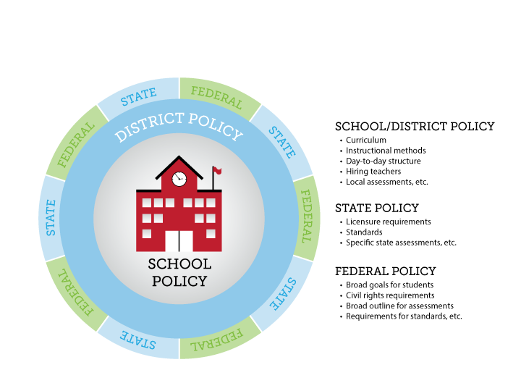
Differentiating Between Federal, State and Local Policies
Existing Colorado Education Law

Slide 12
The Relationship to Standards to Classroom Instruction
Standards
Curriculum
Instruction
Broad goals articulating what students should know, understand, and be able to do over a given time period.
State
An organized plan of instruction: a sequence of instructional units.
Local Districts
Learning experiences designed to meet the needs of students.

Slide 13
History of Academic Standards in Colorado: The Colorado Model Content Standards
House Bill 1313 (passed in 1993) initiated standards based education Colorado
Created standards in reading, writing, mathematics, science, history, civics, geography, economics, art, music, and physical education
Initiated the Colorado Student Assessment Program (CSAP) in 1996
Why standards?
Standards define what students should know and be able to do at the end of a grade level or grade span
Standards advance equity of outcomes for students
Standards reinforce school and district accountability

Slide 14
History of Academic Standards in Colorado: Colorado’s Achievement Plan for Kids (CAP4K) Standards Timeline
Senate Bill 08-212, Officially called the Preschool to Postsecondary Education Alignment Act
2008: CAP4K passes
2009: Standards revision process conducted; new standards adopted in all ten content areas (called the Colorado Academic Standards)
2010: Common Core State Standards in mathematics and English/language arts adopted; standards in these two content areas reissued
2011-2013: Transition process to the Colorado Academic Standards
2013-14: Full implementation of the Colorado Academic Standards
July 1, 2018: The first review and revision cycle for the Colorado Academic Standards is set to conclude (and every six years thereafter)

Slide 15
History of Academic Standards in Colorado: Colorado’s Achievement Plan for Kids (CAP4K)
Requirements for the Colorado Academic Standards:
Minimally include reading, writing, mathematics, science, history, geography, visual arts, performing arts, physical education, world languages, English language competency, economics, civics, and financial literacy
HB 16-1198 requires addition of optional, secondary computer science standards by July 2018
Be comparable in scope, relevance, and rigor to the highest national and international standards
Require the development of creativity and innovation skills; critical-thinking and problem-solving skills; communication and collaboration skills; social and cultural awareness; civic engagement; initiative and self-direction; flexibility; productivity and accountability; character and leadership; and information technology application skills
Be aligned with career and technical education standards, as practicable
Be aligned with the state’s postsecondary and workforce description
Lead to postsecondary and workforce readiness

Slide 16
Overview of Draft ESSA Standards Section

Slide 17
Federal and State Requirements: Challenging Academic Standards
ESSA Requirements | State Requirements
Assurance that the state has adopted challenging standards | CAP4K required the State Board of Education to adopt postsecondary aligned standards by December 2009; the standards must be comparable in scope, relevance, and rigor to the highest national and international standards
The standards apply to all public schools | CAP4K requires each local education provider to adopt local standards that meet or exceed state standards; districts may adopt the state’s standards
The standards include at minimum the subject areas of mathematics, reading or language arts, and science | CAP4K requires standards in reading, writing, mathematics, science, history, geography, visual arts, performing arts, physical education, world languages, economics, civics, financial literacy, computer science*
The standards are aligned with credit-bearing coursework and state career and technical education standards | CAP4K requires the academic standards to (1) align with the postsecondary and workforce readiness description co-adopted by the State Board of Education and the Colorado Commission on Higher Education and (2) lead to postsecondary readiness

Slide 18
Federal and State Requirements: Alternate Achievement Standards
ESSA Requirements The alternate achievement standards must be: | State Requirements
Aligned with the state academic standards | The Colorado Exceptional Children’s Education Act (ECEA) corresponds to federal guidance of IDEA Part B statute and regulation addressing the alignment of challenging academic standards. Sec. 300.160(c)(2)(i) and (ii) (I) and the adoption of alternate achievement standards for students with the most significant cognitive disabilities. Sec.200.300.160(c)(2) (iii)
Promote access to the general education curriculum
Reflect professional judgment as to the highest possible standards achievable by students with the most significant cognitive disabilities
Designated in the individualized education program for each such student as the academic achievement standards that will be used for the student
Aligned to ensure that a student who meets the alternate academic achievement standards is on track to pursue postsecondary education or employment

Slide 19
Federal and State Requirements: English Language Proficiency Standards
ESSA Requirements The English language proficiency standards must: | State Requirements The Colorado English language proficiency standards meet all ESSA requirements:
Be derived from the four recognized domains of speaking, listening, reading, and writing | CAP4K requires Colorado’s standards to include standards for English language proficiency. Adopted in 2009, the Colorado English language proficiency standards, through WIDA*, incorporate the four recognized domains.
Address the different proficiency levels of English learners | The Colorado English language proficiency standards address the following six levels of English language proficiency: 1—Entering, 2—Emerging, 3—Developing, 4—Expanding, 5—Bridging, and 6—Reaching.
Align with the State’s challenging academic standards | The Colorado English language proficiency standards provide English learners with the social and instructional language necessary for school and access to grade level academic content standards.
*WIDA: World-class Instructional Design and Assessment

Slide 20
Next Steps
The Standards Spoke Committee will make any needed revisions based on feedback/comments received.
The Standards section of the ESSA state plan has been drafted and is posted on the CDE website for review.
The Standards Spoke Committee requests that the Hub Committee include the draft Standards section in its recommendation to the State Board of Education

Slide 21
Questions? Comments?

Slide 22
Title Programs and Assurances Spoke Committee Report to the ESSA Hub Committee

Slide 23
Goals for Today
Provide information about the Title Programs Spoke Committee and its work
Provide information about Title program purposes and ESSA decision points
Provide information about Title program funding and program administration
Gather feedback, concerns, recommendations, and direction from the Hub Committee regarding the above to guide our work

Slide 24
Context
ESSA establishes broad policy requirements for states and school districts:
Academic Standards
Aligned Assessments
School Accountability
School Improvement
Teacher Effectiveness
Creates Title programs and provides funding to states and local school districts to support implementation of the requirements and raise student achievement and close achievement gaps.

Slide 25
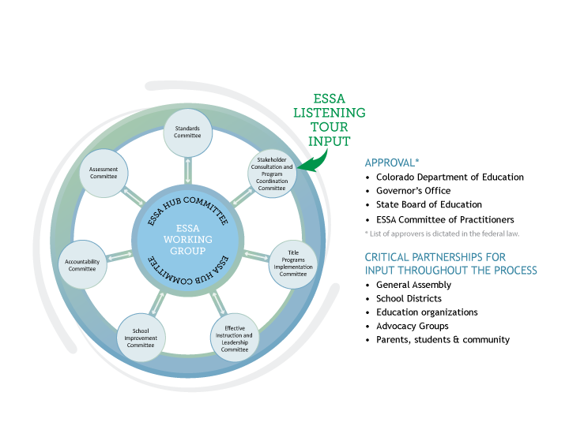
ESSA State Plan Development
Notes:
Under the guidance of the State Board of Education, the Colorado Department of Education (CDE) will utilize a Hub/Spoke Committee structure for ESSA state plan development.
A formal, central Hub Committee that will have an oversight role in the development of a draft of our state plan to be submitted to the State Board in early 2017.
ESSA topical spoke committees will be responsible for developing and appropriately vetting sections of the state plan.
Spoke committees
Standards Committee
Assessment Committee
Accountability Committee
Effective Instruction and Leadership Committee
School Improvement Committee
Title Program Plans/Assurances Committee
Stakeholder Consultation/Program Coordination Committee

Slide 26
Title Programs and Assurances Spoke Participants
First | Last | Affiliation | Role
Clinton | Allison | Fountain 8 | Director of Curriculum and Student Achievement
Kirk | Banghart | Moffat Consolidated School District | Superintendent
Amy | Beruan | Aurora Public Schools | Title I Coordinator
Alice | Collins | Westminster 50 | Director of ELD
Lori | Cooper | Center 26 JT | Direct of Curriculum, Instruction, and Assessment
Jesus | Escarcega | Aurora Public Schools | Director of Grants
Mary Ellen | Good | Centennial BOCES | Director of Federal Programs
Holly | Goodwin | Diocese of Colorado Springs | Superintendent - Nonpublic School
Laura | Gorman | Douglas County RE-1 | Grant & NCLB Coordinator
Roy | Holloway | Boulder Valley RE-2 | Director of Humanities, Federal Programs, and Extended Learning
Melanie | Jones | Division of Youth Corrections | Neglected/Delinquent Administrator
Lynn | Kintz | Retired - Academy 20 | Education Consultant
Lucinda | Long-Webb | Durango 9-R | Teacher & Parent Liaison for Indian Education Program
Jessica | Martinez | Eagle County Schools | Director of ELL Programs
Lynn | Mather | Retired - Durango 9-R | Chief Academic Officer
John | McKay | Poudre R-1 | Director of Language, Culture, and Equity
Bridgette | Muse | Eaton Schools RE-2 | Federal Programs Administrator
Tory | Richey | Cripple Creek - Victor School District | Assistant Superintendent
Dawn | Roedel | Denver County 1 | NCLB/CDE Compliance Specialist
Arlene | Salyards | NE BOCES | Special Projects Director
Amy | Spruce | Adams 12 Five Star Schools | Certified Recruitment and Retention Administrator
Tracy | Thatcher |  | Parent
Mitzi | Swiatkowski | EC BOCES | Federal Programs Director
Clare | Vickland | Charter School Institute | Director of Student Services
Myra | Westfall | Valley School District, Sterling | School Board Member
ESEA Committee of Practitioners

Slide 27
Title Programs and Assurances Spoke Meetings
Title Programs and Assurances/ESEA Committee of Practitioners Meetings:
August 18, 2016, 10:00 am – 3:00 pm
September 8, 2016, 10:00 am – 3:00 pm
September 22, 2016, 10:00 am – 3:00 pm
October 6, 2016, 10:00 am – 3:00 pm
November 17, 2016, 10:00 am – 3:00 pm
Title Programs and Assurances Spoke Committee information can be found at:
http://www.cde.state.co.us/fedprograms/essa_stateplandevelopment_titleprograms

Slide 28
Work of the Title Programs and Assurances Spoke Committee
Advise the Department regarding its system of grants administration, including:
Applications and RFPs
Program Monitoring and Program Reviews
Fiscal Issues
Reporting and Program Evaluation
Supports and Technical Assistance
Present and submit draft sections, recommendations, and other related information to the Hub committee for its consideration.

Slide 29
ESSA State Plan Title Programs Requirements
Each SEA must describe:
How it will use funds under the programs included in the consolidated state plan and support LEA use of funds - in combination with state and local funds - to ensure that all children have a significant opportunity to meet challenging state academic standards and career and technical standards and attain, at a minimum, a regular high school diploma.

Slide 30
ESSA State Plan Title Programs Requirements
Each SEA must describe:
Its system of grants performance management for implementation of State and LEA plans regarding supporting all students:
Including homeless, migrant, economically disadvantaged, racial and ethnic groups, English learners, students with disabilities, students in foster care, children in military families.
The description must include information on the SEA’s review and approval of LEA plans, collection and use of data, monitoring, continuous improvement, and technical assistance.

Slide 31
Grants Management
Goals of Grants Management
Maximize the impact of the grants on behalf of students, parents, and taxpayers
Minimize the administrative burden of BOCES, school districts, and schools
Be efficient, effective, frugal stewards of the funds
To be informed consumers of the grants so that we not only understand the requirements of the grants, but understand the opportunities and flexibility afforded by the grants to improve students services
Understand and meet legal requirements tied to the grants, work toward equitable opportunities for all students.

Slide 32
Title Grant Programs
Three types of grants
Competitive
State-administered grants
Formula grants

Slide 33
Title Programs
All of these grants are intended to supplement and not supplant state and local effort and all have these basic components:
Allocation/Award/Funding
Assurances/Acceptance of funds
Stakeholder Consultation
Needs Assessment
Plans/Applications/Proposals
Program-specific Requirements, strategies, timelines
Budget
Monitoring
Reporting and Program Evaluation

Slide 34
ESSA Themes
Although not necessarily new, these themes cut across the allowable use of ESSA Title program funds:
Career and Technical Education
Early Learning
Healthy Students
Well-rounded Education
Supports for Teachers
Supports for Students
Need to reflect these themes in our applications and guidance materials.

Slide 35
Competitive Title Programs

Slide 36
Competitive Grant Application Process
Release & Publicize
The Office of Competitive Grants and Awards and program managers meet to develop the rules, funding eligibility, application requirements, scoring rubric, and timeline.
Plan & Develop
CDE provides technical assistance to potential eligible applicants, including hosting a webinar, posting Q&As, and answering questions.
Technical Assistance
After approval of the application, CDE releases applications in the Scoop and the program posts the application to its website and sends the application to its networks.
Notes:
QUESTIONS?

Slide 37
Competitive Grant Review Process
Peer Review
CDE (CGA, program, grants fiscal) review applications for eligibility and inclusion of all required elements (signatures, electronic budget, etc.). Applications are then sent to peer reviewers.
CDE Review
CDE reviews peer scoring and feedback. Grants Fiscal reviews budgets. CDE finalizes feedback and sends award notifications. Applicant must send back all changes by specific date to be funded.
Grants Awarded
Peer reviewers individually review and score applications for quality and adherence to the rubric. Reviewers come together during an in-person team review day to discuss and reconcile scoring and make funding recommendations to CDE.
Notes:
QUESTIONS?

Slide 38
Guiding Principles for Competitive Grant Management
Create an equitable and defensible process for administering grants.
Leverage resources and funding to create maximum impact for the field and positive student outcomes.
Grant Program Implementation
Create efficiency for grant management and minimize administrative burden to the field
Ensure federal compliance
Provide evaluation to ensure quality programs that result in student success.

Slide 39
General Technical Assistance and Support
Full-day grant writing trainings throughout state (close to 150 participants trained):
2015: Alamosa, Colorado Springs, Denver, Castle Rock, Grand Junction, Greeley, Limon and Steamboat Springs
2016: Colorado Springs, Greeley, Leadville, Lamar, Denver
CGA Grants Forecast: (http://www.cde.state.co.us/cdeawards/cga_grantsforecast)
Purpose: Ensure quality and equity in use of funds

Slide 40
CDE Competitive Grant funding at a glance
Average success rate for a grantee: 76%
Average success rate for a rural grantee: 82%
Grantees with a 100% success rate: 65%
Rural grantees with a 100% success rate: 76%
Average number of applications per grant: 12
Median award amount for all applicants: ~$125,000
*All data based on FY2014-15 funding opportunities.
Notes:
100% success rate: of the grants they applied for, they were awarded every one.

Slide 41

21st Century Community Learning Centers Grant Program (21st CCLC)
Title IV, Part B of ESSA
Creates community learning centers
Provides academic enrichment opportunities during non-school hours or periods when school is not in session
Offers broad array of activities and programming aligned with challenging State academic standards
Provides literacy and educational services to the families of participating students
Serves students that attend high-poverty, low-performing K-12 schools.

Slide 42
21st CCLC Overview
FY16-17 Funding: Colorado received $11.58 million
Colorado currently has two grant cohorts with 55 grantees running 105 centers
Average grant size: $192,111
Grant cycle: 5-year grant cohorts
ESSA sets the minimum grant award at $50,000
Colorado Outcomes
Grantees served 21,918 students in 2014-15
Of 21st CCLC participants served:
76% had better academic performance
72% had improved participation in class
68% improved in completing homework to the teacher’s satisfaction
Outcomes based on 2014-15 reporting.

Slide 43
21st CCLC Grant Program and ESSA
ESSA requirements are connected with the consolidated state plan and new requirements for the 21st CCLC state application
ESSA increases funding for state activities from 3% to 5%.
State activities include: capacity building, technical assistance, professional development, monitoring, program evaluation and coordination with other federal and state programs and resources
21st CCLC ESSA Feedback: 21st CCLC State Advisory Board, Colorado Afterschool Partnership, special events and a reauthorization training for grantees and the field

Slide 44
21st CCLC’s Next Funding Cycle
Next RFP to fund programs starting in the 2018-19 school year
Eligible entities are LEAs, community-based organizations, other public or private entities, or a consortium of two or more agencies
New requirements under the federal application in the areas of:
Eligibility – how do we define high-poverty and low-performing
RFP process – rigorous peer review process and
Evaluation - state and local
Allowable usages of funds under ESSA have been expanded to include programming such as: environmental literacy, career and technical programs, internships and apprenticeships

Slide 45

Homeless Education and McKinney-Vento Overview
Number of Colorado Public School Students Experiencing homelessness in 2014-15: 24,685 students in grades PK-12 (more than a 200% increase since 2003-04)
The number of unaccompanied homeless youth identified and served in Colorado public schools in 2014-15: 2,052 students (55% increase since 2009-10)

Slide 46
Homeless Education and McKinney-Vento Overview
Title IX, Part A of ESSA and the McKinney-Vento Act have federal educational rights for students experiencing homelessness that all LEAs must meet
Purpose: To remove educational barriers facing children and youth experiencing homelessness, with an emphasis on educational enrollment, attendance, and success
All MV students are categorically eligible for Title IA and LEAs must reserve set-aside funding to help meet their needs
Grant Administration: Competitive Supplemental Grant Program

Slide 47
MV Supplemental Grant Program Overview
For FY16-17, Colorado received $696,654
Eligible entities: All Colorado LEAs and BOCES are eligible to apply
75% distributed through competitive grants to grantees, 25% state administration and activities
State activities include: providing professional development, technical assistance, monitoring, evaluation, coordination with other federal and state programs, responding to inquires from homeless parents and students, working with LEA Homeless Education Liaisons to improve identification and to heighten the awareness and capacity of the liaisons and personnel to respond to specific needs in the education of homeless children and youths

Slide 48
MV Supplemental Grant Program (cont)
Colorado currently has 14 LEA grantees and 2 BOCES MV grantees
Grant cycle: 3-year cohort
Grant ranges are from $10,000 minimum and $40,000 maximum
The average grant size: $32,656
Grant program funds supplemental programming that tracks and evaluates academic progress; LEA/BOCES school support and collaboration
Priority is given to applicants that:
Serve the greatest need and are providing direct services to homeless children and youth (inclusive of preschool and high school age students)
Demonstrate high-level collaboration with Title I, Part A
Have established partnerships with homeless service providers and school personnel
Next RFP to fund programs will be released for programs starting 2019-20 school year

Slide 49
McKinney-Vento and ESSA
ESSA requirements are connected with the consolidated state plan and new requirements for the new MV state plan
New requirements under the ESSA MV state plan include:
Removing foster care placement on 12/10/16
Increased specificity and intention regarding liaison capacity
Increased collaboration expectations with Title IA
Clearer preschool provisions
Increased credit accrual and college readiness assistance and procedures
Feedback from the MV field includes: statewide McKinney-Vento Homeless Education Liaison training 10/4/16, feedback from grantees, Colorado Advisory Council on Homeless Youth, meetings with primary stakeholders and partners

Slide 50
Discussion Questions
21st CCLC:
What supports should CDE provide to ensure high-quality programs?
What state priorities related to high poverty and low performing schools should the state consider in the next funding cycle?
McKinney-Vento:
What supports should CDE provide to improve the skills of LEA Homeless Education Liaisons in identification and engagement of students experiencing homelessness?
What supports are needed to ensure McKinney-Vento students receive appropriate full or partial credit upon transfer or transition to a new school?

Slide 51
State-Administered Title Programs: Migrant Education Program

Slide 52
Migrant Education Program (MEP)
Title I Part C, Purpose:
(1) support high-quality and comprehensive educational programs for migratory children
(2) ensure that migratory children who move among the States are not penalized in any manner
(3) ensure that migratory children are provided with appropriate educational services
(4) ensure that migratory children receive full and appropriate opportunities to meet the same challenging State academic content
(5) design programs to help migratory children overcome educational disruption, cultural and language barriers, social isolation, various health-related problems, and other factors that inhibit the successful transition to postsecondary education or employment; and
(6) ensure that migratory children benefit from State and local systemic reforms.

Slide 53
Migrant Program Fiscal Responsibility
FY16-17 Colorado Migrant Allocation - 5 Sub grantees - $6,964,975
Highest Allocation- $2,178,090
Lowest Allocation- $633,106
Funding, provided by the USDE, Office of Migrant Education, is based on the number of migrant children that are identified and certified in the State of Colorado. Funds that each state receives are based on a formula that is developed by the Office of Migrant Education.
Funding Streams / Programs Under this Part | List all grant programs under this part | Entitlement or Discretionary | State Allocation (Yes/No) | LEA Allocation (Yes/No)
 | Migrant Education Program (MEP) | Entitlement | Y | N
Purposes(s) | The purpose of this part is to establish or improve, directly or through local operating agencies, programs of education for migratory children.

Slide 54
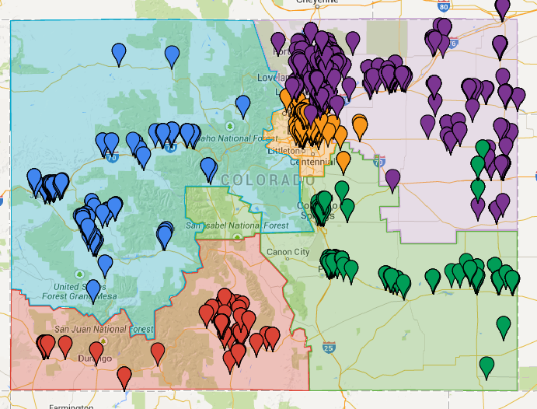
Migrant Program CDE Regional Approach
Five Regions:
Metro
Northern
South West
South East
West Central
Notes:
CDE has utilized a regional approach in delivering Migrant Services across the State. There are five Migrant Regions to serve all school districts.
All identified migrant students located within the boundaries of each Region will be served directly by the Regional office or by a participating school district.

Slide 55
Migrant Program Government Performance and Results Act
Percentage of MEP students that scored at or above proficient on the state’s annual Reading/Language Arts assessments in grades 3-8 and high school.
Percentage of MEP students that scored at or above proficient on the state’s annual Mathematics assessments in grades 3-8 and high school.
Percentage of MEP students who were enrolled in grades 7-12, and graduated or were promoted to the next grade level.
Percentage of MEP students who entered 11th grade that received full credit for Algebra I or a higher Mathematics course.

Slide 56

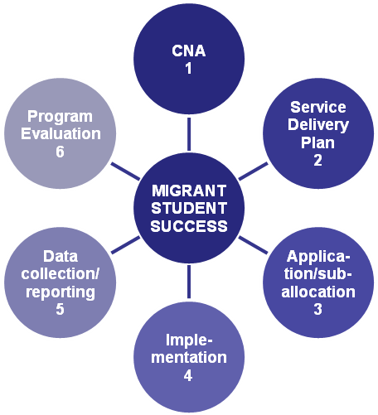
Migrant Program Planning Cycle

Slide 57
Direct Services from CDE’s Migrant State Office
Summer Migrant Youth Leadership Institute (SMYLI)
11 days at a Colorado university
Close Up: New American for High School Students
5 days in Washington D.C.
Binational Migrant Initiative
Transfer Document – Mexico and US
Teacher Exchange Program
Parent Advisory Council
Provide information on needs and guidance for services
Statewide representation

Slide 58
Formula Title Programs

Slide 59
Title I Program
Title I, Part A: Improving Basic Programs Operated by State and Local Educational Agencies
Purpose:
To provide all children significant opportunity to receive a fair, equitable, and high quality education and to close achievement gaps.

Slide 60
How LEAs Allocate Title I-A funds to Schools
LEAs choose a poverty method to use in ranking their schools
Free Lunch, Free and Reduced Lunch, Temporary Aid to Need Families (TANF), Community Eligibility Provision (CEP).
LEAs assign funds to schools in Rank Order by poverty percentage
LEAs choose how much funding to provide to schools
LEAs budget these funds for school level programs
Schoolwide
Targeted Assistance

Slide 61
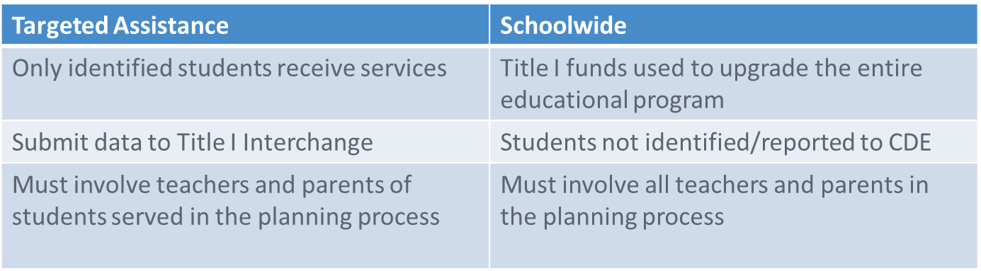
Title I Program
Basic programs:
Schoolwide: Funds may be used for activities that are part of schoolwide plan and aligned to the comprehensive needs assessment
Targeted Assistance: Funds may only be used to meet the needs of participating children.

Slide 62
ESSA Title I
For 2017 – 2018, a LEA must have a plan on file with the SEA that:
Describes the programs and activities that support a fair and equitable education for each and every student
Is developed in consultation with stakeholders
Addresses disparities in teacher distribution
Meets LEA responsibilities related to school improvement (as applicable)
Coordinates and integrates services with preschool programs
Supports efforts to reduce the overuse of discipline practices that remove students from classrooms
Coordinates academic, career and technical education content

Slide 63
ESSA Title I
Parent Information – 2017-2018
Must inform parents of ability to request info regarding teacher qualifications
Must provide parents information regarding their child’s academic achievement
Notify if taught by teacher that does not meet applicable state certification or licensure requirements
Policy regarding student participation in statewide assessments – post information on each assessment
Inform parents of ELs of the reason their child was identified as EL and the services for which they are eligible

Slide 64
ESSA Transition
ESSA Preserved rank order
Must serve 75% or higher
LEAS may use 50% threshold for High Schools
Targeted Assistance Programs
No changes
Schoolwide – Transition
May request a waiver to operate SW program in a school below 40%
Transition to “new” SW requirements during 2016-2017 SY
May transition early
ESSA SW Program Requirements and Rubric http://www.cde.state.co.us/fedprograms/swtoolkit

Slide 65
Title I Choice/SES Provisions
Choice/SES
Required reservation is repealed
States may reserve up to 3% for:
Career and technical education
Advanced placement/IB test fees
Tutoring
Transportation to support choice
Or, LEAs may use district-level set asides for these activities

Slide 66
Title I, Part D: Neglected or Delinquent Program
Title I, Part D: Prevention and Intervention Programs for Children and Youth Who Are Neglected, Delinquent, or At-Risk
To improve educational services for children and youth in state and local institutions for neglected or delinquent children
Specific to LEAs with facilities that serve these students in their district

Slide 67
Title II, Part A
Purpose: to provide grants to State educational agencies and subgrants to local educational agencies to—
Increase student achievement consistent with the challenging State academic standards;
Improve the quality and effectiveness of teachers, principals, and other school leaders;
Increase the number of teachers, principals, and other school leaders who are effective in improving student academic achievement in schools; and
Provide low-income and minority students greater access to effective teachers, principals, and other school leaders.

Slide 68
Title II, Part A
 | NCLB | ESSA
State level funds | Administration: 1% State level activities: 2.5% Higher Ed partnerships: 2.5% | Administration: 1% State level activities: up to 4% allowed
Allowable uses: LEA | In general, any activities that are supplemental and meet the purpose of Title II, including: Professional development Recruitment of teachers Retention activities Class-size reduction | Same as NCLB, but also now explicitly allows: Training on trauma and mental health Training on school safety issues Identification of gifted students Preventing child sexual abuse Instructional library programs
Accountability | Sanctions on use of funds for: non-highly qualified teachers | Must address gaps in equitable access to teachers

Slide 69
Title III: Language Instruction for English Learners and Immigrant Students
Established to help ensure that English learners, including immigrant children and youth, attain English proficiency and develop high levels of academic achievement in English by:
Assisting schools and districts develop, implement, and sustain evidence-based ELD programs
Providing resources to schools and districts for preparing educators (Pk-12), school leaders and district leaders to effectively teach English Learners
Providing resources to schools and districts to promote and engage family, parents, and community members of ELs in language instruction education programs and the school/district community

Slide 70
ESSA EL Definition
ESSA defines an “English learner” as an individual who, among other things, has difficulties in speaking, reading, writing, or understanding the English language that may be sufficient to deny him or her the ability to meet challenging state academic standards.

Slide 71
Title III Required Activities
Title III grantees must:
Provide effective language instruction educational programs that meet the needs of English learners and demonstrate success in increasing English language proficiency and student academic achievement;
Provide effective professional development to instructional staff, principals, administrators, community based-personnel classroom teachers that addresses the challenges and opportunities of ELs and the instructional educational program provided in the district/school
Include parent, family, and community engagement activities as they relate to ELs and their families

Slide 72
Every Student Succeeds Act
States will “establish and implement, with timely and meaningful consultation with local educational agencies representing the geographic diversity of the State, standardized, statewide [EL] entrance and exit procedures.” (ESSA §3111, §3113)
Notes:
MC

Slide 73
Draft ESSA Regulations on Accountability and State Plans
§299.19(c)(3) [3113(b)(2)] Regulations clarify:
Standardized statewide EL entrance and exit procedures must include uniform criteria applied statewide
Prohibits a “‘local option,’ which cannot be standardized and under which LEAs could have widely varying criteria”
Exit procedures must include objective, valid, and reliable criteria, including a score of proficient on the State’s annual ELP assessment
Notes:
MC

Slide 74
Draft ESSA Regulations on Accountability and State Plans
§299.19(c)(3) [3113(b)(2)] Regulations clarify:
Scores on content assessments cannot be included as exit criteria (not valid and reliable measures of ELP, may result in prolonged EL status, civil rights violations)
Exit criteria must be applied to both Title I EL subgroup and Title III services (exit EL status for both Title I and Title III purposes)

Slide 75
USED Data Collection Associated Requirements
ESSA requires each LEA receiving Title III funds to submit:
The number and percentage of ELs in the programs and activities who are:
Making progress toward English language proficiency*,
Attaining English language proficiency by the end of each school year,
Exiting the LIEP/ELD based on their attainment of English language proficiency,
Meeting the challenging State academic standards for each of the 4 years after the student is no longer receiving services*, and
Not attaining English language proficiency within 5 years of initial classification as an EL and first enrollment in the LEA.
*Must be reported in the aggregate and disaggregated, at a minimum, by English learners with a disability.

Slide 76
Title IV, Part A: Student Support and Academic Enrichment Program
Title IV, Part A: Student Support and Academic Enrichment Grants – New Program
To build state, district, and school capacity to provide students with access to a well-rounded education, improve the use of technology in order to improve student achievement, and improve conditions for student learning
Well-Rounded Education: Definition
Note - $1.6 billion authorized in statute, $300 million being discussed in appropriations

Slide 77
Title IV
Districts that receive more than $30,000 will have to fund activities in each of three categories:
Well-Rounded (at least 20% of funds), which include AP and IB test fee reimbursement, STEM, Arts and Computer Science.
Healthy Students (at least 20% of funds), which includes bullying and drug abuse prevention.
Technology (at least one activity, and no more than 15% can go toward the purchase of technology infrastructure).

Slide 78
Title V, Part B, Subpart 2: Rural and Low-Income School Program
Title V, Part B, Subpart 2: Rural and Low-Income School Program
To assist rural school districts in using federal resources more effectively to improve the quality of instruction and student academic achievement

Slide 79
ESEA Programs: Grants Performance Management
Capacity Building
Consolidated Application
Universal Support and Monitoring
Risk Based Program Reviews

Slide 80
ESEA Programs: Grants Performance Management
Building local capacity to plan and implement effective programs that are student centered.
Self-service resources
Regular trainings
Targeted Outreach
Capacity building
Consolidated Application
Universal monitoring
Risk based program reviews

Slide 81
ESEA Programs: Grants Performance Management
Targeted Outreach
Program quick references
Planning tools
Regular trainings
ESEA Virtual Academy
Statewide ELD Professional Learning Opportunities
Self-service resources
ELD Program Review
UIP review and feedback
Needs assessment tools
Program rubrics
English Learner Guidebook
IN DEVELOPMENT: ESEA Grants Administration Handbook
Regional Network Meetings
Equity & Excellence Conference
Program planning support
Capacity building
Consolidated Application
Universal monitoring
Risk based program reviews

Slide 82
ESEA Programs: Grants Performance Management
What is the Consolidated Application?
Single application for federal formula grants
Title I, Part A
Title II, Part A
Title III, Part A
Title IV, Part A
Title V, Part B (rural support)
Administered annually
Online platform
Capacity building
Consolidated Application
Universal monitoring
Risk based program reviews

Slide 83
ESEA Programs: Grants Performance Management
Tiered Approach to Monitoring Programs
Tier 1
Universal activities
All LEAs (who accept funds)
Tier 2
LEAs with Comprehensive Support Schools (CSI)
Tier 3
Intensive Activities
LEAs with schools who have persistently underperforming subgroups (Targeted Support Schools)
LEAs with ESEA allocations above $2 million
LEAs failing to meet ESEA fiscal requirements
LEAs failing to meet application/reporting deadlines
Targeted activities
Priority Improvement and Turnaround LEAs
LEAs with schools in the lowest five percent (Comprehensive Support Schools)
Capacity building
Consolidated Application
Universal monitoring
Risk based program reviews

Slide 84
ESEA Programs: Grants Performance Management
How does CDE regularly monitor all LEAs for compliance with ESEA?
Universal Program Review Activities:
IN DEVELOPMENT: Self assessment tool
Consolidated Application
Data Collections
Consolidated State Performance Reports
EDFacts reporting
End of year reports
Set-aside reports
Human Resources
State accountability system
Tracking of funds drawdowns
Comparability
Maintenance of effort
Capacity building
Consolidated Application
Universal monitoring
Risk based program reviews

Slide 85
ESEA Programs: Grants Performance Management
Existing | Targeted Activities | Intensive Activities
 | District UIP review ESEA program plan development support Consolidated Application planning support
New with ESSA | Review of Targeted Support and Improvement plans for schools not showing improvement Targeted review of indicators identified in universal monitoring and risk assessment | Pre-program review meeting Onsite program review Collaborative action planning Progress monitoring
Capacity building
Consolidated Application
Universal monitoring
Risk based program reviews

Slide 86
Discussion Questions
Currently, CDE prioritizes schools and districts for a more rigorous application review, program monitoring, and increased support and technical assistance based on the results of the school and district performance frameworks. What do you think about that?
How should CDE support districts and schools in recruiting and retaining effective teachers that can meet the needs of all students?
ESSA requires the state to establish standardized entrance and exit criteria for English language development programs. Should Colorado ask for an additional year to finalize the criteria for implementation in 2018-2019 instead of the required 2017-2018?
What does a well-rounded education mean for Colorado?

Slide 87
Title Program Allocations and Fiscal Issues

Slide 88
NCLB Grants FY16-17
Notes:
This slide includes all Federal Education Grants awarded to Colorado. Most are administered by CDE as the pass through entity, however some (with stars) are direct ED grants to LEAs.

Slide 89
NCLB Formula Grants FY16-17
Notes:
Total award to Colorado for Title I is $150.74 million; this includes Title I-A and Title I-D
Total award to Colorado for Title II-A is $24.26 million
Total award to Colorado for Title III is $8.94 million; this includes Title III-A and Title III Set Aside Immigrant
Total award to Colorado for Title VI-B is 0.52 million
Each program includes approximately 1% admin; total admin for all programs is $2.18 million

Slide 90
Title I-A Allocation Process

Slide 91
Acronyms & Definitions
ESSA – Every Student Succeeds Act
NCLB – No Child Left Behind
CSDB – Colorado School for the Deaf and Blind
CSI – Charter School Institute
CMSA – Census Metropolitan Statistical Area
EFIG – Education Finance Incentive Grant
Formula children – 5-17 year olds from low-income families that are determined through the U.S. Bureau Census and are the basis for allocations
LEA – Local Education Agency
LEP – Limited English Proficient
MSA – Metropolitan Statistical Area
SEA – State Education Agency
Special LEA – LEA that is not listed by the Census Bureau
USDE – United States Department of Education

Slide 92
ESSA Title I-A FY17-18 Illustration Only
Notes:
Approximately 89% of the States Title I allocation will be used for distribution to LEA’s. This will include Title I-A and Title I-D (Delinquent).
7% of the Title I allocation to the State will be a MANDATORY set aside for School Improvement grants, 95% of which is to be awarded to LEAs on a formula or competitive basis with 5% retained for State activities and administration.
3% of the States Title I allocation is an OPTIONAL set aside for Direct Student Services (e.g. SES) to be awarded to “geographically diverse LEAs”.
$2.08 million for administration includes 1% of the total allocation, plus 5% administration out of the School Improvement Grants, and 1% administration out of Direct Student Services grants.

Slide 93
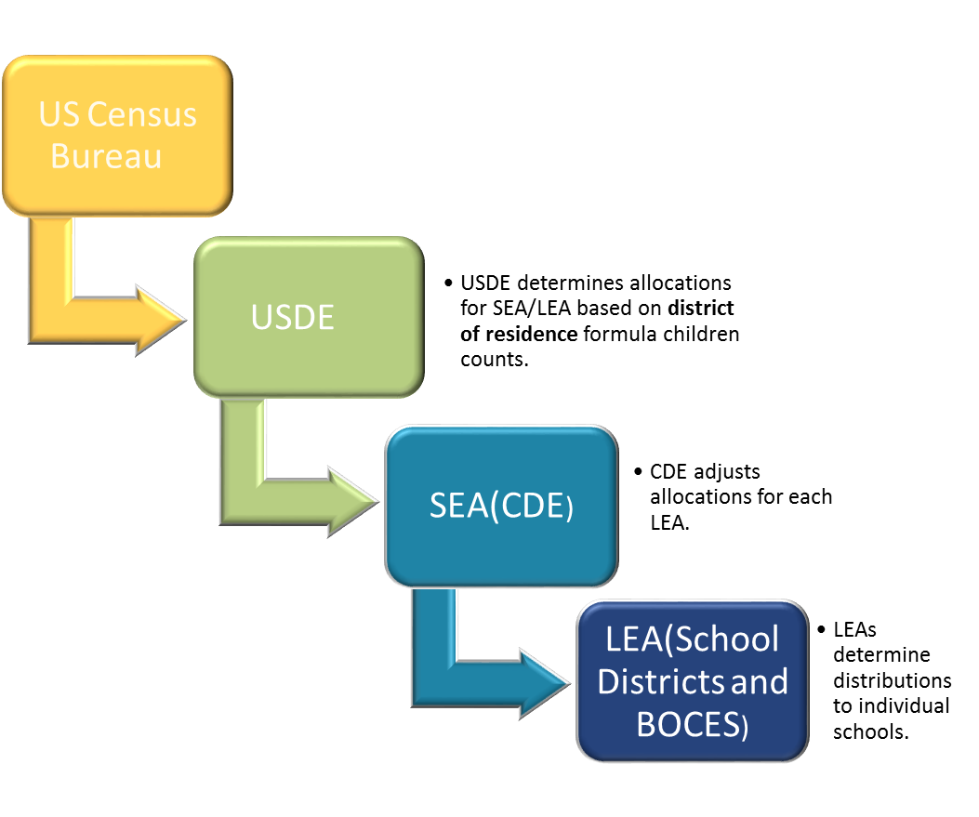
How are Allocations Made to States and School Districts?
Notes:
District of residence Formula Children Count
5-17

Slide 94
How USDE Allocates Title I To CDE
Allocated through four statutory formulas, each with their own criteria, that are based primarily on population, census poverty estimates, and the cost of education in each state
Basic, Concentration, Targeted and Education Finance Incentive Grant (EFIG)
Each have individual criteria for eligibility
Allocated based on US Census Bureau poverty estimates
2014 data used for 2017 allocations – data is 3 years in arrears
USDE applies the first Hold-Harmless Provision
USDE sends allocation figures by individual LEAs to CDE

Slide 95
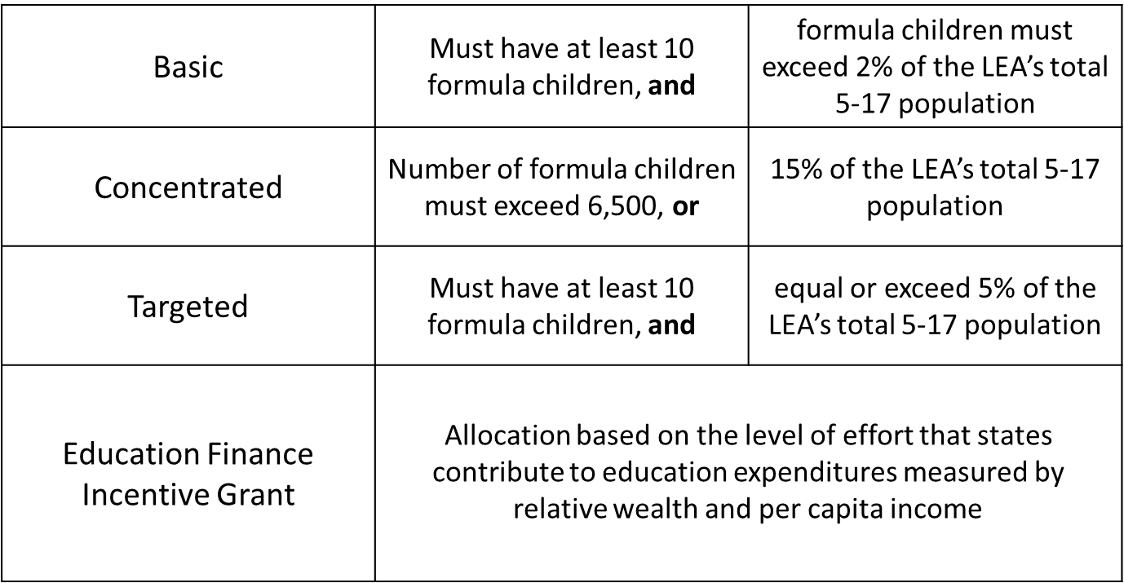
Title I, Part A Components

Slide 96
Title I, Part A Components for FY16-17
Notes:
Preliminary Numbers
We have gotten this year: Prelim, Final, Revised Final

Slide 97
How USDE Allocates Funds to CDE
USDE sends source documentation to CDE on individual LEAs that include:
Populations
Total Formula children count which includes the total of:
Poverty count from census data (3 years in arrears)
Neglected
Foster Care
Temporary Assistance to Needy families (TANF)
Total population ages 5-17
Formula children as a percentage of the total 5-17 population
Allocations
Current year allocations broken out by each of the 4 components of Title I for each LEA
Current year Total Allocation for each LEA
Previous year allocations broken out by each of the 4 components of Title I for each LEA
Previous year Total Allocation for each LEA
Notes:
Two worksheets and source documents that are sent to CDE from the Feds

Slide 98
How CDE Allocates Title I to LEAs
Awards range From $852 - $29,622,309 - Average $794,119
Allocations from USDE are adjusted in CDEs allocation formula for:
State administrative costs
Special LEAs
CSDB and CSI
Multi District Online Pilot
Required set asides
Delinquent and School Improvement
Hold Harmless provisions
CDE sends updated allocation figures to individual LEAs

Slide 99
State Administration
‘‘SEC. 1004. STATE ADMINISTRATION.
‘‘(a) IN GENERAL.—Except as provided in subsection (b), to
carry out administrative duties assigned under parts A, C, and
D of this title, each State may reserve the greater of—
‘‘(1) 1 percent of the amounts received under such parts;
or
‘‘(2) $400,000 ($50,000 in the case of each outlying area).
‘‘(b) EXCEPTION.—If the sum of the amounts appropriated for
parts A, C, and D of this title is equal to or greater than
$14,000,000,000, then the reservation described in subsection (a)(1)
shall not exceed 1 percent of the amount the State would receive,
if $14,000,000,000 were allocated among the States for parts A,
C, and D of this title.
All entities (including States, Guam, Virgin Islands and others) receiving Title I grant funding use their proportional share of the $14B as a base to calculate their 1% administration set aside.
States proportional share of the $14B is proportionally shared by Title I-A, Title I-C and Title I-D.

Slide 100
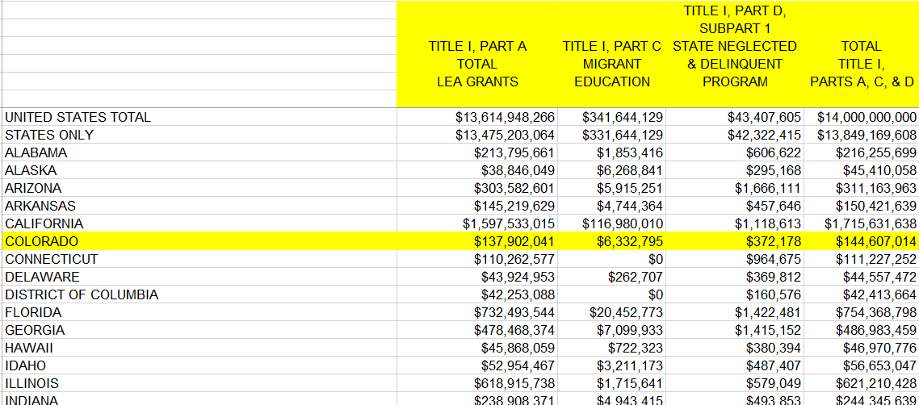
State Administration
Notes:
0.9148% of the actual allocation

Slide 101
Special LEAs
A special LEA is one that is not listed by the Census Bureau
CSI and CSDB are considered a special LEA
The USDE provides guidance that states must adhere to in order to allocate funds to special LEAs
Manual adjustments are made to determine this funding
District of residence, at-risk count, formula children
Iterations of allocations depend on district of residence and the CSI schools within geographic boundaries

Slide 102
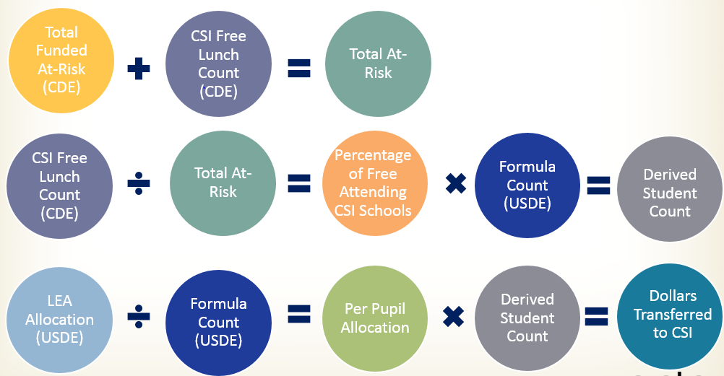
Illustration of Process that Reallocates Funding to Special LEAs

Slide 103
Multi-District Online Pilot
Allocations are adjusted for the State Board Approved Multi-District Online Pilot Program according to the following criteria:
Must be a multi-district online school
Must not have CSI as its authorizer
Must have, at minimum, 10 free lunch students from outside the LEA’s boundaries
Must have a higher free lunch percentage compared to the LEA’s percentage
Must be served in the preceding year of the allocation OR must have been in existence utilizing the same school code for two years preceding the allocation year
Must be participating in the United States Department of Agriculture school meal program
Uses the same process as Special LEAs

Slide 104
Required Set-Asides
Title I-A Allocations to districts are adjusted for state-level required set-asides:
Title I-D Delinquent
School Improvement

Slide 105
Title I-D Delinquent
Educational programs for neglected, delinquent and at-risk youth
Delinquent State allocation is sent to USDE and allocated to delinquent facilities based on prior year student counts
Notes:
USDE tells CDE what the # is off the 150mil
CDE allocates based on delinquent facility counts

Slide 106
Title I-A School Improvement
Grants for intensive and sustained support to schools designated as in need of improvement
7% for ESSA
Eligibility for access to set aside
Lowest 5% of Title I schools in the state
High Schools with grad rate less than 67%
Schools with underperforming Subgroups
Estimated ~ $10,500,000
95% of set-aside must go to LEAs with identified schools
SEA must
Prioritize LEAs with large numbers of identified schools
Take into account the geographic diversity of the LEAs in the state
Notes:
This is how the Set-Aside will work with ESSA – Under NCLB it is 4%

Slide 107
Title I-A School Improvement Direct Services
SEAs may withhold an additional 3% for Direct Services to students.
Estimated ~ $4,500,000
99% must be distributed to LEAs with low performing schools
HS student supports such as
GED
Concurrent enrollment
Credit recovery
After school tutoring
Title I School Choice options

Slide 108
ESSA Title I-A FY17-18 Illustration Only
Notes:
Approximately 89% of the States Title I allocation will be used for distribution to LEA’s. This will include Title I-A and Title I-D (Delinquent).
7% of the Title I allocation to the State will be a MANDATORY set aside for School Improvement grants, 95% of which is to be awarded to LEAs on a formula or competitive basis with 5% retained for State activities and administration.
3% of the States Title I allocation is an OPTIONAL set aside for Direct Student Services (e.g. SES) to be awarded to “geographically diverse LEAs”.
$2.08 million for administration includes 1% of the total allocation, plus 5% administration out of the School Improvement Grants, and 1% administration out of Direct Student Services grants.

Slide 109
3% Set Aside
Should CDE retain an additional 3% of Title I funds for Direct Services to Student?
What we heard on the listening tour
Pros
Cons
Discussion

Slide 110
How Hold-Harmless Effects Set-Asides
LEAs with an increase in funding over the previous year contribute to set-asides
However, LEA Allocations cannot fall below the hold-harmless threshold
State may not reduce the 7% for year one of ESSA
Hold Harmless may suffer in 2017-18
Notes:
The 4% was reduced to 3.91% in 14-15
(winners)

Slide 111
Title I, Part A Hold-Harmless Provision
Statute guarantees that the LEA receive at least 85, 90, or 95 percent of the amount it was allocated in the preceding year.
Basic, Targeted, and Education Finance Incentive Grant
If the district is no longer eligible for funding under these Title I, Part A components, hold-harmless provisions do not apply.
The percentage guarantee varies according to the percentage of formula children in each LEA.
Concentration Grant
Guaranteed four consecutive year hold-harmless provision.
No annual eligibility requirements during the hold-harmless period.
Notes:
% of hold harmless is based on the poverty percentage
Two different types
Eligibility is held harmless
$ are held harmless

Slide 112
Alternative Methodology for Small and Rural LEAs
CDE may use alternative data for small LEAs with a population under 20,000
Pool small/rural LEAs Title IA funds and redistribute within the same pool
Large LEAs would not be affected
 | Current | Under 20,000 | Difference
Large Metro District A | 7,000 | 7,000 | 0
Large Metro District B | 5,000 | 5,000 | 0
Large Metro District C | 3,000 | 3,000 | 0
Large Metro District D | 5,000 | 5,000 | 0
Small Rural District A | 200 | 100 | (100)
Small Rural District B | 500 | 300 | (200)
Small Rural District C | 100 | 200 | 100
Small Rural District D | 300 | 500 | 200

Slide 113
How LEAs Allocate Title I-A to Schools
LEAs choose a poverty method to use in ranking their schools
LEAs assign funds to schools in Rank Order by poverty percentage
LEAs choose how much funding to provide to schools
LEAs budget these funds for school level programs
Schoolwide
Targeted Assistance

Slide 114
Title II-A Allocation Process

Slide 115
Title II-A Supporting Effective Instruction
Awards range From $826 - $3,991,948 - average $131,456
NEW Allocation Formula
CDE to LEA Allocations
20% of funds allocated based on total 5-17 year old population
80% of funds based on formula student population
USDE to CDE Allocations
4 year phase in of new formula
FY 2017-18 – 35% - 65%
FY 2018-19– 30% - 70%
FY 2019-20– 25% - 75%
FY 2020-21– 20% - 80%
Notes:
This will significantly change the amount of funds received by LEAs!
The current formula is based on Hold Harmless amounts from 2001 for two old grants – Eisenhower and Class Size Reduction – which will be gone with the new law.
The new formula will be based on current student counts, and current poverty, which will drastically change allocations
Colorado 14th lowest out of US States with a poverty rate of 12.1% for 2014, the most recent year for which data is available
In 2001 Colorado ranked 10th lowest, with a poverty rate of 8.7%

Slide 116
Title II-A
NCLB | ESSA
Eisenhower $3,706,445 | 80% formula student population
Class Size Reduction $17,803,446 | 20% total 5-17 year old population
Additional Allocation above $21,509,911
80% formula student population
20% total 5-17 year old population
Notes:
~25 mil for 16-17
This will significantly change the amount of funds received by LEAs!
The current formula is based on Hold Harmless amounts from 2001 for two old grants – Eisenhower and Class Size Reduction – which will be gone with the new law.
The new formula will be based on current student counts, and current poverty, which will drastically change allocations

Slide 117
Title III Allocation Process

Slide 118
Title III-A Allocation Process
Awards range from $63 - $1,791,341 - average $52,965
The State’s allocation from USDE is based on the total number of LEP students in Colorado, as compared to all LEP students nationally, which determines the funding available to the State
LEA funding eligibility is based on the number of LEP (ELL) students enrolled in the LEA
October Count from the prior year

Slide 119
Title III Set Aside Immigrant (SAI)
To be eligible for the Title III Set Aside Immigrant funding, LEAs must have experienced:
An increase in the number of immigrant children and youth enrolled in the district comparing the most recent October immigrant count with the average immigrant count reported to CDE in the preceding 2 years
LEA receives funding if most recent immigrant count exceeds the two year average
CDE allocates the funds based on a per pupil amount of the increased in immigrant children and youth
Notes:
States are required to set aside a portion of their Title III-A grant to provide funding to school districts impacted by increased immigrant student enrollment and to help ensure that immigrant children and youth receive enhanced instructional opportunities to help them meet State academic and achievement standards.

Slide 120
Title V – Allocation Process previously Title VI-B (NCLB)

Slide 121
Title V
Awards range from $15,371 - $123,346 - average $44,929
An LEA will be eligible for funding if it meets the following criteria:
The total number of students in average daily attendance at all schools served by the LEA is fewer than 600 or
Each county in which a school served by the LEA is located has a total population density of fewer than 10 persons per square mile, and
All of the schools served by the LEA are designated with a school locale code of 7 or 8 as determined by USDE
7 - Rural, Outside MSA: Any territory designated as rural by the Census Bureau that is outside a CMSA or MSA of a Large or Mid-size City.
8 - Rural, Inside MSA: Any territory designated as rural by the Census Bureau that is within a CMSA or MSA of a Large or Mid-size City.
Funding is allocated among eligible LEAs using the Average Daily Attendance from prior year
Notes:
7 - Rural, Outside MSA: Any territory designated as rural by the Census Bureau that is outside a CMSA or MSA of a Large or Mid-size City. 8 - Rural, Inside MSA: Any territory designated as rural by the Census Bureau that is within a CMSA or MSA of a Large or Mid-size City.
MSA – one or more contiguous counties that have a core area with a large population nucleus and adjacent communities that are highly integrated by economics or socially) with the core.
CMSA – an area that meets the requirement to qualify as a Metropolitan Statistical Area (MSA) and that has a population of 1,000,000 or more, and the components of which are large urbanized counties or a cluster of such counties (cities and towns in New England) that have substantial commuting interchange.

Slide 122
Discussion Questions
Should we retain 3% of Colorado’s Title I funds for competitive Direct Student Services grants?
Should we further explore the under 20,000 student enrollment Title I allocation option with the Title Programs Spoke Committee?

Slide 123
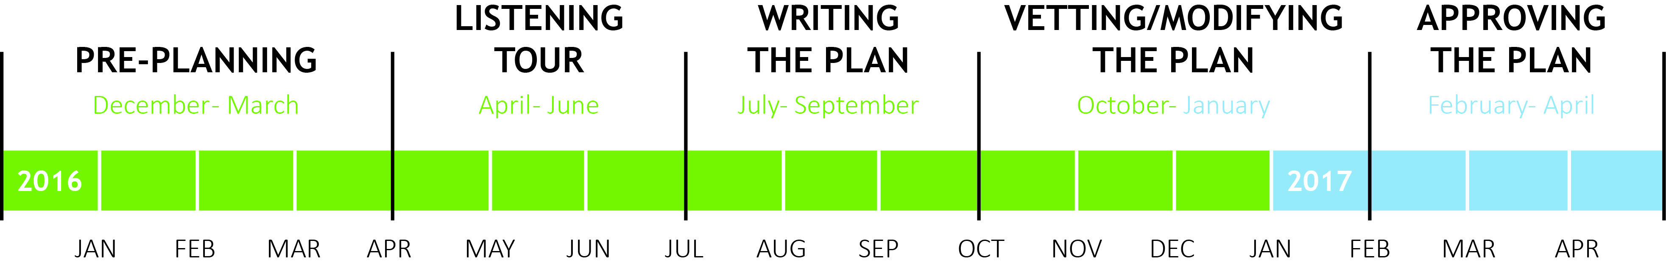
Wrap-Up
Hub Updates
Approval of Meeting Minutes
CDE Updates
Timeline

Slide 124
Upcoming Meeting Dates
Colorado - ESSA State Plan Development – Calendar
December 2016 | January 2017 | February 2017 | March 2017
Hub December 12 10am – 4pm | Hub January 9 10am – 2pm & January 19 12pm – 4pm | Hub February 6 10am to 2pm | Wrap Up and Submission
SBE December 14-15 | SBE January 11-12 | SBE February 8-9 | SBE March 8-9
Spoke Committees: Accountability Assessment Effective Instruction and Leadership School Improvement | Spoke Committees: Accountability Title Programs & Assurances School Improvement | Spoke Committees: All Spokes | Spoke Committees: All Spokes

Slide 125
Meeting Evaluation
What worked?
What would make the
meeting more effective?

Slide 126
Next Meeting
5th ESSA Hub Committee Meeting details
Monday, December 12, 2016
Location: State Board Room -201 E. Colfax Ave., Denver, CO 80203
Time: 10:00 AM – 4:00 PM
Agenda and materials will be provided a week in advance and will also be posted on our website: http://www.cde.state.co.us/fedprograms/essa_stateplandevelopment
Notes:
Presentations from select spoke committees. Tentatively schedule: Stakeholder Consultation/Program Coordination and Title Programs spokes.

