Slide 1









Every Student Succeeds Act (ESSA)
Standards Spoke Committee Meeting #3
September 22, 2016
1

Slide 2
Agenda
Welcome and introductions
Quick review of process
Discuss draft standards section
Q & A
Wrap-up

Slide 3
Welcome and Introductions

Slide 4
CDE Staff
Melissa Colsman, Ph.D, Teaching and Learning Executive Director
Karol Gates, Standards and Instructional Support Director

Slide 5
Standards Spoke Committee Work Plan and Process
5

Slide 6
Process for ESSA State Plan
Development: Standards Section
Committee input for draft outline
CDE drafts outline from input
Committee provides feedback on outline
CDE drafts narrative from outline
Public draft narrative shared with Hub Committee and State Board of Education
Committee provided with public version of draft narrative
CDE revises narrative based on committee feedback
Committee provides feedback on draft narrative
Public draft narrative shared with the public for feedback
Proposed revisions are shared with committee
Final draft narrative completed
6

Slide 7

How and When Will the Standards Spoke Committee Meetings Be Conducted?
Timeline | Tasks
August 18, 3:30 – 4:30 | Informational webinar about the Standards Spoke Committee
August 22 | Sign-up deadline for committee
August 24 | Committee members are announced and added to standards spoke committee webpage Committee members have access to draft outline
August 29; 3:30 – 4:30 | Virtual committee meeting to discuss questions regarding draft outline
September 1 | Input due for section outline
September 8; 3:00 – 4:30 | Virtual committee meeting to review draft outline
September 15 | Committee members have access to the first draft of the section
September 22; 3:00 – 4:30 | Virtual committee meeting to review first draft of the section
September 29 | Feedback due for first draft of the section
October 6 | Committee members have access to second draft of the section
7

Slide 8

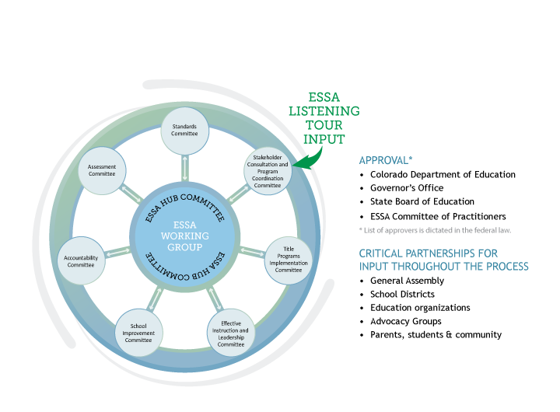




ESSA State Plan Development
8
Notes:
Presenter
2016-09-21 21:56:58
--------------------------------------------
Under the guidance of the State Board of Education, the Colorado Department of Education (CDE) will utilize a Hub/Spoke Committee structure for ESSA state plan development. A formal, central Hub Committee that will have an oversight role in the development of a draft of our state plan to be submitted to the State Board in early 2017.
ESSA topical spoke committees will be responsible for developing and appropriately vetting sections of the state plan. Spoke committees
Standards Committee Assessment Committee Accountability Committee
Effective Instruction and Leadership Committee School Improvement Committee
Title Program Plans/Assurances Committee
Stakeholder Consultation/Program Coordination Committee Spoke committee membership and meeting process
2-3 CDE Leads identified in mid-July. Leads are responsible for keeping the work on track, acting as subject area experts, maintaining records and assignments, organizing spoke work and meetings, and submitting final drafts and decisions points to the Hub.
CDE has a number of existing stakeholder and committee groups that will be called upon as part of this process. For example, the ESEA Committee of Practitioners will be the foundation of the Title Programs group, but we will supplement membership wherever possible and feasible.
Spoke leads are still developing materials; organizing the committee work and schedule; and crafting a work plan timeline. As a result, some committees are closer to finalizing membership than others and it may take some time to completely finalize spoke committee membership. We will make every effort to include all interested applicants and we ask for your patience as we take the time to be as inclusive as possible.

Slide 9
Section Components
Challenging Academic Content Standards and Aligned Academic Achievement Standards.
Alternate Academic Achievement Standards.
English Language Proficiency Standards.

Slide 10
Component A:
Challenging Academic Content Standards and Aligned Academic Achievement Standards
Requirements to address:
Assurance that the state has adopted challenging standards
The standards apply to all public schools
The standards include at minimum the subject areas of mathematics, reading or language arts, and science, and
The standards are aligned with credit-bearing coursework and state career and technical education standards
10

Slide 11
Component B:
Alternative Academic Achievement Standards
Requirements to address:
The alternative achievement standards must…
Be aligned with the state academic standards
Promote access to the general education curriculum
Reflect professional judgment as to the highest possible standards achievable by such students
Be designated in the individualized education program for each such student as the academic achievement standards that will be used for the student
Be aligned to ensure that a student who meets the alternate academic achievement standards is on track to pursue postsecondary education or employment.
11

Slide 12
Component C:
English Language Proficiency Standards
Requirements to address:
The State has adopted English language proficiency standards that…
Are derived from the four recognized domains of speaking, listening, reading, and writing
Address the different proficiency levels of English learners
Align with the State’s challenging academic standards
12

Slide 13
Q&A
Q & A
13

Slide 14
Work Plan Reminder
Timeline | Tasks
August 18, 3:30 – 4:30 | Informational webinar about the Standards Spoke Committee
August 22 | Sign-up deadline for committee
August 24 | Committee members are announced and added to standards spoke committee webpage Committee members have access to draft outline
August 29; 3:30 – 4:30 | Virtual committee meeting to discuss questions regarding draft outline
September 1 | Input due for section outline
September 8; 3:00 – 4:30 | Virtual committee meeting to review draft outline
September 15 | Committee members have access to the first draft of the section
September 22; 3:00 – 4:30 | Virtual committee meeting to review first draft of the section
September 29 | Feedback due for first draft of the section
October 6 | Committee members have access to second draft of the section
14

Slide 15
Wrap Up

