Slide 1
CDE Office Hours
June 24, 2021

Slide 2
CDE Team Introductions!
ESSER/ESEA
Nazie Mohajeri-Nelson, Director of ESEA Office (mohajeri-nelson_n@cde.state.co.us)
DeLilah Collins, Assistant Director of ESEA Office (collins_d@cde.state.co.us)
Kristin Crumley, ESSER Monitoring & Reporting Specialist (Crumley_k@cde.state.co.us)
ESEA Regional Contacts assigned to your district
Fiscal Experts
Jennifer Okes, Chief Operating Officer (okes_j@cde.state.co.us)
Kate Bartlett, Executive Director of School District Operations (Bartlett_k@cde.state.co.us)
Jennifer Austin, Director of Grants Fiscal Management (Austin_j@cde.state.co.us)
Robert Hawkins, Grants Fiscal Analyst (Hawkins_s@cde.state.co.us)
Steven Kaleda, Grants Fiscal Analyst (Kaleda_s@cde.state.co.us)

Slide 3
ESSER Office Hours
Topics
Updates and Reminders
Family, School, and Community Partnerships (stakeholder engagement)
Notes:
Nazie

Slide 4
Updates, Clarifications, and Follow-Ups

Slide 5
REVENUE RECOGNITION and ESSER FINAL APPROVAL
ISSUE
Districts and their auditors have expressed concerns about revenue recognition based on the application of GASB 33. This concern is related to recognizing a receivable and revenue for ESSER expenditures at 6/30/21 FYE, when final approval of budget has not been provided.
RESOLUTION
Eligibility is a requirement in order to recognize federal revenue.
GASB 33 pp 30.d. Government-mandated nonexchange transactions and voluntary nonexchange transactions. Recipients should recognize revenues in the period when all applicable eligibility requirements have been met and the resources are available.
CDE has determined that final budget approval is NOT an eligibility requirement for these Federal Funds. Eligibility is met when CDE verifies that student counts/population and other subaward requirements per statute are met; the awardee is in good standing with the SEA and an allocation has been calculated and ‘obligated’ for the awardee.
The Final Approval of the budget is in fact, an administrative and reimbursement requirement, NOT an eligibility requirement.
Final approval of budget is NOT a trigger for revenue recognition.
60 DAY REVENUE RECEIPT
The 60 day rule doesn’t necessarily apply to all government revenue in the same way. These could be differentiated in an LEA’s finance policy. In fact, one could argue that resource availability could extend to the full period of availability of the federal funds.
GASB FOOTNOTE:
With respect to property taxes only, NCGA Interpretation 3, paragraph 8, as amended, states that ―such time thereafter shall not exceed 60 days. Measurability and probability of collection are discussed in paragraph 11 of this Statement.
Notes:
Steven

Slide 6
Updates and Reminders
Applications Closing on June 30, 2021
  ESSER I – PAR application will close on June 30, 2021 and carryover application will open July 1.
    Any unexpended funds must be carried forward and resubmitted for approval in the carryover application.
    If an approved budget line item has not changed but funds remain to be spent, copy the item over and in the beginning of the description indicate that the item was “Previously Approved”. This will help expedite the review and approval process.
    All unexpended funds being used for a different activity must be submitted for review and approval.
  2020-2021 Consolidated Application PAR will also close on June 30, 2021.
ESSER and ESEA Monitoring Updates
  LEAs that have been identified for ESSER and/or ESEA monitoring in the 2021-2022 school year should have received or will receive a notification this week. The list of LEAs being monitored next year and in future years will be posted on our monitoring websites: https://www.cde.state.co.us/fedprograms/monit/index and https://www.cde.state.co.us/caresact/essermonitor by early next week.
  Later this summer (~August) LEAs participating in monitoring next year will be invited to participate in some front loading trainings about the monitoring process, timeline for submitting evidence, and support on identifying the evidence to be submitted.
    For questions pertaining to monitoring process, please contact Tammy Giessinger (ESEA), Michelle Prael (ESEA), Kristin Crumley (ESSER), DeLilah Collins (ESSER and ESEA), or Nazie Mohajeri-Nelson (ESSER and ESEA).

Slide 7
Updates and Reminders
All districts have substantial approval on ARP ESSER III applications
  Can obligate funds
  Cannot draw down funds until final approval, which requires a submittal of the LEA Plan for the use of funds by December 16, 2021
    Two options:
      Submit full budget and 1 narrative response
      Submit 3 narrative responses by December 16 and budget by March 24, 2022
  LEA Plans require meaningful stakeholder engagement – today’s presentation

Slide 8
Leveraging Funds to Support Engagement Activities
Federal Programs and Office of Family School Community Partnerships

Slide 9
Contact Information
Kristen Collins
Office of ESEA Programs in the Federal Programs Unit
Senior Consultant-Title I Family and Community Engagement & Tile V
720-481-0736 or Collins_K@cde.state.co.us
Darcy Hutchins
Director of Family School Community Partnerships
Hutchins_D@cde.state.co.us

Slide 10

Family, School, and Community Engagement in ESSER III
LEA plans for use of ARP ESSER III must include meaningful stakeholder engagement with the following groups:
  Students
  Parents and Families
  School and District Administrators (including SPED administrators)
  Teachers
  Principals
  School leaders
  Unions
  Tribal organizations
  Civil rights organizations (including disability rights organizations)
  Stakeholder groups representing the interests of children with disabilities, English Learners, children experiencing homelessness, children and youth in foster care, migratory students, youth that are incarcerated and other underserved student populations.

Slide 11
Examples of Engagement Activities
District/School Accountability Committees
Home Visit Programs
Whole Child Supports-Financial Literacy for Parents, ESL For Parents
Math/Literacy Nights
Liaisons
Surveys
Diversify communication modalities

Slide 12
U.S Department of Education Defines Meaningful Engagement
Stakeholder engagement is a core element of the State and LEA planning process for the use of ARP ESSER funds. The Interim Final Rule (IFR) and the ARP ESSER State Plan template include a specific list of stakeholders with which an SEA or LEA must consult. We believe that it is important that each LEA ensures that consultation is broad and represents the diversity of the community within the district.
Stakeholder consultation is essential and we look forward to identifying local practices and sharing across Colorado to amplify best practices on LEAs and schools are engaging the diverse communities that they serve.
American Rescue Plan Elementary and Secondary School Emergency Relief Fund State Plan Requirements: U.S. Department of Education May 6, 2021 https://oese.ed.gov/files/2021/05/ARP-ESSER-Plan-Office-Hours-5.6.21.pdf

Slide 13
Why Family, School and Community Engagement?
Family, school, community partnerships has been proven to have positive outcomes on
  School readiness
  Improve language development
  Literacy & Math achievement
  Social-emotional skills as well as
  High School graduation rates
  Increased attendance/Decrease in habitual truancy
Notes:
Sheldon, S. B. (2003). Linking school-family-community partnerships in urban elementary schools to student achievement on state tests. Urban Review, 35(2), 149–165.
Sheldon, S. B., & Epstein, J. L. (in press-b). Focus on math achievement: Effects of family and community involvement. Journal of Educational Research.
Sheldon, S. B., & Jung, S. B. (2018). Student outcomes and parent teacher home visits. Center on School, Family, & Community Partnerships, Johns Hopkins University. Recuperado de http://www. pthvp. org/wp-content/uploads/2018/12/181130-StudentOutcomesandPTHVReportFINAL. pdf.
if a school as a whole has at least 10% student participation in the home-visit program, the findings are comprehensive of the entire school, not just student receiving a home-visit
Van Voorhis, F. L. (2003). Interactive homework in middle school: Effects on family involvement and students' science achievement. Journal of Educational Research, 96(9), 323–339.
55 years

Slide 14
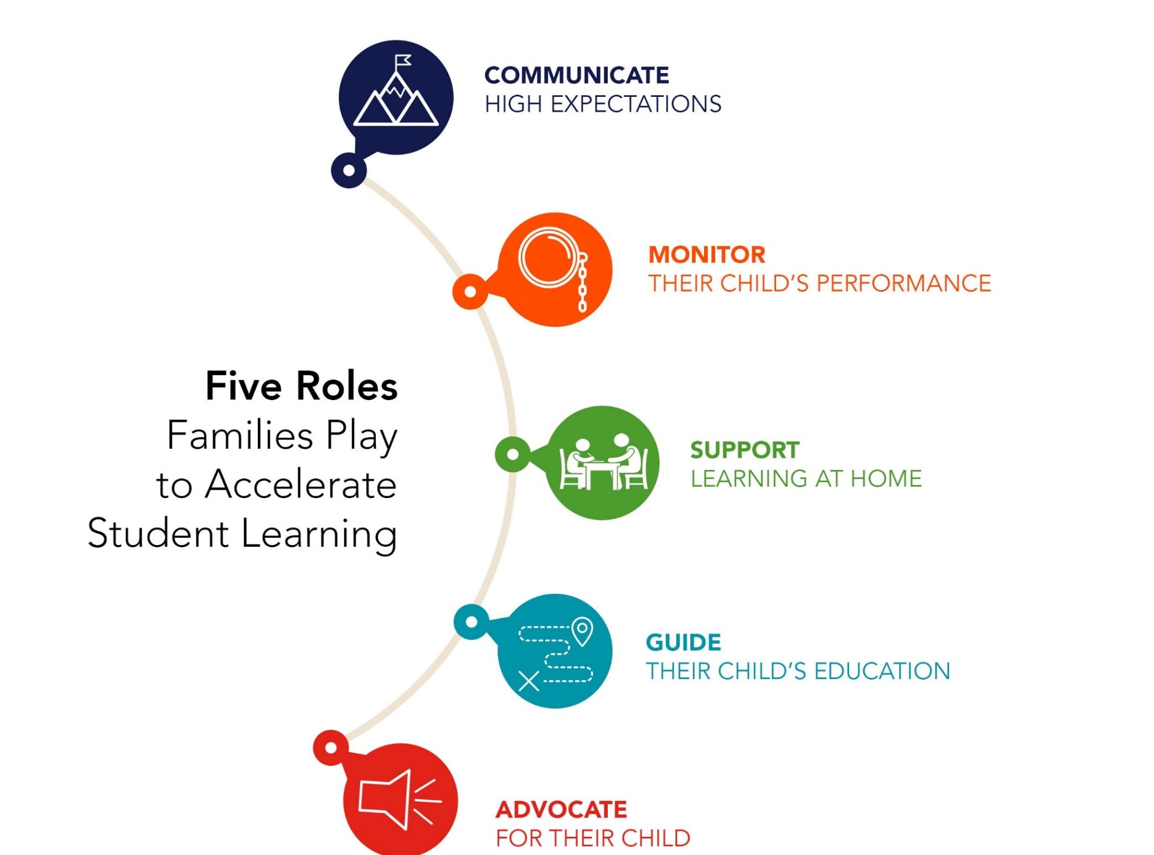
Notes:
2 minutes
Key Messages:
Flamboyan has focused specifically on family engagement for more than 10 years…. Research and practice have taught us that important these five roles are…
The five roles that families play to accelerate student learning are communicate high expectations, monitor their child’s performance, support learning at home, guide their child’s education and advocate for their child.
These 5 roles that come from the literature and research on effective family engagement and provides a clear direction for what effective family engagement aims to achieve.
Effective family engagement is when educators share the information and resources that families need to play these roles well.
For example, it is important for parents to communicate to their children that they have high expectations and that they value education. One very simple but effective way parents do that is by asking children what they learned in school that day. Many of you are parents; when you ask your children what they learned at school today, what do they say? But…If your teacher sends home an email describing that they’re studying ancient Rome that week and suggests a list of three questions, like “ask your child who was his favorite emperor”, then you can have the conversation and do your job communicating the value of learning.
If you get info about how your son or daughter did on the last quiz or test – you can be monitoring and holding kids accountable, but if you don’t find out that they didn’t hand in any homework until the end of the grading period, then you can’t help
All parents play these five roles in some form or another. However, some parents have more access to resources, information, and relationships to play them well than others, and that’s where our focus on students most impacted by inequity is grounded.

Slide 15


Continuum of High Impact FSCP Strategies
Parent training events
Goal-setting talks
Celebrations
Family help on administrative tasks
Relationship building
Regular, personalized communication
Fundraisers
Parent resource rooms
Back to school night
Academic partnering
Family support services
Interactive homework
Positive phone calls home
Home visits
Potlucks
Ongoing communications
Performances & showcases
Generic school newsletters
Data sharing
Modeling of learning support strategies
Notes:
5 minutes
There are no “right answers,” but here is how we look at these strategies in terms of impact on student success.
The family engagement activities that schools often engage in are school-wide, not learning-focused, and require families to come to the school.
“Numbers of participants” is what gets recognized – rather than the increase in a parent’s ability to play the five roles.
If families are being asked repeatedly to come to school but are not getting anything that will help them with what they most care about – educating their individual child, then schools often see the undesired effect of families choosing NOT to attend school events because they feel like their time is wasted.
Ask: What similarities do you notice between the schoolwide impact strategies? What do you notice about the activities on the higher impact side of the chart? What do they have in common? So what can we infer about high impact family engagement?
Emphasize: (Prompt if they don’t say: 1) teacher-led; 2) learning-focused; 3) individualized; 4) they either build relationships or support academic partnering; 5) most of them don’t require the family to come to the school

Slide 16
FSCP Research Review
Anne Henderson & Karen Mapp | Nancy Hill & Diana Tyson | William Jeynes | Patricia B. López, Rebecca A. Alexander, Sera J. Hernandez | Tyler Smith & Susan Sheridan
A New Wave of Evidence: The Impact of School, Family, and Community Connections on Student Achievement. (2002) | “Parental Involvement in Middle School: A Meta-Analytic Assessment of the Strategies That Promote Achievement” Developmental Psychology (2009) | Parental Involvement and Academic Success (2010) Also see 2003; 2005; 2007, 2012; 2017 | “Equity Issues in Parental and Community Involvement in Schools: What Teacher Educators Need to Know.” Review of Research in Education (2013) | “The Effects of Teacher Training on Teachers’ Family-Engagement Practices, Attitudes, and Knowledge.” Journal of Educational and Psychological Consultation (2019)

Slide 17
Leveraging Funds to Support Engagement Activities

Slide 18
Considerations in Leveraging Funding Sources to support FSCP
What is the goal of the proposed engagement activity?
Is the activity going to be implementing in a school identified for Improvement?
Who is the audience benefiting or participating in the activity? I.E. Families, staff, community, students
What is the school or district need that is being addressed by implementing this activity?
Notes:
Overall goal for positive outcomes for students
High level-The WHY

Slide 19
The Elementary and Secondary Education Act (ESEA)

Slide 20
Elementary and Secondary Education Act (ESEA) Programs
Title I, Part A - Improving the Academic Achievement of the Disadvantaged
Title I, Part A is the largest federal program supporting both elementary and secondary education. The program's resources are allocated based upon the poverty rates of students enrolled in schools and districts and are designed to help ensure that all children meet challenging state academic standards.
Title I, Part C - Education of Migratory Children
The Migrant Education Program (MEP) provides supplemental support to eligible migrant children and youth. The purpose of the program is to ensure that migratory children are not penalized in any manner by disparities among curriculum, graduation requirements, academic content and student academic achievement standards, and ensure that migratory children are provided with appropriate educational services and opportunities so they can succeed in school and graduate from high school being postsecondary education or employment ready.
Title I, Part D - Neglected, Delinquent and At-Risk
Title I, Part D provides funds for youth in state-operated institutions. It also provides assistance to school districts who work with local correctional facilities. Colorado receives formula funds based on the number of students in state institutions and costs per pupil.
Title II, Part A - Educator Quality
Title II, Part A of the Every Student Succeeds Act (ESSA) of 2015 is intended to increase student academic achievement consistent with challenging State academic standards, improve the quality and effectiveness of educators, increase the number of educators who are effective in improving student academic achievement in schools, and provide low-income and minority students greater access to effective educators.
Title III - English Learners
Title III is designed to improve the education of limited English proficient (LEP) students by helping them learn English and meet challenging state academic content and student academic achievement standards. The program provides enhanced instructional opportunities for immigrant students.
Title IV, Part A - Student Support and Academic Achievement
Title IV, Part A of the Every Student Succeeds Act of 2015 is intended to improve students’ academic achievement by increasing the capacity of States, local educational agencies (LEAs), schools, and local communities to provide all students with access to a well-rounded education, improve school conditions for student learning, and improve the use of technology in order to improve the academic achievement and digital literacy of all students.
Title V Part B - Rural Education Initiative
Title V, Part B of the Every Student Succeeds Act of 2015 (ESSA) is intended to address the unique needs of rural school districts that frequently lack the personnel and resources needed to compete effectively for Federal competitive grants and receive formula grant allocations in amounts too small to be effective in meeting their intended purpose.
Title VI - Indian, Native Hawaiian and Alaska Native Education
Title VI works with local educational agencies, Indian tribes and organizations, postsecondary institutions, and other entities toward the goal of ensuring that programs that serve Indian children are of the highest quality and provide for not only the basic elementary and secondary educational needs, but also the unique educational and culturally related academic needs of these children

Slide 21
Elementary and Secondary School Education Relief Funds
ESSER I, II & III

Slide 22
Elementary and Secondary School Education Relief Funds
The various ESSER funding opportunities have provided financial assistance to education entities to address the needs that have arisen due to COVID-19
Examples of Engagement Activities using ESSER:
  Provide technology access and guidance to families and educators.
  Invest in professional learning for all educators to understand families in their community contexts and needs they face.
  Invest in data systems that allow schools to better track family needs, student attendance, and provide families with better access to real-time learning data, opportunities to understand the data, and make the data actionable.
  Hire new staff whose specific role is family and community engagement (e.g., parent liaisons, coordinators, etc).
  Hire social workers who can connect with families and make referrals and community connections and provide counseling
Notes:
Hire new staff May-Coffee Chat 3rd Friday of the Month

Slide 23
Empowering Action for School Improvement (EASI)

Slide 24
Empowering Action for School Improvement (EASI)
The Exploration route of the Empowering Action for School Improvement (EASI) application is focused on identifying needs and exploring options through external reviews, stakeholder engagement, and effective planning. There are several offerings to assist LEAs identifying areas of strength and need (External Review), building a plan centered around those prioritized needs (Improvement Planning) as well as how to engage a variety of stakeholders in improvement conversations (Stakeholder Engagement). The EASI application also offers the opportunity for LEAs/schools to explore their school systems centered on a particular population of students or areas (i.e., English Learner, AEC, and Literacy).

Slide 25
Resources
National Association for Family, School and Community Engagement (NAFSCE) Equity, Relationships, and Learning: Opportunities for FSCP within the American Rescue Plan
EASI-Stakeholder Engagement in Improvement Planning
Title I, Part A Parent and Family Engagement
Examples of FSCP Activities Implemented during COVID
The American Recovery Plan-Stakeholder Engagement
Promising Practices
  COVID Specific PPPs
Coffee Chats
P-12 Framework
  Rubric & Resource Guide (ENG)
  Rubric & Resource Guide (Español)
SAC/DAC Network Series

Slide 26
QUESTIONS?

Slide 27
CDE Team Introductions!
ESSER/ESEA
Nazie Mohajeri-Nelson, Director of ESEA Office (mohajeri-nelson_n@cde.state.co.us)
DeLilah Collins, Assistant Director of ESEA Office (collins_d@cde.state.co.us)
Kristin Crumley, ESSER Monitoring & Reporting Specialist (Crumley_k@cde.state.co.us)
ESEA Regional Contacts assigned to your district
Fiscal Experts
Jennifer Okes, Chief Operating Officer (okes_j@cde.state.co.us)
Kate Bartlett, Executive Director of School District Operations (Bartlett_k@cde.state.co.us)
Jennifer Austin, Director of Grants Fiscal Management (Austin_j@cde.state.co.us)
Robert Hawkins, Grants Fiscal Analyst (Hawkins_s@cde.state.co.us)
Steven Kaleda, Grants Fiscal Analyst (Kaleda_s@cde.state.co.us)

