Slide 1
CDE Office Hours
May 12, 2022

Slide 2
ESSER Office Hours
Topics
Updates and Reminders
  USDE Monitoring of SEAs
  Consolidated Application Deadlines
    Non-public School Consultation and School Improvement Retention Forms
    20-21 PAR Deadline
  Deadline to Draw Down Funds by End of Fiscal Year
  ESSER III Supplemental Award Deadlines
  Cons App In-Person Work Sessions
ESSER Expanded Learning Opportunities (ELO) Grant Program
Notes:
Nazie

Slide 3
Updates, Reminders, and Clarifications
Notes:
Nazie

Slide 4
ESEA/ESSA Updates
Consolidated Application and U.S. Department of Education Monitoring of CDE

Slide 5
21-22 Consolidated Application PAR
2020-2021 Consolidated Application PAR requests must be submitted by June 15, 2022.
  Any outstanding comments from previously submitted PAR requests must also be addressed by June 15, 2022.
If you want to draw down funds prior to the end of the fiscal year, CDE must receive your Request for Funds (RFF) by June 1.
Reminder: Draw down funds before they expire!!!

Slide 6
22-23 Consolidated Application Updates
Now open and accepting applications!
  Online application
  Requires a login username and password through the CDE Identity Management System; work with your Local Access Manager (LAM)
Non-Public Consultation form and the School Improvement Retention of Funds form are both available on the website and are due on May 31st.
  These will need to be uploaded in the application.
Applications are due June 30, 2022!
For questions or assistance, please contact your ESEA Regional Contact.

Slide 7
Reminders ~ in Preparation for the Consolidated Application Submission!
Coordinate with early childhood centers to plan transition of preschool students to Title I, Part A schools.
Declare participation in Community Eligibility Provision to School Nutrition, if applicable. CEP is an optional poverty measure used for serving Title I schools.
Evaluate English learner redesignation status including ELs with disabilities.
Have LEA budget discussions that include staff assignments to ensure compliance with Title I, Part A comparability and EDT requirements for the following school year.
  Ensure students of poverty and minority students have access to experienced, effective educators teaching in-field.
  Ensure comparable services in Title I v. non-Title I schools.
  Ensure decisions about state and local funds are neutral of school’s Title I status.
Plan and collaborate with local neglected or delinquent facilities to plan activities for Consolidated Application, if applicable.
Attend Consolidated Application trainings.

Slide 8
Upcoming In-Person Consolidated Application Work Sessions
CDE staff will be available to walk you through filling out the application and answer any questions you have.
Metro Region: Friday, May 13 from 9:30-12:30 at Bemis Public Library in Littleton – Register Here
North Central and Northeast: Thursday, May 19 from 12:30-3:30 at Greeley School District Family Center – Register Here
Southwest: Thursday, May 19 from 8:30-11:30 at Durango School District Administration Building – Register Here
Northwest and West Central: Wednesday, May 25 from 8:30-11:30 at Basil T. Knight Center in Grand Junction – Register Here
Notes:
Shannon

Slide 9
Upcoming Training
Equitable Distribution of Teachers Series Training #4: Building an EDT Plan
This training helps LEAs build an EDT plan that addresses gaps and adequately answers the EDT question of the Consolidated Application.
Target Audience: LEAs with medium or large EDT gaps (district leadership, HR, hiring managers, principals); LEAs with small gaps also welcome.
Prep: LEAs will need access to their 20-21 EDT data from Syncplicity. Recommended to watch the recording of at least training #3 of the EDT Training Series and come to the training with some possible strategies to address gaps ready.
Date: Tuesday, May 31, 2022
Time: 10am-12pm
Register HERE
Agenda
Small vs Med/Large Gaps
Alternative Calculator Assurance
Walkthrough of the EDT Plan Narrative Question
EDT Monitoring Indicators
Contact Wilson_S@cde.state.co.us for any logistics questions or Kaloudis_N@cde.state.co.us with questions about the training.
Notes:
Shannon

Slide 10
U.S. Department of Education (USDE) Targeted Monitoring of Colorado Title I
USDE monitoring:
  Comprehensive - full federal program
  Targeted - focused on a specific component of a federal program
  Universal - broad oversight of a federal program
Colorado has been selected for targeted monitoring on Title I
  Area of focus:
    Resource Allocation Review -
      CDE’s oversight of LEA’s resource allocations to ensure that equitable access to resources for high poverty/high need schools, particularly those identified for Comprehensive (CS) or Additional Targeted (ATS) Support and Improvement under ESSA
  Timeline:
    Desk Review in June 2022
    Self-assessment and evidence submitted to USDE on May 6, 2022
What will this mean for our LEAs?
  No LEAs selected for participation
  No evidence or documentation asked of or on behalf of LEAs
  Evaluating CDE’s oversight; could have long-term implications on LEAs if we have findings
Notes:
Nazie

Slide 11
ESSER Updates
Application and U.S. Department
of Education Monitoring of CDE

Slide 12
Use of Funds Plans Update
For all LEAs that received a 90% allocation of ESSER III funds, the Safe In-Person and Use of Funds plans are due May 13th.
The Use of Funds plan requirements can be fulfilled by posting a PDF of your budget on your website.
The Safe In-Person plan must follow the requirements listed on the previous slide.
Please submit the URLs for both via the Smartsheet form.
CDE has received Safe In-Person plans from 166 LEAs and Use of Funds plans from 115 LEAs.
Notes:
Mackenzie

Slide 13
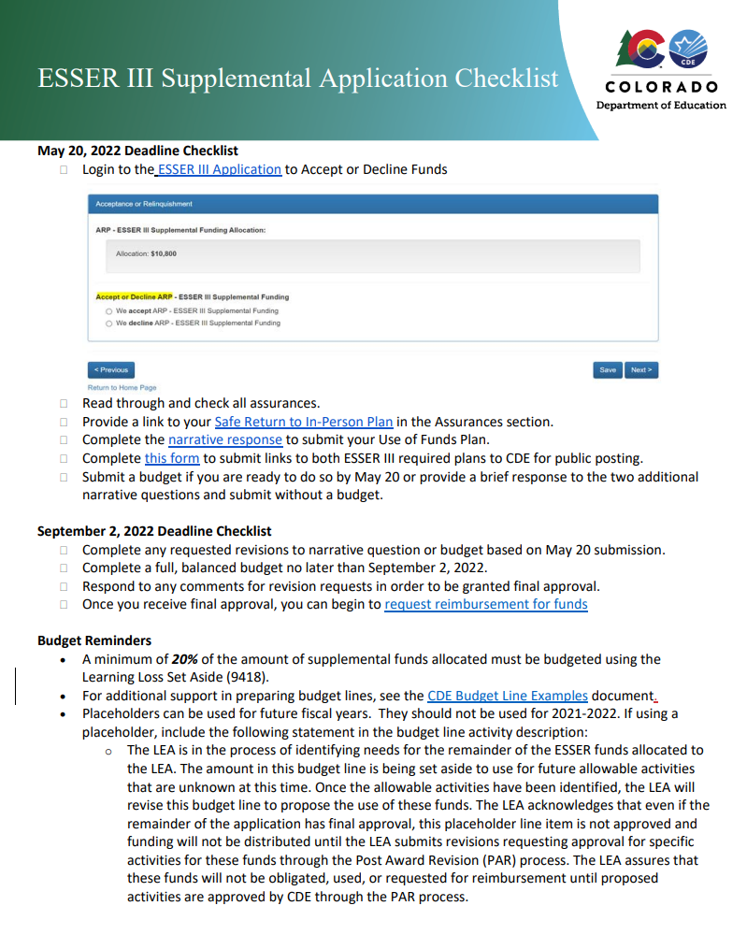
ESSER III LEA Plans for Supplemental Funds
Due May 20 for Supplemental Funds (with separate applications)
Safe In Person Plan
Use of Funds Plan
For LEAs who received additional supplemental funds:
Use of Funds plan must include how you are using your supplemental funds
Please submit hyperlinks to your Use of Funds Plan using this form by May 20
New Resource: ESSER III Supplemental Application Checklist
Notes:
Mackenzie
Focusing on supplemental funds with a separate application.
For districts who received additional supplemental funds, they should already have these submitted with the original

Slide 14
ARP ESSER III Supplemental Funds Clarifications!
Deadline Clarification - For recipients of Supplemental Awards under ARP ESSER III:
LEA Use of Funds Plans - Due May 20, 2022
  Narrative Questions OR
  First narrative questions + full budget
If did not submit full budget as part of LEA Use of Funds Plan on May 20th, must submit full budget by September 2, 2022
Grant Recipients - ARP ESSER III Supplemental
BOCES
Administrative Units
Facility Schools
Districts with low or no allocation under the 90%
ARP ESSER III 90% Allocation Recipients = Districts based on Title I Allocations
Notes:
Mackenzie

Slide 15
Resources to support meeting this May 20 Deadline
Safe Return to In-Person Instruction Plan (Safe Return to School) Checklist
For guidance on how to answer Narrative Question 1, see CDE's Narrative Question Guidance or see the office hours presentation and slides (PPT) from August 26, 2021.
For guidance on how and what to post on the LEA website to meet statutory requirements, see the Use of Funds Plan Guidance (PDF).
List of LEA Plans
Full list of deadline and additional resources
Notes:
Mackenzie

Slide 16
Reporting Reminder
All LEAs received an ESSER survey question about student engagement and if you allocated ESSER funds in 2020-2021 to schools, including charters, you also received a survey question about method used to determine school allocations.
Thank you to those of you who have already submitted your ESSER data on student engagement and school level allocations.
If you have not yet submitted, please submit data by May 27, 2022!
Notes:
Mackenzie

Slide 17
U.S. Department of Education (USDE) Universal Monitoring of ESSERs I, II, & III
USDE monitoring:
  Comprehensive - full federal program
  Targeted - focused on a specific component of a federal program
  Universal - broad oversight of a federal program
Colorado has been selected for universal monitoring of ESSER; Quarterly meetings with Program Officer
  Area of focus:
    May 2022 Meeting -
      CDE’s oversight of the 20% Set Aside and LEA Uses of Funds Plans
  Timeline:
    Desk Review on May 5, 2022
    Self-assessment and evidence submitted to USDE on April 21, 2022
What will this mean for our LEAs?
  No LEAs selected for participation
  No evidence or documentation asked of or on behalf of LEAs
  Evaluating CDE’s oversight; could have long-term implications on LEAs if we have findings
    Area of concern - LEA plans not available on the CDE website
    More to come when we receive our monitoring report
Notes:
Nazie

Slide 18
ESSER Expanded Learning Opportunities (ELO) Grant Program
Pursuant to the American Rescue Plan of 2021
May 2022
Notes:
Introduce Speakers - Spencer Ellis

Slide 19
Introduction
Significant interruptions to in-person learning due to the COVID-19 pandemic have led to potentially devastating and long-lasting negative impacts on student achievement, impacting every part of Colorado society. These negative impacts on student achievement are not equal; students furthest from privilege are at risk of the most opportunity loss. Research suggests that while all students may fall behind as much as seven months because of interruptions to in-person learning due to the COVID-19 pandemic, students who are identified as most in need may fall behind as much as ten months, exacerbating already entrenched inequities. Responding to learning opportunity loss and the widening of opportunity gaps could be the greatest challenge our state faces over the next few years, and the state has an urgent and immediate need to provide additional support to ensure students are well prepared for the future.
As Colorado students and families continue to recover from the impacts of the COVID-19 pandemic, the Colorado Department of Education seeks to support and empower students and families across the state through a coordinated, comprehensive, and consistent community approach. The pandemic has exposed and exacerbated the academic and personal challenges many students face. Helping them overcome those challenges requires not only the efforts of educators during the school day but also the efforts of student-centric afterschool and summer programming.
As such, the Colorado Department of Education (CDE) is creating a grant program that will support districts and community-based organizations (CBOs) in creating new or expanding existing expanded learning opportunities (ELOs). This program will be funded under the Elementary and Secondary School Emergency Relief (ESSER III) state reserve.
Notes:
Spencer

Slide 20
Purpose and Program Activities
This program exists to distribute funds to qualified applicants, pursuant to the American Rescue Plan requirements for the state education agency to reserve 1% of the state set aside to fund evidence-based comprehensive afterschool programs and an additional 1% to fund evidence-based summer enrichment programs, to create expanded learning opportunities that address students’ academic and personal needs, ensure families can continue to engage in and support their students’ learning, and ultimately continue to strengthen schools and communities during COVID-19 recovery.
This funding opportunity seeks to accelerate student learning and strengthen student engagement in that learning by:
Providing students with comprehensive out-of-school time programs, including after school and during the summer, that build upon a student’s school-day instruction to provide the continuity necessary to meet their academic, social, emotional, and mental health needs exacerbated by the COVID-19 pandemic.
Providing students a safe and healthy environment where additional educational enrichment services, programs, and activities are offered to students, particularly those who are disproportionately adversely affected by the COVID-19 pandemic.
Offering families of students served opportunities for active and meaningful engagement in their children’s education, to ultimately positively impact student academic outcomes.
Providing students and their families with a deeper connection to their school and community, allowing them to understand and take advantage of the full breadth of school and community supports and opportunities available to them.
The following are projected outcomes of this funding opportunity:
Expanded capacity for districts and community-based organizations to leverage after school and summer programming to accelerate the completion of lost or unfinished learning; and
Strengthened student engagement in learning–both in the traditional school day and out.

Slide 21
Eligible Applicants
Eligible entities may apply for this funding opportunity. The term “eligible entity” means:
A public local educational provider (LEP) including:
  A school district on behalf of all or a subset of schools (including charter schools);
  A Board of Cooperative Educational Services (BOCES);
  The Charter School Institute (CSI), including on behalf of a charter school or schools authorized by CSI;
  A Facility School; and
  The Colorado School for the Deaf & Blind.
A public library;
A Colorado community-based organization (CBO);
An Indian tribe or tribal organization (as such terms are defined in section 4 of the Indian Self-Determination and Education Act (25 U.S.C. 450b)); and
Institutions of higher education or other public agencies/entities.
Note: A group of two or more such agencies, organizations, or entities (listed above) is eligible to apply as a consortium.

Slide 22
Priority Consideration
This program is designed to support eligible applicants in creation and/or expansion of expanded learning opportunities through after school and summer programming. Available grant funding will be distributed to eligible applicants based on the application rubric described below in “Application Scoring”. Priority will be given to applications meeting the following priority considerations:
The application identifies one or more of the following student groups as the target student population for the programming and describes as an actionable plan for engaging those students in the program:
  Students most impacted by the pandemic, including students from low-income families, children with disabilities, students with limited English proficiency, racial and ethnic minorities, migrant students, students experiencing homelessness, foster care youth, and highly mobile students;
  Students who have become disengaged from school and/or dropped out of school (out-of-school youth);
  Students who may be at risk for academic failure and/or at a high risk of dropping out; and/or
  Other students disproportionately affected by COVID-19 (as demonstrated by description and evidence provided by applicant).
At least one district served by the application is identified as rural or small rural.
The application clearly identifies evidenced-based programmatic outcomes related to accelerating learning or increasing student achievement in the areas of English language arts, mathematics, and/or English language proficiency.
The application includes programs and activities for students and their families proposed in the application.

Slide 23
Available Funds
ARP ESSER requires that each SEA use 1% percent of the state set aside funds to fund evidence-based summer enrichment programs and 1% of the state set aside funds to fund evidence-based summer enrichment programs.
The Colorado Department of Education will be making up to a total of $10 million of ARP ESSER III funding available for this program for these two purposes. Eligible applicants are invited to submit applications that meet the needs of their program(s) with a maximum of $2 million per application (inclusive of all programs identified within the application). Additionally, program budgets should not exceed $2,000 per student served annually by the program, which takes into account all program costs (e.g., administrative, programming, and transportation costs).
Applicants will be notified of the award no later than September 1, 2022. Funds will be awarded for the performance period starting on July 1, 2022 and ending no later than September 30, 2024. Funding requests should include the entire performance period. Funded awardees are eligible to be reimbursed for allowable grant activities starting no later earlier than July 1, 2022. Please note that costs associated with grant writing and submission of grant application are unallowable.
Applications must adequately align the proposed use of funds in the budget and budget narrative. There will be no carryover of funds allowed past the performance period. The “supplement and not supplant” requirements do not apply to use of ESSER funds under this funding opportunity. However, while the supplement and not supplant requirements of ESEA do not apply to ESSER funds, an applicant that uses ESSER funds to pay for activities previously supported under a program that is subject to the supplement and not supplant requirements may be negatively impacted. Additionally, applicants using ESSER funds to address state or local revenue losses may have implications for Maintenance of Effort (under ESEA and IDEA) and Maintenance of Equity (under ARP ESSER III).
Grantees are not allowed to charge program participants membership or participation fees (weekly, annual, etc.). In addition, grantees are not allowed to generate program income from the program funded with this grant opportunity.

Slide 24
Allowable Uses of Funds
Program Types
Various program types are allowed under this application, depending on when grant-funded activities will occur and which program model applicants wish to include. Applicants may choose one or more of the following program types to include in their application.
After school programs (i.e., programs that occur within the traditional school year but outside of the traditional school day) including, but not limited to:
Extended school days;
5th-day academies;
Tutoring programs;
Saturday programs; and
Community-based afterschool academic and enrichment programs.
Summer programs (i.e., programs that occur outside of the traditional school year) including, but not limited to:
Summer camps;
9th grade academies;
Intersession programs;
Summer credit recovery programs;
Summer library literacy programs; and
Back to school academies (e.g. jump start programs).

Slide 25
Allowable Uses of Funds
(Continued)
Program Focus
Applicants may choose one or more of the following academic or social, emotional, and mental health (SEMH) focus areas to include in their application.
  Academic Needs: Mathematics - Accelerating learning or strengthening student achievement in mathematics.
  Academic Needs: English language arts - Accelerating learning or strengthening student achievement in English language arts.
  Academic Needs: English language proficiency- Accelerating learning or strengthening student achievement in English language proficiency.
  Academic Needs: Other - Accelerating learning or strengthening student achievement in other academic areas including, but not limited to, STEM (Science, Technology, Engineering, and Mathematics) or STEAM (Science, Technology, Engineering, Arts, and Mathematics), social studies, civics, the arts, and physical education.
  SEMH Needs: Engaging disengaged youth - Programs that seek to engage and/or re-engage youth that have dropped out of school, stopped attending school, or have otherwise become disengaged from the school and their learning.
  SEMH Needs: Engaging families in learning - Programs that engage families in the learning of students.
  SEMH Needs: Other - Any other evidence-based program that meets the social, emotional, and/or mental health needs of the students served by the program.

Slide 26
Allowable Uses of Funds
(Continued)
Allowable Use of Funds
Each eligible entity that receives a grant award may use the award funds to carry out a broad array of activities through in-person (when health guidelines allow), virtual, remote or hybrid models of programming. Attachment A provides a non-exhaustive list of allowable programs/activities.
Examples of unallowable activities/costs include, but are not limited to:
  Pre-award costs (those incurred before the grant effective date–indicated on the Grant Award Letter–including preparation of the initial grant application);
  Services that duplicate or supplant those provided by the Colorado Talking Book Library;
  Non-academic/entertainment programming;
  Food for staff;
  The purchase or rehabilitation of real estate and other real property.
These funds are specific to this program, the ESSER Expanded Learning Opportunities Grant Program, and uses of funds for any other purpose are not allowed. Please review the ESSER Allowable Uses document for further clarity. If you have any questions regarding allowable expenses, please reach out to Evan Davis (davis_e@cde.state.co.us) for assistance.

Slide 27
Duration of Grant
Funds awarded through this program are available as of the date of the Grant Award Letter (July 2022) and must be expended no later than September 30, 2024.

Slide 28
Evaluation and Reporting
Each applicant receiving funding through the ESSER Expanded Learning Opportunities Grant Program is required to report, at a minimum, the following information to the Department on or before July 31 following each school year for which an applicant has received funding:
  A description of the status of planned activities (e.g., completed, in progress);
  Any adjustments made to the LEP’s program plan and the reason adjustments were made;
  The number of students served by the applicant’s program(s) (separated by program);
  The staff and positions recruited, reassigned, hired, or provided professional development to support the program;
  Any student outcomes (including, but not limited to, academic outcomes, student engagement outcomes, and school climate outcomes) identified through the implementation of the program(s) (separated by program); and
  A description of the measurable student outcomes (including academic, social and/or emotional outcomes), disaggregated by student groups, and whether the expected result of the activities described in the plan were met.
Additionally, per H.B. 21-1259, CDE will be streamlining reporting requirements for this grant program and other expanded learning opportunities grants funded by state or ESSER funds. This single reporting system will require grant recipients to submit once annually for all students participating in any of these additional supports, along with information regarding their type and level of participation.
LEPs receiving funding will also be required to submit Interim Financial Reporting and Annual Financial Reporting. Details and formats for all reporting will be provided upon award and as part of the budget workbook and/or grant award letter (GAL).
Notes:
Spencer

Slide 29
Technical Assistance
Several types of technical assistance are offered to all potential applicants to encourage high-quality applications. All of these technical assistance opportunities are available at no cost to applicants. Resources include:
  Office hours will occur during the regularly scheduled ESEA Office Hours which are held biweekly on Thursdays from 2:00 to 3:30pm. Dates of ELO Office Hours will be posted on the ESSER Expanded Learning Opportunities (ELO) Grant Program webpage.
  CDE will, on the ESSER Expanded Learning Opportunities (ELO) Grant Program webpage, provide a regularly updated list of Frequently Asked Questions (FAQs) to support applicants in quickly addressing questions that might arise.
If interested in applying for this funding opportunity, submit the Intent to Apply by Friday, May 13, by 11:59 pm MDT. The Intent to Apply is encouraged, but not required to submit an application.
Notes:
Kim

Slide 30
Application Contacts
Program Questions:
Spencer Ellis, High Impact Tutoring Program Manager
720-237-3306 | ESSERelo@cde.state.co.us
Budget/Fiscal Questions:
Evan Davis, Federal Fiscal Grants Supervisor davis_e@cde.state.co.us
Application Process Questions:
Kim Burnham, Grants Program Administration
(720) 607-1495 | CompetitiveGrants@cde.state.co.us

Slide 31
Upcoming Meetings
Notes:
Nazie

Slide 32

Any Requests for Upcoming Topics or Questions!
Upcoming Office Hours
May 26
  ESSER III Evidence-Based Interventions
  IDEA Maintenance of Equity and Other Requirements for ESSER Fund Recipients
June 9
  GEPA Requirements for ESSER Grants
Notes:
Nazie

Slide 33
CDE Contacts!
Emails: Lastname_Firstinital@cde.state.co.us
(e.g., Smith_a@cde.state.co.us)
Federal Programs & Supports (ESEA/ESSER Program Supports) | School Finance & Operations (Fiscal and Systems Supports)
Nazie Mohajeri-Nelson, Federal Programs & Supports Unit ESEA Programs Specialists and ESEA Regional Contacts (assigned by district) Title I: Laura Meushaw, Kathryn Wisner, Niko Kaloudis, Evita Byrd Title II: Niko Kaloudis, Karen Bixler Title III: Kathryn Wisner, Rachel Temple Title IV: Tammy Giessinger Title V: TBD ESEA and ESSER: Shannon Wilson ESSER Program Monitoring Specialists Kristin Crumley Jonathan Schelke Kim Boylan ESEA and ESSER Data and Reporting Specialists Tina Negley Alan Shimmin Mary Shen Mackenzie Owens | Kate Bartlett, Executive Director of School District Operations Unit Fiscal Specialists Jennifer Austin, Director of Grants Fiscal Management ESEA Robert Hawkins, Grants Fiscal Analyst Steven Kaleda, Grants Fiscal Analyst ESSER Fiscal Specialist Steven Kaleda Grants Fiscal Analyst ESSER Monitoring Bill Parsley, ESSER Fiscal Monitoring Supervisor Hilery Morris, ESSER Fiscal Monitoring Application Systems Specialists DeLilah Collins, Director of Grants Program Administration Online Applications Systems Technical Support Michelle Prael
Notes:
Nazie

