Slide 1
CDE Office Hours
December 1, 2022

Slide 2
ESSER Office Hours
Topics
Updates and Reminders
Safe Return to In-person Instruction Plans
Setting up Implementation Plans that Strengthen an ESEA Investment
Monitoring Updates and Q&A
Notes:
Nazie

Slide 3
Updates, Reminders, and Clarifications
Notes:
Nazie

Slide 4
Updates and Reminders
ESSER online applications are used for reporting and evaluation purposes
Request to fill in gaps or make updates
Public reports on uses of and impact of stimulus funds
Nutrition Office Resources on Healthy School Meals for All
Frequenlty Asked Questions Document
Webinar PPT slides
Healthy Meals for All webinar 11.17.22

Slide 5
Safe Return to In-Person Instruction Plans
Notes:
Kim

Slide 6
ESSER III Safe Return to In-Person Instruction Plans
“…during the period of the ARP ESSER award established in section 2001(a) of the ARP Act (i.e., until September 30, 2023), an LEA must periodically, but no less frequently than every six months, review and, as appropriate, revise its plan.”
If the plan is still up-to-date, simply post “Reviewed on xx/xx/2022(3)” on the LEA’s website.
When submitting a PAR, please check the link posted within the “Fiscal, Program and Reporting Assurances” section of the application and update, if necessary.
For more information, please see SE 7. 1 in the Monitoring Program Requirements.
Notes:
Quick reminder that ESSER III Safe Return to In-Person Instruction Plans are a Stakeholder Engagement Requirement, SE 7.1, that includes “during the period of…”. Going forward, a good rule of thumb would be, when you’re submitting a PAR, please check the link you provided within the Fiscal, Program and Reporting Assurances section of the application. Review what is posted, and if the plan is still effective, please simply include a “Reviewed on such-and-such date”. Perhaps it would be helpful to check at the start of the school year, and after the winter break.

Slide 7
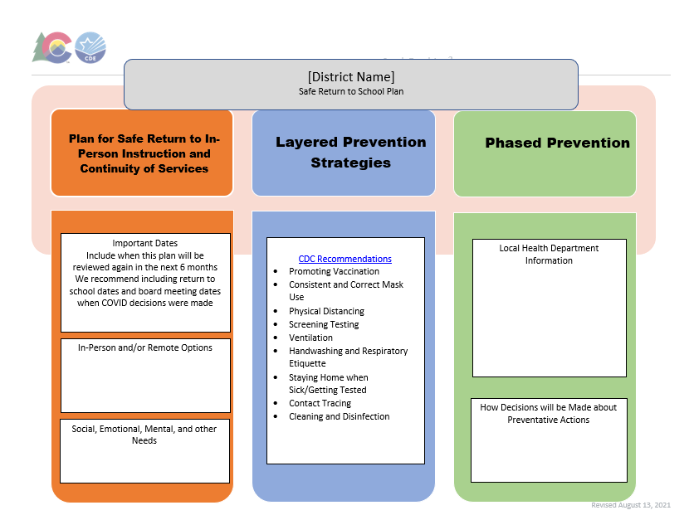
ESSER III Safe Return to In-Person Instruction Plans
Link to LEA Plans
Safe Return to In-Person Instruction Plan Checklist
Safe Return to In-Person Instruction Plan Template
Notes:
These links can help you check if your plan is meeting the program requirements, and under “Quick Links”, you can download a template (seen here) to update your plan, the template does include the 3 major components of what’s required. I’ll pause now for any questions… Please don’t hesitate to reach out to your ESSER Contact if you have any questions. Thank you!

Slide 8
Implementation Plans to Strengthen an ESEA Investment
Notes:
Evita & Nazie

Slide 9
Implementation Plan to Strengthen ESEA Investments
It is a best practice to develop an implementation plan before initiating an allowable activity funded by ESEA federal funds. According to Non-Regulatory Guidance: Using Evidence to Strengthen Education Investments, "An implementation plan, developed with input from stakeholders, sets up SEAs, LEAs, and schools for successful implementation" 119 LRP 48032 (EDU 09/16/16). The implementation plan could include:
· A logic model informed by research or an evaluation suggesting how the intervention will likely improve relevant outcomes.
Reference: Tiegen, A. (2022, October 5). Do set up implementation plan to strengthen an ESEA investment. Title1Admin®.com. Retrieved October 6, 2022, from https://www.title1admin.com/TI2/index.jsp?contentId=22743413
Notes:
Evita

Slide 10
Implementation Plan to Strengthen ESEA Investments
· Well-defined and measurable outcomes.
· Clearly defined roles and responsibilities for people involved at all levels of the project.
· Timelines for successful execution.
· Resources needed to support the intervention.
· Monitoring, evaluation, and data collection strategies.
Reference: Tiegen, A. (2022, October 5). Do set up implementation plan to strengthen an ESEA investment. Title1Admin®.com. Retrieved October 6, 2022, from https://www.title1admin.com/TI2/index.jsp?contentId=22743413
Image by vectorjuice on Freepik.com
Notes:
Evita

Slide 11
Program Evaluation
Purpose: Examine the program (implementation) to determine if desired outcomes are reached/achieved; helps with decision making on how to refine and improve the program; and allows answering questions about the value of programs and the investments being made.
Cycle: Planned, iterative, and includes feedback loops
Logic Model - graphical representation of a program that promotes shared understanding and explicit connections between program components
Evaluation Questions
Develop Methodology
Data Collection and Analysis
Results
Dissemination and Use of Results to Inform Programmatic Decisions
Formal? Comprehensive? Process? Outcome?
Notes:
Nazie

Slide 12
Program Evaluation Training Modules and Resources
Co-developed with Marzano Research
Five Modules:
Logic Models and Evaluation Questions
Assessing the Availability and Quality of Existing Data
Identifying and Developing Data Collection Instruments
Coding, Cleaning, and Analyzing Data
Interpreting and Presenting Findings
Request individualized training or technical assistance by emailing Nazie Mohajeri-Nelson or Tina Negley
Notes:
Nazie

Slide 13
Monitoring
Update and Q&A
Notes:
Tammy

Slide 14
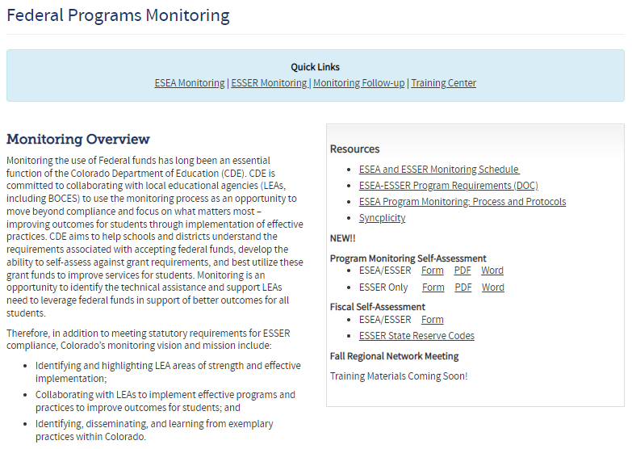
Self-Assessments Update
The Program Monitoring and Fiscal Self-Assessments are now available on the Monitoring website.

Slide 15
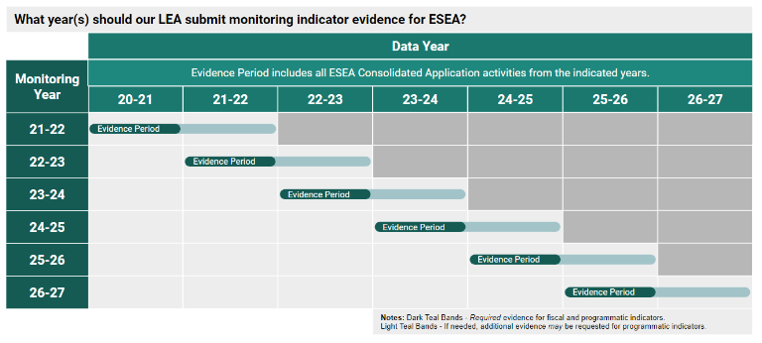
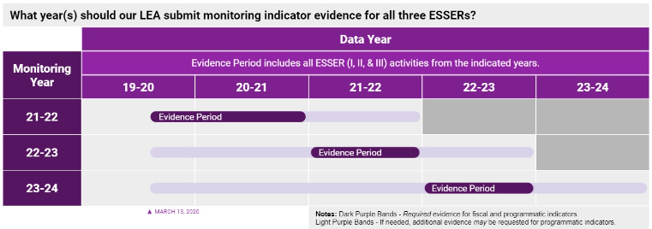
Fiscal Year Reminders
To clarify, Fiscal is looking for all of your FY22 ESSER expenditure activity (and ESEA if applicable).

Slide 16
Monitoring Status Poll
Our LEA has completed and submitted both the program and the fiscal monitoring self-assessments.
Our LEA has completed and submitted one of the self-assessments.
Our LEA is working on one or both of the self-assessments.
Our LEA has not started either of the self-assessments.
Our LEA is not being monitored this year.

Slide 17
Time for Q&A
I need help with…
I would like CDE to provide…
I am wondering…
I would like to share…

Slide 18
Upcoming Meetings
Notes:
Nazie

Slide 19
Any Requests for Upcoming Topics or Questions!
Upcoming Office Hours
December Changes!
December 15
December 29 - Cancelled
January Changes!
January 12
January 26 - BruMan Training
February Changes!
February 9
February 23

Slide 20
CDE Contacts!
Emails: Lastname_Firstinitial@cde.state.co.us
(e.g., Smith_a@cde.state.co.us)
Federal Programs & Supports (ESEA/ESSER Program Supports) | School Finance & Operations (Fiscal and Systems Supports)
Nazie Mohajeri-Nelson, Executive Director of Federal Programs & Supports Unit Program Specialists Program Implementation Supervisor: Laura Meushaw Program Monitoring Supervisor: Tammy Giessinger Program Effectiveness Supervisor: Tina Negley ESEA Programs Specialists and ESEA Regional Contacts (assigned by district) Title I: Laura Meushaw, Evita Byrd, Rachel Echsner Title II: Karen Bixler Title III: Rachel Temple Title IV: Tammy Giessinger, Nathan Hickman Title V: Shannon Wilson ESSER Program Specialists Kristin Crumley Jonathan Schelke Kim Boylan Shannon Wilson ESEA and ESSER Data and Reporting Specialists Tina Negley Mary Shen Mackenzie Owens | Kate Bartlett, Executive Director of School District Operations Unit Fiscal Specialists Jennifer Austin, Director of Grants Fiscal Management ESEA Robert Hawkins, Grants Fiscal Analyst Steven Kaleda, Grants Fiscal Analyst ESSER Fiscal Specialist Steven Kaleda Grants Fiscal Analyst ESSER Monitoring Bill Parsley, ESSER Fiscal Monitoring Supervisor Hilery Morris, ESSER Fiscal Monitoring Kristina Jones, Federal Fiscal Monitoring and Reporting Specialist Werner Hagemann, ESSER Fiscal Monitoring Specialist Application Systems Specialists DeLilah Collins, Director of Grants Program Administration Online Applications Systems Technical Support Michelle Prael

