Slide 1
CDE ESEA Office Hours
November 13, 2025

Slide 2
ESEA/ESSER Office Hours
Topics:
Updates and Reminders
School District Review Program

Slide 3
Updates and Reminders

Slide 4
Reminders
If you have final approval on the Consolidated Application, remember to drawdown funds by December 1st (1st Monday of the month)!

Slide 5
U.S. Census Bureau Annual
School District Review Program

Slide 6
Purpose
The School District Review Program (SDRP) enables state officials to review the Census Bureau’s school district information and update Local Educational Agency (LEA) ID numbers, boundaries, names, levels, and grade ranges.
School district boundary data are used to estimate the number of school-aged children, ages 5 through 17, in families experiencing poverty for each financially responsible school district.
  The SDRP considers a school district financially responsible when they pay for the education of the students that reside within their boundaries.
  These poverty estimates serve as the basis of Title I eligibility and are used to determine the distribution of Title I funding.

Slide 7
SDRP Phases
Two phases of the SDRP:
  Annotation Phase - State officials review and update the Census Bureau’s school district boundaries and information for their state. Available until December 2025.
  Verification Phase - State officials review the Census Bureau’s latest school district information to verify the accuracy and completeness of their Annotation Phase submission. Officials have one week to complete the verification starting in April 2026.

Slide 8
School District Boundaries
CDE is inviting districts to assist in the boundary review. Districts are encouraged to view their district boundaries online, using the TIGERweb application to determine if they accurately reflect school district boundaries.
  TIGERweb (https://tigerweb.geo.census.gov/tigerweb/) is the Census Bureau’s online application for viewing school district and legal boundaries.
  Applies to school district boundaries effective on or before January 1, 2026.

Slide 9
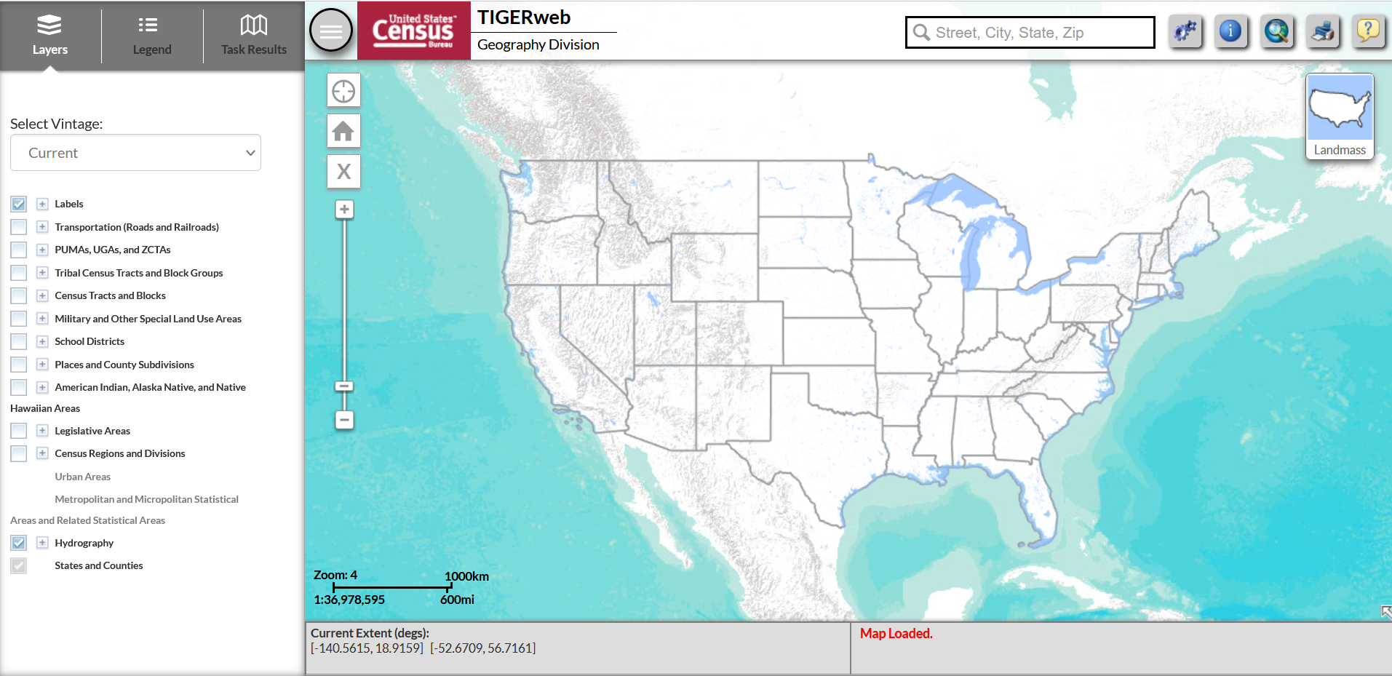
TIGERweb - Homescreen

Slide 10
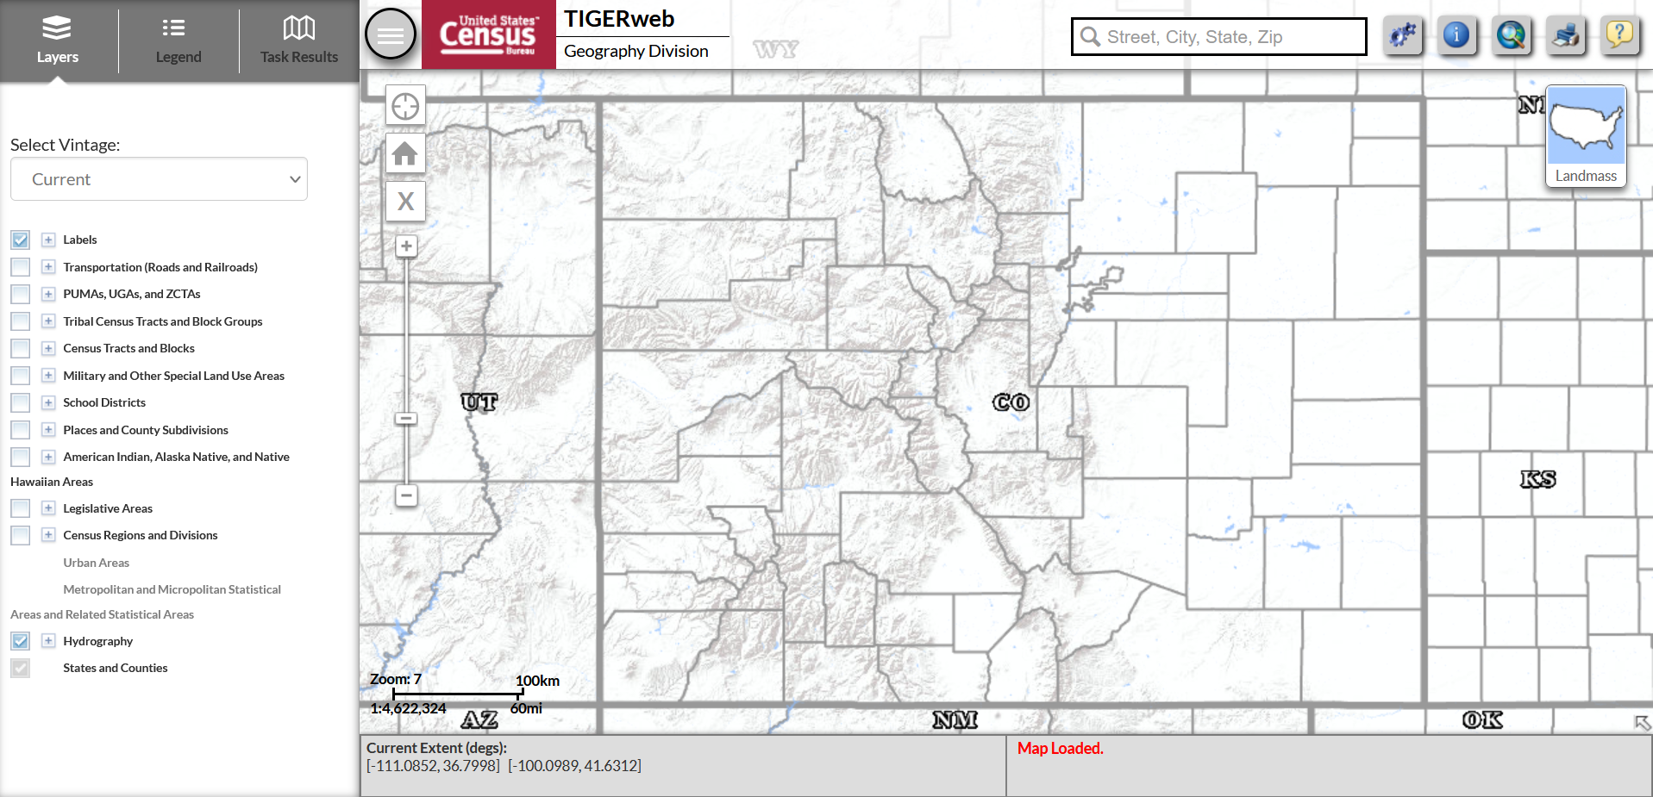
TIGERweb - Colorado

Slide 11
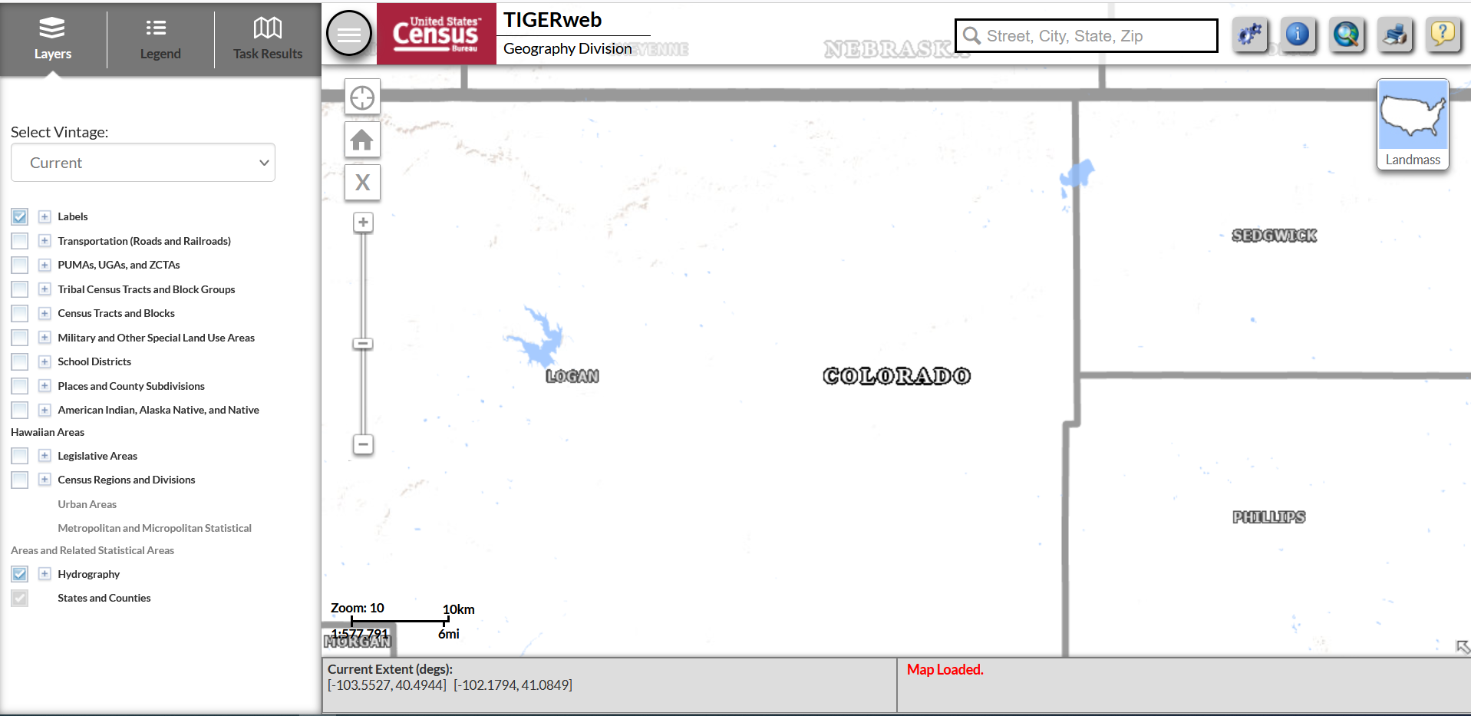
TIGERweb – Default Settings

Slide 12
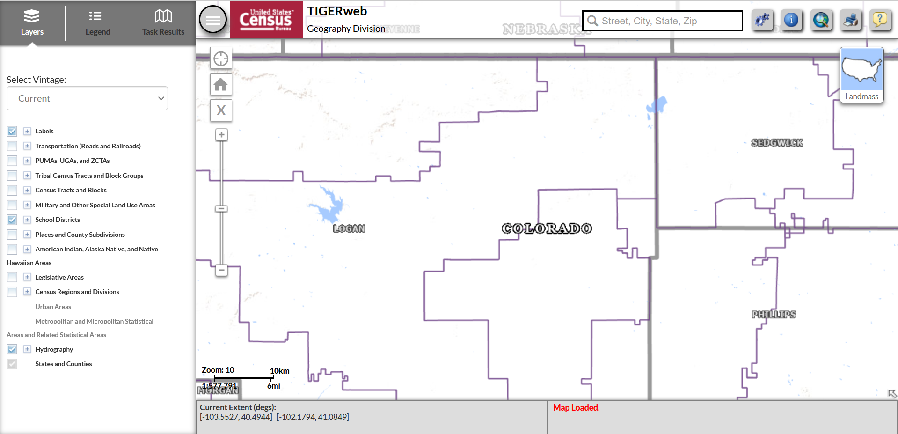
TIGERweb – District Boundaries

Slide 13
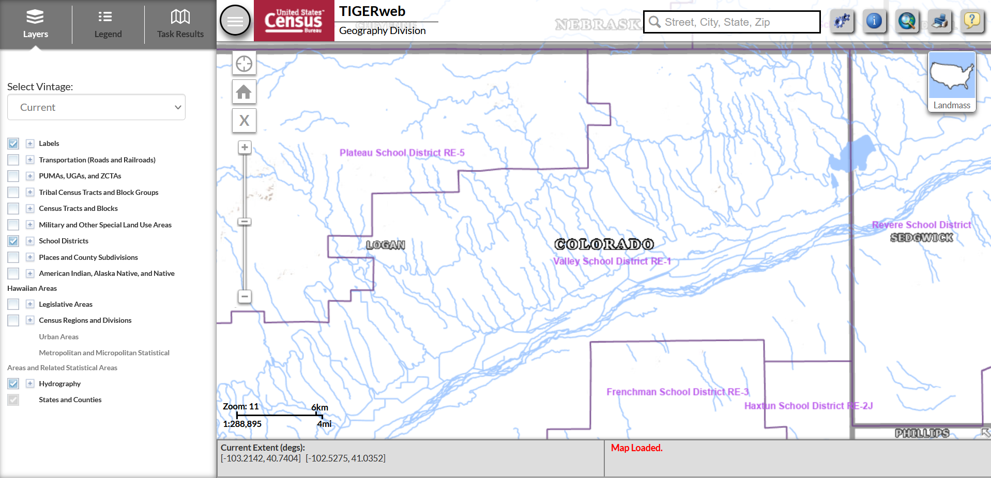
TIGERweb – Hydrography

Slide 14
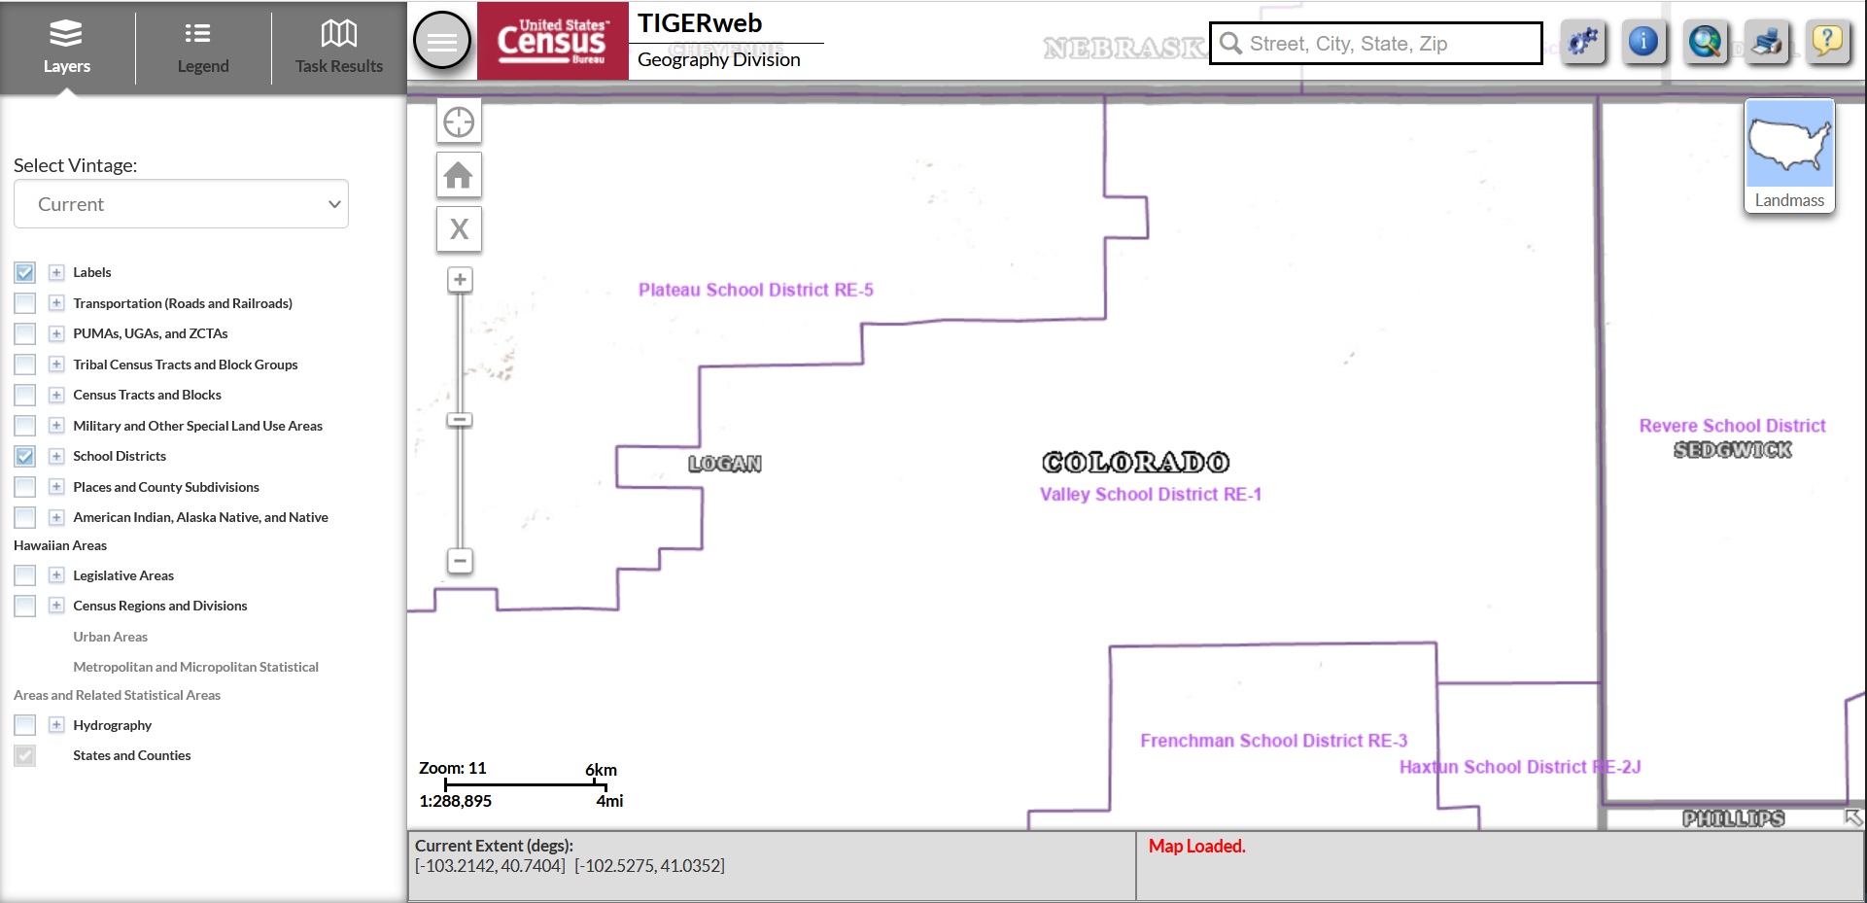
TIGERweb – Removing Features

Slide 15
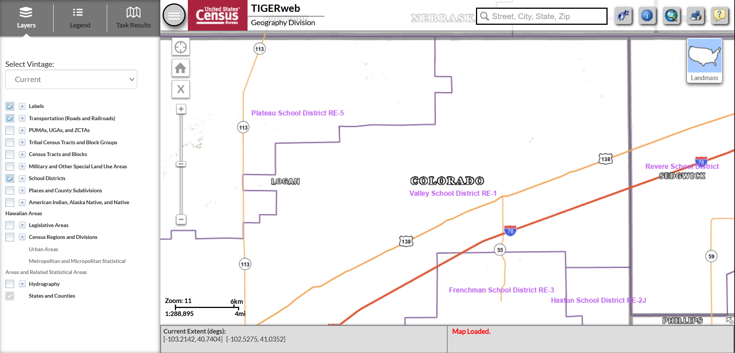
TIGERweb - Transportation

Slide 16
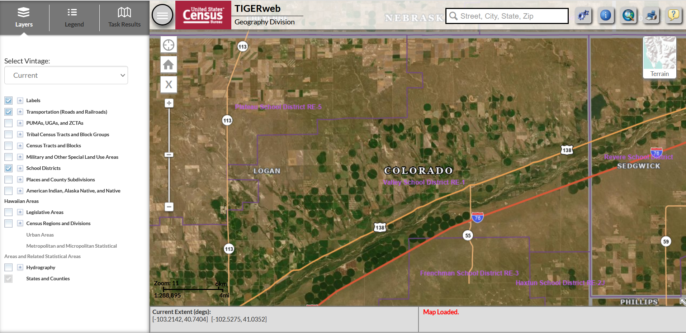
TIGERweb – Map Views

Slide 17
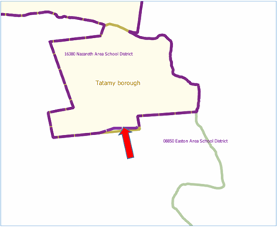
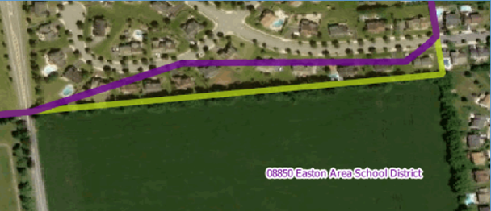
Correcting District Boundaries
To report an error in the district boundaries online, districts should take a screenshot of the current boundaries (using the TIGERweb system) and then annotate the updated boundary location on the same screenshot.
  District should notify CDE as soon as possible to report any errors.

Slide 18
Submitting Boundary Changes
All requests to update school district boundaries should be submitted to Tina Negley (negley_t@cde.state.co.us).
  Districts are encouraged to submit changes as soon as possible. All annotated screenshots must be submitted no later than December 15th to ensure the information is successfully uploaded in the Geographic Update Partnership Software (GUPS) by the December deadline.
  Note that the Census Bureau generally does not accept boundary changes of less than 30 feet when the correction does not affect housing. In remote areas with sparse population, the Census Bureau considers a difference of 60-75 feet to not be significant if housing units are not present.

Slide 19
Contact Information
For all SDRP-related questions, please reach out to:
  Tina Negley
  negley_t@cde.state.co.us
  720-766-2793

Slide 20
Upcoming Meetings

Slide 21

Looking Ahead…
Any requests for topics or questions?
Upcoming Office Hours
  December 4
  December 18

Slide 22
CDE Contacts!
Emails: Lastname_Firstinitial@cde.state.co.us (e.g., Smith_a@cde.state.co.us)
Federal Programs & Supports (ESEA/ESSER Program Supports) | School Finance & Operations (Fiscal and Systems Supports)
Nazie Mohajeri-Nelson, Executive Director of Federal Programs & Supports Unit Program Specialists Program Implementation Supervisor: Laura Meushaw Program Implementation Coordinator: Christina Adeboye Sullivan Program Monitoring Supervisor: Tammy Giessinger ESEA Monitoring Coordinator: Kristin Crumley Program Effectiveness Supervisor: Tina Negley Program Evaluation & Research Coordinator: Anna Rowan ESEA Programs Specialists and ESEA Regional Contacts (assigned by district) Title I: Laura Meushaw, Evita Byrd, Rachel Echsner, Kim Boylan Title II: Rachel Echsner Title III: Rachel Temple, Kim Boylan Title IV & Stronger Connections Grant: Nathan Hickman, Evita Byrd Title V: Christina Adeboye-Sullivan, Rachel Echsner ESSER Specialist: Kim Boylan ESEA Data and Reporting Specialists Melissa Chaffin (ESEA) Jerry Ring (ESEA) Anna Rowan (ESEA) | Vacant, Executive Director of School District Operations Unit Fiscal Specialists Jennifer Austin, Director of Grants Fiscal Management ESEA Robert Hawkins, Grants Fiscal Analyst Steven Kaleda, Grants Fiscal Analyst ESSER Fiscal Specialist Steven Kaleda Grants Fiscal Analyst ESSER Monitoring Bill Parsley, ESSER Fiscal Monitoring Supervisor Hilery Morris, ESSER Fiscal Monitoring Application Systems Specialists DeLilah Collins, Director of Grants Program Administration Online Applications Systems Technical Support Jessica Hollingshead Michelle Prael

