Slide 1
CDE ESEA Office Hours
October 23, 2025

Slide 2
ESEA/ESSER Office Hours
Topics:
Updates and Reminders
Federal Programs Monitoring Overview
Updated Paraprofessional Guidance

Slide 3
Updates and Reminders

Slide 4
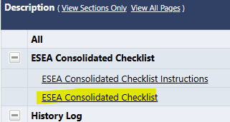
Updates and Reminders (Part 1 of 2)
No news from the national level
FYI ~ Submitting Constitutionally Protected Prayer Certification based on Cons App assurances
Nothing required of LEAs at this time
Platform migration -
2023 and older applications for funds will not be available as of 11/1/25
Please remember to download a PDF of any application you might need
Consolidated Application Revisions Requested
If your application was reviewed and returned by CDE for edits, you can view your feedback on the ESEA Consolidated Checklist in GAINS.
Please view your feedback and make revisions as soon as possible in order to receive Final Approval.

Slide 5
Updates and Reminders (Part 2 of 2)
Comparability Reminder
If CDE was not able to determine Comparability for your LEA in SY 24-25, alternative Comparability calculators to demonstrate the district was in compliance for SY 24-25 were due on October 10. If applicable, please submit your alternative calculator or action plan as soon as possible.
Questions? Contact: comparability@cde.state.co.us

Slide 6
Empowering Action for School Improvement (EASI)
LEAs with schools identified for support and improvement under state or federal accountability can apply for grants through the Empowering Action for School Improvement (EASI) grant.
Cohort 9 2025-26 applications are now available in GAINS. Completed applications must be submitted by Wednesday, December 3, 2025, by 4 pm.
Resources & Support:
9/25 Office Hours PowerPoint & Recording: ESSA Identification Methodology & Categories and UIP Requirements
Contact:
Laura Meushaw: 720-728-9023 | Send an email to Laura
Lindsay Cox: 720-990-7851 | Send an email to Lindsay

Slide 7
Federal Programs Monitoring Overview
October 23, 2025

Slide 8
Which LEAs Need this Information?
All LEAs should be familiar with the requirements associated with accepting federal funds through ESEA.
All LEAs are monitored within a multi-year monitoring cycle and should continuously ensure compliance with program requirements.

Slide 9
Outcomes for Today’s Training
Review the Federal Programs monitoring purpose
Understand what happens during each step of the timeline
Know how to begin preparing for monitoring
Acronyms used today:
LEA: Local Education Agency PMSA: Program Monitoring Self-Assessment
FPSU: Federal Programs and Supports Unit
GAINS: Grants Administration Implementation and Navigation System
ESEA: Elementary and Secondary Education Act
ESSA: Every Student Succeeds Act

Slide 10
Purpose of Monitoring

Slide 11
Overview
Monitoring formalizes the integral relationship between CDE and Colorado LEAs in implementing effective programs using Federal funds.
Program monitoring is implemented from a program perspective and meant to accomplish the following objectives:
Focus on What Matters (Improving Outcomes for Students)
Reduce Burden on LEAs
Improve Communication with LEAs
Differentiate and Customize Support for LEAs
Ensure Basic Requirements Are Met

Slide 12
Purpose and Intent
ESEA Program Intent:
To ensure all students, particularly underserved students, have equitable
access to a high-quality education and educators.
Purpose of Monitoring:
To ensure that federal funds are used appropriately to implement programs
that meet the intent of each program.

Slide 13
Program Monitoring Timeline

Slide 14
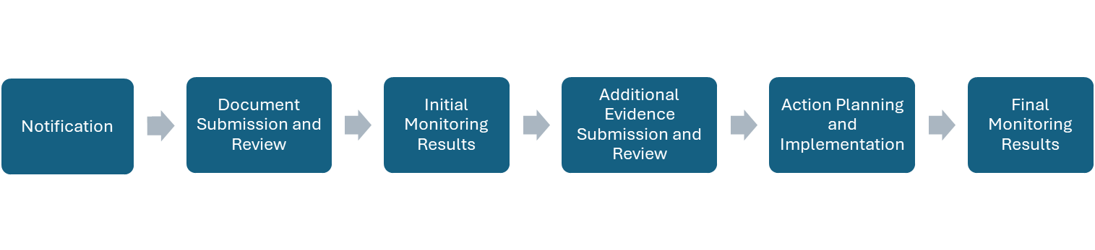
ESEA Monitoring Process
Please visit the updated ESEA Program Monitoring Process website for additional information.

Slide 15
Monitoring Schedule
All LEAs will participate in ESEA program monitoring during a multi-year cycle
The Monitoring Schedule is posted on the Federal Programs Monitoring website.
37 LEAs, including 3 BOCES, will be monitored in 2025-2026

Slide 16
Notification
The delay in funding allocations has postponed several FPSU processes this year. Monitoring is included in these delays.
Notification letters will be sent later this winter to the Authorized Representative and Monitoring Contact listed in the 2026 Consolidated Application.
Once LEAs receive this notification, the FPSU team will conduct a training for completing the PMSA in the GAINS platform.

Slide 17
Document Submission and Review
All LEAs participating in ESEA Program Monitoring will submit the Program Monitoring Self-Assessment (PMSA) through GAINS.
LEAs will use the self-assessment to review applicable program requirements and submit a self-rating, narrative summary, and supporting documentation for review. Additional information regarding the process for submitting the self-assessment can be found in the ESEA PMSA Process Guide.
The FPSU team will review each submission to determine if the evidence submitted demonstrates compliance or if additional documentation is required.

Slide 18
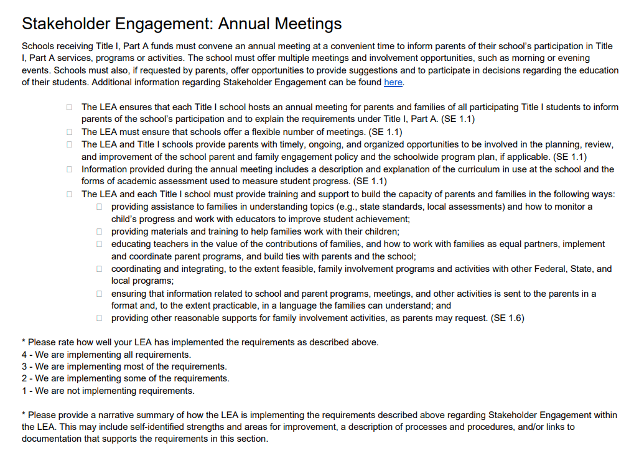
Example 1: Title I, Part A Annual Meetings
This screenshot is from page 10 of the PMSA PDF.
Each checkbox is a federal requirement under Title I, Part A.

Slide 19
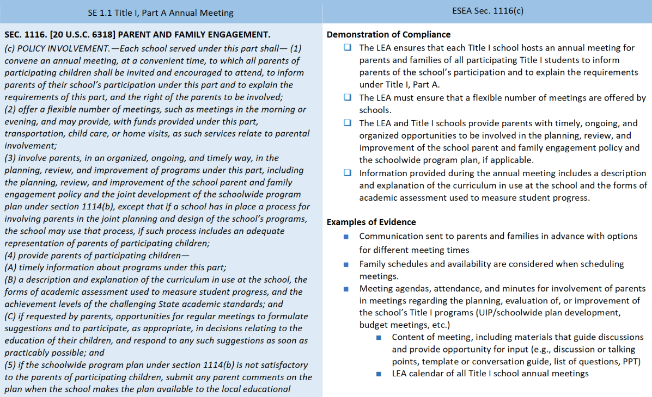
Example 1: Demostration of Compliance & Examples of Evidence
This screenshot is from indicator SE 1.1 on page 73 of the Program Requirements document.
The bottom right corner shows examples of evidence that can be submitted to demonstrate compliance.

Slide 20
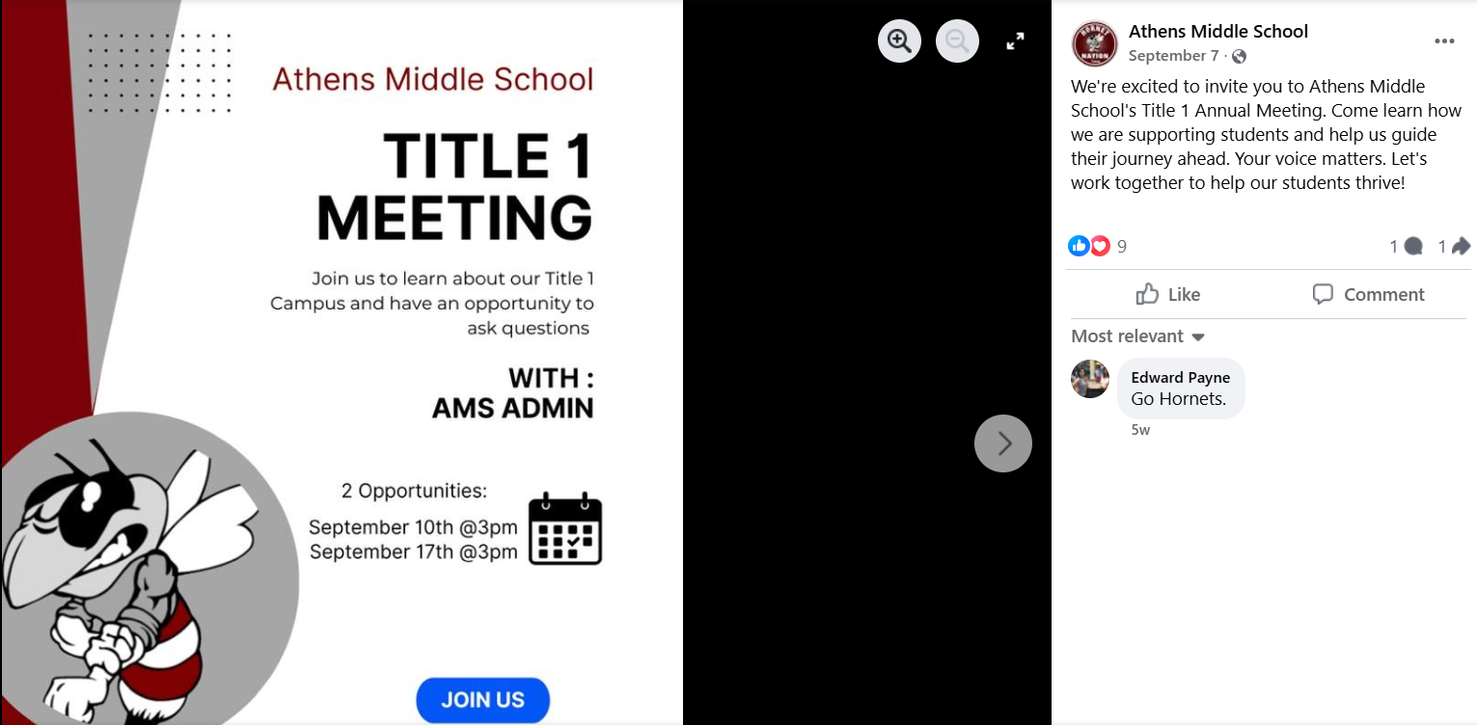
Example 1: Evidence Submitted
The LEA ensures that each Title I school hosts an annual meeting for parents and families of all participating Title I students to inform parents of the school’s participation and to explain the requirements under Title I, Part A. (SE 1.1)
The LEA must ensure that schools offer a flexible number of meetings. (SE 1.1)
Sample Facebook post for a Title I school:
This screenshot demonstrates that the school held its meetings and that a flexible number of meetings were offered.

Slide 21

Example 1: Evidence Submitted, con’t
Information provided during the annual meeting includes a description and explanation of the curriculum in use at the school and the forms of academic assessment used to measure student progress. (SE 1.1)
The sample slide deck from Northeast Early College in Denver Public Schools demonstrates that the school held its annual meeting. The slides include curriculum and assessment information. The slides also offer parents the opportunity to be involved in the planning, review, and improvement of the school parent and family engagement policy and the schoolwide program plan.

Slide 22
Initial Monitoring Results
Once the FPSU team has reviewed all initial submissions, initial monitoring results will be shared with the LEA through the GAINS monitoring instrument.
Rating | Rating Summary
 | Meeting All Requirements; No Additional Recommendations
 | Meeting All Requirements; Recommendation(s)
 | Not Meeting All Requirements; Corrective Action(s)
 | Not Meeting All Requirements; Corrective Action(s) and Recommendation(s)
 | Additional Evidence Needed
 | Not Applicable

Slide 23
Additional Evidence Submission and Review
The LEA will be able to see the initial monitoring results and will submit additionally requested evidence.
Once additional evidence is submitted, the FPSU team will conduct another review of evidence.

Slide 24
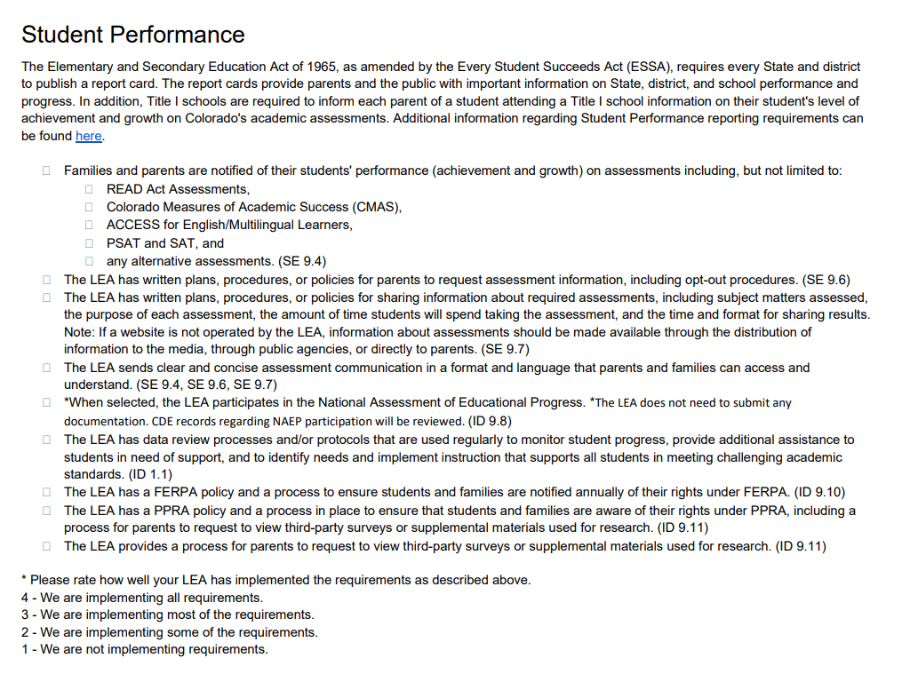
Example 2: Student Performance
This screenshot is from page 11 of the PMSA PDF.
Each checkbox is a federal requirement under ESEA.

Slide 25
Example 2: Additional Evidence Submitted
In addition to the LEA’s narrative response, the following evidence was submitted.
Program Requirement | Initial Evidence Submission:
Families and parents are notified of their students' performance (achievement and growth) on assessments including, but not limited to: READ Act Assessments, Colorado Measures of Academic Success (CMAS), ACCESS for English/Multilingual Learners, PSAT and SAT, and any alternative assessments. (SE 9.4) | Copy of Student CMAS Report sent to Parent
The LEA sends clear and concise assessment communication in a format and language that parents and families can access and understand. (SE 9.4, SE 9.6, SE 9.7) | Sample Parent Reports; Link to LEA’s Assessment website
The LEA has written plans, procedures, or policies for parents to request assessment information, including opt-out procedures. (SE 9.6) | *
The LEA has a FERPA policy and a process to ensure students and families are notified annually of their rights under FERPA. (ID 9.10) | Link to Board Policies; Sample parent notification
The LEA has a PPRA policy and a process in place to ensure that students and families are aware of their rights under PPRA, including a process for parents to request to view third-party surveys or supplemental materials used for research. (ID 9.11) | Link to Board Policies; Sample parent notification

Slide 26
Action Planning and Implementation
When a corrective action is required, CDE will partner with the LEA to design an action plan that is reasonable for the LEA to implement within an agreed upon timeline.

Slide 27
Final Monitoring Results
Once all corrective actions have been resolved, the monitoring instrument will be updated to reflect final monitoring results. These results will be shared with the LEA through GAINS.

Slide 28
What’s Next

Slide 29
Gather Evidence
The 2025-2026 PMSA within GAINS is not yet live; however, the PDF version of the PMSA is available now on the FPSU Monitoring Webpage.
Using the PMSA PDF, LEAs can begin to gather evidence for monitoring now, including
Documents
Links
Narrative information

Slide 30
LEA Shareouts Poll
Educator Qualifications
How does the LEA provide timely notice to parents when a student has been taught for 4 or more consecutive weeks by a teacher who does not meet applicable State certification or licensure requirements at the grade level and subject area in which the teacher has been assigned?
What evidence would demonstrate compliance for the above requirement?
(multiple choice)
District Policy
District Procedures
Sample Letter sent to Parents
Letter Template for District
Any or all of the above

Slide 31
LEA Shareouts
Turn on microphone or type in the chat…
What is some documentation you could start collecting now to make the PMSA submission simpler later?
Consider the following questions:
Stakeholder Engagement: Annual Meeting
How are parents invited to or notified of the Title I annual meeting?
What information is presented at the Title I annual meeting?
How are parents and families provided opportunities to give feedback on LEA ESEA fund plans?

Slide 32
“Pro Tips”
Ensure your board policies are publicly available.
If you use a policy for evidence, also upload evidence of implementation of that policy. Please note that some policies may address multiple requirements.
Please ensure access to files and folders. We have encountered a few situations of being unable to access Google drives and docs.
Evidence with Personally Identifiable Information (PII) can be submitted through Syncplicity (not GAINS).

Slide 33
Questions?

Slide 34
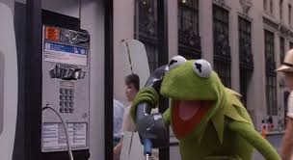
CDE Program Monitoring Team Contacts
Tammy Giessinger
720-827-5291 (c)
giessinger_t@cde.state.co.us
Kristin Crumley
720-660-1369 (c)
crumley_k@cde.state.co.us
Kim Boylan
720-354-7031 (c)
boylan_k@cde.state.co.us
Nathan Hickman
720-833-8194 (c)
hickman_n@cde.state.co.us

Slide 35
Updated Paraprofessional Guidance

Slide 36
Instructional Paraprofessionals
An instructional paraprofessional is an individual who provides instructional support for classroom teachers. Instructional paraprofessionals should be supervised directly by a licensed teacher.
Exceptions: A paraprofessional is not considered an instructional paraprofessional if they:
are proficient in English and a language other than English and only acts as a translator to enhance the participation of limited English proficient children;
have instructional-support duties that consist solely of conducting parental involvement activities; or
only have non-instructional duties (such as providing technical support for computers, providing personal care services, or performing clerical duties).

Slide 37
Updated Paraprofessional Guidance & Requirements
Read the guidance here: 34 CFR 200.58
Instructional paraprofessionals who are hired by the LEA and who work in a program supported with Title I, Part A funds must meet the following requirements:
secondary school diploma or its recognized equivalent.
AND
Completed at least two years of study at an institution of higher education; or
Obtained an associate's or higher degree; or
Met a rigorous standard of quality, and can demonstrate—through a formal state or local academic assessment—knowledge of, and the ability to assist in instructing, as appropriate—
Reading/language arts, writing, and mathematics; or
Reading readiness, writing readiness, and mathematics readiness

Slide 38
Formal Assessments
Paraprofessionals may demonstrate through a formal state or local academic assessment their knowledge and ability to assist in instructing, as appropriate.
Formal assessments should be valid and reliable.
An assessment is valid if it measures mathematics, reading, and writing content at a level equivalent to the knowledge obtained by attending two years of college and is applicable to duties being assigned to the paraprofessional.
An assessment is reliable if it provides consistent results.
An LEA may develop its own assessment.
Existing assessments that are valid and reliable for the purposes of assessing paraprofessionals’ subject matter competency are the ACT-Work Keys and ETS-ParaPro assessments.

Slide 39
Paraprofessionals in Title I Programs
Schoolwide Title I Programs | Targeted Assistance Title I Programs | Title I Preschool Programs
All instructional paraprofessionals in Title I Schoolwide programs must meet the ESSA qualification requirements. | Instructional paraprofessionals in Title I Targeted Assistance programs who work with Title I students and whose salaries are paid with Title I funds must meet the ESSA qualification requirements. | Instructional paraprofessionals in Title I Preschool programs who work with Title I students and whose salaries are paid with Title I funds must meet the ESSA qualification requirements

Slide 40
Paraprofessionals in ESEA Monitoring
Indicator ID 1.5 Paraprofessional Qualifications
Demonstration of Compliance The LEA has a process to ensure that all instructional paraprofessionals in Title I Schoolwide and/or Title I Targeted Assistance programs meet the ESSA qualification requirements.
Examples of Evidence HR hiring and onboarding policies and processes that ensure Title I paraprofessionals meet requirements HR report that demonstrates how paraprofessional meet requirements (names redacted) Sample of Paraprofessional Qualifications/Credentials (names redacted)
§ 200.58 Qualifications of paraprofessionals
Monitoring will begin during the 2026-2027 school year.

Slide 41
Additional Paraprofessional Guidance
Visit the updated Paraprofessional Guidance webpage for more information including allowable uses of ESEA funds for paraprofessionals.

Slide 42
Upcoming Meetings

Slide 43

Looking Ahead…
Any requests for topics or questions?
Upcoming Office Hours
November 13
School District Review Program Process
Due to scheduling conflicts and the upcoming holiday, Office Hours will be held once in November on
November 13.

Slide 44
CDE Contacts!
Emails: Lastname_Firstinitial@cde.state.co.us (e.g., Smith_a@cde.state.co.us)
Federal Programs & Supports (ESEA/ESSER Program Supports) | School Finance & Operations (Fiscal and Systems Supports)
Nazie Mohajeri-Nelson, Executive Director of Federal Programs & Supports Unit Program Specialists Program Implementation Supervisor: Laura Meushaw Program Implementation Coordinator: Christina Adeboye Sullivan Program Monitoring Supervisor: Tammy Giessinger ESEA Monitoring Coordinator: Kristin Crumley Program Effectiveness Supervisor: Tina Negley Program Evaluation & Research Coordinator: Anna Rowan ESEA Programs Specialists and ESEA Regional Contacts (assigned by district) Title I: Laura Meushaw, Evita Byrd, Rachel Echsner, Kim Boylan Title II: Rachel Echsner Title III: Rachel Temple, Kim Boylan Title IV & Stronger Connections Grant: Nathan Hickman, Evita Byrd Title V: Christina Adeboye-Sullivan, Rachel Echsner ESSER Specialist: Kim Boylan ESEA Data and Reporting Specialists Melissa Chaffin (ESEA) Jerry Ring (ESEA) Anna Rowan (ESEA) | Vacant, Executive Director of School District Operations Unit Fiscal Specialists Jennifer Austin, Director of Grants Fiscal Management ESEA Robert Hawkins, Grants Fiscal Analyst Steven Kaleda, Grants Fiscal Analyst ESSER Fiscal Specialist Steven Kaleda Grants Fiscal Analyst ESSER Monitoring Bill Parsley, ESSER Fiscal Monitoring Supervisor Hilery Morris, ESSER Fiscal Monitoring Application Systems Specialists DeLilah Collins, Director of Grants Program Administration Online Applications Systems Technical Support Jessica Hollingshead Michelle Prael

