Slide 1
CDE ESEA Office Hours
September 25, 2025

Slide 2
ESEA/ESSER Office Hours
Topics:
Updates and Reminders
Overview of ESSA Identification Methodology and Categories
UIP Requirements for ESSA Identified Schools and Resources Overview

Slide 3
Updates and Reminders

Slide 4
Updates
FERs are due by September 30, 2025
Consolidated Applications are by October 3, 2025
Notes:
Nazie

Slide 5
2025-2026 Consolidated Application Timeline -
Complete Application
Date | Action | Details
Friday, October 3 | Submit a complete Consolidated Application within GAINS on or before 10/3/2025. | CDE will review applications for final approval once a complete application is submitted by the LEA’s Authorized Representative. Budget needs to be balanced to submit. This may require removing any projected carryover amounts. Regional Contacts will be reviewing applications on a rolling basis once submitted. Highly Recommend referencing the Consolidated Application Planning Document when completing application. Current Bug Tracker: Districts with OVER $30,000 in Title IV; Title IV Well-Rounded (WR), Safe and Healthy Students (SHS), Effective Use of Technology (EUT) validations not calculating correctly what is budgeted. (Warning) Districts UNDER $30,000 in Title IV: Funds must be budgeted in a least one of the three focus areas (WR, SHS, EUT). However, an error appears when funds are budgeted to SHS or EUT. Options: Change the budget lines to WRE in order to submit and revise when bug is fixed Wait to submit application when bug has been fixed

Slide 6
Final Expenditure Report (FER)
Date | Action | Details
Tuesday, September 30 | Final Expenditure Report (FER) due on or before 9/30/2025. | In order for official carryover to be transferred into the 2025-2026 Consolidated Application, an LEA must submit and receive approval on the FER. 67 approved FERs (carryover → 25-26 application) 62 not yet submitted FER Authorized Rep Approved is the only submitted Status to CDE for review FERs should be inclusive of all funds requested from the FY25 (2024-2025) application. The FER is available in GAINS under 2025. Instructions are available (FER Small Bite instructions and Recording.) Carryover can be included for final approval or may be approved in post award, depending on the status of the application when the FER is approved.

Slide 7
ESSA Identification
Notes:
Nazie

Slide 8
Overview
Every state that accepts funds under the Every Student Succeeds Act (ESSA), the most recent reauthorization of the Elementary and Secondary Education Act (ESEA), must have a process for identifying schools for support and improvement that is approved by the U.S. Department of Education.
  Must include all public schools in methodology for identification, including Alternative Education Campuses (AECs) and schools with Grade K-2 only.
The State (CDE) must notify the districts of their schools that have been identified for ESSA support and improvement.
Districts must notify schools and support them in the development of an improvement plan that meets ESSA requirements.
Notes:
Every state that accepts funds under the Every Student Succeeds Act (ESSA), the most recent reauthorization of the Elementary and Secondary Education Act (ESEA), must have a process for identifying schools for support and improvement that is approved by the U.S. Department of Education. This process must include all public schools in the methodology for identification, including Alternative Education Campuses, or AECs, and schools that enroll students in Kindergarten through 2nd grade only. CDE must notify districts of their schools that have been identified for support and improvement under ESSA, and districts must notify schools and support them in the development of an improvement plan that meets ESSA requirements.

Slide 9
ESSA State Plan: Most Recent Amendments (FYI)
April 2025
Use the more asset-based term of “Multilingual Learner” instead of “English Learner”.
Revisions to the School Quality and Student Success (SQSS) indicator.
  Resume using the standard definition of chronic absenteeism (excused and unexcused absences).
  Resume the use of science achievement.
  Addition of a SQSS measure (chronic absenteeism) for K-2 schools.
Change the methodology used for Comprehensive Support and Improvement (CS) - Low Graduation Rate to be based on the three-year weighted average of the 7-year graduation rate.
Notes:
Colorado’s most recent amendment included the following changes:
Transition to using the more asset-based term of “Multilingual Learner” instead of “English Learner”.
Revisions to the School Quality and Student Success, or SQSS, indicator. Specifically, resume using the standard definition of chronic absenteeism, which includes both excused and unexcused absences, and resume using science achievement. Also, adding the SQSS indicator to the K-2 school methodology, using chronic absenteeism rates.
Change the methodology used for Comprehensive Support and Improvement - Low Graduation Rate to be based on the three-year weighted average of the 7-year graduation rate only.

Slide 10
ESSA Identification Update
Districts with identified schools (except K-2 schools) received notifications from Lindsay Jaeckel (CDE) by September 15, 2025.
  Sent to Superintendent, Title I Contact (if provided in GAINS), Authorized Representative, and District Accountability Contact
  Includes
    Outline of changes in state and federal (ESSA) accountability
    Resources and grants (EASI) available for identified schools
    Improvement planning requirements
    Link to a Data Dashboard
ESSA School Profiles were shared with districts via Syncplicity.
In the near future, the list of all ESSA identified schools will be posted on CDE’s Methods for Identification and Exit Criteria for ESSA Support and Improvement website.
Notes:
Districts with identified schools received an email notification from CDE on September 15th, which was sent to the Superintendent, Title I Contact, Authorized Representative for the ESEA Consolidated Application, and District Accountability Contact. The notification included an outline of changes in state and federal accountability, resources and grants available for identified schools, improvement planning requirements, and a link to the Data Dashboard. ESSA School Profiles were shared with districts via Syncplicity, and in the near future the list of all ESSA identified schools will be posted on CDE’s Methods for Identification and Exit Criteria for ESSA Support and Improvement website.

Slide 11
Indicators Used in School Identification Methodology
K-2 Only Schools
READ Act Data is used for the Academic Achievement and Growth indicator
Alternative Education Campus (AECs)
When necessary, the following indicators are also used to differentiate among lowest performing AECs, in addition to the other indicators listed to the left
Attendance rate
Truancy rate
Academic Achievement
  English Language Arts (ELA) and Math mean scale scores
Academic Progress (Growth)
  ELA and Math median growth percentiles
Progress in Achieving English Language Proficiency (ELP)
  ACCESS median growth percentiles
  Percent on-track to attaining proficiency
School Quality or Student Success
  Science mean scale scores (elementary/middle/high)
  Chronic absenteeism rate (elementary/middle)
  Dropout rate (high)
Graduation Rates
  4-year adjusted cohort rate
  7-year adjusted cohort rate
Notes:
This slide provides a brief overview of the five indicators used in the ESSA Identification process.
Colorado utilizes mean scale scores on the CMAS, COALT, and SAT assessments, in both English language arts and math, for the Academic Achievement indicator. Please note that this includes students in grades 3-8 and grade 11.
Median growth percentiles for the CMAS and SAT English language arts and math assessments are utilized for the Academic Progress indicator, for students in grades 4-8 and grade 11.
The Progress in Achieving English Language Proficiency Indicator is based on median growth percentiles from the ACCESS assessment, as well as the percentage of English learners that are on-track to attaining fluency within a six-year timeline.
The School Quality or Student Success Indicator, often referred to as the SQSS indicator, consists of three measures. Science mean scale scores for all schools, chronic absenteeism rates for elementary and middle schools only, and dropout rates for high schools only.
The last indicator, Graduation Rates, includes both 4-year and 7-year graduation rates.
Please note the box on the right, which outlines identification criteria for alternative education campuses or AECs. Colorado is required to include all schools in the ESSA identification process and use a consistent identification process across all schools. When necessary, Colorado utilizes attendance and truancy rates in addition to the other indicators, to further differentiate among the lowest performing AECs.

Slide 12
Student Groups Included in Identification Methodology
ESSA includes review of schools based on performance of:
All students
Multilingual/English learners (ML/EL)
Students with disabilities
Students experiencing poverty
Students from each racial/ethnic group, separately
  Aggregated Non-White group - Any non-White students from racial/ethnic groups that do not meet the minimum number of students to be reported on their own will be combined into one group for accountability purposes
Notes:
ESSA requires that states look at the performance of individual student groups in addition to the performance of all students. The following student groups are included in the ESSA identification process: English learners, students with disabilities, students experiencing poverty, and students from each racial or ethnic group. In addition, in order to maximize the number of students that can be included in the accountability process, Colorado has developed an “Aggregated Non-White group”. Any non-White students from racial or ethnic groups that do not meet the minimum number of students to be reported on their own, will be combined into one Aggregated Non-White group for accountability purposes.

Slide 13
Identification Categories
K-2 Schools will be identified based on READ Act data later in October and LEAs will be notified at a later date.
Annual identification of schools for Support and Improvement under ESSA:
Comprehensive Support and Improvement (CS)
  CS - Lowest 5%
    Title I schools with the lowest total percentage points earned
  CS - Low Graduation Rate
    All public high schools with a 7-year graduation rate below 67 percent based on three years of aggregated data
  CS - Former ATS
    Title I schools identified for Additional Targeted Support for four consecutive years for the same student group will be moved to this category
Targeted Support and Improvement (TS)
  TS
    Schools with at least one consistently underperforming student group
  Additional Targeted Support (ATS)
    Subset of TS schools with at least one disaggregated group that, on its own, meets the criteria for CS - Lowest 5%
Second Phase:
Adjusted Achievement Scores for over 5% non- participation.
~
Possible to be identified due to participation only
Notes:
Colorado annually identifies schools for support and improvement. Schools can be identified based on one of two categories: Comprehensive Support and Improvement, or CS, and Targeted Support and Improvement, or TS.
Within Comprehensive Support and Improvement, there are three sub-categories: CS – Lowest 5 Percent, CS – Low Graduation Rate, and CS – Former ATS.
The CS – Lowest 5 Percent category includes Title I schools with the lowest total percentage points earned, based on a composite scores calculated from the 5 indicators mentioned on the previous slide.
The CS – Low Graduation category includes all public high schools, including AECs, with a 7-year graduation rate below 67 percent based on three years of aggregated data.
The CS – Former ATS category includes Title I schools that have been identified for Additional Targeted Support and Improvement for four consecutive years for the same student group.
Within Targeted Support and Improvement, there are two sub-categories: Targeted Support (TS) and Additional Targeted Support (ATS).
The Targeted Support category includes schools with at least one consistently underperforming student group.
The Additional Targeted Support category is a subset of TS and includes schools with at least one disaggregated group that, on its own, meets the criteria for CS – Lowest 5 percent.
Please keep in mind that it is possible for a school to be identified for CS or TS based on participation only. Under ESSA, schools are required to assess at least 95 percent of students on the state assessments. Non-participants, including parent excusals, in excess of 5 percent must be counted as non-proficient and assigned the lowest possible scale score on the missed assessment. Colorado identifies schools for support and improvement based on actual mean scale scores first, then runs a second round of identifications based on participation-adjusted mean scale scores.
K-2 schools will be identified later in October and LEAs will be notified at a later date.

Slide 14
Exiting Identification
CS - Lowest 5%
  3 year designation
  Can exit when:
    Has not been re-identified for 3 consecutive years
    Has a higher performance (percentage points earned) than the year of identification
CS - Low Grad Rate
  3 year designation
  Can exit when:
    Has not been re-identified for 3 consecutive years
    No longer has a 7-year graduation rate, based on three years of aggregated data, below 67 percent
TS or ATS
  Exit criteria and timeline is established by the district
Notes:
Comprehensive Support and Improvement is a 3 year designation. Schools are eligible to exit from CS - Lowest 5% when they have not been re-identified for 3 consecutive years and when they have a higher performance, based on total percentage points earned, than the year in which they were identified. Schools are eligible to exit from CS - Low Graduation Rate when they have not been re-identified for 3 consecutive years and when they no longer have a 7-year graduation rate, based on three years of aggregated data, below 67 percent.
TS and ATS exit criteria and timelines are established by the district.

Slide 15
Identification Categories in 2025-2026
Under ESSA, districts may have schools identified in the following categories:
Comprehensive Support and Improvement (CS) – Lowest 5%
  On Watch - School no longer meets identification criteria, but has not yet exited CS status
  Due to Participation Only - School met identification criteria as a result of participation-adjusted calculations
Comprehensive Support and Improvement (CS) - Low Graduation Rate
  On Watch - School no longer meets identification criteria, but has not yet exited CS status
Targeted Support (TS)
  2018-19, 2022-23, 2023-24, 2024-25 - Not Exited by District - School no longer meets identification criteria, but was not exited by district
  Due to Participation Only - School met identification criteria as a result of participation-adjusted calculations
Additional Targeted Support (ATS)
  2018-19, 2022-23, 2023-24, 2024-25 - Not Exited by District - School no longer meets identification criteria, but was not exited by district
  Due to Participation Only - School met identification criteria as a result of participation-adjusted calculations
Notes:
This slide provides a high-level overview of the various flags that may be included as part of a school’s identification.
Within CS – Lowest 5 percent:
A school can be flagged as On Watch, which indicates the school no longer meets identification criteria, but has not yet exited CS status, which is a multi-year identification. Please note this was previously labeled as Hold, but we have transitioned to On Watch to better align with the categories used for the Performance Frameworks.
A school can also be flagged as Due to Participation Only, if the school meets identification criteria as a result of participation-adjusted calculations only.
Within CS – Low Graduation rate:
A school can be flagged as On Watch, as previously described.
We do not currently have any schools identified for CS – Former ATS.
Within TS and ATS:
A school can be flagged as Not Exited by District, which indicates the school no longer meets identification criteria, but was not exited by the district. Districts are responsible for establishing exit criteria and timelines for TS as part of their Consolidated Application and are responsible for notifying CDE when each school has exited. If a school was not exited by the district, the designation will indicate the year of the original identification.
A school can also be flagged as Due to Participation Only, if the school meets identification criteria as a result of participation-adjusted calculations only.

Slide 16
Preliminary Results:
ESSA Identification vs.Performance Frameworks - Notable Differences
Notes:
Now that we’ve provided a high-level overview of the ESSA Identification process, we’d like to discuss some of the notable differences between the ESSA Identification process and the Performance Frameworks.

Slide 17
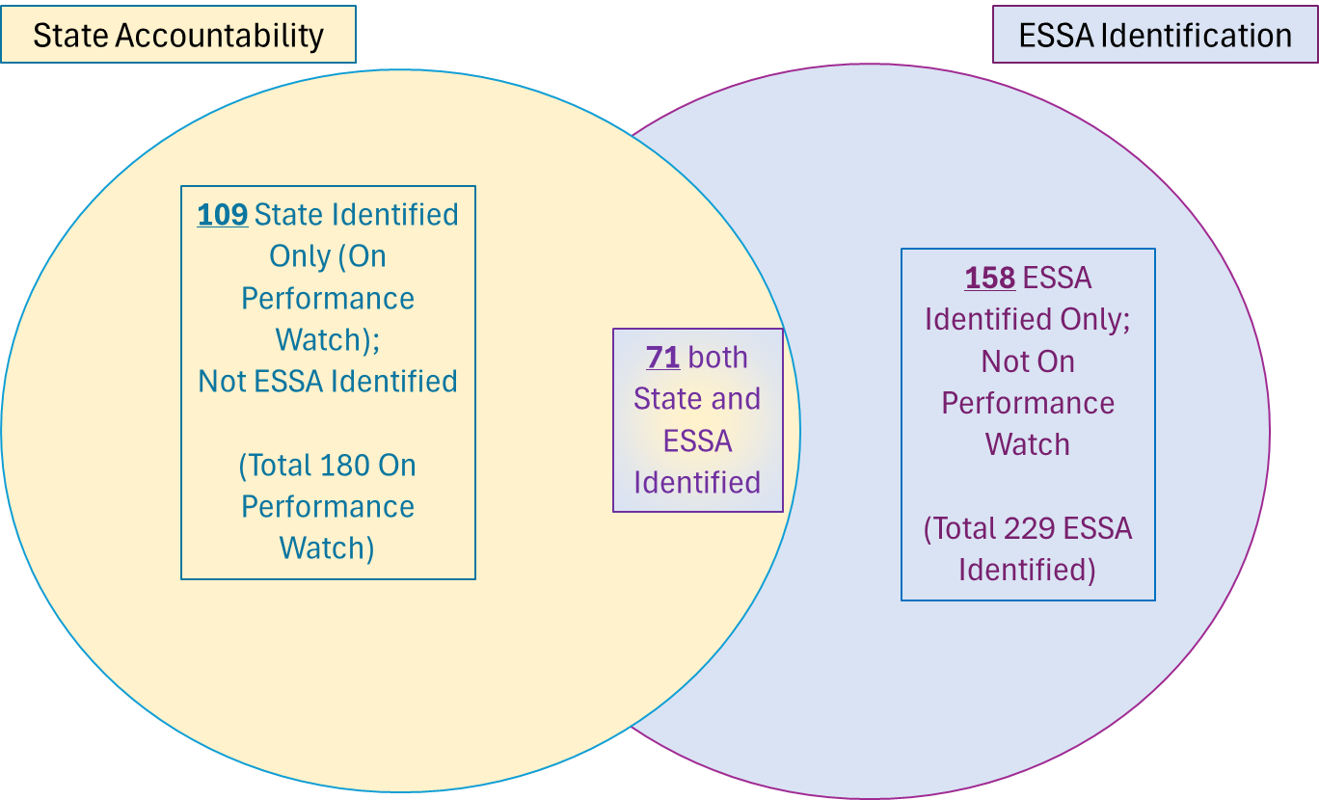
Preliminary Fall 2025 State and Federal Identifications
Numbers are subject to change
Based on preliminary SPF ratings
Does not include K-2
Notes:
This slide shows the overlap between the School Performance Framework ratings and ESSA identifications. Please note these numbers are based on preliminary SPF ratings and do not reflect the request to reconsider process. There are a total of 180 schools on Performance Watch based on the Fall 2025 SPF preliminary ratings. Of those, 109 schools are state identified only, not ESSA identified. There are a total of 229 schools identified under ESSA. Of those, 158 are ESSA identified only, not on Performance Watch. There are a total of 71 schools that both state and ESSA identified.

Slide 18
Notable Differences between State and Federal Identification
Description or Indicator | State: Performance Frameworks | Federal: ESSA Identification
Categories of Identification | Turnaround, Priority Improvement, Improvement, and Performance based on a composite score taking into consideration all indicators | Comprehensive Support & Improvement (CS) - Lowest 5% - based on overall performance - similar to State CS - Low Graduation Rate - based only on graduation rate Targeted Support and Improvement (TS) and Additional Targeted Support and Improvement (ATS) - based on the performance of student groups
High School Assessments | Include PSAT 9/10 data (Academic Achievement) and SAT 11 data (PWR) | Includes SAT 11 data (Academic Achievement) only
Science Assessment | Science mean scale scores are part of Academic Achievement | Science mean scale scores are part of the SQSS indicator
School Quality or Student Success (SQSS) | NA | Elementary and middle school: chronic absenteeism and science achievement High school: dropout rate and science achievement
Graduation Rate | best of 4-, 5-, 6-, and 7-year graduation rate | For CS-low graduation rate: only 7-year For all other categories: 4-year and 7-year graduation rates
Postsecondary & Workforce Readiness (PWR) Indicator | Matriculation rate | NA
Years of Data Included in Analyses | utilize one year of data (unless criteria is met for using multi-year frameworks) | utilizes three years of aggregated data (and up to five years of aggregated data may be used for smaller systems)
Alternative Education Campuses (AECs) | AEC Frameworks include completion rates | Utilizes same methodology for all schools
Notes:
Although the Performance Frameworks and ESSA Identification use many of the same indicators and metrics, there are some notable differences that contribute to the Venn diagram on the previous slide. Examples include:
Differences in the categories of identification. Performance Frameworks assign an overall rating (Performance, Improvement, Priority Improvement, Turnaround, and Insufficient State Data) based on a composite score taking into consideration all indicators. ESSA Identification includes the CS - Lowest 5% category based on overall performance, similar to the state, but also requires the identification of schools based solely on graduation rates, for CS - Low Grad, and based on the performance of student groups, for TS and ATS.
Another difference is that Performance Frameworks include PSAT 9/10 data and SAT 11 data, while ESSA Identification includes SAT 11 data only. For the Performance Frameworks, PSAT 9/10 data is included in the Academic Achievement indicator, while SAT 11 data is included in the Postsecondary and Workforce Readiness, or PWR, indicator. For ESSA Identification, SAT 11 data is part of the Academic Achievement indicator.
Science mean scale scores are part of the Academic Achievement indicator for Performance Frameworks, but part of the SQSS indicator for ESSA Identification.
ESSA includes a School Quality or Student Success Indicator, which is not part of the Performance Frameworks. This indicator includes the use of chronic absenteeism rates, which are not utilized in the Frameworks.
Only 4-year and 7-year graduation rates are used for ESSA Identification, while Performance Frameworks utilize the best of the 4-, 5-, 6-, and 7-year graduation rate.
Performance Frameworks include a Postsecondary & Workforce Readiness (PWR) Indicator, which is not utilized in ESSA Identification.This indicator includes the use of matriculation rates, which are not part of ESSA Identification.
Performance Frameworks typically utilize one year of data (unless criteria is met for using multi-year frameworks), whereas ESSA Identification utilizes three years of aggregated data (and up to five years of aggregated data may be used for smaller systems).
There are separate AEC Frameworks, whereas ESSA Identification requires the use of the same methodology for all schools.

Slide 19
Example - Graduation Rate Differences
Federal (ESSA Identification)
  All schools with aggregated 7-year graduation rates below 67 percent are identified for CS - Low Graduation Rate.
State (Performance Frameworks):
  Standard Framework - The “best of” graduation rate (best of the 4-, 5-, 6-, or 7-year rate) is compared to the following cut scores:
Graduation Rate | Rating
At or above 95.0% | Exceeds
At or above 85.0% but below 95.0% | Meets
At or above 75.0% but below 85.0% | Approaching
Below 75.0% | Does Not Meet
  AEC Framework - The “best of” completion rate is compared to the following cut scores:
Graduation Rate | Rating
At or above 69.4% | Exceeds
At or above 49.5% but below 69.4% | Meets
At or above 40.0% but below 49.5% | Approaching
Below 40.0% | Does Not Meet
Notes:
This slide highlights key differences based on the use of graduation rates in the Performance Frameworks compared to ESSA Identification.
For ESSA Identification, all schools with aggregated 7-year graduation rates below 67 percent are identified for CS - Low Graduation Rate.
For the Performance Frameworks, the standard frameworks use a best of graduation rate compared to an established set of cut scores. The AEC frameworks use a best of completion rate instead, again compared to an established set of cut scores. A completion rate of 49.5% of higher, for example, would earn a Meets rating on the AEC frameworks, which is below the ESSA requirement of 67 percent.

Slide 20
Deeper Dive:
Fall 2025 ESSA Identification Results
Notes:
Now we will walk through the Fall 2025 ESSA Identification Results.

Slide 21
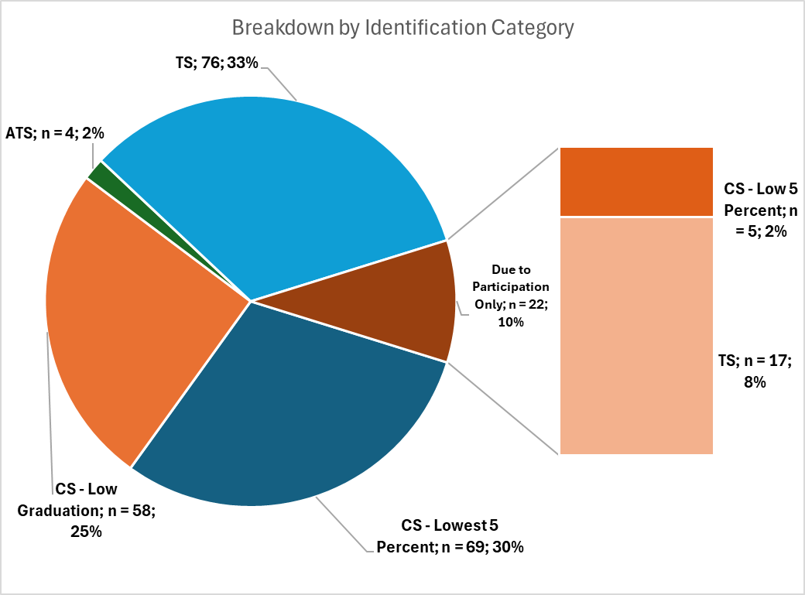
Overview of Fall 2025 ESSA Identification
229 schools currently identified for support and improvement under ESSA (not including K-2)
20 newly identified schools
22 schools identified due to participation only
Largest number of schools are identified based on performance of student group(s) - TS/ATS
Notes:
Currently, we have 229 schools identified for support and improvement under ESSA, not including K-2 schools.
There are 20 newly identified schools this year. The largest number of schools fall into the TS category, with 76 schools. There are 4 schools in the ATS category, 1 of which was not exited by the district. There are 58 schools in the CS – Low Graduation Rate category, with 2 on watch and 30 currently identified for their fourth or more year. And there are 69 schools in the CS – Lowest 5 percent category, with 30 on watch and 4 currently identified for their fourth or more year.
There are an additional 22 schools that were identified due to participation only, of which 5 are in the CS – Lowest 5 percent category and 17 are in the TS category.

Slide 22
Schools Identified for Targeted Support
*Note: Schools can be identified for more than one student group; therefore, counts may not add up to total.
Student Group | Additional Targeted Support # of Schools | Additional Targeted Support % of ATS | Targeted Support # of Schools | Targeted Support % of TS
Students Eligible for Free/Reduced Meals | 2 | 50.0% | 29 | 31.2%
Students with Disabilities | 3 | 75.0% | 19 | 20.4%
Multilingual Learners | 0 | 0.0% | 5 | 5.4%
Racial/Ethnic Groups | 2 | 50.0% | 80 | 86.0%
American Indian or Alaska Native | 0 | 0.0% | 3 | 3.2%
Asian | 0 | 0.0% | 1 | 1.1%
Black or African American | 0 | 0.0% | 13 | 14.0%
Hispanic or Latino | 2 | 50.0% | 28 | 30.1%
White | 1 | 25.0% | 12 | 12.9%
Native Hawaiian or Other Pacific Islander | 0 | 0.0% | 12 | 12.9%
Two or More Races | 0 | 0.0% | 15 | 16.1%
Aggregated Non-White | 1 | 25.0% | 22 | 23.7%
Total | 4 | N/A | 93 | N/A
Notes:
This slide provides an overall of the specific student groups associated with schools identified for Targeted Support and Improvement. Please note that schools can be identified for more than one student group, therefore the counts may not add up to the total.
Of the 4 schools identified for ATS, 2 were identified based on the performance of students eligible for free/reduced meals, 3 were identified based on the performance of students with disabilities, and 2 were identified based on the performance of specific racial/ethnic groups.
Of the 93 schools identified for TS, 29 were identified based on the performance of students eligible for free/reduced meals, 19 were identified based on the performance of students with disabilities, 5 were identified based on the performance of multilingual learners, and 80 were identified based on the performance of specific racial/ethnic groups.

Slide 23
Reminder: ESSA School Profiles
Shared via Syncplicity with:
Superintendents
District Accountability Contacts
Authorized Representatives in Consolidated Application
The above individuals can also request access for additional school and/or district personnel by sending an email to Yazmine Patino (patino_y@cde.state.co.us).
Notes:
ESSA School Profiles were created for every school identified for support and improvement under ESSA. Profiles were shared via Syncplicity with superintendents, district accountability contacts, and authorized representatives from the Consolidated Application. Authorized individuals can request access for additional school and/or district personnel by sending an email to Yazmine Patino.

Slide 24
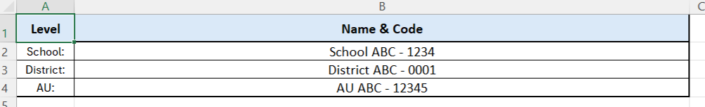
School Profiles: Cover Page
Notes:
The ESSA School Profiles start with a cover page showing the school, district, and administrative unit, or AU, information.

Slide 25
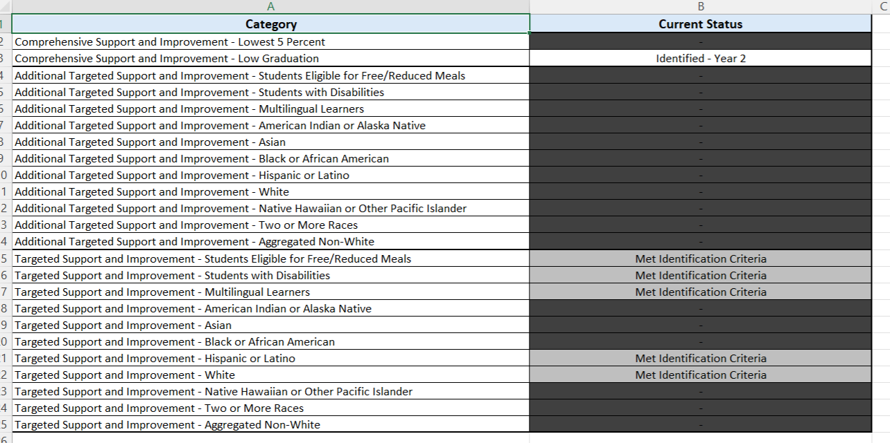
School Profiles: ESSA Identification
Notes:
The next section in the ESSA School Profiles is the ESSA Identification section. A few things to note in this section:
More than one identification category may be noted, if a school meets identification criteria for multiple categories. Schools are only identified for a single category, however, based on prioritization of the categories in the order listed. In this example, you’ll see the school met identification criteria for both CS - Low Grad and TS. The CS - Low Grad identification was prioritized, as evidenced by the Identified status. The TS identification was not prioritized, which is why the status indicates met identification criteria and the information is greyed out.
For CS and ATS designations, the profiles include the consecutive year of identification. In this example, the school is in Year 2 of CS identification.
For ATS and TS designations, the profiles indicate the specific student groups for which schools were identified. In this example, the school met TS identification criteria for multiple student groups, including students eligible for free/reduced meals, students with disabilities, and multilingual learners.
Designations may also indicate On Watch, Due to Participation Only, or Not Exited by District as applicable.

Slide 26
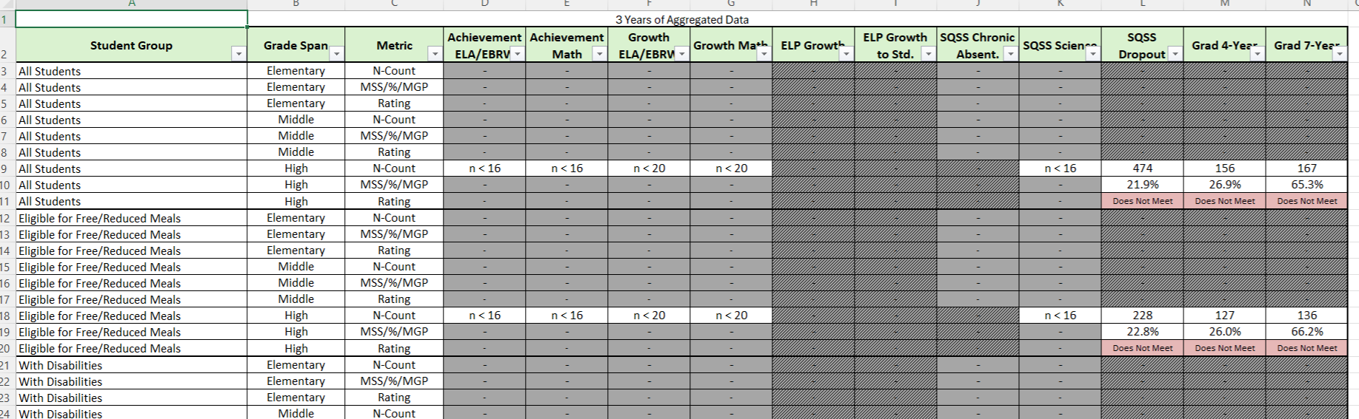
School Profiles: Data
Notes:
The last section in the ESSA School Profiles, labeled Actual Data, includes specific performance data for each student group for each ESSA indicator:
The student group is noted in the first column, followed by grade span, and metric.
If an indicator or grade span does not apply, the information will be greyed out.
If the minimum number of students for a given indicator was not met, the profiles will display n < 16 or n < 20 as applicable.
Otherwise, the profiles will display the n-count, or number of students with data for that metric, specific rate, for example, the mean scale score, median growth percentile, or percentage, and the associated rating. In this example, the Dropout rate is 21.9% for all students, which earns a Does Not Meet rating.
If a school was identified due to participation only, their profile will include their actual mean scale scores, as well as an additional tab labeled “Participation Adjusted Data” which contains their participation-adjusted mean scale scores.

Slide 27
Additional Information
For more information, please visit Colorado’s ESSA Methods and Criteria for Identification of Schools for Support and Improvement Webpage
For additional information regarding the methodology, criteria, or data used to identify schools for support and improvement under ESSA, please contact:
  Tina Negley
    Supervisor, Program Effectiveness Office
    720-766-2793
    negley_t@cde.state.co.us
  Anna Rowan
    ESEA Research Analyst
    720-215-7456
    rowan_a@cde.state.co.us
  Nazie Mohajeri-Nelson
    Executive Director, Federal Programs and Supports Unit
    720-626-3895
    mohajeri-nelson_n@cde.state.co.us
Notes:
For more information, you can visit CDE’s ESSA Methods and Criteria for Identification of Schools for Support and Improvement webpage. CDE will be updating this webpage within the next couple weeks to include a list of schools identified for support and improvement in Fall 2025, and to provide additional resources regarding the methodology.
For any additional questions regarding the methodology, criteria, or data used to identify schools for support and improvement under ESSA, you can contact myself, Anna Rowan, or Nazie.
Thank you!

Slide 28
School Improvement Planning: ESSA-Identified Schools
TS, ATS, CS
Notes:
I am here today to provide guidance and resources for you to support your ESSA-identified schools.

Slide 29

Outcomes
Understand the LEA role in implementing ESSA requirements for school improvement planning for CS, TS and ATS schools.
Utilize planning resources to support school leaders in developing their UIP.

Slide 30
Acronyms - ESSA School Improvement
TS - Targeted Support
ATS - Additional Targeted Support
CS - Comprehensive Support
UIP - Unified Improvement Plan

Slide 31
Unified Improvement Plan: Multiple Purposes
CDE has developed both a process and template to support schools and districts in their performance management efforts.
A mechanism for triggering additional supports through CDE (especially for schools on the accountability clock.
A system to align improvement planning requirements for state and federal accountability into a single plan.
Alignment
Support
A common format for schools and districts to document improvement planning efforts. Schools/districts on the accountability clock must demonstrate a coherent plan for dramatic change and adjustments over time. Reviews conducted by CDE and State Review Panel.
A statewide strategy to promote improvement planning based on best practice, including use of state and local data and engagement in a continuous improvement cycle.
Best Practice
Documentation
Transparency
A process for including multiple voices, including staff, families and community representatives. Plans are posted publicly.
Notes:
Calling your attention to the upper right, the Unified Improvement Plan in Colorado serves as the school improvement planning instrument in which schools meet state and federal accountability requirements.

Slide 32
LEA Role in Supporting ESSA Identified Schools
Which schools have been identified?
What are the requirements in the UIP for CS, TS, and ATS schools?
What is the LEA’s process for reviewing, approving, and monitoring plans?
What supports are available for LEAs to use with school leaders?
What else should LEAs consider?

Slide 33
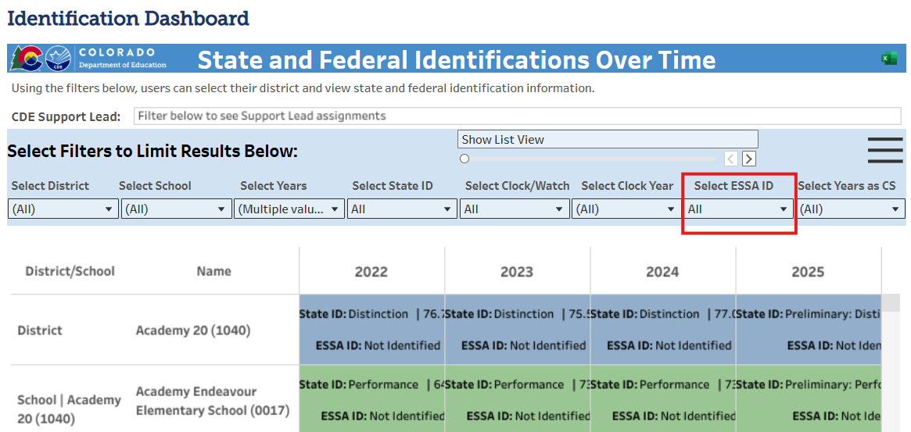
Which schools have been identified?
Refer to the LEA’s Accountability Letter
Use CDE’s Identification Dashboard
Check the ESSA School Improvement Narratives page in the Consolidated Application
Check the ESSA School Improvement Narratives page in the Consolidated Application
Notes:
There are multiple ways to know which schools have been identified for Comprehensive Support (CS), Targeted Support (TS), or Additional Targeted Support (ATS).
Each LEA receives an Accountability Letter at the beginning of the year. https://www.cde.state.co.us/accountability/2025fallaccountabilitynotificationletter
The one-stop shop is the identification dashboard. For ESSA identification, see the drop-down. You can view all schools ESSA identified, or select by CS, TS, and ATS. https://www.cde.state.co.us/accountability/district_identification_dashboard
New this year! The Consolidated Application includes a table of identified schools on the ESSA School Improvement Narratives page.

Slide 34
2. What are the requirements in the UIP for CS, TS, and ATS schools?
ESSA Planning Requirements | UIP Section | CS | TS | ATS
Plans must be developed with stakeholders (including school leaders, teachers, and parents). | Assurances | X | X | X
Stakeholders were made aware of reasons for ESSA identification to inform plan development. | Assurances | X | X | X
Plan is informed by student performance against state-determined long-term goals on each accountability indicator in ESSA. | Student Performance Priorities | X | X | X
Plan includes evidenced-based interventions. | Root Causes and Strategies→ Major Improvement Strategies | X | X | X
Plan includes a school-level needs assessment. | Assurances; Priorities and Targets → Student Performance Priority Evidence and Reasoning | X | Recommended but Not Required | Recommended but Not Required
Plan identifies resource inequities. | Root Causes and Strategies → Root Causes | X | Not Required | X
Plan addresses resource inequities. | Implementation and Actions → Action Steps | X | Not Required | X
Notes:
The table outlining the planning requirements for CS, TS, and ATS schools is available on the ESSA Planning Requirements website. https://www.cde.state.co.us/fedprograms/essaplanningrequirements

Slide 35
3. What is the LEA’s process for reviewing, approving, and monitoring plans?
The LEA’s process for reviewing, approving, and monitoring improvement plans from ESSA-identified schools is shared with CDE through the ESSA School Improvement Narratives in the Consolidated Application.
The ESSA School Improvement Narratives in the Consolidated Application also ask for the process used by the LEA to assist CS and ATS schools with identifying and addressing any resource inequities.
CDE is required to review and approve plans for schools identified as CS.
Notes:
LEAs are required to review and approve plans for TS and ATS schools, as well as CS schools. The state is also required to review and approve plans for CS Schools.

Slide 36
4. What supports are available for LEAs to use with school leaders?
ESSA Planning Requirements
Resource Inequities Planning Requirements
  For CS and ATS Identified Schools
Unified Improvement Planning: Quality Criteria
  The Unified Improvement Plan Quality Criteria supports planning for all schools, including specific criteria for ESSA-identified schools.
  LEAs can also use the Unified Improvement Plan Quality Criteria Rubric for reviewing and approving plans for CS, TS and ATS schools.
  CDE will use the Quality Criteria Rubric for Comprehensive Support Plan Approval for reviewing and approving CS-Identified UIPs.

Slide 37
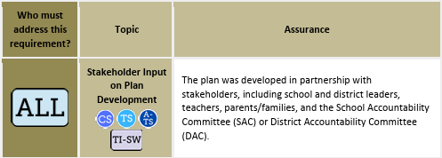
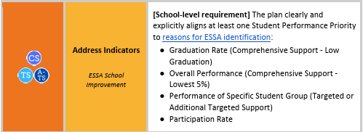
Examples of Quality Criteria
Notes:
The first example shows a planning element that must be addressed by all schools and districts. It is also included in the criteria for approval for CS, TS, and ATS plans.
The second example shows a planning element that is specific to schools with federal identifications.

Slide 38
5. What else should LEAs consider?
UIPs are due on October 15th.
When eligible, schools with additional accountability expectations may still use the biennial flexibility for submission.
Newly identified schools may choose to submit (at the LEA’s discretion) by January 15th to have additional planning time.
For assistance with navigating the UIP tool, email uiphelp@cde.state.co.us.
As always, your Regional Contacts are here to support!

Slide 39
Upcoming Meetings

Slide 40

Looking Ahead…
Any requests for topics or questions?
Upcoming Office Hours
  October 9
  October 23
    Monitoring Training

Slide 41
CDE Contacts!
Emails: Lastname_Firstinitial@cde.state.co.us (e.g., Smith_a@cde.state.co.us)
Federal Programs & Supports (ESEA/ESSER Program Supports) | School Finance & Operations (Fiscal and Systems Supports)
Nazie Mohajeri-Nelson, Executive Director of Federal Programs & Supports Unit Program Specialists Program Implementation Supervisor: Laura Meushaw Program Implementation Coordinator: Christina Adeboye Sullivan Program Monitoring Supervisor: Tammy Giessinger ESEA Monitoring Coordinator: Kristin Crumley Program Effectiveness Supervisor: Tina Negley Program Evaluation & Research Coordinator: Anna Rowan ESEA Programs Specialists and ESEA Regional Contacts (assigned by district) Title I: Laura Meushaw, Evita Byrd, Rachel Echsner, Kim Boylan Title II: Rachel Echsner Title III: Rachel Temple, Kim Boylan Title IV & Stronger Connections Grant: Nathan Hickman, Evita Byrd Title V: Christina Adeboye-Sullivan, Rachel Echsner ESSER Specialist: Kim Boylan ESEA Data and Reporting Specialists Melissa Chaffin (ESEA) Jerry Ring (ESEA) Anna Rowan (ESEA) | Vacant, Executive Director of School District Operations Unit Fiscal Specialists Jennifer Austin, Director of Grants Fiscal Management ESEA Robert Hawkins, Grants Fiscal Analyst Steven Kaleda, Grants Fiscal Analyst ESSER Fiscal Specialist Steven Kaleda Grants Fiscal Analyst ESSER Monitoring Bill Parsley, ESSER Fiscal Monitoring Supervisor Hilery Morris, ESSER Fiscal Monitoring Application Systems Specialists DeLilah Collins, Director of Grants Program Administration Online Applications Systems Technical Support Jessica Hollingshead Michelle Prael

