Slide 1
CDE ESEA and ESSER Office Hours
August 29, 2024

Slide 2
ESEA/ESSER Office Hours
Topics:
Upcoming ESEA Foundations Training
ARP ESSER III Liquidation Extensions
ESSER Reporting Requirements

Slide 3
ESEA Reminders and Updates

Slide 4
ESEA Foundations Training
October 10, 2024 from 1:30-4:00 PM
The Federal Programs and Supports Unit will host an “ESEA Foundations” training. Federal programs directors and district staff who are new to managing federal funds are welcome to attend. The training will provide information on each ESEA program and will highlight a variety of tools and resources for understanding and meeting the ESEA requirements. Time will be reserved during the training for networking within regions. Register here.
Notes:
Rachel E.

Slide 5
ARP ESSER III Liquidation Extensions
Notes:
Nadine, Kriselda

Slide 6
Liquidation Extension Requests
The U.S. Department of Education (USDE) is accepting liquidation extension requests from State Educational Agencies (i.e., CDE) on behalf of the State and all subrecipients of ARP ESSER III grantees for any allowable activities that are properly and fully obligated by September 30, 2024! CDE must submit a request to USDE for approval before extensions can be granted.
Connection to COVID-19 pandemic still required!
Activities must be allowable under ARP ESSER III, reasonable, and necessary to to respond to, recover from, or emerge stronger from the pandemic!
Activities must be in the LEA/grantees’ application for funds (even if submitted through a Post Award Revision).
CDE has created a process for LEA/grantees to submit a request for CDE to include in our State’s submission to USDE for review and approval.
Notes:
Nazie

Slide 7
ARP ESSER III Liquidation Extensions
Obligation and Liquidation Requirements
Program | Obligation Deadline | Liquidation Deadline for LEAs and CBOs | Liquidation Deadline for CDE (Statutory 120 days) | Liquidation Extension Deadline (up to 14-months)
CARES Act: ESSER 1, GEER 1 | September 30, 2022 | November 15, 2022 | January 28, 2023 | March 28, 2024
CRRSA Act: ESSER II, GEER II, EANS 1 | September 20, 2023 | November 15, 2023 | January 28, 2024 | March 31, 2025
ARP Act: ARP ESSER, ARP EANS | September 30, 2024 | November 15, 2024 | January 28, 2025 | March 28, 2026
Notes:
Kriselda

Slide 8
What does it mean to “Obligate” Funds?
The regulations at 34 C.F.R. § 76.707 govern when an obligation of Federal funds by a State or subgrantee such as an LEA occurs. Specifically, the obligation is made on the date that the State or subgrantee makes a binding written commitment to obtain the services, work, or products.
For rental or lease of real or personal property, the obligation is made when the property is used.
For salaries and benefits, the obligation is made when the services are provided (i.e., work is done).
For contracts, the obligation is made when the agreement between both parties is made official.
Notes:
Kriselda

Slide 9
Obligation and Liquidation Requirements
If the obligation is for - | The obligation is made
a) Acquisition of real or personal property | On the date on which the State or subgrantee makes a binding written commitment to acquire the property.
b) Personal services by an employee of the State or subgrantee | When the services are performed.
c) Personal services by a contractor who is not an employee of the State or subgrantee | On the date on which the State or subgrantee makes a binding written commitment to obtain the services.
d) Performance of work other than personal services. | On the date on which the State or subgrantee makes a binding written commitment to obtain the work.
e) Public utility services | When the State or subgrantee receives the services
f) Travel | When the travel is taken
g) Rental of real or personal property | When the State of subgrantee uses the property
h) A pre-agreement cost that was properly approved by the Secretary under the cost principles in 2 CFR part 200, Subpart E – Cost Principles | On the first day of the grant or subgrant performance period
Notes:
Kriselda

Slide 10
What does it mean to “Liquidate” Funds?
The drawing down and expenditure of funds by a grantee for obligations incurred during the grant’s legal obligation period. Timely liquidation occurs during the project performance period and through the first 120 days for the State and 90 days for LEAs/subrecipients after the final day of that period or an extension of that period authorized by ED, pursuant to 2 C.F.R. § 200.344(b).
Notes:
Kriselda

Slide 11
Why Late Liquidation
Additional time to draw down COVID-relief funds so timely obligated activities can be paid
Additional time to carry out contracts, or other properly made obligations, for allowable activities when those obligations were made on or before the statutory deadline of September 30, 2024
Cautions:
  Late liquidation extends the reporting and monitoring periods.
  Prepayment is discouraged and considered a high risk activity
  The obligation date of September 30, 2024 is set in statute and cannot be extended by U.S. Department of Education, nor CDE
Notes:
Kriselda

Slide 12
What activities are eligible?
Activities that contribute to the acceleration of academic success for students, including those furthest from opportunity and with the greatest need
Three main evidence-based strategies to consider
  Increasing daily student attendance
  Providing high-quality tutoring
  Increasing access to before, after, and summer learning and extended learning time
Any allowable costs of ARP ESSER
Notes:
Nadine

Slide 13
Examples of Allowable Expenses for Liquidation Extension
Projects that promote regular student attendance and reduce chronic absenteeism, such as early warning intervention systems or home visits programs
Contracted evidence-based tutoring services throughout the 2024-25 school year and other contracted services such as:
  Provide after school and extended learning time during the 2024-25 school year
  Provide summer learning opportunities for 2024-25 school year
  Counseling services to address mental health needs
Professional development and coaching to educators to build math and literacy instructional capacity provided by a contracted vendor
Targeted improvements to school infrastructure to enhance indoor air quality and environmental safety that keep students healthy in school
Notes:
Nadine

Slide 14
Examples of Unallowable Expenses for Liquidation Extensions
Salary and benefits of school or LEA/Grantee employees after 9/30/24
Stipends paid after 9/30/24 to participate in PD opportunities, provide tutoring, or provide extended learning opportunities to students
Substitutes paid after 9/30/24
Not enough time to obligate the funds
Notes:
Nadine

Slide 15
Considerations
Approval is NOT guaranteed
  U.S. Department of Education has final approval authority
Approval is a function of completeness of the information, timeliness/validity of the obligation, and a prior approval of the activity in the LEAs/grantees’ application or Post Award Revision
Be sure to provide enough information to clearly indicate proper and timely obligations
  LEAs/grantees must submit evidence of obligation at the time of submitting request to CDE
Additional details are necessary when referencing costs related to contracted services
LEAs/grantees must provide a justification regarding the necessity of a liquidation extension. Avoid having the same Use of Funds Justification for each line item
Notes:
Nadine

Slide 16
How to Apply
Fill out a SmartSheet Application with the following information
  LEA/Grantee name, number and UEI
  LEA/Grantee contact name, number, and email
  Funding source the activities come from (90%, Supplemental, State Reserve)
  Total award allocation for that funding source
  Total amount of obligated funds needing an extension
Notes:
Nadine

Slide 17
How to Apply continued
Complete and upload the included Excel Spreadsheet with a line item breakdown for each activity which needs a liquidation extension
  Cover Page
  Budget ID Reference Number AND Activity Name
  Amount obligated, amount liquidated, balance remaining, amount of obligated funds needing extension
  Use of Funds that an extension is being requested for
  Justification as to why these funds need an extension
  Name of documentation of full and proper obligation by 9/30/24
Notes:
Nadine

Slide 18
How to Apply continuation
Upload the completed spreadsheet to the Smartsheet Application
Upload required documentation to the Smartsheet Application
  Copy of the contract for services, purchase order or communication with vendors, contract with change order, etc. to support the request and demonstrate full and proper obligation
Submit ONE application for EACH funding source that has activities you are requesting an extension for
  Submit by October 15, 2024
Notes:
Nadine

Slide 19
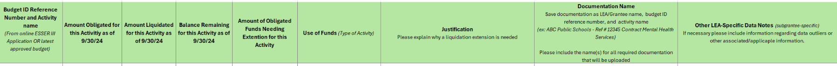
Example of Strong Request
Example of a Strong Request
Budget ID Reference Number: 12345 and Activity Name: Contracted Mental Health Services
Amount Obligated for this Activity as of 9/30/24: $465,097
Amount Liquidated for this Activity as of 9/30/24: $5,097
Balance Remaining this Activity as of 9/30/24: $460,000
Amount of Obligated Funds Needing Extension for this Activity: $460,000
Notes:
Nadine

Slide 20
Example of Strong Request Continued
Example of a Strong Request continued
Use of Funds: Mental health telehealth services; delayed SEL materials (supply chain)
Justification: LEA had contracted for mental health support services to high school students; however, the original vendor went out of business and services could not be completed. A new vendor had to be hired for services in the 2024-2025 school year. New contract was scheduled for Board approval on 8/1/24 with contract execution occurred by end of August 2024 (using funds not reflected as obligated). CONTRACT FULLY OBLIGATED prior to 9/30/24.
Notes:
Nadine

Slide 21
Strong Request Continued
Example of a Strong Request continued
Documentation Name: ABC Public Schools-Ref # 12345 Contract Mental Health Services
Other Specific Data Notes: New contract will provide 300 hours of services.
Notes:
Nadine

Slide 22
Approval and Follow Through Process
ESSER Team Leads will review the submitted application for completeness and reach out with any further questions
Once ESSER Team Leads approve the request it is passed off to members of the ESSER Steering Committee for approval
Once approved by the ESSER Steering Committee the request will be added to CDE’s template to submit to U.S. Department of Education
When CDE receives approval from U.S. Department of Education the LEA will be notified of final approval
LEA will be required to submit a Post Award Revision to add / revise the extended activity, if any additional changes are needed
LEA/grantee will make payments and submit a Request for Funds Form to request reimbursement.
Notes:
Nadine

Slide 23
Start Planning Now
If you are considering requesting a liquidation extension, please email Nazie Mohajeri-Nelson to set up a time to discuss the activity(ies) for which an extension will be requested
Gather documentation of the full and proper obligation
Document reasons for needing a liquidation extension
Notes:
Nadine

Slide 24
Application Links
ARP Late Liquidation Extension SmartSheet Request Form
Excel Spreadsheet
  Link is also available on the Smartsheet
Notes:
Nadine

Slide 25
Important Deadlines
CDE must submit to U.S. Department of Education by December 31, 2024
LEAs and CBOs must submit to CDE by October 15th, 2024
Requests may only include any allowable costs that have been obligated by September 30, 2024 and already approved by CDE as allowable, reasonable, and necessary to respond to, recover from, or emerge stronger from the pandemic.
For activities that will not be liquidated by November 15, 2024
Notes:
Kriselda

Slide 26
Resources
CDE’s Multi-Year Educational Subscriptions Guidance
CCSSO ARP ESSER III Late Liquidation Fact Sheet
U.S. Department of Education Late Liquidation Webinar
Notes:
Kriselda

Slide 27
Contacts
Nazie Mohajeri-Nelson
  mohajeri-nelson_n@cde.state.co.us
  720-626-3895
Nadine Penn
  penn_n@cde.state.co.us
  720-795-2352
Kriselda Craven
  craven_k@cde.state.co.us
  720-355-1118
Notes:
Kriselda

Slide 28
ESSER Reporting Requirements
Notes:
Tina

Slide 29
ESSER Annual Performance Report
The U.S. Department of Education has been authorized by Congress to collect data from all ESSER I, II, and III grantees, including but not limited to the uses and impact of funds. CDE is able to use the ESSER I, II, and III applications to provide the vast majority of the requested data on behalf of our grantees, with the exception of the following data points:
How students with poor attendance or participation have been re-engaged;
How school-level allocations were determined; and
LEA participation in specified ESSER activities.
This is an annual reporting requirement that is a year lagged for each year corresponding with the uses of ESSER I, II, and III funds. For example, in May 2024, CDE reported data for the 2022-2023 ESSER-funded activities.
Notes:
Tina

Slide 30
Re-Engaging Students Survey
All districts will receive a Google Form consisting of the following questions:
Did your LEA seek to re-engage students with poor attendance or participation?
If Yes, how did the LEA seek to re-engage students with poor attendance or participation? (check all that apply)
  Direct outreach to students
  Engaging the school district homeless liaison
  Partnering with community-based organizations
  Offering home internet service and/or devices
  Implementing new curricular strategies to improve student engagement
  Offering credit recovery and/or acceleration strategies
  Other: please describe
Notes:
Tina

Slide 31
Allocating Funds Survey
Only those districts that budgeted funds at the school-level (public schools, including charter schools) during the relevant school year will receive a Google Form consisting of the following questions:
How did your LEA allocate ESSER (I, II, and/or III) funds? (check all that apply)
  Flat amount per school or per pupil
  Number or proportion of students at the school with specific curricular needs, such as students with disabilities or English language learners
  Number or proportion of students at the school who are eligible for Free or Reduced-Price Lunch and/or other indicators of low-income background
  Measure(s) of lost instructional time (“learning loss”)
  Stakeholder or community input
  Title I status
  Other: please describe
Notes:
Tina

Slide 32
LEA Participation in ESSER Activities Template
All subgrantees will receive an Excel template to report on the following:
How did the LEA use ESSER (ESSER I, ESSER II and/or ARP ESSER III) funds to support learning recovery or acceleration for student groups who were disproportionately impacted by the COVID-19 pandemic?
  Evidence-based summer learning or summer enrichment programs
  Evidence-based afterschool programs
  Extended instructional time (including extended school day, week, or year)
  Evidence-based high dosage tutoring
  Early childhood education program expansion or enhancement
  Full-service community schools
  Purchasing educational technology
Notes:
Tina

Slide 33
Summer Learning, Afterschool Programs, and High Dosage Tutoring
If the LEA used ESSER funds for evidence-based summer learning or summer enrichment programs, evidence-based afterschool programs, or evidence-based high dosage tutoring:
Is this program available to all students?
  If no, indicate the number of students this program serves at full capacity.
Total unique headcount of students that participated in this activity.
Indicate the number of eligible students and the number of students that participated in the activity (within each student group).
  Eligible refers to students within the student group who meet eligibility criteria for participation, such as belonging to the appropriate grade for the activity.
Notes:
Tina

Slide 34
Extended Instructional Time
If the LEA used ESSER funds to implement extended instructional time:
Is extended instructional time in place at all schools within the LEA?
  If yes, no further response is required.
If no, indicate the unique headcount of students enrolled in schools within the LEA with mandatory extended instructional time.
Indicate the number students from each student group enrolled in schools with extended instructional time.
Notes:
Tina

Slide 35
Early Childhood Education Program Expansion or Enhancement
If the LEA used ESSER funds to implement early childhood education program expansion or enhancement:
Did this LEA expand or enhance its early childhood program?
If programs were expanded, then:
  How many additional students or slots were funded with ESSER I, ESSER II or ARP ESSER in the most recent school year? Please include students or slots that were fully and partially funded with ESSER I, ESSER II, or ARP ESSER funds.
  Total unique headcount of students enrolled in an early childhood education program within the LEA.
  Indicate the number of students from each student group enrolled in an early childhood education program within the LEA.
Notes:
Tina

Slide 36
Full-Service Community Schools
If the LEA used ESSER funds to implement full-service community schools:
How many new or additional full-service community schools were launched using these funds in this LEA?
How many current full-service community schools received additional services and/or support using these funds?
What is the total enrollment in full-service community schools supported with ESSER funds within this LEA?
Notes:
Tina

Slide 37
Purchasing Educational Technology
If the LEA used ESSER funds to purchase educational technology:
Was educational technology purchased for all students?
If no, indicate the number of students for whom educational technology was purchased.
Indicate the number of eligible students and the number of students that received or were directly supported by the educational technology (within each student group).
Notes:
Tina

Slide 38
Applicable Student Groups
Where applicable, counts must be reported separately for each of the following student groups:
Students with one or more disabilities
Low-income students
English learners
Students in foster care
Migratory students
Students experiencing homelessness
By each major racial/ethnic group
Other student population
  Grantees should only report students counts in this category if the LEA provided programs that targeted specific student groups that are not included in the list of defined categories.
Notes:
Tina

Slide 39
Reporting Deadlines
Data must be collected for the 2023-24 and 2024-25 school years:
SY 2023-24 collections will be due December 20, 2024.
SY 2024-25 collections will be due July 28, 2025 to accommodate late liquidations, but can be submitted as soon as data are available.
CDE will begin disseminating surveys the beginning of September.
Notes:
Tina

Slide 40
Reporting Multiple School Years
To streamline the data collection process, CDE will disseminate surveys/templates for both school years simultaneously.
Re-Engaging Students Survey and School-Level Allocation Survey will consist of separate Google Forms for each school year.
  Each Google Form should only be submitted once per year upon completion.
LEA Participation in ESSER Activities templates will include sections for reporting both school years.
  If data are available for both school years, LEAs may submit a single template containing data for both years by December 20, 2024.
  If data for SY 2024-25 are not yet available, LEAs may initially submit a template containing data for SY 2023-24 only, but revise and resubmit the template to include data for SY 2024-25 at a later date.
Notes:
Tina

Slide 41
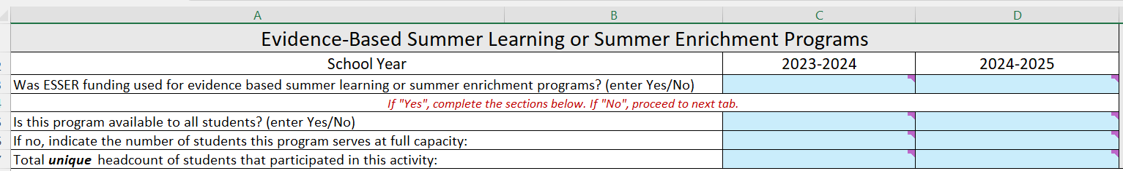
LEA-Level Template, Reporting by Year
LEAs can use the “2023-2024” column to report activities that occurred from July 1, 2023 to June 30, 2024.
LEAs can use the “2024-2025” column to report activities that occurred from July 1, 2024 to September 30, 2024 or activities that continued beyond September (grantees receiving liquidation extensions or fully obligated activities that carried into the liquidation period).
Notes:
Tina

Slide 42
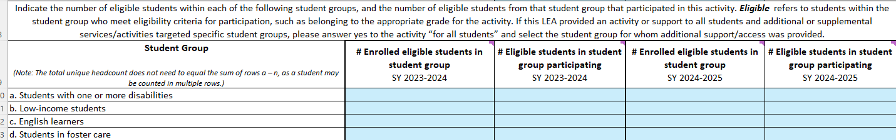
LEA-Level Template, Reporting Student Counts by Year
The number of eligible students and the number of students participating should also be reported separately by school year.
Notes:
Tina

Slide 43
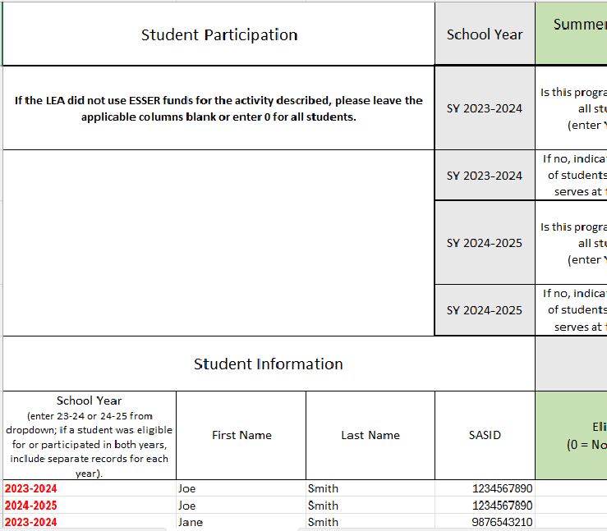
Student-Level Template, Reporting Students by Year
Column A (in red) has been added to indicate the School Year for each student record provided.
Notes:
Tina

Slide 44
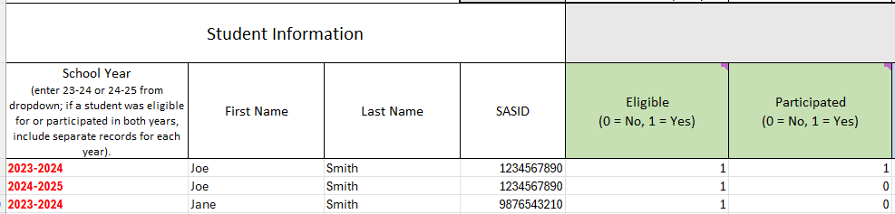
Student-Level Template, Participation by Year
A complete list of eligible and participating students should be submitted for each school year.
  Please note, if a student was eligible and/or participated for both school years, two records (one for SY 2023-24 and one for SY 2024-25) should be submitted for that student. See example for Joe Smith above.
Notes:
Tina

Slide 45
Next Steps
CDE will send forms to LEAs via email
Forms will be posted on CDE’s website
Additional Office Hours will be announced for seeking technical assistance on the forms if needed
One-on-one support can be requested by emailing Yazmine Patino to request to schedule a date and time for TA

Slide 46
Upcoming Meetings

Slide 47

Looking Ahead…
Any requests for topics or questions?
Upcoming Office Hours
  September 12
    Monitoring & RFF Training
  September 26
    Four-week Letter Notifications

Slide 48
CDE Contacts!
Emails: Lastname_Firstinitial@cde.state.co.us (e.g., Smith_a@cde.state.co.us)
Federal Programs & Supports (ESEA/ESSER Program Supports) | School Finance & Operations (Fiscal and Systems Supports)
Nazie Mohajeri-Nelson, Executive Director of Federal Programs & Supports Unit Program Specialists Program Implementation Supervisor: Laura Meushaw Program Implementation Coordinator: Christina Adeboye Sullivan Program Monitoring Supervisor: Tammy Giessinger ESEA/ESSER Monitoring Coordinator: Kristin Crumley Program Effectiveness Supervisor: Tina Negley Program Evaluation & Research Coordinator: Anna Rowan ESEA Programs Specialists and ESEA Regional Contacts (assigned by district) Title I: Laura Meushaw, Evita Byrd, Rachel Echsner, Kim Boylan Title II: Rachel Echsner, Sue Miller-Curley Title III: Rachel Temple, Kim Boylan Title IV & Stronger Connections Grant: Nathan Hickman, Evita Byrd Title V: Christina Adeboye-Sullivan, Rachel Echsner ESSER Program Specialists Jonathan Schelke Kim Boylan Kriselda Craven Nadine Penn ESEA and ESSER Data and Reporting Specialists Melissa Chaffin (ESEA) Jerry Ring (ESEA) Anna Rowan (ESEA) Ian Ray (ESSER) | Vacant, Executive Director of School District Operations Unit Fiscal Specialists Jennifer Austin, Director of Grants Fiscal Management ESEA Robert Hawkins, Grants Fiscal Analyst Steven Kaleda, Grants Fiscal Analyst ESSER Fiscal Specialist Steven Kaleda Grants Fiscal Analyst ESSER Monitoring Bill Parsley, ESSER Fiscal Monitoring Supervisor Hilery Morris, ESSER Fiscal Monitoring Kristina Jones, Federal Fiscal Monitoring and Reporting Specialist Werner Hagemann, ESSER Fiscal Monitoring Specialist Application Systems Specialists DeLilah Collins, Director of Grants Program Administration Online Applications Systems Technical Support Jessica Hollingshead Michelle Prael

