Slide 1
CDE Office Hours
August 27, 2020
Notes:
Nazie

Slide 2
Agenda for Today
ESSER reminders – Nazie
Guidance from USDE: serving preschools (ESSER) – Nazie
  Impact of serving preschools on NPS – DeLilah
Quick update on NPS IFR (ESSER/GEER) – DeLilah
Reporting update (CRF) – Jennifer Austin
Quick update on EDT (ESEA) – Jeremy Meredith
Considerations for using various funding streams to support formerly Title-funded positions/teachers to teach online (ESEA) - Jeremy Meredith
ESEA, ESSER, and CRF Q&A Session
Notes:
Nazie

Slide 3
Reminders and Updates
Notes:
Nazie

Slide 4
ESSER Applications
Please make sure that the correct contact information has been entered on your ESSER applications! Emails have been bouncing back as we have tried to send your final approval letters and Grant Award Letters!
Notes:
Nazie or Steven

Slide 5
ESSER: Updated Guidance from U.S. Department of Education
Q: May an LEA or State Education Agency (SEA) use ESSER funds to provide teachers with young children childcare services?
A: Yes, if the costs are reasonable and constitute a necessary response to the COVID-19 pandemic. See Sections 18003(d) of the CARES Act and 2 CFR §§ 200.403-200.405.
For example, an LEA might contract with a daycare provider to make spaces available for teachers with young children whose regular daycare services are unavailable due to COVID-19 so that those teachers can continue to provide educational services to students. See CARES Act section 18003(d)(12).
An LEA might also provide a retention incentive to teachers with young children that could offset the cost for childcare in order to retain those teachers, which is an allowable use of funds under Title II of the ESEA, if teacher retention is a challenge due to COVID-19. See CARES Act section 18003(d)(1).
Notes:
Nazie

Slide 6
ESSER: Updated Guidance from U.S. Department of Education cont.
Q: May an LEA or SEA use ESSER funds for a pre-kindergarten or other early childhood education program?
A: Yes. Because an early childhood education program is an allowable use of funds under the ESEA, it is allowable under the ESSER Fund if the need for the program is in response to COVID-19, and the costs of the program are reasonable and necessary. CARES Act section 18003(d)(1); 2 CFR §§ 200.403-200.405.
ESEA section 8101(16) defines “early childhood education program” as it is defined in the Higher Education Act of 1965. Under that definition, an “early childhood education program” is:
  a Head Start program or an Early Head Start program carried out under the Head Start Act (42 U.S.C. 9831 et seq.), including a migrant or seasonal Head Start program, an Indian Head Start program, or a Head Start program or an Early Head Start program that also receives State funding;
  a State licensed or regulated childcare program; or
  a program that—
    serves children from birth through age six that addresses the children’s cognitive (including language, early literacy, and early mathematics), social, emotional, and physical development; and (ii) is— (I) a State prekindergarten program;
    a program authorized under section 619 or part C of the Individuals with Disabilities Education Act; or
    a program operated by [an LEA].
    To be an allowable use of funds under section 18003(d)(1) of the CARES Act, an early childhood education program funded under ESSER must meet this definition. CARES Act section 18007(8).
Notes:
Nazie

Slide 7

ESSER Pre-School – Consultation Requirements
How does this new guidance on preschool impact the NPS consultations?
LEAs that provide services to district pre-k programs will need to consult with not for profit non-public pre-schools.
Notes:
DeLilah

Slide 8
Providing Equitable Services to Non-Public Schools with CARES Act Funding
CDE Guidance released 8.18.2020
  Represents FAQ questions and guidance on IFR
  Provides the calculations for proportionate share under the two methods for supporting public school students and teachers with ESSER funds
  NOTE: the attendance area requirement goes away under the IFR
Updated Consultation Forms
  CARES Act Non-public Schools Certification
  CARES Act Non-public Schools Certification Addendum
    Both forms are updated to capture the public and non-public student counts.
Notes:
DeLilah

Slide 9
Update: Non-Public Schools
On Friday, August 20, a federal judge in Washington State issued a preliminary injunction against the IFR. At least two other lawsuits are also pending, challenging the IFR. Although USDOE is currently enjoined from enforcing the IFR, the litigation is in its early stages. Other courts (including appellate courts) may come to different conclusions and may even vacate the injunction. CDE recognizes that the unsettled legal issues makes it difficult for districts to determine how to provide equitable services. Given this ongoing uncertainty, LEAs should consult with counsel when determining how to calculate proportionate share for non-public schools. CDE's ESSER application will allow LEAs to calculate proportionate share in accordance with how districts plan to provide equitable services to non-public schools.
Notes:
DeLilah

Slide 10
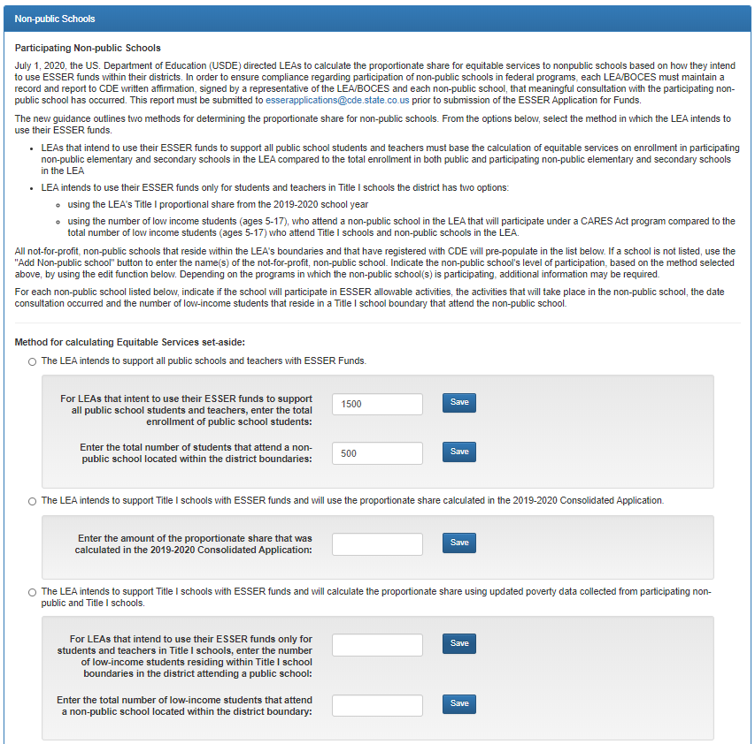
UPDATE: ESSER Application NPS Proportionate Share Calculation

Slide 11
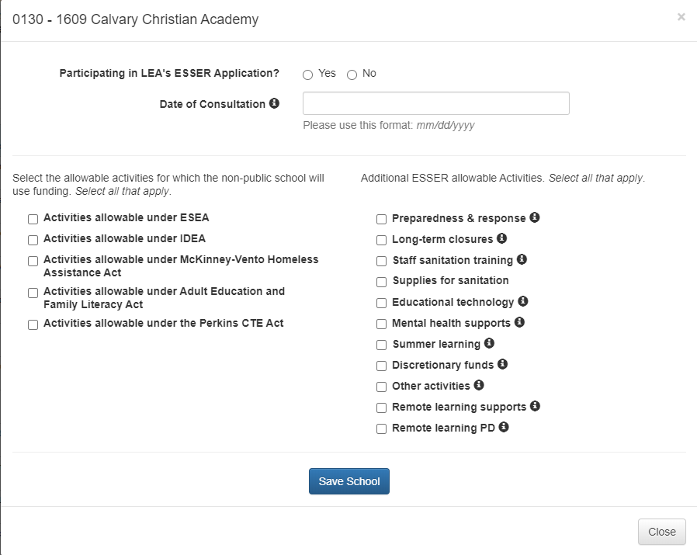
UPDATE: ESSER NPS School Participation
LEAs are no longer required to indicate the Title I School boundary in which the non-public school resides.
Notes:
DeLilah

Slide 12
Reporting Requirements
Jennifer Austin
Notes:
Jennifer Austin

Slide 13
UPDATE: CRF and ESSER Fund Reporting
CRF Funds – Funds Expire 12/30/2020
  Reporting timeline will be extremely tight!
  CDE must collect and report ACTUAL EXPENDITURES through 9/30/2020 no later than 10/2/2020 (we realize your fiscal activity will not be complete for Sept. on this timeframe, quarterly report will be cumulative)
  2nd Report will likely be due approx. 1/3/2021
  CDE is required to provide this detail for all awardees who received $50k or more
  CDE will be required to provide the State Controller’s Office the Detail by 10/3/2020
  GFMU is developing an Excel Workbook reporting specific categories required per the US Treasury
  More details and training to follow on how to complete the CRF Workbook coming VERY soon
ESSER Funds
  Monthly ESSERF reporting will be completed through existing FFATA reporting through CDE Grants Fiscal
  Annual reporting of ACTUAL EXPENDITURES will be managed via the ESSER online application site, with the functionality to enter actual expenditures by approved budget line item
Specific Training and Office Hours will be provided on reporting requirements when finalized.
Notes:
DeLilah

Slide 14
Schooling in SY20-21 and ESEA implications:
EDT and Staff Reassignments
Notes:
Jeremy Meredith

Slide 15
Implications of COVID-19 on Schooling in SY20-21
Health and safety of students and staff is paramount.
Districts are balancing health and safety and delivering quality instruction. Student cohorts, virtual learning academies, and hybrid approaches to in-school learning are being implemented according to local needs.
These approaches are impacting school and even district-level staff assignments.
The staffing needs brought on by COVID-19 have raised new questions about ESSA educator requirements, namely Equitable Distribution of Teachers (EDT). Shifts in staff assignments have also impacted Consolidated Application plans and budgets.
Notes:
Jeremy

Slide 16
EDT Overview and Discussion
Indicator | Definition
Effective | Teacher’s evaluation rating, based on Colorado’s Educator Quality Standards, is Effective or Highly Effective. Half of this rating is based on professional practices; half is based on measures of student learning/outcomes.
In-Field | Teachers with at least one of the following, in the subject they teach: Endorsement on a Colorado teaching license Degree (bachelor’s or higher) 36 semester hours Passing a State Board of Education-approved content exam
Experienced | Teachers with 3 or more full years of K-12 teaching experience (regardless of state).
ESSA requires LEAs accepting Title I, Part A funds to address any disparities in low-income students or minority students’ access to effective, experienced, or in-field teachers compared to their higher-income, non-minority peers. (ESSA, §1112 (b)(2)).
Good to know! LEAs with less than 1,000 students enrolled or only one school per grade span are exempted from EDT analyses.
More information on EDT requirements is located here Educator Qualifications under ESSA and here: Equitable Distribution of Teachers.
Notes:
Jeremy

Slide 17
Staff Assignments and ESEA Plans and allowability of Title Program activities
Please closely consider the impact of staff reassignments or shifting of roles to implement student cohorts, virtual learning, hybrid models, etc. on Title Program allowability.
ESEA Title Program Allowable Uses of Funds, outstanding questions
How Staff are Funded and Federal Requirements. The CARES Act is silent on educator qualification requirements. However, ESSA requirements still apply, because they are dependent on the district acceptance of Title I funds, rather than origin of funding for staff salaries/benefits. So staff supported through CRF or ESSER, just as staff funded by state/local, are all under the same federal requirements.
Notes:
Jeremy

Slide 18
Questions?
Requests for Future Topics?

Slide 19
CDE Team Contact Information
CRF
Jennifer Okes, Chief Operating Officer (okes_j@cde.state.co.us)
Adam Williams, Financial Data Coordinator (Williams_a@cde.state.co.us)
Kate Bartlett, Turnaround Program Manager (Bartlett_k@cde.state.co.us)
…in partnership with the Governor’s Office and Office of the State Controller
ESSER
Nazie Mohajeri-Nelson, Director of ESEA Office (mohajeri-nelson_n@cde.state.co.us)
DeLilah Collins, Assistant Director of ESEA Office (collins_d@cde.state.co.us)
Grants Fiscal
Jennifer Austin, Director of Grants Fiscal Management (Austin_j@cde.state.co.us)
Robert Hawkins, Grants Fiscal Analyst (Hawkins_s@cde.state.co.us)
Steven Kaleda, Grants Fiscal Analyst (Kaleda_s@cde.state.co.us)
EDT and Staff Reassignments
Jeremy Meredith, Title II Specialist (meredith_j@cde.state.co.us)

