Slide 1
CDE Office Hours
June 15, 2023

Slide 2
ESSER Office Hours
Topics
Updates and Reminders
2023-24 Cons App Optional Statements
Upcoming ESSER II Deadlines
Corporal Punishment
Title II Funding
Liquidation Extension Process
ESSER Reporting Requirements Q&A

Slide 3
Updates and Reminders

Slide 4
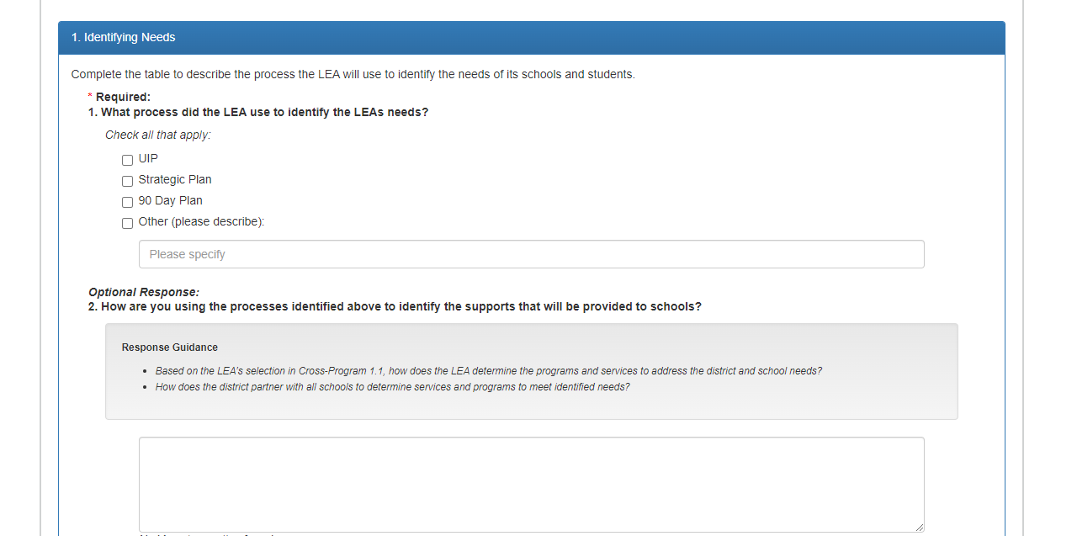
Required vs. Optional Questions
All questions will either indicate whether a question is required or optional:
- Optional
APPLICATION SCREENSHOT
Notes:
Laura

Slide 5
Consolidated Application Reminder
All narrative questions must include a response
All required questions must include an updated response
All optional questions must include
Optional Responses Text OR
A response that addresses current context
Select the check box (Title I Question 3 and 4) if applicable.
Some questions are optional but there is
a funding component that requires a check box. (Cross Program 4.2)
Notes:
Laura

Slide 6
ESSER II PAR Deadline
Any ESSER II or III application revisions, including budgeting placeholders and addressing outstanding comments, must be submitted for approval by June 30, 2023 and June 30, 2024, respectively.
ESSER II and III post-award revisions for 2022-2023 activities are due on or before June 30, 2023.
Other Important Dates
ESSER II funds must be spent on or before September 30, 2023
ESSER II Request for Funds are due by November 1, 2023
Resources
ESSER launchpad page- includes deadlines and resources
Request for funds webpage
ESSER Lead Reviewer list- CDE staff to contact with questions
Notes:
Mackenzie

Slide 7
Corporal Punishment
Notes:
Laura

Slide 8
H.B. 23-1191 Prohibit Corporal Punishment Of Children
During the 2023 legislative session, the Colorado General Assembly approved H.B. 23-1191 Prohibit Corporal Punishment Of Children
Updates state statute to expressly prohibit a person employed by or volunteering in a public school, a state-licensed child care center, a family child care home, or a specialized group facility from imposing corporal punishment on a child.
Defines corporal punishment as as “the willful infliction of, or willfully causing the infliction of, physical pain on a child.”
Many districts already have a policy prohibiting corporal punishment
Notes:
Melissa Bloom

Slide 9
Corporal Punishment
U.S. Department of Education - Dear Colleague Letter
Corporal punishment reduces feelings of safety and physical, emotional, and mental well-being
Research has shown that corporal punishment in schools is associated with
Lower academic performance and achievement
Higher rates of mental health issues, such as mood, anxiety, and other personality disorders
Higher rates of aggression, antisocial behavior, and other externalizing problems
Lower cognitive ability, verbal capacity, and brain development delays
Practice continues in some schools even to this date
When/where corporal punishment is used, student groups are disproportionately impacted
Corporal punishment was used at a higher rate on students of color, particularly boys
Notes:
Laura

Slide 10
Request and Resources
Encourage uses of evidence-based strategies
Multi-tiered systems of support
Positive behavioral interventions and supports
Other evidence-based practices that meet students’ social, emotional, and mental health needs
Focusing on improving school climate and safety
Funds that can be used for this purpose
American Rescue Plan Act of 2021,
Bipartisan Safer Communities Act, and
Elementary and Secondary Education Act, most recently reauthorized as the Every Student Succeeds Act (ESSA)
USDE Technical Assistance Centers
Best Practices Clearinghouse,
National Center on Safe Supportive Learning Environments, and
National Center to Improve Social and Emotional Learning and School Safety

Slide 11
State and District Use of Title II, Part A
Funds in 20-21
Information provided by
Office of Elementary and Secondary Education,
U.S. Department of Education
Notes:
Karen

Slide 12
Title II, Part A Funds
Title II, Part A Funds Support:
Increased student achievement
Improved educator quality and effectiveness
Increased number of effective educators
Increased access to effective educators for low income and minority students

Slide 13
Use of Title II, Part A Funds
How did States and Districts most commonly use Title II-A funds?
States:
Program Administration
Monitoring
Technical Assistance
Districts:
Professional Development

Slide 14
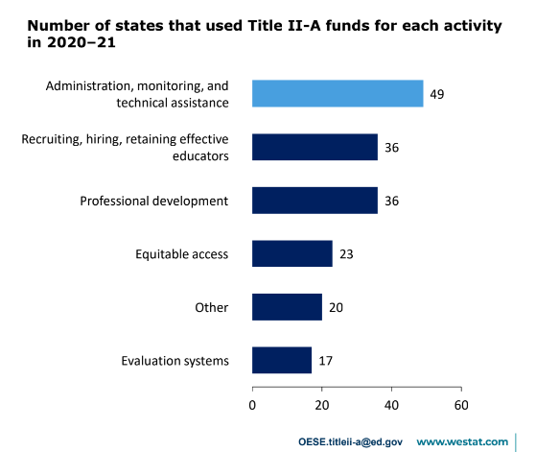
States: Use of Title II-A Funds
States:
At the state level, the most common use of Title II-A was related to program administration, monitoring, and technical assistance.

Slide 15
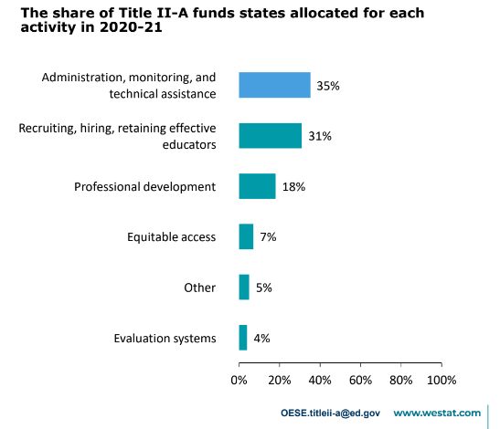
States: Use of Title II-A Funds
States:
At the state level, the largest share of state-level allocations supported administration, monitoring, and technical assistance.

Slide 16
States: Use of Title II-A Funds
State Professional Development Spending
36 States used funds for professional development
Most of the funds states spent on professional development were devoted to programs for principals (26 states and $8.6 million).
States reported supported professional development to improve instruction and instructional leadership in STEM (21 states and $3.8 million), among other things.

Slide 17
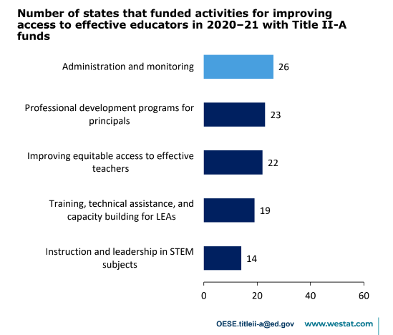
States: Use of Title II-A Funds
States use Title II-A funds to improve equitable access to effective educators.

Slide 18
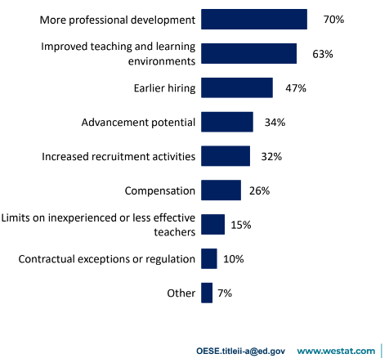
Districts: Use of Title II-A Funds
Districts:
District strategies to improve with-in district equitable distribution of teachers.
Less than one-fifth of districts (19%) used Title II-A funds to improve equitable distribution of effective educators.
Most commonly reported strategies were:

Slide 19
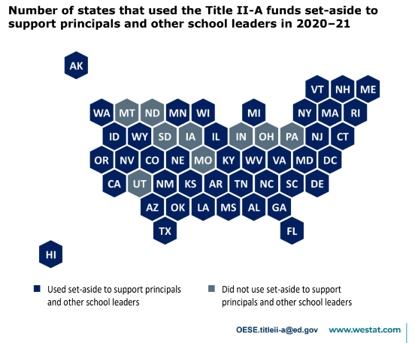
States: Use of Title II-A Funds
States:
Use of Leadership Set-Aside
More than one-half of all states reserved additional funds for activities to support principals and other school leaders.

Slide 20
Professional Development
What does ESSA mean by “professional development”?
Section 8101 [20 USC 7801]
The term, “professional development” means activities that are…sustained (not stand-alone, 1-day, or short-term workshops), intensive, collaborative, job embedded, data-driven and classroom focused.

Slide 21
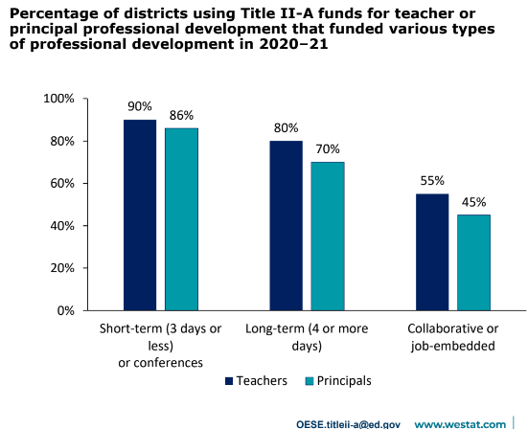
Districts: Use of Title II-A Funds
Districts:
Professional Development (PD)
Districts most commonly used funds for short-term PD.
Many districts also supported longer term PD and some supported PD that was collaborative or job embedded.

Slide 22
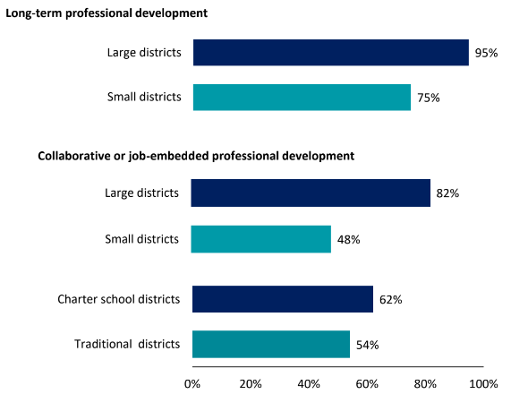
Districts: Use of Title II-A Funds
Districts:
Professional Development (PD)
Large districts were more likely than small districts to report all types of professional development.
Charter school districts were more likely than traditional school districts to report collaborative or job-embedded professional development.

Slide 23
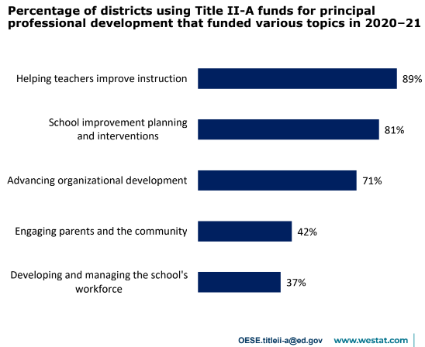
Districts: Use of Title II-A Funds
Districts:
Teacher Professional Development Topics
Professional development for teachers most commonly focused on improving instructional practice, content, knowledge or technology.

Slide 24
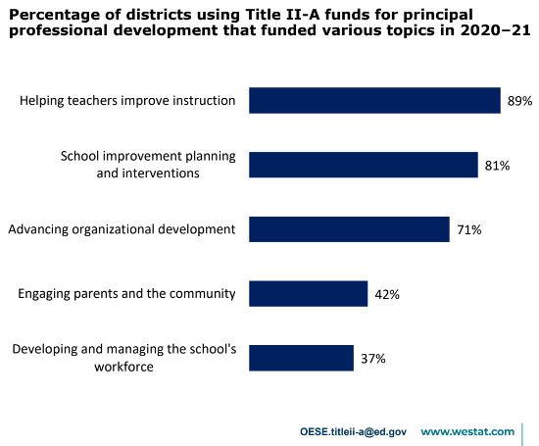
Districts: Use of Title II-A Funds
Districts:
Principal Professional Development Topics
Professional development for principals most commonly focused on helping teachers improve instruction.

Slide 25
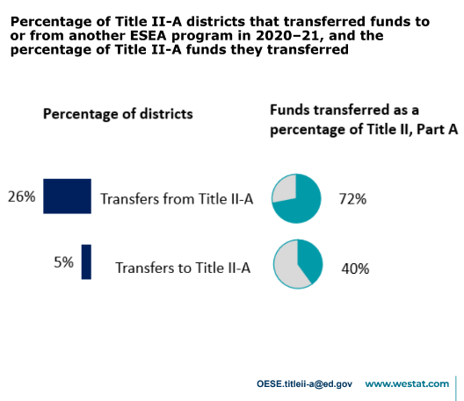
Districts: Use of Title II-A Flexibility Options
Fewer districts transferred funds between Title II-A and other programs.
Nearly one-third of all districts took advantage of the transferability flexibility option.

Slide 26
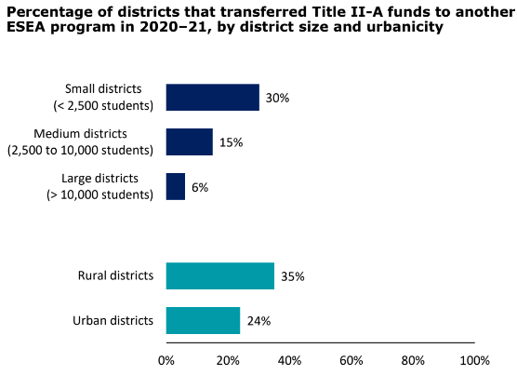
Districts: Use of Title II-A Flexibility Options
Districts:
Funds Transferability
A large percentage of small and rural districts transferred funds from TII-A to another program.

Slide 27
Changes in the Use of Funds from 2019-2020 to 2020-2021
States and districts spent a larger share of Title II-A funds on recruiting hiring, and retaining effective educators.
Districts were more likely to support internet-based professional development for teachers and fewer professional conferences or organizations.
Districts transferred a larger share out of Title II-A into other programs.

Slide 28
Questions for district teams to think about with consideration to Title II-A Funds…
What strategies is your district currently using for recruitment and retention (not necessarily limited to Title II-A support)?
What new strategies has your district implemented and/or are considering for recruitment and retention?
What do your TLCC results say about the professional development needs of teachers?
What changes has your district made to professional development strategies over the past few years?
Do your professional development activities support long-term, job-embedded, ongoing PD?

Slide 29
Title II, Part A Resources
Colorado Department of Education Title II-A Webpage:
Office of Elementary and Secondary Education Act Title II, Part A Information
Contacts at CDE:
Karen Bixler bixler_k@cde.state.co.us
Rachel Echsner echsner_r@cde.state.co.us

Slide 30
Liquidation Extension Process
Notes:
Laura

Slide 31
Update on CRRSA Liquidation Process
The USDE updated the liquidation extension template for ESSER II, GEER II, and EANS
The CRRSA template is paired with an updated Frequently Asked Questions document
Under this process, a State may only request an extension of up to 14 months past the close of the automatic 120-day liquidation period. Thus, requests submitted through this process may extend to, but not exceed March 31, 2025.
Reviews and approval from the U.S. Department of Education will occur on a case-by-case basis.
CDE will be creating a process to collect the necessary information to submit a request for an extension on behalf of LEAs. If you believe your LEA may need an ESSER II extension, please email Nazie Mohajeri-Nelson.
Notes:
Mackenzie

Slide 32
ESSER Reporting
Notes:
Mackenzie

Slide 33
Reporting Overview
The U.S. Department of Education (USDE) has been authorized by Congress to collect data from all ESSER I, II, and III (and other ESSER award) grantees, including but not limited to the uses and impact of funds.
CDE is able to use the ESSER I, II, and III applications to provide the vast majority of the requested data (809 data elements total) on behalf of our LEAs.
Data requested by the USDE includes information on all LEAs’ expenditures and planned activities in the following four main activity types:
Addressing Physical Health and Safety
Meeting Students’ Academic, Social, Emotional, and Other Needs (Excluding Mental Health Supports)
Mental Health Supports for Students and Staff
Operational Continuity and Other Allowed Uses

Slide 34
Data Elements Needed
Data elements we collect from LEAs:
How students with poor attendance or participation have been re-engaged (submitted for this year; will be sending out FY 22-23 survey soon)
How school level allocations were determined (submitted for this year; will be sending out FY 22-23 survey soon)
LEA and school-level participation in ESSER activities (due in September for this year)
We collect these three data elements from LEAs because we cannot get this data from the ESSER applications.

Slide 35
Reporting Resources
ESSER Grantee/Subgrantee Reporting webpage has resources, trainings, and data collection templates/surveys to support grantees in successfully meeting these reporting requirements.
Contact:
Tina Negley (negley_t@cde.state.co.us)
or
Mackenzie Owens (owens_m@cde.state.co.us)

Slide 36
Upcoming Meetings

Slide 37
Looking Ahead…
Any requests for topics or questions?
Upcoming Office Hours:
June 22 Office Hours
No Office Hours in July

Slide 38
CDE Contacts!
Emails: Lastname_Firstinitial@cde.state.co.us (e.g., Smith_a@cde.state.co.us)
Federal Programs & Supports (ESEA/ESSER Program Supports) | School Finance & Operations (Fiscal and Systems Supports)
Nazie Mohajeri-Nelson, Executive Director of Federal Programs & Supports Unit Program Specialists Program Implementation Supervisor: Laura Meushaw Program Implementation Coordinator: Christina Adeboye Sullivan Program Monitoring Supervisor: Tammy Giessinger ESEA/ESSER Monitoring Coordinator: Kristin Crumley Program Effectiveness Supervisor: Tina Negley ESEA Programs Specialists and ESEA Regional Contacts (assigned by district) Title I: Laura Meushaw, Evita Byrd, Rachel Echsner Title II: Karen Bixler, Rachel Echsner Title III: Rachel Temple Title IV: Tammy Giessinger, Nathan Hickman Title V: Melissa Chaffin ESSER Program Specialists Jonathan Schelke Kim Boylan Kriselda Craven ESEA and ESSER Data and Reporting Specialists Tina Negley Mary Shen Mackenzie Owens Melissa Chaffin | Amy Carman, Executive Director of School District Operations Unit Fiscal Specialists Jennifer Austin, Director of Grants Fiscal Management ESEA Robert Hawkins, Grants Fiscal Analyst Steven Kaleda, Grants Fiscal Analyst ESSER Fiscal Specialist Steven Kaleda Grants Fiscal Analyst ESSER Monitoring Bill Parsley, ESSER Fiscal Monitoring Supervisor Hilery Morris, ESSER Fiscal Monitoring Kristina Jones, Federal Fiscal Monitoring and Reporting Specialist Werner Hagemann, ESSER Fiscal Monitoring Specialist Application Systems Specialists DeLilah Collins, Director of Grants Program Administration Online Applications Systems Technical Support Michelle Prael

