Slide 1
CDE Office Hours
June 9, 2022

Slide 2
ESSER Office Hours
Topics
Updates and Reminders
Consolidated Application Deadlines
21-22 PAR Deadline
ESSER Reporting Survey
Expanded Learning Opportunity Grant
Monitoring Progress Report
ESSER GEPA Requirements

Slide 3
Updates, Reminders, and Clarifications

Slide 4
Consolidated Application Updates
The 22-23 Consolidated Application is now open!
Online application
Requires a login username and password through the CDE Identity Management System; work with your Local Access Manager (LAM)
Applications are due June 30, 2022!
2021-2022 Consolidated Application PAR requests must be submitted by June 15, 2022.
Any outstanding comments from previously submitted PAR requests must also be addressed by June 15, 2022.
Keep in mind that expenditures (including carryover activities) that occur in FY 22-23 cannot be requested for reimbursement until final approval is granted in the ConsApp.
For questions or assistance, please contact your ESEA Regional Contact.
Notes:
Shannon

Slide 5
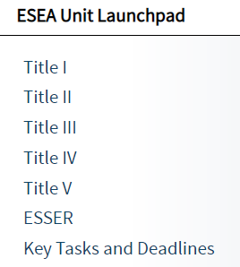
ESEA Launchpad
We have added new resources to The Launchpad
The Launchpad is intended to support LEA staff who are new federal programs by providing an introduction to programs run by the Federal Programs and Supports Unit
We have added introductory pages for each of the Title programs and ESSER
Provide a glossary of key terms and an overview of the program requirements with links to more detailed information
Notes:
Shannon

Slide 6
Reporting Reminder
All LEAs received an ESSER survey question about student engagement and if you allocated ESSER funds in 2020-2021 to schools, including charters, you also received a survey question about method used to determine school allocations.
Thank you to those of you who have already submitted your ESSER data on student engagement and school level allocations. This data is very important for reporting to the USDE.
If you have not yet submitted, please submit data by Friday, June 10!
Notes:
Mackenzie

Slide 7
Expanded Learning Opportunities (ELO) Grant Program
ELO Grant Overview and Resources
Timeline:
Applications Due: June 28, 2022
Grant Award Notification: September 1, 2022
Website: ELO Grant Program Website
CDE Contact:
Robert Beauchamp
ELO Grant Manager
Phone: 720-595-4893
Beauchamp_r@cde.state.co.us
Notes:
Robert Beauchamp

Slide 8
Monitoring Progress Report
Notes:
Shannon

Slide 9
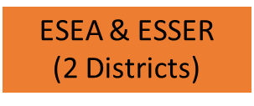
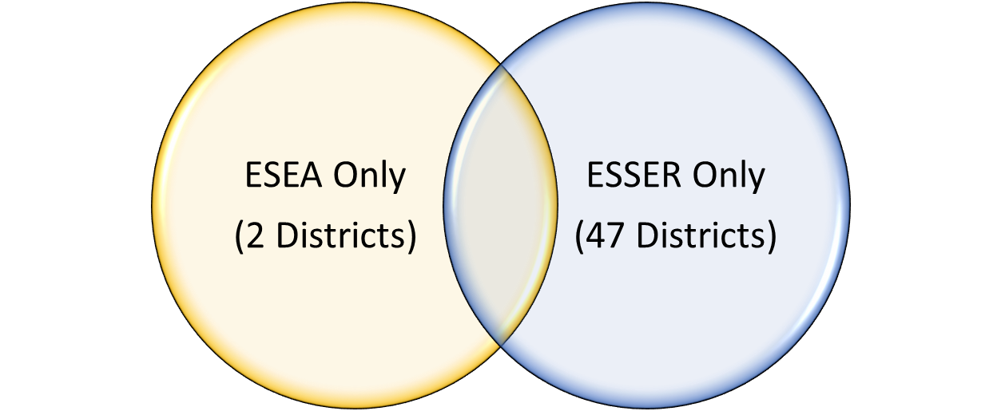
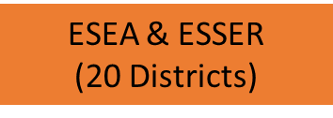
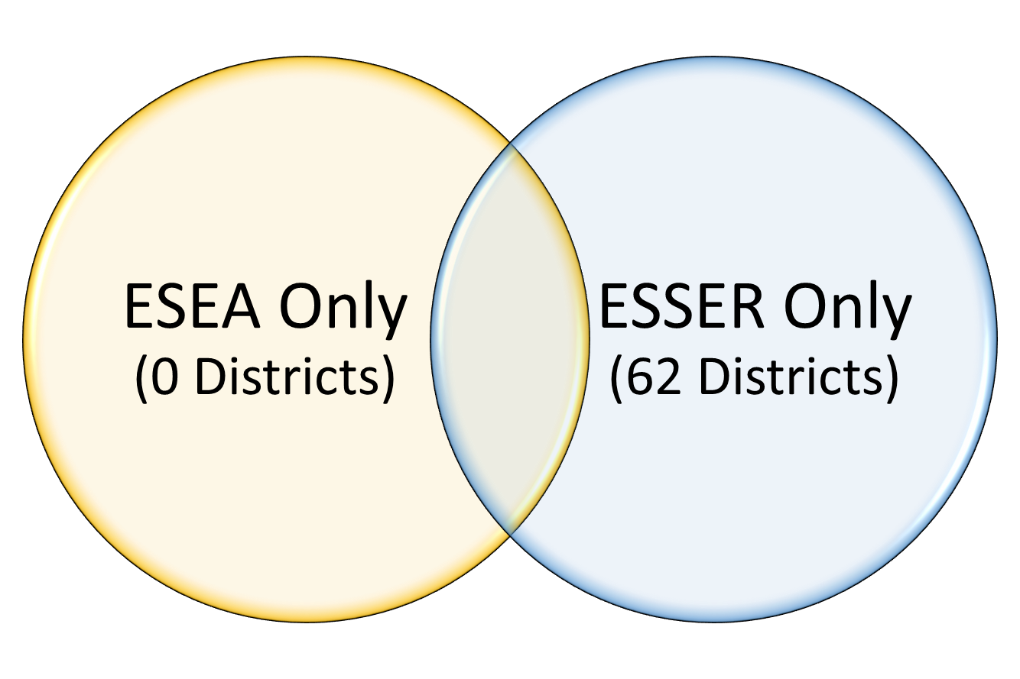
Monitoring Schedule Status
21-22 Monitoring Year
22-23 Monitoring Year
To see when you will be monitored, see the
Monitoring Schedule document

Slide 10
Progress Update
Finishing 21-22 Process
This year’s process has taken longer than expected
Currently wrapping up evidence reviews
LEAs may receive requests for additional information in the coming weeks
Once the evidence review is complete, we will send LEAs a draft of the monitoring report
LEAs will have 10 business days to send any feedback before the report becomes final
If you are being monitored this year, look for these emails! We hope to have all reports sent as they are finished over the next 8 weeks.
Starting the 22-23 Process
We will email Monitoring Notification letters later this summer
Letters will list the indicators that the LEA will be monitored for and a timeline for the process
Training and support will be offered late summer/fall

Slide 11
ESSER GEPA Requirements

Slide 12
Purpose of this Review
Each LEA that accepts federal funds must have a GEPA statement on file with the SEA (i.e., CDE) that applies to each federal award.
Based on advice from BruMan, equitable access to each federal award must be considered separately.
Through monitoring, CDE will be evaluating whether districts have a process to ensure equitable access to ESSER funded activities.
Objective of this training: LEAs will understand the GEPA requirements and be prepared to demonstrate compliance with requirements during their next monitoring process.
Notes:
Kristin

Slide 13
GEPA Requirement
“Based on local circumstances, you should determine whether these or other barriers may prevent your students, teachers, etc. from such access or participation in, the Federally-funded project or activity. The description in your application of steps to be taken to overcome these barriers need not be lengthy; you may provide a clear and succinct description of how you plan to address those barriers that are applicable to your circumstances. …
In designing your projects, applicants for Federal funds address equity concerns that may affect the ability of certain potential beneficiaries to fully participate in the project and to achieve to high standards. Consistent with program requirements and its approved application, an applicant may use the Federal funds awarded to it to eliminate barriers it identifies.”
https://www2.ed.gov/fund/grant/apply/appforms/gepa427.pdf
Notes:
Kristin

Slide 14
GEPA Is/Is Not
GEPA Statement IS: | GEPA Statement is NOT:
Opportunity to identify proposed use of funds Determine, based on local circumstances, how funds will address barriers to access and participation Focus on historically underserved categories such as race, gender, national origin, socioeconomic status, or disability Something that can be updated each time a federal program application needs to be completed | A request for approval of funding of specific activities Based solely on an LEA’s vision, mission, or equity statement Something you have to use your federal funds to address
Notes:
Jonathan
Statements are written based on root causes specific to the local context of the LEA
Each statement includes the identification of the barrier, as well as the activity that will be or has been implemented to address the barrier

Slide 15
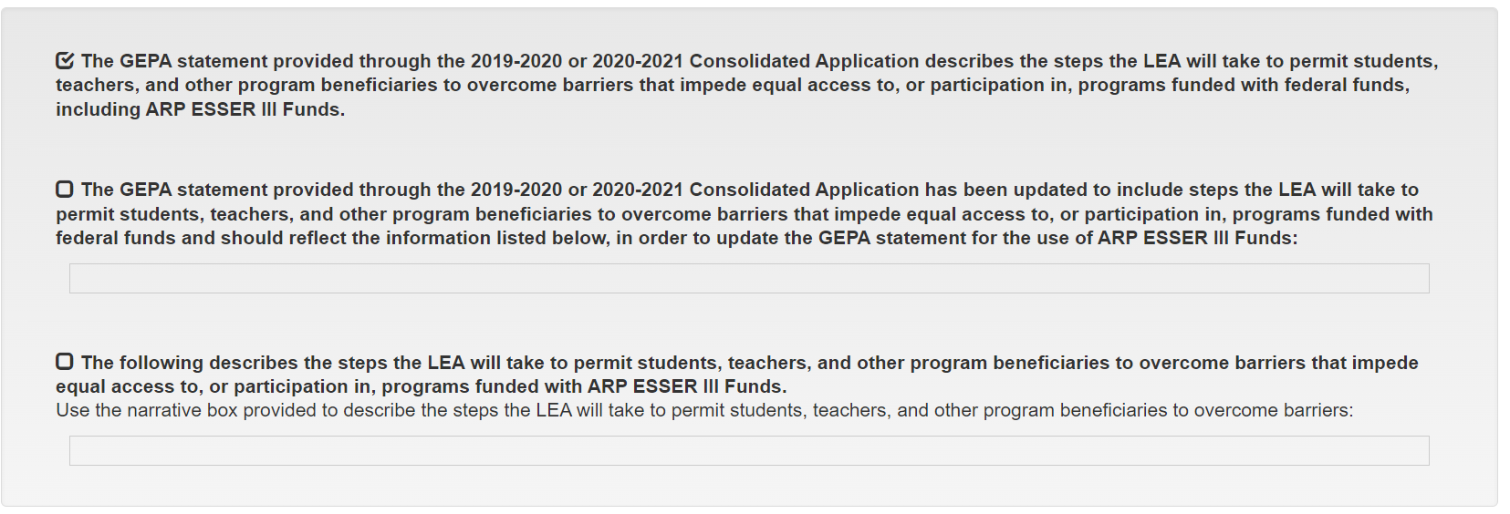
ESSER Application Choices
Notes:
Jonathan

Slide 16
Ensure Compliance
Look at your ESSER budget items. Are there any barriers to accessing the activities funded through ESSER?
Check to see what you selected for each ESSER application
If using Cons App GEPA statement, check what you wrote in your Consolidated Application
Ask yourself: Is that GEPA statement relevant to what we are doing with ESSER funds? Are there barriers to the activities we are funding through ESSER? What steps have we or should we be taking to ensure equitable access?
Determine a method to document how you have considered barriers and the steps you have taken to overcome those barriers.
Be prepared to provide evidence that you have taken steps to overcome barriers for the activities funded with ESSER funds.
Notes:
Jonathan

Slide 17
Upcoming Meetings

Slide 18
Any Requests for Upcoming Topics or Questions!
Upcoming Office Hours
June 23
Late liquidation waiver opportunity from the U.S. Department of Education

Slide 19
CDE Contacts!
Emails: Lastname_Firstinitial@cde.state.co.us
(e.g., Smith_a@cde.state.co.us)
Federal Programs & Supports (ESEA/ESSER Program Supports) | School Finance & Operations (Fiscal and Systems Supports)
Nazie Mohajeri-Nelson, Federal Programs & Supports Unit ESEA Programs Specialists and ESEA Regional Contacts (assigned by district) Title I: Laura Meushaw, Kathryn Wisner, Niko Kaloudis, Evita Byrd Title II: Niko Kaloudis, Karen Bixler Title III: Kathryn Wisner, Rachel Temple Title IV: Tammy Giessinger Title V: TBD ESEA and ESSER: Shannon Wilson ESSER Program Monitoring Specialists Kristin Crumley Jonathan Schelke Kim Boylan ESEA and ESSER Data and Reporting Specialists Tina Negley Alan Shimmin Mary Shen Mackenzie Owens | Kate Bartlett, Executive Director of School District Operations Unit Fiscal Specialists Jennifer Austin, Director of Grants Fiscal Management ESEA Robert Hawkins, Grants Fiscal Analyst Steven Kaleda, Grants Fiscal Analyst ESSER Fiscal Specialist Steven Kaleda Grants Fiscal Analyst ESSER Monitoring Bill Parsley, ESSER Fiscal Monitoring Supervisor Hilery Morris, ESSER Fiscal Monitoring Application Systems Specialists DeLilah Collins, Director of Grants Program Administration Online Applications Systems Technical Support Michelle Prael

