Slide 1
CDE ESEA and ESSER Office Hours
April 10, 2025

Slide 2
ESEA/ESSER Office Hours
Topics:
Rural LEA and BOCES Office Hours
Updates and Reminders
Real Property Reporting

Slide 3

Rural Resources
And Connection Opportunities
Federal Programs and Supports Unit
April 2025
Notes:
Christina

Slide 4

Agenda
Welcome!
Updated Resources and Rural Focused Opportunities
Consolidated Application Clarifications
<1000 students enrolled: Updates
BOCES specific guidance
Spring RNMs
Title Countdown
Title V and AFUA
Other Title Formula Grants: Rural Considerations
  Title V
    SRSA (AFUA eligibility)
    RLIS (in Consolidated Application)
  AFUA
-Q & A
Notes:
Christina

Slide 5
Why now?
Federal Guidelines and Processes evolve (including the learning involved with our new grants management system, GAINS)
Awareness that sometimes those guidelines and processes impact rural districts in unique ways or create different opportunities
Focus on increasing LEA access to like-districts to learn about “bright spots” and share how federal funds are having a positive impact
Acknowledgement that Administrators in rural districts often wear many different hats and can’t access every office hour/training, so access to just-in-time information in efficient ways is critical
Notes:
Christina

Slide 6
Where To Find Resources
Notes:
Christina

Slide 7

CDE Website:
Title V, Part B & Rural Education Resources
Notes:
Christina

Slide 8

Office Hours: Periodically Focused on Rural School Topics
Thanks for joining us today!
Notes:
Christina

Slide 9

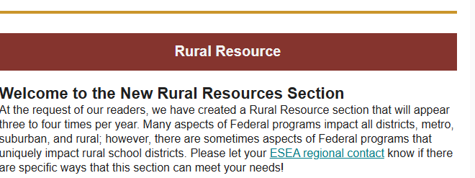
Beeline: Rural Resource focused section 3-4 times per year
February Beeline
Notes:
Christina

Slide 10
Recent Updates
Notes:
Rachel E

Slide 11
Equitable Distribution of Teachers and Comparability
Starting in SY 2025-2026, Equitable Distribution of Teachers (EDT) and Comparability requirements will apply to LEAs with enrollment of less than 1,000 students if there is more than one school per grade span*.
EDT gaps will need to be addressed by the LEA during SY 2025-2026. If medium or large gaps are identified in 2024-2025 they will be documented in the 2026-2027 Consolidated Application.
Comparability is analyzed by CDE on behalf of LEAs annually. LEAs with Consolidated Schoolwide programs or non-comparable schools according to CDE’s analysis will submit an alternative comparability calculator (Excel via Syncplicity) or comparability action plan (online form via Smartsheet) to CDE in SY 2025-2026.
*Grade Span:
elementary, middle, K-8, high school, K-12, etc.
Notes:
Rachel E presents - Please verbally state that comparability is analyzed by LEAs every other year, however LEAs should track and document comparability annually at the local level. Grade span for comparability is aligned with how the grade span is defined in the Consolidated Application.

Slide 12
BOCES Related Updates to the Consolidated Application
The Consolidated Application will be released in two phases:
BOCES will be able to view, but not complete, the EDT, ESSA School Improvement Narratives, and the Targeted and Additional Targeted Support Schools pages until member districts have completed the signover of funds.
Once the member districts complete the LEA ARAC, CDE will load the data for these pages into the BOCES application.
BOCES and member districts should review all assurances annually. General Assurances are available now in the Consolidated Application (in phase one) to be completed by BOCES and member districts. Title specific assurances will become available when budgets are available in phase two.
The Grants Program Administration (GPA) will share a BOCES specific GAINS systems training on May 1st.
Notes:
Rachel E

Slide 13
BOCES Related Updates, Continued
Allocations: Separate section shows member district allocations
LEA Data Profile: BOCES select, "Refer to Member District Application."
LEA Set-Aside & School Ranking: BOCES will complete these sections for districts with less than 1,000 as the method of serving
Narratives: BOCES-level narrative added to more Titles
Pro tip: Use the planning resource in the “Consolidated Federal Programs Application Overview” section while completing the Consolidated Application.
Notes:
Rachel E presents, Evita helps build slide

Slide 14
Rural Considerations: Title Countdown
Notes:
Christina

Slide 15
Title V, Part B: Rural Education Achievement Program
Notes:
Christina

Slide 16

Title V, part B:
RLIS (Consolidated Application: state managed)
SRSA (REAP: federally managed)
Generally speaking, these two grants are used to supplement activities that you are doing in the other Title grants. Rural LEA’s may be eligible for one or both, but only one can be selected. We recommend selecting the one with the highest allocation.
For RLIS (Rural Low Income Schools), be sure to select the funding code in the Consolidated Application that includes the name of the grant where the activities are allowable. (e.g. TVB (TIA) - Title V, Part B - Title I, Part A Activity)
Notes:
Christina

Slide 17
As a refresher (from our website):
Program Requirements and Eligibility
Districts do not need to submit any data as part of eligibility determination. Data is obtained through existing sources.
Rural Low Income School (RLIS) eligibility requires that:
20 percent or more of children aged 5 to 17 served by the school district must be from families with incomes below the poverty line, AND
All schools served by the district must have a locale code of 32, 33, 41, 42, or 43 (assigned by the U.S. Department of Education’s National Center for Education Statistics) OR be located in an area of the State defined as rural by a governmental agency of the State.
Small Rural School Achievement (SRSA) eligibility requires that:
The total number of students in average daily attendance (ADA) at all of the schools served by the district is fewer than 600 OR each county in which a school served by the district is located has a total population density of fewer than 10 persons per square mile and;
All of the schools served by the district are designated with a school locale code of 41, 42, or 43, as determined by the secretary of education OR be located in an area of the State defined as rural by a governmental agency of the State.
Dual-Eligibility: Under ESSA (beginning FY2017)
School districts can be eligible for both SRSA and RLIS and must choose one grant under which to receive funds in any given fiscal year.
School districts that are eligible to participate in SRSA may exercise the Alternative Fund Use Authority (AFUA) (regardless of whether or not SRSA funds are accepted) in the ESEA Consolidated Application when budgeting funds from other titles. All districts wishing to use the AFUA must notify CDE in the Consolidated Application. *Note: School districts eligible only for RLIS cannot exercise the Alternative Fund Use Authority.
Notes:
Christina

Slide 18
SRSA eligibility = opportunity to use AFUA
Alternate Fund Use Authority (AFUA): Allows for eligible LEA’s to use funds in Title II or IV more flexibly, including to cover additional Title I eligible expenses.
Use the raise hand function or thumbs up reaction button if you accessed AFUA last year.
Anyone want to share how you found it to be helpful?
Notes:
Christina

Slide 19
Reminder:
Title V (RLIS) allocations are typically not available in the Consolidated Application until later in the summer/fall.
Title V (SRSA) is an application submitted to the federal government directly. Questions are directed to reap@gov.ed.
Notes:
Christina

Slide 20
Title IV, Part A: Student Support and Academic Enrichment
Notes:
Christina

Slide 21
Title IV Flexibilities! AFUA (noted previously) and…
Rural districts tend to receive Title IV allocations that are less than $30,000, in which case, the proportion requirement to spend 20% of the total allocation in Well Rounded Education, 20% of the total allocation in Safe and Healthy Students, and some portion in Use of Technology would not apply. Districts with an allocation less than $30,000 may spend the allocation in one content category or multiple content categories.
Districts may find it useful to work through a BOCES or consortium to create the greatest impact with Title IV funds.
Notes:
Christina

Slide 22
Title III: Supplemental Supports for English Learners
Notes:
Christina (with input from Rachel T and Kim)

Slide 23
Minimum of $10,000 required to accept the funds, OR…
Since rural districts tend to receive smaller Title III allocations, they may join with other school districts to form a consortium. One of the districts [or a BOCES] must serve as the fiscal agent for the consortium, and is legally responsible for the grant.
These transfers can happen easily in the GAINS system on the Allocations page.
Note: Unlike Title III, Part A, Immigrant Set-Aside funds can be accepted if the allocation is less than $10,000.
Notes:
Christina

Slide 24
Title II, Part A: High Quality Teachers and Principals
Notes:
Rachel E

Slide 25
Title II in Small Districts
Title II, Part A funds can be used to pay for educators or obtain endorsements to be considered in-field.
Title II, Part A funds can also be used for recruitment and retention efforts or professional development.
If eligible, districts can utilize the Alternative Fund Use Authority (AFUA) which allows school districts greater flexibility in spending the funds they receive under Title II, Part A and Title IV, Part A. Districts may also transfer Title II, Part A funds to Title I, Part A, Title III, or Title IV, Part A.
Information on the multiple pathways to obtaining teacher licensure can be found on this Pathways to Teacher Credentials page and on the Teacher Apprenticeship Program page.
Notes:
Rachel E

Slide 26
Title I, Part A: Improving the Academic Achievement
of the Disadvantaged
Notes:
Rachel E

Slide 27
Title I Flexibilities
ESEA offers flexibilities for school districts with enrollment of less than 1,000 students; it is necessary to select “less than 1,000” as the method of serving to access these flexibilities.
Title I requirements related to rank order and the 125% rule do not apply to school districts with enrollment of less than 1,000 students.
Equitable distribution of teachers (EDT) analysis and comparability requirements do apply to districts with enrollment of less than 1,000 students if there is more than one school at a grade span.
Districts with enrollment of less than 1,000 students are eligible to submit a combined UIP for their schoolwide plan.
Notes:
Rachel E

Slide 28
Q&A/Idea Sharing
Notes:
Rachel E

Slide 29
Thank you for being here!
Let us know how we can support you! Feel free to contact your ESEA Regional Contact to ask any follow up questions. FPSU team members that directly support Title V include:
Rachel Echsner
echsner_r@cde.state.co.us
Christina Adeboye Sullivan adeboye-sullivan_c@cde.state.co.us
Notes:
Rachel E

Slide 30
Thank you for all you do for students!
Notes:
Rachel E

Slide 31
ESEA & ESSER Reminders and Updates
Notes:
Nazie

Slide 32
Updates and Reminders
ESSER Annual Performance Report
ESSER Liquidation Extension Rescinded by ED
Comparability - Alternative Calculators are due by April 15, 2025

Slide 33
Upcoming Equitable Services Training
SAVE the DATE and sign up to join us for a co-presented (Federal Programs and Supports Unit and the Exceptional Student Services Unit at CDE) session to address Equitable Services and to answer your questions:
Date: May 15, 2025
Time: 8:30am-10am
Registration Link
This training is designed for both LEA leaders and Non-Public School leaders. We look forward to the opportunity to have the discussion around both ESEA and IDEA equitable services.
Notes:
Christina

Slide 34
Upcoming Regional Network Meetings
The Federal Programs and Supports Unit (FPSU) will be hosting a training and several in-person work sessions this spring to support LEAs with the completion of the 2025-2026 Consolidated Application for ESEA funds. Anyone at your LEA who manages federal funds is encouraged to attend both the virtual training and a work session.
Virtual Training
Thursday, May 1st, 2025 1:00-2:00pm | Register for the Zoom meeting HERE
In-Person Work Sessions
FPSU is hosting work sessions across the state. Please visit the Regional Networking Meetings Webpage for information on specific locations, dates and registration links.
NOTE: Work sessions must have at least 10 LEA attendees registered 72 hours prior to the event in order for CDE to host the meeting in-person.
Notes:
Rachel E

Slide 35

LEA Leadership for School Improvement and CS-Y3+ Convening
When: April 24th 2:00 - 3:30
Where: Office Hours Zoom Link
Who: Federal Program Leaders and Colleagues
“Bring a friend” based on your local structure….
District Leaders who Support School Improvement for ESSA-Identified Schools
District Leaders who Support Alternative Education Campuses (AECs), Charters, Online Schools
Accountability Leaders
LEA Leaders who support CS-Y3+ Schools must attend since we will be addressing More Rigorous Action as required by ESSA.

Slide 36
Colorado LEAs with CS-Y3+ Identified Schools - MUST Attend
Adams 12
Adams 14
Boulder
Centennial BOCEs
CSI
Colorado Springs 11
Delta 50
DPS
District 49
East Otero
Ed Reenvisioned
Englewood
Ft. Morgan
Jefferson County
Mesa 50
Montezuma-Cortez
Montrose
Plateau Valley 50
Poudre
Pueblo 60
Sheridan
Notes:
Sue

Slide 37
Real Property
Notes:
Nazie, Kim

Slide 38
Outcomes
After receiving this training, LEAs will be able to:
Understand Real Property reporting requirements for ESSER-funded construction and facility improvement projects.
Determine which reporting requirements are applicable based on an individual LEA’s use(s) of ESSER funds.
Access resources for additional information.

Slide 39
Reporting Requirements

Slide 40
ESSER Reporting on Uses of Funds and Investments
Submitted to CDE
Submitted to CDE
Annual Performance Report
Student Engagement Survey
School Level Allocations Survey
Participation in Specific Activities (Summer, afterschool programs)
Notice of Federal Interest
Filed with the County or Local Government
$1 mill or more
Protects Federal interest
Real Property Reporting
Pertaining to any real property purchased or improvement with ESSER funds
Any dollar amount
Status Report on Federal interest
Not Submitted to CDE

Slide 41
Notice of Federal Interest (NFI)
Grantees or subgrantees with a renovation, major remodeling, construction, or real property project where the Federal interest is significant— typically $1 million or more in COVID-19 relief funds—were required to record the Notice of Federal Interest (NFI) in the official real property records for the jurisdiction in which the improved or purchased property is located by January 28, 2025.
(2 CFR § 200.316)
The NFI is not submitted to CDE. Hold for Monitoring Purposes.

Slide 42
Important!
Real Property Reporting is
Separate and Different
from the Notice of Federal Interest.

Slide 43
Real Property Reporting
All grantees and subgrantees must submit required real property reports to CDE, regardless of the amount of the Federal interest in the real property.
The reports are due for the first time by September 1, 2025, and annually thereafter for the next 15 years by September 1 of each year.
The reporting period of first report will be from date of purchase/investment through June 30, 2025.
Each year thereafter, the reporting period will be from July 1-June 30 prior to the submission date.
(2 CFR § 200.330)

Slide 44
What is Real Property?
UGG defines real property as “land, including land improvements, structures and appurtenances thereto, and legal interests in land, including fee interest, licenses, rights of way, and easements. Real property excludes moveable machinery and equipment.” (2 CFR § 200.1)
Appurtenances: In real estate, an appurtenance is a permanent structure or right that is attached to a property and remains with it when it is sold.
Notes:
What is real property? Real property is defined as land and anything that is permanently attached to it, including structures, fixtures, and rights. Think what would be included with the property if it was sold. Moveable property and fixtures (such as, furniture, curtains, even doorknobs) are not included in the definition of Real Property.

Slide 45
Built-In/Fixed versus Moveable
The National Center for Education Statistics (NCES) has suggested criteria to consider when determining if an item is built-in/fixed or moveable.
Moveable (not real property)
Transportable from one location to another without appreciable damage or change to either location
Does not function as integral part of the building or site and are not permanently fastened or attached to the building or site
Consider the permanency of the installation not size or weight of the item
Built-In/Fixed (potentially real property appurtenances)
Integral part of a building that is permanently fastened to the building, functions as part of the building, and would cause appreciable damage to the building if removed
Permanently attached to a site and functions as part of the site
Guiding question: If you were moving from this building, would the item stay or come with you?

Slide 46
Examples
Built-In/Fixed
Elevators
Fire Protection Systems
Plumbing
Heating
Ventilation
Windows
Built-In Air Conditioning Systems
  Excludes window or console air conditioning units that do not require ductwork or cooling towers
  Rooftop Units (RTUs) are also excluded.
Moveable
Items bolted or screwed to the floor that can be moved as a unit once fasteners are removed
Kitchen Equipment with no permanent connection to the building
Structures not attached to the building that are not anchored to the ground by a solid foundation
  Mobile Classroom
  Sheds without a permanent foundation
Notes:
Go through the process of considering the items as listed on the previous slide for determination purposes. Rooftop HVAC units may be considered moveable.

Slide 47
Real Property Reporting Overview
Any grantees/subgrantees that used ESSER funds, in whole or in part, to improve or purchase real property must submit an annual status report regarding the property to the State.
Who Collects the Data?
  The State (i.e., CDE) must collect data annually about the status of the real property using form(s) required by the federal government.
How is the Data Collected?
  The collection will include a cover page form and an attachment, which may include details about projects.
Who Submits Data?
  LEAs that have an ESSER-funded (even if partially ESSER-funded) renovation, major remodeling, or real property project must submit the annual reports.
How Will the Data Be Used?
  The State (CDE) must retain the reports on file for audit or monitoring purposes.
How Long Will the Collection Last?
  For at least 15 years or until the property is sold or transferred (which requires a separate form and process)

Slide 48
Examples of Improvement Projects

Slide 49
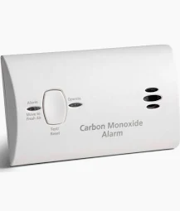
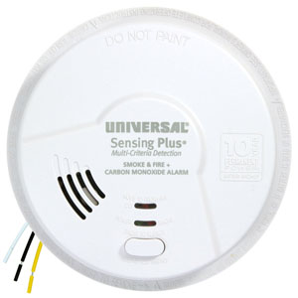
Example #1 – Carbon Monoxide Detector
No. Under $1 million
Project: Carbon Monoxide Detector Purchase & Installation
Total cost: $259,000
Notice of Federal Interest (NFI) required?
Yes, for each parcel/property, for 15 years.
CO2 Detectors hard-wired/permanently affixed to walls
Real Property Reporting Required?
CO2 Detectors not hard-wired/permanently affixed to walls.
No. Considered moveable.

Slide 50
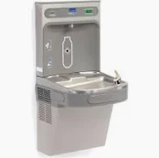
Example #2 – Water Fountain Upgrades
No. Under $1 million
Project: upgrade all school buildings’ water fountains to touchless
Total cost: $552,000
Notice of Federal Interest (NFI) required?
Real Property Reporting Required?
Yes, only one report needed for 15 years.
Fountains are built in/fixed
All fountains are in one property
Yes, one report is required for each property for 15 years.
Fountains installed in multiple properties

Slide 51

Example #3 – HVAC Upgrades
Yes. Project is $1 million or more.
Project: HVAC upgrades for all schools
Total project cost: $1.2 million
Notice of Federal Interest (NFI) required?
Rooftop Units (RTUs) considered moveable, not a permanent fixture.
No.
Real Property Reporting Required?
Yes, for each parcel/property, for 15 years.
Was ductwork/plumbing upgraded as part of the project?
Yes
No.
No.

Slide 52

Example #4 - Windows
No. Project is under $1 million.
Project: New windows installed in elementary school
Total project cost: $60,000
Notice of Federal Interest (NFI) required?
Real Property Reporting Required?
Yes, for each parcel/property for 15 years.

Slide 53
Does this apply to my LEA?
CDE understands that some projects may not meet the requirements of the SF-429; however CDE cannot make that decision without fully knowing the scope of the work. With that understanding, all subrecipients claiming federal funds for construction, property improvements, or installations of new equipment will need to complete the Real Property status report.
After reviewing initial submissions, CDE will determine whether or not the project meets the standard for annual review and will release subrecipients from the obligation if the project does not qualify under the required reporting.

Slide 54
Submitting Real Property Reporting

Slide 55
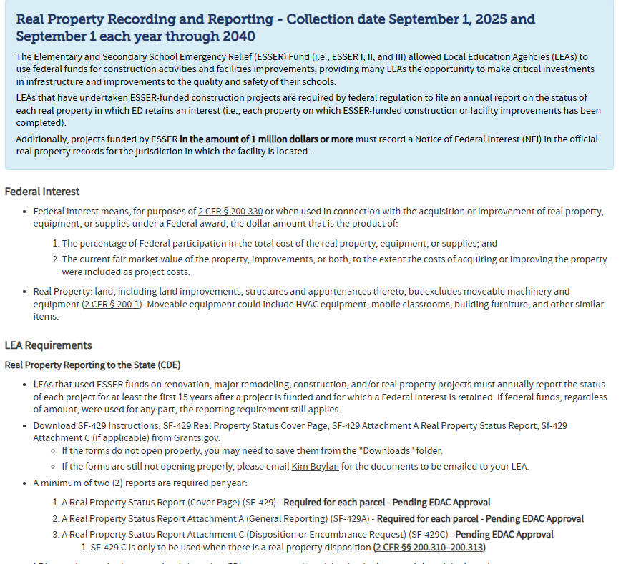
Accessing the Real Property Reporting Forms and Instructions
All SF-429 forms are available to download from Grants.gov and will be linked on the ESSER Grantee/Subgrantee Reporting Webpage.

Slide 56
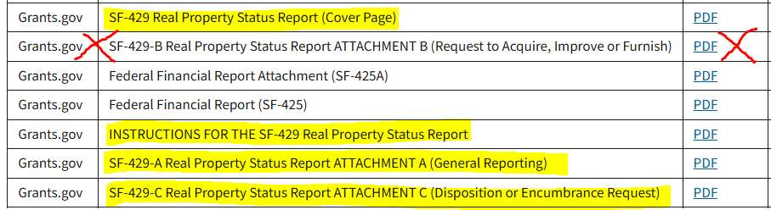
Step 1: Download Instructions and forms for the SF-429 Real Property Status Report
From Grants.gov Post-Award Reporting Forms webpage, download and save all highlighted documents. *Please keep in mind that CDE will not be collecting SF-429 B, and only collecting SF-429 C if applicable.

Slide 57
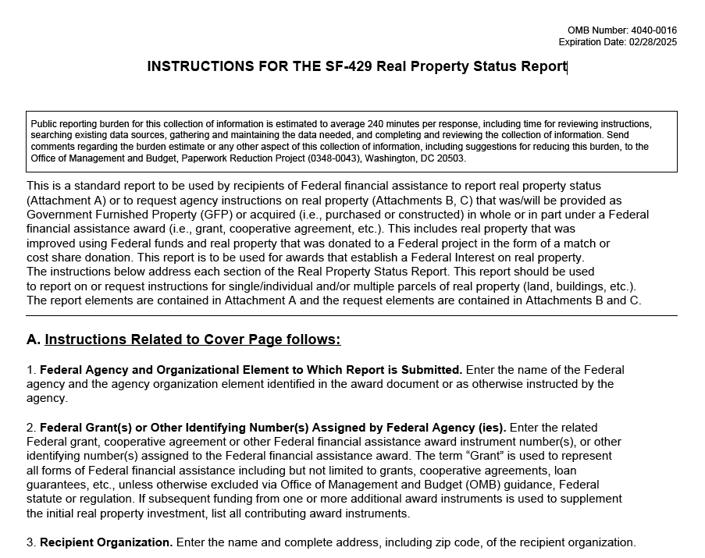
Step 2: Refer to SF-429 Real Property Status Report Instructions
The Instructions document provides step-by-step guidance for each required field for SF-429 Cover Page, SF-429-A and SF-429-C forms.
(SF-429-B will not be collected by CDE; SF-429-C will only be collected if applicable.)

Slide 58
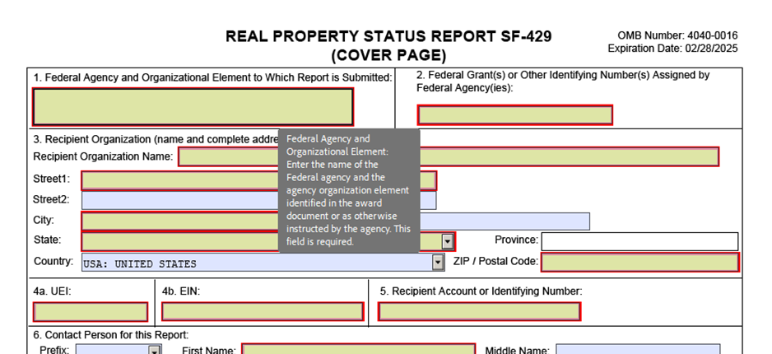
Step 3: Complete SF-429 Cover Page and SF-429-A forms (also complete SF-429-C, if applicable)
Tip: When you hover over each form field, an informational box will appear as a helpful guide. The red outlines indicate which fields are required.
Submit one Cover Page and SF-429-A forms for each property, each year.
Notes:
SF-429-A will be completed every year UNLESS the LEA is requesting to acquire, improve, or furnish or to request a disposition/encumbrance of the Real Property.
SF-429-C will only be completed if the LEA requests permission to dispose of property that has been improved or purchased with ESSER funds or to add an encumbrance to such property.
An encumbrance is a claim against a property made by a party who is not the property owner. An encumbrance can impact the transferability of the property and restrict its free use until the encumbrance is lifted.The most common types of encumbrance apply to real estate; these include mortgages, easements, and property tax liens.

Slide 59
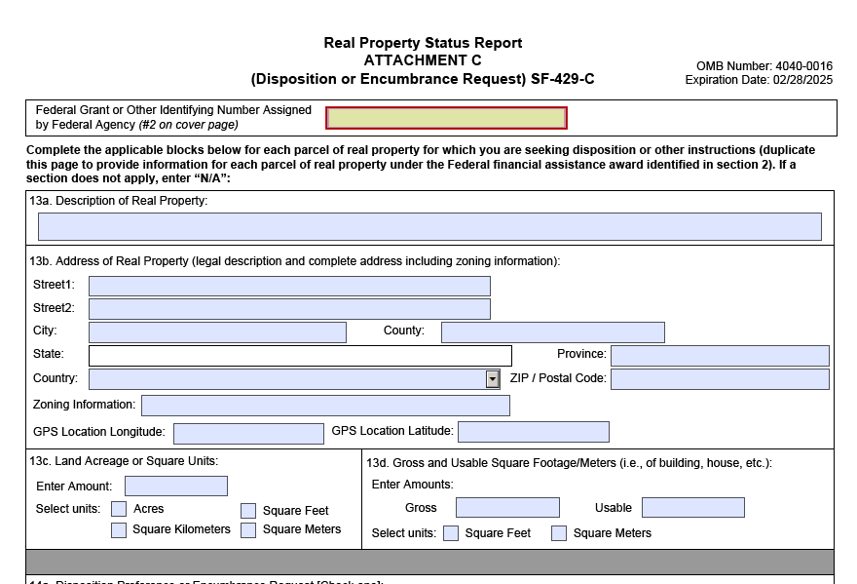
Step 4 (if applicable): Complete SF-429 C
SF 429-C is open for submission all year long and is to be submitted prior to disposition or sale. The first year may include property that is already disposed.
Submit one Cover Page and SF-429-C forms for each disposed property.
Notes:
SF-429-A will be completed every year UNLESS the LEA is requesting to acquire, improve, or furnish or to request a disposition/encumbrance of the Real Property.
SF-429-C will only be completed if the LEA requests permission to dispose of property that has been improved or purchased with ESSER funds or to add an encumbrance to such property.
An encumbrance is a claim against a property made by a party who is not the property owner. An encumbrance can impact the transferability of the property and restrict its free use until the encumbrance is lifted.The most common types of encumbrance apply to real estate; these include mortgages, easements, and property tax liens.

Slide 60
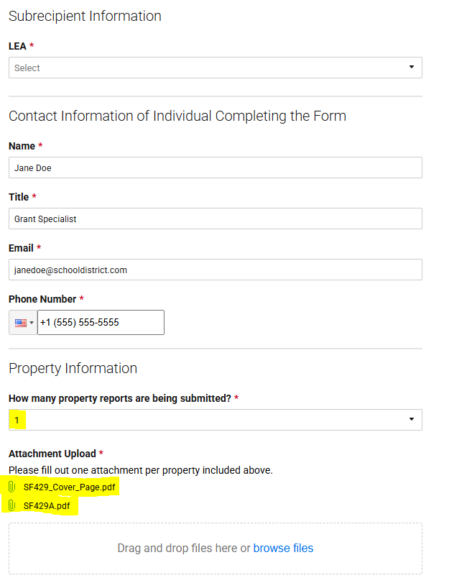
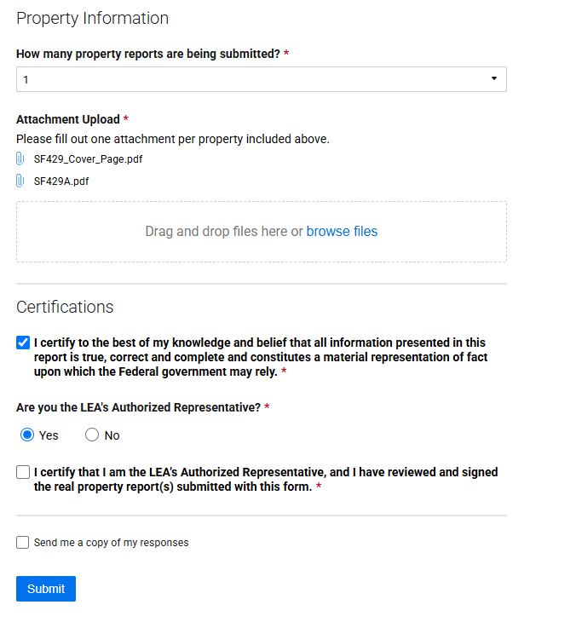
Step 5: Complete the Smartsheet Submission Form
Due Date
First Report Due September 1, 2025
September 1 of Each Subsequent Year
Period of Federal Interest (Reporting Period)
First Report: Investment date - June 30, 2024
Subsequent Years: July 1 - June 30 prior to report submission date
Notes:
If submitting more than 10 attachments, please submit additional Smartsheet submission forms.

Slide 61
Time to Explore!

Slide 62
Accessing Reporting Materials
Please visit the ESSER Grantee/Subgrantee Reporting website for links to download the forms, and access the ESSER Real Property Status Report Submission Smartsheet.
What questions do you have?
Notes:
https://www.cde.state.co.us/caresact/essergrantee/subgranteereporting

Slide 63
Resources

Slide 64
Resource Links
USDE Guidance and FAQ
Grants.gov Post-Award Reporting Forms
ESSER Reporting Website
  Training Slides and Recording of today’s training will be linked in the next few days.
Filing a Notice of Federal Interest (NFI)

Slide 65
Contacts
For questions about the Real Property Data Collection, please contact:
Kim Boylan
ESEA/ESSER Monitoring Specialist
boylan_k@cde.state.co.us
(720) 354-7031
Tammy Giessinger
Federal Programs Monitoring Supervisor
giessinger_t@cde.state.co.us
(720) 827-5291
For questions about ESSER surveys, please contact:
Tina Negley
Program Effectiveness Supervisor
negley_t@cde.state.co.us
(720) 766-2793
Melissa Chaffin
ESEA Reporting Specialist
chaffin_m@cde.state.co.us
(720) 908-1379
For any ESSER-related questions or concerns, please contact:
Nazanin Mohajeri-Nelson, Ph.D.
Executive Director of Federal Programs and Support Unit
mohajeri-nelson_n@cde.state.co.us
(720) 626-3895

Slide 66
Upcoming Meetings

Slide 67

Looking Ahead…
Any requests for topics or questions?
Upcoming Office Hours
  April 24
    CS-Y3+ Spring Convening
  May 8
    Schoolwide and Targeted Assistance Programs

Slide 68
CDE Contacts!
Emails: Lastname_Firstinitial@cde.state.co.us (e.g., Smith_a@cde.state.co.us)
Federal Programs & Supports (ESEA/ESSER Program Supports) | School Finance & Operations (Fiscal and Systems Supports)
Nazie Mohajeri-Nelson, Executive Director of Federal Programs & Supports Unit Program Specialists Program Implementation Supervisor: Laura Meushaw Program Implementation Coordinator: Christina Adeboye Sullivan Program Monitoring Supervisor: Tammy Giessinger ESEA/ESSER Monitoring Coordinator: Kristin Crumley Program Effectiveness Supervisor: Tina Negley Program Evaluation & Research Coordinator: Anna Rowan Strategic Recovery Office (ESSER State Reserve): Matt Koziol ESEA Programs Specialists and ESEA Regional Contacts (assigned by district) Title I: Laura Meushaw, Evita Byrd, Rachel Echsner, Kim Boylan Title II: Rachel Echsner, Sue Miller-Curley Title III: Rachel Temple, Kim Boylan Title IV & Stronger Connections Grant: Nathan Hickman, Evita Byrd Title V: Christina Adeboye-Sullivan, Rachel Echsner ESEA and ESSER Data and Reporting Specialists Melissa Chaffin (ESEA) Jerry Ring (ESEA) Anna Rowan (ESEA) | Vacant, Executive Director of School District Operations Unit Fiscal Specialists Jennifer Austin, Director of Grants Fiscal Management ESEA Robert Hawkins, Grants Fiscal Analyst Steven Kaleda, Grants Fiscal Analyst ESSER Fiscal Specialist Steven Kaleda Grants Fiscal Analyst ESSER Monitoring Bill Parsley, ESSER Fiscal Monitoring Supervisor Hilery Morris, ESSER Fiscal Monitoring Application Systems Specialists DeLilah Collins, Director of Grants Program Administration Online Applications Systems Technical Support Jessica Hollingshead Michelle Prael

