Slide 1
2025 Winter Regional Network Meeting
Federal Programs and Supports Unit

Slide 2
Updates and Reminders
Requesting Reimbursement - in GAINS
Office Hours Materials
Grants Fiscal Training on Fund Requests PowerPoint
Grants Fiscal Training on Fund Requests Recording
Submit requests monthly!
ESSER Reporting
Written procedures

Slide 3
Federal Updates
Current Funding
School Year 2024-2025
Continuing Resolution
Federal Judge Injunction - Federal Government
Cannot terminate grants or contracts on the grounds that they are ‘equity-based’
Cannot ask grantees or contractors to certify that they are not operating programs that promote DEI
Commissioner’s twice weekly emails - now available on CDE’s website

Slide 4
Winter RNM

Slide 5
Agenda
Comprehensive Needs Assessments
Updated Family, School and Community Partnerships Stakeholder Guidance
Comprehensive Needs Assessments and the Consolidated Application
Updated USDE Guidance
Timely GAINS Tips
Networking Time

Slide 6
Purpose
Build understanding of Comprehensive Needs Assessments
Understand how to use a Comprehensive Needs Assessment to plan ESEA funds
Share updated guidance from the Family, School and Community Partnerships office and USDE
Network with LEAs to learn more about the Consolidated Application process and implementation

Slide 7
2025-2026 Consolidated Application Timeline
CDE is in the process of finalizing revisions for the 2025-2026 Consolidated Application. While the application can be viewed in the GAINS system, it is currently not open. We anticipate part of the application being available to applicants in March. We will notify contacts directly once the application is available. Please contact the district’s Regional Contact if you have any questions.
Task | Projected Completion Date
Virtual Winter Training (CNA, Narratives and Pre-work) | February 27 and March 4, 2025
Cross Program Section Available | End of March
GAINS System Training | May
Allocations Uploaded and Budgets Available for LEAs | TBD
Work Sessions | May
Application Due | June 30
Summer Support Opportunity | August
Financial Expenditure Report (FER) Due | September 30

Slide 8
Comprehensive Needs Assessment

Slide 9

What is a Comprehensive Needs Assessment?
A comprehensive needs assessment (CNA) is a process that is used to identify strengths, needs and performance challenges in a school or district, determine their root causes, and set priorities for future action.
Schools and districts should use the comprehensive needs assessment to inform improvement planning and budgeting.

Slide 10
What Types of Data Should be Included in a CNA?
Data sources used in a CNA can include:
Student data - academic data by grade level and student group (FRL, students with disabilities, English learners), graduation rates, other data relative to your context
School by school level data
Student Engagement data (attendance)
Discipline data
Hiring and retention data - areas of need in hiring
Family and community engagement data
Staff surveys
Student surveys
Parent surveys
Listening Sessions
Data collection for the CNA should be prioritized based on your local context.
In the chat: What is one need your district has identified and what data sources have been most helpful?

Slide 11
Comprehensive Needs Assessment Rubric
Meets Expectations
Includes a variety of data, including performance (e.g., local and state student assessment data) and student engagement data (e.g., student attendance), perception data (e.g., parent and student surveys) and school system process (e.g., diagnostic review) to form a complete and accurate representation of the school’s comprehensive needs.
Includes detailed analysis of performance, student engagement, and other data for all students and disaggregated for student groups identified in 1111(c)(2) of ESSA (economically disadvantaged students, students from major racial and ethnic groups, children with disabilities and English learners), as applicable for the school.
The CNA is conducted in a manner that identified student, teacher, school and community strengths and needs.
The CNA identified a manageable number of priorities (recommended one or two priorities), at the right level of magnitude and aligned with the needs assessment for school improvement.
If the school is continuing activities from the previous year, local evidence shows continuous improvement for all students, particularly those not yet meeting standards.
The updated ESSA Schoolwide Requirements and Rubric document is a tool to better understand what is expected to be included in a CNA.

Slide 12

Where will my CNA be Documented?
Many LEAs use their Unified Improvement Plan (UIP) or their Strategic Plan to document their Comprehensive Needs Assessment. Schoolwide plans can be documented in the streamlined UIP.

Slide 13

Where do we Start?
Consider your local context. Start with your “why.” What do you already know?
For example, what is the mission for your district/school? What can you reflect on regarding achieving your LEA’s mission? What are your goals for your students and what do you intuitively know about meeting these goals (successes, hurdles, etc.)?
Consider what is currently being implemented and how it’s going. Have your programs been effective? What to continue, adjust, or stop doing in your work?

Slide 14
An Example: Start with the End in Mind
Backwards Design: Supporting effective use of funds through alignment with identified needs and strategic planning
The goal of a CNA is to identify existing barriers to increasing teacher efficacy and ensuring all students receive high quality learning experiences with equitable access to resources that help them grow and achieve grade level expectations.
A CNA can look a lot of different ways, but the thought process that drives this snapshot of the current state of learning in a school/district can be considered through the lens of Belonging, Consistency, and Coherence. The Opportunity Makers (2024) TNTP.
These priorities and the needs identified through the CNA drive the development of the Consolidated Application and the district’s use of ESEA funds.

Slide 15

Opportunity Makers: Consider These “Buckets” in Your Work
The Opportunity Makers (2024) TNTP. Available at: https://tntp.org/publication/the-opportunity-makers/ (Accessed: 30 January 2025).
Opportunity Makers defines our current reality that only 5% of US schools are closing achievement gaps.
These 5% of schools achieved this by:
Creating a culture of belonging,
Delivering consistent grade-level instruction, and
Building a coherent instructional program.
This aligns with our experience but can be hard to create. How might schools use this structure to clarify the micro moves that will create the desired impacts? How might we define the manageable steps to make this our reality?

Slide 16

Belonging: Learning is Personal and Collective
What does it mean to be an “insider” at school? How might your team be increasingly culturally responsive?
Individual Knowledge: Educators know each young
person well as an individual and a learner.
Individual Needs: Educators work in teams to meet
the needs of each individual child.
Individual Growth: Schools focus on incremental
progress for every student over many years.

Slide 17
Belonging is a prerequisite for learning.
Consider the identities of the families you serve in assessing needs.
These are the Guiding Principles from the Tools of Cultural Proficiency.*
*Lindsey, Nuri-Robins, Terrel, and Lindsey (2019). Cultural Proficiency, A Manual for School Leaders, 4th Edition. Thousand Oaks, CA: Corwin.
Culture is a predominant force in society.
People are served in varying degrees by the dominant culture.
People have individual and group identities.
Diversity within cultures is vast and significant.
Each cultural group has unique cultural needs.
The best of both worlds enhances the capacity of all.
The family, as defined by each culture, is the primary system of support in the education of children.
School systems must recognize that marginalized populations have to be at least bicultural and that this status creates a distinct set of issues to which the system must be equipped to respond.

Slide 18

Consistency: Clarity in Adult Actions Matters
Consistent Content: Teachers give all students the
same assignment with different support.
Consistent Collaboration: Teachers work together
in teams to improve their instruction.
Consistent Reinforcement: Leaders focus on a few
core practices and monitor them consistently.
Specificity and explicitness matters: What are the micro-moves that increase consistency in instruction?

Slide 19

Coherence: Alignment of Adult Actions Matters
Coherence in Class: Students work on the same quality content in both core classes and intervention.
Coherence at School: Teachers have the clarity and support they need to focus.
Coherence at Home: Caregivers know where their
students stand and how to help.
Cohesion in the work: How might your improvement efforts “make sense” to all vs feeling like multiple initiatives?

Slide 20
Family, School and Community Stakeholder Guidance

Slide 21
Stakeholder Engagement in the CNA
Meaningful stakeholder engagement is an essential component of a comprehensive needs assessment and is reflected throughout the Consolidated Application.
Meaningful engagement is defined as a process that involves collaboration and input from a variety of stakeholders. This includes families, students, educators, and community members.

Slide 22

Office of Family, School, and Community Partnerships
Coordinate family engagement across the Colorado Department of Education
Systemic
Support
Structure
Office of FSCP
Work with district-level staff to support their unique needs
Staff the State Advisory Council for Parent Involvement in Education (SACPIE)

Slide 23
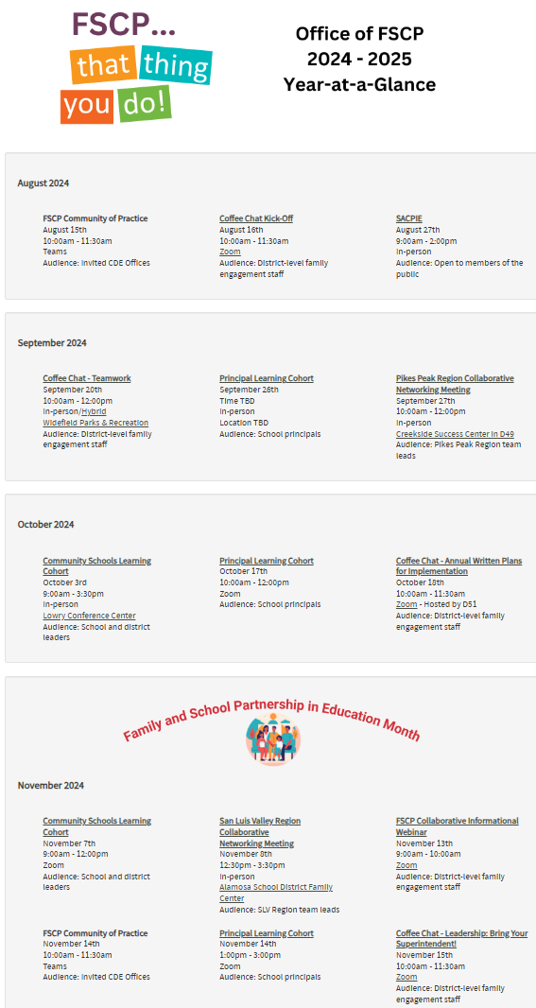


Office of FSCP Offerings
Promising Partnership Practices
Coffee Chats
Year at a Glance

Slide 24
Stakeholder Engagement in Federal Programs Resource
A resource to help districts and schools meet federal stakeholder engagement requirements, using evidence-based principles of strong family, school, and community partnerships.
Organized by ESEA Stakeholder Engagement Program Requirements (SE).
SE 9.1 Development of the LEA Plan
SE 9.2 Reasonable Opportunity for Public Comment
SE 1.1 Title I, Part A Annual Meeting
SE 1.2 Annual Report to the Public
SE 1.3 LEA Parent and Family Engagement Policy
SE 1.4 School Parent and Family Engagement Policy
SE 1.6 Building Parent and Family Capacity
SE 9.4 Student Performance
SE 9.6 Parent Access to Assessment Information
SE 9.7 Public Sharing of Assessment Information
SE 9.9 Meeting with Parents and Families of English Learners
SE 9.11 Annual Consultation-Non-Public Schools
Parent Notifications

Slide 25
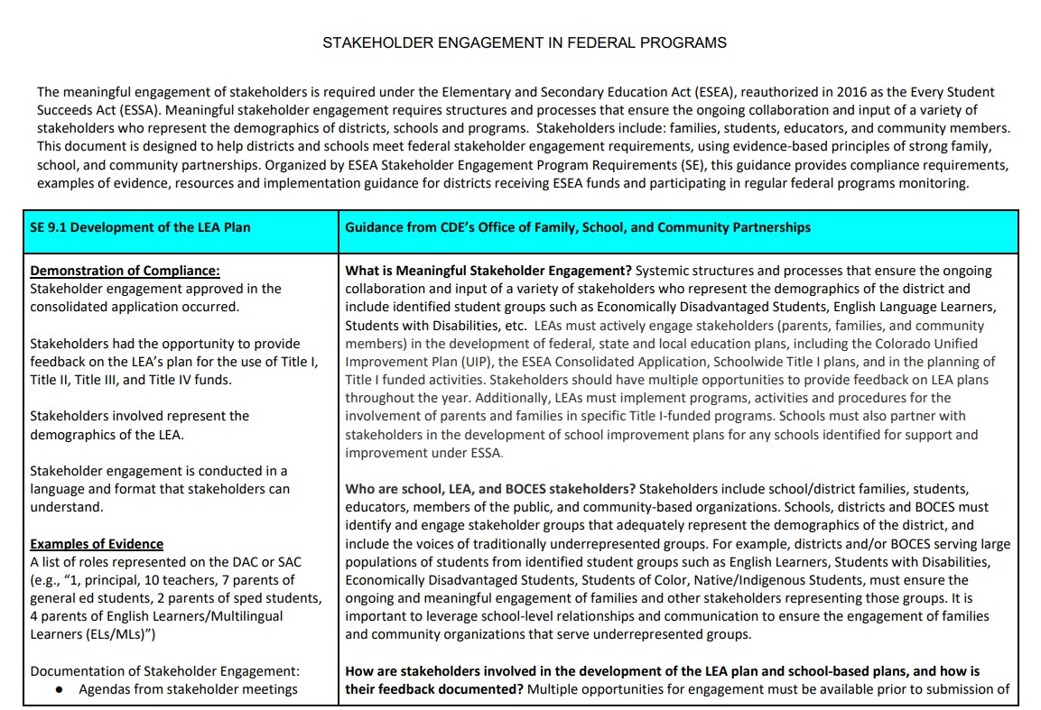
Stakeholder Engagement in Federal Programs Resource Contd

Slide 26
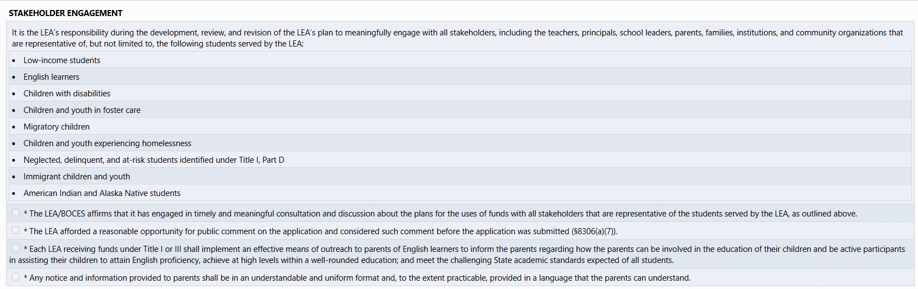
Parent and Family Engagement in the Consolidated Application
General Assurances

Slide 27
Parent and Family Engagement in the Consolidated Application Cont.
Cross Programs - Stakeholders
1.1 Identify the stakeholders who were involved in reviewing relevant data (i.e., comprehensive needs assessment results, performance data, relevant survey data) and assisting with developing the ESEA Plan (Consolidated Application). Check all that apply.
1.2 Describe the process for meaningfully engaging the stakeholders, selected in Question 1.1, in determining the needs and selected strategies of the LEA and/or participating schools.
4.1 Select the strategies implemented by the LEA to conduct outreach and implement programs, activities and procedures for effective involvement of families.
4.2 In addition to the strategies selected in 4.1, describe how the LEA implements effective outreach to parents and families of multilingual learners on their involvement as it relates to:
a) the academic achievement of students
b) attaining English proficiency, achieve at high levels
c) meeting the Colorado Academic Standards.

Slide 28
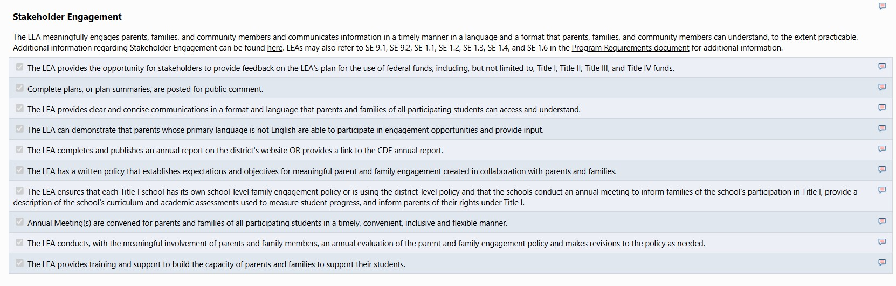
Parent and Family Engagement in ESEA Monitoring

Slide 29

District Spotlight
Jesse Tijerina
Director of Federal and State Programs

Slide 30

Winning with Title I
Winning with Title I:
Reimagining Strategies for Student Success
Thompson School District

Slide 31

Title I as a Boxing Match
Created by Thompson School District
Title I schools sometimes face supplemental programs that fail to meet expectations, reinforcing disparities and strengthening educational barriers. Without a solid game plan, stepping into the ring can be chaotic, driven by instinct and reaction rather than strategy. Without a clear plan, purposeful FSCP practices, and intentional training, educators risk tackling these challenges alone or reverting to past approaches with limited success.
Notes:
Nathan/Jesse

Slide 32

Title I as a Sweet Science
Created by Thompson School District
A training plan is essential for Title I programming as it provides a strategic roadmap tailored to address educational barriers and capitalize on students’ assets. This blueprint, developed throughout an extensive Comprehensive Needs Assessment, helps students navigate the complexities of learning and schooling, anticipate the unfamiliar, and make real-time adjustments. A well-informed training plan ensures that each student receives access, support, and opportunity, increasing the likelihood of agency, autonomy, and achievement along their educational journey.

Slide 33

Created by Thompson School District
Family, School, & Community Partnerships (FSCP): By strategically braiding and leveraging funding, TSD will increase FTE associated with FSCP programming and develop a tiered FSCP High-Impact Strategic Plan. This plan will provide classified and certified staff with comprehensive learning opportunities and ongoing coaching support. State and Federal Programs staff will partner with schools to lead school and district-based FSCP efforts via Title I sites and the Family Center. Implementing this strategic plan, which focuses on partnering effectively with parents, families, and community members, will enable TSD to effectively bridge student learning between school and real life.
Climate and Culture: TSD is committed to creating welcoming environments that foster engagement among students, families, and community members, using feedback to inform decision-making and improve climate and culture efforts, while implementing high-impact strategies to promote inclusivity, remove educational barriers, and authentically support academic excellence for each student; specifically those from diverse backgrounds and high-mobility.
FSCP High-Impact Strategic Plan
Reimagining the Intervention
Climate & Culture
Continuous Improvement
Continuous Improvement: Continuous Improvement Teams will engage in targeted professional learning and PLCs to design, implement, and evaluate best practices in literacy and math, focusing on data informed student needs to enhance instructional strategies, embrace students’ assets, and promote student achievement.
Reimagining the Intervention: TSD will improve literacy and math outcomes by integrating culturally responsive interventionists and instructional aides into K-5 classrooms with significant academic needs. This evidence-based model embeds targeted support within the classroom to address disparities identified through the School Performance Framework (SPF) and district assessments, prioritizing students with the greatest academic needs.

Slide 34
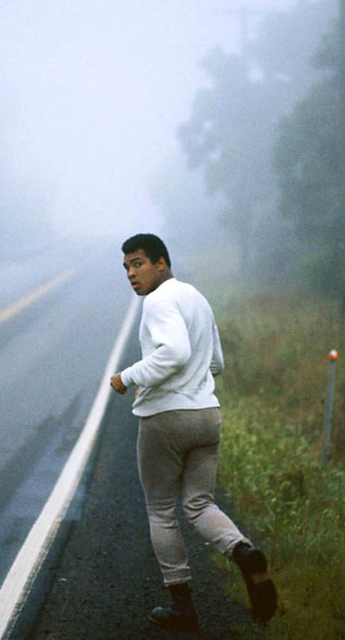
Created by Thompson School District
The Roadwork
Funding Source Alignment SPF, UIP, & DUIP Data Digs Community Asset Mapping School Diagnostic Reviews (EASI) Title I Strategic Design Team Title I Strategic Design Planning ESEA National Conference Title I Principal Interest Surveys Multilingual Learner (ML) Profiles Seeing Is Believing Site Visits High-Mobility Data Technician Instructional Tours | Comprehensive Needs Assessment (CNA) SY 23/24 Title I ConApp Revisions SY 24/25 Title I ConApp Rewrite Panorama Perception Survey Data Digs FSCP Empathy Interviews Student Shadowing Highly-Mobile Community Resource Fairs Highly-Mobile Points of Contact Translator & Interpreter Check-Ins Grant-Based Specialists Check-Ins Non-Public & Private Consultations

Slide 35

Created by Thompson School District,
The Corner
Students, Parents, & Guardians Health Clerks Case Managers & Social Workers Teachers & Instructional Coaches District & School Leaders Special Education SACs, DAAC, & PLTs CEI Thompson Educational Foundation Department(s) of Human Services FSCP Specialists McKinney-Vento Liaisons Educational Stability Specialists | Transportation & Nutrition Departments Athletic Directors & Director of Athletics Counselors & School Psychologists CLDE Departments Community Patrons & Organizations High-Mobility Data Technician Front Office Staff Highly-Mobile Points of Contact Assessment & Evaluations Department Business Services Department Human Resources Department Gifted & Talented Point of Contact CDE

Slide 36

Created by Thompson School District.
The Training Plan
Cross-Programming PLC FSCP High Impact Strategic Plan District Family Center Title I School-Based FSCP Hubs Equity Resource Budget Allocation EASI Stakeholder Engagement Funds General Funds Support(s) Seeing Is Believing Site Visits Rocky Mountain Family Engagement Collective Multilingual Learner (ML) Profiles Student Leadership Workshops Title I Peer Network Contigo Partnership Series Gifted & Talented Programming CDE & CEI Partnerships | Title I Professional Learning Conference Classified Professional Learning Series TSD Instructional Framework Title I School-Based FSCP Specialists ILA Translate Live Devices Literacy Based After-School Programming Prioritized Recruitment & Retention Roadwork Professional Learning Series FSCP Peer-to-Peer Network Multicultural Community Libraries Local, State, & Federal Funding Alignment Highly-Mobile Community Resource Fairs Highly-Mobile Points of Contact Rocky Mountain Family Engagement Collective Hanover Research Capstone Report and Audit FSCP Coffee Chats

Slide 37

reated by Thompson School District
The fight is won or lost far away from witnesses - behind the lines, in the gym, and out there on the road, long before I dance under those lights.
-Muhammad Ali

Slide 38
CNA and the Plan-Do-Study-Act (PDSA) Cycle
in the Consolidated Application

Slide 39
How is the CNA Connected to the Consolidated Application?
Your LEA’s CNA will serve as a guide for how to use your ESEA funds. Strategies and activities funded through ESEA should be addressing an identified need in your CNA.
The person/group who completed the UIP/Strategic plan should be actively involved in the creation of the Consolidated Application.
Connections to Title I, Part A Schoolwide Plans (when applicable) should be prevalent throughout narratives and should inform the uses of funds.
Identified needs should be apparent throughout narrative responses and correlated budgeted expenses.

Slide 40
Where will the CNA Appear in the Consolidated Application Questions?
Cross Program 1.1 Identify the stakeholders who were involved in reviewing relevant data (i.e., comprehensive needs assessment results, performance data, relevant survey data) and assisting with developing the ESEA Plan (Consolidated Application). Check all that apply.
Cross Program 1.2 Describe the process for meaningfully engaging the stakeholders, selected in Question 1.1, in determining the needs and selected strategies of the LEA and/or participating schools.
Cross Program 2.1 Based on the LEA’s comprehensive needs assessment, describe the identified needs that will be addressed with ESEA funds. Consider needs related to students, human capital, academic and behavioral needs, professional development, or any other critical needs. For each of the identified needs, describe the intended goals and desired outcomes. Note, the district will indicate in the budget the evidence-based strategies associated with each Major Improvement Strategy.
Cross Program 3.1 Discuss the process and the outcome data the LEA uses to inform decisions to modify, continue, or terminate ESEA-funded strategies. Include a description of how stakeholders are engaged in the evaluation of effectiveness.
Budget: Selecting Major Improvement Strategies in the budget

Slide 41
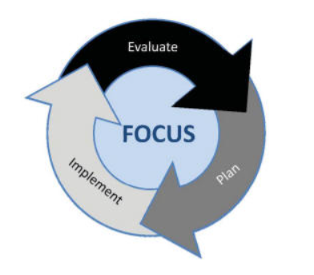
Planning Cycle for Federal Funds
Conduct CNA and identify local needs
Monitor implementation and effectiveness of programming
Consider potential evidence-based strategies to address needs
Adjust implementation based on actual data
Implement plan to address needs
Use guiding questions to determine allowability and appropriate funding source
Finalize Plan

Slide 42
While Completing the Cons App…
Prioritize school needs and expected impacts: How can you prioritize ESEA funds from each grant to address the LEA’s identified needs?
Evidence Based Interventions
Stakeholder engagement in identifying strategies/uses of funds
Consider schools with the highest needs (may vary based on the purpose of the Title) and prioritize funds accordingly to ensure schools receive adequate funding
Consider target student outcomes (based on your local data) and desired adult actions.
Consider your micromoves!
Use the Review Checklist while answering narrative questions.
Think About Monitoring!
Document feedback received and revisions to plans based on stakeholder feedback.
Review student achievement data for improved outcomes.
Maintain evidence that funds are used for activities that match the application approved by CDE.

Slide 43
Progress Monitoring Throughout the School Year
Conduct CNA and identify local needs
Progress Monitor your programs and uses of ESEA funds throughout the year to determine effectiveness. Were your programs a good investment?
What needs to be added, tweaked, or stopped to provide the needed consistency and coherence in instructional programs?
Reminder: LEAs can revise activities in Post-Award Revision, if needed.
Monitor implementation and effectiveness of programming
Consider potential evidence-based strategies to address needs
Adjust implementation based on actual data
Implement plan to address needs
Use guiding questions to determine allowability and appropriate funding source
Finalize Plan

Slide 44
The Roadmap for the Journey
Review your data (starting point for the CNA)
Lift up team perspective on current needs (stakeholders in the CNA)
Consider your needs around Belonging, Consistency, and Coherence
Elicit team input and investment in finalizing priorities for improving instruction and outcomes (response to the CNA)
Determine which priorities you intend to fund with Federal grants
Capture that plan in your draft Narratives for the Consolidated Application
Draft your Budget for the Consolidated Application (estimated numbers)
Attend a Regional Networking Workgroup to complete (or at least close to it) your Consolidated Application this spring
Ensure that your funding plan is aligned with your CNA and supports your identified priorities to support your school community

Slide 45
Resources for the Consolidated Application
Comprehensive Needs Assessment Webpage
Federal Programs Monitoring Webpage
ESSA Schoolwide Requirements and Rubrics document
Evidence Based Interventions
Consolidated Application Review Checklist
Family, School and Community Partnerships Webpage
Unified Improvement Planning Webpage

Slide 46
And know your Regional Contact!
We can be a co-pilot anytime you need us!
Regional Contacts

Slide 47
Updated Guidance: Title II, Part A

Slide 48

Using Title II, Part A Funds to Strategically Support Educator Recruitment, Retention, Professional Learning, and Improved Student Outcomes
Title II Strategic Use of Funds:
Improve compensation and working conditions
Create, improve and expand pathways into the profession
Provide induction* and professional learning
Offer educator leadership and career advancement opportunities
Promote educator diversity
Read the Non-Regulatory Guidance HERE

Slide 49
Improve Compensation and Working Conditions
Did you know…. Title II can be used to…
Increase pay for teacher leaders who take on coaching, mentoring
Support recruitment and retention bonuses and stipends (especially hard-to-staff)
To support teachers to add additional certifications (CTE, special education, etc.)
To reduce or eliminate non-instructional responsibilities
Support professional learning for school leaders
Examples:
Check here first for Colorado! https://cdhe.colorado.gov/educators/educator-funding-opportunities
In Maryland, educators can demonstrate additional expertise and leadership to receive increased compensation.

Slide 50
Create, Improve and Expand Pathways into the Profession
Did you know…. Title II can be used to…
Develop and provide Teacher Residency Programs
Support “Grow Your Own Programs”
Combine with Perkins funds to support career preparation for education
Examples:
TEACH Colorado launched in 2019 to deliver research-backed interventions and support to help reduce barriers to entering the profession.
UNLV in Nevada sponsors a Paraprofessional Pathways Project.

Slide 51
Provide Induction and Professional Learning: Induction
Additional coaching and mentoring, including release time for observation
Additional mentoring and professional development beyond the first year
Compensate additional teacher leaders (special education, ESL) to provide support during induction
“Title II Part A funds can support developing, expanding, and implementing induction programs for new educators provided they do not take the place of other state or local funds that would otherwise be made available for that purpose.”

Slide 52
Provide Induction and Professional Learning: Professional Learning
Professional Learning Must Be:
Sustained
Evidence-based
Job-embedded
Comprehensive
Professional Learning to Support:
Teachers
Principals
To support knowledge of:
Instruction for English learners
Students with Disabilities
Effective Use of Technology
Bridge Early Childhood to Kindergarten teachers

Slide 53
Offer Educator Leadership and Career Advancement Opportunities
Did you know…. Title II can be used to…
Provide release time or compensation for additional teacher leader responsibilities
Fund teacher pursuit of advanced career opportunities or additional endorsements
Examples:
Denver Public Schools offers multiple teacher leadership roles (New Teacher Ambassador, Team Lead, etc.)
New York City established Teacher Career Pathways to enable more than 1400 teachers to serve in leadership roles and earn increased compensation

Slide 54
Promote Educator Diversity
Reminder: The General Education Provisions Act (GEPA, 20 U.S.C. §1228a) requires that programs funded with funds ensure equal opportunity for all eligible students, teachers, and other program beneficiaries in a manner that overcomes barriers to equitable participation, including barriers based on gender, race, national origin, disability, and age.
Diversifying our workforce is critical to addressing teacher shortages
Colorado’s Report, Diversifying the Educator Workforce: Disrupting Inequities, advocated for the following sample strategies:
Financial incentives: housing stipends, loan forgiveness, retention bonuses
Paid student-teacher residencies
Fund recruitment efforts
Provide and sustain coaching and mentoring programs, especially for historically underrepresented groups
U.S. Department of Education: Supporting a Diverse Educator Workforce to Support Teaching and Learning

Slide 55
Title II - Questions?

Slide 56
GAINS

Slide 57
Tips and Tricks
Use the reviewer checklist
Prepopulated narrative questions
Budget Excel template
Copy 2025 Budget Detail
Start consulting with Non-Public Schools
Review list of schools ESSA-Identified (CS, TS, ATS) during planning and prioritization

Slide 58
Networking Time

Slide 59
Questions to Consider
What are your Expected Outcomes?
2-3 specific impacts you hope to see in your school(s).
What are your first steps to get there?
What might be the priorities you want to address with federal funds? (depending on the level of funding your LEA receives)
How will you prioritize schools served? (poverty levels, needs, supporting consistency and coherence)
How do you progress monitor your programs?
What led to improved outcomes for students?
How will you evaluate the impact of your Federally-funded activities?
What has been successful? What needs to continue? What were challenges? What needs to change based on this year's CNA?

Slide 60

Networking Time Cont’d
Join the room that suits your interests:
CDE facilitated conversation
LEA facilitated collaboration- Program design focus
LEA facilitated collaboration- Program evaluation focus
Rural LEA Collaboration

Slide 61
Thank you!

Slide 62
CDE Contacts
Emails: Lastname_Firstinitial@cde.state.co.us (e.g., Smith_a@cde.state.co.us)
Federal Programs & Supports (ESEA/ESSER Program Supports) | School Finance & Operations (Fiscal and Systems Supports)
Nazie Mohajeri-Nelson, Executive Director of Federal Programs & Supports Unit Program Specialists Program Implementation Supervisor: Laura Meushaw Program Implementation Coordinator: Christina Adeboye Sullivan Program Monitoring Supervisor: Tammy Giessinger ESEA/ESSER Monitoring Coordinator: Kristin Crumley Program Effectiveness Supervisor: Tina Negley Program Evaluation & Research Coordinator: Anna Rowan Strategic Recovery Office (ESSER State Reserve): Matt Koziol ESEA Programs Specialists and ESEA Regional Contacts (assigned by district) Title I: Laura Meushaw, Evita Byrd, Rachel Echsner, Kim Boylan Title II: Rachel Echsner, Sue Miller-Curley Title III: Rachel Temple, Kim Boylan Title IV & Stronger Connections Grant: Nathan Hickman, Evita Byrd Title V: Christina Adeboye Sullivan, Rachel Echsner ESSER Program Specialists Kriselda Craven ESEA and ESSER Data and Reporting Specialists Melissa Chaffin (ESEA) Jerry Ring (ESEA) Anna Rowan (ESEA) | Vacant, Executive Director of School District Operations Unit Fiscal Specialists Jennifer Austin, Director of Grants Fiscal Management ESEA Robert Hawkins, Grants Fiscal Analyst Steven Kaleda, Grants Fiscal Analyst ESSER Fiscal Specialist Steven Kaleda Grants Fiscal Analyst ESSER Monitoring Bill Parsley, ESSER Fiscal Monitoring Supervisor Hilery Morris, ESSER Fiscal Monitoring Application Systems Specialists DeLilah Collins, Director of Grants Program Administration Online Applications Systems Technical Support Jessica Hollingshead Michelle Prael

