Slide 1
CDE ESEA and ESSER Office Hours
January 15, 2026

Slide 2
ESEA/ESSER Office Hours
Topics:
Reminders and Updates
Reallocated Grant Opportunity
Monitoring Training

Slide 3
ESEA Reminders and Updates

Slide 4
Reminders
The National Association of ESEA Program Administrators (NAESPA) is hosting its annual conference in Denver this year!
When: February 10-12, 2026
Title: Cultivating Communities for Student Success
Where: Colorado Convention Center, Downtown Denver OR online
Cost: $719 per person
Description:
This event serves as a vital platform for professional growth, learning, and the exchange of ideas in education. Whether you attend in person or virtually, this Conference promises to empower you with the knowledge and resources you need to excel in your field. Together, we work towards achieving the shared vision of improving education for all youth.

Slide 5
Updates
Due to the NAESPA Conference, our February Office Hours dates will be:
Thursday, February 5 [changed due to conference]
Thursday, February 26 [on the typical schedule]

Slide 6
Reallocated Grant Opportunity

Slide 7
Purpose
The Reallocated Funds Grant is intended to provide additional funding and support to districts for the purpose of
addressing LEA needs associated with allowable uses of Title II, Part A, Title III, Part A and Title IV, Part A and
CDE strategic priorities of increasing student engagement and strengthening the educator workforce.

Slide 8
ESEA Reallocated Grant Funding Streams
Title II, Part A - intended to increase student academic achievement consistent with challenging State academic standards, by supplementing strategies to improve the quality and effectiveness of educators, increase the number of educators who are effective in improving student academic achievement in schools, and provide low-income and minority students greater access to effective educators.
Title III, Part A - a supplemental grant under the ESEA that is designed to improve and enhance the education of English learners (ELs) in becoming proficient in English, as well as meeting the Colorado Academic Content standards.
Title IV, Part A - intended to improve students’ academic achievement by increasing the capacity of States, local educational agencies (LEAs), schools, and local communities to provide all students with access to a well-rounded education, improve school conditions for student learning, and improve the use of technology in order to improve the academic achievement and digital literacy of all students.

Slide 9
Eligible Applicants
Title II, Part A | Title III, Part A | Title IV, Part A
LEAs have been prioritized for this grant based on the following metrics: Teacher retention rate, principal retention rate, unfilled positions, percentage of teachers with preferred license types LEAs were assigned a performance band using the 20th, 50th, and 80th percentile markers for each metric | LEAs have been prioritized for this grant based on the following metrics: LEAs that have TS school identified based on performance of MLs Districts with high numbers of American Indian/Alaska Native students who are identified as ML Districts that received a Language Instruction Education Program (LIEP) review in the last 3 years conducted by the Office of Culturally and Linguistically Diverse Education (CLDE) office. | LEAs have been prioritized for this grant based on the following metrics: Chronic Absenteeism and Dropout Rates LEAs were assigned a performance band using the 20th, 50th, and 80th percentile markers for each metric

Slide 10
Available Funds and Duration of Grant
The duration of the grant is from the date the application is awarded (approximately March 13th) to September 30, 2026. All funds must be obligated by September 30, 2026, and requested for reimbursement from CDE by November 1, 2026. Carryover is not available for these funds.
Title II, Part A | Title III, Part A | Title IV, Part A
$800,000 available Up to $100,000 per eligible district. If requests exceed the amount available, funds will be evenly distributed to the prioritized districts that apply (up to $100,000 per district) and have approvable expenditures. If funds remain, the review team will determine if districts not currently prioritized have requests that are reasonable and necessary. | $750,000 available Up to $50,000 per eligible district. If requests exceed the amount available, funds will be distributed to approvable grants based on priority points listed in Appendix A. If funds remain, the review team will determine if districts not currently prioritized have requests that are reasonable and necessary. | $1,200,000 available Up to $100,000 per eligible district. If requests exceed the amount available, funds will be evenly distributed to the prioritized districts that apply (up to $100,000 per district) and have approvable expenditures. If funds remain, the review team will determine if districts not currently prioritized have requests that are reasonable and necessary.

Slide 11
Allowable Uses
Title II, Part A | Title III, Part A | Title IV, Part A
Funds for CDE vetted professional learning that strengthens educator workforce and/or builds the capacity of staff to increase student engagement and accelerate student outcomes. Allowable costs: Cost of PD (e.g., registration) Stipends for participants or coaches Substitutes PD Materials Travel | Activities that will support a District Language Instruction Education Program (LIEP), Multilingual Learners (MLs); including American Indian/Alaska Native, Gifted Education, and Special Education ML students, and strengthen the educator workforce, aligned with the CDE’s strategic priorities of accelerating student outcomes. Such as: Professional Learning Instructional Materials Supplemental Supports (i.e., summer school) Family Engagement Opportunities (i.e., home visits) | Activities that build the capacity of staff to increase student engagement and accelerate student outcomes. Such as: Summer School Programming Concurrent Enrollment Programs designed to improve student attendance and engagement School Orientation for staff and/or students Supplemental enrichment curriculum Home Visits Implementation of schoolwide positive behavioral interventions and supports Professional development (e.g., Teach Like A Champion, Capturing Kids Hearts) Implementation of and/or enhancing data systems for tracking attendance

Slide 12
Application - Application due in GAINS on
Complete application due in the GAINS system by 4 p.m. on February 26, 2026
A complete application in the online system includes:
Signed Assurances
Detailed Budget (outlined in the rubric)
For any purchased service contract request, upload a Memorandum of Understanding (MOU) (e.g., duration, expectations, deliverables, timeline) and/or and scope of work with the selected provider and/or facilitator. If a finalized MOU is not available prior to award, a draft MOU or SOW is acceptable.

Slide 13
Timeline for All Opportunities
Dates | Grant Activity
Monday, January 12, 2026 | Application available within GAINS
Thursday, January 15, 2026 from 2 - 3:30 PM | Virtual Grant Kick Off
Thursday, February 26, 2026 | Complete application due in the GAINS system by 4 p.m.
February 26 – March 13, 2026 | Review of Applications
March 13, 2026 | Applicants will be notified of application status
March 27, 2026 | Any required revisions must be made prior to final approval of the application
April 2026 | Grant award letters issued
September 30, 2026 | All funds must be obligated
November 1, 2026 | Funds must be requested for reimbursement from CDE

Slide 14

Completing the ESEA
Program Monitoring Self-Assessment (PMSA)
January 15, 2026

Slide 15
Which LEAs Need this Information?
All LEAs should be familiar with the requirements associated with accepting federal funds through ESEA.
All LEAs are monitored within a multi-year monitoring cycle and should continuously ensure compliance with program requirements.
The Office Hours training from October 23, 2025 provided an overview of the purpose of monitoring and how to use available monitoring resources to ensure LEA compliance. The PowerPoint and Recording are available on the Federal Programs’ Resources and Technical Assistance page.
Today’s training is specifically designed for LEAs that are being monitored during the current year or anyone who would like to learn how to use the Program Monitoring Self-Assessment for self-monitoring.

Slide 16
LEAs Participating in 2025-2026 Program Monitoring
LEA Number | LEA Name
0010 | Mapleton 1
1520 | Durango 9-R
0060 | Strasburg 31J
0170 | Deer Trail 26J
0220 | Archuleta County 50 Jt
0510 | Kit Carson R-1
0520 | Cheyenne County Re-5
0640 | Centennial R-1
0930 | Kiowa C-2
0960 | Agate 300
0970 | Calhan RJ-1
1050 | Ellicott 22
1080 | Lewis-Palmer 38
LEA Number | LEA Name
1195 | Garfield Re-2
1340 | West Grand 1-JT
1350 | East Grand 2
1410 | North Park R-1
1450 | Arriba-Flagler C-20
1460 | Hi-Plains R-23
1480 | Stratton R-4
1490 | Bethune R-5
1500 | Burlington RE-6J
1780 | Genoa-Hugo C113
1790 | Limon RE-4J
1810 | Karval RE-23
2010 | Creede School District
LEA Number | LEA Name
2070 | Mancos Re-6
2590 | Ridgway R-2
2600 | Platte Canyon 1
2670 | Holly RE-3
3040 | Arickaree R-2
3070 | Woodlin R-104
3220 | Idalia RJ-3
3230 | Liberty J-4
9025 | East Central BOCES
9075 | Southeastern BOCES
9095 | Northwest Colo BOCES

Slide 17
Outcomes for Today’s Training
Preview the Program Monitoring Self-Assessment (PMSA) Structure
Participate in a GAINS Walkthrough
Review Next Steps
Acronyms used today:
LEA: Local Education Agency PMSA: Program Monitoring Self-Assessment
FPSU: Federal Programs and Supports Unit
GAINS: Grants Administration Implementation and Navigation System
ESEA: Elementary and Secondary Education Act
ESSA: Every Student Succeeds Act

Slide 18
Purpose and Intent
ESEA Program Intent:
To ensure all students, particularly underserved students, have equitable
access to a high-quality education.
Purpose of Monitoring:
To ensure that federal funds are used appropriately to implement programs
that meet the intent of each program.

Slide 19
Program Monitoring Self-Assessment Structure

Slide 20

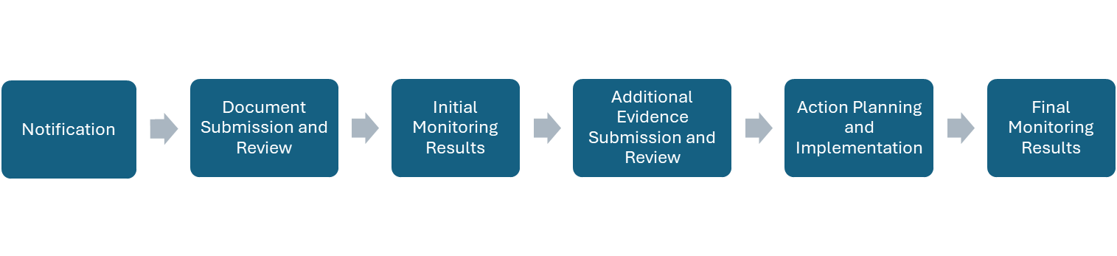
ESEA Monitoring Process

Slide 21
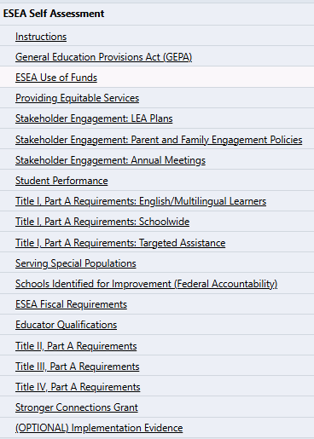
Getting Started
The ESEA Program Monitoring Self-Assessment (PMSA) will be completed and submitted within GAINS.
A working copy of the PMSA is available in PDF format for LEA’s reference on CDE’s Federal Programs Monitoring Page.
The ESEA PMSA Process Guide for GAINS outlines the next steps of the process.

Slide 22

Program Monitoring Self-Assessment Sections
Overview of statutory requirements (informational with checkboxes)
Self-Rating (required)
Narrative (required)
Requested Support (optional)
Section to upload supporting documentation (required)

Slide 23
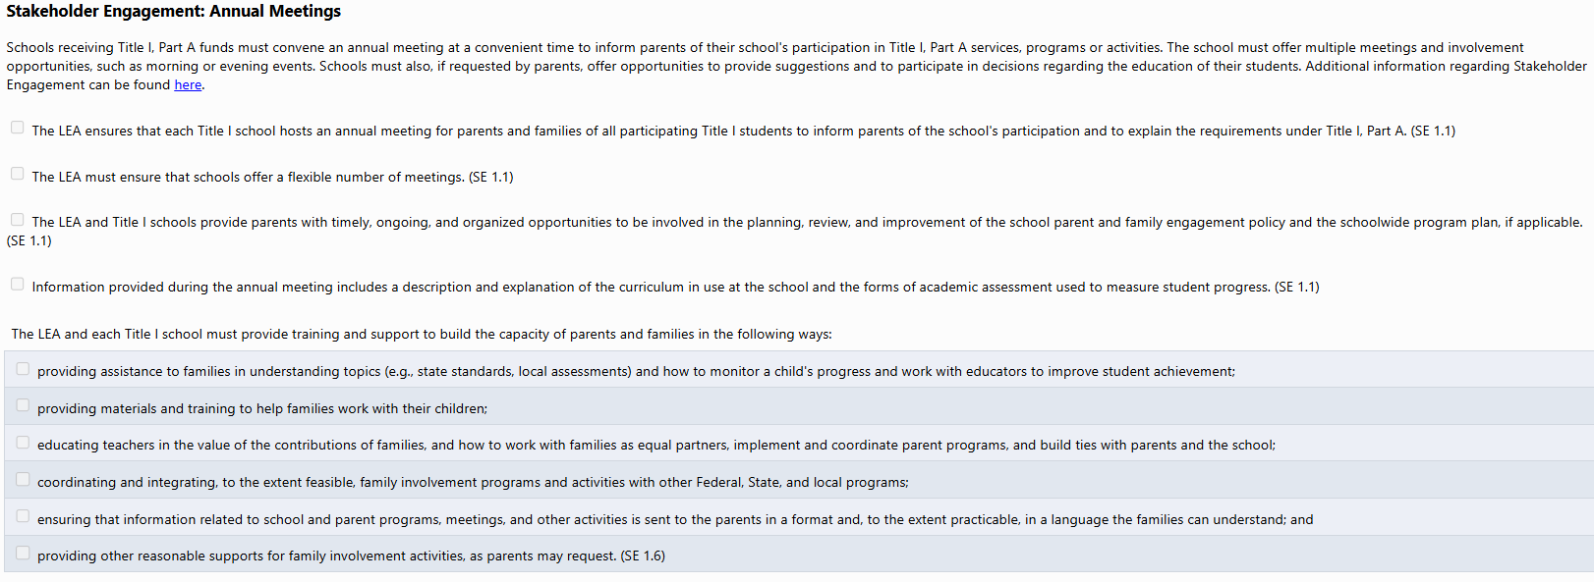
Overview of Statutory Requirements

Slide 24

Program Monitoring Requirements Resource
Program Monitoring Requirements
Resource outlines requirements for all sections of the PMSA, including:
Statute
Demonstration of Compliance
Examples of Evidence

Slide 25
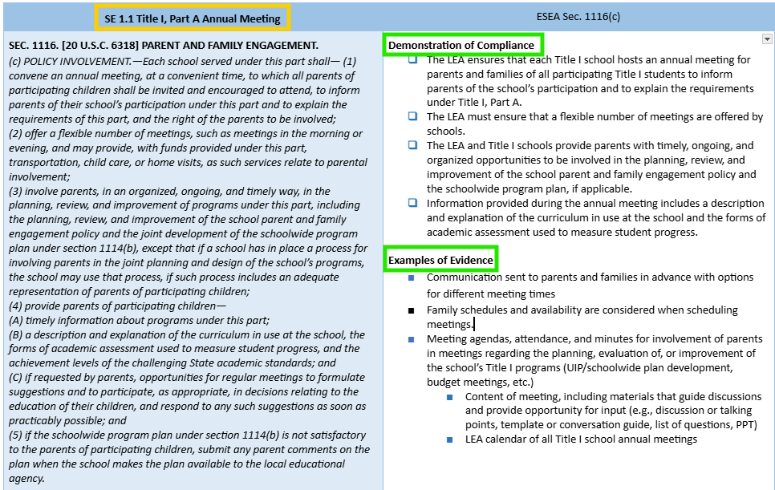
Program Monitoring Requirements Example
Each requirement (or set of requirements) in the PMSA is followed by an indicator number.
The indicator number corresponds to the indicator’s location in the Program Monitoring Requirements document.

Slide 26
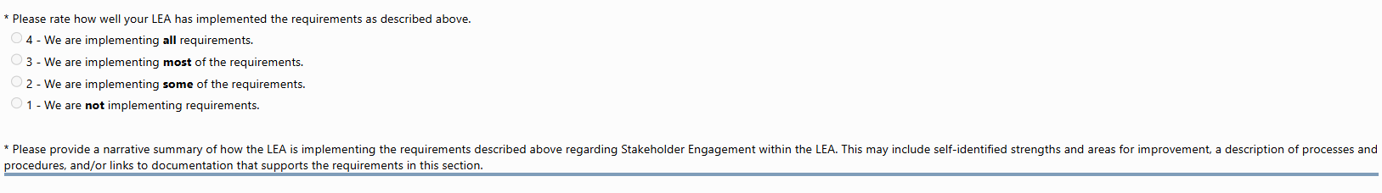

Self-Rating and Narrative
Please refer to Appendix A in the ESEA PMSA Process Guide for GAINS for additional information on what to include in narrative responses.

Slide 27
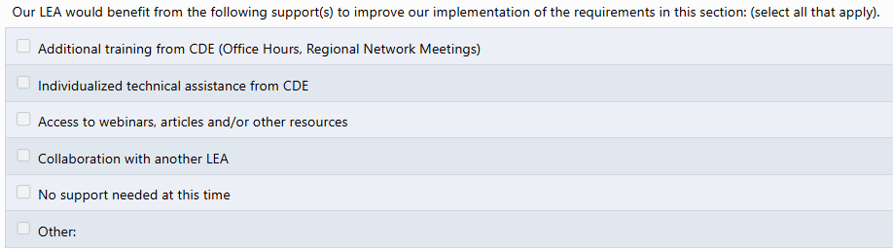

Request(s) for Support

Slide 28
Uploading Documentation/Evidence
Reviewers are looking for evidence to support that requirements for each checkbox at the top of each page have been met.
LEAs can submit links or documents. Some LEAs in the past have shared links to a Google folder with their information or a Word document with links.
When submitting documentation through GAINS, please redact any personally identifiable information (PII). If PII is a necessary part of the documentation being submitted (e.g., evidence for monitoring), please submit via Syncplicity instead of GAINS.
Please note that when you upload a document, it will be named the title of each page, unless you create a new name. It is helpful to be specific and to include the indicator reference number (such as SE 1.1).

Slide 29
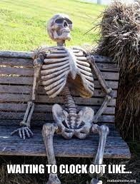
Time Commitment for the PMSA
How much time should this take?
If the LEA has been compiling necessary evidence for each requirement, a reasonable expectation for completing the PMSA in GAINS is approximately two to three hours. If evidence still needs collected, this will increase the time.
If additional team members are needed to support different programs, time to check in with those team members will need to be considered.

Slide 30

PMSA Deadline
The Program Monitoring Self-Assessment (PMSA) in GAINS is due on March 12, 2026.
Please reach out to the monitoring team if additional time is needed.

Slide 31
BOCES and Member Districts
The organization(s) implementing the requirements should complete the applicable sections of the PMSA.
If funds are being used for BOCES-level activities, the BOCES will complete that section of the PMSA. Member districts will indicate that information can be found in the BOCES PMSA for these sections. Note: In this context, BOCES-level activities means activities carried out by BOCES staff with minimal or no involvement from member district staff.
If funds are only being used for member district-level activities, the member district will complete the section of the PMSA. The BOCES will indicate that information can be found in specific member district PMSAs for the sections.
If funds are being used for both BOCES-level and member district-level activities, both entities should complete the sections of the PMSA for their funded activities.
In many cases, activities have involvement from both the member district and BOCES staff, and therefore, both entities should provide a response for activities to ensure all evidence of compliance is demonstrated.

Slide 32
GAINS Walkthrough

Slide 33
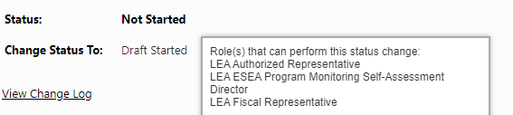
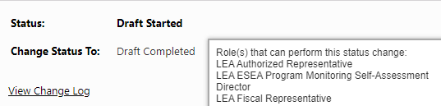
GAINS User Roles
Who can begin the Program Monitoring Self-Assessment?
LEA Authorized Representative
LEA Fiscal Representative
LEA ESEA Program Monitoring Self-Assessment Director
Who can edit and submit the PMSA?
LEA Authorized Representative
LEA Fiscal Representative
LEA ESEA Program Monitoring Self-Assessment Director
Who can assign additional access to a team member as a Program Monitoring Self-Assessment Director?
LEA User Access Administrator

Slide 34

Facilitated GAINS Walkthrough
Tour of PMSA Monitoring Instrument within GAINS

Slide 35
Next Steps

Slide 36
Next Steps for LEAs and CDE
For LEAs:
Ensure that roles are assigned for access to the PMSA.
Complete the PMSA in GAINS by March 12, 2026.
Ensure the status of the PMSA is changed to “Authorized Representative Approved” when ready to submit.
For CDE:
The Program Monitoring Office team will review each LEA’s PMSA and provide initial results upon submission.
If additional evidence is needed to determine compliance, reviewers will request the additional evidence through GAINS.

Slide 37
Questions?

Slide 38
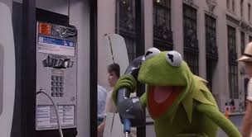
CDE Program Monitoring Team Contacts
Tammy Giessinger
720-827-5291 (c)
giessinger_t@cde.state.co.us
Kristin Crumley
720-660-1369 (c)
crumley_k@cde.state.co.us
Kim Boylan
720-354-7031 (c)
boylan_k@cde.state.co.us
Nathan Hickman
720-833-8194 (c)
hickman_n@cde.state.co.us

Slide 39
Upcoming Meetings

Slide 40

Looking Ahead…
Any requests for topics or questions?
Upcoming Office Hours
February 5
February 26
Due to scheduling conflicts, Office Hours will be held on February 5th and 26th.

Slide 41
CDE Contacts!
Emails: Lastname_Firstinitial@cde.state.co.us (e.g., Smith_a@cde.state.co.us)
Federal Programs & Supports (ESEA/ESSER Program Supports) | School Finance & Operations (Fiscal and Systems Supports)
Nazie Mohajeri-Nelson, Executive Director of Federal Programs & Supports Unit Program Specialists Program Implementation Supervisor: Laura Meushaw Program Implementation Coordinator: Christina Adeboye Sullivan Program Monitoring Supervisor: Tammy Giessinger ESEA Monitoring Coordinator: Kristin Crumley Program Effectiveness Supervisor: Tina Negley Program Evaluation & Research Coordinator: Anna Rowan ESEA Programs Specialists and ESEA Regional Contacts (assigned by district) Title I: Laura Meushaw, Evita Byrd, Rachel Echsner, Kim Boylan Title II: Rachel Echsner Title III: Rachel Temple, Kim Boylan Title IV & Stronger Connections Grant: Nathan Hickman, Evita Byrd Title V: Christina Adeboye-Sullivan, Rachel Echsner ESSER Specialist: Kim Boylan ESEA Data and Reporting Specialists Melissa Chaffin (ESEA) Jerry Ring (ESEA) Anna Rowan (ESEA) | Vacant, Executive Director of School District Operations Unit Fiscal Specialists Jennifer Austin, Director of Grants Fiscal Management ESEA Robert Hawkins, Grants Fiscal Analyst Steven Kaleda, Grants Fiscal Analyst ESSER Fiscal Specialist Steven Kaleda Grants Fiscal Analyst ESSER Monitoring Bill Parsley, ESSER Fiscal Monitoring Supervisor Hilery Morris, ESSER Fiscal Monitoring Application Systems Specialists DeLilah Collins, Director of Grants Program Administration Online Applications Systems Technical Support Jessica Hollingshead Michelle Prael

