Slide 1









October 6, 2016 CoP
October 6, 2016

Slide 2
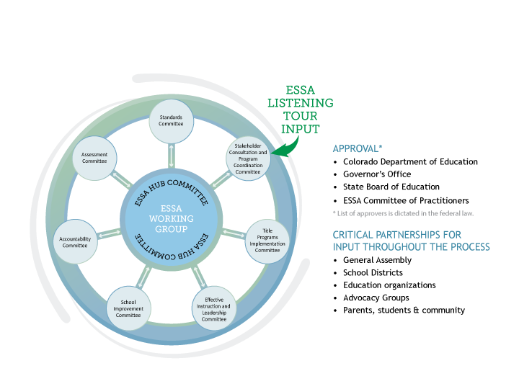
ESSA State Plan Development

Slide 3


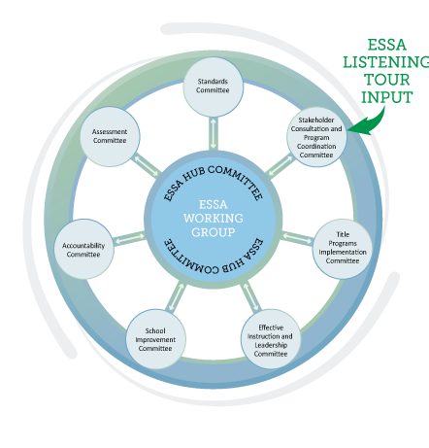
Charge for Spoke Committee
Draft, review, and revise sections of
Colorado’s ESSA State Plan;
Provide recommendations on content specific decision points
Identify possible areas for additional flexibility in state legislation
Propose responses to and provide justifications for decisions made concerning stakeholder feedback; and,
Present and submit draft sections, recommendations , and summaries of the ESSA state plan work to the Hub committee.

Slide 4


Participants
Newly formed group of stakeholders from across the state
  School Districts
    District Leaders
    Educators
  BOCES
  Institutes of Higher Education
  Education Partners
    ASCD (formerly the Assoc. for Supervision and Curriculum Development)
    Center for Teaching Quality
    Colorado Education Association
    Colorado Education Initiative
    KIPP Colorado Schools
4
Public Education Business Coalition (PEBC)

Slide 5

August 4, 2016, 1:00 – 4:00 p.m.
Effective Instruction and Leadership Spoke Meetings:
Equity Working Group: August 22, 2016, 1:00 – 4:00 p.m.
Support Working Group: August 22, 2016, 1:00 – 4:00 p.m.
September 7, 2016, 10:00 a.m. – 2:00 p.m.
  October 10, 2016 – Hub Committee
  October 12th or 13th, 2016 – State Board of Education
October 14, 2016, 10:00 a.m. – noon
November 2, 2016, 10:00 a.m. – 2:00 p.m.
5

Slide 6

Requirements and Decisions
6

Slide 7

Decision Points
Identify educator definitions for:
  Experienced/inexperienced
  In-field/out-of-field
  Effective/ineffective
CDE’s identified use of Title I and II funds in support of districts
CDE’s support to improve preparation programs and strengthen teachers, principals and leaders ability to identify and support students with specific learning needs
CDE’s support of local districts’ implementation of educator evaluation systems
Definition of para-professional standards and demonstration of
meeting those standards
7

Slide 8

Recommendations
Define ‘inexperienced’ as teachers with 0-2 years of experience teaching in any educational setting.
Define ‘in-field’ as holding a license with an endorsement in
the subject area in which the teacher is assigned to teach.
Continue to use the definition of effective/ineffective contained in SB 10-191.
Keep references to State model educator evaluation system broad and do not include any details that are not required.
Maintain paraprofessional requirements aligned to former highly-qualified rules in NCLB
8

Slide 9


Consequences
Definition | Potential Unintended Consequence | Discussion Question(s)
In-field: endorsed | Teachers in schools with waivers from licensure (charter schools) would largely be counted as ‘out-of-field’. | Should we identify a unique definition for waiver (including public and charter) schools? If so, what should it include?
In-field: endorsed | Teachers who were considered ‘highly qualified’ under NCLB without the endorsement may be then counted as ‘out-of-field’ until they apply for and meet endorsement standards. | Can we live with this unintended consequence in the short-term while we flesh out additional pathways to add endorsements?
Inexperienced 9 | Is there truly an equitable application of experience for all educators. | What criteria counts as 0-2 years of experience? Does part time or .25 time count for two full years just as a full time 100% teacher?

Slide 10
Questions
Feedback for the Spoke Committee
If we define in-field as an educator who holds an endorsement in that content, what could this mean in different contexts for our districts?
If we use the definition of experienced to include all educators with 2 or more years of teaching, then how could this impact retention and recruitment?
If we keep current paraprofessional requirements, what are the implications for the field?
What is needed to have an experienced, effective and in-field educator in front of students?
10

Slide 11


Contact Info
Thank you for your time and insight today!
For more information, contact the Effective Instruction and Leadership Spoke Committee leads:
  Colleen O'Neil
(303) 866-6945 | Oneil_C@cde.state.co.us
  Jennifer Simons
(303) 866-3905 | Simons_J@cde.state.co.us
11

