Slide 1
Consolidated Application – How to Complete your Forms

Slide 2
Agenda
We will cover how to fill out the following forms relating to the Consolidated Application:
Approval and Transmittal Form
School Improvement Retention of Funds Form
Non-Public Consultation Form
BOCES ARAC Form

Slide 3
Consolidated Application –
Requirements for Substantial Approval
Activity | Due Date | Submission Location
Non-Public School Consultation Forms | May 31 | Non-Public Schools page
School Improvement Retention of Funds Form | May 31 | Documents Upload page
Approval and Transmittal Form | June 30 | Documents Upload page
BOCES Member District ARAC Form (found in application) | June 30 | Sign Over Info & Uploads
Native American Education Tribal Consultation Form | June 30 | Submit to the Consolidatedapplications@cde.state.co.us or to Georgina Owen
Online Application | June 30 | https://www.cde.state.co.us/apps/consapp2023/login

Slide 4
Approval and Transmittal Form

Slide 5
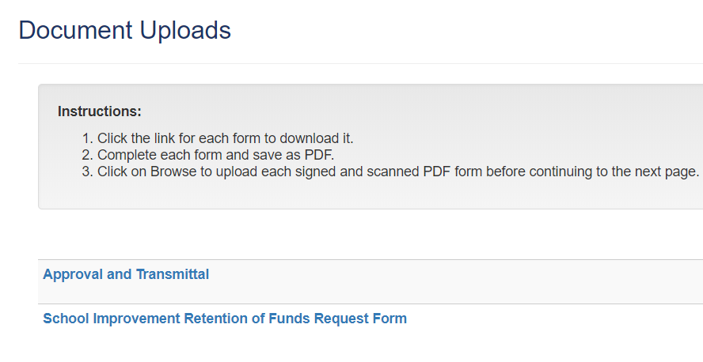
Approval and Transmittal Form: Location
This form is required for all applicants who submit an application
Download this form through the Consolidated Application in the “Document Uploads” section.
Click on the highlighted blue text and it will begin to download the document

Slide 6
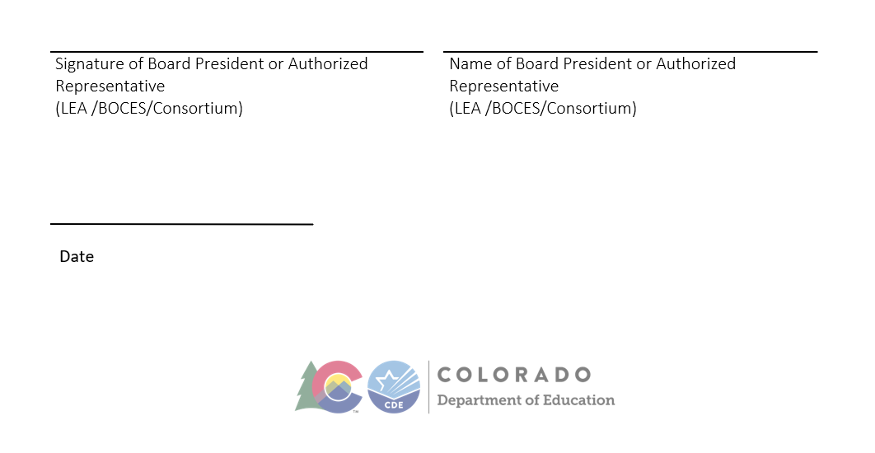
Approval and Transmittal Form: Required Fields
Ensure that the Board President or the Authorized Representative sign at the bottom:

Slide 7

Approval and Transmittal Form: Completion
Submit as a PDF through the Consolidated application in the “Document Uploads” Section
If successful, it will show that the file has been uploaded in green text
If you uploaded the wrong file, you can delete that file with the orange button

Slide 8
School Improvement Retention of Funds

Slide 9
School Improvement Retention of Funds Request Form: Frequently Asked Questions
Those districts with identified Comprehensive Support and Improvement and Targeted Support and Improvement will have this form appear in the “Document Uploads” section of the Consolidated Application
This form is asking whether or not the state can retain 10% of the state’s allocation to go towards CS/TS schools through EASI:
  The Colorado Turnaround Network
  Connect for Success
  English Language Development Program Review
  District Designed Improvement efforts
  Support for improvement planning and implementation
This does not impact the districts allocation!

Slide 10
School Improvement Retention of Funds Request Form: Location
Download this form through the Consolidated Application in the “Document Uploads” section.
Click on the highlighted blue text:

Slide 11
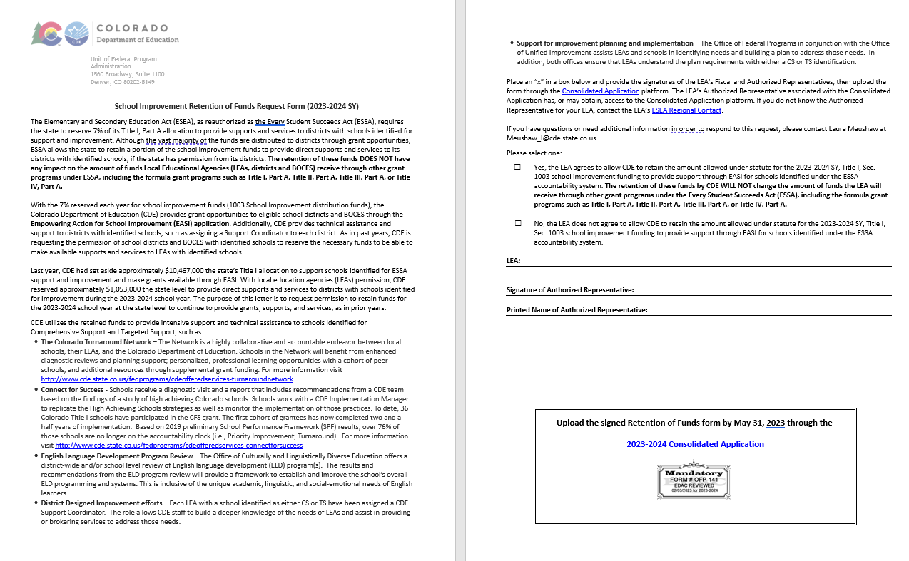
School Improvement Retention of Funds Request Form

Slide 12
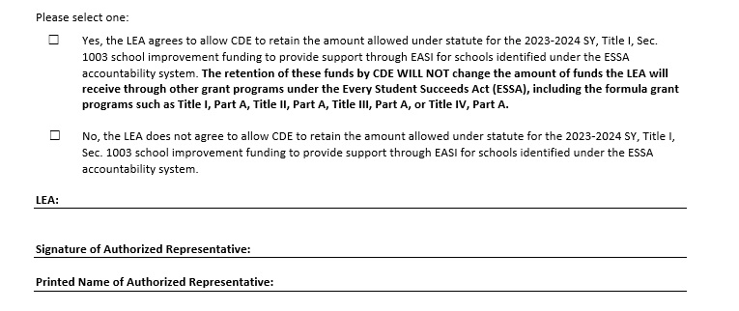
School Improvement Retention of Funds Request Form: Required Fields
Be sure to checkmark whether or not you will allow CDE to retain those funds
Fill out your LEA name
Have your Authorized Representative sign the form

Slide 13
School Improvement Retention of Funds Request Form: Completion
Submit as a PDF through the Consolidated application in the “Document Uploads” Section
If successful, it will show that the file has been uploaded in green text
If you uploaded the wrong file, you can delete that file with the orange button
If you have any questions regarding this form, please reach out to Laura Meushaw.

Slide 14
Non-Public Consultation Form (NPS)

Slide 15

Non-Public Consultation Form: Location
You can find the consultation form on CDE’s website.
Districts and BOCES can use CDE’s consultation form or their own that they have to consult Non-Publics

Slide 16
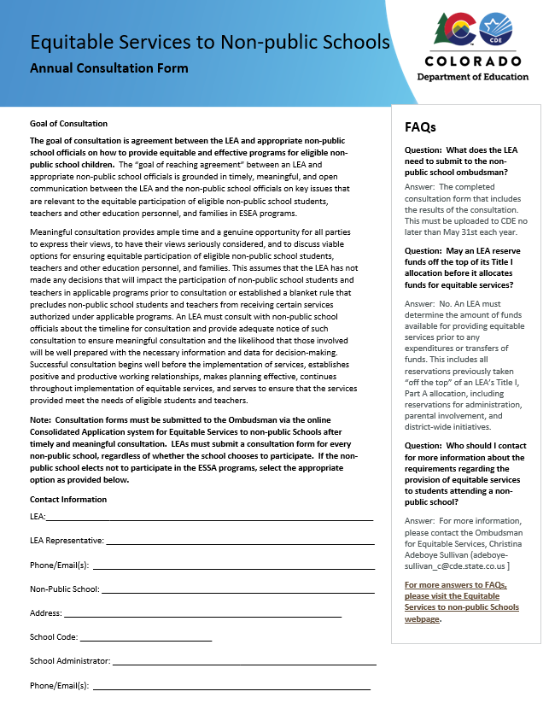
Non-Public Consultation Form: Required Fields (Page 1)
Be sure to fill out the LEA’s information and the Non-Public School’s information on the first page

Slide 17
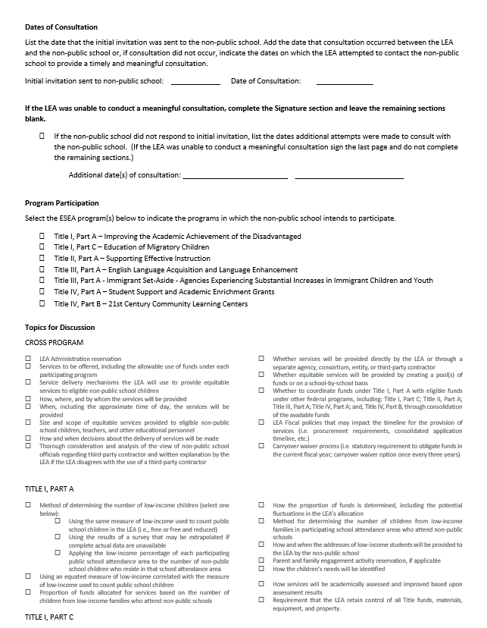
Non-Public Consultation Form: Required Fields (Page 2)
The second page needs to include the dates you reached out to the Non-public school
If they did not respond to your invitation, please put a check next to the line where it says, “…did not respond..”
The rest of the page is for consultation so districts and BOCES can mark which programs the NPS would like to participate in

Slide 18
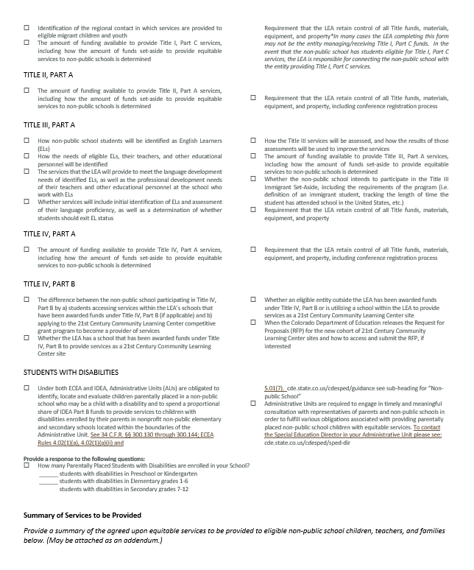
Non-Public Consultation Form: Required Fields (Page 3)
Page three continues with the other programs that the NPS would like to participate in
If you were unable to reach them, you can leave this part blank

Slide 19
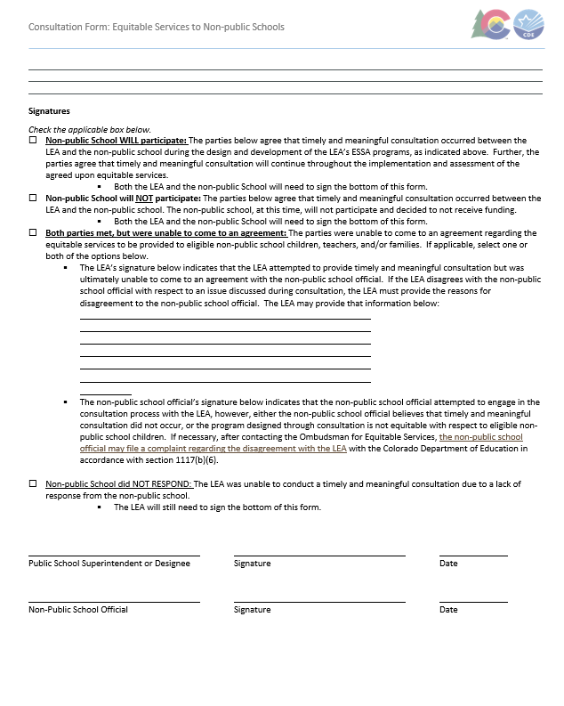
Non-Public Consultation Form: Required Fields (Page 4)
For the final page, please be sure to check one of the boxes under the “Signatures” section
The Public School Superintendent or Designee will need to sign this form even if there wasn’t a consultation with the NPS
If the NPS declines to participate, both signatures are needed
If there was a consultation, both parties need to sign the form

Slide 20
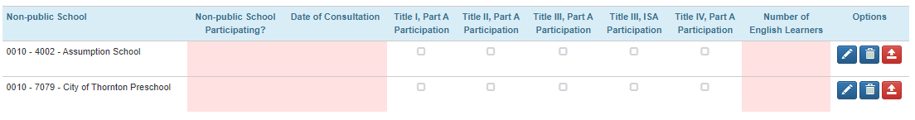
Non-Public Consultation Form: Completion
Please upload each consultation form to the chart on the Non-public Schools page in the Consolidated Application.
You will upload a PDF to each red arrow.
The only time you don’t upload a consultation form is if the school is ineligible for services. In that case, please use the trashcan to remove the school from the chart.

Slide 21
Acceptance, Relinquishments, Assignment and Certification (ARAC)

Slide 22
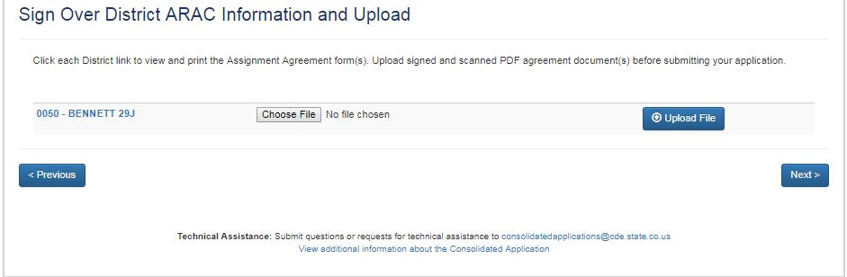
ARCA: Location
The BOCES can download the form on the “Sign Over District ARAC Information and Upload” section of the application once a district assigns funds over to the BOCES.
Click on the highlighted blue text:

Slide 23
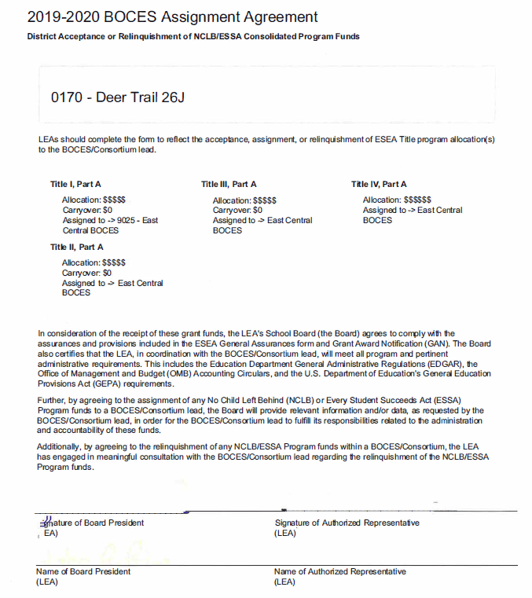
ARAC: Required Fields
Requires a signature from the Authorized Representative and the Board President

Slide 24
ARAC: Completion
Submit as a PDF through the Consolidated application in the “Sign Over District ARAC Information and Upload” Section
If successful, it will show that the file has been uploaded in green text
If you uploaded the wrong file, you can delete that file with the orange button

Slide 25
Contact us with Questions!
If reviewing this slide deck after the live presentation, feel free to contact your Regional Contact, the Grants Program Administration Office, or the Grants Fiscal Office. Questions can also be sent to consolidatedapplications@cde.state.co.us

