Slide 1
2023-2024 Consolidated Application Work Session
Federal Programs and Supports Unit

Slide 2
Welcome
Sign in
Get a nametag
Connect to WiFi
Network Name:
Password:
Find a seat but don’t get too comfortable…we will be rearranging after introductions

Slide 3
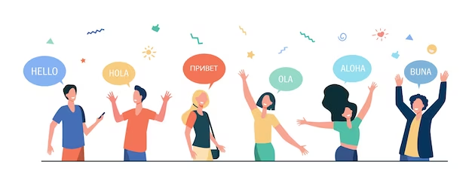
CDE Introductions
[insert the names and titles of the various CDE staff present]
Federal Programs and Supports Unit
Regional Contact
Regional Contact
Grants Program Administration Office
Office of Grants Fiscal (for virtual support)
Notes:
Additional Support Staff List

Slide 4
Work Session Agenda
Logistics
Norms
Objectives
Who’s in the Room?
Upcoming Due Dates
Logging into the Application
Clarifying Questions about the Application and the 23-24 Updates
WORK TIME
Resources and Contacts

Slide 5
Logistics
WiFi
Bathrooms

Slide 6
Meeting Norms
Participate fully.
Lean into discomfort; have a growth mindset.
Share the space with others in small groups & in the room; invite people into the conversation.
Leave the room to meet your needs (taking calls, restroom breaks, refill water bottle, etc.).

Slide 7
Objectives
Participants will be able to:
Access and navigate the application.
Know which CDE staff and other LEA staff to reach out to for questions and support.
Begin completing aspects of their application.
Identify clear next steps for completing the 23-24 Consolidated Application on time.

Slide 8
Who’s in the Room?
Sit-down IF…
This is your 1st year writing a ConsApp.
This is your 2nd year of writing a ConsApp.
This is your 3rd year of writing a ConsApp.
This is up to your 5th year of writing a ConsApp.
This is up to your 8th year of writing a ConsApp.
This is up to your 10th year of writing a ConsApp.
Notes:
[If the group is small (fewer than 5), skip this slide]

Slide 9
Think-Pair-Share
Think: What do you hope to accomplish or get out of today’s work session?
Pair: Stand up and form groups of 3-4.
Try to include:
1 person that has never worked on a ConsApp.
1 person that has worked on a ConsApp 1-3 times.
1 person that has worked on a ConsApp more than 3 times.
Share: Take 4 minutes each to:
Introduce yourself.
Name the LEA you represent & your role there.
Identify your level of experience with the ConsApp.
Answer the question above.
Notes:
[If the group is small (fewer than 5), have each person just introduce themselves.]

Slide 10
Due Dates and Logging in to the Application

Slide 11
Timeline: Substantial Approval
In order to receive Substantial Approval on the 2023-2024 Consolidated Application, the applicant will need to submit the following:
Activity | Due Date | Submission Location
Non-Public School Consultation Forms | May 31 | Non-Public Schools page
School Improvement Retention of Funds Form | May 31 | Documents Upload page
Approval and Transmittal Form | June 30 | Documents Upload page
BOCES Member District ARAC Form (found in application) | June 30 | Sign Over Info & Uploads
Native American Education Tribal Consultation Form | June 30 | Submit to the Consolidatedapplications@cde.state.co.us or to Georgina Owen
Online Application | June 30 | https://www.cde.state.co.us/apps/consapp2023/login
Notes:
Substantial approval allows the applicant to obligate funds.
In order to receive Substantial Approval, you will need to submit the online application, along with a few documents that may pertain to your district. Almost all the forms need to be submitted through the consolidated application, except for the tribal forms. Those districts that it applies to, Georgina Owen (Title Program Manager), submits them on behalf of the district. So work with her to make sure that gets submitted on time.

Slide 12
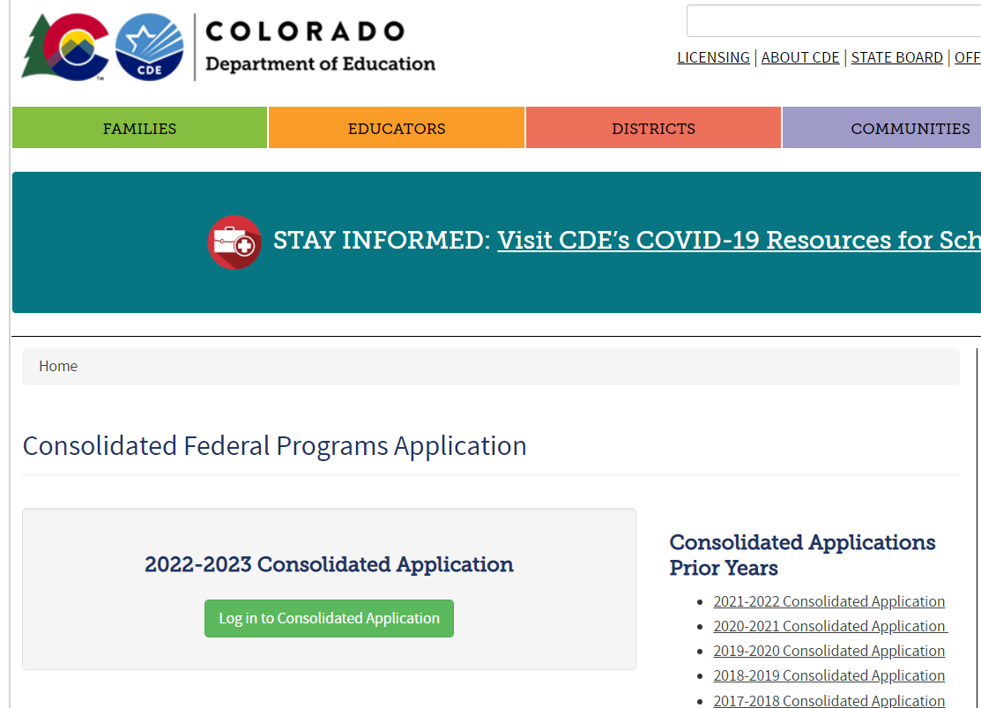
Accessing the Application
bit.ly/3v2G9pC
OR
Google “cde consolidated application” then click the first link.

Slide 13
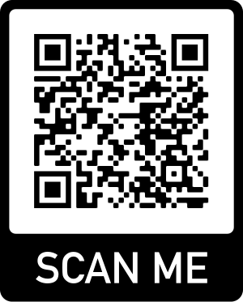
23-24 Consolidated Application Login Reminder
The application access is through the Identify Management system (IdM), using the same login and password details used for Data Pipeline and the Unified Improvement Plan.
A good first step, if you have used IdM before, is to check with your District Local Access Management (LAM) Group to grant you access to the CONSAPP application in IdM.
If you haven’t used the IdM system before or are having trouble logging in with it, please use the access assistance form to find your district’s LAM Group.
If you have used IdM before and have confirmed you have access to the Consolidated Application, please contact us at consolidatedapplications@cde.state.co.us for additional technical assistance
Here are some additional resources to assist you:
Reset Your IdM Password
Local Access Manager Quick Access Guide (DOCX)
Identity Management Quick Reference Guide (PDF)
Access Assistance Form
Notes:
[HAVE AUDIENCE LOG INTO THE APP]

Slide 14
Extension Requests
If the LEA/BOCES is unable to submit all the requirements for Substantial Approval by June 30 the LEA or BOCES may request an extension by submitting a completed extension request form. The extension request form is available online: www.cde.state.co.us/fedprograms/consapp/index
The LEA/BOCES may not encumber funds until a complete application has been submitted to CDE and granted Substantial Approval. Once the extension request has been submitted and approved, the LEA/BOCES has until the last business day in July to submit requirements for Substantial Approval.
Notes:
If you are looking at the upcoming dates and you aren’t sure if you can complete everything on time, we do have an extension request form. This form lets us know at CDE that your application will be turned in late. However, you can not encumber funds until everything is turned in. So if you want another month to turn everything in, you wouldn’t get that substantial approval date until July 30th or August 1st. We can’t backdate it to July 1^{st.}

Slide 15
Updates to the 2023-2024 Application

Slide 16
Transition Consolidated Application
The Consolidated Application is typically on a three year cycle.
The 2022-2023 was the third year in the cycle.
So, 2023-2024 would normally be the first year in the application cycle.
New Grants Management System
CDE is working on a new Grants Management System that would be implemented for the Consolidated Application in the 2024-2025 school year.
The 2023-2024 Consolidated Application is a “Transition” application.
Transition Application
Will look like a year 1 application with less requirements.

Slide 17
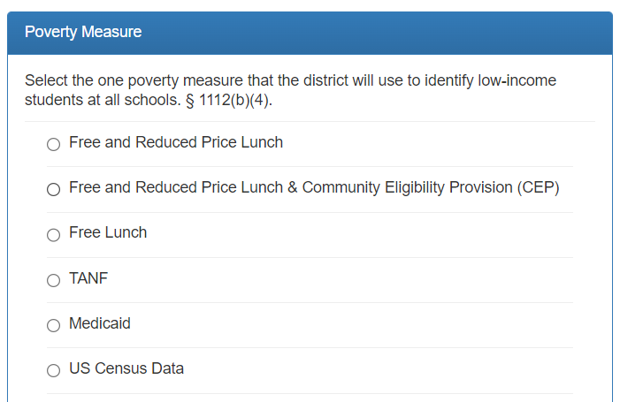
Poverty Measure
For 2023-2024:
Only the 2022-2023 poverty data
Same poverty measure options as prior years and afforded by the law
2022 October Count will be the only data source for FRL pre-populated into the system
Resources:
Department of Education, Within-District Allocation Guidance (Feb. 2022)
Healthy Meals for All information
Notes:
For 2023-2024, districts will have to same poverty measure options as prior years and afforded by the law. However, as previously mentioned, the poverty data used will be based on 2022 October Count only. District will no longer have the option of multiple data sources. We wanted to briefly discuss the Healthy Meals for All program which will be in full effect for 2023-2024 school year. Many districts have expressed concern that this new program will impact the number of families that complete the Free and Reduced Lunch forms. We are working closely with our Nutrition group as well as the Department of Education to better understand if and how this new program will impact our schools. One significant learning is that the way the program works is the district is either CEP eligible in which case they must apply for CEP. This only accounts for approximately 24 districts in the state. For the other 150 some odd districts, the plan is that the district collects from the federal lunch program and the state will cover the rest. So it continue to be essential that families fill out the form. Included on this slide is a link to a flyer that discusses all of this and how the program and Title I intersect. The Nutrition group also has some great flyers in English and Spanish that can be sent to families to help explain that these forms not only access food but potentially bring additional monies to the school. These flyers will be available in the RNM google folder. The link will be given at the end of the presentation. Also, we are happy to brainstorm how best to proceed once you start digging into your FRL information and start ranking schools.

Slide 18
Updates/Changes to the 2023-2024 Consolidated Application
Funding year designations
LEA Profile will no longer have the option to select different years of data. This section will look the same as pre-pandemic applications.
Required Versus Optional Narratives
Not all narratives will be required this year. The application will indicate which narratives are required versus optional.
Budget
The LEA will still complete the budget section for any Title they accept funds.
Notes:
Michelle

Slide 19
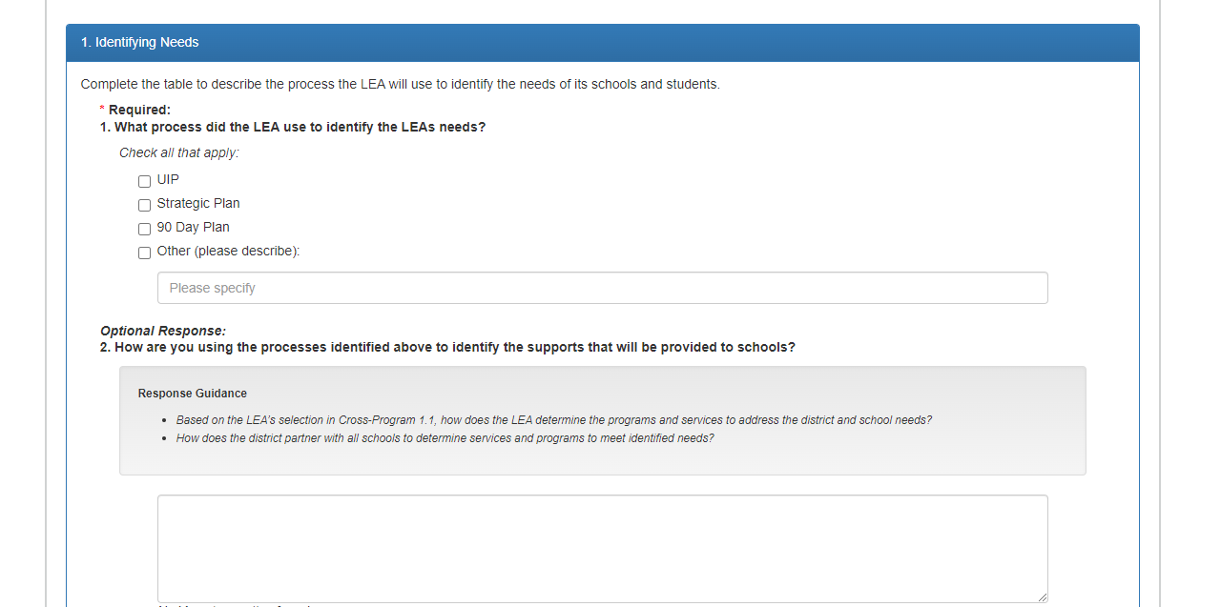
Required vs. Optional Questions
All questions will either indicate whether a question is required or optional:
- Optional
APPLICATION SCREENSHOT

Slide 20
Required Vs. Optional Narratives

Slide 21
Required Narrative Questions - Cross Program
1.1. What process did the LEA use to identify the LEAs needs?
3.3. Describe how the LEA will consult with relevant educators, families, and community members in developing proposed activities with Title III funding.
4.1. Describe how the LEA implements effective outreach to parents and families of English Learners on their involvement in the academic achievement and being active participants in supporting their student to attain English proficiency, achieve at high levels within a well-rounded education and meet the Colorado Academic Standards.
[3.3 only appears if the LEA has a Title III allocation]

Slide 22
Required Narrative Questions - Title I, Part A
2. Describe the services being provided to children and youth experiencing homelessness in coordination with the McKinney-Vento Homeless Assistance Act (42 U.S.C. 11301 et seq.) to support enrollment, attendance, school stability and academic success, and the guidance and support provided at the school level.
5 - 5.5: Describe how the LEA will address any [20-21] gaps in low-income and minority students being taught at disproportionate rates by ineffective, inexperienced, or out-of-field teachers, compared to other students. For information and guidance, see CDE's Equitable Distribution of Teachers webpage. This resource provides planning guidance and evidence-based strategies to address human capital challenges.
[5 - 5.5 only appear if the LEA has a medium or large sized EDT gap]

Slide 23
Required Narrative Questions - Targeted Support and Improvement
[This page only appears for the LEAs that have schools identified as Targeted and Additional Targeted Support and Improvement]
1. What is the LEA’s process for reviewing, approving, and monitoring Targeted Support (TS) and Improvement, including plans from schools identified for additional targeted support and improvement? For LEAs with ATS schools, how does the LEA assist the schools in identifying and addressing any resource inequities?
2. Select how the LEA will exit TS and ATS schools:

Slide 24
Required Narrative Questions - Targeted Support and Improvement Continued
[This page only appears for the LEAs that have schools identified as Targeted and Additional Targeted Support and Improvement]
3. In order to ensure schools identified for support and improvement under ESSA are appropriately reported to the U.S. Department of Education, and made eligible for school improvement funds, each LEA/BOCES must maintain a record and report to CDE when a school has exited from Targeted Support and Improvement status or Additional Targeted and Support and Improvement. All schools currently identified for TS or ATS will pre-populate in the list below.
For each school, indicate whether the school has exited from TS/ATS status. If the LEA has indicated that it will annually exit all schools no longer meeting the state's identification criteria (Question 2), please select the "Pending state's identification process" option. When this option is selected, schools will be exited from TS/ATS status if they are not re-identified the subsequent year. However, the LEA may opt to keep a particular school on the list if the school would benefit from continued support.
If the LEA has indicated that it has established other exit criteria and timelines, please select "Yes" to indicate that a school has met the LEA's exit criteria and timeline, or "No" to indicate that the school has not yet met the LEA's exit criteria and timeline.

Slide 25
Required Narrative Questions - Title I, Part D
[This page only appears for the LEAs with a Title I, Part D Allocation]
2.2 Provide a description of the formal agreements that exist between the LEA and correctional facilities or alternative school programs serving children and youth involved in the juvenile justice system. §1423(2)
3.1 Please provide a description of how the participating schools will facilitate a successful transition for children and youth from the correctional facilities to the schools. §1423(4)

Slide 26
Required Narrative Questions - Title II, Part A
[This question only appears for the LEAs that have schools identified as Comprehensive, Targeted and Additional Targeted Support and Improvement]
2. Complete the tables below to describe how the LEA will prioritize Title II, Part A funds to schools implementing comprehensive or targeted and additional targeted support and improvement activities, and among those schools, have the highest percentage of children identified as low-income

Slide 27
Required Narrative Questions - Title III, Part A
[This page only appears if the LEA has a Title III allocation]
1. Complete the tables to describe how professional development is funded.

Slide 28
Required Narrative Questions - Title IV, Part A
No questions required.

Slide 29
Reminder
*LEAs must complete each applicable budget, even if narratives are not required.*

Slide 30
Helpful Tips for Completing the Application

Slide 31
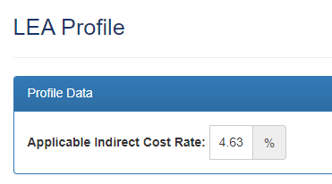
Application Tips: Module A
GEPA Statements
Ensure your LEA’S mitigation narrative addresses specific barriers.
If you indicate Title funds will be used to address a barrier, ensure that is reflected in the budget.
Indirect Cost Rate
Use the indirect cost override to balance budget.
Title IX Lead
More than one Title IX Lead on the Contacts page will cause an error. Select only on person as the lead.
Location Dropdown
You must select a school to serve on the school profiles page to ensure it appears on the location dropdown.
Will appear on location dropdown
Will not appear on location dropdown

Slide 32
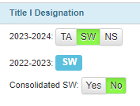
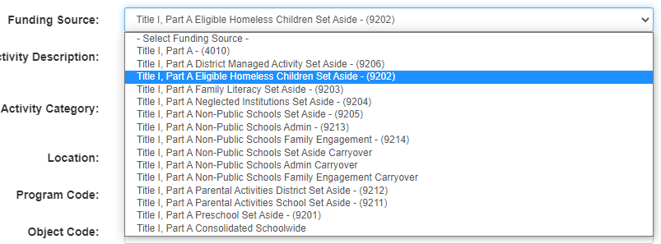
Application Tips: Title I
Schoolwide vs. Consolidated Schoolwide
Schoolwide is a programmatic selection. Consolidated Schoolwide is an accounting function. Not all Schoolwide programs are served with consolidated schoolwide funds.
Title I Budget
For location, select the elementary school name with (E) rather than the elementary school and preschool with (PK), unless the preschool is served.
Select the corresponding funding source for set-asides (i.e., Homeless set-aside, preschool set-aside, District Managed Activity)
Preschool Table
Must be completed and zeroed out.

Slide 33
Application Tips: Title II
Stipends and FTE
When using Title II funds for stipends, the FTE should be “0”.
Substitutes and FTE
When using Title II funds for substitutes, the FTE should be “0”.

Slide 34
Application Tips: Title III
Funding source
If TIII funds are combined with other funding sources, select both“other funding sources” and “TIII”.

Slide 35
Application Tips: Title IV
Budget
Ensure the Activity Category matches the Funding Source.

Slide 36
Resources for Finishing the Application
Notes:
[Let the groups start working on their applications and walk around to help.]

Slide 37
Consolidated Application Resources
The Consolidated Application Virtual Training Library
Contains all the programmatic recordings from 2020.
Included a “2022-2023 Updates to Training” section for those programs that may have changed or added additional components from that 2020 training
Includes the contact information for each program if you have questions
The ESEA Unit Launchpad
A resource for LEA staff in roles dealing with federal funds
2023 Winter RNM Recording
Describes the planning and implementation cycle for federal funds
The Consolidated Application Manual
Within-District Allocation Guidance
Reach out to your Regional Contacts for additional support
Technical Assistance Request
Set up time with your Regional Contact for one on one support

Slide 38
Additional Support:
Reach out to your Regional Contacts.
Technical Assistance Request - Set up time with your Regional Contact for one on one support.
Dedicated times during existing Thursday afternoon office hours.
Notes:
We have a Technical Assistance Request form that you can fill out to set up technical assistance time. A lot of people used the form last year and you can designate which sections of the applications you need help with. It will ask for days and times that work best for you and our team will set up a meeting with you and the appropriate individuals to provide you with support. As always, if you have questions, you can reach out to your Regional Contact for assistance.
We will also host office hours.

Slide 39
Work Time
Notes:
[Let the groups start working on their applications and walk around to help.]

Slide 40
Federal Programs and Support Unit
ESEA Office | Position | E-mail
Nazie Mohajeri-Nelson | Director of Federal Programs and Support Unit | Mohajeri-Nelson_N@cde.state.co.us
Emily Owen | Program Support | Owen_E@cde.state.co.us
ESEA Staff | Position | E-mail
Laura Meushaw | Program Implementation Supervisor | Meushaw_L@cde.state.co.us
Tammy Giessinger | Title IV Coordinator and Program Monitoring Supervisor | Giessinger_T@cde.state.co.us
Evita Byrd | ESEA Senior Consultant: Title I | Byrd_E@cde.state.co.us
Rachel Echsner | ESEA Senior Consultant: Titles I and II | Echsner_R@cde.state.co.us
Karen Bixler | ESEA Senior Consultant: Title II | Bixler_K@cde.state.co.us
Rachel Temple | ESEA Senior Consultant: Title III | Temple_R@cde.state.co.us
Nathan Hickman | ESEA Senior Consultant: Titles ID and IV | Hickman_N@cde.state.co.us
Kristin Crumley | ESEA/ESSER Monitoring Coordinator | Crumley_K@cde.state.co.us
Christina Adeboye-Sullivan | Program Implementation Coordinator: Title III and Ombudsman | Adeboye-Sullivan_C@cde.state.co.us
TBD | Title V | TBD

Slide 41
Federal Programs and Support Unit
ESSER Staff | Program Expertise | E-mail
Kristin Crumley | ESEA/ESSER Monitoring Coordinator | Crumley_K@cde.state.co.us
Jonathan Schelke | ESSER Monitoring Specialist | Schelke_J@cde.state.co.us
TBD | ESSER/ESEA Grants Administration Coordinator | TBD
Mackenzie Owens | ESSER Reporting Specialist | Owens_M@cde.state.co.us
Kim Boylan | ESSER Monitoring Specialist | Boylan_K@cde.state.co.us
DARE Staff | Expertise | Email
Tina Negley | Supervisor of Program Effectiveness | Negley_T@cde.state.co.us
Melissa Chaffin | ESEA Reporting Specialist | Chaffin_M@cde.state.co.us
Mary Shen | ESEA Program Evaluator and Lead Research Analyst | Shen_M@cde.state.co.us
Mackenzie Owens | ESSER Reporting Specialist | Owens_M@cde.state.co.us
Notes:
Michelle

Slide 42
Grants Program Administration Office
GPA Staff | Program Expertise | E-mail
DeLilah Collins | Director of Grants Program Administration Office | Collins_D@cde.state.co.us
Michelle Prael | Senior Consultant | Prael_M@cde.state.co.us
Jessica Hollingshead | Operations Supervisor | Hollingshead_J@cde.state.co.us
Megan Allen | Director Assistant | Allen_M@cde.state.co.us
Notes:
Michelle

Slide 43
Grants Fiscal Office
Grants Fiscal Staff | Program Expertise | E-mail
Jennifer Austin | Director of Grants Fiscal | Austin_J@cde.state.co.us
Robert Hawkins | Grants Fiscal Analyst | Hawkins_R@cde.state.co.us
Steven Kaleda | Grants Fiscal Analyst | Kaleda_S@cde.state.co.us
Notes:
Michelle
As well as our Grant Fiscal Partners.

Slide 44
Share Out
Share Out:
What are 1-2 next steps you are going to take when getting back to your LEA to continue the work that was done today?
Questions?

