Slide 1
2022-2023 Consolidated Application Functionality Training
Notes:
Michelle

Slide 2
Agenda
Unit Updates
Upcoming Due Dates and Reminders
Application Updates
Consolidated Application Walkthrough
Additional Support
Questions
Breakout Session by Content
Consolidated Application Overview

Slide 3
Unit Updates
Notes:
Nazie

Slide 4
Federal Programs and Support Unit
In order to better support and meet the needs of the LEAs that we serve, CDE is undergoing re-organization, including changes to the Unit of Federal Programs Administration, which housed the Office of ESEA Programs.
The ESEA Office will soon be the Federal Programs and Supports Unit
Responsible for the administration of ESEA and ESSER programs
  Application review and approval
  Technical assistance, guidance, and support to LEAs (ESEA Regional Contacts) on use of federal funds
  Monitoring
  Evaluation
  Reporting
Notes:
Nazie

Slide 5
Grants Program Administration Office
CDE launched the new Grants Program Administration office, directed by DeLilah Collins, staffed by existing staff from the Unit of Federal Programs Administration.
Located in the School Finance Division
Allows greater coordination with the Grants Fiscal Management Unit
Oversees the implementation of a new grants management system
Continue to support competitive grant applications
Notes:
DeLilah

Slide 6
Unit Updates cont.
Joint Responsibility
Clear and frequent coordinated communication and
Continuity of services
What should you expect from CDE?
GPA
ESEA
System functionality and technical support systems issues
Review process and timelines
Content within the consolidated Application (development of questions)
Technical assistance and guidance pertaining to the uses of funds
Application approval in consultation with GPA and Grants Fiscal
Notes:
DeLilah

Slide 7
Consolidated Application Overview

Slide 8
Consolidated Application – Purpose and Structure
LEAs that have received an ESEA allocation must submit an LEA Plan and Budget for the proposed uses of ESEA funds.
The SEA must approve the uses of funds before funds are obligated or spent.
A final approval of the LEA’s applications is necessary to request reimbursement.
Programs included are Titles:
  I Part A; I Part D
  II Part A
  III Part A and Immigrant Set Aside
  IV Part A
  V Part B (for eligible rural districts)
Structure and core elements
  A comprehensive needs assessment;
  Meaningful, ongoing consultation with parents, teachers and other community members;
  The identification of students in need of additional support;
  Delivery and progress monitoring of evidenced-based student supports; and
  Evaluation of programs and activities funded by the ESSA.
The 2022-2023 Consolidated Application is Year 3 of the application
Notes:
Under the ESSA, state educational agencies (SEAs) are required to collect local education agency (LEA) plans that address the requirements of the law, as well as descriptions of the activities the LEA will implement with its Title I, II, III, and IV allocations. To meet this requirement, the Colorado Department of Education (CDE) has developed, with stakeholder input, a consolidated application, which includes a set of five cross-program questions, organized around five core elements

Slide 9
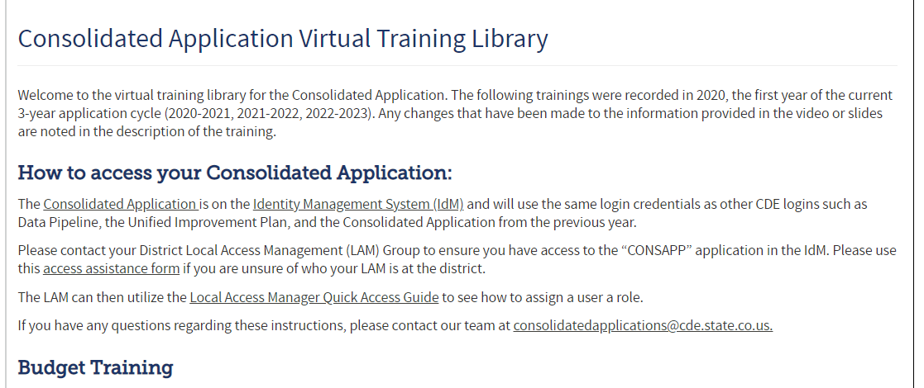
Consolidated Application Virtual Training Library
The Consolidated Application Virtual Training Library contains all the programmatic recordings from 2020.
  Included a “2022-2023 Updates to Training” section for those programs that may have changed or added additional components from that 2020 training
  Also includes the contact information for each program if you have questions
Notes:
Michelle

Slide 10
Due Dates and Reminders
Notes:
Michelle

Slide 11
22-23 Consolidated Application Login Reminder
The application access is through the Identify Management system (IdM), using the same login and password details used for Data Pipeline and the Unified Improvement Plan.
  A good first step, if you have used IdM before, is to check with your District Local Access Management (LAM) Group to grant you access to the CONSAPP application in IdM.
  If you haven’t used the IdM system before or are having trouble logging in with it, please use the access assistance form to find your district’s LAM Group.
  If you have used IdM before and have confirmed you have access to the Consolidated Application, please contact us at consolidatedapplications@cde.state.co.us for additional technical assistance
Here are some additional resources to assist you:
  Reset Your IdM Password
  Local Access Manager Quick Access Guide (DOCX)
  Identity Management Quick Reference Guide (PDF)
Notes:
Michelle
Request access from your LAM ASAP

Slide 12
Timeline: Substantial Approval
In order to receive Substantial Approval on the 2022-2023 Consolidated Application, the applicant will need to submit the following:
Activity | Due Date | Submission Location
Non-Public School Consultation Forms | May 30 | Non-Public Schools page
School Improvement Retention of Funds Form | May 30 | Documents Upload page
Approval and Transmittal Form | June 30 | Documents Upload page
BOCES Member District ARAC Form (found in application) | June 30 | Sign Over Info & Uploads
Native American Education Tribal Consultation Form | June 30 | Submit to the Consolidatedapplications@cde.state.co.us or to Georgina Owen
Online Application: including assurances, GEPA statements, narrative responses, and budget. | June 30 | http://www.cde.state.co.us/apps/consapp2022/login
Notes:
Michelle
Substantial approval allows the applicant to obligate funds.
In order to receive Substantial Approval, you will need to submit the online application, along with a few documents that may pertain to your district. Almost all the forms need to be submitted through the consolidated application, except for the tribal forms. Those districts that it applies to, Georgina Owen (Title Program Manager), submits them on behalf of the district. So work with her to make sure that gets submitted on time.

Slide 13
Extension Requests
If the LEA/BOCES is unable to submit all the requirements for Substantial Approval by June 30 the LEA or BOCES may request an extension by submitting a completed extension request form. Please submit the Extension Request to the consolidatedapplications@cde.state.co.us. The CDE will then review the request and either approve it or deny it.
The LEA/BOCES may not encumber funds until a complete application has been submitted to CDE and granted Substantial Approval. Once the extension request has been submitted and approved, the LEA/BOCES has until the last business day in July to submit requirements for Substantial Approval.
Notes:
Michelle
If you are looking at the upcoming dates and you aren’t sure if you can complete everything on time, we do have an extension request form. This form lets us know at CDE that your application will be turned in late. However, you can not encumber funds until everything is turned in. So if you want another month to turn everything in, you wouldn’t get that substantial approval date until July 30th or August 1st. We can’t backdate it to July 1^{st.}

Slide 14
Consolidated Application Manual
The Consolidated Application Manual assists applicants with the completion and submission of the application. The Consolidated Application Manual:
  Follows the workflow of the application platform
  Provides a description and definition of all parts of the application
  Provides screen shots of areas in the application platform
  Incorporates all narrative questions, assurances, additional resources and requirements in one document
Please note that the manual was published for Year 1 of the application cycle.
Notes:
Michelle
We are currently updating our Consolidated Application Manual to reflect the new changes. Once it is ready, you will find the manual at the link on this slide. This will be a great resource for anyone who is new or needs a quick refresher on requirements. The manual follows the workflow of the platform so your team can easily find the sections needed to complete the application. It is also helpful if you have multiple people working on different sections of the application, those individuals can jump to the section they need to learn about it and they can ensure they are including everything.

Slide 15
Updates
Notes:
Michelle

Slide 16
Updates/Changes to the 2022-2023 Consolidated Application
Funding year designations
  LEA profile includes the option to choose between 2019-2020, 2020-2021, or 2021-2022 student October data
Title I, Part A Question 5 Assurance
  The LEA has used CDE’s Alternative EDT Calculator and can demonstrate compliance with EDT requirements for some or all indicators with medium/large gaps that were identified in CDE’s EDT analyses. In the Title I, Part A Narrative - General Comments below, the LEA will note which indicators no longer have medium/large gaps and which data year was used to confirm that. The LEA will maintain a completed copy of the alternative calculator on file for monitoring purposes. For any medium/large gaps that still exist, the LEA will submit an EDT Plan by completing the following 6 questions.
Set-Aside and Title IV Content Categories Summary
  New section to track Title IV Carryover items by purpose area (Well-rounded, Safe and Healthy, Education technology)
20-21 and 21-22 Narrative Responses will carryover to the 22-23 application
Notes:
Michelle

Slide 17
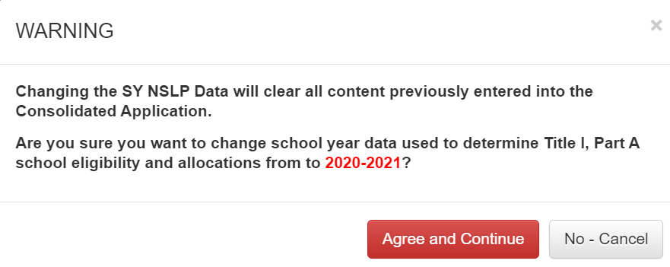
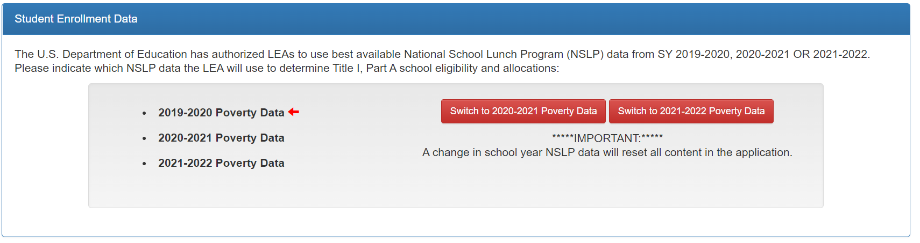
Funding Year Designation
Please note that when you switch the data year, the Poverty Measure will reset and you will have to pick the measure again.
Notes:
Michelle
We have added functionality to the LEA Profile page. As you can see, we added a section where you can select the data you wish to use for the 22-23 application. It is important to note that you should decide which data year to use prior to filling out the application. We will mention this multiple times today but if you fill out your entire application and then decide to see what 2019-2020 data might look like, this will completely wipe the data from your application.

Slide 18
BOCES - Funding Year Designation
LEAs that assign Title I funds to a BOCES will be able to change the data year.
  The BOCES will not be able to change the data year for each district in the BOCES application.
  Please note that the data year option does not show up for districts that Decline or Assign funds
Steps for BOCES to change the data year for a Member District:
The BOCES will need to go into the Member District’s application and will need to initially ACCEPT Title I on the “Funds Allocation” page
This will allow the data year change on the LEA Profile to appear
The BOCES will then carefully select which year to use for that Member District
Please then go back to “Funds Allocation” page and change ACCEPT to ASSIGN TO [insert BOCES]
This will allow the correct data to populate the BOCES application
Please utilize the BOCES Data Year Change Step-by-Step Document to see the steps above visually.
Notes:
Michelle

Slide 19
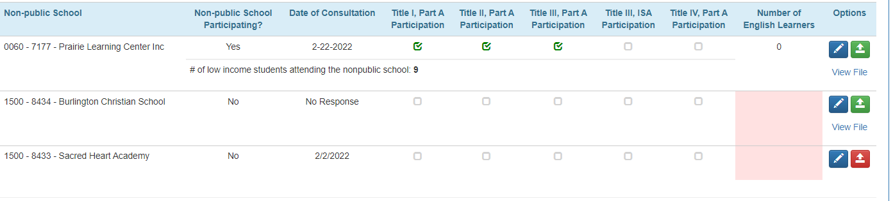
BOCES Reminders: Non-Public Schools Chart
Non-Public Schools can’t be deleted in the BOCES application:
However, the member district application can delete the non-public schools:
Notes:
Michelle

Slide 20
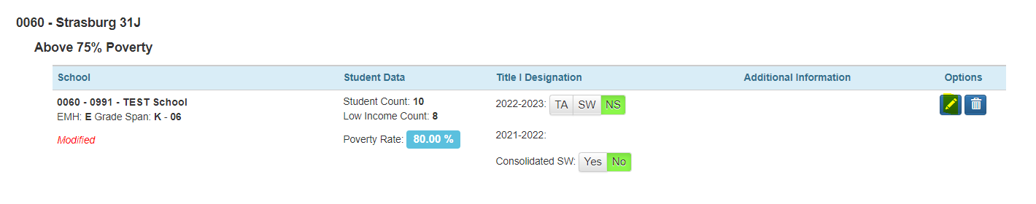
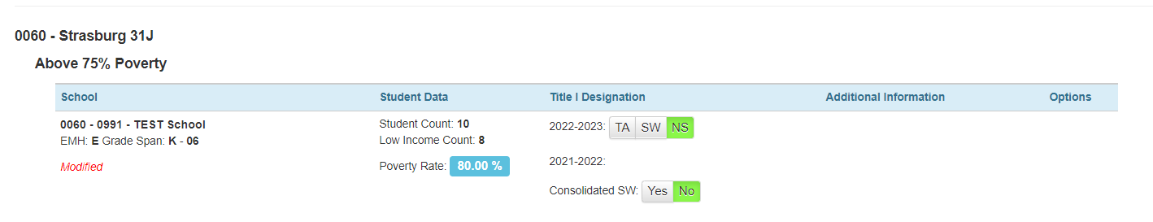
BOCES Reminders: School Profiles Page
This is similar to the Non-Public Schools chart where the BOCES can’t edit the schools in the district. This takes place in the member district’s application:
Strasburg Application:
East Central BOCES Application:
Notes:
Michelle

Slide 21
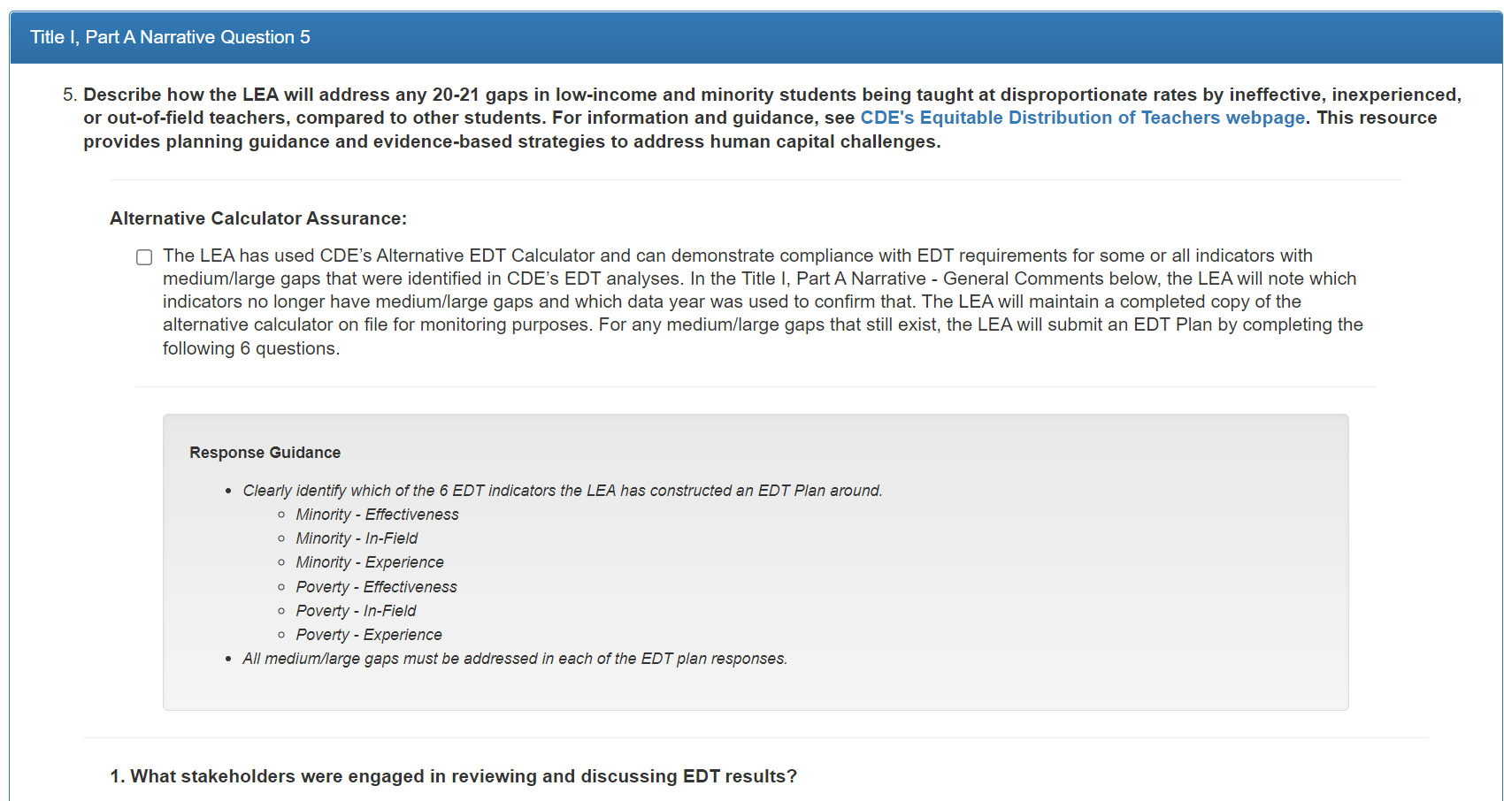
Optional EDT Alternative Calculator Assurance
Notes:
Niko

Slide 22
Optional EDT Alternative Calculator Assurance
Statutory intent of EDT can be met at many levels.
CDE is able to calculate EDT at the school level.
LEAs that have identified gaps must develop a plan to address gaps by answering the questions in the Consolidated Application regarding EDT.
Because the CDE analyses compares percentages of effective, in-field, and experienced teachers across schools, LEAs can use local data (particularly if analyses can be conducted using classroom or teacher level data) and the EDT Alternative Calculator to demonstrate compliance at the student/teacher level.
There are 6 data elements which can be identified with a small, medium, or large gap (any of the blue cells below could be identified with gaps):
Student Group/EDT Category | Effectiveness | In-field | Experience
Minority
Poverty
Notes:
Niko

Slide 23
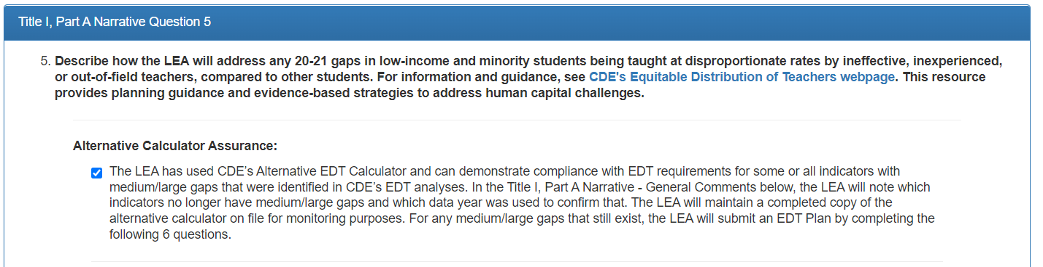
Alternative Calculator DOES Demonstrate Compliance
Select the assurance checkbox.
Add the following information in the General Comments box:
  Which identified indicator(s) were met through the Alternative Calculator data.
  The data year used in the Alternative Calculator.
Maintain a completed copy of the Alternative Calculator on file locally for monitoring purposes. Do not upload the data into the Consolidated Application nor email them to CDE during the application period.
Notes:
Niko

Slide 24
Alternative Calculator DOES NOT Demonstrate Compliance
Do not select the assurance checkbox.
An LEA with small gaps will create and implement an EDT Plan locally.
An LEA with medium/large gaps will develop an EDT plan, submit the plan by answering the 6 EDT questions, then implement the plan after approval.
Notes:
Niko

Slide 25
Updated Response Guidance
Questions themselves have not changed.
Include responses for all indicators identified by CDE analyses with medium or large gaps.
  Exclude plans/responses pertaining to indicators for which the Alternative Calculator demonstrates that a gap does not exist at the teacher or classroom level.
Please be sure to include the names of the indicator(s) that you are addressing when answering EDT Plan questions 1-6.
If your plan includes addressing multiple medium/large gaps, please clearly differentiate between the indicators in the response boxes.
Response Example Text
Poverty - Experience: District ABC identified 3 root causes of this gap…
Minority - In-Field: District ABC identified 2 root causes of this gap…

Slide 26
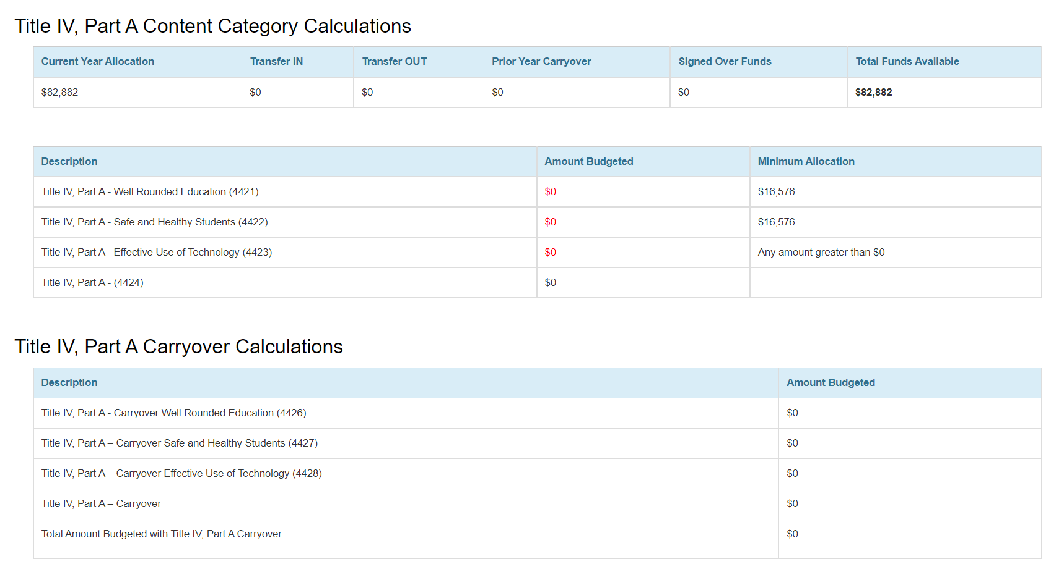
Title IV, Part A Carryover Calculations
Notes:
Tammy
Two Title IV, Part A budget summary tables, one for the current year allocation and the second for carryover funds, have been added to the Set-Asides and Content Area Calculations page of the Consolidated Application. LEAs should budget all activities in the Title IV, Part A budget using the funding codes for the activities aligned content area in order to populate the budget summary tables. Please note that carryover funds do not need to remain categorical if the Title IV, Part A percentage requirements were met in the previous year.

Slide 27
2022-2023 Consolidated Application Walk Through
https://sitespubdev.cde.state.co.us/apps/consapp2022/
Notes:
Michelle & DeLilah

Slide 28

Additional Support:
Reach out to your Regional Contacts
Technical Assistance Request - Set up time with your Regional Contact for one on one support
Dedicate time during existing Thursday afternoon office hours
In-person work sessions throughout May by Region
Notes:
Michelle
We have a Technical Assistance Request form that you can fill out to set up technical assistance time. A lot of people used the form last year and you can designate which sections of the applications you need help with. It will ask for days and times that work best for you and our team will set up a meeting with you and the appropriate individuals to provide you with support. As always, if you have questions, you can reach out to your Regional Contact for assistance.
We will also host office hours.

Slide 29
ESEA Team
ESEA Office | Position | E-mail
Nazie Mohajeri-Nelson | Director of the ESEA Programs Office (soon to be Federal Programs and Supports Unit) | Mohajeri-nelson_n@cde.state.co.us
Emily Owen | Program Support | Owen_e@cde.state.co.us
ESEA Team | Position and Regional Contact Region | E-mail
Laura Meushaw | Title I School Improvement Coordinator and Southeast | meushaw_l@cde.state.co.us
Evita Byrd | ESEA Senior Consultant: Title I and Northeast/North Central | byrd_e@cde.state.co.us
Niko Kaloudis | ESEA Senior Consultant: Title I and II and Northeast/North Central | Kaloudis_n@cde.state.co.us
Karen Bixler | ESEA Senior Consultant: Title II and Northwest/West Central | bixler_k@cde.state.co.us
Kathryn Wisner | ESEA Senior Consultant: Title I and III and Southwest | Wisner_k@cde.state.co.us
Rachel Temple | ESEA Senior Consultant: Title III and Northwest/West Central | temple_r@cde.state.co.us
Tammy Giessinger | ESEA Senior Consultant: Title IV and Southeast | giessinger_t@cde.state.co.us
TBD | ESEA Senior Consultant: Title ID, IV, V and TBD | TBD
Shannon Wilson | ESSER & ESEA Grants Administration Coordinator | Wilson_s@cde.state.co.us

Slide 30
Federal Programs and Support Unit
ESEA Office | Position | E-mail
Nazie Mohajeri-Nelson | Director of ESEA Programs Office (soon to be the Federal Programs and Support Unit) | Mohajeri-nelson_n@cde.state.co.us
ESSER Office | Program Expertise | E-mail
Kristin Crumley | ESSER Monitoring Specialist | crumley_k@cde.state.co.us
Jonathan Schelke | ESSER Monitoring Specialist | schelke_j@cde.state.co.us
Kim Boylan | ESSER Monitoring Specialist | Boylan_k@cde.state.co.us
Shannon Wilson | ESSER & ESEA Grants Administration Coordinator | wilson_s@cde.state.co.us
Mackenzie Owens | ESSER Reporting Specialist | owens_m@cde.state.co.us
DARE Office | Expertise | Email
Tina Negley | ESSA Accountability, Program Evaluation, and Reporting | negley_t@cde.state.co.us
Alan Shimmin | ESEA Reporting and Data Collections | shimmin_a@cde.state.co.us
Mary Shen | ESEA Program Evaluation, Research, and Accountability | shen_m@cde.state.co.us
Notes:
Michelle

Slide 31
Grants Program Administration Office
GPA Staff | Program Expertise | E-mail
DeLilah Collins | Director of Grants Program Administration Office | collins_d@cde.state.co.us
Michelle Prael | Consultant | prael_m@cde.state.co.us
Jessica Hollingshead | Operations Supervisor | hollingshead_j@cde.state.co.us
Megan Allen | Director Assistant | allen_m@cde.state.co.us
Notes:
Michelle

Slide 32
Grants Fiscal Office
Grants Fiscal Staff | Program Expertise | E-mail
Jennifer Austin | Director of Grants Fiscal | Austin_j@cde.state.co.us
Robert Hawkins | Grants Fiscal Analyst | Hawkins_r@cde.state.co.us
Steven Kaleda | Grants Fiscal Analyst | kaleda_s@cde.state.co.us
Notes:
Michelle
As well as our Grant Fiscal Partners.

Slide 33

Questions??
Notes:
Michelle
Before we jump into our breakout sessions, does anyone have any questions?

Slide 34
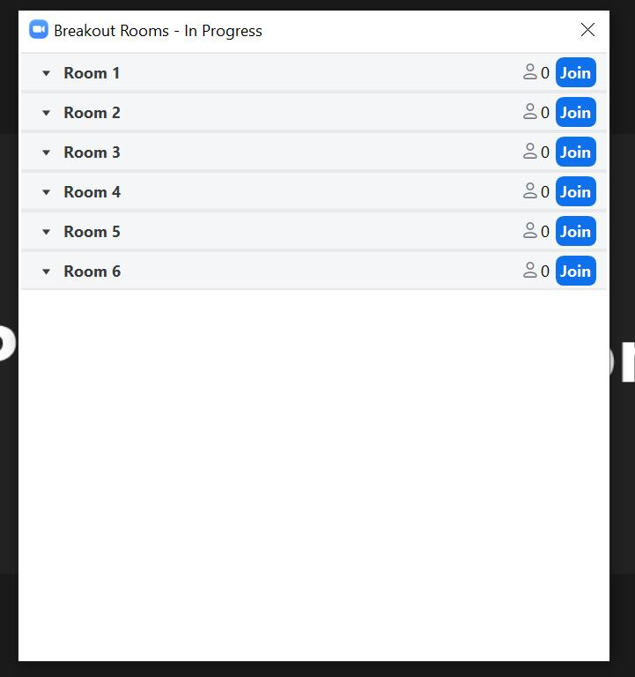
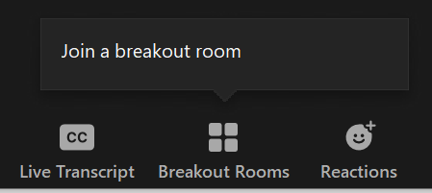
How to Join a Breakout Session
We will have multiple sessions by topic, please feel free to join any of them to ask questions
You can also jump around to other rooms if you’d like
Step 1: Select “Breakout Rooms” at the bottom of your Zoom screen and “Join a breakout room”
Step 2: Select “Join” for the breakout room you wish to go to
Notes:
Michelle

Slide 35
Breakout Session by Program
Join the room you need and feel free to jump around
Breakout 1
Laura Meushaw & Evita Byrd
Topics:
Title IA questions
  LEA Profile: How to Serve Schools
  Rank Order
  75% Rule
Title ID questions
Breakout 2
Niko Kaloudis & Karen Bixler
Topics:
Title II questions
EDT questions
Breakout 3
Kathryn Wisner & Rachel Temple
Topics:
Title III questions
Non-Public School questions
Breakout 4
Tammy Giessinger & Tina Negley
Topics:
Title IV questions
Title V questions
Cross Program Narrative questions
Targeted Support page questions
Breakout 5
DeLilah Collins & Michelle Prael
Topics:
Application functionality questions

