Slide 1
Regional Network Meeting
(RNM)
December 2018

Slide 2
Agenda
Introductions
CDE Updates Consolidated Application/Post Award Revision (PAR) CDE Supports Contacts Equitable Distribution of Teachers Website Improvement Planning
Break
Monitoring Overview Timeline Resources
Lunch (12:00)
Monitoring Work Session
Notes:
9:30 am-9:45 am-Introductions
9:50 am-10:50 am- CDE Updates and EDT
10:50-11:05 am-Break
11:05 am-12:00 pm-Improvement Planning, Monitoring Plans
12:00 pm-12:30 pm- Lunch
12:30 pm-3:00 pm- Monitoring Work Session

Slide 3
Introductions
Office of ESEA
Nazanin (Nazie) Mohajeri-Nelson Director, ESEA Programs Office 303-866-6205 mohajeri-nelson_n@cde.state.co.us | DeLilah Collins Assistant Director, ESEA Programs Office 303-866-6850 collins_d@cde.state.co.us
Sofia Hernandez Sosa Program Support 303-866-6963 hernandez-sosa_s@cde.state.co.us | Michelle Prael Program Support 303-866-6998 prael_m@cde.state.co.us

Slide 4
Regional Contacts
ESEA Staff | Region | Phone | E-mail
Joey Willett | North Central & Northeast | 303.866.6700 | willett_j@cde.state.co.us
Barb Vassis | North Central & Northeast | 303.866.6065 | vassis_b@cde.state.co.us
Robert Thompson | Northwest & West Central | 303.866.6842 | thompson_r@cde.state.co.us
Laura Meushaw | Pikes Peak & Southeast | 303.866.6618 | meushaw_l@cde.state.co.us
Kristen Collins | Northwest & West Central | 303.866.6705 | collins_k@cde.state.co.us
Tammy Giessinger | Pikes Peak & Southeast | 303.866.6992 | giessinger_t@cde.state.co.us
Jeremy Meredith | Southwest | 303-866.3905 | meredith_j@cde.state.co.us
Brad Bylsma | Southwest | 303.866.6937 | bylsma_b@cde.state.co.us
Grants Fiscal Staff | Program Expertise | Phone | E-mail
Robert Hawkins | Grants Fiscal Analyst | 303.866.6775 | Hawkins_r@cde.state.co.us

Slide 5
Regional Contacts ~ Metro
LEA | ESEA Staff
0020 Adams 12 Five Star Schools | DeLilah Collins Brad Bylsma
0030 Adams County 14 | Robert Thompson
0180 Adams-Arapahoe 28J | Joey Willett DeLilah Collins
0480 Boulder Valley RE 2 | Jeremy Meredith
0130 Cherry Creek 5 | DeLilah Collins Brad Bylsma
0540 Clear Creek RE 1 | Tammy Giessinger
0880 Denver County 1 | Robert Thompson DeLilah Collins Brad Bylsma
0900 Douglas County RE 1 | Jeremy Meredith
0920 Elizabeth C-1 | Laura Meushaw
0120 Englewood 1 | Laura Meushaw
1330 Gilpin County RE-1 | Kristen Collins
1420 Jefferson County R-1 | Joey Willett Robert Thompson
0140 Littleton 6 | Kristen Collins
0010 Mapleton 1 | Laura Meushaw
2600 Platte Canyon 1 | Laura Meushaw
0040 School District 27J | Joey Willett
0123 Sheridan 2 | Joey Willett Brad Bylsma
8001 Charter School Institute | DeLilah Collins
0070 Westminster Public Schools | Jeremy Meredith Nazie Mohajeri-Nelson

Slide 6
RNM Purpose
Provide LEAs with Federal Programs updates
Prepare for the 18-19 Monitoring process
Collaborate with LEAs to identify and share effective practices in implementing ESEA Family and Stakeholder Engagement Requirements
Provide networking opportunity for LEAs to connect with and learn from each other
Notes:
LEAs and Schools identified under ESEA for Improvement and support must partner with stakeholders to develop an improvement plan, today will review how CDE will be looking at Stakeholder Involvement in Improvement Plans and success criteria for plan approval.
The 18-19 Monitoring process will focus on indicators around stakeholder engagement and fiscal requirements. Today’s RNM will help districts understand what to expect through the monitoring process, existing sources of information CDE will be looking at, and additional evidence to submit to CDE for monitoring.
The afternoon portion is designed to share common practices and challenges around family and stakeholder engagement as well as innovative best practices around Colorado. Our goal as a service agency is to identify exemplar practices around the state and share or connect districts to enhance their programs and practices

Slide 7
CDE Updates

Slide 8
Update: Consolidated Application
Application review status
CDE is still in the process of reviewing modifications on a daily basis. Please reach out to ESEA Regional Contact if your application has not received final approval to discuss next steps.
All feedback must be addressed before CDE can grant final approval.
Application platform updates for 19-20
Reminder: 3 year plan
No major changes expected
Updates to functionality and edit checks
Application feedback for 20-21
Opportunities coming soon
Notes:
UPDATE:
Application review status:
ESEA team is prioritizing reviews to get all applications to final approval as soon as possible. If your district has feedback or comments from CDE that have not been addressed, please reach out to your Regional Contact as soon as possible for support in completing your application.
All feedback must be addressed before CDE can grant final approval. If your application has not received final approval you will not be able to request for reimbursement or draw down funds to pay for any of the activities or programs in the application.
Application platform updates for 19-20
Reminder 3 year plan therefore there will not be any major changes to the application. CDE is in the process of improving the platform functionality and edit checks.
There will be an updated application for 20-21 and CDE will be in touch with LEA contacts to provide feedback and input for the 20-21 Consolidated Application

Slide 9
Update: Post-Award Revisions (PAR)
Provides the opportunity for LEAs and BOCES to adjust/revise the activities and budget that were approved in the initial consolidated application review process.
Once all LEAs have received final approval, CDE will open up the Consolidated Application for Post-Award Revisions. The process and functionality of the PAR system is not changing from last year.
2018-2019 Post-Award Revisions
Revision system will open in December and will remain open through Tuesday, April 30, 2019.
A training webinar with guidance for the PAR process is coming soon!
Hold all revision requests until the PAR window is open.
Notes:
The Post-Award Revision process provides an opportunity for LEAs and BOCES to make adjustments or revisions to the activities and budget line items that were approved through the initial Consolidated Application review process. LEAs and BOCES will also be able to review their final award amounts and any carryover funds.
For the 2018-19 Consolidated Application, the revision system will be open soon and will remain open through Tuesday, April 30, 2019.
Additional resources, guidance, and a webinar will be recorded and posted on the website. Please hold all revision requests until the Post Award Revision system is open
Final allocations are in, once all applications are submitted to CDE, we will push in final allocations for all programs into the platform and post final allocations to Grant Fiscals website.

Slide 10
Update: CDE Support Contacts
CDE has implemented Support Coordinators to provide districts with our lowest performing schools more responsive and aligned guidance and support tailored to their unique context. Supports Coordinators are your first contact when you don’t know who to call.
Examples of opportunities that Support Coordinators may help navigate:
Needs assessment and planning
Understanding local context
Providing state accountability information (i.e., Performance Frameworks)
Consulting on strategy selection
Brokering needed supports
Help on implementation efforts
Additionally, ESEA Programs Office has Regional Contacts for support on anything related to ESEA requirements, the Consolidated Application, or guidance/resources on implementing effective practices.
Consolidated Application
ESEA programs
ESEA monitoring
Effective practices
ESSA identification for support and improvement
EASI
Notes:
Support Coordinators:
All districts have received notifications on their Support Coordinators at CDE. Support Coordinators are designed to be brokers at CDE so that LEAs can reach out to Support Coordinators about anything and the Support Coordinator will connect the district with the expert staff or department at CDE. For example, Laura with Federal Programs can answer questions about ESEA funds or EASI, but if a district reached out about P-3 programs she would connect them with the appropriate staff at CDE to provide the district with the most valuable information.
Regional Contacts:
The ESEA office has provided districts with a single contact internally about anything related to the Consolidated Application, ESEA programs, monitoring, improvement plans or effective practices.

Slide 11
Update: Equitable Distribution Of Teachers (EDT) - Overview
ESSA requires states to evaluate annually whether low-income and minority students are taught disproportionately by ineffective, out-of-field, or inexperienced teachers compared to their higher-income, non-minority peers, and address any disparities that exist.
EDT Analyses: Process
Step 1
Step 2
Step 3
CDE analyzes the FTE in core courses for 3 criteria:
effective,
in-field,
experience
For each LEA, CDE compares the district’s schools that fall into the state’s highest poverty and minority quartiles to those in the lowest quartiles to identify equity gaps.
CDE provides the results of the poverty and minority EDT analyses to all LEAs with enough data to be included in the analyses.
For more information on EDT, see CDE’s website: www.cde.state.co.us/fedprograms/equitabledistributionofteachers
Notes:
Equitable Distribution of Teachers replaces the Highly Qualified requirement under ESSA. CDE uses October Count and HR Data provided by the districts
CDE conducts the Equitable Distribution of Teachers (EDT) analyses annually on behalf of districts and notifies them of any disproportionalities gaps in student access that may raise equity concerns. EDT analyses compare the proportions of effective, in-field, and experienced teachers in the highest and lowest poverty quartile schools and the highest and lowest minority quartile schools. If a district has schools in the highest poverty/minority quartile, but not in the lowest poverty/minority quartile, CDE compares the highest quartile schools to the state percentage. ESSA requires LEAs accepting Title I, Part A funds to submit a plan to CDE to address any disparities in the rates at which low-income and minority students are taught by inexperienced, out-of-field, or ineffective teachers. This plan is captured in the Consolidated Application for Federal Funds.

Slide 12
Update: EDT - LEA Eligibility for Poverty/Minority Analyses
LEAs received poverty analysis results
Eligible districts receive one or both analyses.
Districts without schools in the highest poverty and highest minority quartile did not receive any analyses.
Eligible LEAs
LEAs received minority analysis results
All Colorado Districts
Ineligible LEAs
About 40% of districts were eligible for inclusion in the EDT reporting cycle for 2017-18.
Over 60% of districts were ineligible for the EDT analysis, meaning they either had <1,000 students enrolled, or <1 school per grade span.
Most LEAs are experiencing challenges in teacher experience and effectiveness in schools with highest proportion of students experiencing poverty (Quartile 1).

Slide 13
EDT Resources: On the Horizon
Resource | Purpose
School-Level EDT Results | This data file provides the school-level number and percent of teachers who are not in-field, experienced and effective, to facilitate district reflection and action planning. This will be shared via Syncplicity in December.
Explanation of EDT Methodology | This document explains, in detail, the approach the Federal Programs team takes to collection and analysis of LEA data to produce the poverty and minority EDT analysis results.
Meeting ESSA EDT Requirements - | This FAQ document addresses common questions about what ESSA requires of state EDT analyses, what to do in the event of EDT identification, and available federal and state funds that can be leveraged to address inequitable distribution of teachers.

Slide 14
Updates: Website
CDE recently surveyed members of the ESEA Committee of Practitioners regarding the functionality of the Federal Programs homepage.
What we found:
While the Federal Programs web presence generally meets your needs, it often takes longer than anticipated to find what you are looking for.
The majority of participants:
Begin their search on the Federal Programs homepage
Use the search bar to find what they are looking for
Visit our pages to find specific tools and resources
Notes:
Federal Programs Webpage
•In the process of restructuring our website so that information is easier to access without clicking through several links before finding the information or utilizing the search bar

Slide 15
Updates: Website Outcomes
CDE aims to:
Reduce the amount of time it takes to find specific tools and resources
Remove old resources
Make it easier to find relevant documents
Make the Federal Programs homepage more useful
Links to most-used tools and resources
News and updates
Improved navigation
The primary goal of the Federal Programs website is to meet the needs of the field. To that end, we would like your feedback regarding the Federal Programs homepage. If you have ideas or suggestions regarding the website redesign, please contact Joey Willett at willett_j@cde.state.co.us.

Slide 16
Updates: Improvement Planning-
ESSA Statutory Requirements (CS Schools)
ESSA §1111(d) School Support and Improvement
(1) Local educational agencies (LEAs) with schools identified for Comprehensive Support and Improvement (CS) shall, for each identified school, in partnership with stakeholders, locally develop a comprehensive support and improvement plan for the school to improve student outcomes
(2) Each school identified for targeted (TS) or additional (ATS) targeted support and improvement shall locally develop, in partnership with stakeholders, and implement a targeted support and improvement plan to improve student outcomes based on ESSA indicators for each student groups that resulted in the school’s identification
Notes:
Under Accountability Requirements under ESSA, schools identified for improvement must develop an improvement plan with local education agencies that are developed in partnership with stakeholders. Regardless of the improvement identification, the improvement plan must be developed in partnership with stakeholders.

Slide 17
Updates: CS and TS Planning Requirements
CS Plan
•Approved by school, LEA and CDE •Developed in partnership with stakeholders •Use UIP to meet plan requirements: •Informed by student performance •Includes school-level needs assessment •Identifies evidence-based interventions •Address resource inequities •Formula and other ESSA funds may support strategies •CDE monitors plan implementation •CDE offers planning support
TS/ATS Plan
•Approved by school and LEA. If applying for funds, then CDE will review plan. •Developed in partnership with stakeholders •May use the UIP to meet plan requirements: •Informed by student performance for disaggregated group(s) •Identifies evidence-based interventions •Additional Targeted also addresses resource inequities •Formula and other ESSA funds may support strategies •LEA monitors plan implementation. If awarded funds, CDE will monitor too. •CDE offers planning support
Notes:
There are some differences in submission and approval based on the identification type. CDE reviews and approves all CS plans to ensure that the plan meets all of the statutory requirements. TS plans are not submitted to CDE for review and it is up to the LEA to develop criteria for approval of TS improvement plans.

Slide 18

Updates: Upcoming Dates Regarding Improvement Plans
CS Improvement Plans
Due in January if Priority Improvement or Turnaround Plan Type
Due in April if Improvement or Performance Plan Type
Training: www.cde.state.co.us/fedprograms/essaplanningrequirements
TS Improvement Plans
To be determined by the district
Notes:
CS Improvement Plans are submitted through the UIP process. For schools identified for Comprehensive Support as well as Priority Improvement or Turnaround, Improvement plans are submitted in January 2019 for review, feedback, and approval. Schools identified for Comprehensive Support and are on Improvement or Performance Plan Type must submit their Improvement Plans in April of 2019 through the UIP submission process.
Flex timeline
Schools that have been identified for support and improvement under ESSA and have a Plan Type of Improvement or Performance, may take advantage of the flexible timeline. The State (CDE) only has to review and approve the CS improvement plan once during the 3-year designation.
Guidance for districts on TS - in development. Working with the CoP
All TS School Improvement plans are submitted to the district and the district sets the timeline for submission and approval
CS Improvement Plans are due in January if Plan Type is Priority Improvement or Turnaround. Improvement and Performance Plan Types are due in April
CS Improvement Plans are submitted through the UIP process. For schools identified for Comprehensive Support as well as Priority Improvement or Turnaround, Improvement plans are submitted in January 2019 for review, feedback, and approval. Schools identified for Comprehensive Support and are on Improvement or Performance Plan Type must submit their Improvement Plans in April of 2019 through the UIP submission process.
All TS School Improvement plans are submitted to the district and the district sets the timeline for submission and approval

Slide 19
Monitoring

Slide 20
Monitoring: Overview
Monitoring plans were developed in consultation with stakeholders:
Prioritized a limited number of high-impact indicators
Phase-in indicator categories over time
Meaningful stakeholder engagement
Identification and delivery of services
Evaluation of program impact
Provide training, guidance, and technical support before monitoring
Provide follow-up and follow-through support based on monitoring results
Collaboratively build monitoring plans and reports with each LEA

Slide 21
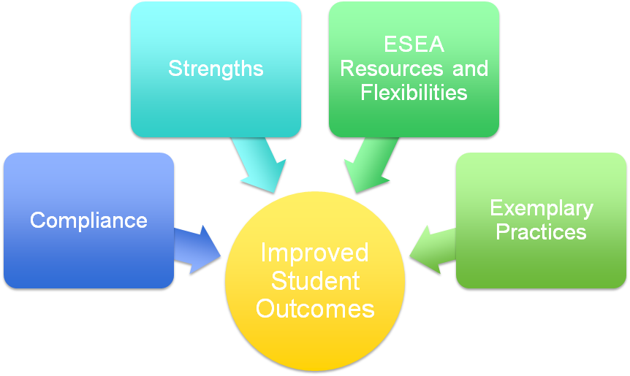
Monitoring: Goals
Notes:
Under the ESSA statute, each state educational agency that accepts federal funds is responsible for ensuring compliance with ESSA requirements through monitoring of local educational agencies’ use of funds and implementation of ESSA-funded programs, strategies, and practices. But monitoring also provides us a tremendous opportunity to focus on what matters and that is improved outcomes for students.
Therefore, in addition to meeting the statutory requirement to ensure compliance with ESSA, Colorado will be using the monitoring process to
•Identify and highlight areas of strength and effective implementation within each local educational agency (LEA; includes districts and BOCES)
•Collaborate with LEAs to implement effective programs and practices that capitalize on the use of ESEA resources and flexibilities
•Identify exemplary practices within the state to learn from and disseminate

Slide 22
Monitoring: Process
Frontloading
Technical Support
Ongoing Support
Collaboratively Building Reports
Follow Up and Follow Through
Dissemination of Effective Practices
Updated Supports
Training
Collaboratively Building Plans
Collaboratively Building Action Steps Based on Existing Strengths
Guidance
Maximizing Use of ESEA Resources & Flexibilities
Notes:
Talking points:
Timeline, cycle of monitoring, ongoing support

Slide 23
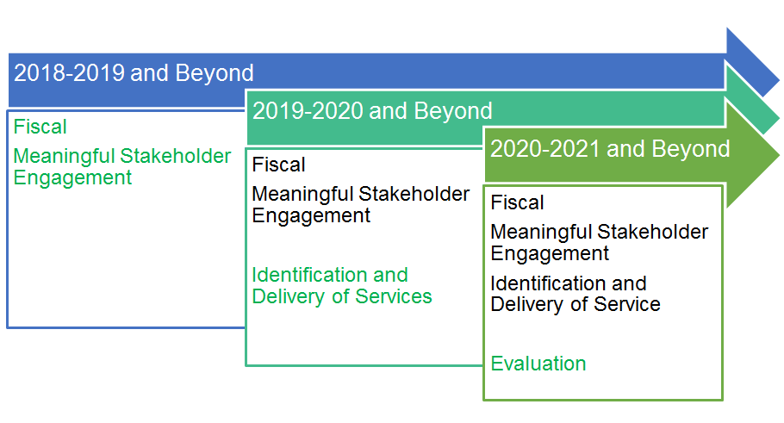
Monitoring: Four Categories of Indicators: Phase-in Approach
Notes:
Stakeholder Engagement Occurs in:
Cons App
Included in the development of the ESEA plan and use of federal funds
Monitoring
Implementation and Evaluation of Stakeholder Engagement
CS improvement Planning
Developed in partnership with stakeholders
This is what we are looking for this year, next year, stakeholder engagement strategies that are effective and have greater impact on student achievement, how do you do that in cons. app. UIP, monitoring

Slide 24
Monitoring: Levels of Review
Tier I – Universal
All LEAs are randomly selected to be reviewed over the course of 6 years
Prioritized indicators
Desk and phone reviews
Tier II
Annual selection of several (between 10-15) LEAs for more focused look at implementation and support
Selected based on size of award, newness of staff or other eligibility criteria
Select prioritized indicators aligned to reasons for selection
Desk, phone and possibly onsite reviews
Tier III
Annual selection of a few (2-5) LEAs for a very focused review of implementation and continuous support
Selected based on school performance
Select prioritized indicators
Desk, phone and onsite

Slide 25
Monitoring: 2018-2019 Timeline
CDE Activities | LEA Activities
November
Continue providing guidance and training on fiscal and stakeholder indicators in the monitoring process and feedback on reviews. Conduct CDE office hours | Participate in CDE training and office hours Begin gathering evidence (documentation that demonstrates compliance)
December
Conduct CDE office hours Conduct fiscal indicator training | Participate in fiscal indicator training Continue to gather evidence/documentation
January
Conduct Data Management System training | Participate in Data Management System training Submit evidence into Data Management System
January - February
Document review for Tier I | Submit documents for review through the Data Management System Respond to questions about documents submitted
March - May
Conduct Tier III Reviews Write and submit monitoring reports | Participate in Tier III Reviews
June
Provide ongoing support until LEAs meet requirements | Address recommendations and plan for implementation

Slide 26
Monitoring: Webinars and Other Supports
All LEAs selected for Monitoring for the 18-19 year have been notified via telephone and will receive letters soon.
CDE is facilitating a series of webinars around Monitoring to support districts in understanding key elements of implementation that we will be looking for during Monitoring around Stakeholder Engagement.
We encourage all LEAs to participate in the webinars. Your feedback is crucial to improving the supports provided in subsequent years.
Trainings on fiscal indicators will occur in near future.
All the webinars are recorded and posted on our ESSA Monitoring Webinars page.
Additionally, CDE has linked any existing guidance related to 2018-19 Universal Program Requirements on the Universal Review homepage.
Notes:
Monitoring Resources: Stakeholder Engagement
•The CDE Communications team has been highlighting several Promising Practices in Colorado that exemplify the National Standards for Parent Involvement in Education.

Slide 27
LUNCH

Slide 28
Monitoring Workshop
Notes:
I Do (webinar)
We do (activity together)
You do (using your own response)
Show them indicator, have their responses from cons app prepared have them identify key elements, align key elements with potential existing examples of evidence they would have, check their evidence for compliance, if can’t identify examples, connect with CDE resource to support ie. Darcy

Slide 29
PLACEHOLDER: Workshop Outline
Set the stage: Hand out and demo 18-19 universal program requirements doc
Micro: A closer look at SE 9.1 Stakeholder Engagement in the Consolidated Application
Explain how cons app responses and program requirements doc will be used by review team
small-Group discussion re: what evidence would you submit?
Find a partner.
Access your responses to Cross-program question #3 in the Consolidated Application. Discuss with your partner:
What activities are described?
Do the activities described meet all of the requirements (demonstration of compliance)?
What evidence will you submit to demonstrate compliance?
Share a summary of your discussion with the whole group
Macro: Jigsaw Activity
Partner with a few people in your vicinity.
Find your indicators in the 2018-19 Universal Program Requirements document
Review the Demonstration of Compliance and Examples of Evidence sections
Is it clear what is needed to demonstrate compliance?
What evidence will you submit?
Are there any examples of evidence that are missing?
Briefly summarize the Statutory Indicator in your own words.
Share your summaries and examples of evidence with the larger group.
Going Beyond: From Compliance to Effective Practices
Based on the examples of evidence and practices discussed today, use the notecatcher to identify practices that demonstrate compliance
With your small group, evaluate practices using notecatcher
What is your desired outcome from this practice?
Are you seeing the results you’d like to see?
What could be changed about this practice to produce greater results?
Discuss as a large group and document effective practices

Slide 30
Monitoring: 2018-19 Program Requirements
CDE has recently created a condensed draft of the 2018-19 Universal Program Requirements. This document contains only the program requirements that will be monitored in 2018-19.
Additionally, CDE has revised the Demonstration of Compliance description for each indicator to include criteria for demonstrating compliance and examples of evidence.
To demonstrate compliance, LEAs must meet ALL criteria outlined in the demonstration of compliance section
LEAs are not required to submit all examples of evidence. This is a list of options that may assist in deciding what evidence to submit. The list is not exhaustive, and LEAs may have other examples of evidence specific to their local context.
Notes:
Hand out 18-19 universal program requirements doc. Take some time to let them review it and answer any questions they have about the document.
Highlight the changes to the demonstration of compliance section.

Slide 31
Monitoring Workshop: A Closer Look at SE 9.1
SE 9.1 Stakeholder Engagement in the Consolidated Application for ESEA Funds
Statutory Indicator
The LEA’s Consolidated Application is:
developed, reviewed, and revised (as necessary)
in partnership with Stakeholders, and
includes an examination of the comprehensive needs assessment, planned actions, funds allocation, and the previous annual evaluation.
Demonstration of Compliance
Evidence that stakeholder engagement described in the Consolidated Application was implemented. Criteria for compliance:
Stakeholders represent the demographics of the LEA and Title I schools within the LEA
Communication and materials used are provided in languages and formats based on needs of participants
Stakeholders were active participants in the process

Slide 32
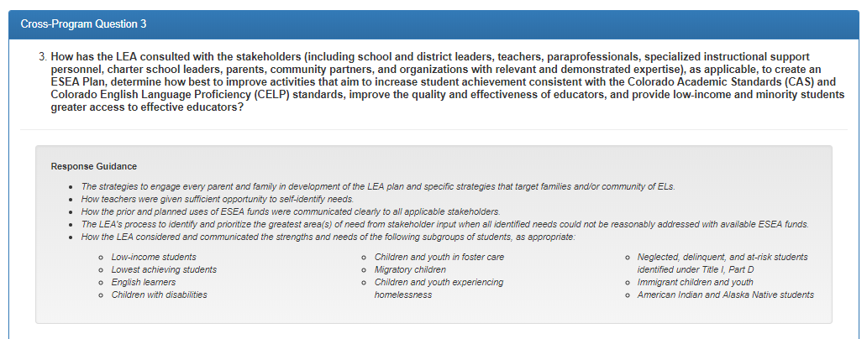
Monitoring Workshop: SE 9.1 in the Consolidated Application
Notes:
The narrative response provided by LEA’s in Cross-Program Question #3 informs CDE of the process the LEA has implemented to meaningfully engage stakeholders in the development of the ESEA plan. The narrative response provided will inform CDE on the evidence to collect to determine if the implementation of stakeholder involvement in the development of the ESEA plan meets federal requirements.

Slide 33
Monitoring Workshop: Cross Program Question #3 Example Response
The LEA utilizes the UIP process to engage stakeholders in developing the ESEA Plan. Parents, teachers, and community members that sit on the District Accountability Committee meet quarterly. The DAC reviews disaggregated academic achievement data and develops an action plan for decreasing trend lines. The district also utilized Teacher Leader Committees to review student data weekly and modifies intervention strategies to address students not showing academic growth or at risk of not meeting grade level on CAS or CELP. The DAC and TLC identify priority areas of need and evaluate how ESEA funds can be leveraged to improve student academic outcomes. The ESEA plan is brought to DAC and TLC for final feedback and recommendations then the district incorporates feedback and recommendations into the plan.

Slide 34
Monitoring Workshop: How the Consolidated Application Informs Monitoring
The LEA utilizes the UIP process to engage stakeholders in developing the ESEA Plan. Parents, teachers, and community members that sit on the District Accountability Committee meet quarterly. The DAC reviews disaggregated academic achievement data and develops an action plan for decreasing trend lines. The district also utilized Teacher Leader Committees to review student data weekly and modifies intervention strategies to address students not showing academic growth or at risk of not meeting grade level on CAS or CELP. The DAC and TLC identify priority areas of need and evaluates how ESEA funds can be leveraged to improve student academic outcomes. The ESEA plan is brought to DAC and TLC for final feedback and recommendations then the district incorporates feedback and recommendations into the plan.
Based on this response, what are some examples of evidence or documentation that would demonstrate these practices were implemented?
Notes:
Have

Slide 35
Monitoring Workshop: SE 9.1
Find a partner.
Access your responses to cross-program question #3 in the Consolidated Application. Discuss with your partner:
What activities are described?
Do the activities described meet all of the requirements (demonstration of compliance)?
What evidence will you submit to demonstrate compliance?
Share a summary of your discussion with the whole group.

Slide 36
Monitoring: 2018-19 Universal Indicators
Meaningful Stakeholder Engagement (SE)
SE 9.1 Stakeholder Engagement in the Consolidated Application
SE 9.4 Student Performance
SE 9.8 Parent Notification - English Learner Identification
SE 9.9 Meeting with Parents and Families of English Learners
SE 9.11 Annual Consultation with Non-Public Schools
SE 1.1 Title I, Part A Annual Meeting
SE 1.3 Parent and Family Engagement Policy
SE 1.10 Comprehensive Plans
SE 1.11 Targeted Support Plans
SE 3.1 Provision of Parent, Family, and Community Engagement Activities
Fiscal
FR 9.1 Supplement, Not Supplant in Titles II and IV, Part A
FR 9.2 Maintenance of Effort
FR 1.1 Title I, Part A Supplement, Not Supplant
FR 1.2 Title I, Part A Carryover
FR 1.4 Rank Order
FR 1.6 Title I, Part A Comparability
For more information regarding universal reviews, visit www.cde.state.co.us/fedprograms/universalreview.
Notes:
This slide is just meant to highlight the specific indicators that will be reviewed during the 2018-19 universal reviews.
“These indicators have been referred to as ‘priority indicators’ in previous drafts, including the comprehensive list of indicators (the long document that includes all 80something indicators).”

Slide 37
Monitoring Workshop: Understanding the Requirements
Partner with a few people in your vicinity.
Find your indicators in the 2018-19 Universal Program Requirements document.
Briefly summarize the Statutory Indicator in your own words.
Review the Demonstration of Compliance and Examples of Evidence sections
Is it clear what is needed to demonstrate compliance?
What activities are taking place that meet the requirements?
What evidence will you submit?
Are there any examples of evidence that are missing?
Share your summaries and examples of evidence with the larger group.
Notes:
Jigsaw approach to having a group discussion about the indicators (Thank, Tammy!). We’ll hand out indicators or let them draw from a hat or something. Track examples of evidence during share-out.

Slide 38
Monitoring Workshop: From Compliance to Effective Practices
In addition to providing a method for LEAs to demonstrate compliance, CDE aims to utilize the monitoring process to identify and share practices that have been found to be effective in Colorado.
Choose a practice/activity that you use to engage stakeholders. Describe that activity to your partner.
Evaluate the effectiveness of each activity.
What is your desired outcome from this practice (immediate and distal)?
Are you seeing the results you’d like to see?
What evidence is there of the results?
What could be changed about this practice to produce greater results?
Share a summary of your conversation with the whole group.
Notes:
Track effective practices

Slide 39
Contacts
Nazanin (Nazie) Mohajeri-Nelson
Director, ESEA Programs Office
303-866-6205
mohajeri-nelson_n@cde.state.co.us
DeLilah Collins
Assistant Director, ESEA Programs Office
303-866-6850
collins_d@cde.state.co.us
James (Joey) Willett
ESEA Senior Consultant, Title I and Title ID
303-866-6700
willett_j@cde.state.co.us
Barbara Vassis
ESEA Lead Consultant, Title I & Title II
303-866-6065
vassis_b@cde.state.co.us
Kristen Collins
ESEA Consultant, Title I Parent & Family Engagement Specialist & Title V
303-866-6705
collins_k@cde.state.co.us
Laura Meushaw
ESEA Senior Consultant, Title I & School Improvement
303-866-6618
meushaw_l@cde.state.co.us
Brad Bylsma
Director of Coordinated Supports, Title I
303-866-6937
bylsma_b@cde.state.co.us
Jeremy Meredith
ESEA Senior Consultant, Title II
303-866-3905
meredith_j@cde.state.co.us
Robert Thompson
ESEA Senior Consultant: Title III
303-866-6842
thompson_r@cde.state.co.us
Tammy Giessinger
ESEA Consultant: Title IV
303-866-6992
giessinger_t@cde.state.co.us
Michelle Prael
Program Support
303-866-6998
prael_m@cde.state.co.us
Sofia Hernandez Sosa Program Support 303-866-6963 hernandez-sosa_s@cde.state.co.us

