Slide 1
Fall 2025 Orientation Slide Deck:
Overview and Tips for Using this Orientation “Shell”
This orientation slide deck serves as a shell and a starting point for districts and BOCES to present relevant information and local protocols and processes for completing educator evaluations for the 2025-26 school year.
It is not meant to be used “as-is”.
Information specific to the local district/BOCES needs to be added, as well as a determination made regarding which slides to include for different audiences.
Notes:
Please reference the “Notes” section with the slides for additional suggestions for how you might customize the content on the slides, as well as what key points you might share.

Slide 2
Fall 2025 Orientation Slide Deck:
Overview and Tips for Using this Orientation “Shell”
Tips for Using this Slide Deck in your Orientation:
  Use the completely white slides to add content and tailor your presentation to district/BOCES-specific processes and protocols for educator evaluation. For example:
    Add your district/BOCES logo and branding (placeholder included within slides)
    Text in green font offers ideas for possible content to include on that slide and needs to be removed prior to sharing with your staff
  A tremendous amount of local flexibility exists within the evaluation system. A reminder (including a link) to examples is offered on pages where opportunities exist to tailor aspects of the evaluation process.
Notes:
The purple shaded slides at the start of this slide deck should be hidden or deleted prior to using with your team.

Slide 3
Fall 2025 Orientation Slide Deck:
Overview and Tips for Using this Orientation “Shell”
Additional Tips for Using this Slide Deck in your Orientation:
  Not all content will be relevant for all audiences. Slides may be hidden and/or deleted depending upon the audience, e.g., returning staff as distinct from staff new to your district/BOCES.
    Slides with CDE branding address information about state statute and State Board rule, as well as the State Model Evaluation System (SMES). This information may be relevant and included or may already be widely known and therefore can be removed.
    Additionally, some slides can be used as a handout only to provide reinforcement of content as needed (in lieu of inclusion in the slide deck).
  Additional content suggestions, as well as relevant links to other resources, can be found within the “Notes” section on most slides.

Slide 4
Fall 2025 Orientation Slide Deck:
Overview and Tips for Using this Orientation “Shell”
Tips for Local Model Evaluation Systems Using this Slide Deck in your Orientation:
  Remove slides which directly reference the State Model Evaluation System (SMES). Many slides are still relevant for local model evaluation systems, including the Educator Effectiveness Overview section and the Local Flexibilities section.
  Additional content suggestions, as well as relevant links to other resources, can be found within the “Notes” section on most slides.

Slide 5
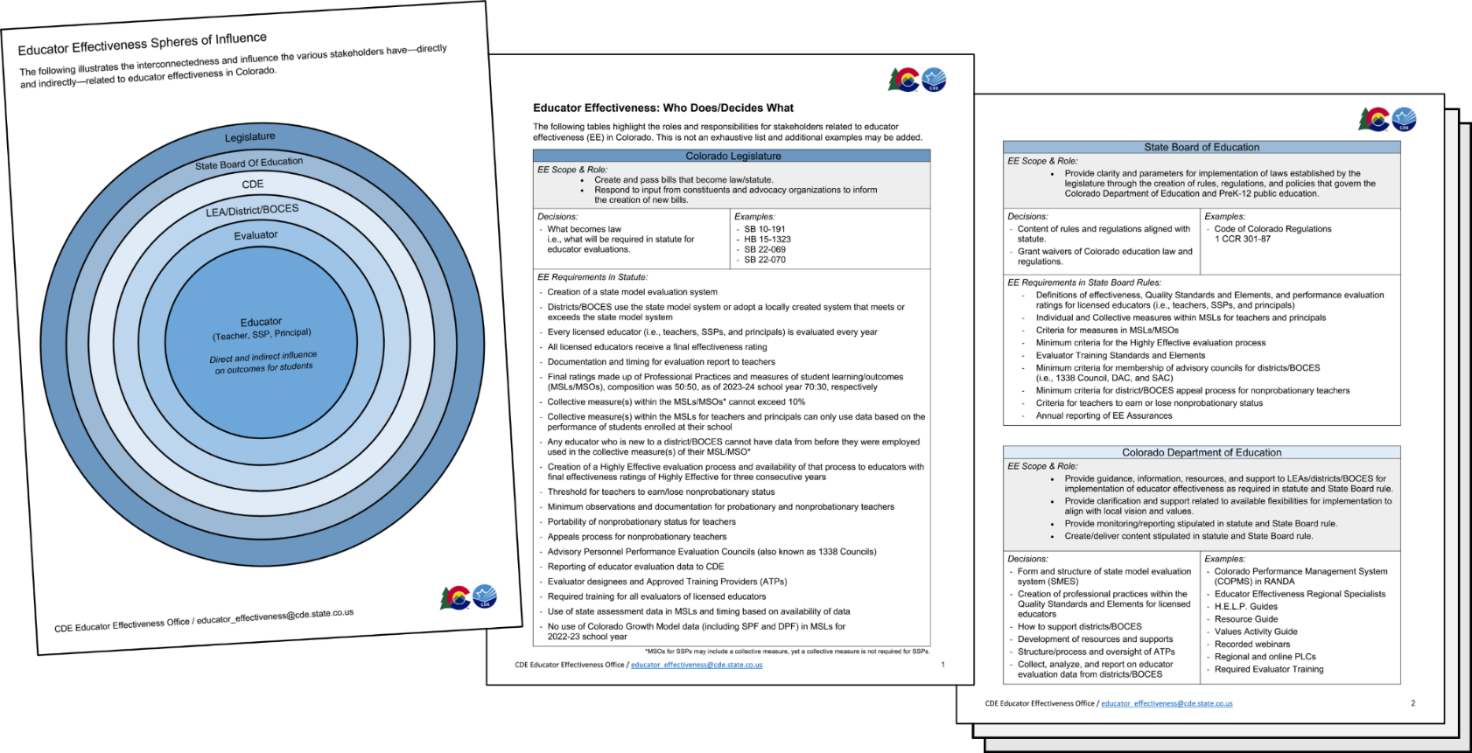
Fall 2025 Orientation Slide Deck:
Overview and Tips for Using this Orientation “Shell”
See the notes section on this slide for additional explanation and suggestions for how you might use this slide in your educator orientation.
Notes:
This packet and information illustrates the interconnectedness and influence the various stakeholders have—directly and indirectly—related to educator effectiveness in Colorado. Specifically, this provides the delineation of the various roles and responsibilities for decision making when implementing educator evaluations in Colorado – from the state legislature that establishes the statutory requirements through to decisions made at the local level by school districts and BOCES for implementation. This packet also highlights the active roles evaluators and educators play in the evaluation process, along with the many flexibilities that are available to ensure evaluation processes and systems are reflective of local values and context.
Note – The images on the slide provide a preview of the PDF packet accessible via the link below – it is not necessarily intended to be read as is from the slide.
While it is included within the overview section, districts/BOCES are welcome to include/incorporate this content into their orientation slide deck and/or materials.
This content, including a downloadable PDF, is available online at: https://www.cde.state.co.us/educatoreffectiveness/spheres-of-influence

Slide 6
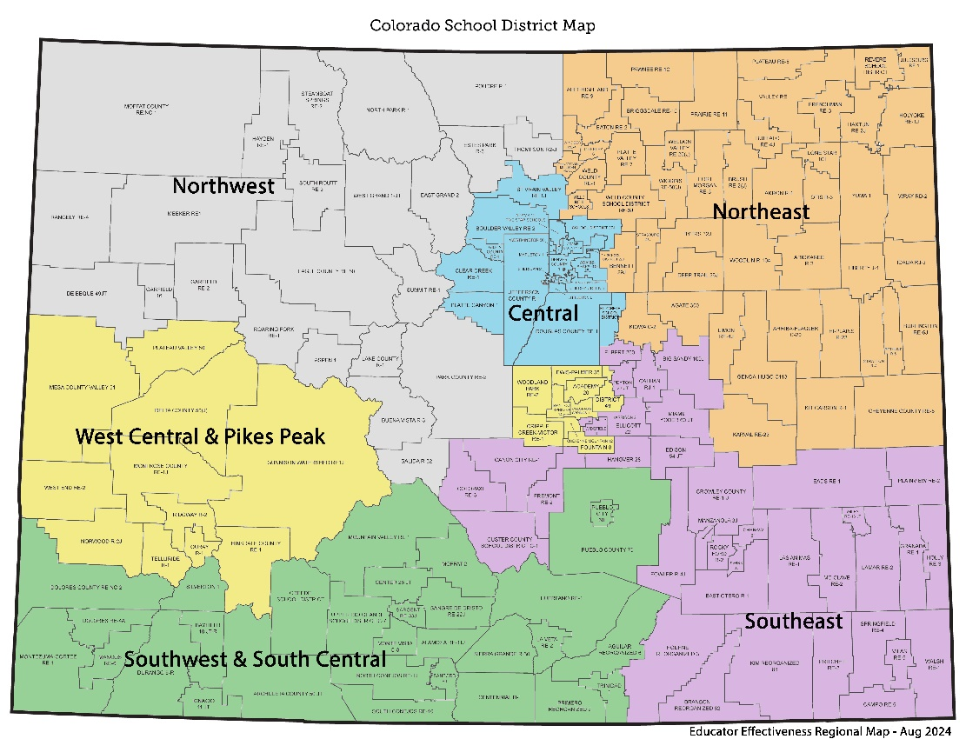
Fall 2025 Orientation Slide Deck:
Overview and Tips for Using this Orientation “Shell”
  Please contact your EE Regional Specialist for additional support customizing this slide deck.
Region | Regional Specialist
Southwest and South Central | Curtis Garcia garcia_c@cde.state.co.us 303-981-8950
West Central and Pikes Peak | Alissa Poduska poduska_a@cde.state.co.us 720-601-6731
Central | Debbie Hearty hearty_d@cde.state.co.us 720-646-2936
Southeast | Paula Chostner chostner_p@cde.state.co.us 720-682-9032
Northwest | Jennifer Needham needham_j@cde.state.co.us 720-955-0553
Northeast | Jill Davis davis_j@cde.state.co.us
http://www.cde.state.co.us/educatoreffectiveness/ee-regions
Notes:
The Educator Effectiveness (EE) Office offers differentiated support to districts/BOCES through our team of Regional Specialists. The EE Regional Specialists can assist districts/BOCES as they support educator practice and build an integrated, systematic approach to educator evaluation – as a part of the state model system or a district’s locally created evaluation system.
The Educator Effectiveness Regional Specialists are available to meet with districts/BOCES to discuss local needs. Please use the chart above to help identify your Educator Effectiveness Regional Specialist. Feel free to contact your specialist with any questions you may have or support you may need!

Slide 7
Annual Orientation for Educator Evaluation
2025-2026 SCHOOL YEAR
<<date(s)>>
Create your own title slide with district/BOCES/School logo and branding
District/BOCES Logo
Notes:
This orientation slide deck serves as a shell and a starting point for districts and BOCES to present the relevant information and local protocols/processes for completing educator evaluations.
It is not meant to be used “as-is”. Information specific to the local district will need to be added and individual choices should be made for which slides to include for different audience groups.

Slide 8
Educator Evaluation:
The Purpose
The primary goal of educator effectiveness (EE) and educator evaluations is to provide meaningful feedback that supports educators to continually grow as professionals.
The Great Teachers and Leaders Act (Senate Bill 10-191) and the Kindergarten through Twelfth Grade Licensed Personnel Performance Evaluations Act (Senate Bill 22-070) are the groundbreaking legislation that established the guiding statutory requirements for educator evaluations in Colorado.
Notes:
Additional information and resources can be found at:
SB10-191 Overview
https://www.cde.state.co.us/educatoreffectiveness/learn-more-sb-10-191
SB22-070 Overview
https://www.cde.state.co.us/educatoreffectiveness/learn-more-sb-22-070

Slide 9
Educator Effectiveness Requirements
Notes:
The following content describes the what is required for educator evaluations in Colorado per state statute and State Board rules (1 CCR 301-87).
These requirements are applicable to all licensed educators (i.e., teachers, SSPs, and principals/APs), regardless if a district/BOCES is using the state model evaluation system or a locally created evaluation system.
Colorado Evaluation Systems
http://www.cde.state.co.us/educatoreffectiveness/colorado-evaluation-systems
Educator Evaluation Requirements
http://www.cde.state.co.us/educatoreffectiveness/statutory-requirements
Educator Effectiveness FAQs
https://www.cde.state.co.us/educatoreffectiveness/faqs

Slide 10
Educator Evaluations and Statutory Requirements
A system to evaluate the effectiveness of licensed personnel and continually improve the quality of education and student outcomes.
Provide meaningful feedback for professional growth and continuous improvement.
Provide a basis for making decisions in the areas of hiring, compensation, promotion, assignment, professional development, earning and retaining non-probationary status, dismissal, and nonrenewal of contract.
Notes:
Key considerations to include when highlighting the points included on the slide:
Human judgment
Data should inform decisions, but human judgment will always be a part of the process
Processes and techniques are recommended to improve individual judgment and minimize errors and bias
Embodiment of continuous improvement by monitoring
Data from the rollout intended to capture what works and what doesn’t
Changes in practices and tools
Emerging research and best practices
Providing credible and meaningful feedback with:
Actionable information
Opportunities for improvement
Idea that this is a process and not an event
Involves all stakeholders in a collaborative process
Families, teachers, specialized service professionals, administration, school board, etc.
Specialized service professionals involved throughout development process
Takes place within a larger, aligned and supportive system
All components of the system must focus on increasing the number of educators and students who are successful

Slide 11
Educator Evaluations: Requirements - The Basics
  Every licensed educator receives an evaluation and a final effectiveness rating (FER) every school year
    Includes teachers, special services providers (SSPs), and principals/APs
  The final effectiveness rating comes from:
    70% Professional Practices (scores for the Quality Standards, i.e., rubrics)
    30% Measures of Student Learning/Outcomes (MSLs/MSOs)
      MSLs for teachers and principals/APs include individual and collective measures
      MSOs for SSPs include two measures aligned with area of service delivery
  Districts/BOCES can use the state model evaluation system or create their own local model evaluation system
    Those using the state model system can use the Colorado Performance Management System (COPMS) in RANDA for free
Notes:
Additional information can be found at:
Educator Evaluations Requirements:
https://www.cde.state.co.us/educatoreffectiveness/statutory-requirements
Educator Effectiveness FAQs (updated periodically)
https://www.cde.state.co.us/educatoreffectiveness/faqs

Slide 12
Statutory Requirements
Final Effectiveness Ratings
Highly Effective
Effective
Partially Effective
Ineffective
An appeals process must be in place for each district/BOCES
Notes:
An educator’s Final Effectiveness Rating in the state of Colorado is a combination of Professional Practices (70%) and Measures of Student Learning/Outcomes (30%) culminating into one of four ratings:
Ineffective, Partially Effective, Effective and Highly Effective. .
This is an annual rating for each licensed educator which is reported to CDE annually through the Staff Evaluation Snapshot.
Statutory Requirements:
Requires an annual evaluation for all licensed personnel, i.e., teachers, special services providers (SSPs), and principals.
Requires statewide definitions and minimum standards for what it means to be an effective teacher, SSP, and principal.
Requires that the final effectiveness rating for all teachers, SSPs, and principals include 30% measures of student academic growth. (details provided on following slides)
Requires that an appeals process is in place for each district and BOCES.

Slide 13
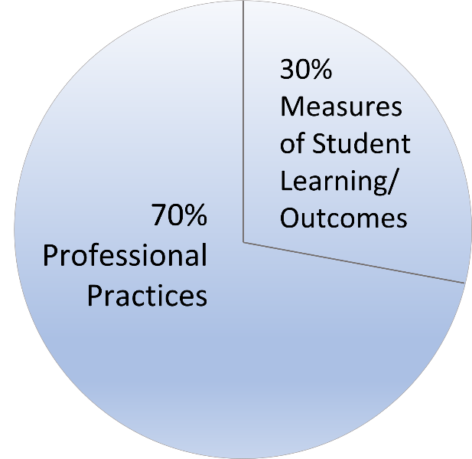
Statutory Requirements:
Composition of Final Rating
  70% of the final effectiveness rating is based on professional practices
  30% is based on measures of student learning/outcomes (MSLs/MSOs)
  C.R.S. 22-9-106 (1)(e)(II)
Notes:
Beginning in the 2023-24 school year, there was a shift in the composition of the Final Effectiveness Rating from 50% professional practices and 50% MSLs and MSOs, to 70% professional practices and 30% MSLs and MSOs.
This places a greater emphasis on professional practices, or the rubrics, when determining an educator’s final effectiveness rating.

Slide 14

Professional Practice
Requirements
Districts determine the weights for the Quality Standards.
  In the state model system the Quality Standards can be weighted equally or differently to emphasize an area of focus or priority to the district.
Required minimum observations*:
  Probationary Teacher = minimum of 2 observations
  Nonprobationary Teachers = minimum of 1 observation
  Special Services Providers (SSPs) = minimum of 1 observation
  Principals/APs = minimum of 1 observation
  *Districts/BOCES can set the number of observations for each role beyond the minimum.
Methods for Evaluating Professional Practices.
  In addition to observation, at least one of the following measures must be used based on specific duties of the educator: (a) student perception measures (e.g., surveys) where appropriate and feasible; (b) peer feedback; (c) feedback from parents or guardians; or (d) review of lesson plans, student work samples or student support documentation.
Local flexibility options!
Notes:
Districts may decide the weight for each Educator Quality Standards to align with district priorities.
For example, if improving instruction strategies is the goal for your Unified Improvement Plan, consider weighting Quality Standard I for teachers and principals higher than the other quality standards.
LOCAL FLEXIBILITY for EDUCATION EVALUATION OPPORTUNITY!
Weighting Educator Quality Standards: http://www.cde.state.co.us/educatoreffectiveness/flex-weight
Observations: http://www.cde.state.co.us/educatoreffectiveness/flex-observations

Slide 15
Overview of MSLs/MSOs
Requirements
  Measures of Student Learning/Outcomes (MSLs/MSOs) = 30% of the total final effectiveness rating
  Collective measure(s) for teachers and principals:
    cannot exceed 10% of the total final rating
    can only use data based on the performance of students enrolled at their school
  Educators new to the school/district/BOCES cannot have data from previous school year(s) applied to their measures
Notes:
Refinements to the MSL/MSO requirements went into effect beginning in the 2023-24 school year per Senate Bill 22-070.
Please note that the collective measure can be less than 10% (minimum of 1%) and it cannot exceed 10%.
Given the requirement that data must be based on performance of students at the educator’s school, district performance framework (DPF) data is no longer available for use in MSLs/MSOs.
MSLs/MSOs must not include data from prior to the date of an educator’s employment with the district/BOCES.

Slide 16
Key Points about MSLs/MSOs
  Measures of Student Learning/Outcomes (MSLs/MSOs) goals and measures are ideally relevant, rigorous, and attainable.
  MSLs/MSOs are based on student outputs.
  MSLs/MSOs offer an opportunity for educators and evaluators to work together to set these measures/outcomes.
Notes:
Measures of Student Learning Guidance:
http://www.cde.state.co.us/educatoreffectiveness/studentgrowthguide
LOCAL FLEXIBILITY for EDUCATION EVALUATION OPPORTUNITY!
Measures of Student Learning: http://www.cde.state.co.us/educatoreffectiveness/flex-mslos
Connecting the PGP and MSL/Os: http://www.cde.state.co.us/educatoreffectiveness/flex-pgp-mslo

Slide 17

Measures of Student Learning (MSL)
Teacher Requirements
A measure of individually-attributed growth C.C.R.5.1(D)(7)(a)
A measure of collectively-attributed growth C.C.R.5.1(D)(7)(b)
  Collective measure cannot exceed 10% of the total final effectiveness rating
  Collective measure can only use data based on the performance of students enrolled at their school
Educators new to the school/district/BOCES cannot have data from prior to employment used in their MSL
Local flexibility options!
Notes:
Beginning in the 2023-24 school year, districts/BOCES cannot use the district performance framework (DPF) as a part of the Measure of Student Learning/Outcome (MSL/MSO) portion of a licensed personnel’s evaluation.
Per state statute, districts may use school performance data (i.e., SPF) in collective measures for teachers, provided the data was not created prior to the date on which the teacher commenced employment and that the collective measure does not exceed 10 percent.
PLEASE NOTE:
State assessment results are no longer required in teachers’ MSLs.
School Districts and BOCES may use state assessment results when available.
LOCAL FLEXIBILITY for EDUCATION EVALUATION OPPORTUNITY!
http://www.cde.state.co.us/educatoreffectiveness/flex-mslos

Slide 18
Individual and Collective Measures
Individually-attributed growth measure:
  Student results on a measure are attributed to one licensed educator.
Collectively-attributed growth measure:
  Student results on a measure are attributed to two or more licensed educators.
Notes:
A measure of individually-attributed growth.
This means that student results on a measure are attributed to one licensed educator. How do educators including SSPs, Principals and teachers know their students are learning?
A measure of collectively-attributed growth.
This means that student results on a measure are attributed to more than one licensed person. This could mean two educators, a team, a PLC, a content team, or a school. As you think about a collective measure consider this an opportunity to ensure a focus on a district or school initiative. For example, if the effective implementation of PLCs across all schools is a district priority and/or initiative, the collective measure may be a school expectation to have one of their measures be around the effectiveness of their PLCs measured by the focus established within the PLCs related to student growth and achievement.

Slide 19
Measures of Student Learning (MSL)
Principal Requirements
Data included in the school performance framework is used to evaluate Principal performance. C.C.R. 5.1(D)(3)(a)
  School Districts and BOCES may choose to weight specific components of the school performance framework differently than they are weighted in the school performance framework, depending on the Principal’s responsibilities and the performance needs of the school, so long as student longitudinal growth carries the greatest weight.
Selected measures are consistent with the MSLs used for the evaluation of Teachers in each principal’s school. C.C.R. 5.1(D)(3)(b)
Local flexibility options!
Notes:
The use of Colorado Growth Model data is required in MSLs for principals only, per state statute.
Beginning with the 2023-24 school year, per SB22-070, districts/BOCES cannot use the district performance framework (DPF), in the Measure of Student Learning/Outcome (MSL/MSO) of a licensed personnel’s evaluation.
LOCAL FLEXIBILITY for EDUCATION EVALUATION OPPORTUNITY!
http://www.cde.state.co.us/educatoreffectiveness/flex-mslos

Slide 20
Measures of Student Learning (MSL)
Principal Requirements
Measures must reflect growth of students in all subject areas and grades, not only those in subjects and grades that are tested using statewide summative assessments. C.C.R. 5.1(D)(3)(d)
  Principal MSLs must reflect the broader responsibility a principal has for ensuring the overall outcomes of students in their building.
Measures must be reflective of the grade levels the principal oversees, i.e., early childhood to grade 3; grades 4 to 8; and grades 9 to 12. C.C.R. 5.1(D)(3)(h)(i)(j)
Local flexibility options!
Notes:
LOCAL FLEXIBILITY for EDUCATION EVALUATION OPPORTUNITY!
http://www.cde.state.co.us/educatoreffectiveness/flex-mslos

Slide 21
Measures of Student Outcomes (MSO)
Special Services Providers Requirements
    A minimum of two (2) measures aligned with the role and duties of the SSP.
      All nine (9) licensure categories of SSPs employed by the school district or BOCES must include measures in their MSO. C.C.R. 5.1(D)(11)(b)
    Data used in evaluating SSPs must be collected from the sites, or a representative sample of the sites, at which the SSP provides services. C.C.R. 5.1(D)(11)(d)
Local flexibility options!
Notes:
Remember that 30% of a licensed SSP’s final effectiveness rating (FER) must come from Measures of Student Outcomes (MSOs).
The requirements of the Measures of Student Outcomes for SSPs include:
Minimum of two (2) measures aligned to the specific role and duties of the individual SSP.
Data used in evaluating SSPs shall be collected from the site(s), or a representative sample of the sites, at which the SSP provides services.
NOTE: While collective measures are not required for SSPs, a collective measure can be used for one of their measures. If a collective measure is used in an SSP’s MSO it must comply with the requirements set forth for teachers and principals, i.e., it may not exceed 10%.
LOCAL FLEXIBILITY for EDUCATION EVALUATION OPPORTUNITY!
http://www.cde.state.co.us/educatoreffectiveness/flex-mslos

Slide 22
Statutory Requirement:
Appeals Process
Each district must have a process for a non-probationary educator to appeal a SECOND consecutive rating of Ineffective or Partially Effective.
  CDE has created a guidance document to support districts in developing their local appeals’ processes. (example on next slide)
Local flexibility options!
Notes:
State law requires that each school district provide an appeal process to allow teachers who receive a second consecutive rating of ineffective or partially effective to appeal that rating.
The intent of the appeal process is to determine a final evaluation rating and identify whether or not a teacher retains non-probationary status.
Decisions about a teacher’s employment status are separate from decisions about final evaluation ratings and probationary or non-probationary status.
State Model Appeals Process Guidance: http://www.cde.state.co.us/educatoreffectiveness/model_appeals_process_guidance
LOCAL FLEXIBILITY for EDUCATION EVALUATION OPPORTUNITY!
http://www.cde.state.co.us/educatoreffectiveness/flex-appeals

Slide 23
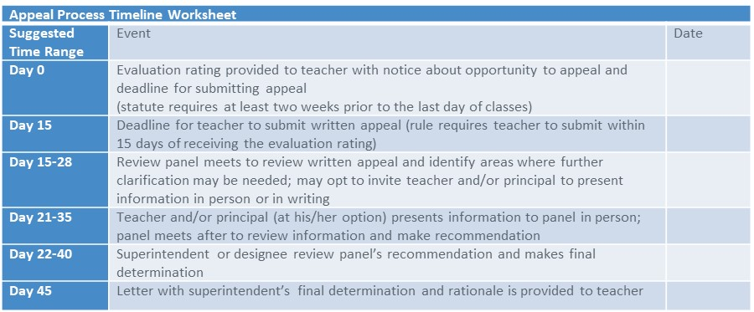
Statutory Requirement:
Appeals Process – Sample Timeline
Notes:
State law requires that each school district provide an appeal process to allow nonprobationary teachers who receive a second consecutive rating of ineffective or partially effective to appeal that rating. The intent of the appeal process is to determine a final evaluation rating and identify whether or not a teacher retains nonprobationary status.
A probationary teacher who does not agree with their rating must inform the evaluator and try to come to an agreement.
Decisions about a teacher’s employment status are separate from decisions about final evaluation ratings and probationary or nonprobationary status.
This table is a sample timeline for districts and BOCES to consider in developing their appeal processes.
State Model Appeals Process Guidance: http://www.cde.state.co.us/educatoreffectiveness/model_appeals_process_guidance
LOCAL FLEXIBILITY for EDUCATION EVALUATION OPPORTUNITY!
http://www.cde.state.co.us/educatoreffectiveness/flex-appeals

Slide 24
District Level Guidance: Appeals Process
District Logo
Provide an overview of information specific to your district and district-level decisions related to the appeals process for educator evaluations including, at minimum, what is required.
    -You may choose to delete the prior two slides completely, as appropriate, and address your own process which may be far more comprehensive than the mandated minimum.
In our district, the appeal process includes:
Notes:
State Model Appeals Process Guidance: http://www.cde.state.co.us/educatoreffectiveness/model_appeals_process_guidance
LOCAL FLEXIBILITY for EDUCATION EVALUATION OPPORTUNITY!
http://www.cde.state.co.us/educatoreffectiveness/flex-appeals

Slide 25
Additional
Statutory Requirements
Districts and BOCES must have an Advisory Personnel Performance Evaluation Council (1338 Council)
  This council consults and advises the local school board as to the fairness, effectiveness, credibility, and professional quality of local evaluation systems, processes and procedures.
Districts and BOCES determine how licensed personnel in unique roles will be evaluated
  This may include educators in dual roles, teachers on special assignment, instructional coaches and deans.
All educators must be given a written evaluation report upon the completion of the evaluation cycle
  Evaluation reports must be available no later than two weeks before the end of the school year.
Notes:
NOTE: additional information regarding 1338 Councils is provided later in this slide deck.

Slide 26
Highly Effective
Evaluation Process
Districts/BOCES decide IF to offer
  For those that offer the Highly Effective evaluation process, they must create implementation guidance
  Decision must be made, and educators notified at the beginning of the school year
Requirement for an annual evaluation remains in place for all educators using the Highly Effective evaluation process
Notes:
Districts and BOCES have the option to offer a Highly Effective evaluation process to licensed personnel who have earned a Highly Effective final effectiveness rating for three consecutive years.
Note: it is not a requirement for districts and BOCES to offer a Highly Effective evaluation process.
For districts and BOCES who do decide to offer a Highly Effective evaluation process, they must create implementation guidance and educators must be notified of their status at the beginning of the school year.

Slide 27
Highly Effective
Evaluation Process
Available for licensed personnel who have earned a final rating of Highly Effective for three consecutive years
  For the 2025-26 school year, educators who earned a rating of Highly Effective for the school years 2024-25, 2023-24, and 2022-23
District/BOCES determines how to align this process with existing evaluation processes and local values
  A Highly Effective (HE) evaluation process is supported in the Colorado Performance Management System (COPMS) in RANDA
Notes:
Note that for the Highly Effective evaluation process, the requirement of annual evaluations remains in place.
A webpage providing an overview and additional context can be found at www.cde.state.co.us/educatoreffectiveness/highly-effective-evaluation-process-overview .
Further, and to aide districts and BOCES in determining how to align the process with existing evaluation processes and local values, CDE will provide guidance and parameters for the process. The Values Activity Guide has also been updated to include questions specifically related to the highly effective evaluation process. The Values Activity Guide can be found on the Downloadable Resources and Related Links webpage of the CDE Educator Effectiveness website and via the following link: https://www.cde.state.co.us/educatoreffectiveness/values-activity
Note that the process is supported in COPMS (RANDA).

Slide 28
District Level Guidance
District Logo
IF applicable, i.e., your district is offering a Highly Effective evaluation process this school year, provide an overview of the specific parameters and process for implementation within your district. For example, any local decisions for who will be able to use the HE process, when educators will be notified, and how this will be supported in the performance management system (COPMS in RANDA or your local performance management system).
In our district, the Highly Effective evaluation process includes:
Notes:
Highly Effective Evaluation Process Overview:
https://www.cde.state.co.us/educatoreffectiveness/highly-effective-evaluation-process-overview

Slide 29
Required Evaluator Training
Required training for all evaluators of licensed personnel, i.e., for evaluators of teachers, SSPs, and principals/APs
The deadline to complete the training is based on the individual evaluator’s license renewal date
  Beginning August 1, 2024, all new/renewed licenses will require training completion and the designation on their license the training is complete
  This is a one-time training requirement – once the evaluator receives the designation on their license, they do not have to complete the training again
The training offered by CDE, E-Train, includes two parts: Part I (asynchronous) and Part II (in-person)
  Please visit the CDE website for more information: https://www.cde.state.co.us/educatoreffectiveness/e-train
Notes:
Evaluators can access the evaluator training through one of three avenues:
Through a CDE-led training of E-Train
Through an authorized provider of CDE’s E-Train Part II
Through an approved evaluator training program provided by a district or BOCES
Districts/BOCES can create and provide their own training aligned to the evaluator training standards in State Board rule C.C.R.5.3 (H)(2).
All training programs must meet or exceed the evaluator training standards and elements in State Board rule.
More information regarding this training requirement, as well as additional details regarding CDE’s E-Train is available on the CDE webpage (address listed on the slide).
Additional talking points as needed:
This is applicable to all evaluators of licensed personnel. That is all evaluators of teachers, SSPs, and principals/APs
Connected to licensure – once completed, an E-Train designation will be added to the evaluator’s license
The one-time training is provided by CDE at no cost to participants

Slide 30
State Model
Evaluation System (SMES)
Notes:
NOTE: If using a locally created evaluation system or a combination of the state model system and a locally created system, replace and/or enhance the following section as needed to align with local practices.

Slide 31

Professional Practices
Quality Standards by theme
Quality Standard | Teacher | SSP | Principal/AP
I. | Content & Pedagogy | Domain Mastery & Expertise | Organizational Leadership
II. | Learning Environment | Learning Environment | Positive & Safe School Culture
III. | Effective Instruction | Effective Service Delivery | Instructional Leadership
IV. | Professionalism & Leadership | Professionalism & Leadership | Professionalism & Leadership
70%
Professional
Practices
Notes:
70% of the final effectiveness rating is based on the observation of professional practices defined through a rubric that meets or exceeds the Quality Standards defined in State Board Rule (1 CCR 301-87).
The theme for each Quality Standard for all educators are listed on this slide.
The standards are aligned among all three educator categories: Teacher, Special Service Provider and Principal/AP.

Slide 32
Rubrics by the Numbers
 | Teacher | SSP | Principal/AP
Standards | 4 | 4 | 4
Elements | 17 | 17 | 17
Professional Practices | 157 - 171 | 99 - 146 | 215
70%
Professional
Practices
Notes:
70% of the final effectiveness rating is based on the observation of professional practices defined through a rubric that meets the State defined quality standards.
The standards for all educators are on this slide.
The standards are aligned among all three educator categories: Teacher, Special Service Provider and Principal/AP.
The following lists the available rubrics within each category:
Teacher
Teacher
Special Education (SPED) Teacher
Teacher Librarian
Teacher on Special Assignment (TOSA), e.g., Instructional Coach
Special Services Providers (SSPs)
School Audiologist
School Counselor
School Nurse
School Occupational Therapist
School Orientation & Mobility Specialist
School Physical Therapist
School Psychologist
School Speech & Language Pathologist
School Social Worker
Principal/AP
Principal/AP

Slide 33
Teacher Rubrics
The following options are available rubrics for Teachers:
    Teacher
    Teacher Librarian
    Special Education (SPED) Teacher
    Teacher on Special Assignment (TOSA)
    e.g., Instructional Coach

Slide 34
Special Services Providers (SSPs)
Who are
Special Services Providers
(SSPs)?
School
Audiologists
School Orientation and Mobility Specialists
School Psychologists
School
Speech-Language Pathologists
School Counselors
School Nurses
School
Occupational Therapists
School
Social Workers
School
Physical Therapists

Slide 35
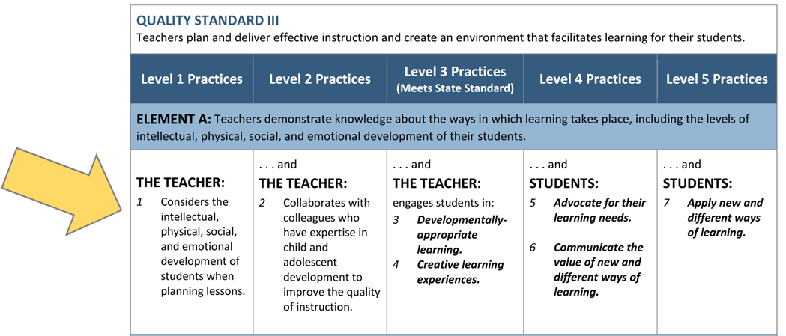
State Model Evaluation Rubric Anatomy: Professional Practices
Professional Practices are what evaluators use to inform their observations, data collection, documentation, and preparation for feedback in support of the educator’s practice and growth.
Please note: The rubrics in the state model evaluation system are asset-based – the practices build upon each other across the levels.
The example provided is from the Teacher rubric.

Slide 36
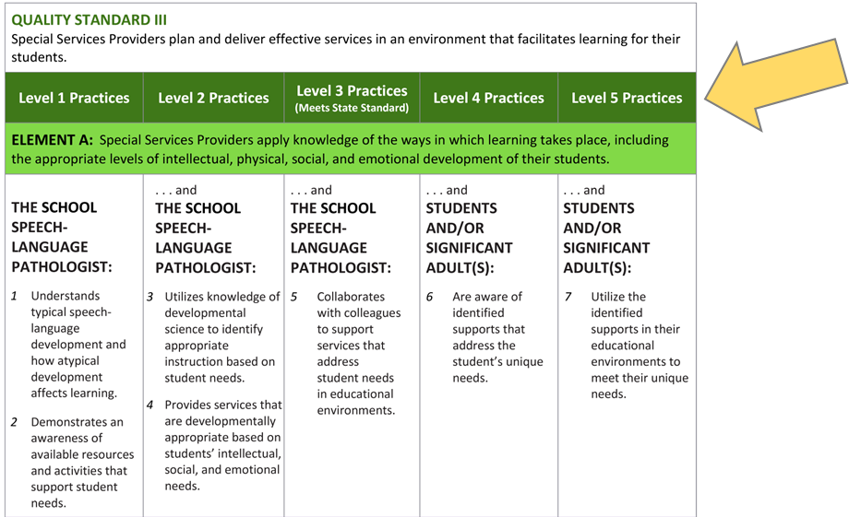
Evaluation Rubric Anatomy:
Professional Practice Levels
In the state model evaluation system, the performance practice rating levels are Level 1 Practices to Level 5 Practices.
Level 1 practices are foundational and then expectations build in complexity, breadth, and depth through to Level 5 Practices.
Please note: Practices in Levels 1 through 3 directly reflect the practices of the educator, with Levels 4 and 5 reflecting the anticipated results from the educator’s practice.
A rating of Level 3 is considered meeting the State standard.
The Levels of practice are applicable to all licensed groups. The example provided is from the SSP rubric for School Speech-Language Pathologists.

Slide 37
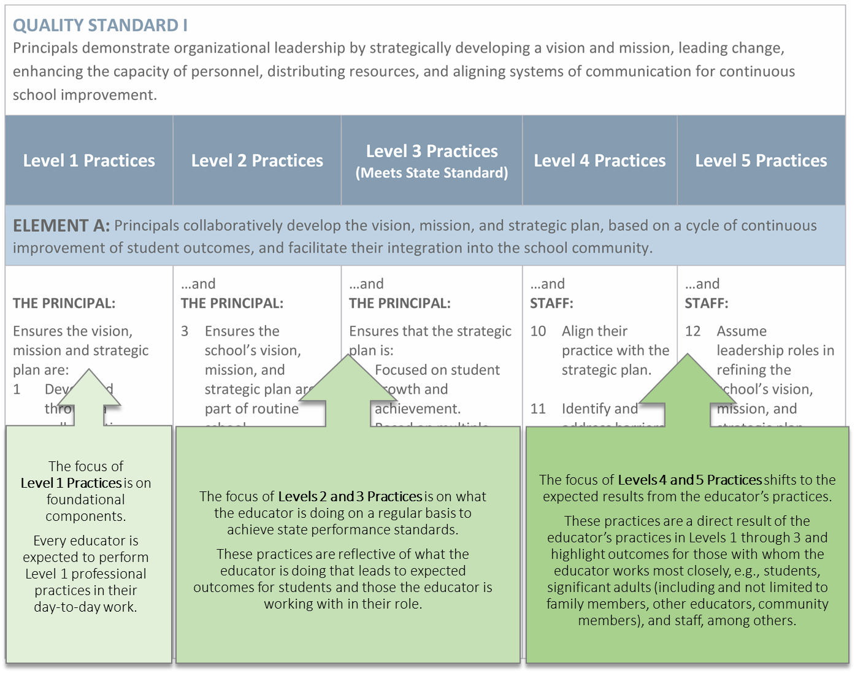
Evaluation Rubric Anatomy: Professional Practice Levels
In the state model evaluation system, the Professional Practices increase in rigor, depth, breadth, and complexity as you move from left to right across the rubric.
This graphic shows how these 5 Levels work together to clarify expectations and build a path for improvement and growth.
The example provided is from the Principal/AP rubric.

Slide 38
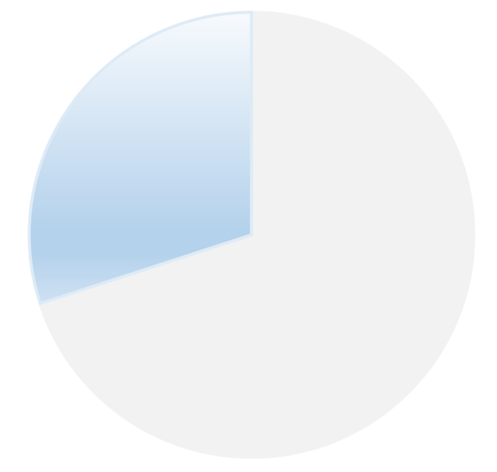
MSLs/MSOs
The MSL/MSO portion of an educator’s evaluation in the SMES is aligned with requirements per state statute and State Board rule.
Measures of Student Learning (MSLs)
Teachers
Principals
30%
MSLs/MSOs
Measures of Student Outcomes (MSOs)
Special Services Providers (SSPs)
Notes:
30% of the final effectiveness rating connects the professional practices with the impact on student growth and development, called Measures of Student Learning (MSLs) and Measures of Student Outcomes (MSOs). This growth is measurable and computed mathematically into the final effectiveness rating.
Additional information, including the requirements for each group of educators, is available on the CDE website: https://www.cde.state.co.us/educatoreffectiveness/msl-mso-overview-and-statutory-requirements
NOTE: For those districts/BOCES using the Colorado Performance Management System (COPMS) in RANDA, specific guidance and information regarding updates in the system and support for creating MSLs/MSOs is available on the CDE Educator Effectiveness website https://www.cde.state.co.us/educatoreffectiveness

Slide 39
SMES Scoring System
  Scoring within the state model system:
  1000 total points: 700 points for prof. practices and
  300 points for MSLs/MSOs
A final rating of Effective remains the rating to meet the state standard.
A Partially Effective rating should indicate areas for growth and development towards meeting the state standard.
Educators rated Highly Effective should expect to earn a professional practice rating that is above the state standard (i.e., Accomplished or Exemplary) and a minimum MSL/MSO rating of Expected.
If an educator earns an MSL/MSO rating of Less than Expected, the highest FER they can achieve is Effective.
Additional details about the SMES scoring is available on the EE website
Notes:
Beginning in the 2023-24 school year, revisions to the scoring system in the state model evaluation system went into effect. This includes a shift in the total points possible to 1000 points. 700 points from professional practices, and 300 points from MSLs/MSOs.
To learn more about the scoring system revisions, please visit our website at www.cde.state.co.us/educatoreffectiveness/smes-revised-scoring-overview

Slide 40
Educator Evaluation Cycle

Slide 41
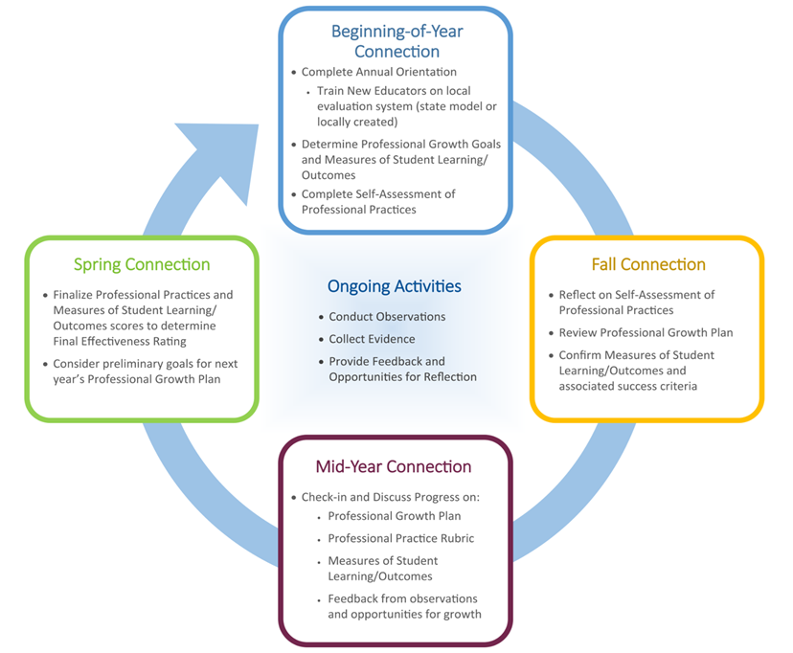
Educator Evaluation Cycle
Notes:
As a reminder, the evaluation process focuses on four key points of connection between evaluator and the person being evaluated. These connections will help in planning your evaluation cycle throughout the school year. The four State Model Connection points can be used, or replaced with local touch points, as appropriate throughout this slide deck for districts that may use their own locally-developed evaluation system in lieu of the state model.
Overview of the CO State Model Evaluation System, including information related to unique roles to be evaluated:
http://www.cde.state.co.us/educatoreffectiveness/statemodelevaluationsystem
Implementation Guidance associated with the State Model Evaluation System:
http://www.cde.state.co.us/educatoreffectiveness/implementationguidance
Within the subsequent slides each of the four key points is highlighted and slides are provided to add information that is specific to your district/BOCES.
LOCAL FLEXIBILITY for EDUCATION EVALUATION OPPORTUNITY!
Finding time in evaluations: http://www.cde.state.co.us/educatoreffectiveness/flex/findingtimeinevals

Slide 42
District Level Guidance
District Logo
Provide an overview of information specific to your district and district-level decisions related to the process for educator evaluation.
- Possible content to highlight, as well as available resources/links are included in the “Notes” section.
In our district, the evaluation process includes:
Notes:
Possible district decisions to highlight:
Teacher Evaluation Requirements
SSP Evaluation Requirements
Principal/Assistant Principal Evaluation Requirements
Inter-Rater Agreement/Reliability Support
Update local educator agency (LEA) settings.
Decide educator quality standard weights
Decide district observation requirements
Timeline:
Orientation
Self-Assessment
Professional Growth Plan
Observations – using peers and/or alternate evaluators
Use of Artifacts and the Discrepancy Model
Measures of Student Learning/Outcomes
Mid-Year Review
End-of-Year Rubric
End-of-Year Measures
Final Meeting
Appeals Process
LOCAL FLEXIBILITY for EDUCATION EVALUATION OPPORTUNITY!
Evaluating Unique Roles: http://www.cde.state.co.us/educatoreffectiveness/flex-uniqueroles
Weighting of Educator Quality Standards: http://www.cde.state.co.us/educatoreffectiveness/flex-weight
Training Options: http://www.cde.state.co.us/educatoreffectiveness/flex-training
Sharing the Self-Assessment: http://www.cde.state.co.us/educatoreffectiveness/flex-sharing-sa
Professional Growth Plan: http://www.cde.state.co.us/educatoreffectiveness/flex-goals
Professional Growth Plan and Measures: http://www.cde.state.co.us/educatoreffectiveness/flex-pgp-mslo
Observations: http://www.cde.state.co.us/educatoreffectiveness/flex-observations
Observation Feedback: http://www.cde.state.co.us/educatoreffectiveness/flex-obs-feedback
Using Alternate Evaluators: http://www.cde.state.co.us/educatoreffectiveness/flex-designees
Using Peers to Provide Feedback: http://www.cde.state.co.us/educatoreffectiveness/flex-peers
Discrepancy Model Approach to Evaluation: http://www.cde.state.co.us/educatoreffectiveness/flex-disc-model
Measures of Student Learning: http://www.cde.state.co.us/educatoreffectiveness/flex-mslos
Sharing the Evaluator Rubric: http://www.cde.state.co.us/educatoreffectiveness/flex-sharing-rubric
Appeals: http://www.cde.state.co.us/educatoreffectiveness/flex-appeals

Slide 43
Building Level Guidance
District Logo
Provide an overview of building level decisions related to the process for educator evaluation.
- Possible content to highlight, as well as available resources/links are included in the “Notes” section.
In our district, the evaluation process includes building-level guidance such as:
Notes:
Possible district decisions to highlight:
Teacher Evaluation Requirements
SSP Evaluation Requirements
Principal/Assistant Principal Evaluation Requirements
Inter-Rater Agreement/Reliability Support
Update local educator agency (LEA) settings.
Decide educator quality standard weights
Decide district observation requirements
For districts/BOCES using the Colorado Performance Management System (COPMS) in RANDA:
Identify the person(s) responsible for evaluation support, technical support for the performance management system and Local Access Manager (LAM).
Identify the person to disable all accounts for educators no longer employed by the district/BOCES.
Enable the new school year within the first two weeks of the school year (users will not be able to log in until the new school year is enabled).
Update roles and ensure that all teachers are assigned evaluators and accounts within the data management system.
Timeline:
Orientation
Self-Assessment
Professional Growth Plan
Observations – using peers and/or alternate evaluators
Use of Artifacts and the Discrepancy Model
Measures of Student Learning/Outcomes
Mid-Year Review
End-of-Year Rubric
End-of-Year Measures
Final Meeting
Appeals Process

Slide 44
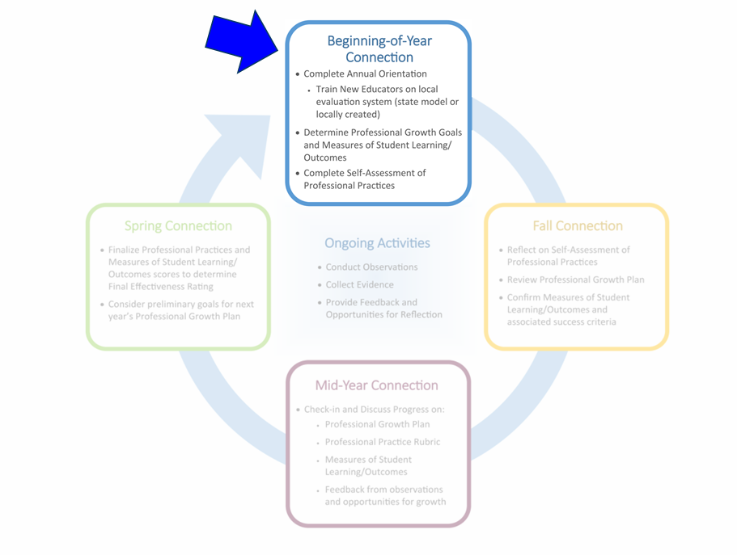
Educator Evaluation Cycle
Notes:
As a reminder, the evaluation process focuses on four key points of connection between evaluator and the person being evaluated. These connections will help in planning your evaluation cycle throughout the school year. The four State Model Connection points can be used, or replaced with local touch points, as appropriate throughout this slide deck for districts that may use their own locally-developed evaluation system in lieu of the state model.
LOCAL FLEXIBILITY for EDUCATION EVALUATION OPPORTUNITY!
Finding time in evaluations: http://www.cde.state.co.us/educatoreffectiveness/flex/findingtimeinevals

Slide 45
Beginning of the year connections:
Orientation and Training
  Annual Orientation: For ALL educators (new and returning)
    Provides updates and highlights any new system features
    Provides any process updates for the district/BOCES
    Ensures shared understanding of evaluation requirements and local processes
    Supports fulfillment of requirement that educators are aware of what is included in their evaluation for the school year
  Training: For educators new to the State Model Evaluation System
    Ensures foundational knowledge
    Ensures reliability and accuracy
    Typically occurs once for an educator
Local flexibility options!
Notes:
Prior to using the state model system, educators should be trained on the system’s processes, tools and materials to ensure that everyone has the foundational knowledge needed to implement the system. Well-trained and knowledgeable users help ensure the reliability and accuracy of the final ratings. This typically occurs once for an educator.
LOCAL FLEXIBILITY for EDUCATION EVALUATION OPPORTUNITY!
http://www.cde.state.co.us/educatoreffectiveness/flex-training

Slide 46
Beginning of the year connections:
Self-Assessment
Each educator completes a self-assessment at the beginning of the year:
  Educators complete their self-assessment by the end of the first month of the school year.
  Educators may choose to share the self-assessment with their evaluator or not.
  The self-assessment can inform the development of professional growth goals.
Local flexibility options!
Notes:
This provides an opportunity for educators being evaluated to reflect on their ability to face the challenges ahead during the coming school year, including the measures to which they will be held accountable, student needs and their professional growth plan.
LOCAL FLEXIBILITY for EDUCATION EVALUATION OPPORTUNITY!
Sharing the Self-Assessment:
http://www.cde.state.co.us/educatoreffectiveness/flex-sharing-sa
Professional Growth Plan:
http://www.cde.state.co.us/educatoreffectiveness/flex-goals

Slide 47
Beginning of the year connections:
Self-Assessment
District Logo
Add building level decisions:
Notes:
On this slide you can add any requirements you have for the self-assessment such as:
Timeline for completion
Sharing protocol
Using the Resource Guide for Deepening the Understanding of Teacher's Professional Practices as needed (http://www.cde.state.co.us/educatoreffectiveness/rev-resourceguide)
Guidance for using the self-assessment as goals are prepared
LOCAL FLEXIBILITY for EDUCATION EVALUATION OPPORTUNITY!
Sharing the Self-Assessment: http://www.cde.state.co.us/educatoreffectiveness/flex-sharing-sa

Slide 48
Beginning of the year connections:
Professional Growth Plans (PGP)
Within the first month of the school year:
  The educator and their evaluator review annual school goals to ensure alignment between the goals stated in the educator’s Professional Growth Plan (PGP).
    Educators can consider the context, lessons learned, and how the 2024-25 school year may be informing goals for the 2025-26 year.
    Opportunity exists to adjust professional growth goals in consideration of that context.
  The educator’s self-assessment can inform the development of professional growth goals.
  Educator growth plans are based on input from the educator.
Local flexibility options!
Notes:
LOCAL FLEXIBILITY for EDUCATION EVALUATION OPPORTUNITY!
Professional Growth Plan: http://www.cde.state.co.us/educatoreffectiveness/flex-goals

Slide 49
Beginning of the year connections:
Professional Growth Plans (PGP)
District Logo
Provide overview of information related to building level decisions related to PGPs and related processes/practices.
Building level decisions on PGPs include:
Notes:
Add your building requirements for the educator growth plans on this slide such as:
Timeline for completion and goal expectations:
number of goals
number of action steps
whether someone else will help them with the goal
LOCAL FLEXIBILITY for EDUCATION EVALUATION OPPORTUNITY!
Professional Growth Plan: http://www.cde.state.co.us/educatoreffectiveness/flex-goals

Slide 50
Beginning of the year connections:
Measures of Student Learning/Outcomes
Key Reminders for Creating MSLs/MSOs:
  Confirm Measures of Student Learning/Outcomes (MSLs/MSOs) goals and measures are relevant, rigorous, and attainable.
  Maximize opportunities for educators and evaluators to work together to set these measures/outcomes.
  Measures of Student Learning are based on student outputs.
  For additional help on MSLs/MSOs use the following link:
  Measures of Student Learning/Outcomes (MSLs/MSOs): Overview and Requirements
Local flexibility options!
Notes:
Measures of Student Learning Guidance:
http://www.cde.state.co.us/educatoreffectiveness/studentgrowthguide
LOCAL FLEXIBILITY for EDUCATION EVALUATION OPPORTUNITY!
Measures of Student Learning: http://www.cde.state.co.us/educatoreffectiveness/flex-mslos
Connecting the PGP and MSL/Os: http://www.cde.state.co.us/educatoreffectiveness/flex-pgp-mslo

Slide 51
Beginning of the year connections:
Measures of Student Learning/Outcomes
District Logo
Provide overview of information related to building level decisions related to the MSLs/MSOs and related processes/practices.
Building level decisions on MSLs/MSOs include:
Notes:
On this slide you could include the breakdown of weights and measures for your educators, i.e., what percentages will be used for the different measures within their 30% MSL/MSO portion of their evaluation.
LOCAL FLEXIBILITY for EDUCATION EVALUATION OPPORTUNITY!
Measures of Student Learning: http://www.cde.state.co.us/educatoreffectiveness/flex-mslos
Connecting the PGP and MSLs/MSOs: http://www.cde.state.co.us/educatoreffectiveness/flex-pgp-mslo
Add in your building specific information about MSLs.
For example: the process for creating the MSLs, the date by which MSLs should be set and if ready, insert your pie on this slide.

Slide 52
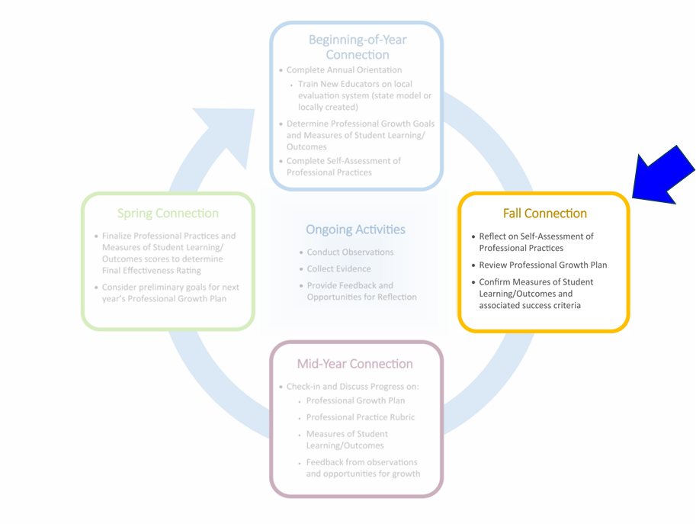
Educator Evaluation Cycle
Notes:
As a reminder, the evaluation process focuses on four key points of connection between evaluator and the person being evaluated. These connections will help in planning your evaluation cycle throughout the school year. The four State Model Connection points can be used, or replaced with local touch points, as appropriate throughout this slide deck for districts that may use their own locally-developed evaluation system in lieu of the state model.
LOCAL FLEXIBILITY for EDUCATION EVALUATION OPPORTUNITY!
Finding time in evaluations: http://www.cde.state.co.us/educatoreffectiveness/flex/findingtimeinevals

Slide 53
Fall Connection
During the Fall Connections, maximize time to:
  Reflect on the rubric and update the educator’s self-assessment as needed.
  Review professional growth plan to ensure that adequate progress is being made toward completing all action steps and achieving goals.
    Best practice is to do this periodically throughout the year
  Confirm the educator’s goals and measures are still relevant, rigorous, and attainable.
    Refine and adjust if/as needed
Local flexibility options!
Notes:
These meetings could be formal or informal, brief, ongoing or scheduled depending on the district policy or preference.

Slide 54
Fall Connections:
District Logo
Provide overview of information related to local decisions related to the Fall Connection – highlight any information not covered in the Beginning of Year connections.
During Fall Connections:
Notes:
LOCAL FLEXIBILITY for EDUCATION EVALUATION OPPORTUNITY!
Measures of Student Learning: http://www.cde.state.co.us/educatoreffectiveness/flex-mslos
Connecting the PGP and MSLs/MSOs: http://www.cde.state.co.us/educatoreffectiveness/flex-pgp-mslo
add in your building specific information about MSLs.
For example: the process for creating the MSLs, the date by which MSLs should be set and if ready, insert your pie on this slide.

Slide 55
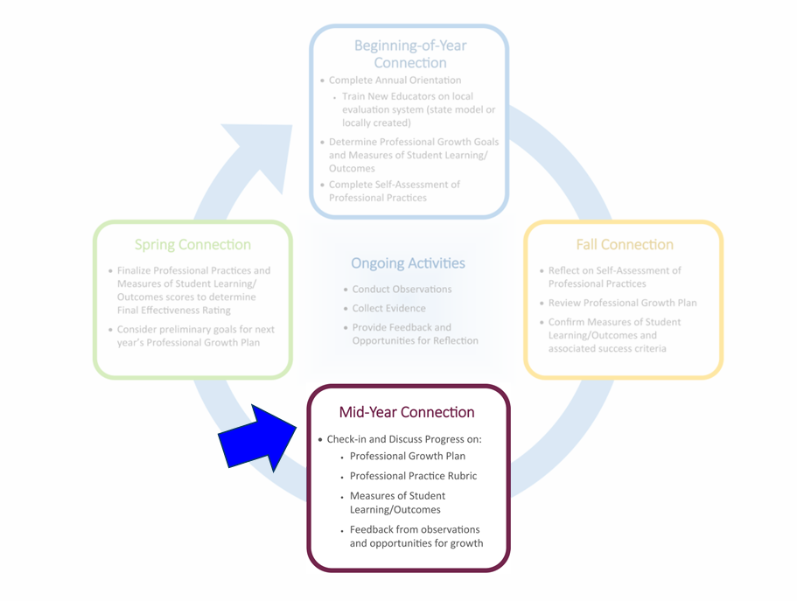
Educator Evaluation Cycle
Notes:
As a reminder, the evaluation process focuses on four key points of connection between evaluator and the person being evaluated. These connections will help in planning your evaluation cycle throughout the school year. The four State Model Connection points can be used, or replaced with local touch points, as appropriate throughout this slide deck for districts that may use their own locally-developed evaluation system in lieu of the state model.
LOCAL FLEXIBILITY for EDUCATION EVALUATION OPPORTUNITY!
Finding time in evaluations: http://www.cde.state.co.us/educatoreffectiveness/flex/findingtimeinevals

Slide 56
Mid-Year Connections
The Mid-Year Review provides the best opportunity for educator and evaluator to discuss progress and make adjustments prior to the End of Year conversation.
During the Mid-Year Review:
  The educator and their evaluator review progress towards achieving professional goals.
  Discuss and adjust the educator’s growth plan and rubric if/as needed.
  Set the stage for the End of Year Conversation between educator and evaluator.
Local flexibility options!
Notes:
The mid-year meeting is the BIG meeting between educator and evaluator and sets the rest of the year up for success.
Principals/Evaluators and educators are strongly encouraged to prioritize this review for an in-depth discussion of progress towards goals as well as take time to explore any potential adjustments that may need to be made in setting the stage for the End of Year Conversation.
Additional considerations for prior to, during, and post to maximize the Mid-Year Review can be found at: http://www.cde.state.co.us/educatoreffectiveness/maximizing_myr

Slide 57
Mid-Year Connections
District Logo
Provide overview of information related to building-level decisions related to the Mid-Year Review and related processes/practices.
Mid-Year Reviews in our building include:
  .
Notes:
Add any deadlines or specifics for your building Mid-Year Reviews on this slide. For example: Completion dates, what the educator should bring to the mid-year, should they make an appointment, among others.

Slide 58
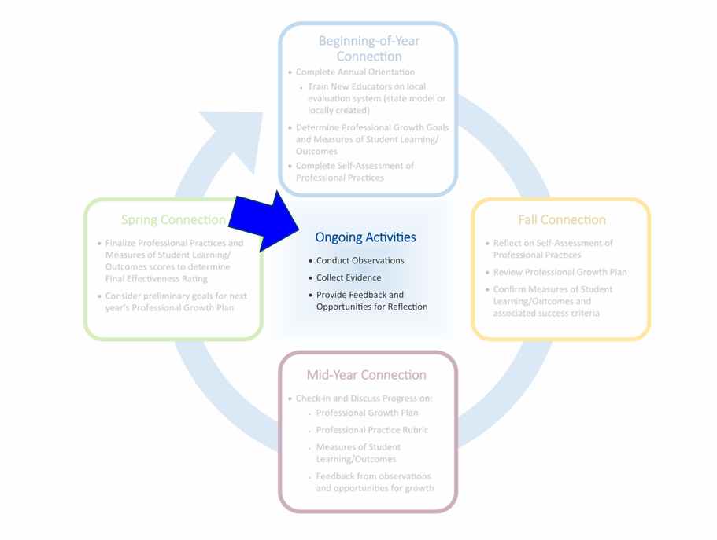
Educator Evaluation Cycle
Notes:
As a reminder, the evaluation process focuses on four key points of connection between evaluator and the person being evaluated. These connections will help in planning your evaluation cycle throughout the school year. The four State Model Connection points can be used, or replaced with local touch points, as appropriate throughout this slide deck for districts that may use their own locally-developed evaluation system in lieu of the state model.
LOCAL FLEXIBILITY for EDUCATION EVALUATION OPPORTUNITY!
Finding time in evaluations: http://www.cde.state.co.us/educatoreffectiveness/flex/findingtimeinevals

Slide 59
Ongoing Activities:
Observation and Feedback
Throughout the evaluation cycle, consider the following:
  Conduct observations to collect evidence of professional practices.
    Explore other ways to collect evidence beyond classroom observations
  Seek opportunities to observe educators outside the classroom.
    What avenues might exist to gain a full picture of what an educator does, such as attending/observing PLCs and parent meetings, among others
  Feedback from the evaluator to the educator ideally takes place throughout the school year, along with opportunities for the educator to reflect and incorporate actionable feedback into their practice.
Local flexibility options!
Notes:
The evaluator, who is responsible for accurately and fairly rating professional practices, should take advantage of all opportunities to examine the performance of the educators for whom they have evaluation responsibilities. Additionally, there are many opportunities throughout the school day in which staff members may be evaluated outside of the classroom, and evaluators who take advantage of those opportunities will have the information necessary to make fair and accurate determinations of the staff members’ performance.
New information is now available on the CDE website that focused on effective observation and feedback in various learning environments (including remote/online):
Providing Effective Observations and Feedback
http://www.cde.state.co.us/educatoreffectiveness/observationfeedback
LOCAL FLEXIBILITY for EDUCATION EVALUATION OPPORTUNITY!
Observations: http://www.cde.state.co.us/educatoreffectiveness/flex-observations
Observation Feedback: http://www.cde.state.co.us/educatoreffectiveness/flex-obs-feedback

Slide 60
Ongoing Activities:
Observation Process
Collect | Align | Prepare and Plan | Provide Feedback
The evaluator collects evidence related to the educator’s rubric and identified goals | The evaluator sorts and aligns the evidence to specific professional practices within the educator’s rubric | The evaluator prepares and plans for sharing feedback with the educator | The evaluator provides feedback to the educator using the collected evidence
Sequence adapted from Rhode Island Department of Education training materials
Better Feedback for Better Teaching, Bill and Melinda Gates Foundation, 2016
Local flexibility options!
Notes:
This is a graphic from Better Feedback for Better Teaching, adapted by the Rhode Island Department of Education and included within CDE’s evaluator training, E-Train.
You may want to share this with your educators, so they are aware of best practices for collecting data and giving feedback.
LOCAL FLEXIBILITY for EDUCATION EVALUATION OPPORTUNITY!
Observations: http://www.cde.state.co.us/educatoreffectiveness/flex-observations
Observation Feedback: http://www.cde.state.co.us/educatoreffectiveness/flex-obs-feedback

Slide 61
Ongoing Activities:
Observation and Feedback
District Logo
District level decisions on observation and feedback
In our district, this looks like…
Notes:
The district should inform educators about the process of observation and feedback. For example: how often will the educator be observed, how will feedback take place, can they request an observation, how will they be informed about upcoming observations or will they be unannounced?
LOCAL FLEXIBILITY for EDUCATION EVALUATION OPPORTUNITY!
Observations: http://www.cde.state.co.us/educatoreffectiveness/flex-observations
Observation Feedback: http://www.cde.state.co.us/educatoreffectiveness/flex-obs-feedback

Slide 62
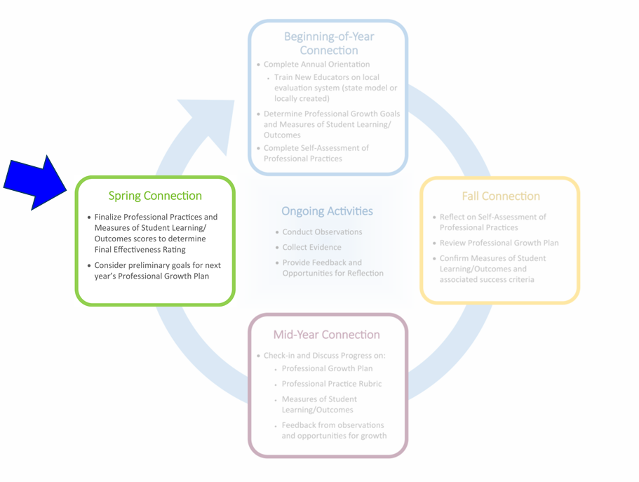
Educator Evaluation Cycle
Notes:
As a reminder, the evaluation process focuses on four key points of connection between evaluator and the person being evaluated. These connections will help in planning your evaluation cycle throughout the school year.
The four State Model Connection points can be used, or replaced with local touch points, as appropriate throughout this slide deck for districts that may use their own locally-developed evaluation system in lieu of the state model.
LOCAL FLEXIBILITY for EDUCATION EVALUATION OPPORTUNITY!
Finding time in evaluations: http://www.cde.state.co.us/educatoreffectiveness/flex/findingtimeinevals

Slide 63
Spring Connections
Conduct an End of Year conversation
  Build upon the Mid-Year review and conversation between the evaluator and the educator.
  Discuss professional practice ratings, along with artifacts and any other evidence needed to confirm the accuracy of ratings.
If agreement on the final effectiveness rating is reached, both evaluator and educator may sign the final effectiveness rating.
  NOTE: It can be helpful to maximize the time together and complete the signatures at the close of the conversation while together.

Slide 64
Spring Connections
No later than two weeks prior to
the end of the school year:
If agreement exists on the final effectiveness rating, both evaluator and educator sign-off on rating.
If the evaluator and educator being evaluated did not agree on the final effectiveness rating:
  They should jointly review additional evidence to help each other understand their respective positions on rating levels.
  The purpose of this meeting is to come to agreement.
If agreement is not reached:
  The supervisor is responsible for determining final ratings on professional practices and overall effectiveness.

Slide 65
Spring Connections
Before the next evaluation cycle begins, each educator develops a professional growth plan (PGP) designed to:
  address any area(s) in which growth and development are needed
  identify area(s) of interest to deepen understanding and application to hone professional practices
  identify required professional development or training
  identify other resources/support to implement the PGP
Any necessary updates to the plan may be made at the beginning of the next school year.

Slide 66
Spring Connections in our district
District Logo
Include district level decisions for:
finalizing the evaluation assessment/rubric
finalizing MSL/MSOs
completing the current goals and using that information to plan goals for the next year

Slide 67
Advisory Personnel Performance Evaluation Council
Engaging Stakeholders and the 1338 Council
Notes:
The Advisory Personnel Performance Evaluation Council (formerly known as the 1338 Committee) can be a powerful group to bring together to make recommendations about the components of a local evaluation system.
LOCAL FLEXIBILITY for EDUCATION EVALUATION OPPORTUNITY!
http://www.cde.state.co.us/educatoreffectiveness/flex-adv-evaluation-council

Slide 68
What is a 1338 Council?
Advisory Personnel Performance Evaluation Council (also known as a “1338 Council”)
State statute outlines that every school district and BOCES in Colorado shall have an advisory personnel performance evaluation council. (C.R.S. 22-9-107)
State Board rule specifies that each school district and BOCES in Colorado must have an advisory personnel performance evaluation (1338) council to consult with the local school board as to the fairness, effectiveness, credibility, and professional quality of local evaluation systems, processes, procedures. (C.C.R. 5.2)
Notes:
State board rule specifies that each school district in Colorado must have an Advisory Personnel Performance Evaluation (1338) council to consult with the local school board as to the Fairness, effectiveness, credibility, and professional quality of local evaluation systems, processes, procedures.
It also specifies that each BOCES that employs licensed personnel must have a “BOCES Advisory Personnel Performance Evaluation Council”.
This state board rule applies to all districts, you may use the state model or a locally created rubric and model, the rule applies to all.
The council is advisory to the local school board. They do not have a decision-making role/authority.

Slide 69

Who serves on 1338 Councils?
State board rule specifies that membership of district 1338 Councils must, at a minimum, consist of the following members appointed by the local school board:
One teacher
One administrator
One principal from the school district
One school district resident who is a parent with a child attending a school within the district
One school district resident who is not a parent with a child attending a school within the district
Image source: Google
Notes:
The following members must be part of the membership of a 1338 Council per requirements in State Board rule:
One teacher
One administrator
One principal from the school district
One school district resident who is a parent with a child attending a school within the district
One school district resident who is not a parent with a child attending a school within the district
The membership of a district’s 1338 Council may overlap with other district committees (i.e., accountability committees), particularly in smaller districts.

Slide 70

The role of 1338 Councils
1338 Councils were established to provide school boards with input & feedback around 4 key areas:
  Fairness of local evaluation systems
  Effectiveness of local evaluation systems
  Credibility of local evaluation systems
  Professional quality of local evaluation systems
School districts and BOCES determine how to meaningfully engage their 1338 Councils throughout the school year.
Image source: Google
Notes:
1338 Councils were established to provide local school boards with input and feedback around 4 key areas:
Fairness of local evaluation systems
Effectiveness of local evaluation systems
Credibility of local evaluation systems
Professional Quality of local evaluation systems

Slide 71
District Level Guidance
District Logo
Provide an overview of the local Advisory Personnel Performance Evaluation Council (also known as 1338 Council or Committee).
    -This may be a good opportunity to recruit participation in your local committee/council and/or share decisions informed by the council as well as any upcoming work of the council in support of educator evaluations in the district.
In our district, this committee/council:
Notes:
Engaging Stakeholders
https://www.cde.state.co.us/educatoreffectiveness/flex/engaging-stakeholders

Slide 72
Support
Contact Information

Slide 73
District/Building Contacts and Resources
District Logo
Colorado Performance Management System (COPMS) in RANDA:
  Login Support through our District Local Access Manager (LAM)
    Include name(s) and email address(es)
  System support
    copms@cde.state.co.us
  Additional Building contacts and resources
    Include name(s) and email address(es)
Notes:
Add the names and contact information for people that can assist educators if they have questions. COPMS information is provided here for district/BOCES who utilize the state provided platform – this can be replaced with district’s local contact information as appropriate.

Slide 74
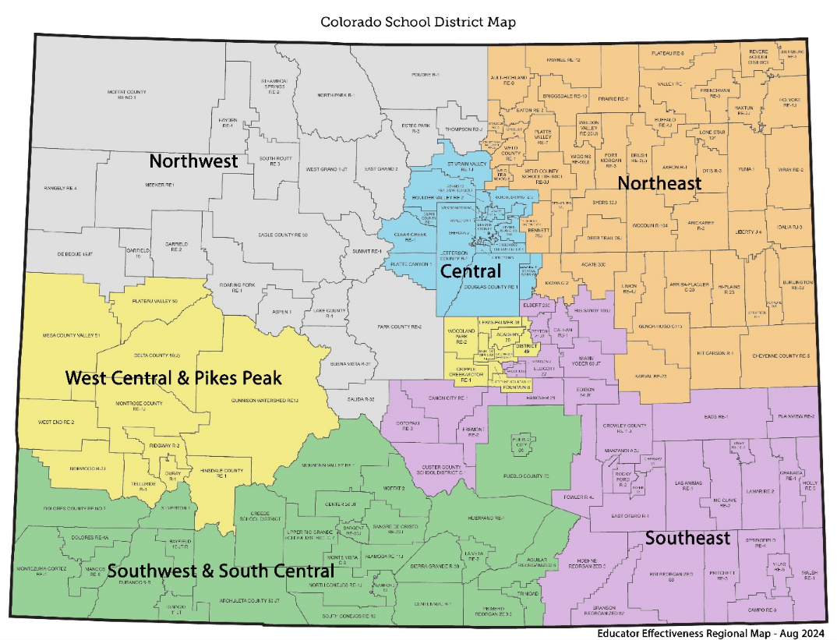
Educator Effectiveness Office and Regional Specialists
  Please contact the Educator Effectiveness Office (educator_effectiveness@cde.state.co.us) or your EE Regional Specialist for additional support and information as needed.
Region | Regional Specialist
Southwest and South Central | Curtis Garcia garcia_c@cde.state.co.us 303-981-8950
West Central and Pikes Peak | Alissa Poduska poduska_a@cde.state.co.us 720-601-6731
Central | Debbie Hearty hearty_d@cde.state.co.us 720-646-2936
Southeast | Paula Chostner chostner_p@cde.state.co.us 720-682-9032
Northwest | Jennifer Needham needham_j@cde.state.co.us 720-955-0553
Northeast | Jill Davis davis_j@cde.state.co.us
http://www.cde.state.co.us/educatoreffectiveness/ee-regions
Notes:
The Educator Effectiveness (EE) Office offers differentiated support to districts/BOCES through our team of Regional Specialists. The Regional Specialists can assist districts/BOCES as they support educator practice and build an integrated, systematic approach to educator evaluation – as a part of the state model system or a district’s unique evaluation system.
The Educator Effectiveness Regional Specialists are available to meet with districts/BOCES to discuss local needs. Please use the chart above to help identify your Educator Effectiveness Regional Specialist. Feel free to contact your specialist with any questions you may have or support you may need!

