Slide 1
Implementing the
State Model Evaluation System
for
Measures of Student Learning

Slide 2
Before we begin…
Find your work group – it’s important where you sit. Try to sit with members of your school or district.
On the wall you will see a chart that will be used to capture everyone’s level of comfort and knowledge with Measures of Student Learning. Place a dot on the chart the best represents your level of comfort and knowledge currently.
High Knowledge
Next
Low Knowledge
Low Comfort
High Comfort
Notes:
This formative assessment if very helpful for trainers to know their impact on attendees. Participants will start the day charting where they currently sit with comfort and knowledge and will then return to this activity to re-chart their learning over the course of the training.

Slide 3

Introductions
Notes:
Trainers introduce themselves and can have group introductions depending on size or familiarity. Please customize this slide to fit your own needs regarding icebreakers and introductions

Slide 4

Agenda
Measures of Student Learning
Welcome and Purpose
Introductions
Measures of Student Learning
  Steps 1-6
  Create a template/pie chart
    Feedback and critical questioning
  Decision Framework
Work Session and Next Steps
Closing – Feedback and Reflection
Notes:
The agenda highlights the entire day’s focus. Schools and districts could take each of the 5 steps and break them in to separate trainings.

Slide 5
Training Objectives:
Desired Outcomes
What do we hope to accomplish today?
  To understand the legislative requirements for Measures of Student Learning in educators’ evaluations.
  To gain a clear understanding of the steps for including Measures of Student Learning in your evaluation system
  Make preliminary decisions on Measures of Student Learning
  To determine next steps for your school, district, or BOCES
Notes:
During today’s sessions, we hope that you will:
Gain a clear understanding of the requirements set in SB 10-191 for student learning outcomes/student growth
Understand the shift from student growth to student learning outcomes; student growth is still our focus, not achievement, per se, but it becomes embodied in student learning outcomes
Gain a clear understanding of the 6 step guidance, which includes:
How to categorize teachers based on assessments required and available
Creating a sample pie template for groups of teachers based on the data requirements
Be able to use the Assessment Review Tool (ART) to help validate assessments and provide feedback for improvement
Be able to use the Measures of Student Learning Tool to weight and score measures
Create a work plan for your district/BOCES
You’re role is critically important… you have the opportunity to set the mood of how these changes are being implemented in your district/school. The words you choose matter. As you are training on the six steps of the new evaluation system, you are also establishing the importance and purpose of what this change in evaluation is all about. Also, you want to be able to inform the 1338 and/or District Accountability Committees (DAC) about the process for determining a rating for Student Learning Outcomes.
These key themes help to ease fears and ensure that your teachers know that this work is being done in a way that is fair and supportive of their ongoing professional growth.

Slide 6
Meeting Norms:
How We Will Play Together
We will…
Honor everyone’s time
Listen to learn and apply to your context
Balance participation and share airspace
Paraphrase, probe, pause
Suspend judgment
Commit to practice and follow-through
Avoid technological distractions
Have a sense of humor
Notes:
We suggest highlighting a few of these norms that would best fit the audience. Please feel free to edit these as needed based on your own group norms.

Slide 7
Line Dance
Take two steps forward if you’ve explored or read the Measures of Student Learning guidance document.
Take one step forward if you know the 4 requirements for Measures of Student Learning (based on SB 191).
Take two steps forward if you feel comfortable explaining the 4 requirements.
Take two steps forward if you have completed an Assessment inventory in your school or at your grade level/content area.
Take one step forward if you’ve explored or utilized the Measures of Student Learning Tool.
Take one step forward if you’ve explored or utilized the Assessment Review Tool.
Take one step forward if you’ve participated in conversations about Measures of Student Learning in your school/district.
Take one step back if you are unsure what measures will be included in your evaluation system or what decisions your school/district has made.
Take one leap forward for attending this training!
Notes:
We’ve added this as a form of assessment for the trainers. Certainly determine if this exercise is helpful for your group, especially if you as a trainer already know where they sit in terms of all the things listed.
As always, please feel free to add your own Ice breaker activity or formative assessment.

Slide 8
Colorado Department of Education
Framework for System to Evaluate Teachers
Definition of Teacher Effectiveness
Professional Practice Quality Standards
I. Know Content
II. Establish Environment
III. Facilitate Learning
IV. Professionalism
Measures of Student Learning
50% Professional Practice Standards 50% Measures of Student Learning
Observations of Other Measures Teaching Aligned with CDE Guidelines
Weighting: How Much Does Each Standard Count Towards Overall Performance?
State Other Assessments Other Measures
Summative for Non-tested Aligned with Assessments Areas CDE Guidelines
Match of test to teaching assignments
Weighting:
State Scoring Framework: How Do Measures of Quality Standards
Result in a Determination of Individual Performance?
Effectiveness Ratings
Ineffective Partially Effective Effective Highly Effective
Appeals Process

Slide 9
From Student Academic Growth
to
Measures of Student Learning
Measures of Student Learning
Using multiple measures to determine student learning over time.
Colorado Growth Model (CGM) establishes technical measure of “growth.”
Notes:
Throughout this training the term “growth” is intended to mean student learning over time. The intent of Senate Bill 10-191 and the State Board of Education rules is to ensure that students make at least a year’s growth in a year’s time regardless of where the student begins and to ensure that educator’s use multiple types of assessments to determine how much learning has occurred. This training refers to the multiple Measures of Student Learning, including growth, as Measures of Student Learning. The reason for this is that many assessments may be used to contribute to an educator’s body of evidence however very few assessments can be called “growth” measures. Measures of Student Learning are inclusive of student growth (as visually captured here), such as data generated from the Colorado Growth Model, as outlined in Senate Bill 10-191.

Slide 10
Measures of Student Learning
Brainstorm
  How do you measure student learning in your district/school?
Notes:
Have on chart and record thinking. This can be used later in creating templates/pie charts.
This activity should help to emphasize that assessing student learning is a part of best classroom practice. In most cases, educators are measuring student learning over the course of a school year.
There are multiple ways in which educators measure student learning. It’s helpful to have folks brainstorm beyond traditional state a vendor tests. Push the audience to expand their thinking and discuss the ways in which educators assess and communicate student learning on continual basis

Slide 11
Approaches for Selecting and Using Multiple Measures in Educator Evaluation
Step 1: Begin with the Colorado Academic Standards to identify what students are expected to know and be able to do.
Step 2: Identify available assessments being used in your district to evaluate student learning throughout the year.
Step 3: Group available assessments according to teacher types.
Step 4: Select measures and assign weights to measures for use in educator evaluations.
Step 5: Determine success criteria for results from included Measures of Student Learning.
Step 6: Combine weighted ratings from individual measures into an overall Measures of Student Learning (MSL) rating.
Notes:
The steps above are hyperlinks to the guidance document
These steps are outlined in the guidance document found online. The purpose of this training is to walk through each of these steps in order to support schools and districts in constructing their own evaluation system.

Slide 12

Core Values
Poster session:
  In your group, discuss and document your core values regarding Measures of Student Learning in an educator effectiveness system.
    What are your non-negotiables?
    What are your best hopes?
    What unintended consequences do you want to protect against?
  Be prepared to share your thinking!
Notes:
This activity can be extremely beneficial. Have participants split into groups and identify their core values regarding Measures of Student Learning in an educator effectiveness system. What are their best hopes for this system. What are their core values. How can we use this system to amplify and serve our core values?

Slide 13
Guardrails / Rules for Measures of Student Learning in Educator Evaluation
VI. Responsibility for student academic growth
50% Student Academic Growth
Refers to outcomes on a measure that are attributed to an individual licensed person,
e.g. End of Course Exam for a 6th Grade Teacher’s students
Evaluated using the following:
(1) a measure of individually-attributed growth,
(2) a measure of collectively-attributed growth;
(3) when available, statewide summative assessment results; and
(4) for subjects with statewide summative assessment results available in two consecutive grades, results from the Colorado Growth Model.
Refers to outcomes on a measure attributed to two or more licensed personnel,
e.g. 10th gr. Math CMAS – All Secondary math teachers in school
Notes:
Mention a secondary and elementary example for each.
Make sure: These rules come directly from SB191
Individual – The teacher is directly responsible
Collective/Attributed – team / school / co-teacher
CGM – available for 4-10 r/w/m
Collectively characterized as shared among grade level, dept., school or provider (Sped, Intervention)

Slide 14
Collective vs. Individual Attribution
Table Talk:
  At your table, discuss if you want more collective or individual attribution in your evaluation system.
    Consider the advantages and unintended consequences of both collective and individual.
  Be prepared to share your thinking.
Notes:
From the guidance doc:
“an overly high percentage of collective attribution will decrease the ability at the school or district level
to recognize high-performing teachers (who may be held back by the average) and to identify
struggling teachers (who may be “propped up” by the average). Therefore, it is imperative that districts understand the importance of finding the right balance between collective and individual attribution.”

Slide 15
Using State Assessment Data in Evaluation
How do you plan on incorporating state assessment data into your MSL system?
When and how do you plan on setting success criteria?
What process will you create to ensure that educators receive evaluation results 2 weeks prior to the last day of class?
How will you construct MSLs for teachers who are new to your school or district and were not present when that state data was collected?

Slide 16

Measures of Student Learning
Determine how student learning is currently measured in your district
  Conduct an assessment inventory to identify what is currently being used to measure student learning
  Identify where gaps exist
Notes:
Handout: Copy of the Assessment Inventory or share the Excel version.
The Assessment Inventory is a great resource to build teacher involvement when building your local system. Schools/districts may want to have teams of teachers complete this inventory. This could also be used during an all staff meeting. Having these completed inventories for your own system will aid in building vertical and horizontal articulation.

Slide 17
Categorizing Educators
Example:
Colorado Growth Model (CGM)
Reading, Writing, Math
(Gr. 4-10)
2.
State Summative
Reading, Writing, Math (Gr. 3)
Science
(Gr. 5, 8, 11)
Social Studies
(Gr. 4, 7, 11*)
PSAT/SAT (HS)
WIDA ACCESS (ELL)
No Summative/CGM
All Other Teachers
What are the pros and cons of creating groups of like teachers based on the types of measures that must be included in their body of evidence?
Based on what is expected in law, what categories of teachers are possible?
Notes:
In reviewing the requirements for assigning student learning outcomes to educators, it is clear that many teachers will not have all the assessments listed in the requirements. Because assessments are more available for certain groups of teachers then they are for others, it is useful for districts to categorize teachers into groups based on the types of assessment data available. Below is an example of how teachers can be categorized based on teaching assignment and data available.
NOTE: you may want to create a special category for teachers who are new to your district or school and were not present when prior year state data was collected

Slide 18
How Do We Make Decisions?
Individual Teacher Decisions
Individual teacher and evaluator will make decisions unique to their professional responsibilities. Weights and measures will vary for every teacher in the district/BOCES.
What process will work best for your school, district or BOCES?
There is no right or wrong answer to this question! What process will work best given your context, what is feasible, meaningful and valued?
Teacher Category/Group Decisions
Each teacher category will make general decisions about weights of measures, however actual Measures of Student Learning may differ. Each teacher category may have different percentages.
All Teacher Decisions
All teachers in the district/BOCES will have the same weights for measures included in their evaluation. The weights will remain consistent, however the measures may vary based on the subject and grade level.

Slide 19

Measures of Student Learning
Select and weight multiple Measures of Student Learning to be included in educator evaluations.
  What can we do as a district or school to build comparable bodies of evidence in like groups of teachers?
  Let’s try it!
    Measures of Student Learning Tool
Notes:
Measures of Student Learning Tool is available on the website. Consider demonstrating how to use the tool to make decisions about assessments and their weights. Using the second page to rate a teachers performance allows participants to see any unintended consequences of weighting/individual/collaborative decisions.

Slide 20
Creating Specific Weighting Templates
Create a template using the Measures of Student Learning tool.
Questions to consider:
    What assessments must we include?
    How much influence will they have on the evaluation?
Create a pie chart for a category of teacher or individual teacher that shows your thinking.
    Include a rationale.
Notes:
If there are no teams present, group them by familiarity or individual teaching assignment (k-2, 3-5, 6-8- and HS) and have them create a template using that assignment. When groups are sharing out, ask them to think about each individual poster and then have them think about all the posters as a collective system. Is there alignment and congruency?

Slide 21
Pie Chart Feedback
Round Robin
Each group should select a spokesperson to share your thinking and rationale for your choices.
Audience should consider feedback on:
  The collective vs. the individual attribution
  Types of assessments
  Weights
Notes:
Have each group that has prepared a sample pie chart share out their thinking. This activity will allow presenters to anticipate questions they might receive about their thinking and will allow participants to practice asking questions and providing feedback on thinking. Both of these skills will be necessary for school districts when they return to their buildings.

Slide 22
Debrief/Reflection
Did the feedback help shape any of your thinking?
Any aha’s?
What might you reconsider/change if anything?
Notes:
Record concerns/things to consider for next steps.

Slide 23
Using Local Assessments in Evaluation
Districts, BOCES and schools may decide after completing the Assessment Inventory that a locally created assessment would likely be included as a measure in evaluation.
Districts and BOCES can use the Assessment Review Tool to show they are taking steps to ensure that the locally created measurements they select are fair, valid, and reliable.
Notes:
The assessment review tool helps by seeking to ensure that the assessments are fair, valid and reliable.

Slide 24
Assessment Review Tool
  Assessment Review Tool
Criteria used in this tool:
  Alignment
  Scoring
  Fair and Unbiased
  Opportunities to Learn
Notes:
Alignment – In the process of evaluating assessments to measure student achievement, we want to ensure the assessments support the CAS and GLEs, including the DOK of the corresponding standards.
Scoring Guide – When measuring student learning there should be a fair and objective tool. Although scoring of constructed responses can be subjective, the clearer the scoring criteria are, the more reliable the scores will be. In addition, the inclusion of exemplars assists in reliable scoring of student work.
Fair and Unbiased – Measures of Student Learning should provide access and opportunity for all students, including students with disabilities, ELL, and GT students. By ensuring appropriate formatting, vocabulary and language, and accommodations all students are able to demonstrate their understanding of the concepts and skills.
Opportunities to Learn – Because we want assessments that will demonstrate student understanding, assessments should engage students in authentic situations that can be generalized to other content areas and other contexts. The information gained from the student work should allow teachers and parents to have a clear sense of students’ understanding of the learning expectations. In addition, assessment should clearly allow the teacher to know how to use the results to plan for the future instruction.
Click on the Final to show how it brings all the data together to make an informed decision.
Click on the assessment review tool to scan through the tabs.

Slide 25
Categorizing, Weighting, and Selecting Measures Reflection
Decision Points
  How will our district create templates for different teacher roles and the types of assessments that exist?
  Who will participate in the process?
  What do we need to know in order to make good decisions?
  What resources (internal and external) do we have/need?
  How will we know if we have made good
  decisions?
Notes:
Use these debriefing questions to guide the planning process at the local level.

Slide 26

Measures of Student Learning
Use a Student Learning Objective Process to set outcome targets and Success Criteria based on data from the selected measures.
Notes:
Step 4: You can use this sample Student Learning Objective process or your own

Slide 27
Student Learning Objective Process
What is a Student Learning Objective Process?
  Enables educators to utilize academic standards to establish learning outcomes for students, monitor progress and evaluate the degree to which students achieve those outcomes
  In educator evaluation systems, this process serves as a:
    Method of measuring student growth, progress or mastery of the standards
Notes:
This definition provides a high level understanding of what a Student Learning Objective Process is all about.

Slide 28
Student Learning Objective Process
The essential steps of a Student Learning Objective Process include:
  Understanding the Colorado Academic Standards in order to select learning outcomes
  Collecting baseline information to inform target and scale setting
  Assessing quality, attainment level and rigor of student learning targets and Success Criteria
  Monitoring student learning (formative practice)
  Determining attainment of student learning targets and Success Criteria
  Reflecting and refining a Student Learning Objective Process
Notes:
The coming slides will walk participants through this process.

Slide 29
Student Learning Objective Process
THE PROCESS OF: Understanding the Colorado Academic Standards
THE PROCESS OF: Selecting Learning Outcomes for Target Setting
THE PROCESS OF: Procuring or Developing Assessments Using Quality Criteria
Turn and Talk:
Why is it important to start a Student Learning Objective process with the Colorado Academic Standards?
How does this first step support the work done in professional practice?
What tool is in place to support you with part of this process?
Notes:
a Student Learning Objective Process begins with the Colorado Academic Standards. Once educators are familiar with the structure of the CAS, then they will want to determine what students should know and be able to do during the educator’s course or school year. Once this learning has been determined, the educator should then determine what assessment will accurately and fairly measure student learning using the quality criteria outlined in the Assessment Review Tool.

Slide 30
Student Learning Objective Process
THE PROCESS OF: Understanding the Colorado Academic Standards
THE PROCESS OF: Selecting Learning Outcomes for Target Setting
THE PROCESS OF: Collecting Baseline Information
THE PROCESS OF: Setting Student Learning Targets
THE PROCESS OF: Setting Appropriate Success Criteria for Measurement
THE PROCESS OF: Procuring or Developing Assessments Using Quality Criteria
Notes:
Baseline information help to determine a beginning point for when setting Success Criteria and targets.
There are multiple methods for collecting baseline information, including prior year’s data, pre-test/post-test, state summative assessments in other content areas that impact learning (i.e. reading is critically important in social studies, so TCAP reading and writing might help to inform baseline information. Use the best information and the best data you have as a beginning point.

Slide 31
Possible Student Learning Targets and Success Criteria
Examples of student learning targets and success criteria:
16 of my 21 students will increase their reading proficiency by 1-2 grade levels.
9 more students will receive + at the end of the year.
The median score on my end of course assessment last year was 73%. At the end of the course for this year, the median score will be at least 78%.
Notes:
These are examples of Student Learning Objectives to trainees can visualize a finished product while moving through the steps to create an objective.

Slide 32
Student Learning Objective Process:
Strategies for Target Setting
Possible strategies to consider when determining how students will be captured when target setting:
  Individual – Teacher sets individual goals for students and then determines how many students met their individual goals
  Whole Class – Teacher sets a goal that would be applied to all students in a class
  Subgroup of Students – Teacher sets a goal for a group(s) of students with similar baseline data levels
  Case Load – Teacher sets a goal for the specific students he or she supports
  Some of these strategies may work better with some teaching assignments. Can you think of which teaching assignments might work best with which strategy based on your local context?
Notes:
Have people take the “Setting Student Learning Targets and Scales” handout to follow along. All of this information is found on the handout.
Please note that scales and success criteria are synonomous.

Slide 33
Student Learning Objective Process:
Strategies for Target Setting
Possible strategies to consider when setting learning targets for students: All targets are indicators of growth using a variety of data sources:
  Proficiency data Targets – students meeting grade level expectations
    Examples: a % of students will pass the end-of-course exam; a % of students will score a 3 or better on the AP exam
  Growth data Targets – students growing over the course of instruction
    Examples: a % of students will progress one fitness level; a % of students will make projected growth or better on the MAP assessment
  Averaging data Targets – students’ average score on an assessment
    Example: Students will answer, on average, 80% of the questions correctly on the end-of-course exam
Notes:
Have people take the handout to follow along. All of this information is found on the handout.

Slide 34
Possible Student Learning Targets
What are the targets in these examples?
16 of my 21 students will increase their reading proficiency by 1-2 grade levels.
9 more students will receive + at the end of the year.
The median score on my end of course assessment last year was 73%. At the end of the course for this year, the median score will be at least 78%.
Notes:
These are the original examples provided in the previous slide. The targets in these examples are underlined so participants understand the parts of a Student Learning Objective.

Slide 35
Student Learning Objective Process:
Strategies for Success Criteria Setting
Teachers set ranges (how many students are expected to meet the set target) across 4 rating levels: more than expected, expected, less than expected, and much less than expected
Teachers collaboratively set ranges with their evaluator
  Ranges will vary from year to year and possibly class to class as baseline data will vary due to student beginning points
  Collaboratively setting ranges will allow teachers and evaluators to calibrate about expected student learning outcomes
Notes:
Have people take the handout to follow along. All of this information is found on the handout.

Slide 36
Student Learning Objective Process:
Strategies for Success Criteria Setting
You can use the Measures of Student Learning Tool to record the targets and success criteria you have established.
When Colorado Growth Model data is available the success criteria indicating expected student learning outcomes has been established for you.
Notes:
Consider showing the Measures of Student Learning Tool and select CGM as your type of assessment. Once this is selected, a prepopulated scale will appear. By showing this tool, educators will have a concrete example and have one less possible scale to set.

Slide 37
Possible Student Learning Scales
What are the Scales in these examples?
16 of my 21 students will increase their reading proficiency by 1-2 grade levels.
9 more students will receive + at the end of the year.
The median score on my end of course assessment last year was 73%. At the end of the course for this year, the median score will be at least 78%.
Notes:
These are the original examples provided in the previous slide. The Success Criteria in these examples are underlined so participants understand the parts of a Student Learning Objective.

Slide 38
Student Learning Objective Process: Target and Scale Setting Practice
With a partner, use the Setting Student Learning Targets and Scales worksheet to analyze one set of data.
  Portfolio/Performance Outcomes
  Baseline Reading Levels
  End of Course Summative Exam Results
  Rubric Outcomes
Practice setting a student learning outcome target for expected outcomes.
Notes:
Use the handout to complete this activity.

Slide 39
Student Learning Objective Process:
Target and Scale Setting
  ALL 4 sets of data
  Performance Assessment/Portfolio Outcomes
  Reading Levels (beginning of the year)
  Cumulative exam
  Rubric Results
+ | √ | - | √ | + | √ | - | √ | + | √ | - | √ | √ | + | - | √ | - | + | + | - | √
18 | 24 | 24 | 30 | 38 | 40 | 40 | 50 | 50 | 50 | 50 | 50 | 60 | 60 | 60 | 60 | 70 | 70 | 70 | 80 | 80
66 | 89 | 68 | 75 | 74 | 80 | 94 | 99 | 60 | 55 | 71 | 73 | 95 | 96 | 84 | 82 | 79 | 81 | 98 | 74 | 86
6 | 4 | 1 | 5 | 5 | 2 | 6 | 2 | 5 | 2 | 1 | 6 | 3 | 3 | 5 | 3 | 1 | 2 | 6 | 4 | 4
Notes:
Use the handout to complete this activity.

Slide 40
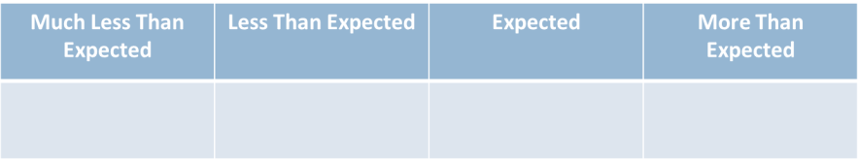
Student Learning Objective Process:
Scale Setting Practice
Think about what your expected outcomes are (targets).
Establish the ranges for each of the categories below.
How did you decide on the ranges?
Are your expectations rigorous, yet attainable?
Notes:
Use the handout to complete this activity.

Slide 41
Student Learning Targets and Scales:
Reflection on Pre and Post Data
  Performance Assessment/Portfolio Outcomes
  Reading Levels (beginning of the year)
  End of year cumulative exam
  Rubric results
+ | √ | √ | + | - | √ | √ | + | + | √ | √ | + | + | + | ₊ | - | √ | √ | + | √ | +
30 | 40 | 38 | 38 | 50 | 50 | 50 | 60 | 50 | 60 | 70 | 70 | 60 | 70 | 70 | 80 | 80 | 70 | 80 | 80 | 80
75 | 90 | 76 | 89 | 80 | 99 | 90 | 91 | 80 | 70 | 82 | 79 | 94 | 95 | 98 | 95 | 66 | 87 | 98 | 85 | 71
5 | 5 | 3 | 6 | 6 | 4 | 3 | 5 | 6 | 6 | 4 | 5 | 4 | 4 | 6 | 5 | 3 | 6 | 5 | 6 | 5
Notes:
Use this data to determine the attainment level of your student learning objective set during this activity. Did you get expected growth, less than expected growth, etc?

Slide 42
Student Learning Objective Process
THE PROCESS OF: Understanding the Colorado Academic Standards
THE PROCESS OF: Selecting Learning Outcomes for Target Setting
THE PROCESS OF: Procuring or Developing Assessments Using Quality Criteria
THE PROCESS OF: Collecting Baseline Information
THE PROCESS OF: Setting Student Learning Targets
THE PROCESS OF: Setting Appropriate Success Criteria for Measurement
THE PROCESS OF: Assessing Quality, Attainment Level and Rigor of Student Learning Targets and Success Criteria
Notes:
Assessing the quality, attainment level and rigor of student learning targets and Success Criteria is the next step. This can be a very formalized step that has been systemized (where educators will bring to their goal setting meeting their baseline information and the educator and evaluator will work together to collaboratively set a Student Learning objective) or a step that is a little looser with requirements (where the educators will collect their own baseline information, set their student learning objective and then bring that drafted SLO to the goal setting meeting). The next slide talks about some considerations.

Slide 43
Student Learning Objective Process
Determine Target and Success Criteria Quality
Will your district establish quality criteria for the use of Student Learning Targets and Success Criteria?
Criteria for establishing quality targets and success criteria might include:
  Approval processes
  Collaboratively established
  Level of attainment
  Rigor
  Based on previous data
  Meet or exceed past student performance
Notes:
These are points of consideration for schools and districts. Other states and districts across the country have established protocols and systems for this exact step.

Slide 44
Student Learning Objective Process
THE PROCESS OF: Understanding the Colorado Academic Standards
THE PROCESS OF: Selecting Learning Outcomes for Target Setting
THE PROCESS OF: Procuring or Developing Assessments Using Quality Criteria
THE PROCESS OF: Collecting Baseline Information
THE PROCESS OF: Setting Student Learning Targets
THE PROCESS OF: Setting Appropriate Success Criteria for Measurement
THE PROCESS OF: Assessing Quality, Attainment Level and Rigor of Student Learning Targets and Success Criteria
THE PROCESS OF: Monitoring Student Learning (Formative Practice)
Notes:
The next step in a Student Learning Objective Process involves monitoring student learning. This step closely aligns with the expectations set out in the teacher rubric on supporting students in their learning and adjusting instruction to meet the needs to students. This step should also allow educators to track student progress on meeting a Student Learning Objective set out by the teacher, that way the final score used in evaluation will not come as a surprise to the teacher.

Slide 45
Student Learning Objective Process
THE PROCESS OF: Understanding the Colorado Academic Standards
THE PROCESS OF: Selecting Learning Outcomes for Target Setting
THE PROCESS OF: Procuring or Developing Assessments Using Quality Criteria
THE PROCESS OF: Collecting Baseline Information
THE PROCESS OF: Setting Student Learning Targets
THE PROCESS OF: Setting Appropriate Success Criteria for Measurement
THE PROCESS OF: Assessing Quality, Attainment Level and Rigor of Student Learning Targets and Success Criteria
THE PROCESS OF: Monitoring Student Learning (Formative Practice)
THE PROCESS OF: Determining Attainment of Student Learning Targets and Success Criteria
Notes:
At the end of the school year or course, the teacher will want to collect the information necessary to determine the attainment level of a Student Learning objective. The next slide will provide the participants the opportunity to determine their attainment level using another set of data.

Slide 46
Student Learning Objective Process
THE PROCESS OF: Understanding the Colorado Academic Standards
THE PROCESS OF: Selecting Learning Outcomes for Target Setting
THE PROCESS OF: Procuring or Developing Assessments Using Quality Criteria
THE PROCESS OF: Collecting Baseline Information
THE PROCESS OF: Setting Student Learning Targets
THE PROCESS OF: Setting Appropriate Success Criteria for Measurement
THE PROCESS OF: Assessing Quality, Attainment Level and Rigor of Student Learning Targets and Success Criteria
THE PROCESS OF: Monitoring Student Learning (Formative Practice)
THE PROCESS OF: Determining Attainment of Student Learning Targets and Success Criteria
THE PROCESS OF: Reflecting and Refining Student Learning Objective Process
Notes:
Now that participants have gone through setting a student learning objective, what changes to their objective setting would they change or modify? Why would you make those modifications?

Slide 47
Considerations when Setting Student Learning Targets
Considerations when including a Student Learning Objective Process in evaluation:
  Assessment literacy of educators creating targets
  Data literacy of educators
  Time and effort required of teacher and evaluator
  Focus of school or district (all students and/or subgroups of students)
  Available information or data in school or district
  Ease or readiness level of teachers and evaluators
  Possible approval process of strategies selected
  Number of targets wanted as a district/building
Notes:
These are considerations for districts and schools to take into account when establishing their student learning objective process.

Slide 48
Student Learning Objective Process
Reflection
  What are the pros and cons of using a Student Learning Objective Process?
  What are teachers already doing to support process?
    Are there groups of teachers that already do something very similar to creating Student Learning Targets and Success Criteria?
  What additional ideas do you have for making a Student Learning Objective Process more manageable?
Notes:
Use these debriefing questions to guide the planning process at the local level.

Slide 49

Measures of Student Learning
Combine the results of multiple measures to get a single Measures of Student Learning rating.
Notes:
This step is aided by the Measures of Student Learning Tool on the third tab. If you have used this tool during training, you may have already worked through this step. The next slide provides a screenshot of what the final report might look like once data has been imported.

Slide 50
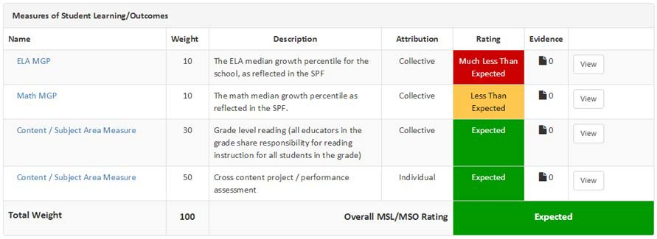
Combining Outcomes
Draft Example
Notes:
These are just sample reports. These may change as the system is finalized, but give a picture of how it might be calculated using the 540 scale.

Slide 51
Combining Outcomes
Measures/Results from Colorado Growth Model and Student Learning Objectives (SLO) | MSL Rating | Score Earned | Weight Assigned | Weighted Score
CMAS ELA –MGP (collective School) | Much Less than Expected | 0 | .10 | .00
CMAS MATH – MGP (Collective School) | Less than Expected | 1 | .10 | .10
SLO 1 Results (collective grade level reading) | Expected | 2 | .30 | .60
SLO 2 Results (individual teacher) | Expected | 2 | .50 | 1.00
Sum of Weights |  |  | 1 | 1.70

Slide 52
Decision Framework
Putting It All Together
  The Decision Framework helps districts aggregate the 50% Professional Practices and the 50% Measures of Student Learning to reach a final rating of one of the following:
    Highly Effective
    Effective
    Partially Effective
    Ineffective
  Both the MSL and PP scores are converted to a 540 scale and added together for a total of 1080 possible points.
Notes:
Please refer to the “Determining a final effectiveness rating” document for a more comprehensive explanation.

Slide 53
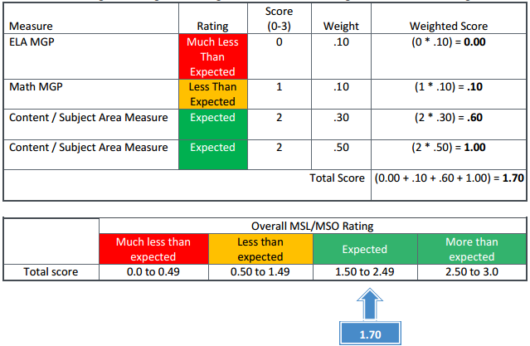
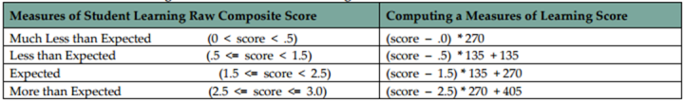
Measures/Results from Colorado Growth Model and Student Learning Objectives (SLO) | MSL Rating | Score Earned | Weight Assigned | Weighted Score
CMAS ELA –MGP (collective School) | Much Less than Expected | 0 | .10 | .00
CMAS MATH – MGP (Collective School) | Less than Expected | 1 | .10 | .10
SLO 1 Results (collective grade level reading) | Expected | 2 | .30 | .60
SLO 2 Results (individual teacher) | Expected | 2 | .50 | 1.00
Sum of Weights |  |  | 1 | 1.70
297

Slide 54
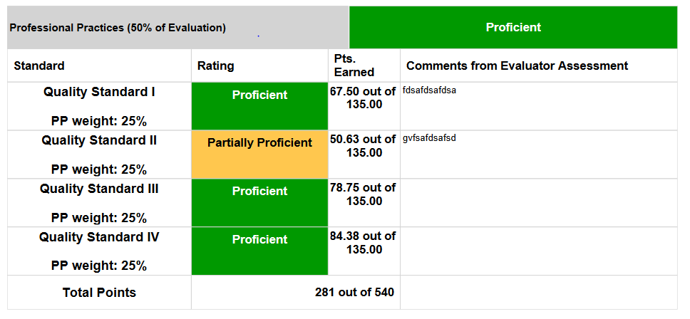
Notes:
Again, this is a sample report. The educator evaluation performance management system will do the behind-the-scenes calculation to generate this report. How might a report like this be helpful in having a conversation with a teacher about her practice?

Slide 55
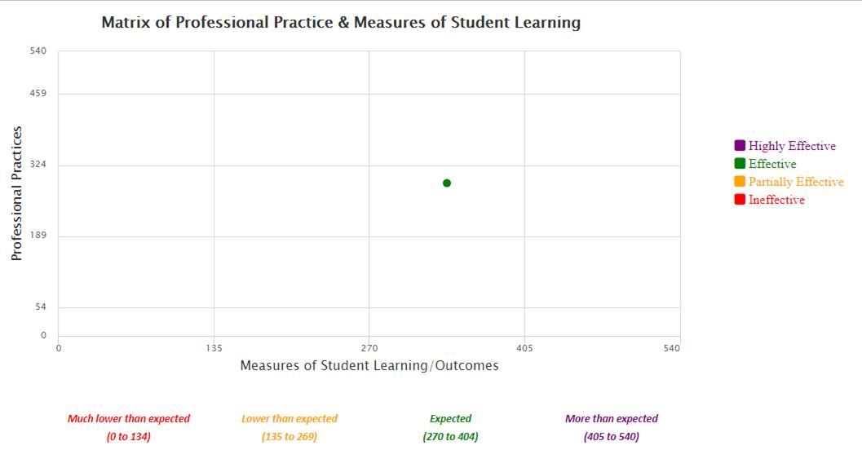

Slide 56
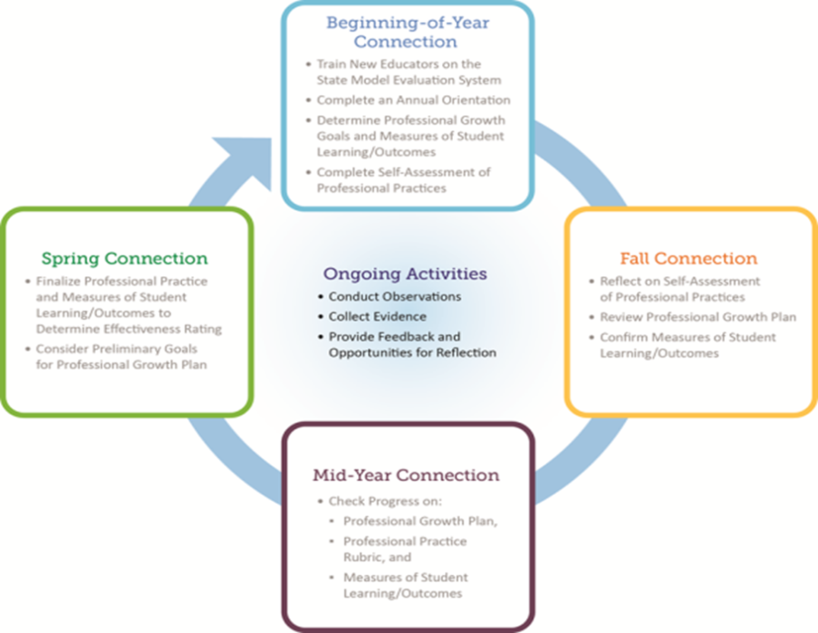
Evaluation Process
for
Teachers
Notes:
How will you implement the evaluation process to provide educators with growth producing feedback and support student learning?
How will you make overt connections between Measures of Student Learning and professional practices?

Slide 57

What are your next steps?
Consider decision points, priorities and what you value.
Identify next steps for your Performance Evaluation Committee.
Notes:
Where are you in this system development process and how will you move this work forward?

Slide 58
Let’s Get to Work!
CDE Educator Effectiveness website: http://www.cde.state.co.us/EducatorEffectiveness/
  FAQ’s, Fact Sheets
  Policy and State Model Evaluation System Info
  User’s Guide for MSL Support
CDE Educator Talent e-newsletter
  Sign up for the Educator Talent newsletter to stay informed
Notes:
We briefly spoke about the importance of words and key messages earlier today. As you go back to your districts and begin communicating and training staff on SB 191 and the State Model Evaluation System, HOW you present the information will be an important factor in how your audience reacts.
For example, take the following statement:
“We have to implement the new evaluation requirements called for in SB 191.”
Turn to a partner and quickly discuss how you can improve this statement using some of the key messages we’ve gone through today.
Brief share out. Looking for a new sentence like….
“We are improving how we evaluate and support educators in [district name] by implementing the State Model Evaluation System which will provide our educators with more meaningful feedback so they can continue to grow professionally and achieve maximum results with students.”
We’ve created several helpful resources to guide you in your next steps and future communication efforts.
HAND OUT 1-PAGER ON COMMUNICATIONS RESOURCES
This hand-out provides some of the key messages as well as links to several resources that you will definitely want to book-mark. For example, the “Communications Toolkit” on the Educator Effectiveness website (under resources) has everything from talking points to communications pitfalls to guidance on answering the tough questions that are sure to come up to drop-in articles that you can copy and paste and use for communications in your districts and schools.
You can also contact us any time for other specific needs… [transition to next slide].

Slide 59
Where are you now?
On the wall you will see a chart that will be used to capture everyone’s level of comfort and knowledge with Measures of Student Learning. Place a dot on the chart the best represents your level of comfort and knowledge now that we are near the end of the training.
Next
High Knowledge
Low Knowledge
Low Comfort
High Comfort
Notes:
This formative assessment if very helpful for trainers to know their impact on attendees. Participants will start the day charting where they currently sit with comfort and knowledge and will then return to this activity to re-chart their learning over the course of the training.

Slide 60
Feedback
Please take a few minutes to complete your feedback form.
Notes:
Don’t forget to get feedback on your training.

Slide 61

Contact Us
  http://www.cde.state.co.us/educatoreffectiveness/contactus

