Slide 1


Early Learning Needs Assessment
Preschool-Third Grade Office
School Improvement and Planning Office
Notes:
Speaker notes:
Good afternoon and welcome to the early learning needs assessment webinar.
My name is Megan Prior Rogers, and I am currently the Kindergarten School Readiness Consultant in the Preschool-3rd Grade Office.
My name is Susan Barrett, and I am a School Improvement Supervisor in the School Improvement and Planning Office
Our goals for our time together today are to
Acknowledge the current context of education and learning
Develop an awareness of what an early learning needs assessment is and may include
Connect this learning to school readiness in CO, the current educational context, and school improvement
Identify clear first steps
Throughout the session, we will pause and ask for your participation in reflection and application.
However, please feel free to post questions or comments in the chat at any time.
If you are not able to see the chat window, please hover over the bottom of your zoom screen and this should bring up a toolbar.
From the tool bar, you should be able to click on the chat button in the bottom center to open the chat window
Also know the mute and camera button are also located in this toolbar
If you need any technical assistance today, please feel free to chat us

Slide 2
Poll: Who's in the room?
What is your current role?
  Instruction and/or assessment
  School leadership
  District leadership
  Early childhood leadership
Temperature check
  Red: Stressed, overloaded, or on edge
  Orange: Juggling work and focusing only on top priorities.
  Yellow: Busy but managing okay.
  Green: Positive and balanced, ready to focus and be creative
  Blue: Sad, grief, fear, or loss of control
  Grey: Listless, unfulfilled, difficult to focus on anything
What is your level of familiarity with an early learning needs assessment?
  We regularly conduct an assessment within our community to understand the needs of our youngest learners and their families.
  We have completed an early learning needs assessment in the past, but do not do so regularly
  We have an interest in our community but are still gathering more information about what this might entail.
  I think it’s the name of this webinar?
Collective Impact Forum, 2020
Notes:
Speaker notes:
Now, let's hear from you and find out more about who is in the room

Slide 3
Current Context
Early Childhood is a priority across the state
  Full-day kindergarten
  Creation of a state Early Childhood agency
  Increase availability of high-quality pre-school
Enrollment
  The Colorado Preschool Program reported just under a 17% reduction in 2020 preschool enrollment compared to 2019 CPP enrollment.
  In 2020-2021, preschool special education enrollment decreased by 1,702 (-19%) children from the prior school year.
  Kindergarten enrollment decreased by 5,800 students (or 9.1%) in 2020, from 64,009 students in 2019 to 58,209 students in 2020.
Academic
  46% of first grade students assessed well below grade level benchmark on interim literacy assessments (ELAT) in Fall 2020; a 64% increase from 2019-2020.
Notes:
Speaker notes:
To begin, let's take a moment to acknowledge the current context of education and learning, especially in relation to school readiness and early learning.
Several key factors are influencing teaching and learning and have been over the course of the past year.
This is the statewide view and may or may not be a direct parallel to your district or school.
First, Early childhood is a priority in Colorado. We can see this in several key initiatives over the past several years, including
The establishment of full day kindergarten as an option to all families in CO
More recent legislation, includes the creation of a new Early Childhood state agency in CO.
Additionally, the increase in availability of high-quality preschool through universal prek as a result of Prop EE passing
In addition to early childhood being a current state priority, we also see the impact of the pandemic affecting our youngest children and their families, including
A decrease in enrollment in preschool and kindergarten. While enrollment across the state was lower during the 2020-2021 school year, preschool and kindergarten saw the greatest declines.
We also see a negative impact on some academic progress. Data from the early literacy assessment tool project indicated that the closure of in-person school during spring of 2020 negatively impacted literacy development in K-3.
For example, 46% of first graders, those in kindergarten during the statewide school closures of the spring of 2020, assessed well below grade level benchmarks on interim literacy assessments during the BOY assessment window.
We also see superintendents and school leaders identifying mental health as a top priority in elementary.
What does this context tell us:
It's a context of rapid change with significant importance
We also know we are at the doorstep of a new year, and we know and recognize the work you all are doing to support the youngest learners in your community as you begin.
Let's take a moment to pause, reflect and share.
In the chat is a link to a jamboard: https://jamboard.google.com/d/1G0L5_TvMk5BVM8v0b8u8QqflPpFcHT-TWxUI46boX9k/edit?usp=sharing
We will use the first 3 slides now to reflect on the following:
What are your hopes for your youngest learners?
What are you already doing to support your youngest learners?
What are the barriers to achieving your hopes?
Transition:
We cannot have the greatest impact on learning and development without greater partnership and collaboration in early learning
Change, or pivots, will continue.
Our hope is to clearly define system and community needs and to identify the most effective strategies with the greatest impact on our youngest learners and their families
To do this, we need a process to understand these needs within a complex and changing system

Slide 4
Assessing Needs within Early Learning
Quality
Community Collaboration
Transitions
Continuity of Learning
Notes:
Speaker notes:
The topic of today: assessing early learning needs within the context of school readiness
For the purpose of today, when we say early learning, we are thinking inclusively of children across early childhood and early elementary. A first step in your community may be defining early learning. This could be PreKindergarten or Preschool through 3rd grade. This could Birth or prenatal through 3rd grade.
What does this entail
Today, we will look at these 4 components relating to school readiness and early learning
--quality within early learning
--collaboration within the early learning community
--the experiences of children as they transition from one grade to the next, one school to the next, or between programs
--continuity of learning across early childhood
Let's take a look at the research base for these elements

Slide 5




Research Context
High quality programs produce high quality outcomes (Elango et al., 2016)
Collaborative community approaches strengthen positive outcomes for children and families (Heckman, 2015)
Effective transitions increase positive child outcomes (LoCasale-Crouch et al., 2008)
Continuity of learning ensures quality experiences every step of the way (NAESP, 2014)
Notes:
Speaker notes:
Research asserts the following 4 key aspects.
High quality programs produce high quality outcomes (Elandgo et al., 2016).
Children’s earliest experiences build brain architecture (Harvard CDC). These simple circuits provide the foundation for more complex circuits achieved through future learning. The early years create the building blocks for educational achievement. This is especially of interest now and over the next several years, as the experiences of young children have varied.
In addition, creating environments supportive of positive interactions with trusted adults in early childhood shape brain circuitry through the back and forth of responsive interactions, also called serve and return. These might include noticing and encouraging a child’s interest or naming a feeling or a new object.
Consistent, positive relationships with adults, caregivers and teachers, act as a buffer against toxic stress and support lifelong health.
When provided with intentional, engaging and responsive early experiences, children thrive. Lifelong, these outcomes include better education, employment, and economic productivity, responsible citizenship, strong communities, and successful parenting of the next generation. (Harvard CDC) (Heckman, 2016)
2) To achieve this for all children and families it takes a village. Collaborative approaches strengthen positive outcomes, layering supports for each child and family, to the benefit of all children. The Harvard’s Center on the Developing child identifies 3 principles to align policies and supports to science at both state and local levels. These include:
Ensuring supportive responsive relationships for children and adults.
Strengthening core life skills AND
Reducing sources of stress in the lives of children and families. (Harvard CDC)
3) When this collaboration includes district and community partners representing early learning, preschool through elementary, transitions between a child’s early experiences and entrance into Kindergarten or 1st grade becomes seamless. Multiple studies have found a positive correlation between the number of transition practices and positive student outcomes as students enter Kindergarten.
4) This connection and collaboration between programs and schools, leaders, teachers and service providers aides in providing continuity of learning as a child enters Kindergarten, 1st grade and beyond. As part of ready schools, leadership connects within the community, including preschool programming and EC services like migrant, or mental health to create a sense of belonging, shared leadership and responsibility toward the families and children within their community.
Engaging all members of a learning community in both the rationale and strategies for a connected and seamless learning experience for children, leads to local policies, regulations, and governance that’s representative of the needs and members of the community.
The analysis of an early learning needs assessment, as a part of continuous improvement, facilitates this by identifying quality of programming, identifying key programs and agencies, and additional community partners with whom to partner, so that intentional local efforts can increase effective transitions in support of strong local policies, regulations, and governance that’s representative of the community and leads to continuity of learning and ready schools.
Resource links:
https://heckmanequation.org/resource/early-childhood-education-quality-and-access-pay-off/
https://heckmanequation.org/resource/quality-early-childhood-education-enduring-benefits/ (heckman, 2015)
Harvard:
https://developingchild.harvard.edu/resources/three-early-childhood-development-principles-improve-child-family-outcomes/
https://developingchild.harvard.edu/resources/three-core-concepts-in-early-development/

Slide 6
Ready Child, Ready System
School readiness describes both the preparedness of a child to engage in and benefit from learning experiences, and the ability of a school to meet the needs of all students enrolled in publicly funded preschool or kindergarten. School readiness is enhanced when schools, families, and community service providers work collaboratively to ensure that every child is ready for higher levels of learning in academic content.
~State Board of Education, 2017
Notes:
Speaker notes
The intent is to increase school readiness and school performance. These same components work to fulfill Colorado's definition of school readiness.
This is accomplished by:
Forming or strengthening preschool and elementary partnerships
Assessing and prioritizing needs and taking collective action on strategies to effectively address these needs
Understanding the experiences of the child and family prior to and as they enter k or 1 to deepen understanding of the specific needs within the community
Connecting data across preschool-elementary and using this analysis to prepare ready schools
This is the context for an ELNA

Slide 7
Learning from Past Disruptions
Enrollment gradually increased.
As student’s enrolled, school readiness and learning varied beyond any one common factor creating a need to assess school readiness as students returned, and to continue assessing to inform instruction. This informed instruction prioritized individualized learning and emphasized social emotional learning and support.
With individualized learning, research suggests it took 2 years to resolve the greatest gaps in learning and development between a typical pre-disruption cohort and post-disruption cohorts.
Districts and schools who built and maintained strong partnerships with families, built schools back stronger.
Notes:
Speaker notes
Transition: So why now.
While research on the impact of previous disruptions to education does not provide a direct comparison on the impact of disruptions over the past year, researchers have studied similar aspects of past disruptions, such as hurricane Katrina, which suggest an opportunity for learning.
Here are key findings related to early learning
Enrollment gradually increased as students returned to school over periods of time.
As student’s enrolled, school readiness and learning varied beyond any one common factor creating a need to assess school readiness as students returned, and to continue assessing to inform instruction. This informed instruction prioritized individualized learning and emphasized social emotional learning and support.
With individualized learning, research suggests it took 2 years to resolve the greatest gaps in learning and development between a typical pre-disruption cohort and post-disruption cohorts.
Districts and schools who built and maintained strong partnerships with families, built schools back stronger.

Slide 8
Assessing Needs within Early Learning
Quality
Understanding the landscape of Birth-5 programming
Community Collaboration
Transitions
Continuity of Learning
Understanding the key factors impacting early elementary achievement, child and family outcomes as students move through the early childhood and early elementary
The relationship between elementary schools, early childhood programs and agencies within the community
Understanding the available and needed services for families within the community
Notes:
Speaker notes
Transition: we have looked at the research base in support of school readiness and early learning, the SBE's definition, and the urgency for why this is critical in the wake of disruptions to instruction and early learning experiences.
Let's take a look at a general overview of assessing early needs by digging into each of these research-based components.
Quality
The key to quality is understanding the landscape of early childhood, assessing the quality of experiences and programming in early childhood and elementary, and the accessibility to both.
Community Collaboration
Assessing the available and needed services for families within the community through a community needs analysis
Effective Transitions
This component leads to understanding the key factors impacting early elementary achievement, both child and family outcomes, as students move through early childhood and early elementary
Continuity of Learning
The strength of relationship between elementary schools, early childhood programs and agencies within the community as represented through MOU/agreement, joint PD and family engagement activities that lead to better aligned policies, curriculum, and experiences for families and children.
Each of these is grounded in a drive for continuous improvement and shared/distributed leadership and in existing system frameworks, such as MTSS, and a can be a part of existing teamwork.
So that we continue
to build high quality programming producing high quality outcomes,
build relationships and shared leadership throughout the community, and
strengthen partnerships as students transition into K to provide continuity of learning
Throughout all of this, there is an opportunity to collect and analyze both quantitative and qualitative data. Susan will walk us through that next.

Slide 9
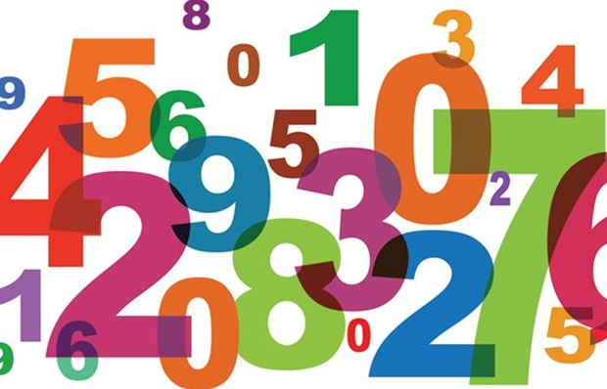

Assessing Needs within Early Learning
Quantitative Data can be counted or measured; it refers to numerical data
Qualitative Data is descriptive, referring to things that can be observed but not measured.
Examples of Common Quantitative Data
Assessment Data (e.g., Acadience)
Attendance Data (e.g., average daily attendance)
Examples of Common Qualitative Data
Observations (e.g., classroom observation)
Document review (e.g., curriculum audits)
Experiences (e.g., feedback from families)
Notes:
Speaker notes:
Quantitative Data can be counted or measured; it refers to numerical data
Qualitative Data is descriptive, referring to things that can be observed but not measured.

Slide 10
Early Learning Needs Assessment Minimum Requirements
Measures the extent to which:
Quality early childhood programs exist within a school’s or district’s geographic boundaries
K-3 teachers have EC teaching credentials
Students are enrolled in early childhood programs that receive either state funding (CPP/619) or School Readiness Quality Improvement funds prior to Kindergarten entry
A public school or district works with their local Early Childhood Council and other EC community Agencies
Availability of other Early Childhood Resources
A public school or district collaborates with EC programs on Preschool-Kindergarten transitions
Professional Development provides joint learning opportunities and collaboration between EC providers, teachers and principals
Family Engagement plans provide opportunities for Preschool-3rd grade
Notes:
Speaker notes
Additionally, to align to research, there are several minimum requirements
These provide a floor, but especially when considering continuous improvement, many other data sources could be included to provide a more robust analysis
EasyRetro: https://easyretro.io/publicboard/MO41P8BI0KZ7spaX0Szj8uqLk4O2/0b3c008b-69b5-4433-ae53-55e0c005542e

Slide 11

Districts and Schools
Schools
Elementary school on priority improvement or turnaround
Serve kindergarten through 3rd grade students
Districts
Includes a school on priority improvement or turnaround
Serve kindergarten through 3rd grade
Notes:
Speaker notes:
Schools:
Elementary school on priority improvement or turnaround
Serve kindergarten through 3rd grade students
Districts:
Includes a school on priority improvement or turnaround
Serve kindergarten through 3rd grade

Slide 12

Early Learning Needs Assessment
Schools with Priority Improvement Plan type
Summarizes findings from an ELNA that meets the minimum requirements
Commits to next steps based on the findings
Schools with Turnaround Plan type
Summarizes findings from an ELNA that meets the minimum requirements
AND
Includes a complete analysis of early elementary student achievement data.
Plan identifies appropriate research-based next steps to improve early childhood programs and partnerships.
Notes:
Speaker notes
While grounded in best practice and recommended for all schools and districts, an ELNA is also required for specific schools and districts.
Schools on priority improvement are to:
Schools on Turnaround are to:
Unique: District completes this analysis based on a school(s) plan type

Slide 13

Step by step process
Identify key partners
Reach out to other partners
Clear, common vision and priorities
Select evidence-based strategies
Gather data
Reflect on the process as well as the outcomes
Analyze data
Implement, checking for progress
Notes:
Speaker notes:
So now that we have a broad understanding of an early learning assessment as well as the minimum requirements. Let's take a look at this process, step by step
Identify key partners
Reach out to partners who are not already present
Revisit/create a clear, common vision and priorities
Gather data aligned with these priorities (and the minimum requirements)
Analyze data, use a PSP to identify top priorities and gather additional data as needed to clearly identify the problem
Select evidence-based strategies targeted at the identified problem
Implement, checking for progress
Reflect on the process as well as the outcome
It's important to differentiate between this data collection and the analysis.

Slide 14

Data Collection to Data Analysis
Possible early elementary student achievement data sources:
Kindergarten school readiness assessment data
READ Act interim assessments
Results Matter
Other local student data
Possible analysis:
Longitudinal analysis of student growth from PreK to CMAS
Analyzing the relationship between type of experiences prior to K, quality of program(s) as applicable, and k student entry data and/or growth.
Community needs assessment
This Photo by Unknown author is licensed under CC BY-ND.
Notes:
Speaker notes:
As we collect data, we collect data assessing each of the 4 main components.
During the analysis, we understand early elementary data in the context of the early learning needs assessment data.
That is, by collecting data describing the landscape of early learning, we understand the context in which the data story is set.
For example
As part of gathering data during our early learning needs assessment, we have identified the type of prior educational experiences of 75% of our kindergartners
Following our KSR and READ assessments in K, we can analyze the relationship between type of prior experience (district preschool program, community preschool program, licensed home care, informal care etc.), the quality of such programs as applicable, and K entry or growth data.
An additional example, going back to where we began today--the rate of identification in SPED in K and in Preschool. If we see a higher rate of identification in K than Preschool. We can use the context of the early learning needs assessment to better understand the need of key preschool programs and community agencies with whom to strengthen relationships, in addition to family engagement practices to more effectively identify strategies to reach and positively impact targeted children and families to provide access to early intervention.
While there are many ways to slice the data, the principle remains
First gather the data, then use it to support the analysis and clearly understand the problem

Slide 15
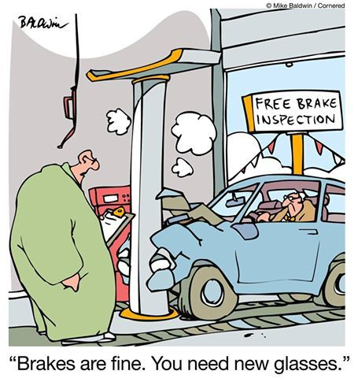
Data Collection to Data Analysis
Notes:
Speaker notes:
A clear sense of the need or problem, can also prevent this
Showing up at the car shop to fix our brakes, when it's our glasses that need replaced.
If your interested in possible approaches to understanding the problem, we will drop a link into the chat for more information: https://www.cde.state.co.us/uip/rootcauseanalysis

Slide 16
Research-based early learning and development strategies
May include:
Increasing the quality and availability of early learning and development programs for students who reside within the neighborhood of the public school
Increasing the resources available in kindergarten through third grade to improve school readiness and early learning such as additional highly-trained staff, training and coaching
Joint-professional development between early childhood and elementary teachers targeting specific, identified learning needs aligned with community goals
Collaboration across the early learning system to identify and reduce barriers to access for children and families.
Notes:
Speaker notes:
Following the analysis, we have a clear indication of need which guides selection of research-based strategies
Possible strategies may include these on the slide
However, the strategy must meet the need
Reviewing these strategies underscores the necessity of district involvement. Schools may not be able to apply these strategies in isolation. Additionally, currently most state-funded preschool (CPP and PSPED) is run at the district level.

Slide 17
ELNA in UIP terms
Prepare to Plan
With the early childhood administrator and other relevant stakeholders, identify and gather data using the P-3 Data Glossary and the School Data Source Guide.
Describe notable trends, prioritize performance challenges, and identify root causes.
Based on the performance trends in the context of your community, identify patterns where there is agreement on priority. Determine why the challenges are occurring within using demographic, process and perception data. Document this analysis.
Identify Major Improvement Strategies/Action Steps
Participate in identifying strategies for responding to identified root causes. Consider action steps that may focus on early learning within a broader school wide strategy.
Notes:
Speaker notes:
Prepare to Plan
With the early childhood administrator and other relevant stakeholders, identify and gather data using the P-3 Data Glossary and the School Data Source Guide.
Describe notable trends, prioritize performance challenges, and identify root causes.
Based on the performance trends in the context of your community, identify patterns where there is agreement on priority. Determine why the challenges are occurring within using demographic, process and perception data. Document this analysis.
Identify Major Improvement Strategies/Action Steps
Participate in identifying strategies for responding to identified root causes. Consider action steps that may focus on early learning within a broader school wide strategy.

Slide 18

Roadmap
What’s feasible now?
  Partner with those with whom you have existing relationships
  Use data you currently collect and have access to
  Analyze early elementary data within the context of available early learning needs assessment data
  Identify action step(s) to guide next year's actions
Notes:
Speaker notes:
What’s feasible now?
Partner with those with whom you have existing relationships
Use data you currently collect and have access to
Analyze early elementary data within the context of available early learning needs assessment data
Identify action step(s) to guide next year's actions

Slide 19

Focused future steps
Focused future steps:
  Identify and reach out to new critical partners using feeder pattern and community needs assessment data
  Build out processes to capture additional data not currently collected
  Adapt current data system(s) to increase automaticity of collecting early learning needs assessment information to switch focus on analysis and shared action.
Notes:
Speaker notes:
Focused future steps:
Identify and reach out to new critical partners using feeder pattern and community needs assessment data
Build out processes to capture additional data not currently collected
Adapt current data system(s) to increase automaticity of collecting early learning needs assessment information to switch focus on analysis and shared action.

Slide 20
Available Resources
Improvement Planning and Early Learning webpage
  Embedding early learning data sources in UIP
Early Learning Needs Assessment Data Sources Guide
P-3 Glossary
CDE Staff:
  Susan Barrett: barrett_s@cde.state.co.us
  Megan Prior Rogers: rogers_m@cde.state.co.us
  Heidi White: white_h@cde.state.co.us
Notes:
Speaker notes:
Improvement Planning and Early Learning webpage
https://www.cde.state.co.us/early/elna
Early Learning Needs Assessment Data Sources Guide
https://www.cde.state.co.us/early/elnadatasourceaguide
P-3 Glossary
https://www.cde.state.co.us/early/p3glossary

Slide 21
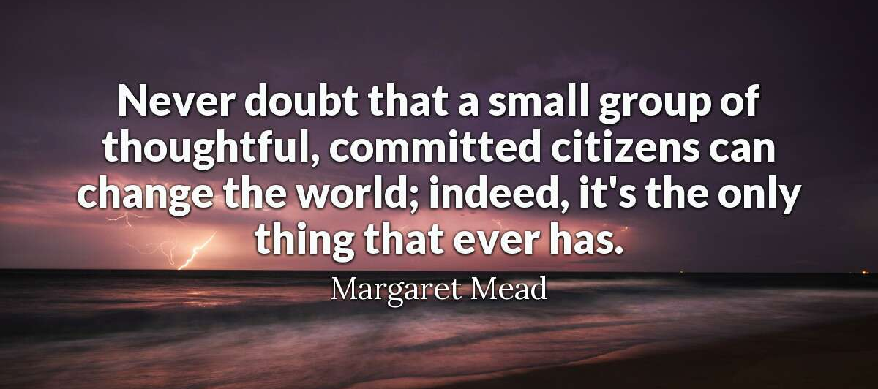
Thank you
Notes:
Speaker notes:
Margaret Mead quote:
Never doubt that a small group of thoughtful, committed citizens can change the world; indeed, it’s the only thing that ever has.

