Slide 1
Overview: Every Student Succeeds Act (ESSA) in Colorado
McKinney-Vento Education of Homeless Children and Youth Program District Training & Sub-grantee Meeting Tuesday, October 4, 2016

Slide 2
Context
Reauthorization of ESEA – Every Student Succeeds Act (ESSA)
Signed into Federal law on December 10, 2015
Defines the civil rights of children within the context of education
Replaces the No Child Left Behind Act
Replaces ESEA Flex Waiver expired August 1st – largely used state laws to meet federal requirements
ESSA establishes broad policy requirements for states and school districts:
Academic Standards
Aligned Assessments
School Accountability
School Improvement
Teacher Quality
Creates programs and provides funding to support state and local implementation of the requirements

Slide 3
Timeline Overview
To receive ESSA funds, Colorado must submit – and receive approval of - an ESSA state plan by March 6, 2017.

Slide 4
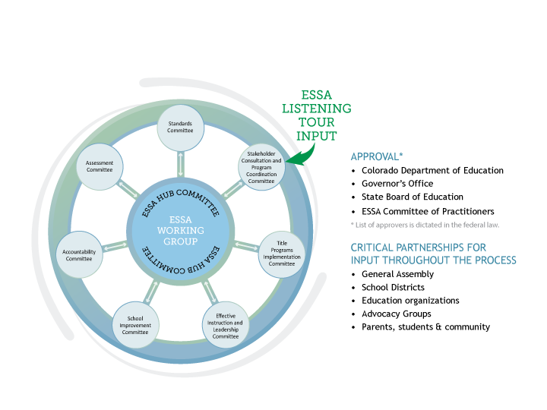
ESSA State Plan Development
Notes:
Under the guidance of the State Board of Education, the Colorado Department of Education (CDE) will utilize a Hub/Spoke Committee structure for ESSA state plan development.
A formal, central Hub Committee that will have an oversight role in the development of a draft of our state plan to be submitted to the State Board in early 2017.
ESSA topical spoke committees will be responsible for developing and appropriately vetting sections of the state plan.
Spoke committees
Standards Committee
Assessment Committee
Accountability Committee
Effective Instruction and Leadership Committee
School Improvement Committee
Title Program Plans/Assurances Committee
Stakeholder Consultation/Program Coordination Committee
Spoke committee membership and meeting process
2-3 CDE Leads identified in mid-July. Leads are responsible for keeping the work on track, acting as subject area experts, maintaining records and assignments, organizing spoke work and meetings, and submitting final drafts and decisions points to the Hub.
CDE has a number of existing stakeholder and committee groups that will be called upon as part of this process. For example, the ESEA Committee of Practitioners will be the foundation of the Title Programs group, but we will supplement membership wherever possible and feasible.
Spoke leads are still developing materials; organizing the committee work and schedule; and crafting a work plan timeline. As a result, some committees are closer to finalizing membership than others and it may take some time to completely finalize spoke committee membership. We will make every effort to include all interested applicants and we ask for your patience as we take the time to be as inclusive as possible.

Slide 5
Charge for the Hub
Acting in an advisory capacity to the Department, oversee Colorado’s process of ESSA state plan development.
The purpose of this committee is to deliver to the State Board of Education a draft of Colorado’s ESSA plan that reflects the final consensus of the committee, the constituencies the members represent, and is in alignment with the vision of the State Board.

Slide 6
Spoke Committees
Charge of spoke committees:
Review ESSA requirements and regulations, existing Colorado state law and rules, and ESSA Listening Tour and other stakeholder feedback to:
Draft, review, and revise sections of Colorado’s ESSA State Plan;
Provide recommendations on content specific decision points
Identify possible areas for additional flexibility in state legislation
Propose responses to and provide justifications for decisions made concerning stakeholder feedback; and,
Present and submit draft sections, recommendations, and summaries of the ESSA state plan work to the Hub committee.
Notes:
Two to three spokes will present at each hub committee meeting to cover decision points, update on draft progress, and summarize stakeholder feedback. The Hub will be asked to weigh in on decisions points and provide input and feedback on process and direction of work.

Slide 7
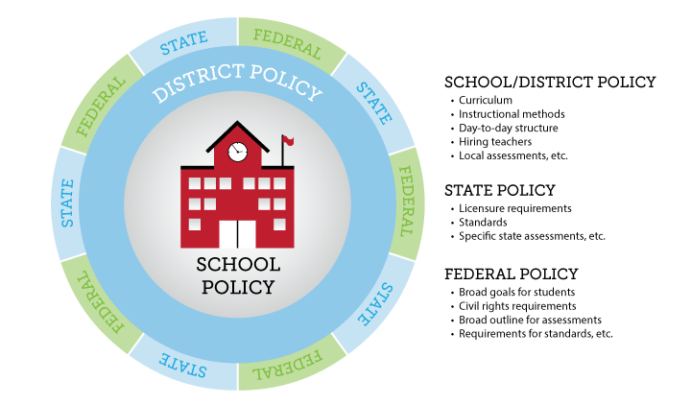
Interaction of State and Federal Education Laws

Slide 8
ESSA State Plan Requirements and Decision Points

Slide 9
State Plan Requirements
Pursuant to proposed USDE regulations, the ESSA state plan components will be:
Consultation and Coordination
Challenging Academic Standards
Assessments
Accountability, Support
Improvement for Schools
Supporting Excellent Educators
Supporting All Students
Notes:
Note alignment with the spoke committees (AP)

Slide 10
Programs to be included in the Colorado’s ESSA State Plan
Title I, Part A: Improving Basic Programs Operated by State and Local Educational Agencies
Title I, Part B, Section 1201: Grants for State Assessments and Related Activities
Title I, Part C: Education of Migratory Children
Title I, Part D: Prevention and Intervention Programs for Children and Youth Who Are Neglected, Delinquent, or At-Risk
Title II, Part A: Supporting Effective Instruction
Title III, Part A: Language Instruction for English Learners and Migrant Students
Title IV, Part A: Student Support and Academic Enrichment Grants
Title IV, Part B: 21st Century Community Learning Centers
Title V, Part B, Subpart 2: Rural and Low-Income School Program
Title VII, Subpart B of the McKinney Vento-Homeless Assistance Act: Education for Homeless Children and Youths

Slide 11
Stakeholder Consultation Requirements
Plan must be developed by the SEA with meaningful consultation with the Governor, members of the State legislature, the State board of education, LEAs, representatives of Indian tribes (in CO), teachers, principals, other school leaders, charter school leaders, specialized instructional support personnel, paraprofessionals, administrators, other staff, and parents.

Slide 12
SEA Plan Coordination
Plan must be coordinated with:
other programs under this Act,
the IDEA,
the Rehabilitation Act of 1973,
the Carl D. Perkins CTE Act of 2006,
the Workforce Innovation and Opportunity Act,
the Head Start Act,
the Child Care and Development Block Grant of 1990,
the Education Sciences Reform Act of 2002,
the Education Technical Assistance Act of 2002,
the National Assessment of Educational Progress Authorization Act,
the McKinney-Vento Homeless Assistance Act, and
the Adult Education and Family Literacy Act.

Slide 13
Standards Requirements
ESSA Requirements:
Challenging statewide standards in math, reading or language arts, and science
Aligned with higher education and CTE expectations
Alternate achievement standards for students with the most significant cognitive disabilities
Standards for English-language proficiency
Colorado Requirements:
Colorado Academic Standards include 10 content areas:
Dance, drama, music, visuals arts, theater arts, social studies, physical education, and world languages
Colorado Academic Standards must be reviewed by July 2018
11
Notes:
The Secretary cannot:
Require a state to submit its standards for review.
In any way mandate, direct or coerce, or exercise any control or supervision over state standards.
ESSA Requirements:
Challenging statewide standards in math, reading or language arts, and science.
Aligned with higher education and career and technical education standards.
Alternate achievement standards for students with the most significant cognitive disabilities.
Standards for English-language proficiency that address speaking, listening, reading, and writing - aligned with the state’s academic standards.
Colorado Requirements:
In addition to the standards required by ESSA, Colorado has standards for dance, drama, music, visuals arts, theater arts, social studies, physical education, and world languages.
SB 08-212 provides for the regular review of the Colorado Academic Standards. The first review and revision cycle is set to conclude by July, 2018.
CDE will disseminate an outline of the timeline and review process in fall, 2016.
1% state cap for alternate assessments. No cap for districts but if they exceed 1% they have to justify it.

Slide 14
Assessment Requirements
ESSA Requirements:
Math and English language arts in grades 3-8 and once in high school
Science once each in elementary, middle and high school
Alternate assessments
English language proficiency assessments
Differing Colorado Requirements:
Three high school assessments: (9th grade ELA/math, PSAT and SAT)
Social studies assessments once each in elementary, middle and high school on a sampling basis
Assessment Flexibility Under ESSA
12
Notes:
Science in grades 3-5, 6-9 and 10-12
Nationally recognized assessment at HS- check in regs
Assessments aligned to the standards
Mathematics and Reading or English language arts in grades 3-8 and once in high school (9-12);
Science once each in elementary, middle and high school grades
Alternate assessments
English language proficiency assessments
Permits states to administer assessments as a single test or as a set of interim tests that can be rolled up into a single annual result for each student.
Includes assessment pilot opportunity – 7 states or 4 consortia – explore other assessments that can be used to in state’s accountability system
Up to 7 states or 4 state consortia may participate in the pilot.
States must submit an application that -
Demonstrates the proposed system is reliable, valid, and meets requirements.
Includes a description of how the state will phase-in the new system.
Includes a description of how students will receive the instructional support needed to meet the state’s aligned standards
Includes the criteria used for LEA participation and a description of the participating LEAs.
State statute requires the same assessments, and in addition includes other HS and social studies assessments.
ACCESS for Els
Colorado Spanish Language Assessments (CSLA) - 3rd and 4th grade, bilingual programs, in US less than 3 years, reading and writing
COAlt DLM and COAlt science (Pearson)

Slide 15
Accountability Requirements
ESSA Requirements
Indicators
Achievement on state tests (overall & disaggregated)*
Growth on state tests (overall & disaggregated)*
Graduation rates (overall & disaggregated)*
English language proficiency of English learners*
Other School Quality and Student Success (overall & disaggregated)
Valid, reliable, same state-wide and differentiates performance
95 percent participation requirement
* Colorado Requirements
13
Notes:
Each state is required to develop a school accountability system that includes:
School ratings
Supports and interventions
What indicators/data are we required to use/do use in annually assessing the performance and progress of schools?
Making progress in achieving English language proficiency.
Other System Quality Indicator (overall & disaggregated)
Elementary and Middle- Student engagement, educator engagement, access to and completion of advanced coursework, post-secondary readiness, school climate/safety, or other.
High schools- measure of opportunity to learn
Combined “academic indicators” have to count “much more”
‘‘(2) SUBGROUP OF STUDENTS.—
In this subsection and subsection (d), the term ‘subgroup of students’ means—
‘‘(A) economically disadvantaged students;
‘‘(B) students from major racial and ethnic groups;
‘‘(C) children with disabilities; and
‘‘(D) English learners.
How is ESSA different than NLCB, the waiver? No AYP, no requirement to assess district performance. From priority and focus schools to comprehensive and targeted schools.
Colorado’s system of school and district frameworks
UIP plan type assignments
Colorado’s accountability clock

Slide 16
Accountability Decision Points
English learner progress measure(s)
“Other indicator” of school quality or student success
Participation requirements
Long-term goals and interim measures
N size and reporting rules
Method for identifying comprehensive and targeted support schools
English learner assessment policy (1st year in US) (shared with assessment spoke)

Slide 17
Participation Requirements
Colorado’s ESSA state plan must provide a clear and understandable explanation of how the state will factor in 95% participation into our statewide accountability system.
ESSA requires 95% of students to be assessed
Impact on accountability and achievement calculations
State law requires districts to have policies in place for notifying parents of the option to excuse their students from testing and procedures for parents to do so.
The State Board of Education passed a resolution prohibiting schools and districts from being held liable for parents choosing to excuse their students from testing.
Funding is not withheld, no lowering of school or district rating
15
Notes:
Please note that some responses suggested changes to assessments, such as relying solely on local tests, that are unallowable in ESSA.

Slide 18
School Improvement Spoke Decision Points
SEA supports for identified schools
Definitions, timelines, interventions, and supports
Comprehensive Support Schools
Targeted Support Schools
Allocation of School Improvement resources
CDE must reserve 7% of the state Title I allocation to support identified schools
Formula v. Competitive
Direct services to districts with identified schools
Identify and define “evidence-based” interventions
Definition
List of approved interventions?

Slide 20
Title I School Improvement Set-Aside
7 % Must be set aside to support schools identified for ESEA School Improvement.
Eligibility for access to set aside
Lowest 5% of Title I schools in the state
High Schools with grad rate less than 67%
Schools with underperforming Subgroups
Estimated ~ $10,500,000
95% of set-aside must go to LEAs with identified schools
SEA must
Prioritize LEAs with large numbers of identified schools
Take into account the geographic diversity of the LEAs in the state
Decision Points
Award funds by formula?
Award funds competitively (as under NCLB)?
Hybrid (formula and competitive)?
Should SEA retain funds a portion of the 7% to provide direct services to districts with identified schools?

Slide 21
Effective Instruction and Leadership Decision Points
ESSA eliminates “highly qualified teacher” requirement from No Child Left Behind
Teachers must meet state licensure requirements
Report data on the professional qualifications of teachers
Whether low-income and minority students are being served at disproportionate rates by “ineffective, out-of-field, or inexperienced teacher”
ESSA gives states discretion to define the following terms:
Effective/ineffective teacher (defined in Colorado statute – SB191)
Qualified/unqualified teacher (defined in Colorado statute - licensure)
In/Out-of-field teacher (this may be defined in Colorado statute)

Slide 22
Effective Instruction and Leadership – Decision Points
States must adopt uniform statewide definitions of the terms:
“inexperienced”
“not teaching in the subject or field for which the teacher is certified or licensed.”
What supports should CDE provide to improve the skills of teachers, principals, or other school leaders in order to enable them to identify students with specific learning needs?
What should CDE do to improve preparation programs and strengthen support for teachers?
How should CDE support or promote equitable access to experienced, qualified, and effective teachers?

Slide 23
Title Programs Decision points
Process to collect Local Educational Agency (LEA) plan requirements as described in ESSA
CDE must have an LEA plan on file, content defined in statute
Multi year plan?
How best to incorporate new grants and newly allowable activities?
How best to collect plans as part of the Consolidated Application?
Relationship to UIP
States may reserve up to 3% of their Title I, Part A allocation for grants in support of direct student services - should CDE reserve an additional 3%?
Requires the State to establish and implement standardized statewide criteria for entrance and exiting of English language development programs*
*Colorado issues entrance and exit criteria through guidance

Slide 24
Optional 3% Set-Aside
SEAs may, after consultation with stakeholders, withhold an additional 3% for Direct Services to students.
Estimated ~ $4,500,000
99% of set-aside must go to LEAs with low performing schools
HS student supports, such as:
GED
Concurrent enrollment
Credit recovery
After school tutoring
Title I School Choice options
Decision Point
Should CDE retain an additional 3% of Title I funds to LEAs to provide direct services to students in low performing schools?

Slide 25
As Part of the ESSA State Plan…
Each SEA must describe:
Its system of performance management for implementation of State and LEA plans regarding supporting all students, including homeless, migrant, economically disadvantaged, racial and ethnic groups, English learners, students with disabilities, etc.
The description of an SEA’s performance management system must include information on the SEA’s review and approval of LEA plans, collection and use of data, monitoring, continuous improvement, and technical assistance. The description must include strategies, rationale, and timelines.

Slide 26
LEA Plan Requirements and Homeless Children and Children in Foster Care

Slide 27
Local Educational Agency (LEA) Plan
CDE is currently seeking input regarding the LEA plan requirements for all Title programs.
Title IA:
Draft: Question for services to homeless children
How will the LEA provide services to homeless children and youths, including with funds reserved under section 1113(c)(3)(A), to support the enrollment, attendance, and success of homeless children and youths, in coordination with the services the local educational agency is providing under the McKinney-Vento Homeless Assistance Act (42 U.S.C. 11301 et seq.)?

Slide 28
LEA plan Considerations (Draft)
1113(c)(3)(A) states that an LEA shall reserve such funds as are necessary to provide services comparable to those provided to children in Title I schools to serve:
Homeless children and youths, including providing educationally related support services to children in shelters and other locations where children may live;
Local plans should describe:
The method used for determined the amount of funds reserved for students experiencing homelessness;
How the amount was determined; and
How the liaison was involved in determining the amount.

Slide 29
Students in Foster Care and ESSA
State plans must include assurances that foster youth be enrolled or remain enrolled in their school of origin, unless there is a determination that it is not in their best interest to do so.
Annual state report cards must contain information on student achievement and graduation rates for foster youth

Slide 30
Next steps
CDE will submit our LEA level plan requirements as part of ESSA state plan.
LEA Plan requirements
Program Review process (monitoring)
Capacity building
October: Continue to work with internal and external stakeholders on plan requirements
Draft by Nov. 2016 to present to HUB and the State Board of Education

Slide 31
Questions?

Slide 32
ESSA… Continuing the Conversation
Additional Resources
ESSA in Colorado blog
http://www.cde.state.co.us/fedprograms/ESSABlog
ESSA Mailbox
essaquestions@cde.state.co.us
ESSA Webpage
http://www.cde.state.co.us/fedprograms/essa
ESSA in Colorado e-newsletter
ESSA Hub and Spoke Committees
http://www.cde.state.co.us/fedprograms/essa_stateplandevelopment

