Slide 1
Unaccompanied Homeless Youth & Transitions into Higher Education
Dana Scott, State Coordinator Education of Homeless Children and Youth
Paula Gumina, Program Specialist
March 13, 2015

Slide 2
Today’s Agenda
Northeast Colorado and Homelessness
Definitions and the Law
Watching for the Signs
Overcoming Barriers
Partners in K-12
Questions and Answers

Slide 3
Homelessness at a Glance
March 13, 2015

Slide 4
A National Perspective
In the 2012-2013 school year, 1,258,182 homeless children and youth were reported as enrolled in U.S. Public Schools
2/3 of homeless adults do not have a high school diploma or GED
10% of all children living in poverty are homeless
Source: National Center for Homeless Education http://center.serve.org/nche/ and National Association for the Education for Homeless Children and Youth www.naehcy.org
Notes:
To offer some national perspective, just over 1.2 million children and youth were identified as McKinney eligible in US Public schools. Visually, that is equivalent to filling Mile High Stadium almost 17 times.

Slide 5
Homelessness in Colorado
24, 062 Homeless Children and Youth were enrolled in Colorado Schools in the 2013-14 school year
Just over 8% represents Unaccompanied Homeless Youth
1,828 Homeless Children and Youth were enrolled in C-BOCES and Greeley schools in the 2013-14 school year
Nearly 10% were reported as Unaccompanied Homeless Youth

Slide 6
Postsecondary Workforce Readiness
Jobs requiring additional training beyond high school are growing three time as fast as jobs requiring only a high school diploma
In 2020, 74% of all jobs in Colorado will require education beyond high school
Raising the bar for all students

Slide 7
McKinney Vento Overview Main Themes
Support for Academic Success
School Stability
Educational Access
Notes:
The overall theme of MV is to protect basic educational rights in order to access, attend and succeed in K-12 education. We mark success in a number of ways throughout the educational journey of a student however success for students in crisis means breaking that cycle of poverty.

Slide 8
“I knew that I didn’t want to be homeless for the rest of my life, and I saw education as the sure path to a more secure future. Hard work does not intimidate; a vacuous future does. To succeed in college is to succeed in life, and never again have to live the way I am living now.”
- Ashleigh, 2005 LeTendre Scholar and Formerly Homeless Student
Notes:
As a student’s level of education increases so does the prospect of financial stability. A college degree represents an opportunity to a homeless youth to break the cycle of poverty.

Slide 9
McKinney-Vento Homeless Education Act Title X, Part C ESEA
Ensures the Educational Rights to Children and Youth Living in Transition:
A Homeless Education Liaison in every school district
Right to immediate enrollment
Choose between the neighborhood school, the school last enrolled or attended (school of origin)
Transportation to the school of origin
Immediately receive free school meals and access to other school resources
Automatic eligibility for Title IA of the Elementary and Secondary Education Act
Notes:
Even if student cannot produce required documents
Includes extra curricular activities
School of origin = best interest of the student
Automatically enrolled in FRL

Slide 10
Responsibilities of Local Liaisons
Identification;
Enrollment;
Community connections and referrals for eligible services;
Parent and Family Engagement and involvement;
Education and advertisement of the educational rights of Homeless children and youth;
Dispute management;
Transportation services, including transportation to the school of origin.
Notes:
Liaisons, will offer their daily roles and responsbilities.

Slide 11
Unaccompanied Homeless Youth(UHY) Transition into Higher Education
College Cost Reduction and Access Act of 2007
Verification is not required for Unaccompanied Homeless Youth
Financial Aid Administrators and Homeless Education Liaisons can verify
Colorado Taskforce on Higher Education for Unaccompanied Homeless Youth
Single Point Of Contact (SPOC) Model
Streamlined Processes/Services
Storage of Important Documents for Students
UHY Verification One-pager
Notes:
In September of 2007, President Bush signed into law the College Cost Reduction and Access Act of 2007
Included within this legislation are amendments to expand the definition of independent student in FAFSA to include:
(1) unaccompanied homeless youth;
(2) youth who are in foster care at any time after the age of 13 or older, and;
(3) youth who are emancipated minors or are in legal guardianships as determined by an appropriate court in the individual's state of residence.
Sample verification template at www.naehcy.org

Slide 12
Definitions
March 13, 2015

Slide 13
Homeless
Homeless = Lacking a primary nighttime residence that is:
Fixed: Stationary, permanent, no subject to change
Regular: Used on a predictable, routine or consistent basis
AND
Adequate: Sufficient for meeting both physical and psychological needs
Chapter 5: Special Cases AVG-127

Slide 14
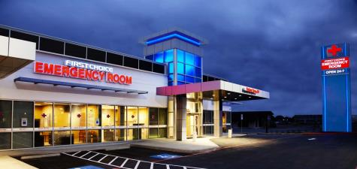
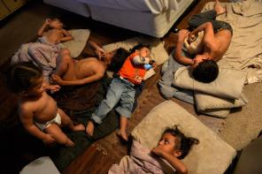
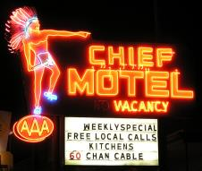
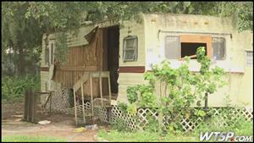
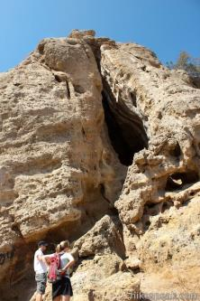
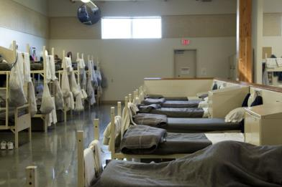

Slide 15
Homeless Youth
Homeless when not living in student housing
Fleeing an abusive parent and living in a homeless situation, even if their parents would provide a place to live
At risk of being homeless
Notes:
Sample questions you can ask: SPOC Tip Sheet Page Four.

Slide 16
Unaccompanied
Not in the physical custody of a parent or guardian
Whether asked or chose to leave
Can be in legal custody of a parent/guardian, but must be living apart
May have periodic contact with parents/guardians but not supported
No lower age limit
Upper age limit = 21 years old

Slide 17
How do youth become unaccompanied?
Family dysfunction
Parental drug use/alcoholism
Conflicts with stepparents/partners
Disapproval of pregnancy or sexual orientation
Safety/well-being at risk
20-50% were sexually abused in their homes
40-60% were physically abused
Notes:
A California survey tells us that over ½ of unaccompanied homeless youth reported they felt more safe being homeless than living at home.

Slide 18
Youth
21 or younger, or
Still enrolled in high school as of the date he/she signs the Free Application for Federal Student Aid (FAFSA)
For FAFSA: Older than 21 and not yet 24 and who are unaccompanied and homeless or self-supporting and at risk of being homeless qualify for a dependency override.
Chapter 5: Special Cases AVG-124

Slide 19
Signs of Homelessness
Lack of continuity in education
Difficulties in school
Paperwork and documentation challenges
Social and behavioral concerns
Poor health/nutrition
Lack of support system
Statements by the student
http://www.naehcy.org/sites/default/files/dl/toolkit.pdf

Slide 20
Barriers to College Access
Lack of support from an adult
Difficulty paying fees
FAFSA completion
Lack of full tuition financial aid package
Payment of expenses without the
assistance of financial aid
Lack of information regarding supports
and services available to them

Slide 21
Barriers to College Success
Continued lack of support from an adult
Mental health issues
Insufficient academic supports
Insufficient services for housing, transportation etc.
Difficulty balancing school with other life demands

Slide 22
Partners in K-12
Recommended Practices: Working with Unaccompanied Homeless Youth
Local resources
How Homeless Education Liaisons can help you

Slide 23
Family Tree’s Higher Education Fund for Homeless Youth
One-time fund
Help purchase necessary school items
Maximum $100/ Western Union Gift Card
SPOCs complete and submit the application www.thefamilytree.org/spoc
Allowable items:
School Supplies
Student ID’s
Vital Documents
Sheet Sets
Hygiene Items
Basic Need Items

Slide 24
Scholarships for UHY
LeTendre Scholarship - $2,000 - students who are/have been homeless during K-12 – average/higher academic achievement
Horatio Alger Colorado Scholarship Program – Colorado residents -exhibited integrity/perseverance in overcoming personal adversity
College Access Scholarship
Fastweb
College Board

Slide 25
Your Handouts:
Tip Sheet
Memo on Homeless Definition
Updated AVG
SPOC list for Colorado
PowerPoint

Slide 26
Contacts
Paula Gumina, Program Specialist
P 303.908.3148
Gumina_p@cde.state.co.us
Dana Scott State Coordinator for the Education of Homeless Children and Youth
P 303.866.6930 scott_d@cde.state.co.us

Slide 27
National Contacts
Cyekeia Lee, Director of Higher Education Initiatives
National Association for the Education of Homeless Children and Youth
Email: clee@naehcy.org www.naehcy.org
Toll-free helpline: (855)-446-2673 highered@naehcy.org

Slide 28
Web Resources
Colorado Department of Education
http://www.cde.state.co.us/dropoutprevention/homeless_highered
National Center on Homeless Education
http://center.serve.org/nche/
National Association for the Education of Homeless Children and Youth
http://www.naehcy.org/
National Law Center on Homelessness and Poverty
http://www.nlchp.org/

Slide 29
Questions
March 13, 2015

Slide 30
Thank you!
March 13, 2015

Slide 31
Citations
Images accessed through a Google Image search
http://www.sjsu.edu/faculty/wooda/motel/colorado/
http://www.fcer.com/locations/san-antonio/northeast-san-antonio
http://goodmenproject.com/good-feed-blog/colorado-proves-housing-the-homeless-is-cheaper-than-leaving-them-on-the-streets/
http://www.hikingintherockies.com/hiking/hike%20reports/williams_canyon/williams_canyon.htm
http://www.tellercountycolorado.com/index.php?page=tent-camping
http://host-46.242.54.159.gannett.com/news/article/267249/8/Mobile-home-park-residents-left-in-lurch
Amon, Joe Trying to Live, Trying to Learn The Denver Post August 20, 2014
http://www.denverpost.com/specialreports/ci_26373110/coming-friday-trying-live-trying-learn?source=infinite

