Slide 1
Teacher Student Data Link (TSDL) Interchange and Snapshot

Slide 2
Agenda
TSDL Interchange
Overview
Interchange Process
Data Uses
Populate CRDC
Migrant Student Reporting
Course Participation Reports
Educator Preparation Program Report
General
Authority to Collect
Timeline
Overall Process
Resources
Online
Contacts
Resources
2023-2024 Steps

Slide 3
General Information

Slide 4
Authority To Collect
Derived from both Colorado Revised Statutes (C.R.S) and the Colorado State Board of Education’s rules:
Concerning Statutory Changes to K-12 Education, House Bill 13-12-19: 22-2-116.5
Course Participation and Student Proficiency Reports, House Bill 14-1376: 22-11-503.5
Monitoring of Written Evaluation System, C.R.S. 22-9-106 (1.5) (a-b)
Rules for administration of a statewide system to evaluate the effectiveness of licensed personnel employed by school districts and boards of cooperative services 1 CCR 301-87(6.04) (i), (A), (C) (2) (b, d, and e), and (C) (3) (a).
Commissioner Duties - reviewing the content of educator preparation programs in Colorado, C.R.S. 22-2-112 (p-q); Commission directive--approval of educator preparation programs—review, C.R.S. 23-1-121 (6)

Slide 5
Overall Process
TSDL Interchange
Create and upload data files
TSDL Snapshot
Create Snapshot Linking Instructors to Students by Course
Review Reports
Finalize Data
CDE Reports
Pre-populate CRDC
Migrant Student Reporting
Course Participation Reports
Educator Preparation Program Report

Slide 6
TSDL Timeline

Slide 7
Interchange Process

Slide 8
Identity Management Roles (same as before)
Teacher Student Data Link Interchange Roles:
TSL~ LEAUSER – upload and modify TSDL interchange files OR
TSL~LEAVIEWER – view (only) TSDL interchange data
Teacher Student Data Link Snapshot Roles:
TLS~LEAAPPROVER – Approves, creates, views Snapshot OR
TLS~LEAUSER - creates, views Snapshot OR
TLS~LEAVIEWER- views snapshot

Slide 9
Record Expectations
Teachers
Courses
Students
Grades 6th -12th
Class for 6+ Weeks
Math, Science, ELA, Social Sciences, AP* & Computer Science*
Migrant
8th-12th Grade
All Courses
Course Completion
Class for 6+ Weeks
Math, Science, ELA, & Computer Science*
Grades 6th -12th
District Employee
Include both Local & State Course Code in File
* Required for Civil Rights Data Collection Only

Slide 10
Interchange Process
Upload files in Data File Upload
Review Batch Maintenance
Review Error Reports in Cognos/Pipeline
Correct Data Files in Source System
Create/Update Data Files
- Continue until all errors are resolved

Slide 11
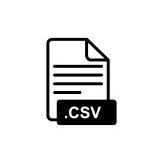
Creating Files
Pull data files from SIS Extract
Create TSDL File
File Layout found online at: https://www.cde.state.co.us/datapipeline/inter_teacherstudent
Tips on Files
Excel, CSV or Text File all accepted
No spaces in file name
No blank fields
Be sure the file is not open when uploading
Be sure you haven’t lost all your leading zeros on a CSV file or it won’t upload (steps for saving them posted online)

Slide 12
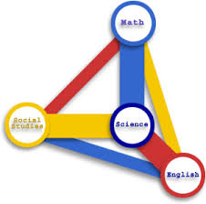
Required 6th - 12th Grade Courses
Mathematics
Science
Social Studies
English Language Arts
Computer Science – to be included in CRDC
ALL AP Courses – to be included in CRDC
All other courses may be included but are not required to be reported in the Course Enrollment or Course Instructor files
CRDC is for Civil Rights Data Collection; 2022-2023 is not CRDC reporting year

Slide 13
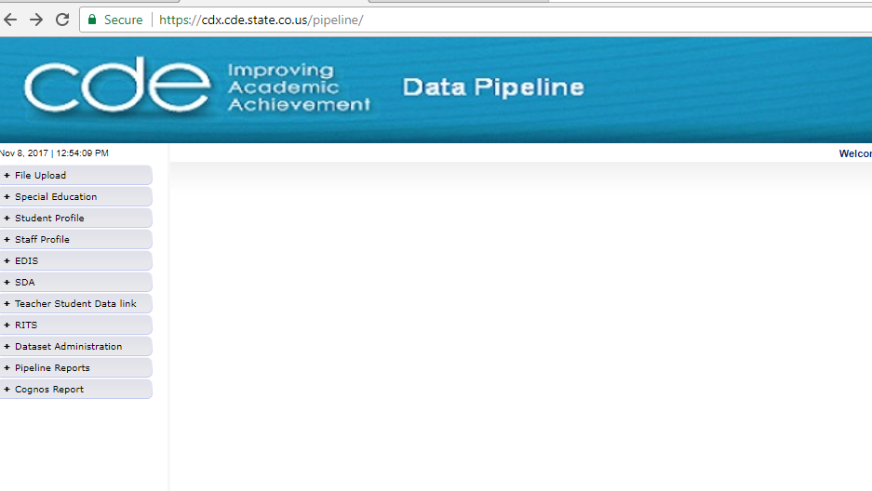
Pipeline Website Review
Batch Maintenance, Format Checker and Data File Upload
Based on your Identity Management Roles
Error reports and other validation reports

Slide 14
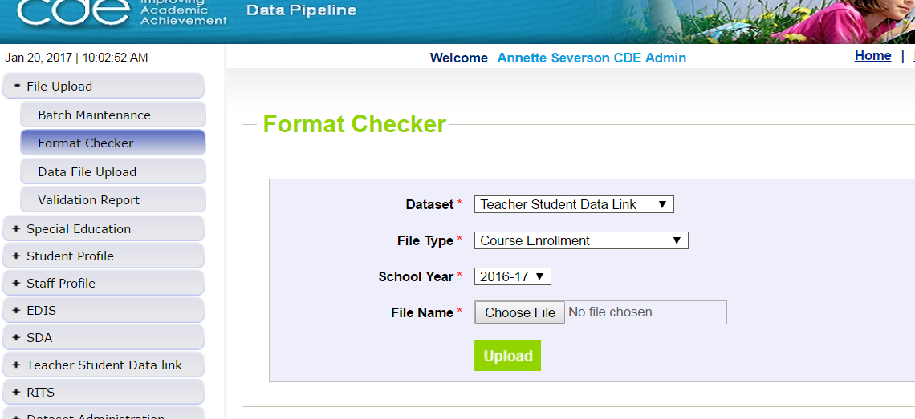
File Upload – Format Checker
TSDL file

Slide 15
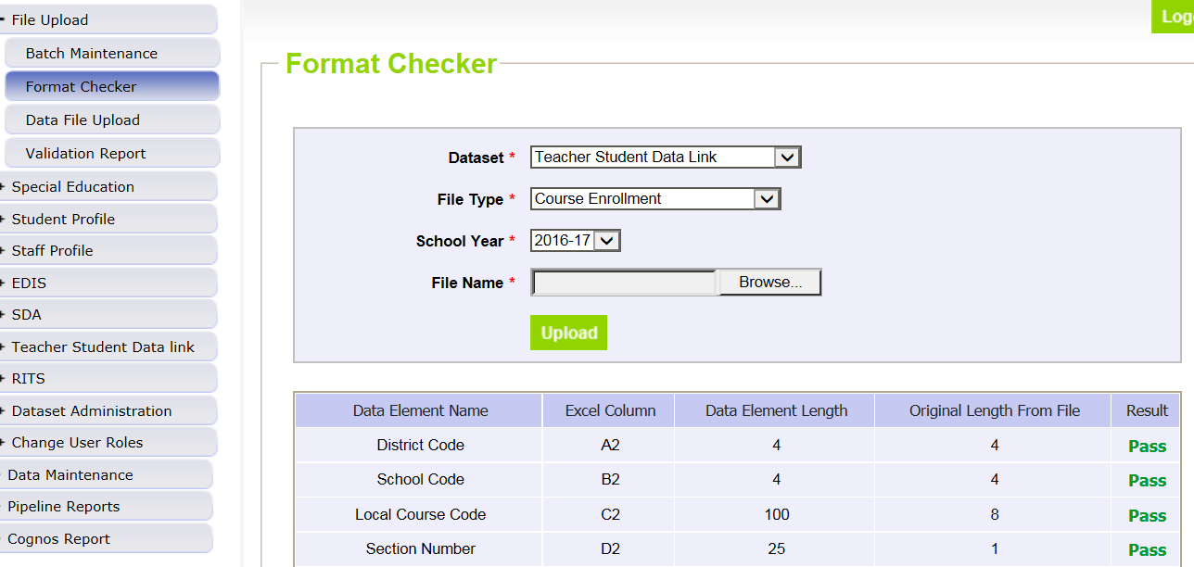
Format Checker – Upload Results

Slide 16
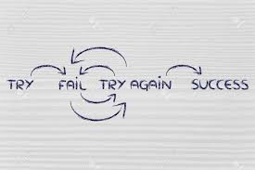
Format Checker Notes
Format Checker will only review the 2nd row in your file
Passing format checker Does Not Equal file will process
Green ‘Pass’ for each field is desired result
Red ‘Fail’ for a field indicates file is not in the correct format- please refer to the 2023-2024 file layout on web

Slide 17
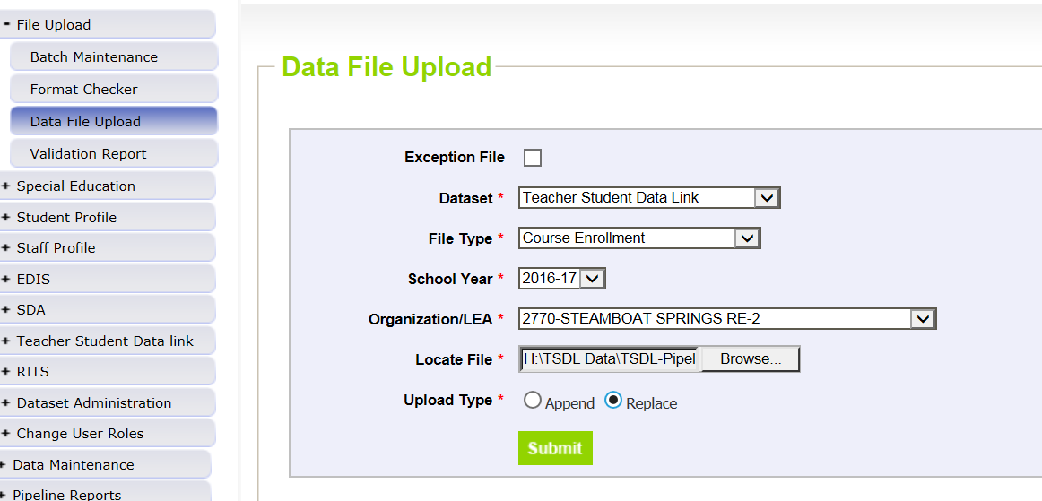
Data File Upload

Slide 18
Data File Upload Types
Append = adds file to existing file, all records from both files included
Can be tricky with fixing errors
Replace = deletes any prior data file and replaces it with the file being uploaded
RECOMMENDED

Slide 19
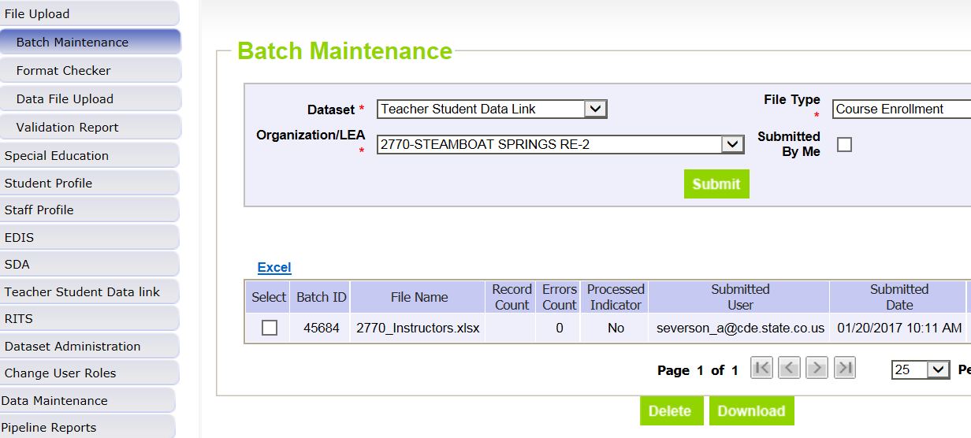
Batch Maintenance Screen – Not Processed

Slide 20
File Not Processed – Next Steps
Ensure file has all green ‘pass’ in format checker
YES?
Open file and review all records are formatted the same as the 2nd row
Be sure all codes and dates have leading zeros included
NO?
Review file layout posted online and re-format the file
For further assistance, contact Peter Hoffman
DO NOT INCLUDE THE FILE IN ANY EMAILS; instead email for assistance and a Syncplicity folder can be created and shared

Slide 21
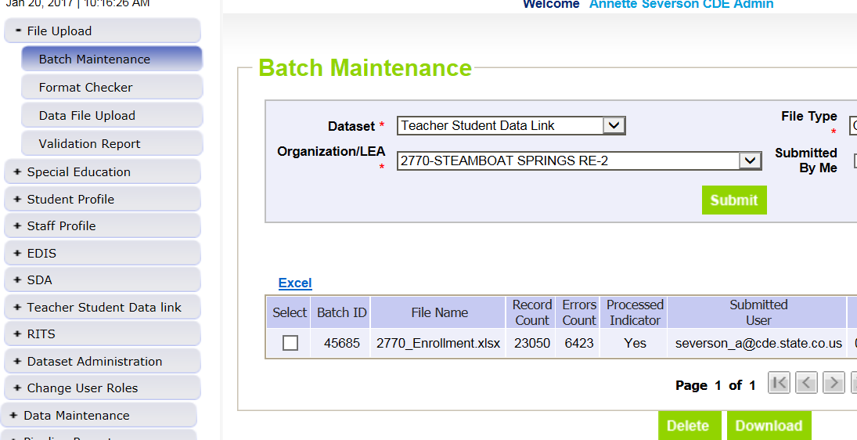
Batch Maintenance – File Processed

Slide 22
File Processed – Next Steps
Use same screen to see the Number of Errors:

Slide 23
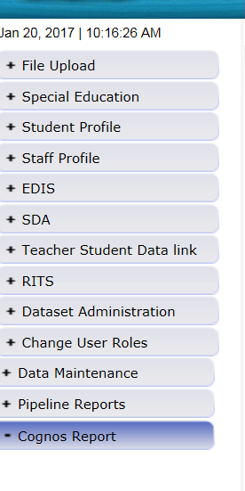
Review Errors in Detail
2 methods available:
Data Pipeline Reports -> Error Reports
Cognos Reports – > Teacher Student Data Link

Slide 24
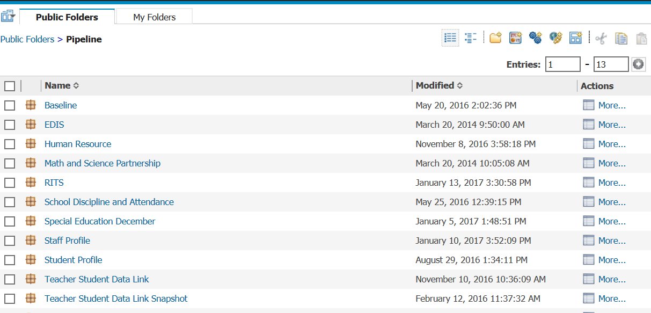
Clicking on Cognos Reports- Opens in a new Screen
These dates are to be ignored

Slide 25
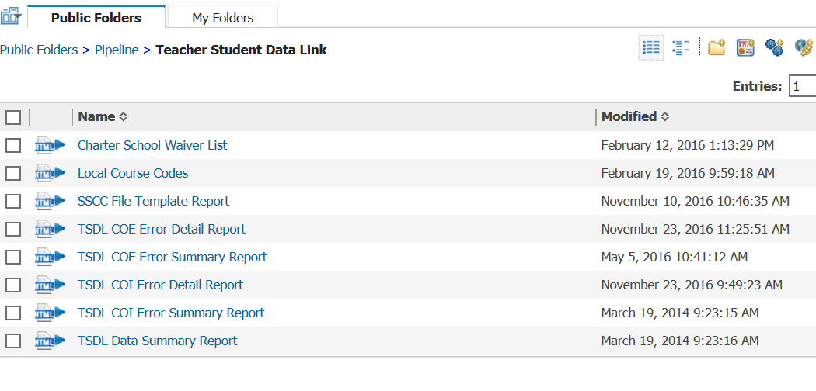
TSDL Interchange Errors
Detail Reports – provides detailed records with descriptions of error
Summary Reports – provides a count of records by type of error
*Do Not Send Error reports via email to CDE for assistance

Slide 26
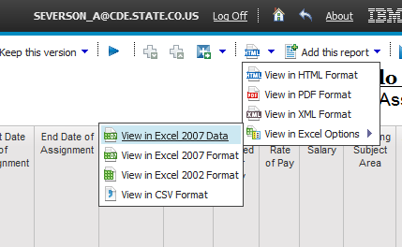
Error Detail Report- Excel

Slide 27
Error Reports
Error Detail Report
Provides specific records causing the error with the error description
Can select to View ALL error records or 1 type of error at a time
Error Summary Report
Provides a count of errors generated per error type and description
Resubmit either file as needed for corrections for all data errors to be resolved
Be sure to update source file with corrections as well

Slide 28
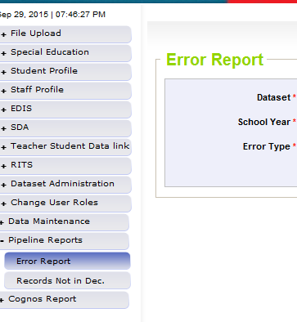
Pipeline Reports
Search:
Dataset = Teacher Student Data Link
School Year = 2021-2022
Error type = Errors and Warnings
File Type: Course Enrollment or Course Instructor
Org/LEA = Code
Click ‘Search’

Slide 29
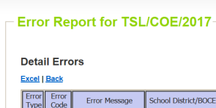
Pipeline Error Reports – Viewing Details
Summary of Errors in File are provided
Click on ‘View Details’ to view each record with the error
Choose ‘Excel’ to download error report in Excel – recommended

Slide 30
Correcting Errors
Correct the errors in the file:
May have to fix errors in both Course Enrollment and Course Instructor files
Keep file versions – in case updated file causes even more errors, you can re-start using a prior file version
CDE does not maintain these versions, once the file has been replaced, all prior data files have been deleted in pipeline
Resubmit your data records using the same process and replacing your existing data file using the Data File Upload tool
All errors must be corrected, all warnings should be reviewed

Slide 31
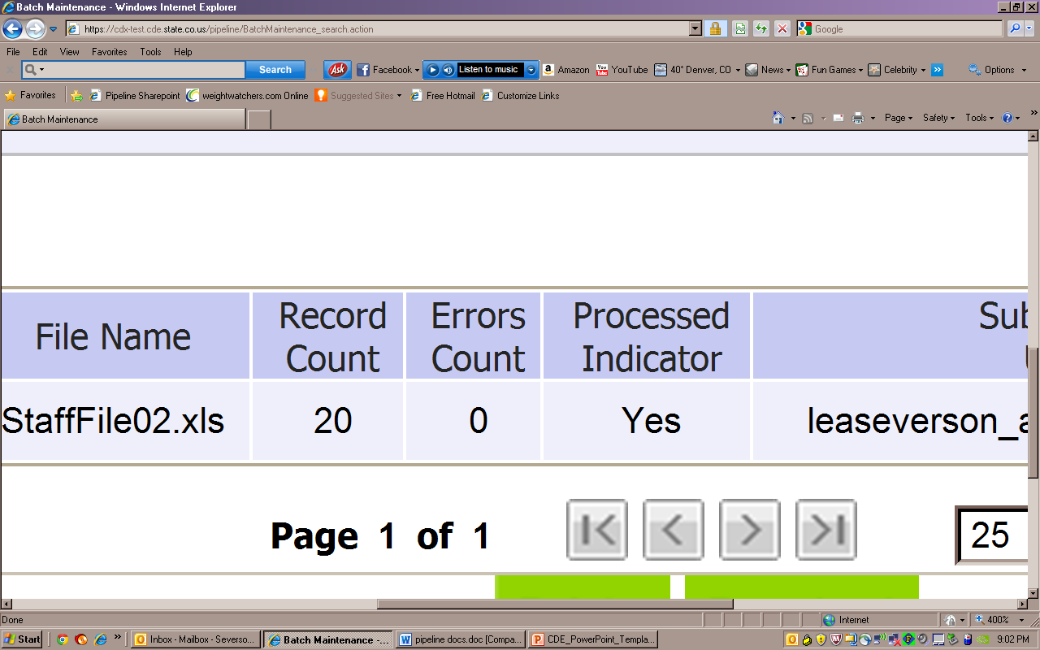
Batch Maintenance: No Errors

Slide 32
Next Steps – TSDL Snapshot
TSDL Upload = Processed and Zero Error Count
Create TSDL Snapshot (opens in January)

Slide 33
TSDL Interchange Resources
TSDL Interchange Documentation found at: http://www.cde.state.co.us/datapipeline/inter_teacherstudent
Contact:
Peter Hoffman: hoffman_p@cde.state.co.us

Slide 34
Snapshot Process

Slide 35
Snapshot Flowchart
Create TSDL Snapshot
Errors? If Yes, Review Error Reports
Correct Interchange File as Needed
Upload Corrected Error Files
Finalize (Data Reviewed as Accurate)
Create new TSDL Snapshot
Errors? If Not, Review Cognos Reports
Send Signed Verification form to CDE

Slide 36
Teacher Student Data Link Snapshot: Access
Local Access Manager (LAM) will need to assign you prior to logging into Pipeline
TLS_LEAAPPROVER – creates, views and finalizes data
TLS_LEAUSER – create and review snapshot data
TLS_LEAVIEWER – View the data only (not modify or submit)
Can only be assigned one or the other.

Slide 37
Creating Snapshot Steps
Log into Data Pipeline
Click on Teacher Student Data Link tab (on the left)
Select ‘Snapshot’ from the expanded list
Enter appropriate search criteria (Teacher Student Data Link Snapshot/2023-2024/Org Code)
Click on Search (green button on bottom)
Select ‘Create Snapshot’
New message should appear: “Snapshot creation triggered and processing. A notification email will be sent upon completion.”

Slide 38
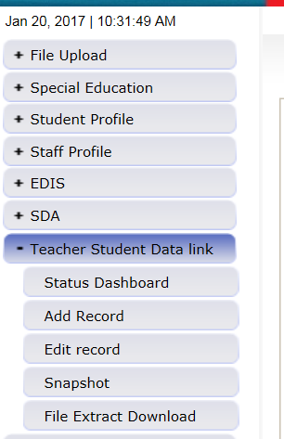
Selecting Teacher Student Data Link -> Snapshot

Slide 39
TSDL Snapshot Screen

Slide 40
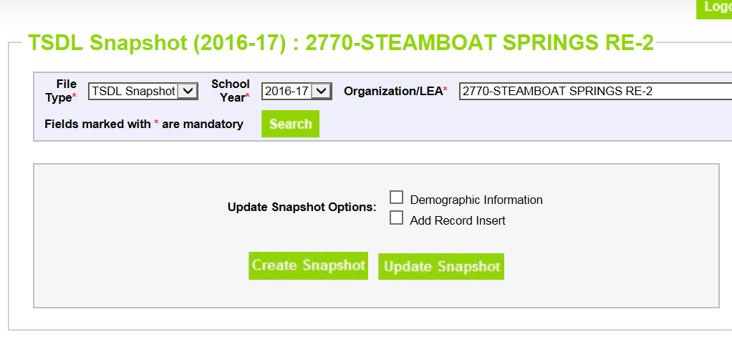
Creating Snapshot- Screenshot

Slide 41
Next Steps
View Status of TSDL snapshot
Email will be sent with status
Status Dashboard screen –shows if processed and # of errors
View Snapshot errors in Cognos or Data Pipeline
Make corrections to Teacher Student Data Link interchange file
Upload updated Teacher Student Data Link interchange file
Re-create Teacher Student Data Link snapshot

Slide 42
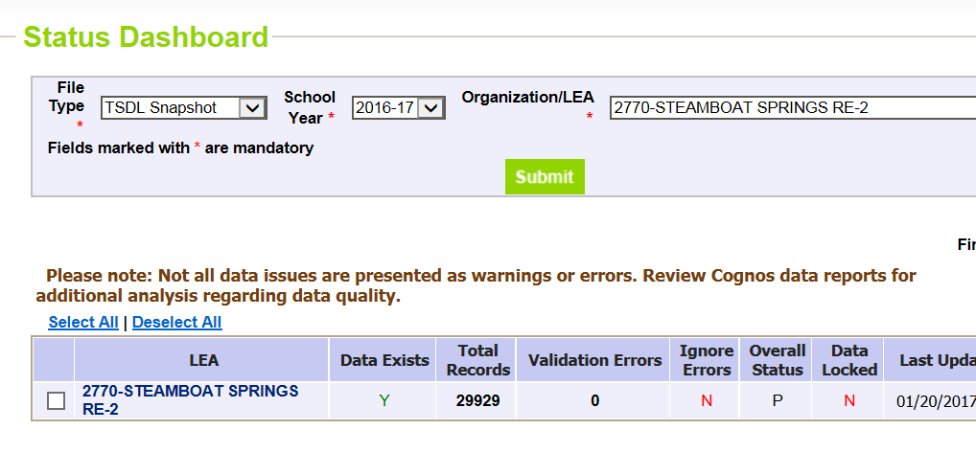
Status Dashboard Screen
Y = snapshot successful!
N= snapshot wasn’t taken/no data in snapshot
# of Snapshot Record Errors
Date/Time of Snapshot created

Slide 43
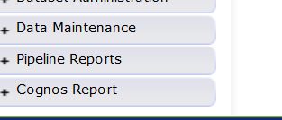
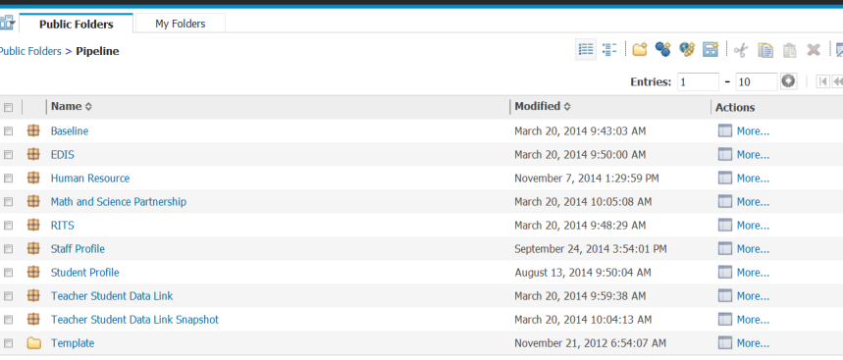
Accessing Cognos Reports
Opens new window
Teacher Student Data Link Snapshot

Slide 44
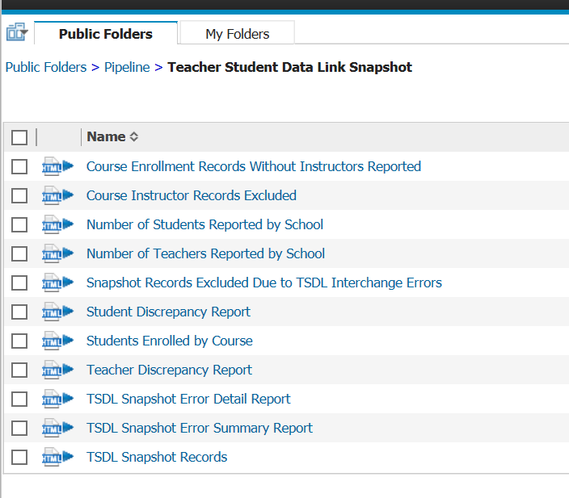
Teacher Student Data Link Cognos Reports

Slide 45
View Errors – Teacher Student Data Link Error Detail Report

Slide 46
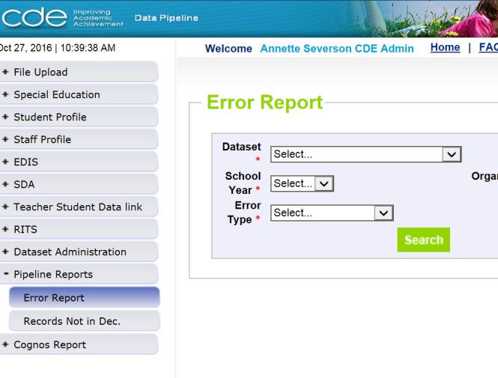
Viewing Errors in Data Pipeline

Slide 47
Edits
Edits are in place to assist with providing most accurate information to CDE which is published, analyzed and reviewed by legislators, federal government, researchers, etc.
Edits should provide adequate information to assist you with determining corrections needed.

Slide 48
Finalizing Steps
Once all Errors are resolved in Snapshot…
Review, review, review data reports for accuracy!
If mistakes/misreporting is found, correct files again and create new snapshot
If data reports are all accurate- you may finalize the data by submitting it to CDE
http://www.cde.state.co.us/datapipeline/tsdl-snap-reports-guide

Slide 49
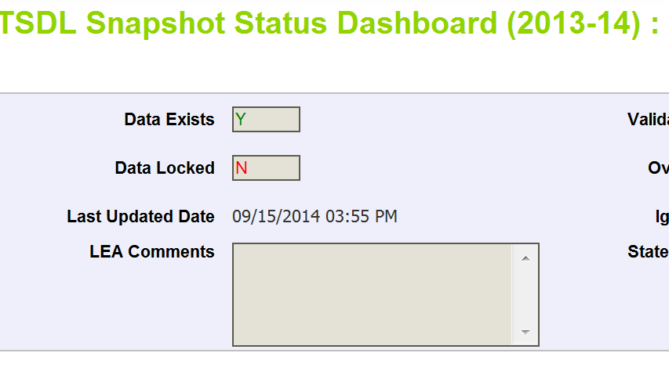
Finalizing Data
Once data is accurate-all reports reviewed and correct…
TLS~LEAAPPROVER for district will need to ‘Submit to CDE’
TSDL Snapshot Status Dashboard (2019-2020):
Star
Submit to CDE

Slide 50
TSDL Snapshot Reports (cognos)

Slide 51
Available Reports
Course Enrollment Records Without Instructors Reported
Course Instructor Records Excluded
Number of Students Reported by School
Number of Teachers Reported by School
Snapshot Records Excluded Due to TSDL Interchange Errors
Student Discrepancy Report
Student Enrolled by Course
Teacher Discrepancy Report
TSDL Snapshot Error Detail Report
TSDL Snapshot Error Summary Report
TSDL Snapshot Records

Slide 52
Course Enrollment Records Without Instructors Reported
Displays All Records from Course Enrollment file where there was no matching record in the Course Instructor file.
Records are matched based on:
School District/BOCES Code
School Code
Local Course Code
Section Number
Term
These records will have no instructor linked to the course/student

Slide 53
Course Instructor Records Excluded
Displays all records in Course Instructor file that are not being included in the snapshot
There is no matching record in the course enrollment file
Snapshots records are created using all Enrollment File records and matching those with the Instructor file based on the fields:
School District/BOCES Code
School Code
Local Course Code
Section Number
Term

Slide 54
Number of Students Reported by School
Provides headcount of students by school code/name
Headcount is counting the unique SASIDs reported for each school

Slide 55
Number of Teachers Reported by School
Provides headcount of teachers by school code/name
Headcount is counting the unique EDIDs reported for each school

Slide 56
Snapshot Records Excluded Due to TSDL Interchange Errors
Due to TSDL Interchange errors (either in Course Enrollment or Course Instructor) the records are not being included in the Snapshot
Next Steps – review and correct TSDL interchange files and create a new TSDL Snapshot

Slide 57
Student Discrepancy Report
Displays ALL students reported in the Student Interchange that are NOT included in the TSDL Snapshot
Also calculates and displays ‘Weeks Enrolled’
Can be used to sort- those enrolled for a long period of time should be included
Can download report into excel to sort as necessary

Slide 58
Students Enrolled by Course
Provides count of students (headcount) by school, final grade/course completion status and local course code
Provides total by school and final grade/course completion status

Slide 59
Teacher Discrepancy Report
Provides list of staff reported in the Staff Assignment file with job class codes 201, 202 and 206 (teachers) that are not included in the TSDL snapshot
Provides the Teaching Subject Area reported in the Staff Assignment file
All 6th- 12th grade mathematics, English language arts, and Sciences teacher MUST be included in the Course Instructor file

Slide 60
Error Reports
TSDL Snapshot Error Detail Report
Displays each error and record in detail
TSDL Snapshot Error Summary Report
Displays a count of records with each error code

Slide 61
TSDL Snapshot Records
Provides the full snapshot records included in your snapshot
Can only provide current year due to size of TSDL snapshot files

Slide 62
TSDL Snapshot Resources
TSDL Snapshot Documentation found at: http://www.cde.state.co.us/datapipeline/tsdl
Contact:
Peter Hoffman: hoffman_p@cde.state.co.us

Slide 63
Resources

Slide 64
Online Resources
Teacher Student Data Link Interchange (TSDL Interchange):
https://www.cde.state.co.us/datapipeline/inter_teacherstudent
Teacher Student Data Link Snapshot (TSDL Snapshot):
https://www.cde.state.co.us/datapipeline/tsdl

Slide 65
CDE Contacts
State Standard Course Codes Teacher Student Data Link Interchange Teacher Student Data Link Snapshot | Peter Hoffman – TeacherStudentDataLink@cde.state.co.us
Educator Preparation Program Report Educator Effectiveness Metrics | Carolyn Haug – haug_c@cde.state.co.us
Migrant Education | Brenda Meyer - meyer_b@cde.state.co.us
Course Participation Reports | B Sanders – sanders_b@cde.state.co.us
Civil Rights Data Collection (CRDC) | Annette Severson – severson_a@cde.state.co.us

Slide 66
Thank you for Joining!
Contact Peter Hoffman at TeacherStudentDataLink@cde.state.co.us with Questions

