Slide 1
Teacher Student Data Link: Collection Overview
2024-2025

Slide 2
Agenda
Collection Purpose & Data Use
Collection Timeline
2025 TSDL Changes
File Layout and Data Sources
What is a Snapshot?
TSDL Interchange File Layout
TSDL Snapshot File Layout
Snapshot Internal Flags
Data Pipeline Process
Prepare
Collection Steps
File Upload
Create/Update Snapshot
Business Rules and Addressing Errors
Status Dashboard & Submitting Snapshot
Reviewing/Validating Data (CEDAR/COGNOS Reports)
Exceptions and Data Change Requests
Additional Information
State Course Codes (SCED)
Common Questions
Contact & Resources

Slide 3
Collection Purpose & Data Use

Slide 4
Purpose
The purpose of The TSDL interchange file captures data that link students in grades 6 through 12 to courses and instructors (if available) for the reported school year. It is also recommended to include all AP and Computer Science courses for CRDC reporting.
Record Expectation:
LEAs should submit one record for each student and core course enrolled for 6 weeks or more along with the educator of record and contributing professional if applicable.
"Core course" means a course in English, mathematics, science, social studies.
For 8th-12th Grade Migrant Students, all courses must be reported.
For the OCR CRDC report, computer science and all AP courses should also be included.
Students enrolled less than 6 weeks would not be required to be reported unless they receive a grade for the core course.

Slide 5
Uses
Primary Uses
9th Grade Success Reporting Points
9th Grade Success Reporting stemming from HB24-1282
Pre-population of Civil Rights Data Collection (CRDC) report (~70% of the fields)
Migrant student reporting stemming from Code of Federal Regulations 44 CFR 200.81, 200.82(c), 200.85, 34 CFR 76.720, 2 CFR 200.327, and 2CFR 200.328.
For each public school that serves the 9th grade:
The number and percentage of first-time ninth grade students who at the end of the school year have not earned at least four core credits OR have failed one or more credits.

Slide 6
Collection Timeline

Slide 7
Teacher Student Data Link Key Dates
Date | Event | Event Description
Wednesday December 11, 2024 | Open | TSDL Upload Interchange file opens.
Thursday February 27, 2025 | Open | TSDL Snapshot opens.
Friday May 16, 2025 | Interim Deadline | TARGET: Date by which you should have uploaded the TSDL Upload interchange file at least once
Friday June 13, 2025 | Interim Deadline | TARGET: Date by which the TSDL Upload interchange should be uploaded and error free.
Friday June 27, 2025 | Interim Deadline | TARGET: Date by which the TSDL snapshot should be created at least once.
Friday August 22, 2025 | Interim Deadline | TARGET: Date by which you should have a complete Teacher Student Data Link Snapshot. Complete Teacher Student Data Link Snapshot means: ◻ All TSDL interchange errors are resolved ◻ All TSDL snapshot errors are resolved If you anticipate that you will not be able to meet this deadline, please contact CDE at TeacherStudentDataLink@cde.state.co.us
Monday August 25, 2025 – Thursday August 28, 2025 | Report Review | Final Snapshot Report Review – This is your opportunity to review reports in detail and make any data corrections you deem necessary to make sure you are reporting valid and reliable data. All data corrections must be completed during this time.
Friday August 29, 2025 | Deadline | Required to have TSDL snapshot error free and finalized before or on this date. TSDL closed and final report is signed and provided to CDE via email TeacherStudentDataLink@cde.state.co.us

Slide 8
TSDL Collection Cycle
September to December
Update SCED codes in SIS, ensure any new classes has appropriate SCED codes assigned.
Ensure the appropriate classes are marked for state reporting in SIS.
When collection opens in December, begin uploading interchange files into Data Pipeline to get a better picture of errors you will be encountering at end of year.
December - May
Utilizing first half of year data, adjust fields in SIS as necessary to work toward error free upload.
If interchange error free, create snapshot to ensure no errors at that level.
May – August
Ensure interchange upload file is error free for entire school years data.
Create Snapshot and ensure it is error free
August 22
TSDL Snapshot created and error free
August 25-28
Report Review
August 29
TSDL Final Submission Deadline
Interchange Open
Snapshot Open
Error Free at EOY
Final Dates

Slide 9
Teacher Student Data Link 2025 Changes

Slide 10
2024-2025 TSDL Changes
No TSDL interchange data field changes
For TSDL Snapshot - Internal Flag refinement for 9th Grade Success Reporting, all new flags are from Student Profile Snapshots:
Added demographic flags
Added in Special Education Status
Added ELL Status
Added Foster Status Flag
New TSDL Snapshot flag: Second Year 9th Grade
This flag is “yes” if the SASID appeared in TSDL with grade 090 in the previous school year, and are reported in the current year for grade 090.

Slide 11
File Layout and Data Sources

Slide 12
What is a Snapshot?

Slide 13
Snapshot (collection): Source Files
A data snapshot begins with uploading the corresponding interchange files. These interchange files become the source of information, or source file for specific data fields on a snapshot.
Source File A
Contains multiple columns of data/information as outlined on the file layout for this source file.
Source File B
Contains multiple columns of data/information as outlined on the file layout for this source file.
File A: Element 1
File A: Element 2
File B: Element 1
File B: Element 2
File A: Element 4
File A: Element 3
File A: Element 5
File B: Element 3
File B: Element 4

Slide 14
Snapshot (collection): Creation
When a snapshot is triggered, it pulls needed information from the source (interchange) files into a new file called the snapshot.
Source File A
Source File B
File A: Element 1
File A: Element 4
File B: Element 1
File B: Element 4
File A: Element 2
File A: Element 3
File A: Element 5
File B: Element 2
File B: Element 3
Snapshot

Slide 15
Snapshot (collection): Internal Flags
Snapshots don’t always use every data element on a source file.
Snapshots often pull in information called “internal flags.” These are calculated pieces of data from information provided on the interchange files or from other internal data in data pipeline.
Source File A
Source File B
Internal Flags
File A: Element 2
File A: Element 5
File B: Element 3
Internal Flag: 1
Internal Flag: 2
Internal Flag: 3
Snapshot
File A: Element 1
File B: Element 1
File A: Element 3
File A: Element 4
File B: Element 2
File B: Element 4

Slide 16
Teacher Student Data Link Interchange File Layout

Slide 17
Interchange Preparation
Ensure all appropriate courses have accurate SCED code assigned.
Ensure all core, AP, and computer science courses have been marked to be included in your state reporting for grades 6-12. For Migrant students grades 8-12, all courses should be included.
Ensure that your Local Course Title field has no commas as this will prevent your file from uploading due to data shifting
Extract files from your Student Information System (State Reporting →TSDL)
Recommended format is .xls or .xlsx (excel)
Data Pipeline also accepts .csv
Leading zeros are required for all data fields to maintain the specified field length
Be careful when opening .csv format in excel to not lose leading zeros
The newest version of excel has a pop-up asking if you want to keep leading zeros
CDE has a guide to keeping leading zeros on Data Pipeline Frequently Requested Codes and Resources Website.
Pro Tip: Use a file naming convention as you will likely extract files multiple times
Example: 0110_TSDL_04052024.xls
Spaces in the file name are not allowed

Slide 18
File Layout Example
Interchange File Layout
Provides a list of each data field included on an interchange (source) file with detailed descriptions and codes.
Excel Column: Where this data field should be in your upload file.
Examples: Examples of acceptable forms of data values for this field.
Remarks: Any important notes regarding the field, such as if it is optional, or other names the field may be known by.

Slide 19
TSDL Interchange Dependencies
Student has been assigned a SASID in the RITS system and has been reported in the Student Interchange
Educator has been assigned an EDID in the EDIS system and been reported as par of the staff profile.
Each record has an appropriate State Course Code (SCED) that corresponds to the Local Course Code / Title as determined by the LEA.
Internal Flag
Internal Flag

Slide 20
TSDL Snapshot File Layout

Slide 21
TSDL Snapshot File Layout Example
Snapshot File Layout
Source Interchange: List of source interchange file the field or flag came from
Source File: Specific file within the source interchange the field or flag came from
Remarks: Any important notes regarding the field.
Snapshot Preparation: Ensure Teacher Student Data Link Interchange upload is error free before taking a TSDL snapshot.

Slide 22
Snapshot Internal Flags

Slide 23
Internal Flags
Calculated Fields
Calculated value based upon current or prior year reported data
Data Fields:
Student’s Federal Race/Ethnicity
English Learner Y/N
Special Education Student
Foster Status
Second Year 9th Grade Flag

Slide 24
Data Pipeline Process

Slide 25
Prepare

Slide 26
Checklist
Ensure you have access/logins for following systems
Your LEA’s Student Information System (SIS)
Must have ability to extract state reporting files and edit student records for related data fields
Data Pipeline & COGNOS/CEDAR
Bookmark important CDE websites & review supporting documentation:
Teacher Student Data Link Interchange website.
NCES School Courses for the Exchange of Data (SCED) website.
Sign up for data pipeline TH emails if you don’t already receive them
Plan to maintain data privacy for Personally Identifiable Information (PII)
What are your internal processes?
Utilize Syncplicity when communicating with CDE
Gather/Save Critical Contact Information
CDE: Peter Hoffman, TeacherStudentDataLink@cde.state.co.us, 720-925-8611
Internal:
Ensure / know which colleagues support/oversee setting up courses in your SIS to ensure you can change Local Course Titles, ensure the correct courses are marked to be included in state reporting and update State Course Codes (SCEDs).

Slide 27
SEY Identity Management (IdM) Roles
Bookmark: Identity Management Site
District Local Access Manager (LAM) assigns account/privileges
Provides access to the various CDE tools
Data Pipeline permissions are needed to complete data collections
A user can only have one role for each Collection
IdM user roles are used by CDE to create email lists & grant collection specific access
COGNOS/CEDAR access mirrors pipeline access
Collection emails – typically only LEA Approvers and LEA Users
Data Pipeline Town
Manually added, can subscribe via email
Syncplicity access
Manually added, monitored by collection leads
Application | Collection | User Role | Access & Notes
Pipeline | TSDL Interchange and Snapshot | LEA User | Required for TSDL Interchange data respondents. Upload file for TSDL Interchange Upload Can create snapshot but cannot submit final status.
Pipeline | TSDL Snapshot | LEA Approver | At least one required per LEA. Create snapshot, submit snapshot, download sign-off form.
Pipeline | TSDL Interchange and Snapshot | LEA Viewer | View CEDAR/COGNOS reports related to the assigned collection but cannot edit data. Useful role for district support staff who help validate data but do not actively complete the collection.

Slide 28
TSDL Identity Management (IdM) Roles
Teacher Student Data Link Interchange Roles:
TSL~LEAVIEWER
TSL~LEAUSER (Preferred Role)
Teacher Student Data Link Snapshot Roles:
TLS~LEAVIWER
TLS~LEAUSER
TLS~LEAAPPROVER (Preferred role, at least one needed to complete collection).
Application | Collection | User Role | Access & Notes
Pipeline | Teacher Student Data Link Interchange and Snapshot | LEA User | Required for TSDL Interchange data respondents. Upload file for TSDL Interchange Upload Can create snapshot but cannot submit final status.
Pipeline | Teacher Student Data Link Snapshot | LEA Approver | At least one required per LEA. Creates snapshot, submits snapshot, download sign-off form.
Pipeline | Both TSDL Interchange and Snapshot | LEA Viewer | View CEDAR/COGNOS reports related to the assigned collection but cannot edit data. Useful role for district support staff who help validate data but do not actively complete the collection.

Slide 29
Data Pipeline Weekly Maintenance
Data Pipeline has a weekly maintenance window on Tuesday afternoons, during which time users may not be able to access file uploads and snapshots.
What does this mean for you?
Avoid uploading an TSDL interchange file or taking a TSDL Snapshot on Tuesdays between 4pm-8pm.
If you are attempting to do a file upload and are locked out of pipeline, try again in about an hour.

Slide 30
Collection Steps

Slide 31
Teacher Student Data Link Collection Steps
Extract TSDL file from SIS. (State Reporting →TSDL or Teacher Student Data Link)
Upload interchange file
Resolve interchange errors
Update student information system
Extract and upload new interchange files
Create TSDL Snapshot
Resolve TSDL Snapshot Errors
TD110-TD113 series (Every School with Grades 6-12 needs a record in each of the core subject areas)
Update student information system
Extract and upload new interchange files
Request exceptions if needed/applicable
Create TSDL Snapshot (repeating steps 1 to 4 as needed)
Validate data
Credits granted accurate for Migrant students?
Accurate course completion status?
Accurate SCED codes to Local Course Title/Identifier?
Submit error-free snapshot and return signoff form to TeacherStudentDataLink@cde.state.co.us
TSL~LEAUSER and TLS~LEAAPPROVER roles in IdM required

Slide 32
File Upload

Slide 33
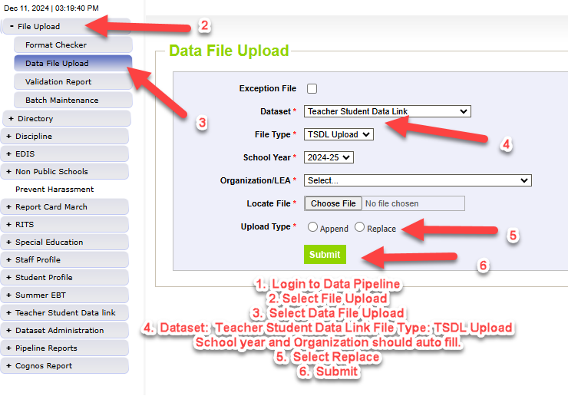
Data File Upload
Update your Interchange files to address errors
Preferred: Update in SIS → Extract → Upload to Pipeline
Alternate Method: Extract File →Import into new Excel Document to preserve leading zeros → Edit Excel file with changes to remedy errors → Upload to Pipeline
Wait for a Confirmation Email from the Pipeline System
The email will show you the number of errors in your upload
Use Pipeline or CEDAR reports to review errors and warnings

Slide 34
Create/Update Snapshot

Slide 35
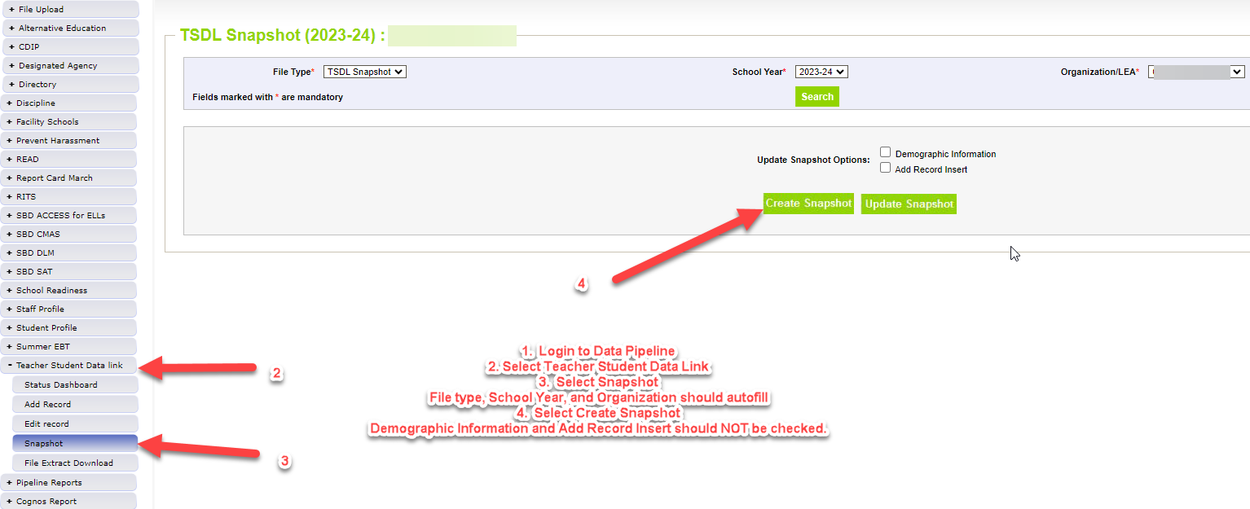
Create Snapshot:
The message “Snapshot creation triggered and processing. A notification email will be sent upon completion” will appear at the top of the screen after you press the confirm snapshot creation button
Wait for the notification email before reviewing errors/warnings
Creating a new snapshot will replace all the records from your previous snapshot

Slide 36
Business Rules and Addressing Errors

Slide 37
Overview
Business Rules are the list of errors and warnings that are checked when an interchange file is uploaded, or snapshot is created
Available on the TSDL Website
Kinds of information checked:
Data format validation for interchange fields
Valid SASID and EDID, Valid SCED code from the current SCED course code list
Credits granted for Migrant students
Local course information is filled out and not blank
Checks on SASIDS with 15 or more records with the same SCED code (warning)

Slide 38
Errors/Warnings: Overview
Errors
Warnings
Must be addressed
Update data fields to clear
Snapshot cannot be submitted if there are any errors
Indicate possible data inconsistencies/coding issues
Pro Tip: Review warnings to look for patterns/areas where district data could be documented in a more accurate manner
Interchange vs Snapshot Business Rules
Interchange
Snapshot
Address data inconsistencies or data formatting errors.
Address data inconsistencies that apply to TSDL data collection specifically
Focused on ensuring a SCED code for each core subject area is reported by school.

Slide 39
Addressing Errors/Warnings
Update your Interchange files to address errors
Preferred: Update in SIS → Extract from SIS → Upload to Pipeline
Alternate Method: Extract File from SIS →Import into new Excel document to preserve leading zeros → Edit Excel file with changes to remedy errors → Upload to Pipeline
Must create a new snapshot to clear snapshot level errors
Snapshot creation causes pipeline to run the data through the business rules again

Slide 40
Checking Errors/Warnings: Pipeline Error Report
Preferred method for checking errors/warnings
Pro Tip: Use check boxes to select a specific error/warning code before reviewing error details as it may be simpler to focus on one business rule topic at a time
Pipeline Error Report is limited to viewing 1000 records at a time.

Slide 41
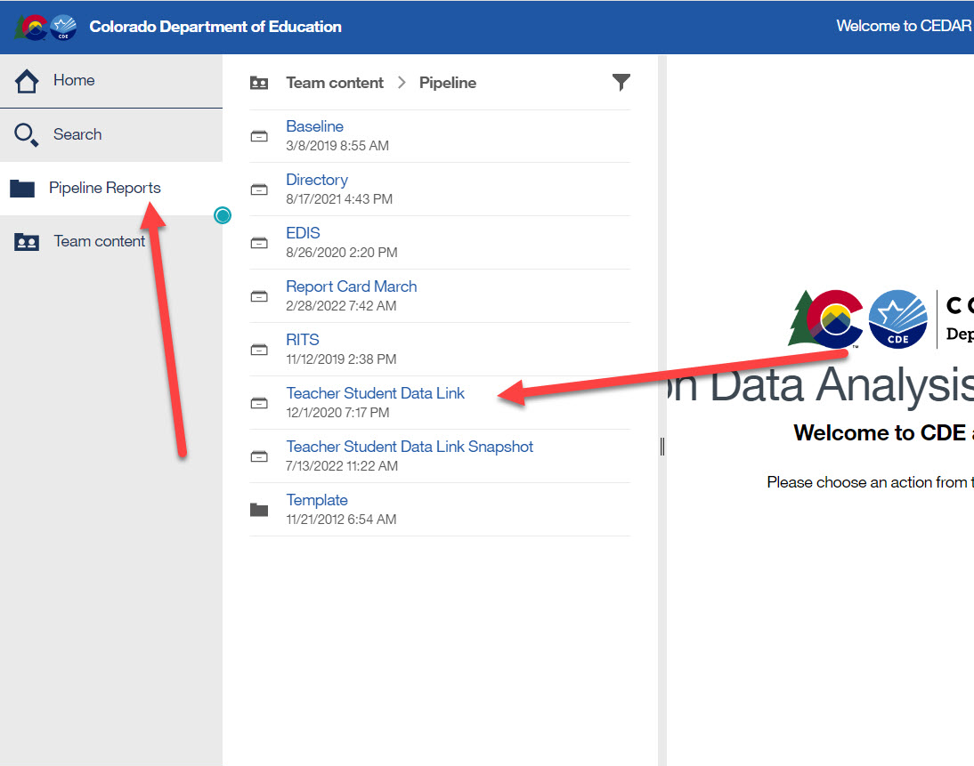
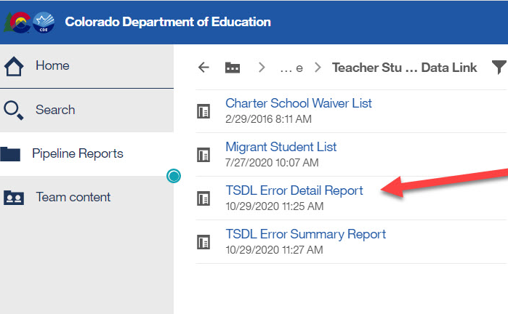
Checking Errors/Warnings: COGNOS/CEDAR
Alternative method for checking errors/warnings
Login to COGNOS/CEDAR using the link in Data Pipeline or the IdM webpage
Use when reviewing 1,000+ individual error detail records
COGNOS/CEDAR is best used to validate data using the various topic specific reports

Slide 42
Status Dashboard & Submitting Snapshot

Slide 43
Status Dashboard Information
Allows you to review the status of a created TSDL snapshot
Quantity of errors
Data Exists ‘Y’ means successful snapshot creation
Data Locked ‘Y’ means snapshot creation is not available
Overall Status
‘P’ Pending
‘S’ Submitted
Last Updated Date
The date/time your TSDL snapshot was last created
Used to submit snapshot to CDE
Used to download the superintendent verification (sign-off) form during the final phase of data collection
Last Updated Date on the status dashboard must be prior to the date on the sign-off form for the form to be accepted

Slide 44
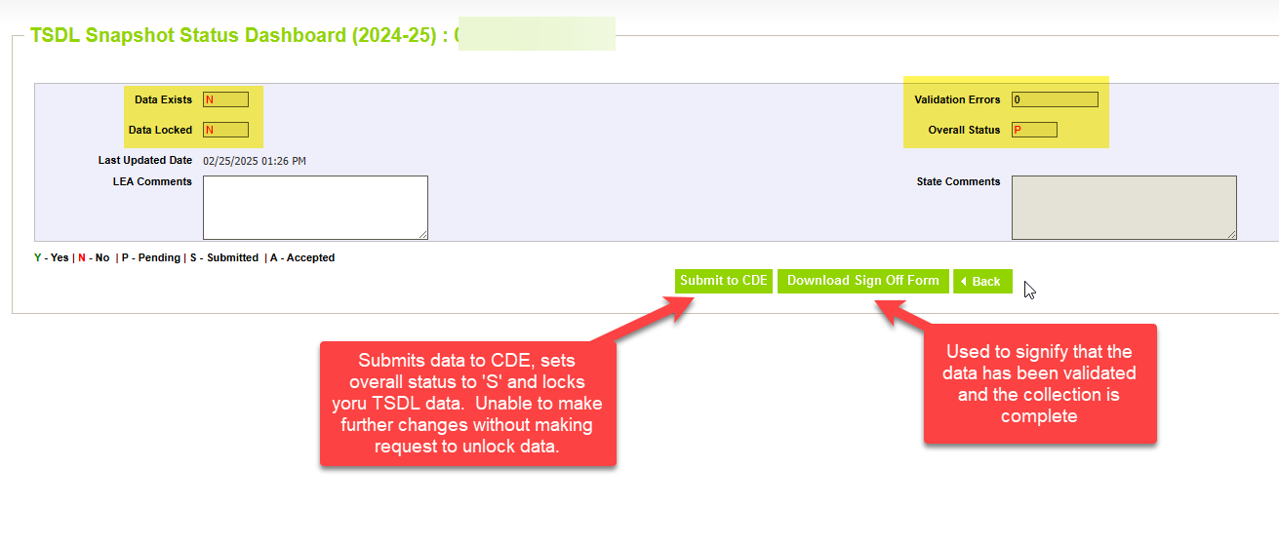
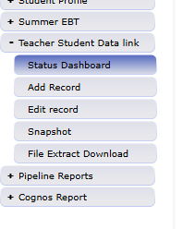
Status Dashboard Screen

Slide 45
Reviewing/Validating Data (COGNOS/CEDAR Reports)

Slide 46
CEDAR/COGNOS Reports Overview
The Colorado Education Data Analysis and Reporting system (CEDAR) is a private, secure system which provides student level data to authorized users. Access to student-level data is limited to educators who have need for such data.
Reports in CEDAR/COGNOS have multiple purposes. Some are used as operational reports to assist data respondents in looking up specific information on students, file/snapshot errors, and students missing from a snapshot due to profile errors. Other reports are used to validate data when finalizing a data collection. Many reports also provide districts with a preview of data that will be published based upon specific data collections
Notes:
Often CEDAR is referred to as COGNOS since COGNOS is the software currently powering the Colorado Education Data Analysis and Reporting system (CEDAR).

Slide 47
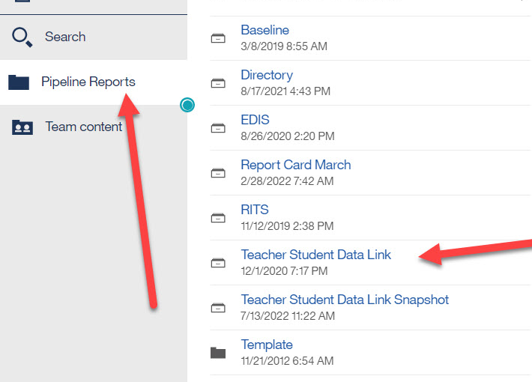
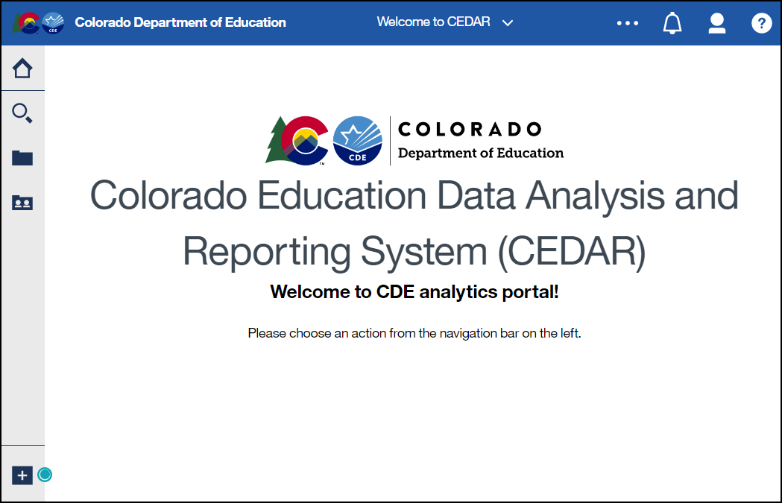
Accessing Reports
Identity Management Landing Page → CEDAR Link
Data Pipeline →

Slide 48
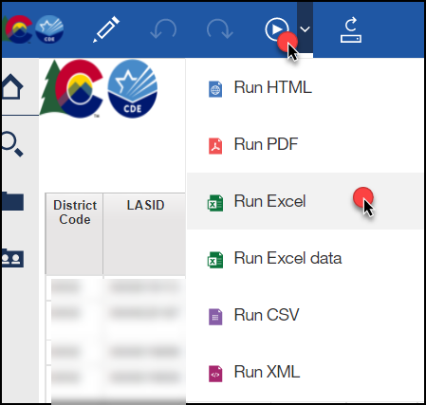
Report Screen & Download
Reports can be downloaded as an excel file for easier sorting/filtering of information.

Slide 49
Moving between reports
Toggle between reports using the recent reports dropdown
Close an open report using the recent reports dropdown

Slide 50
TSDL Interchange Reports
Individuals with permissions to the TSDL Interchange in IdM have access to student profile reports
TSL~LEAVIEWER
TSL~LEAUSER
These reports are operation in nature, assisting districts with reporting accurate data on these fields and providing historical information when helpful
Migrant Student List contains the migrant students that were in the student interchange that should have TSDL records.
Error Detail and Summary reports for viewing more than 1000 records at a time.

Slide 51
TSDL Snapshot Reports
Available to individuals with permissions to TSDL Snapshot in IdM
TLS~LEAVIEWER
TLS~LEAUSER
TLS~LEAAPPROVER
Some reports are operational in nature, designed to assist with the data collection
Student Discrepancy Report is students reported in the student interchange that are not in the TSDL snapshot. It includes weeks enrolled and focus should be on students listed here with enrollment of 6 weeks or more.
Some reports are designed to provide districts with a preview of statistics based on the TSDL data
Students enrolled by course provides a headcount of students by school with course completion status and local course code
Number of Students / Teachers reported by school (Unique SASID and EDIDS).

Slide 52
Exceptions and Data Change Requests

Slide 53
When are reporting exceptions needed?
Reporting exceptions in TSDL are used to clear the associated errors (without changing the data) in unique circumstances where a school’s number of records is accurate but does not contain a course in all core course subject areas.
Data respondents must work with the data collection lead for a given file/snapshot to request an exception be granted
Some reporting exceptions require additional supporting documentation and may be reviewed by other CDE staff
Typically, these are needed for home school programs or circumstances when there is a K-6 school that is being flagged by TSDL Snapshot errors.

Slide 54
Reporting Exception Process
Reach out to TSDL collection lead with errors that may need an exception
TeacherStudentDataLink@cde.state.co.us
TSDL collection lead will gather any necessary / additional information and notify you if approved.
If approved, wait for confirmation from TSDL collection lead that the exception has been processed and reupload TSDL interchange file or re-create TSDL snapshot to verify that errors have been resolved.

Slide 55
Additional Information

Slide 56
State Course Codes (SCED)

Slide 57
School Courses for the Exchange of Data (SCED)
TSDL uses NCES SCED codes for the State Course Code Field
Latest file can be found on NCES website.
Utilize the SCED file to pick codes that closest match the name and description of your local courses.
2024-2025 is utilizing SCED file version 12.0

Slide 58
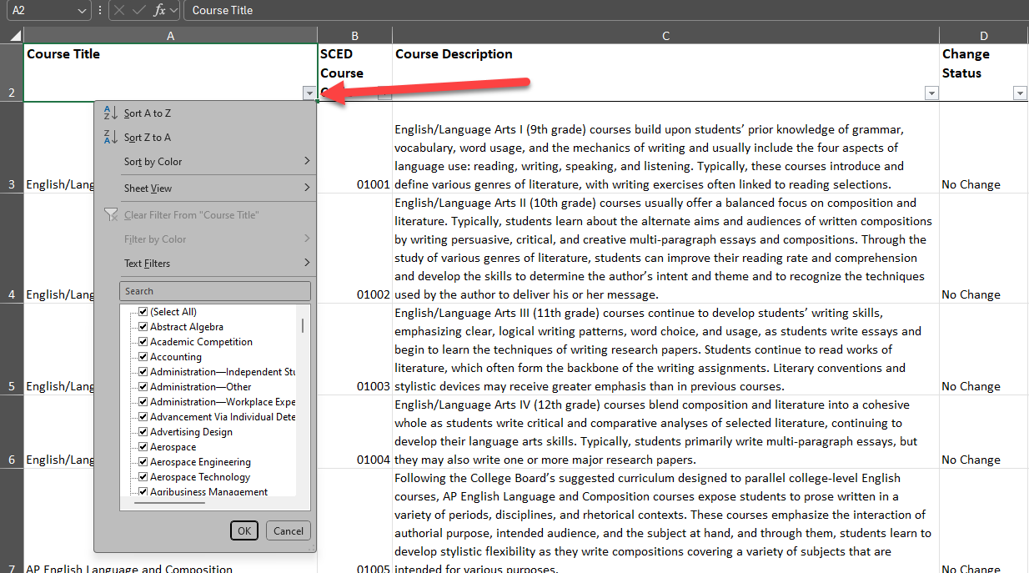
Picking SCED Codes
Utilize the course title dropdown/filter arrow to find a course title that is similar to your local course title.
Broader / more generic searches will give more options - ex. “Algebra” or “Computer Science”

Slide 59
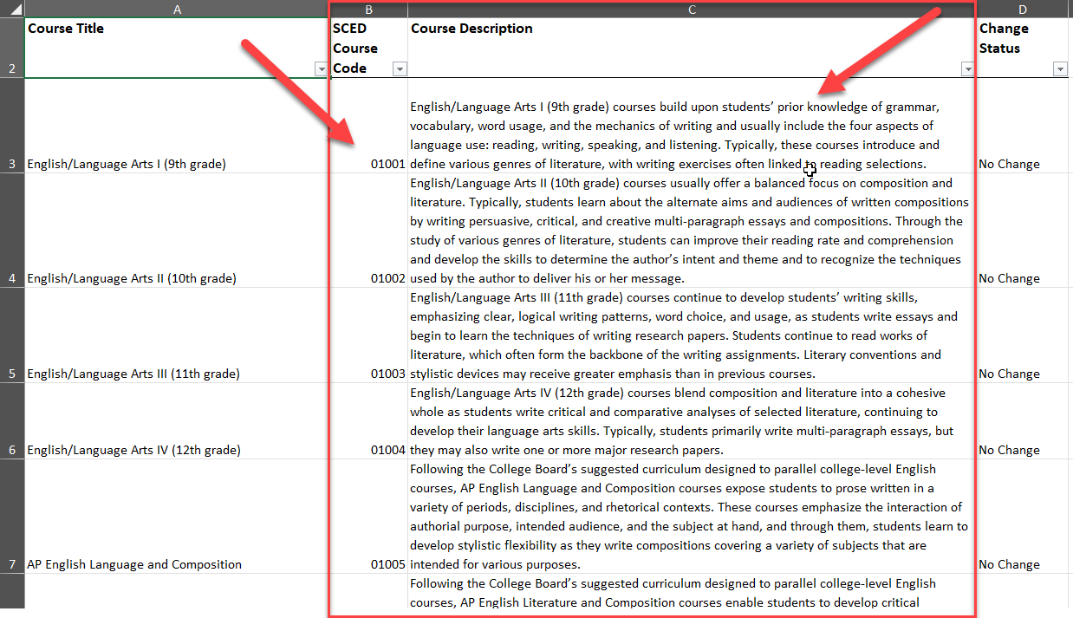
Picking SCED Codes continued
Once you have narrowed down the choices, use the course description that most closely matches your districts local course description to pick a SCED course code.
It is recommended to avoid using the general SCED code options if possible, to help differentiate the different courses. These general codes should be used in instances where no title/description in the SCED file matches your local course.

Slide 60
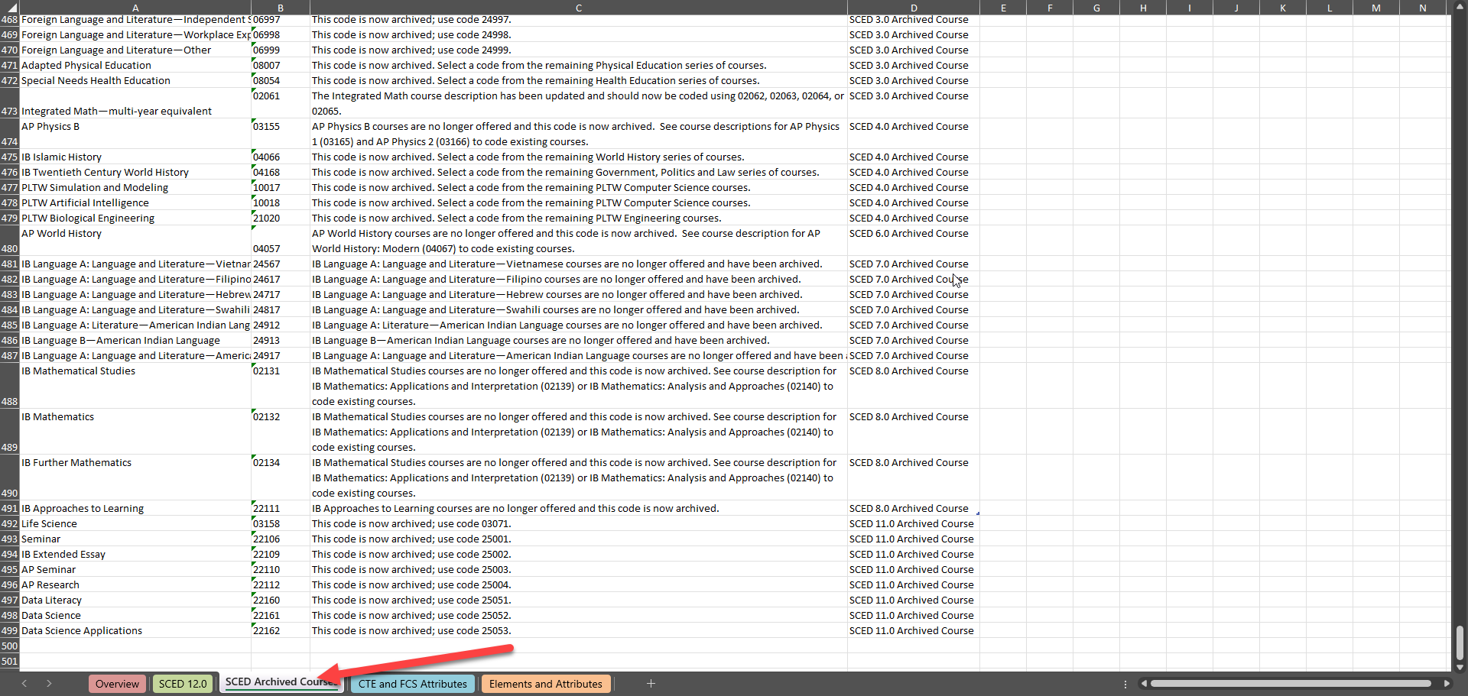
SCED Codes - Errors
If you are getting errors on SCED codes that you think are valid, double check the archived courses tab to see if the code has be replace with a newer one.
Reach out to collection lead if you are getting an error on a code that appears to be valid in the latest SCED file to get it added to CDE’s SCED code list and clear the error.

Slide 61
Common Questions

Slide 62
Common Questions / Errors
If my elementary is K-6, does that need to be reported?
No, however you may receive an error for this school code. Reach out to the TSDL collection lead at TeacherStudentDataLink@cde.state.co.us to start the exception process for this error.
For students taking classes that utilize a college professor or out of state educator, what should I do for the Educator of Record fields?
If there is a local district teacher “in charge” of the class from a district perspective, use their information. Otherwise, leave the Educator of Record fields blank.
If menu options like selecting TSDL in file upload or accessing the Snapshot in the TSDL menu are not available, please ensure you have the appropriate IDM roles setup: TSL~LEAUSER and TLS~LEAPPROVER
Ensure your Local Course Title field does not contain commas, as this will cause a shift in your data and prevent a successful file upload

Slide 63
Contact & Resources

Slide 64
Teacher Student Data Link Collection Lead
Here to answer questions and assist where possible
Don’t get frustrated, reach out!
To best assist you, please help me with the following
Include your 4-digit district code in emails and voicemails
Leave voicemails or send follow-up emails if I miss your call
Ensure your phone number is accurate in IdM (ask your LAM to help if it needs to be updated)
Email: TeacherStudentDataLink@cde.state.co.us
Phone: 720-925-8611

Slide 65
Bookmark/Resource List
Site Name/Link | Information/Uses
Data Pipeline Home Page | Starting point for all pipeline collections, training, and resources
 Teacher Student Data Link | Primary site for TSDL Collection information Contains file layouts, templates, business rules, training materials, and resources
 NCES SCED Codes | Contains the latest School Courses for the Exchange of Data (SCED) code file
 Identity Management (IdM) | This is the landing page with login links to the various CDE data platforms. Data Pipeline, COGNOS/CEDAR Reporting, RITS, etc.
 Frequently Requested Codes and Resources | Includes list of school codes, facility schools, detention centers, etc.
 Trainings | Subpages for Town Hall presentations and general respondent training resources
Syncplicity | Secure file transfer site used to communicate personally identifiable information with CDE if you have questions on specific students during reporting or have exception requests.

