Slide 1
Short Bytes
TREP

Slide 2
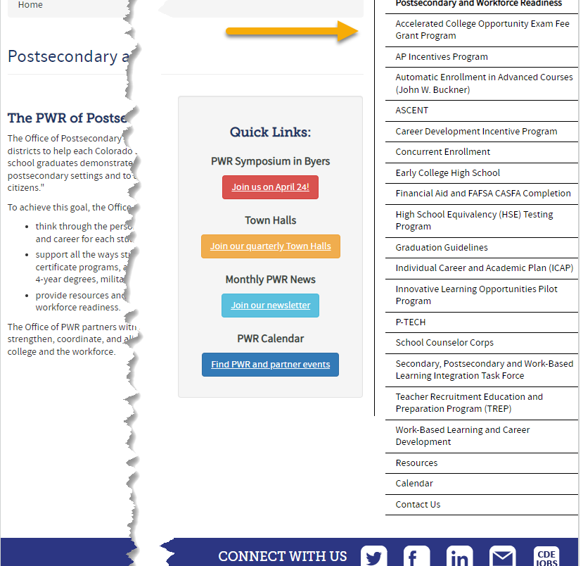
What are Postsecondary Programs?
Provide opportunities for high school students to demonstrate the knowledge and skills (competencies) needed to succeed in postsecondary settings and to advance in career pathways as lifelong learners and contributing citizens.
Support all the ways students can enter into postsecondary education – including certificate programs, apprenticeships and other work-based learning experiences, 2- and 4-year degrees, military, and career training.
Notes:
Erica

Slide 3
General Information: Types of Postsecondary Programs
Years 1-4
Years 5-6
Concurrent Enrollment
Early College
Participating schools only
Dropout Recovery at a Community College
Students Age 16 to 21
P-TECH Years 1-4
Participating schools only
ASCENT (year 5 only)
P-TECH (years 5 & 6)
Student must have been coded as PTECH in year 4
Participating schools only
TREP (years 5 & 6)
Slot allocation
Note: Number of years in High School is determined by the student’s Anticipated Year of Graduation (AYG). Only students with an AYG indicating they are in their 5th year are eligible for ASCENT. Only students in their 5th or 6th year per AYG are eligible for the applicable years of P-TECH or TREP.
Notes:
Erica

Slide 4
TREP Program Overview
Teacher Recruitment Education and Preparation
Creates the opportunity for qualified students in an educator career pathway to concurrently enroll in postsecondary courses and earn college credit at no tuition costs to them or their families, for up to two years after the 12th grade year.
Additional costs, such as textbooks, fees, and transportation, are not required by the district to cover.
Students need to take one class on the pathway in their 12th grade year to be eligible
Limited number of slots available
Districts must submit an Intent to Participate and spreadsheet with student level data to request slots
Notes:
Erica
*Talk about allocation and how that works

Slide 5
Current Year vs. Carryforward
Current Year
Carry Forward
Slots allocated and used in the same year
Funding received by district in same year as the slot was allocated
Can be either year 5 or year 6 slots
Slots that were allocated in the previous year, but not used
Funding was already received by the district in the previous year
Can only be year 5 slots
Notes:
Erica

Slide 6
Postsecondary Program Enrollment
Code | Postsecondary Program | Grade (Restrictions)
17 | TREP Year 5 (Current Year) | Retained 12th Only (12th grade in 5th year of high school per AYG)
18 | TREP Year 5 Carryforward – Full Time | Retained 12th Only (12th grade in 5th year of high school per AYG)
19 | TREP Year 5 Carryforward – Part Time | Retained 12th Only (12th grade in 5th year of high school per AYG)
20 | TREP Year 6 (Current Year) | Retained 12th Only (12th grade in 6th year of high school per AYG)
Student Interchange Source File:
2022-2023 Student Demographic
2023-2024 Student School Association
Notes:
Current: Student will utilize current year allocation slots
Carryforward: Student will utilize a carry forward slot that was not used in the prior year
Carryforward slots must be used before current year
Notes:
To track students that enroll in Postsecondary Programs, we have corresponding codes for each one of our programs. This information is provided to CDE through our Student School Association file to tie the postsecondary program to each student’s enrollment record. This is different in comparison to prior years in which the Postsecondary program enrollment field used to be reported through our Student Demographic File. For our TREP students, we have codes 17, 18, 19 and 20, depending on the TREP allocation slot utilized. Our Year 5 TREP students can be coded with 17, 18 or 19 depending if the student will use a Current Year or Carryforward allocation slot and further, if the student is using a carryforward slot, is the student full-time or part-time. Our code 20 is specifically for our TREP Year 6 students. This students can only use current year slots. Our codes 17 and 20 contribute to each LEAs Current Year Allocation summation and codes 18 and 19 will contribute to your district’s carryforward allocations. Anticipated Year of Graduation (AYG) helps CDE determine if students are in their 5th or 6th years of high school to verify only grade appropriate students are enrolled in the program. Please also note that carryforward slots must be used before current year as these funds have already been allocated to your district.

Slide 7
Allocation/Slot Utilization
Funding Codes -> | 80 | 82 | 85 | 87 | 91 | 92 | 94 | 95 | 96
TREP Year 5-17 Current Year | 1.0 | 0.5 | 0.5 |  | 1.0 | 1.0 | 0.5 | 0.5
TREP Year 5-18 Carryforward (Full Time) |  |  |  | 1.0 |  |  |  |  | 1.0
TREP Year 5-19 Carryforward (Part Time) |  | 0.5 toward Current Year, 0.5 toward Carryforward | 0.5 toward Current Year, 0.5 toward Carryforward | 0.5 |  |  | 0.5 toward Current Year, 0.5 toward Carryforward | 0.5 toward Current Year, 0.5 toward Carryforward | 0.5
TREP Year 6-20 Current Year | 1.0 | 0.5 | 0.5 |  | 1.0 | 1.0 | 0.5 | 0.5
District A has 2.0 Carryforward and 0.5 Current Year Slots
1 Student Coded as TREP Year 5 (17) with 82 funding = 0.5 Current Year
2 Students Coded as TREP Year 5 (18) with 87 funding = 2.0 Carryforward (1.0+1.0)
Notes:
Here is a quick chart to show the different TREP Postsecondary Codes in conjunction with their funding codes and how many slots the student would make up with that coding combination. The TREP Postsecondary Codes are listed on the left hand side of the chart while the funding codes are across the top. With a specific coding combination, you will see the allocation slot numbers indicated in red. For example, TREP Year 5 Current Year students (first row) can use funding codes 80, 82, 85, 91, 92, 94 or 95. The blacked out funding codes should not be used with Postsecondary Code 17. Here is a quick allocation example: District A was allocated 2.0 Carryforward slots (since they did not use those allocations in the prior year) and 0.5 Current Year slots. District A coded one student with TREP Year 5 Current Year (code 17) with an 82 funding code. This equates to 0.5 current year slots. They also have 2 students coded as TREP Year 5 Carryforward Full-time (code 18) with 87 funding codes,. This equates to 2.0 carryforward (1.0+1.0). District A has appropriately allocated all TREP slots.

Slide 8
Postsecondary Annual Coding Cycle
End of Year
October
Monitor for Status Changes
Monitor postsecondary program enrollment changes for students from OCT to SEY
Is the student actively participating in the postsecondary program?
Did the student participate in the postsecondary program at any point in the school year?
Coding remains the same as October unless an enrollment change occurred
Identify students that will be participating in TREP years 5-6 during Fall semester (retention code 2)
Reminder: Districts should verify student meets postsecondary requirements
Site: CDE Postsecondary and Workforce Readiness
Site: CDE Audit Resource Guide
Site: Student Interchange File Layout and Definitions-Student School Association
Student October
Is the postsecondary status of the student as of October 1st (Count Date)
Student End of Year
PS code is the summation of the current school year
PS code is not the status of the student for next year
Retention code 2 is the anticipated status for next year
Notes:
Each school year, we have a typical cycle in order to monitor a student’s postsecondary status throughout the school year. Starting at the top left of our cycle with the Student October Collection. Each LEA should verify that every actively participating postsecondary (or TREP) student is coded as such. These students should be actively participating in this program as of October 1st of that school year. After the closing of the Student October collection, moving to the next section, please monitor these students throughout the school year for status changes. We expect that postsecondary statuses do not change from the beginning to the end of the year, but that doesn’t necessarily mean that it can’t happen. Moving on to Student End of Year. During our Student End of Year Collection, LEAs will not only need to monitor TREP students in the current school year, but also gather a list of those students that plan to participate in the following school year. Coding should remain the same as October unless an enrollment change occurred during the same school year. The Postsecondary code of the student is the summation of the current school year. A helpful question you can ask yourself is “Did the student participate in the postsecondary program at any point in the school year?” Moving on to our second group of students: Students that plan to participate in the following school year. During this collection, LEAs need to identify students that will participate in TREP years 5-6 in the following school year. Using a retention code 2 let’s us know that the student plans to return the following year for TREP.
Please visit the links on this slide if you have questions about postsecondary programs.

Slide 9
Counting for Graduation Rates vs Received Diploma
Colorado Graduation Rates
Diploma Issued
Students who return to participate in ASCENT, TREP, or P-TECH years 5-6 may be counted as a graduate for graduation rate purposes at the end of their 4th year if they have met local and state graduation requirements.
Prevents students participating in these programs from negatively effecting the 4-year on time graduation rate for the district/school.
Students participating in ASCENT, TREP, and P-TECH years 5-6 programs receive their high school diplomas at the end of their corresponding program.
Diplomas & Transcripts reflect a student’s final exit from K-12 education as the graduation date.
Notes:
Some notes on counting TREP students for graduation rates vs. when the student receives their diploma. Students who return to participate in ASCENT, TREP, or P-TECH years 5-6 may be counted as a graduate for graduation rate purposes at the end of their 4th year if they have met local and state graduation requirements. This prevents students participating in these programs from negatively effecting district’s 4-year on time graduation rate. When we talk about the issuance of the diploma for students that participate in our years 5 and 6 programs, they should be provided at the end of their corresponding program. For TREP students, this would more than likely be at the end of their 6th year due to the program. Both the diploma and the transcript will reflect the student’s final exit from K-12 education as the graduation date.

Slide 10
TREP: Coding Pattern
Counted as Graduate in 4th year
Counted as Graduate in 6th year
Years in HS (per AYG) | 4th | 5th | 6th
Grade Level | 120 | 120 | 120
Postsecondary Program | 00 or 02 | 17, 18, 19 | 20
School Entry Type | 02* | 90 | 90
School Exit Type | 90 | 23 | 24 or 23
Retention Code | 2 | 2 | 0
Funding Status (OCT) | 80* | Check Chart | Check Chart
Years in HS (per AYG) | 4th | 5th | 6th
Grade Level | 120 | 120 | 120
Postsecondary Program | 00 or 02 | 17, 18, 19 | 20
School Entry Type | 02* | 02 | 02
School Exit Type | 00 | 00 | 96
Retention Code | 2 | 2 | 0
Funding Status (OCT) | 80* | Check Chart | Check Chart
Notes:
*Entry type and Funding Status in 4th year will be any applicable code
Exit 24 – Previous graduate who completed their TREP 6th year.
Exit 23 – Previous graduate who completed their TREP 5th year and will return for a 6th year or left TREP program in the middle of their 5th/6th year.
Funding Status is in direct relationship with Year 5/Year 6 and Current Year/Carryforward
Notes:
Let’s review two different coding patterns we have for TREP students: students that were counted as a graduate in the 4th year and students that were counted as a graduate in the 6th year. For this presentation’s purpose, we will just review the 4th year graduate to show how to read these charts. Just a reminder, students participating in TREP years 5-6 programs receive their high school diplomas at the end of their corresponding program (year 6).
Students that were counted as a graduate in the 4th year will have the following coding pattern if they anticipate returning as a TREP student in their 5th year (and more than likely their 6th year). These students will be indicated in 12th grade (120). Their postsecondary program in that year will reflect either not in a postsecondary program 00 or 02 which means concurrent enrollment. The school entry type for these students will be any applicable code for that year and the student’s funding status is also any applicable code for that school year (in this case, we have a full-time student – 80). For this example, we are using 02 which means the student continued on as normal from the prior year. The student’s School exit type will need to reflect the student meeting graduation requirements – 90 and marked as retention code 2 meaning that the student plans on returning as a postsecondary student. Moving on to the 5th year column in the orange chart. This is where LEAs will indicate that the student is participating in TREP. The grade level will say consistent with 120 for our 12th grade students. The Postsecondary program for this 5th year student will be 17, 18 or 19 depending on if the student is utilizing a current year or carryforward slot. The School Entry Type will be 90 since the student is returning after being counted as a graduate. Their exit type will be a 23: Previous graduate who completed their TREP 5th year and will return for a 6th year or left TREP. In this case, this student returned for the 6th year. The retention code should stay as a 2 because the student is returning again for their 6th year for our TREP program. The funding code of the student will be dependent on the allocation slot the student is utilizing. Finally moving to our 6th year for this student. The student will move to our Postsecondary code 20 indicating they are a current year TREP year 6 student. Entry will be 90 again because the student graduated in a prior year and is returning. The School Exit Type is depending on if the student completed the TREP program or not. If the student completed the program, you will use code 24. If the student did not complete the program, a code 23 will be used. The Retention code will change from 2 to 0 because the student will not return the next school year and again the funding status will be related to the allocation slot.
For our students that graduate in their 6th year, please use the coding pattern shown in the blue chart as it differs slightly to our other kiddos.

Slide 11
TREP: Types of Business Rule Checks
Students should have exit type 00, 96, 23, or 24
Exit Type 96 or 00 cannot be used if Exit Type 90 was used in a prior year
Exit Type 23 or 24 cannot be used unless the student had Exit Type 90 in a prior year
TREP students included in the subsequent OCT who do not have retention code 2 in the current year SEY
Example:
If 2023-2024 OCT postsecondary code indicating TREP year 5 or 6
Then 2022-2023 SEY must have Retention Code 2
Students in TREP should have Non-School Program code 04 (Third Party Program) because they are taking their courses through the IHE
Students cannot be in TREP year 6 if they were not in TREP year 5 in the prior year
District Code in the current year for TREP students must match their last district of attendance in the prior year
Students in TREP year 5 programs must be in the 5th year of HS per AYG
Students in TREP year 6 programs must be in the 6th year of HS per AYG
Students in TREP should not have retention 2 at the end of their 6th year
Student October (OCT) collection also includes checks to ensure TREP students utilize correct funding codes per OCT collection guidelines and checks TREP slot allocation
Notes:
We have a couple of business rule checks for TREP (not all are listed but let’s review a few). Students should be 00, 96, 23, or 24. TREP students included in the subsequent October Count who do not have retention code 2 in the current year Student End of Year Collection will flag an error. For example, if 2023-2024 OCT postsecondary code indicates TREP Years 5 or 6 then 2022-2023 Student End of Year record must have retention code 2 for that student. Students in TREP should have Non-School Program code 04 (Third Party Program) because they are taking their courses through the IHE. Students cannot be in TREP year 6 if they were not in TREP year 5 in the prior year. District Code in the current year for TREP students must match their last district of attendance in the prior year. Students in TREP year 5 programs must be in the 5th year of HS per AYG. The same thing goes for our 6th year TREP students. Also please, Note: Student October (OCT) collection also includes checks to ensure TREP students utilize correct funding codes per OCT collection guidelines and checks TREP slot allocation

Slide 12
For more information, please reach out to the Student Interchange Leads or Postsecondary Unit.
Notes:
Thank you for listening on this short byte regarding TREP students. For more information, please reach out to the Student Interchange Leads or Postsecondary Unit.

