Slide 1
February 5, 2026
Data Pipeline Town Hall
The goal of Pipeline Town Hall webinars is to provide updates on the Data Pipeline, current, and upcoming data collections.
These webinars also provide a forum for districts, BOCES, and Administrative Units to have questions answered about Data Pipeline.
Notes:
Good morning everyone and thank you for joining our weekly Data Pipeline Town Hall.
My name is _______________and I will be your host this week.
NEXT SLIDE

Slide 2
Agenda
Topic | Presenter
Open Collections and Upcoming Deadlines | Host: Reagan Ward
Stakeholder Feedback Opportunity | Annette Severson
Instructional Days and Hours | Annette Severson
Special Education December Count | Lindsey Heitman
Human Resources | Dawna Gudka
Summer E-BT | Collin Slutzky
Notes:
I will be going over the open collections and upcoming deadlines, we did have a last-minute change to the agenda, and we will not be covering Instructional Days and Hours this week, but we do have ______________________________talking about ________________________________ and etc.

Slide 3
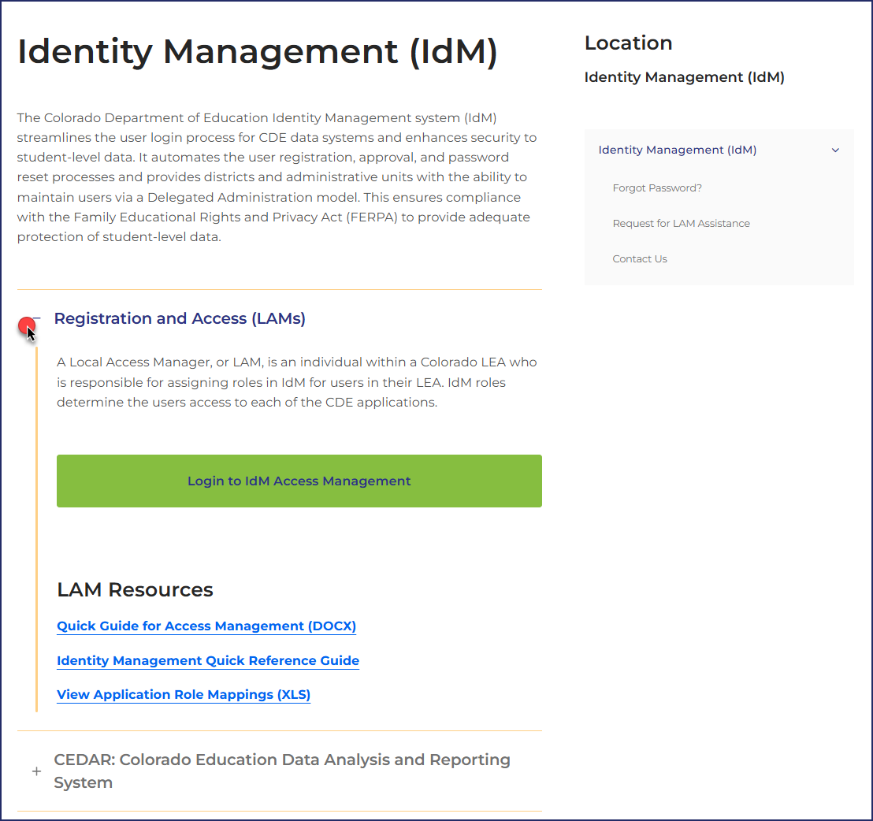
Colorado Department of Education
Identity Management (IdM)
Identity Management Site *NEW*
Links to CDE Applications
  Pipeline, CEDAR/COGNOS, RITS, EDIS, Etc.
Resources on IdM Site
  Frequently Asked Questions
  Application Role Mappings
  LAM Quick Guide
Important: Users are not automatically removed from IdM when their email address is no longer active in your district. The LAM must deactivate their IdM account to ensure only designated staff can access CDE’s data reporting system.
Support:
  Michael Threlkeld
  Forgot Password
  Request LAM Assistance
Notes:
A couple of quick reminders. The CDE Identity management system is what gets you access to all the different data collections. Each district has Local Access Managers who can assign you access to the different systems that you need for your collections. LAMS – Users are not automatically removed from IdM so please make sure you are checking your system making sure that only active users have access. NEXT SLIDE

Slide 4

What is PII?
Student Personally Identifiable Information (PII) is defined by state and federal laws as information that, alone or in combination, personally identifies an individual
  This includes direct identifiers
  (i.e. student and staff names, SASID, EDID, etc.)
  Includes information that when combined is identifiable
Colorado’s Student Data Transparency and Security Act outlines requirements for how Student PII is collected, used and shared
See the Data Privacy and Security website for prepared guidance on how to comply with this and other privacy laws.
Notes:
A quick reminder about PII? PII is personally identifiable information, such as SASIDS, Names, Date of birth, or Social Security Numbers - anything that would allow someone to identify the student with reasonable certainty.

Slide 5

Sharing Data
Use secure methods to transfer any PII to CDE
  Contact Data Collection leads with questions about how to transmit PII securely
    Each Data Collection leads maintains their own Syncplicity folders for specific collections, reach out to the collection lead for access
  Use Syncplicity to encrypt emails to CDE
Avoid sending PII via unencrypted email or to unsecured faxes when sharing data between or within districts
  Use Syncplicity to encrypt emails to CDE
Check local policies for restrictions, requirements, etc. regarding PII
  Do not use PII in trainings, presentations, etc.
  Do not share PII with unauthorized individuals
  Do not share passwords
  Follow local policies when transmitting PII to any third party
Notes:
We want to make sure that PII is not being sent through email, it needs to be sent in a secure manner. At CDE we use Syncplicity, so if you have a need to communicate PII please make sure you email the collection lead you are working with and we will make sure you are setup in Syncplicity. If you do upload a file, please let your collection lead know as we do not get automatic notifications when a file is uploaded.

Slide 6
Open Collections and Upcoming Deadlines

Slide 7
Open Collections and Upcoming Dates: Year-Round & Interchanges
Name | Category | Status | Key Dates
Directory | Year Round | Open | N/A
EDIS | Year Round | Open | N/A
RITS | Year Round | Open | N/A
At-Risk | Interchange | Closed | N/A
Discipline | Interchange | Open | Upload file and continue to resolve errors
Special Education IEP | Interchange | Open | Maintain error free interchange files
Staff | Interchange | Open | Maintain error free staff assignment and staff profile files
Student | Interchange | Open | Maintain error free DEM & SSA files for use in Special Education December Count Upload GG file and review CEDAR/COGNOS reports to monitor GG completion
TSDL Interchange | Interchange | Open | N/A
Title I | Interchange | Open | Maintain error free file
Pipeline Collections Calendar

Slide 8
Open Collections and Upcoming Dates: Snapshots
Name | Status | Final Deadline Date | Next Milestone | Looking Ahead
Special Education December | Open | Feb. 20, 2026 | Interim Deadline: 2/06/26 error free snapshot | Duplicates Process: 2/9/2026 to 2/17/2026
Human Resources | Open | Feb. 19, 2026 | Report Review: 1/22/2026 to 2/13/2026 | Collection Final Deadline: 2/19/26
Student Discipline Snapshot | Soft Open | June 30, 2026 | Office Hours: 02/10/26 @10:00 am Register | Training Event: 02/24/26 @1:00pm Student Discipline Collection Training Afternoon Session Register
Pipeline Collections Calendar

Slide 9
Open Collections and Upcoming Dates: Periodic
Name | Status | Final Deadline Date | Next Milestone | Looking Ahead
Facility Schools December Staff | Open | Feb. 2, 2026 | Opens 11/3/25 | Closes 2/2/2026
Summer EBT | Open | Feb. 27, 2026 | Interim Deadline 2/6/2026 Upload file and review errors | Interim Deadline 2/20/2026 Error-free Summer EBT upload
Instructional Days and Hours | Open | Feb. 27, 2026 | Deadline extended to 2/27/2026
Pipeline Collections Calendar

Slide 10
Stakeholder Feedback Opportunity
Annette Severson

Slide 11
CDE has contracted with WestEd
A non-partisan research, development, and service agency, is helping CDE evaluate whether and what technology solution could reduce the data burden on districts.
Value assessment for a State Information SOLUTION and not just a single SIS
Engaging with stakeholders in the field to get their voice
Researching models in other states (single SIS, hybrid models, improvements to data intake (pipeline) and reporting tools, etc.)
Summary with proposed approaches and estimated costs for the legislature due at the end of June 2026.

Slide 12
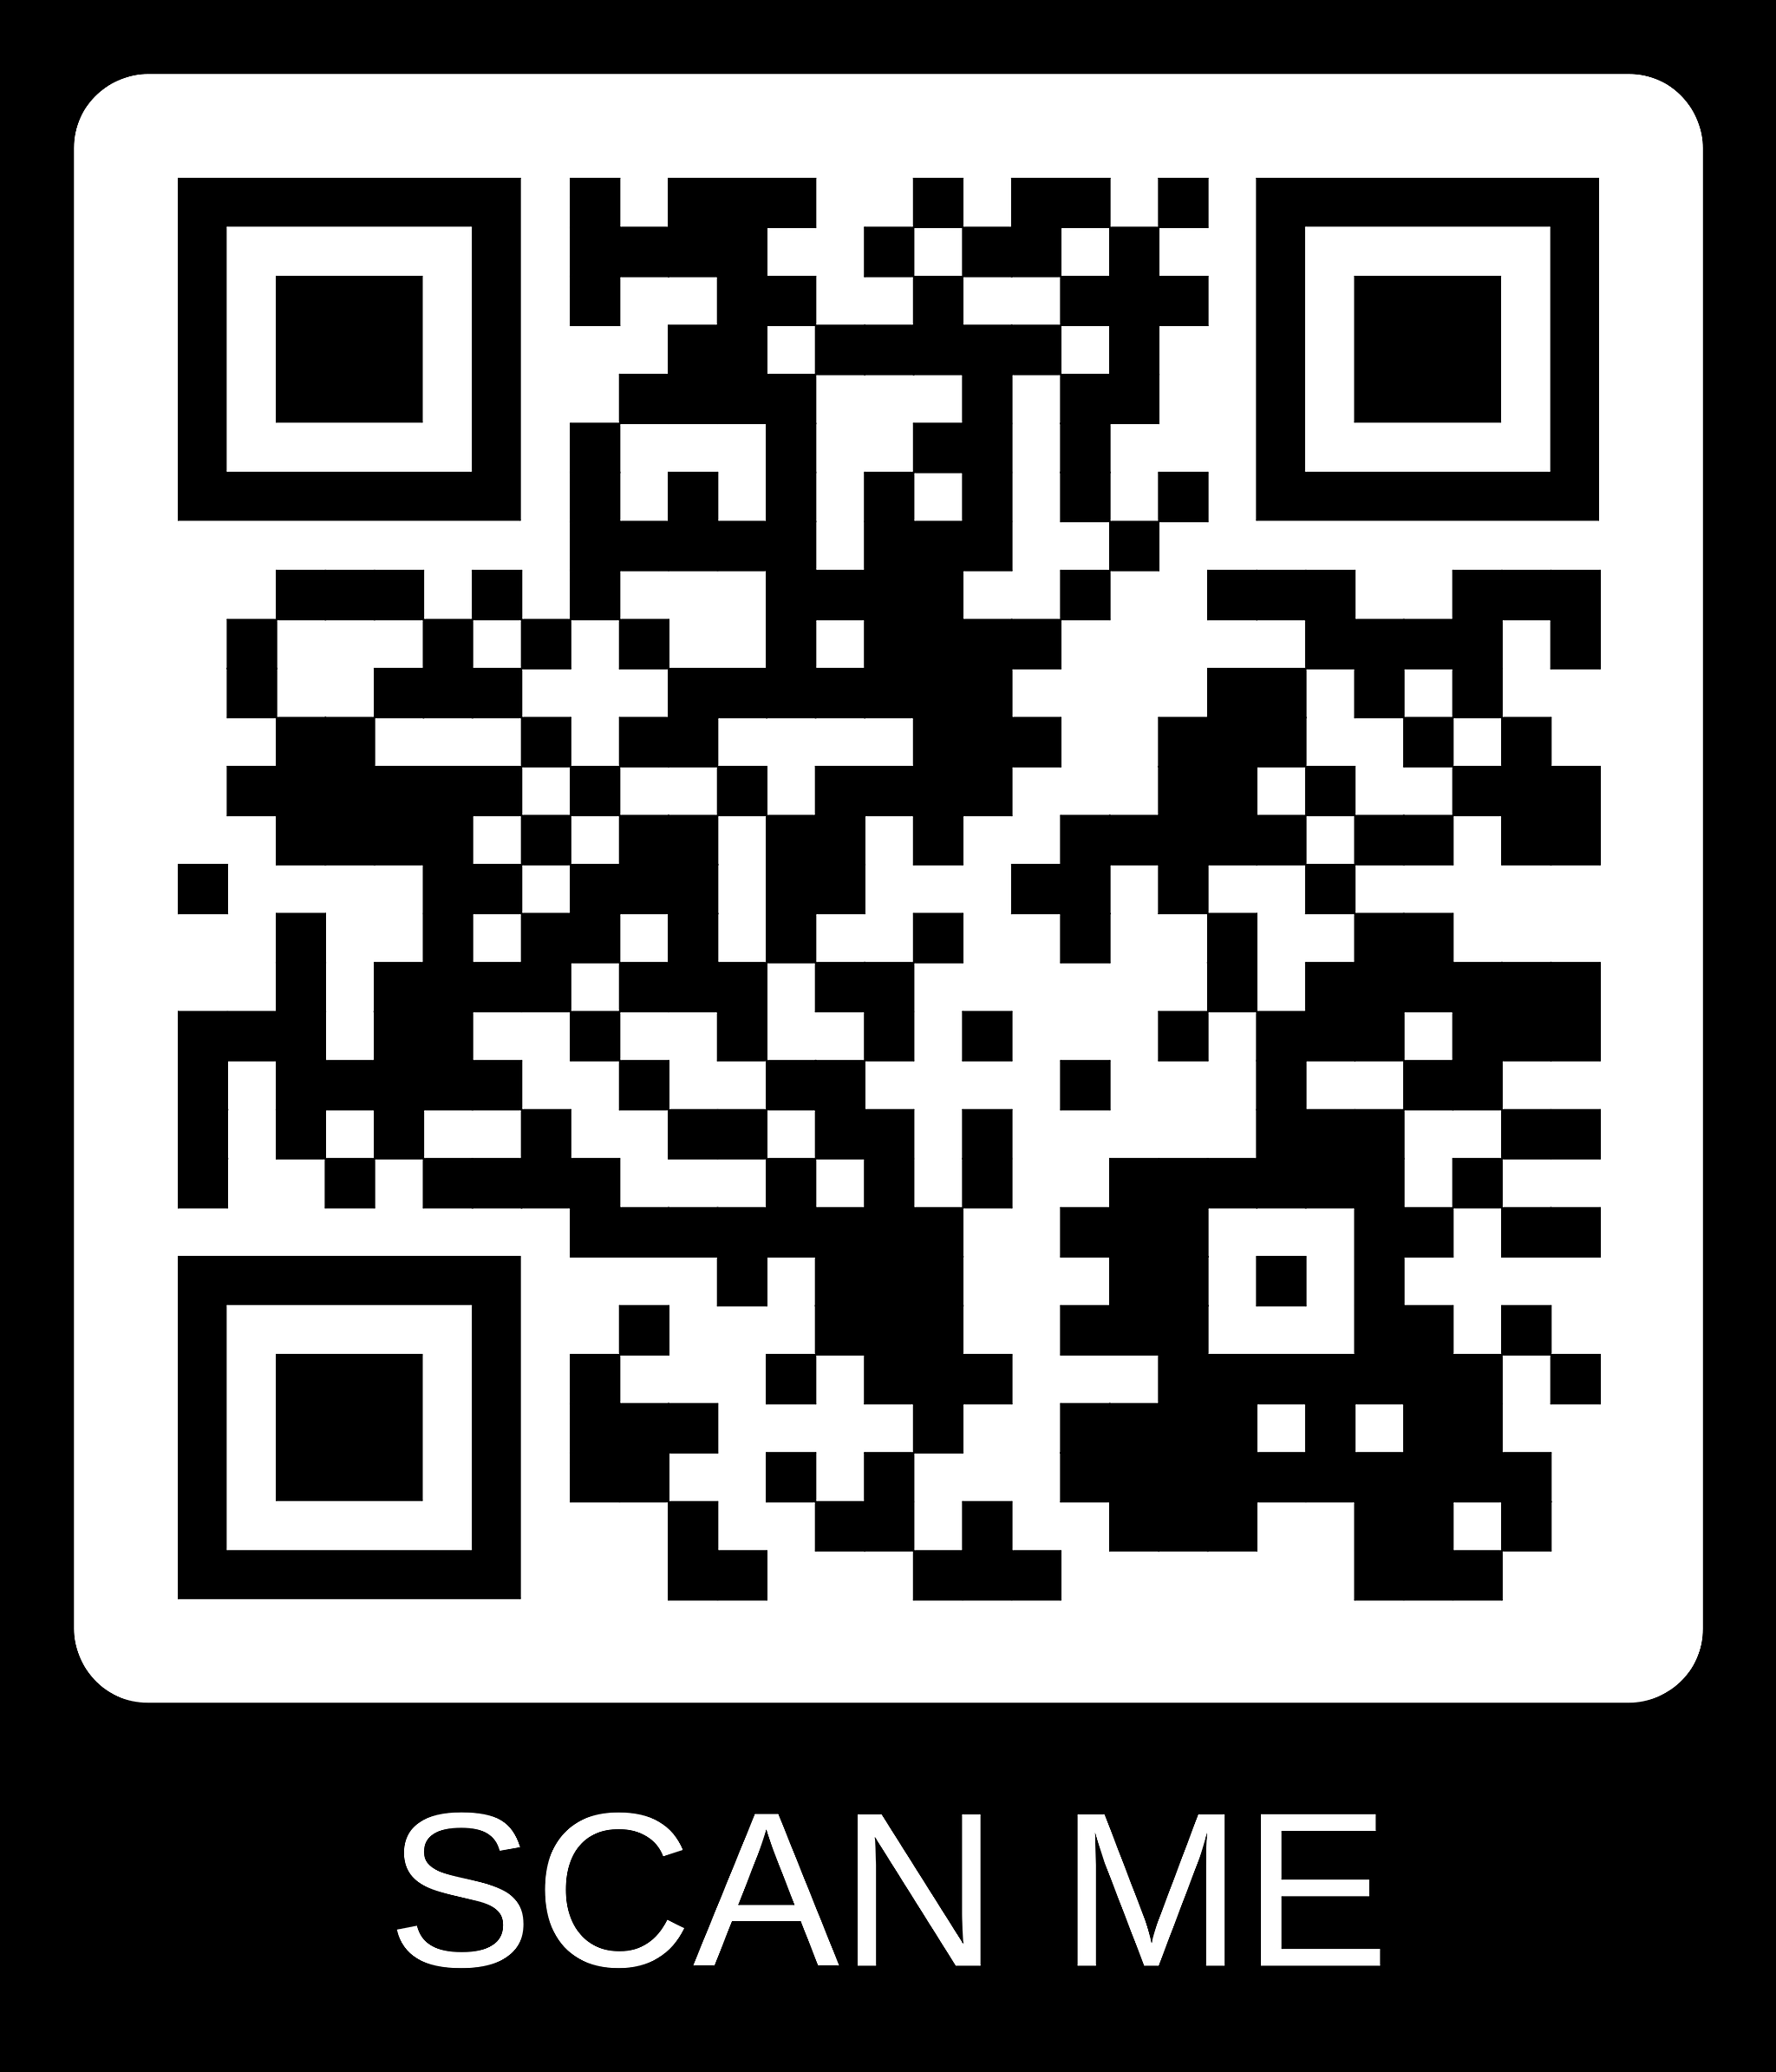
You can get involved in this assessment!
Are you interested in being involved? Use this LEA Interest and Input form
Overall, looking to answer several critical questions:
  What technology solution could reduce the burden on LEPs?
  What would different approaches cost and how could they be funded?
  And fundamentally - is it worth making a change?
Questions?
  Contact Sara Kock skock@wested.org

Slide 13
Instructional Days and Hours
Annette Severson

Slide 14
2025-2026 Data Collection
Deadline has been extended to 2/27/2026
Reach out to Annette Severson (Severson_a@cde.state.co.us) for assistance
Response time may be slow, but I will help as best as I can during this time.
Resources Available: Instructional Days and Hours Webpage
Instructional Days and Hours
Severson_a@cde.state.co.us

Slide 15
2026-2027 Collection Information
Timeline extended – will not open this Spring 2026
More information to come April 1st
  Timeline
  File layout
  Record Expectation
Thank you for your patience and understanding
Instructional Days and Hours
Severson_a@cde.state.co.us

Slide 16
Special Education December Count
Lindsey Heitman

Slide 17

Special Education December Count Status
70 AU/SOPs -December Count Error Status
52 AUs – error free in both Staff and Student December Count snapshots
7 additional AUs – error free in at least one snapshot
18 AUs – errors in one or both snapshots
Special Education December Count
SpedDecCount@cde.state.co.us

Slide 18
Special Education
Timeline Clarification
Friday, January 30 – complete error free snapshot
All Sped IEP and Staff Interchange errors resolved
All December Count Snapshot errors resolved
January 30 – February 6 – Initial Report Review
Friday February 6 is a statewide deadline
Review December Count Staff and Student Cognos reports
No need to sign reports or submit anything to CDE until the final report review week
February 9 – 10 - CDE to run duplicate and other data validity checks on student data
  Email will be sent by Wednesday, 2/11 with instructions for AUs
February 11 – 17 - Administrative Units research and make file changes to resolve duplicate and data validity issues.
Wednesday, February 18 (STATE DEADLINE) - all duplicates resolved and snapshot complete and error-error
  Email will be sent once all duplicates are resolved and it is ok to start submitting your final snapshot
February 18 - 20 Final Report Review and Submission to CDE.
  Approve final Special Education December Count Snapshot in the Data Pipeline by clicking “Submit to CDE” button
  Upload 16 signed reports and Flag Explanation document (if necessary) to the DMS
  Signed reports are uploaded to the Data Management System under the ESSU DMS Documents tab. Please tag the file with the corresponding data collection name
Special Education December Count
SpedDecCount@cde.state.co.us

Slide 19
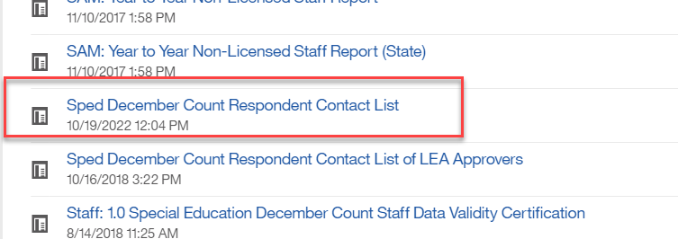
Special Education December Count: Student Warnings
Duplicate Records between AUs – check for these December Student warnings
  DC154: Another AU is also claiming a Funding Status of 50 for this student. Please verify attendance and enrollment records for December 1st. If your record is correct, you may leave it the same.
  DC214: Another AU is reporting that this student is attending in their AU. Please verify attendance and enrollment records for December 1st. If your record is correct, you may leave it the same and ignore this warning.
    The other reporting AU is included in the far right column of the error report
    Reference ‘Pupils Attendance Information Codes’ document from December Count Snapshot webpage under Additional Links for help with PAI and Funding Status Codes.
    Contact List found in Cognos→Special Education December folder
To find the other AU contact info, export the entire report to Excel and search the Admin Unit # column for the AU#. Be sure to email all contacts listed to ensure you catch the right person, sometimes there are several people listed for an AU.

Slide 20
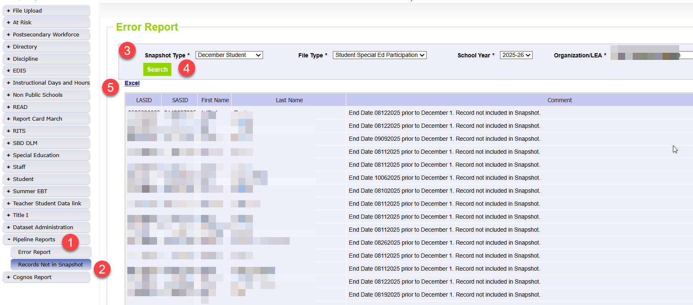
Pipeline Reports → Records Not in Snapshot
MUST CHECK this report so you don’t inadvertently miss records from snapshot that are due funding
Keep in mind not all records on this report should be in your snapshot.
  Records are correctly excluded if they have a Start Date or Exit Date that doesn’t overlap 12/01 or no Start Date at all.
You will want to fix any SASID or LASID mismatches between files, missing records from one file, or records with interchange errors (that should be in your snapshot).
Missing records = missed funding! Check for records that were receiving SPED services as of 12/01/25.
Special Education December Count
SpedDecCount@cde.state.co.us

Slide 21
Questions & Resources:
Special Education December Count
Lindsey Heitman
SpedDecCount@cde.state.co.us
(720) 456-2033
Special Education IEP Interchange Webpage
Special Education December Snapshot Webpage
Staff Interchange

Slide 22
Human Resources
Dawna Gudka

Slide 23
Human Resources Collection Status
Collection Deadline 2/19/26
Human Resources Snapshot Collection-Dawna Gudka
HumanResourcesData@cde.state.co.us

Slide 24
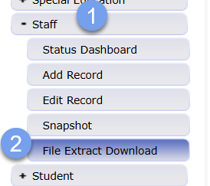
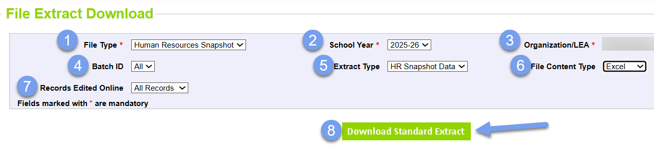
Human Resources Data Validation
Validate your data by
  Review your snapshot records and verify all non-special education staff providing services on 12/1 are accounted for in your data
  Extract your snapshot records in Data
Human Resources Snapshot Collection-Dawna Gudka
HumanResourcesData@cde.state.co.us

Slide 25
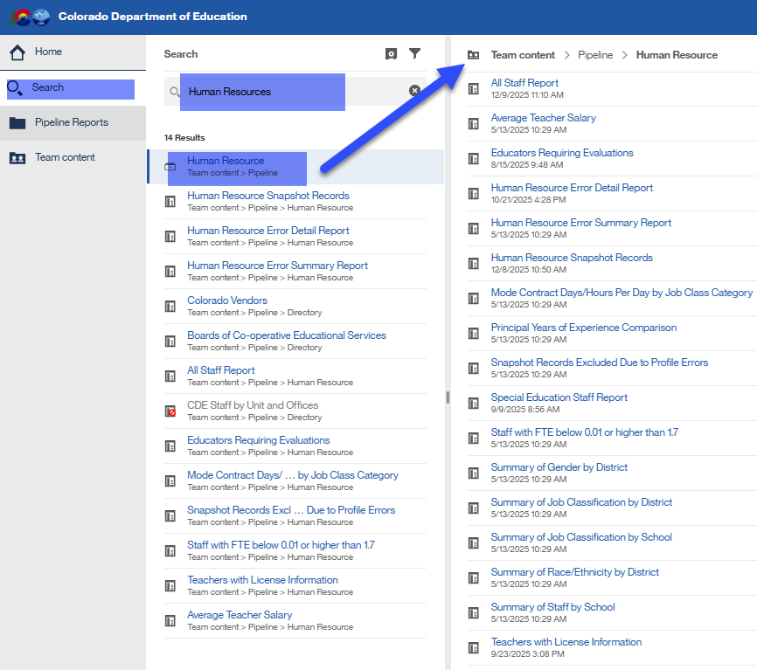
Human Resources Data Validation cont.
Validate your data by
  Review your snapshot records and verify all non-special education staff providing services on 12/1 are accounted for in your data
  Pull the Cognos report “Human Resources Snapshot Records”
  Use Cognos reports to verify data
Human Resources Snapshot Collection-Dawna Gudka
HumanResourcesData@cde.state.co.us

Slide 26
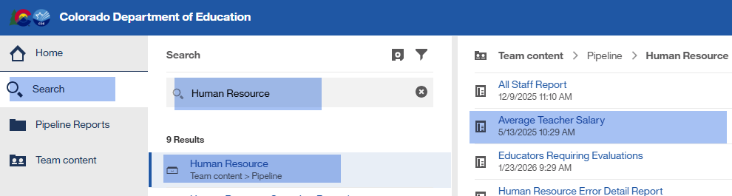
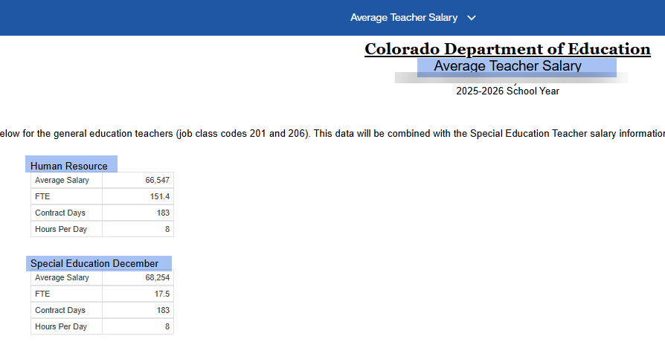
Human Resources Cognos Report Weekly highlight
Average Teacher Salary Cognos Report
Human Resources Snapshot Collection-Dawna Gudka
HumanResourcesData@cde.state.co.us

Slide 27
Questions & Resources:
Human Resources
Dawna Gudka
HumanResourcesData@cde.state.co.us
Please include your LEA or AU code when emailing/voicemail
(303) 598-7901
Staff Interchange website
Human Resources Snapshot website

Slide 28
Summer EBT
Collin Slutzky

Slide 29
Summer EBT Timeline
Date | Event | Event Description
01/28/2026 | Training Event | Summer EBT Data Pipeline Overview 1-2 p.m Registration available here
02/02/2026 | Open | Districts may begin uploading Summer EBT files
02/06/2026 | Interim Deadline | Upload Summer EBT file and review errors
02/20/2026 | Interim Deadline | Upload error-free Summer EBT file
02/25/2025 | Report Review | Review Summer EBT file to ensure Free/Reduced Lunch reporting is correct
02/27/2025 12:00 p.m. | State Deadline | Submit Summer EBT data
Summer EBT
S-ebt@cde.state.co.us

Slide 30
Summer EBT Updates
Trainings slides, recording, and business rules will be posted to the Data Pipeline website ASAP
  Business rules are mostly unchanged from last year
  PB272: This rule compared current Summer EBT counts to the most recent Student October counts.
  This rule never worked correctly due to differences in how Free/Reduced Lunch Eligibility differ between Student October and S-EBT. It has been deactivated
Eligibility requirements are also unchanged from last year
  Reminder: Free/Reduced Price Lunch Eligibility status only considers current year documentation. CEP and carry-over flexibilities do not apply to Summer EBT
Summer EBT
S-ebt@cde.state.co.us

Slide 31
Questions & Resources:
Summer EBT
Collin Slutzky
S-ebt@cde.state.co.us
720-760-3569
S-EBT Data Pipeline & Resources

Slide 32
Next Town Hall:
2/12/2026
Reminder: There are four types of data pipeline collections
The Data Pipeline Website groups collection specific websites by these four types.
Year Round
Interchange
Snapshot
Periodic
  File uploads as needed throughout the year with some set Key dates throughout the year
    RITS, EDIS, Directory
  Do not require finalize/submission process
  Designed for ongoing file uploads throughout the year/window open
  Source files for snapshot collections
  Files typically extracted from applicable district information systems
  Do not require finalize/submission process
  Data pipeline process to combine select data fields from one or more interchange files
  Require finalize/ submission process
  File uploaded based on a specific time frame or data expectations
  Files typically extracted from applicable district information systems
  Independent (mostly) of interchange files
  Require finalize/ submission process

