Slide 1
February 19, 2026 Data Pipeline Town Hall
The goal of Pipeline Town Hall webinars is to provide updates on the Data Pipeline, current, and upcoming data collections.
These webinars also provide a forum for districts, BOCES, and Administrative Units to have questions answered about Data Pipeline.
Notes:
Good morning everyone and thank you for joining our weekly Data Pipeline Town Hall.
My name is _______________and I will be your host this week.
NEXT SLIDE

Slide 2
Agenda
Topic | Presenter
Open Collections and Upcoming Deadlines | Host: Lindsey Heitman
2026-2027 Student Interchange: At-Risk Status | Coreen Miner
Student End of Year | Reagan Ward
Special Education December Count | Lindsey Heitman
Human Resources | Dawna Gudka
Summer EBT | Collin Slutzky
Notes:
I will be going over the open collections and upcoming deadlines, we did have a last-minute change to the agenda, and we will not be covering Instructional Days and Hours this week, but we do have ______________________________talking about ________________________________ and etc.

Slide 3
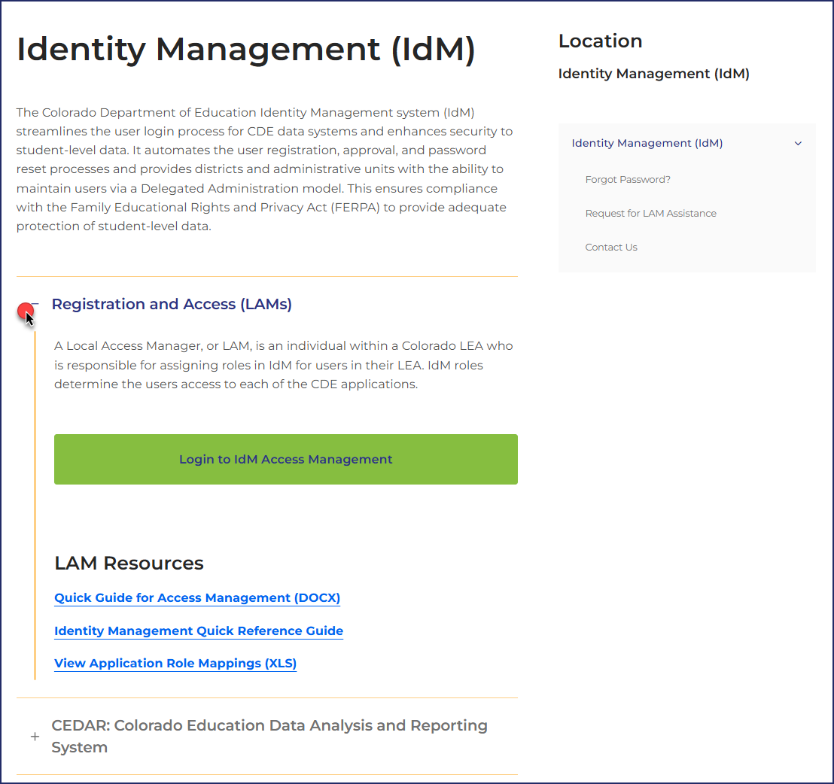
Colorado Department of Education Identity Management (IdM)
Identity Management Site
Links to CDE Applications
Pipeline, CEDAR/COGNOS, RITS, EDIS, Etc.
Resources on IdM Site
Frequently Asked Questions
Application Role Mappings
LAM Quick Guide
Important: Users are not automatically removed from IdM when their email address is no longer active in your district. The LAM must deactivate their IdM account to ensure only designated staff can access CDE’s data reporting system.
Support:
Michael Threlkeld
Forgot Password
Request LAM Assistance
Notes:
A couple of quick reminders. The CDE Identity management system is what gets you access to all the different data collections. Each district has Local Access Managers who can assign you access to the different systems that you need for your collections. LAMS – Users are not automatically removed from IdM so please make sure you are checking your system making sure that only active users have access. NEXT SLIDE

Slide 4

PII & Sharing Data
Personally Identifiable Information (PII)
Sharing Data
Student Personally Identifiable Information (PII) is defined by state and federal laws as information that, alone or in combination, personally identifies an individual
This includes direct identifiers (i.e. student and staff names, SASID, EDID, etc.)
Includes information that when combined is identifiable
Colorado’s Student Data Transparency and Security Act outlines requirements for how Student PII is collected, used and shared
Use secure methods to transfer any PII to CDE
Contact Data Collection leads with questions about how to transmit PII securely
Each Data Collection leads maintains their own Syncplicity folders for specific collections, reach out to the collection lead for access
Use secure (encrypted) methods to share PII between or within districts
Use Syncplicity to encrypt emails to CDE
Check local policies for restrictions and requirements regarding PII
(e.g., trainings, presentations, authorized individuals, passwords, third party, etc.)
Data Privacy and Security
Syncplicity Login

Slide 5
Open Collections and Upcoming Deadlines

Slide 6
Open Collections and Upcoming Dates: Year-Round & Interchanges
Name | Category | Status | Key Dates
Directory | Year Round | Open | School Code Changes: 3/2/2026 to 6/30/2026
EDIS | Year Round | Open | N/A
RITS | Year Round | Open | N/A
At-Risk | Interchange | Closed | N/A
Discipline | Interchange | Open | Upload file and continue to resolve errors
Special Education IEP | Interchange | Open | Maintain error free interchange files
Staff | Interchange | Open | Maintain error free staff assignment and staff profile files
Student | Interchange | Open | Maintain error free DEM & SSA files for use in Special Education December Count Upload GG file and review CEDAR/COGNOS reports to monitor GG completion
TSDL Interchange | Interchange | Open | N/A
Title I | Interchange | Open | Maintain error free file
Pipeline Collections Calendar

Slide 7
Open Collections and Upcoming Dates: Snapshots
Name | Status | Final Deadline Date | Next Milestone | Looking Ahead
Special Education December | Closing Soon | Feb. 20, 2026 | Interim Deadline: | Final Deadline: 2/20/26
Human Resources | Open Closing Soon | Feb. 19, 2026 TODAY | Collection Final Deadline: TODAY 2/19/26 | Data published
Student Discipline Snapshot | Soft Open | June 30, 2026 | Office Hours: 02/10/26 @10:00 am Register | Training Event: 02/24/26 @1:00pm Student Discipline Collection Training Afternoon Session Register
TSDL Snapshot | Coming Soon | Sept. 25, 2026 | TSDL Interchange Opened 2/4/2026 | Snapshot Opens: 3/18/2026
Pipeline Collections Calendar

Slide 8
Open Collections and Upcoming Dates: Periodic
Name | Status | Final Deadline Date | Next Milestone | Looking Ahead
Summer EBT | Open | Feb. 27, 2026 | Interim Deadline 2/6/2026 Upload file and review errors | Interim Deadline 2/20/2026 Error-free Summer EBT upload
Instructional Days and Hours | Open | Feb. 27, 2026 | Deadline extended to 2/27/2026
Report Card March | Coming Soon | April 10, 2026 | Collection Opens: 2/25/2026
School Code Requests Forms – Available March 2nd – June 30th
Pipeline Collections Calendar

Slide 9
2026-2027 Student Interchange: At-Risk Status
Coreen Miner

Slide 10
2026-2027 Updates
File: Student Demographic
Data Fields:
Retiring—Free Lunch Eligibility Identification
New—At-Risk Status
Updated Definition—Free/Reduced Lunch Price Eligible
Codes remain the same
Text updates to provide clarification
Updates expected in April with release of all 2026-2027 Student Interchange file layouts
EDAC Notes
Approved retirement and new field in February 2026
Updated definition will be presented to EDAC in March 2026 for approval
2026-2027 Student Interchange: At-Risk Status Field
armeasure@cde.state.co.us

Slide 11
At-Risk Status Field
New field in the Student Demographic file for the 2026/2027 Student October data submission
Will be used for determining a district’s at-risk count and subsequent funding
Intent is to aid districts in the reporting of at-risk eligibility given flexibilities in Rule (1 CCR 301-39):
6.02(2): In the absence of current year documentation, may use documentation from the prior year
6.02(4): May use the “best” status/documentation from any point in the CEP cycle
2026-2027 Student Interchange: At-Risk Status Field
armeasure@cde.state.co.us

Slide 12
At-Risk Status Field Values
Free
At-Risk Eligibility
Reduced-Price
At-Risk Eligibility
Paid
At-Risk Eligibility
Code | Description
11 | Free: Direct Cert – Current Year
12 | Free: Direct Cert – Prior Year
13 | Free: Direct Cert – Prior Year 2+ (CEP Years 2+ Sites Only)
14 | Free: Income Form – Current Year
15 | Free: Income From – Prior Year
16 | Free: Income Form – Prior Year 2+ (CEP Years 2+ Sites Only)
17 | Free: Other Categorical – Current Year
18 | Free: Other Categorical – Prior Year
19 | Free: Other Categorical – Prior Year 2+ (CEP Years 2+ Sites Only)
Code | Description
21 | Reduced: Direct Cert – Current Year
22 | Reduced: Direct Cert – Prior Year
23 | Reduced: Direct Cert – Prior Year 2+ (CEP Years 2+ Sites Only)
24 | Reduced: Income Form – Current Year
25 | Reduced: Income Form – Prior Year
26 | Reduced: Income Form – Prior Year 2+ (CEP Years 2+ Sites Only)
Code | Description
31 | Paid: No Documents
32 | Paid: Current Year Income Form
2026-2027 Student Interchange: At-Risk Status Field
armeasure@cde.state.co.us

Slide 13
At-Risk Status Field Training
Date: 4/7/2026
Time: 10-11am
Registration Link
Must pre-register by 9am 4/7/26
More training coming throughout spring and summer
2026-2027 Student Interchange: At-Risk Status Field
armeasure@cde.state.co.us

Slide 14
Questions & Resources: At-Risk Data
At-Risk Count Webpage
Coreen Miner & Rebecca McRee
School Auditing Office
At-Risk Questions: armeasure@cde.state.co.us

Slide 15
Student End of Year
Reagan Ward

Slide 16
2025-2026 Changes
Removed data field Innovative Learning Opportunities Pilot
Minor text changes to internal flag definitions to provide additional clarity
Updated data sources for internal flags in the data field list to provide additional clarity
Student End of Year
StudentEndOfYear@cde.state.co.us

Slide 17
Planned Business Rule Updates
Additional cross-collection checks
Summer EBT FRL status compared to SEY FRL status
Missing record error: PWR Collection includes WBL or IRC record, but no record exists in SEY collection
Warning if Student Discipline indicates student received educational services during expulsion, but no SEY record exists where expelled education = yes
Refinement of existing cross-collection checks
SE414 & SE415 missing record warnings for students with IEP interchange records where a SEY snapshot record is expected
Collection level checks
No records with a school entry date after October Count Day
Number of records with an entry date after October Count Day is significantly less than prior years (10% decrease or more)
Checks based upon new entry/exit codes added to the student interchange for 2025-2026.
SE287 upgrade from warning to error—student’s OCT language proficiency differs from SEY for a student who transferred between CO LEAs.
Draft business rules with planned update notes will be posted on the SEY website within the next week.
Student End of Year
StudentEndOfYear@cde.state.co.us

Slide 18
2025-2026 Collection Timeline
Date | Event | Event Description
3/30/2026 to 4/21/2026 | Soft-Open Phase | Optional Phase LEAs may create snapshots while CDE continues ongoing documentation updates and business rule updates.
4/30/2026 to 9/3/2026 | Regular Phase | Primary data collection and clean-up phase All LEAs must participate in this phase, submitting an error-free snapshot by the 9/3/2026 state deadline.
9/21/2026 to 10/15/2026 | Cross LEA Phase | Post-collection phase focused on data validation across Colorado LEAs. All LEAs must participate in this phase, resubmitting an error-free snapshot by the 10/15/2026 deadline.
10/22/2026 to 11/17/2026 | Post-Cross LEA Phase | Final post-collection phase focused on data validation between the current SEY collection and subsequent COCT collection along with data validation across Colorado LEAs. All LEAs must complete the minimum required action during this phase by the 11/17/2026 deadline.
12/1/2026 | Final Deadline | Superintendent Verification (sign-off) forms due
January 2027 | Data Release | Specific date TBD—Data is embargoed until the official data release.
Detailed timeline available on the SEY Website
Student End of Year
StudentEndOfYear@cde.state.co.us

Slide 19
Register for Upcoming Trainings
Date/Time | Training Description and Registration
4/3/2026 9:00-11:00am | Collection Overview Training 1 of 2: This training covers all elements of the Student End of Year collection. This training is being offered in two identical sessions to provide the opportunity for all SEY data respondents to attend a live session. Collection Overview 1 of 2 Registration
5/5/2026 12:30-2:30pm | Collection Overview Training 2 of 2: This training covers all elements of the Student End of Year collection. This training is being offered in two identical sessions to provide the opportunity for all SEY data respondents to attend a live session. Collection Overview 2 of 2 Registration
5/19/2026 1:00-2:00pm | Operational Reports Training: This training covers CEDAR/COGNOS reports designed to support data respondents throughout the collection. Operational Reports Training Registration
6/9/2026 1:00-2:00pm | Common Coding Scenarios Part 1 Training: This training covers common coding scenarios impacting SEY data, primarily focused on scenarios that often require collaboration and monitoring across multiple LEA colleagues. Common Coding Scenarios Pt. 1 Training Registration
7/14/2026 1:00-2:00pm | Common Coding Scenarios Part 2 Training: This training covers common coding scenarios impacting SEY data, primarily focused on scenarios where reporting exceptions may be needed. Common Coding Scenarios Pt. 2 Training Registration
9/15/2026 1:00-2:30pm | Cross LEA Phase Training: This training covers the steps necessary to complete the Cross LEA phase and continued data validation/clean-up. Cross-LEA Phase Training Registration
10/20/2026 1:00-2:30pm | Post-Cross LEA Phase Training: This training covers the steps necessary to complete the Post-Cross LEA phase and final data validation/clean-up. Post-Cross LEA Phase Training Registration
Student End of Year
StudentEndOfYear@cde.state.co.us

Slide 20
SEY Snapshot Dependencies and Criteria
Include all PK-12 students who attended your LEA at any point in the current year.
Dependencies
Criteria
Student has an assigned SASID
Student Interchange Records
Student Demographic
Student School Association
May have multiple records
Graduation Guidelines
Only required for graduating students
Adjustment File
Only required if adjusting prior year data
Replaces need for DEM or SSA records
Title 1 Interchange Records if…
Received Title 1 Targeted Assistance Services at any point in current year
Special Education IEP Interchange Record if…
Student is a Special Education student
Error free interchange records
Enrollment records on the SSA file where…
Primary School = 1 (yes)
School Code is a valid public school
Student PAI code between 01 and 08 (Group A records only)
Grade level is not ‘002’ infant
Matched records from other source files
DEM = SASID, District Code, School Year
GG = SASID
Other Interchange and CDE Sources = SASID, School Year
Student End of Year
StudentEndOfYear@cde.state.co.us

Slide 21
Questions & Resources: Student End of Year
StudentEndOfYear@cde.state.co.us
720-484-9057
Data Pipeline Collection Support Page: Request a SEY meeting
Student End of Year Collection Website
Colorado Education Statistics
Student Interchange Website

Slide 22
Special Education December Count
Lindsey Heitman

Slide 23
Special Education February Timeline
February 11 – 17 - Administrative Units research and make file changes to resolve duplicate and data validity issues.
Wednesday, February 18 (STATE DEADLINE) - all duplicates resolved and snapshot complete and error-error
Email will be sent once all duplicates are resolved and it is ok to start submitting your final snapshot
February 18- 20 Final Report Review and Submission to CDE.
Approve final Special Education December Count Snapshot in the Data Pipeline by clicking “Submit to CDE” button
Upload 16 signed reports and Flag Explanation document (if necessary) to the DMS
Signed reports are uploaded to the Data Management System under the ESSU DMS Documents tab. Please tag the file with the corresponding data collection name
SpedDecCount@cde.state.co.us
Special Education December Count

Slide 24
Special Education December Count - Student and Staff Signature Reports – Due by February 20th
Cognos Reports→ Special Education December Folder (reports are listed on the validity certification reports):
December Student Cognos Validation Reports: 2.0 Student Data Validity Certification 2.1 Significant Year to Year Report by Age Group and Disability
2.2 Significant Year to Year Report by Age Group and Race/Ethnicity
2.3 Significant Year to Year Report by Age Group and Educational Environment
2.4 Significant Year-to-Year Educational Orphan Report
2.5 Indicator 5: Number of Students Aged 6-21 by Educational Environment
2.6 Indicator 6: Number of Students Aged 3-5 by Educational Environment
2.7 Number of Reported Students by Special Education Funding Status by Administrative Unit and Disability
2.8 Number of Reported Students Parentally Placed in a Private School by Disability and Type of Service
2.9 Indicator 9: Disproportionate Representation of Racial and Ethnic Groups in Special Education Ages 3-21
2.10 Indicator 10: Disproportionate Representation of Racial and Ethnic Groups in Specific Disability Categories in Ages 3-21
*Please review Student Warnings
December Staff Cognos Validation Reports:
1.0 Staff Data Validity Certification
1.1 Summary of Special Education Staff by Administrative Unit, District & Job Classification Category
1.2 Summary of Job Classification by District Purchased Service Staff
1.4 Special Education Directors & Child Find Coordinators
SAM 1.5 Non-Qualified Personnel Status
*Please review Staff SAM Warnings DC208, DC209, DC210, DC211
Special Education December Count
SpedDecCount@cde.state.co.us

Slide 25
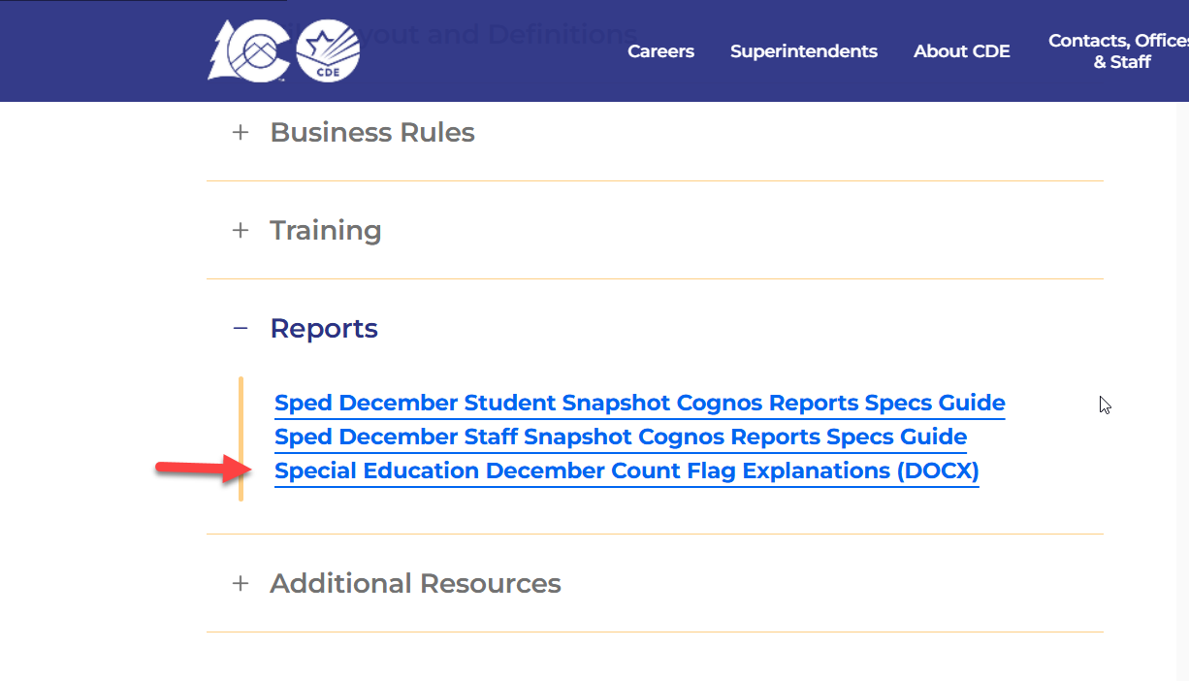
Special Education December Count Flag Explanation Template
AUs are required to submit an explanation for each A flag on the 2.1, 2.2, 2.3, or 2.4 year-to-year reports.
Use the flag explanation template found on the Special Education December Count Snapshot webpage under the Reports section.
Special Education December Count
SpedDecCount@cde.state.co.us

Slide 26
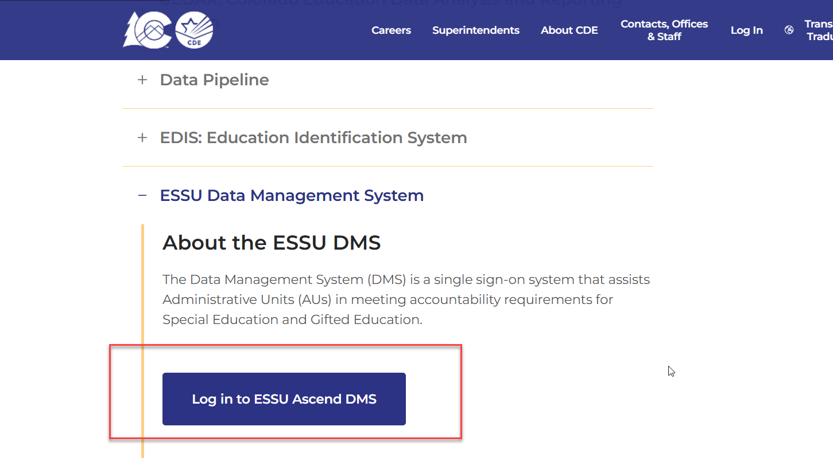
Uploading Reports to the ESSU Data Management System
From the Idm homepage, click ESSU Data Management System log in button
Special Education December Count
SpedDecCount@cde.state.co.us

Slide 27
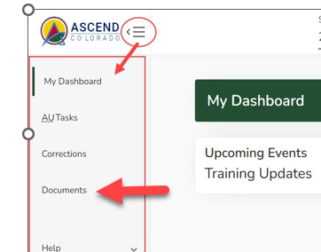
Special Education December Count – Reports Due for Upload to the Data Management System
By February 20, 2026
Upload Required Reports to the Data Management System
Staff Report #’s: 1.0, 1.1,1.2, 1.4, SAM 1.5
Student Report #’s: 2.0, 2.1, 2.2, 2.3, 2.4, 2.5, 2.6, 2.7, 2.8, 2.9, 2.10
Please upload these signed reports to the DMS under the Documents section (same location as the Discipline and EOY Reports).
If you have questions on uploading reports to the DMS or would like confirmation of your upload, please email Josh Fails at Fails_J@cde.state.co.us
Special Education December Count
SpedDecCount@cde.state.co.us

Slide 28
Questions & Resources: Special Education December Count
Lindsey Heitman
SpedDecCount@cde.state.co.us
(720) 456-2033
Special Education IEP Interchange Webpage Special Education December Snapshot Webpage
Staff Interchange

Slide 29
Human Resources
Dawna Gudka

Slide 30


Human Resources Collection Status
Human Resources Snapshot Collection-Dawna Gudka
HumanResourcesData@cde.state.co.us

Slide 31
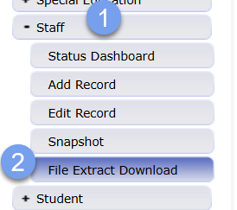
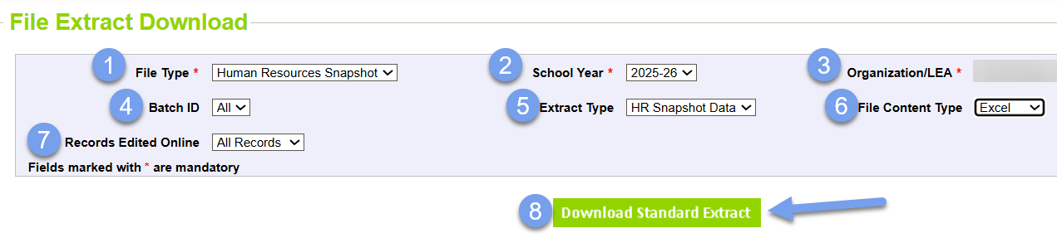
Human Resources Data Validation
Validate your data by
Review your snapshot records and verify all non-special education staff providing services on 12/1 are accounted for in your data
Extract your snapshot records in Data
Human Resources Snapshot Collection-Dawna Gudka
HumanResourcesData@cde.state.co.us

Slide 32
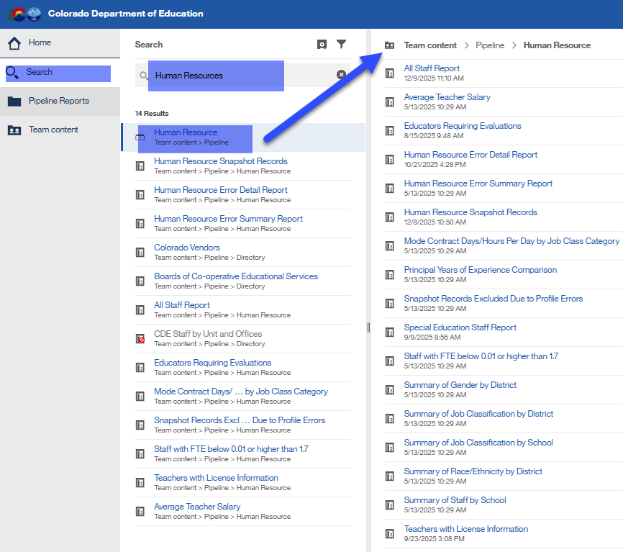
Human Resources Data Validation cont.
Validate your data by
Review your snapshot records and verify all non-special education staff providing services on 12/1 are accounted for in your data
Pull the Cognos report “Human Resources Snapshot Records”
Use Cognos reports to verify data
Human Resources Snapshot Collection-Dawna Gudka
HumanResourcesData@cde.state.co.us

Slide 33
Questions & Resources: Human Resources
Dawna Gudka
HumanResourcesData@cde.state.co.us
Please include your LEA or AU code when emailing/voicemail
(303) 598-7901
Staff Interchange website
Human Resources Snapshot website

Slide 34
Summer EBT
Collin Slutzky

Slide 35
Summer EBT Timeline
Date | Event | Event Description
01/28/2026 | Training Event | Summer EBT Data Pipeline Overview 1-2 p.m Registration available here
02/02/2026 | Open | Districts may begin uploading Summer EBT files
02/06/2026 | Interim Deadline | Upload Summer EBT file and review errors
02/20/2026 | Interim Deadline | Upload error-free Summer EBT file
02/25/2025 | Report Review | Review Summer EBT file to ensure Free/Reduced Lunch reporting is correct
02/27/2025 12:00 p.m. | State Deadline | Submit Summer EBT data
Summer EBT
S-ebt@cde.state.co.us

Slide 36
Summer EBT Reminders
Training slides, recording, and business rules have been posted to the Data Pipeline website
Please use the current form to book office hours. Requests through the old form may not get noticed
If you need help with formatting issues, please contact the S-EBT inbox for access to a Syncplicity folder
103 districts have uploaded data, and 47 districts are submitted and locked. Thank you for your hard work!
Summer EBT
S-ebt@cde.state.co.us

Slide 37
Questions & Resources: Summer EBT
Collin Slutzky
S-ebt@cde.state.co.us
720-760-3569
S-EBT Data Pipeline & Resources

Slide 38
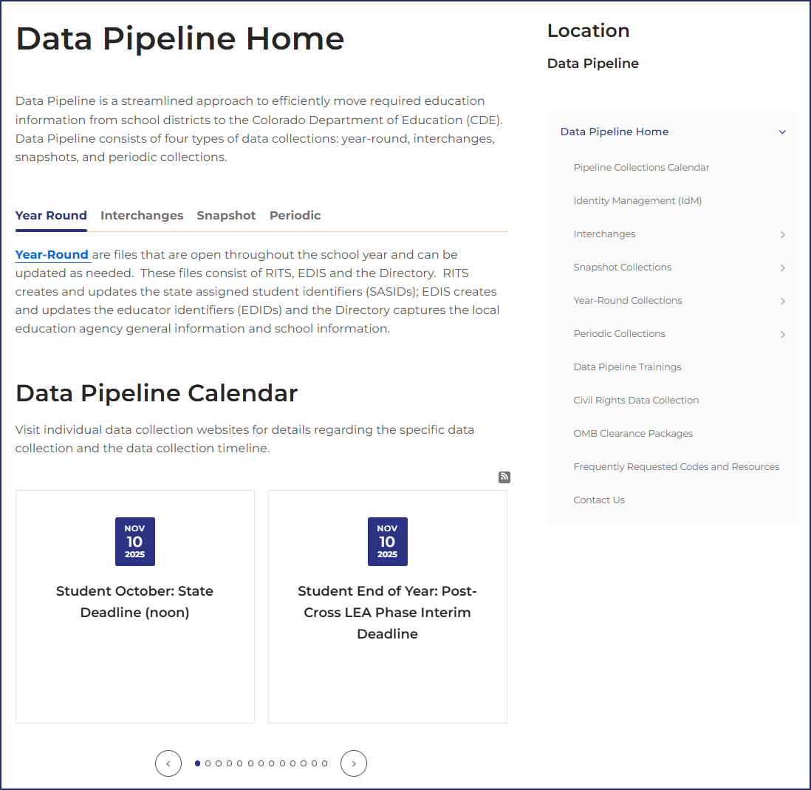
Next Town Hall: 2/26/2026
Visit the Data Pipeline Home Page to access specific collection pages.
Each data collection page has detailed information about the collection such as deadlines, file layouts, business rules, and helpful resources.

