Slide 1
February 26, 2026
Data Pipeline Town Hall
The goal of Pipeline Town Hall webinars is to provide updates on the Data Pipeline, current, and upcoming data collections.
These webinars also provide a forum for districts, BOCES, and Administrative Units to have questions answered about Data Pipeline.
Notes:
Good morning everyone and thank you for joining our weekly Data Pipeline Town Hall.
My name is _______________and I will be your host this week.
NEXT SLIDE

Slide 2
Agenda
Topic | Presenter
Open Collections and Upcoming Deadlines | Host: Reagan Ward
Teacher Student Data Link | Peter Hoffman
Human Resources | Dawna Gudka
Summer EBT | Collin Slutzky
WIDA ACCESS SBD & Assessment SBD Snapshot | Leon Merker
Student End of Year | Reagan Ward
Student Interchange Reminders | Reagan Ward
Notes:
I will be going over the open collections and upcoming deadlines, we did have a last-minute change to the agenda, and we will not be covering Instructional Days and Hours this week, but we do have ______________________________talking about ________________________________ and etc.

Slide 3
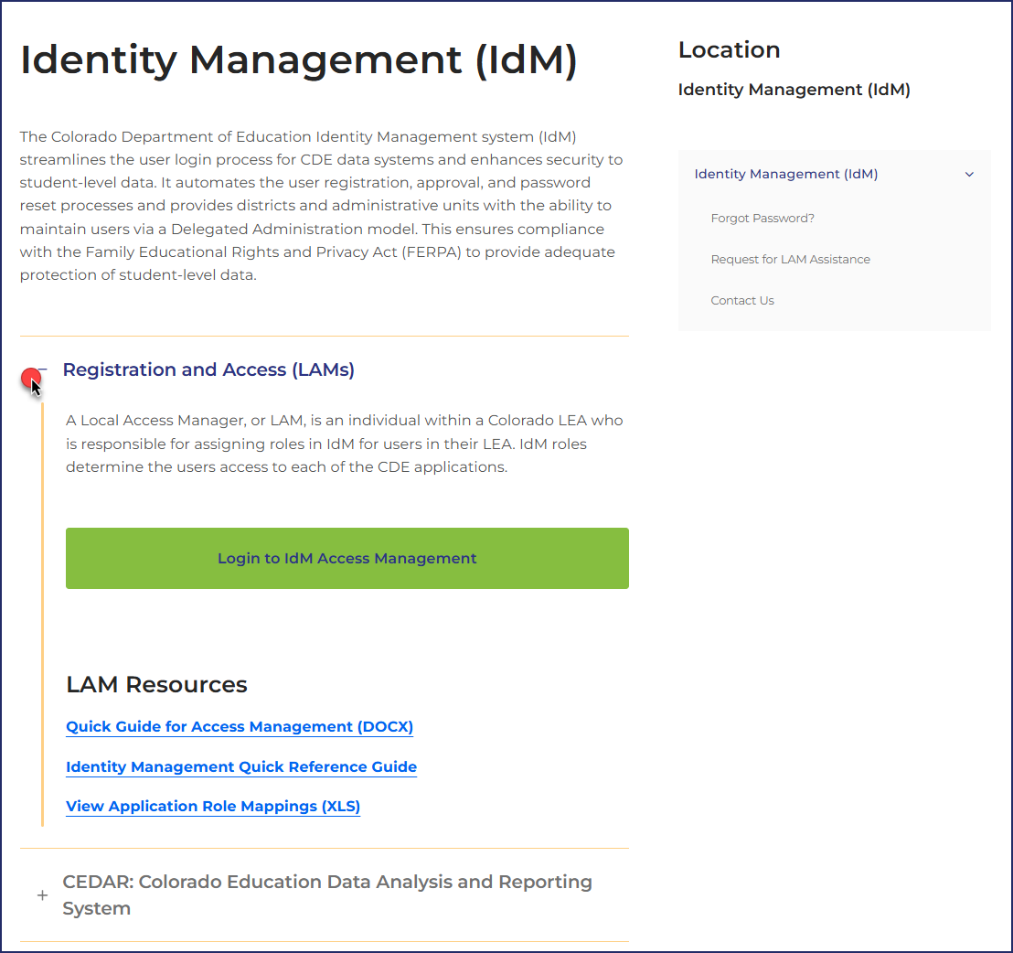
Colorado Department of Education
Identity Management (IdM)
Identity Management Site
Links to CDE Applications
  Pipeline, CEDAR/COGNOS, RITS, EDIS, Etc.
Resources on IdM Site
  Frequently Asked Questions
  Application Role Mappings
  LAM Quick Guide
Important: Users are not automatically removed from IdM when their email address is no longer active in your district. The LAM must deactivate their IdM account to ensure only designated staff can access CDE’s data reporting system.
Support:
  Michael Threlkeld
  Forgot Password
  Request LAM Assistance
Notes:
A couple of quick reminders. The CDE Identity management system is what gets you access to all the different data collections. Each district has Local Access Managers who can assign you access to the different systems that you need for your collections. LAMS – Users are not automatically removed from IdM so please make sure you are checking your system making sure that only active users have access. NEXT SLIDE

Slide 4

PII & Sharing Data
Personally Identifiable Information (PII)
Sharing Data
Student Personally Identifiable Information (PII) is defined by state and federal laws as information that, alone or in combination, personally identifies an individual
  This includes direct identifiers
  (i.e. student and staff names, SASID, EDID, etc.)
  Includes information that when combined is identifiable
Colorado’s Student Data Transparency and Security Act outlines requirements for how Student PII is collected, used and shared
Use secure methods to transfer any PII to CDE
  Contact Data Collection leads with questions about how to transmit PII securely
    Each Data Collection leads maintains their own Syncplicity folders for specific collections, reach out to the collection lead for access
Use secure (encrypted) methods to share PII between or within districts
  Use Syncplicity to encrypt emails to CDE
Check local policies for restrictions and requirements regarding PII
  (e.g., trainings, presentations, authorized individuals, passwords, third party, etc.)
Data Privacy and Security
Syncplicity Login

Slide 5
Open Collections and Upcoming Deadlines

Slide 6
Open Collections and Upcoming Dates: Year-Round & Interchanges
Name | Category | Status | Key Dates
Directory | Year Round | Open | School Code Change Requests: 3/2/2026 to 6/30/2026 Reduced Academic Calendar Applications: 3/2/2026 to 6/30/2026
EDIS | Year Round | Open | N/A
RITS | Year Round | Open | N/A
At-Risk | Interchange | Closed | N/A
Discipline | Interchange | Open | Upload file and continue to resolve errors
Special Education IEP | Interchange | Open | Maintain error free interchange files
Staff | Interchange | Open | Maintain error free staff assignment and staff profile files
Student | Interchange | Open | Interim Deadline 3/12/2026 Upload DEM & SSA files Student Discipline, SPED Discipline, and WIDA ACCESS SBD
TSDL Interchange | Interchange | Open | N/A
Title I | Interchange | Open | Maintain error free file
Pipeline Collections Calendar

Slide 7
Open Collections and Upcoming Dates: Snapshots
Name | Status | Final Deadline Date | Next Milestone | Looking Ahead
Special Education December | Closed | Feb. 20, 2026 | Interim Deadline: | Final Deadline: 2/20/26
Human Resources | Closed | Feb. 19, 2026 | Collection Final Deadline: 2/19/26 | Data published
Student Discipline Snapshot | Soft Open | June 30, 2026 | Office Hours: 3/10/2026 @1:00pm Register | Interim Deadline: 3/12/2026 Upload student interchange files (DEM & SSA)
TSDL Snapshot | Coming Soon | Sept. 25, 2026 | TSDL Interchange Opened 2/4/2026 | Snapshot Opens: 3/18/2026
Pipeline Collections Calendar

Slide 8
Open Collections and Upcoming Dates: Periodic
Name | Status | Final Deadline Date | Next Milestone | Looking Ahead
Summer EBT | Open | Feb. 27, 2026 | Interim Deadline 2/20/2026 Error-free Summer EBT upload | State Deadline 2/27/2026 Submit Summer EBT Data
Instructional Days and Hours | Open | Feb. 27, 2026 | Submit data | Collection Closes: 2/27/2026
Report Card March | Open | April 10, 2026 | Collection Opens: 2/25/2026 | Collection Closes: 4/10/2026
WIDA ACCESS SBD | Coming Soon | March 24, 2026 | Collection Opens: 3/16/2026 | Collection Closes: 3/24/2026, 5pm
Pipeline Collections Calendar

Slide 9
Teacher Student Data Link
Peter Hoffman

Slide 10
Teacher Student Data Link 2025-2026 Timeline
Date | Event | Event Description
Wednesday, February 4, 2026 | Open | TSDL Upload Interchange file opens.
Thursday, March 18, 2026 | Open | TSDL Snapshot opens.
Friday, May 15, 2026 | Interim Deadline | TARGET: Date by which you should have uploaded the TSDL Upload interchange file at least once
Friday, June 12, 2026 | Interim Deadline | TARGET: Date by which the TSDL Upload interchange should be uploaded and error free.
Friday, June 26, 2026 | Interim Deadline | TARGET: Date by which the TSDL snapshot should be created at least once.
Friday, September 18, 2026 | Interim Deadline | TARGET: Date by which you should have a complete Teacher Student Data Link Snapshot. Complete Teacher Student Data Link Snapshot means: All TSDL interchange errors are resolved All TSDL snapshot errors are resolved If you anticipate that you will not be able to meet this deadline, please contact CDE at TeacherStudentDataLink@cde.state.co.us
Monday, September 21, 2026 – Thursday, September 24, 2026 | Report Review | Final Snapshot Report Review – This is your opportunity to review reports in detail and make any data corrections you deem necessary to make sure you are reporting valid and reliable data. All data corrections must be completed during this time.
Friday, September 25, 2026 | Deadline | Required to have TSDL snapshot error free and finalized before or on this date. TSDL closed and final report is signed and provided to CDE via email TeacherStudentDataLink@cde.state.co.us
Teacher Student Data Link
TeacherStudentDataLink@cde.state.co.us

Slide 11
Teacher Student Data Link IDM Roles
TSDL Interchange / Upload Roles:
TSL~LEAVIEWER
TSL~LEAUSER (Recommended Role)
TSDL Snapshot Roles:
TLS~LEAVIEWER
TLS~LEAUSER
TLS~LEAAPPROVER (Recommended role, at least one needed to complete collection
Application | Collection | User Role | Access & Notes
Pipeline | Teacher Student Data Link Interchange and Snapshot | LEA User | Required for TSDL Interchange data respondents. Upload file for TSDL Interchange Upload Can create snapshot but cannot submit final status.
Pipeline | Teacher Student Data Link Snapshot | LEA Approver | At least one required per LEA. Creates snapshot, submits snapshot, download sign-off form.
Pipeline | Both TSDL Interchange and Snapshot | LEA Viewer | View CEDAR/COGNOS reports related to the assigned collection but cannot edit data. Useful role for district support staff who help validate data but do not actively complete the collection.

Slide 12
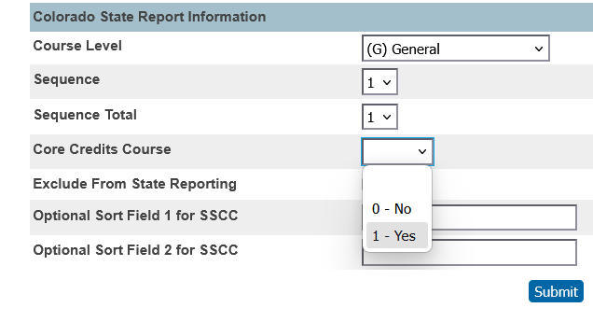
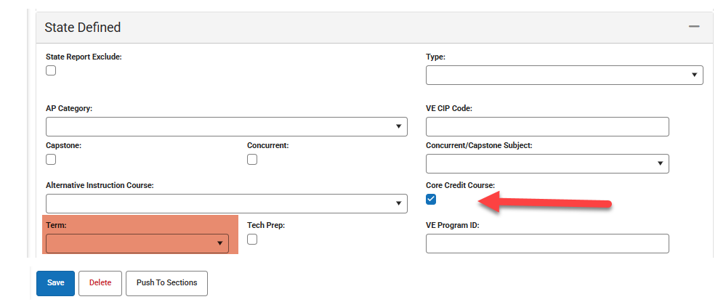
Teacher Student Data Link New Field for 2025-26
Core Credits Course
  Yes (1) or No (0) field indicating whether this course grants core course credit for the student.
  Used for courses that may not have traditional SCED codes for the core subject areas that your LEA is granted core course credits for. Recommended that all traditional core subject area (SCED Codes starting in 01, 02, 03, 04) courses be marked yes(1) for this field.
  Created to help with 9th grade success reporting

Slide 13
TSDL Error Report Issue
Issue with seeing detail in Data Pipeline Error Report Should be fixed.
Still can only view up to 1000 error details
  If you need to view more, utilize the Teacher Student Data Link Error Report in COGNOS.

Slide 14
Questions and Resources
Teacher Student Data Link
Peter Hoffman
TeacherStudentDataLink@cde.state.co.us
720-925-8611
Teacher Student Data Link Interchange Website
Book Time With Me

Slide 15
Human Resources
Dawna Gudka

Slide 16
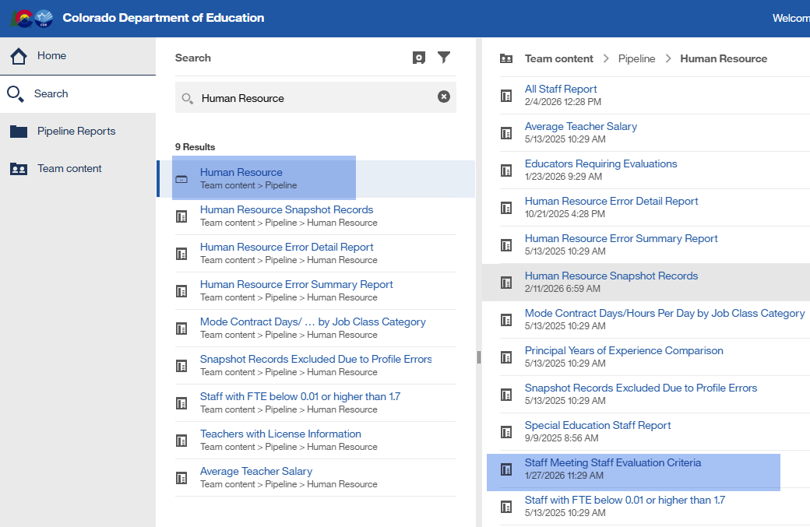
New Human Resources Cognos Report to Prep for Staff Evaluation
Search Human Resources-Staff Meeting Staff Evaluation Criteria
Human Resources Snapshot Collection-Dawna Gudka
HumanResourcesData@cde.state.co.us

Slide 17
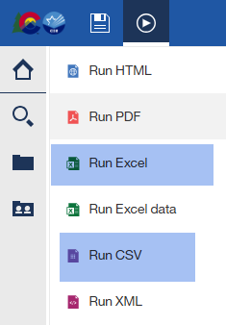
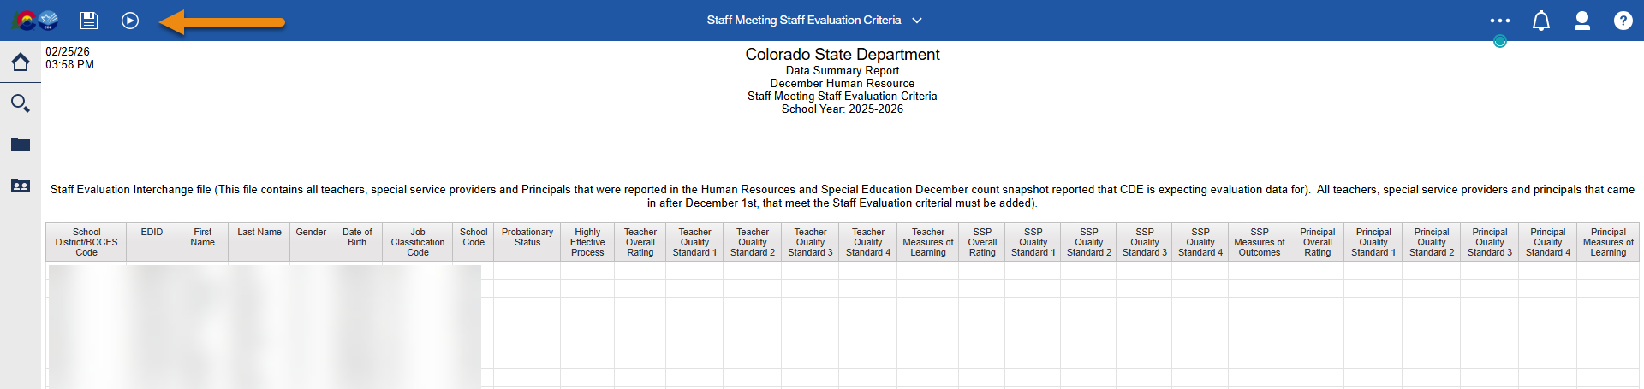
New Human Resources Cognos Report
Search Human Resources-Staff Meeting Staff Evaluation Criteria
Human Resources Snapshot Collection-Dawna Gudka
HumanResourcesData@cde.state.co.us

Slide 18
Questions & Resources:
Human Resources
Dawna Gudka
HumanResourcesData@cde.state.co.us
Please include your LEA or AU code when emailing/voicemail
(303) 598-7901
Staff Interchange website
Human Resources Snapshot website

Slide 19
Summer EBT
Collin Slutzky

Slide 20
Summer EBT Timeline
Date | Event | Event Description
01/28/2026 | Training Event | Summer EBT Data Pipeline Overview 1-2 p.m Registration available here
02/02/2026 | Open | Districts may begin uploading Summer EBT files
02/06/2026 | Interim Deadline | Upload Summer EBT file and review errors
02/20/2026 | Interim Deadline | Upload error-free Summer EBT file
02/25/2025 | Report Review | Review Summer EBT file to ensure Free/Reduced Lunch reporting is correct
02/27/2025 12:00 p.m. | State Deadline | Submit Summer EBT data
Summer EBT
S-ebt@cde.state.co.us

Slide 21
Summer EBT Reminders
Training slides, recording, and business rules have been posted to the Data Pipeline website
Please use the current form to book office hours. Requests through the old form may not get noticed
If you need help with formatting issues, please contact the S-EBT inbox for access to a Syncplicity folder
163 districts have uploaded data, and 130 districts are submitted and locked. Thank you for your hard work!
33 districts still need to submit their data
  Your collection is not complete until you press the 'Submit to CDE' on the status dashboard in Data Pipeline
Summer EBT
S-ebt@cde.state.co.us

Slide 22
Questions & Resources:
Summer EBT
Collin Slutzky
S-ebt@cde.state.co.us
720-760-3569
S-EBT Data Pipeline & Resources

Slide 23
WIDA ACCESS SBD & Assessment SBD
Leon Merker

Slide 24
Websites updated
WIDA ACCESS SBD
Assessment SBD Snapshot
Collection Dates March 16th – March 24th
2025-2026 SBD Manual
2025-2026 Training PPT
Layout and business rules were already available
Replaces SBD for PSAT/SAT and DLM
Deadlines
  Tentative: April 6, 2026, to May 8, 2026
File Layout
Preliminary business rules
Preliminary Assessment SBD Training PPT
WIDA ACCESS SBD & Assessment SBD
sbdsupport@cde.state.co.us

Slide 25
SBD Snapshot Training
Assessment training on the SBD Snapshot process
IDM Role
March 5th, 11:00am to 12:00pm
Teams Meeting Link
SBD Role will be available next week to start assigning data respondents for the snapshot
CMS, DLM, and SAT will be retired
WIDA ACCESS SBD & Assessment SBD
sbdsupport@cde.state.co.us

Slide 26
CMAS SBD Process
CMAS SBD will be in Pearson Access Next
Trainings and layouts are available on the Assessment CMAS website under Data Training Resources
WIDA ACCESS SBD & Assessment SBD
sbdsupport@cde.state.co.us

Slide 27
Questions & Resources:
WIDA ACCESS SBD & Assessment SBD Snapshot
WIDA ACCESS SBD Collection Page
Assessment SBD Collection Page
Leon Merker
Assessment Unit
sbdsupport@cde.state.co.us

Slide 28
Student End of Year
Reagan Ward

Slide 29
2025-2026 Collection Timeline
Date | Event | Event Description
3/30/2026 to 4/21/2026 | Soft-Open Phase | Optional Phase LEAs may create snapshots while CDE continues ongoing documentation updates and business rule updates.
4/30/2026 to 9/3/2026 | Regular Phase | Primary data collection and clean-up phase All LEAs must participate in this phase, submitting an error-free snapshot by the 9/3/2026 state deadline.
9/21/2026 to 10/15/2026 | Cross LEA Phase | Post-collection phase focused on data validation across Colorado LEAs. All LEAs must participate in this phase, resubmitting an error-free snapshot by the 10/15/2026 deadline.
10/22/2026 to 11/17/2026 | Post-Cross LEA Phase | Final post-collection phase focused on data validation between the current SEY collection and subsequent COCT collection along with data validation across Colorado LEAs. All LEAs must complete the minimum required action during this phase by the 11/17/2026 deadline.
12/1/2026 | Final Deadline | Superintendent Verification (sign-off) forms due
January 2027 | Data Release | Specific date TBD—Data is embargoed until the official data release.
Detailed timeline available on the SEY Website
Student End of Year
StudentEndOfYear@cde.state.co.us

Slide 30
Collaborative Webinar
New Collaborative Webinar: SEY & SPED EOY
  Join the SEY & SPED EOY collection leads to explore the similarities and differences in data reporting for these two collections. Topics includes 18-21 Secondary Transition, School Exit Types vs. SPED Basis of Exit, implications of Student PAI Codes vs. SPED PAI Codes, and much more!
When: April 27, 2026
Time: 10:00am to 12:00pm
Register for the SEY & SPED EOY Collaborative Webinar
Student End of Year
StudentEndOfYear@cde.state.co.us

Slide 31
Register for Upcoming Trainings
Date/Time | Training Description and Registration
4/3/2026 9:00-11:00am | Collection Overview Training 1 of 2: This training covers all elements of the Student End of Year collection. This training is being offered in two identical sessions to provide the opportunity for all SEY data respondents to attend a live session. Collection Overview 1 of 2 Registration
5/5/2026 12:30-2:30pm | Collection Overview Training 2 of 2: This training covers all elements of the Student End of Year collection. This training is being offered in two identical sessions to provide the opportunity for all SEY data respondents to attend a live session. Collection Overview 2 of 2 Registration
5/19/2026 1:00-2:00pm | Operational Reports Training: This training covers CEDAR/COGNOS reports designed to support data respondents throughout the collection. Operational Reports Training Registration
6/9/2026 1:00-2:00pm | Common Coding Scenarios Part 1 Training: This training covers common coding scenarios impacting SEY data, primarily focused on scenarios that often require collaboration and monitoring across multiple LEA colleagues. Common Coding Scenarios Pt. 1 Training Registration
7/14/2026 1:00-2:00pm | Common Coding Scenarios Part 2 Training: This training covers common coding scenarios impacting SEY data, primarily focused on scenarios where reporting exceptions may be needed. Common Coding Scenarios Pt. 2 Training Registration
9/15/2026 1:00-2:30pm | Cross LEA Phase Training: This training covers the steps necessary to complete the Cross LEA phase and continued data validation/clean-up. Cross-LEA Phase Training Registration
10/20/2026 1:00-2:30pm | Post-Cross LEA Phase Training: This training covers the steps necessary to complete the Post-Cross LEA phase and final data validation/clean-up. Post-Cross LEA Phase Training Registration
Student End of Year
StudentEndOfYear@cde.state.co.us

Slide 32
Questions & Resources: Student End of Year
StudentEndOfYear@cde.state.co.us
720-484-9057
Data Pipeline Collection Support Page:
Request a SEY meeting
  Student End of Year Collection Website
  Colorado Education Statistics
  Student Interchange Website

Slide 33
Student Interchange Reminders
Reagan Ward

Slide 34

Collections using Student Interchange Data
Student October
Student Discipline
Special Education December
Teacher Student Data Link
AEC Renewal File
Student Attendance
Student End of Year
WIDA ACCESS SBD
READ Spring Assessments
Special Education Discipline
Special Education End of Year
Assessment Student Biographical Data (SBD)
Assessment Pre-ID Files
Snapshot
Snapshot
Snapshot
Snapshot
Snapshot
Snapshot
Snapshot
Snapshot
Periodic
Snapshot
Periodic
CMAS
CoAlt
DLM
SAT/PSAT
Periodic
PWR Collection
Periodic
New 2026
New 2026
Student Interchange
StudentEndOfYear@cde.state.co.us

Slide 35
Student Interchange 2025-2026 Critical Dates
Date | Event | Event Description
3/12/2026 | Interim Deadline | Upload DEM & SSA files LEAs are expected to have an upload date 3/1/2026 or later to meet this interim deadline Student Discipline, SPED Discipline, WIDA ACCESS SBD
3/18/2026 | Other Date | Error-free DEM & SSA files records when matching record in WIDA ACCESS SBD
4/1/2026 | Other Date | Upload DEM, SSA, & GG files to begin preparing for remaining Spring student level collections Assessment SBD, Student Attendance, Student End of Year, READ Spring Assessments, SPED End of Year, TSDL, PWR Collection
4/24/2026 | Other Date | Error-free DEM & SSA files for use in Assessment SBD snapshot
4/30/2026 | Open | ADJ file opens
5/8/2026 | Interim Deadline | Upload files DEM, SSA, GG for use in Spring collections LEAs are expected to have an upload date 4/1/2026 or later to meet this interim deadline SSA file should include attendance data from this point forward
5/28/2026 | Interim Deadline | Error-free DEM & SSA files Student Discipline, SPED Discipline, READ Spring Asmts, AEC Renewal file
6/10/2026 | Interim Deadline | Error-free interchange files (all Spring collections) Student Attendance, Student End of Year, SPED EOY, TSDL, PWR Collections
6/11/2026 to 12/1/2026 | Error-free window | Maintain error free interchange files throughout the remainder of the interchange timeframe
12/1/2026 | Closed | DEM, SSA, GG, and ADJ files close
Exception Requests Contact:
January 2026 to December 2026 – StudentEndofYear@cde.state.co.us
Student Interchange
StudentEndOfYear@cde.state.co.us

Slide 36
Questions & Resources:
Student Interchange
Student Interchange Website
StudentEndOfYear@cde.state.co.us
720-484-9057
Data Pipeline Collection Support Page:
Request a SEY meeting

Slide 37
Next Town Hall:
3/5/2026
Reminder: There are four types of data pipeline collections
The Data Pipeline Website groups collection specific websites by these four types.
Year Round
Interchange
Snapshot
Periodic
  File uploads as needed throughout the year with some set Key dates throughout the year
    RITS, EDIS, Directory
  Do not require finalize/submission process
  Designed for ongoing file uploads throughout the year/open window
  Source files for snapshot collections
  Files typically extracted from applicable district information systems
  Do not require finalize/submission process
  Data pipeline process to combine select data fields from one or more interchange files
  Require finalize/ submission process
  File uploaded based on a specific time frame or data expectations
  Files typically extracted from applicable district information systems
  Independent (mostly) of interchange files
  Require finalize/ submission process

