Slide 1
Student October Duplicate Process Training 2025-2026
Collin Slutzky
StudentOctober@cde.state.co.us

Slide 2
Agenda
- Timeline
- Data Accuracy
- Overview
- Data Pipeline Duplicate Process
- Student October Submission
- Funding Allotments
- Using Syncplicity for Duplicate Count
- Required Documentation
- Considerations and Scenarios
- Contact Information

Slide 3
Timeline

Slide 4
Data Collection and Cleanup Phase Timeline
Date | Event | Event Description
07/14/2025 | Open | Districts may begin uploading Student Interchange Files (Student Demographic and Student School Association).
08/29/2025 | Open | Districts may begin creating snapshots. Student October Snapshot dependencies are the Student Demographic File, Student School Association File, Title I File (if applicable) and At-Risk File.
09/02/2025 | Training Event | Data Pipeline Training 10-11 a.m.
09/04/2025 | Training Event | New Respondent Training 1-2 p.m.
09/10/2025 | Training Event | Multilingual Learner (English Learner) Training 11-12 p.m.
09/16/2025 | Training Event | Veteran Respondent Training 11:30-12:30 p.m.
09/17/2025 | Training Event | Postsecondary Program Coding Training 11-12 p.m.
09/24/2024 | Other Date | First day of Student October Count Window for districts with 5-day school week.
10/01/2025 | Other Date | Official Count Day 2025
10/02/2025 | Interim Deadline | Upload Student Demographic and Student School Association Files. Upload Title I Interchange File (if applicable). Upload At-Risk Interchange File.
10/09/2025 | Interim Deadline | Error free Student Interchange File uploads (DEM and SSA)
10/14/2025 | Training Event | Mid-Collection Office Hours 1-2 p.m.
10/14/2025 | Interim Deadline | Create an initial Student October Snapshot
10/27/2025 | Interim Deadline | Submit any necessary reporting exceptions for review
10/27/2025 | Interim Deadline | Error free Student October Snapshot
10/24/2025 | Training Event | Data Validation and Cognos Reports Training 1-2 p.m.
10/28/2025 | Training Event | Data Pipeline Duplicate Process and Submission Training 9-10 a.m.
11/03/2025 | Report Review | Review Student October Cognos Reports for data validation. Submit Student October Snapshot data as soon as review is complete.
11/10/2025 12:00 p.m. | State Deadline | Submit Student October Snapshot data

Slide 5
Duplicate Count Phase Timeline
Date | Event | Event Description
11/13/2025 12:00 p.m. | Deadline | Duplicate funding documentation due to School Auditing Office
11/19/2025 | Other Date | School Auditing Office makes decisions on funding duplicates
11/26/2025 | Deadline | Resubmit Student October Snapshot data to CDE based on decisions from School Auditing Office
12/05/2025 | Deadline | Collection closes Secretary of the Board of Education Verification (sign-off) form due. Data remains embargoed until the official release in January.
01/21/2026 | Data Release | Official data release
General Duplicate Count Process
  Begins once all districts have submitted their Student October Snapshot to CDE, Monday, November 10th
  ~3 business days after running the duplicate process Duplicate Documentation is due to The CDE School Auditing Office
  ~4 business days after documentation received decisions will be sent to districts
Signature Page
  Due Friday, December 5th: Signed by Secretary of Board of Education AND the Chief Financial Officer
    If your district needs an extension, please send Student October Collection lead an email with the day when your School Board Secretary will be able to sign the form

Slide 6
Data Accuracy

Slide 7
Ensure Accurate Data
Complete the basics of the collection early (Get files error free and create snapshots by the middle of October)
An error free snapshot does not guarantee accurately reported data
Review, Review, Review!
Pull in Subject Matter Experts to assist with verifying data (Finance Department, English Learner Department, Special Education, Registrar)
COGNOS Reports for verification
How to ensure your data is accurate?

Slide 8
Some More Tips for Accurate Data Reporting
Data respondents should be coordinating with their district/LEA business officials
Prior to finalizing Student October Count data, districts should review, at a minimum, the counts that will be used to determine Total Program funding. This includes:
  FTE counts by grade
  Free and Reduced-Price lunch counts for all funded students
  English language learner counts (language proficiency of NEP or LEP)

Slide 9
Overview

Slide 10
Overview
Each year Colorado public school districts and CSI participate in the Student October Count data collection.
Information submitted by districts during this data collection is used to determine each district’s Total Program funding
  Funded pupil, at-risk and ELL counts
Each student has a maximum state-allowable funding level (usually 1.0 FTE)

Slide 11
Duplicate Count Process
In order to ensure no student exceeds the maximum funding level, the duplicate count process is run after all districts and CSI have submitted their Student October Snapshots
Districts will receive an email instructing them to access their Audit Exception report from Cognos if they have students appearing on their report
Districts must provide all required audit documentation to the School Auditing Office by uploading it to the district’s audit Syncplicity folder by the deadline

Slide 12
Cognos Audit Exception Report
The Cognos Audit Exception Report for each district lists students:
Who are being submitted for funding by
  At least one other district
  Another district and BOCES
The Audit Exception Report consists of two sections:
Summary of Pupils Being Reported by Another District: Funding Duplicates
  Do submit documentation to the School Auditing Office for these students.
  If you do not submit documentation, your district will automatically lose funding.
Summary of Pupils Being Reported by Another District: PAI Duplicates
  Do not submit documentation to the School Auditing Office for these students.
  A student listed in this section has been reported by a district/BOCES with an 01-08 Pupil Attendance Information (PAI) code and by a district/BOCES with an 01-08 code. You may want to change the student’s PAI code to 31 or 33.

Slide 13

Preparation
The turnaround time for providing duplicate count documentation is very short!
Districts and CSI are encouraged to monitor the “Summary of Pupils Being Reported by Another District” Cognos report as soon as they submit a snapshot.
This may include contacting the other district (if appropriate) and beginning to gather electronic documentation evidencing funding eligibility.

Slide 14
Duplicate Count Phase Timeline (Again)
Date | Event | Event Description
11/13/2025 12:00 p.m. | Deadline | Duplicate funding documentation due to School Auditing Office
11/19/2025 | Other Date | School Auditing Office makes decisions on funding duplicates
11/26/2025 | Deadline | Resubmit Student October Snapshot data to CDE based on decisions from School Auditing Office
12/05/2025 | Deadline | Collection closes Secretary of the Board of Education Verification (sign-off) form due. Data remains embargoed until the official release in January.
01/21/2026 | Data Release | Official data release
General Duplicate Count Process
  Begins once all districts have submitted their Student October Snapshot to CDE, Monday, November 10th
  ~3 business days after running the duplicate process Duplicate Documentation is due to The CDE School Auditing Office
  ~4 business days after documentation received decisions will be sent to districts
Signature Page
  Due Friday, December 5th: Signed by Secretary of Board of Education AND the Chief Financial Officer
    If your district needs an extension, please send Student October Collection lead an email with the day when your School Board Secretary will be able to sign the form

Slide 15
Duplicate Count Process High-level
The School Auditing Office will review all documents for each student to determine who should submit the student for funding, and at what level.
The School Auditing Office will notify each district of its duplicate count findings.
Decisions will be uploaded to the district’s Syncplicity “Duplicate Count” subfolder.
Data Services will unlock the Snapshot for any district needing to change their data per the duplicate count findings.
Districts will then need to:
Make the appropriate adjustments to their interchange files AND
Regenerate their Student October Count Snapshot AND
Re-submit their Snapshot

Slide 16
Data Pipeline Duplicate Process

Slide 17
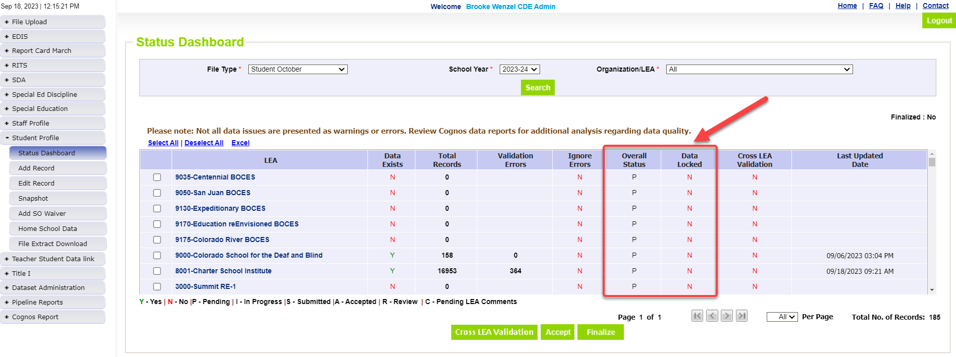
Waiting for all Districts to Submit
All districts must have Overall Status = ‘S’ and Data Locked = ‘N’
  Submitting your data will change these flags in the system

Slide 18
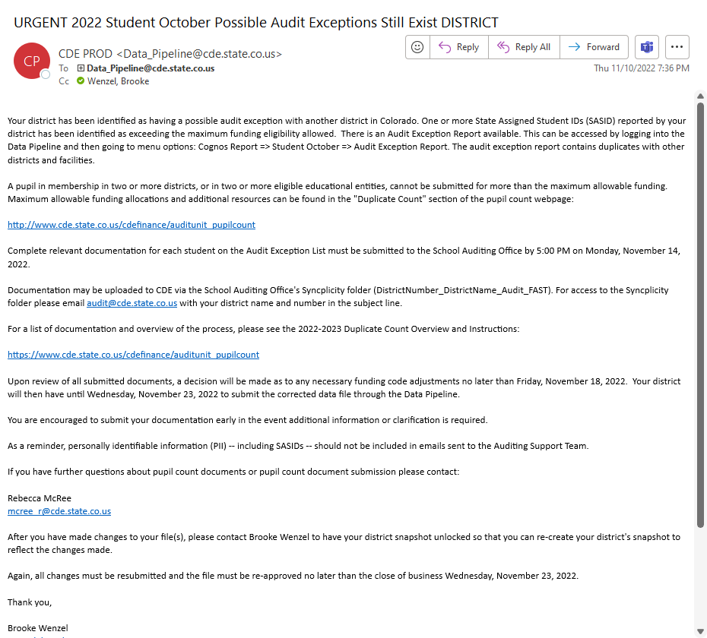
Run Cross LEA – Email is sent upon completion
- You will receive an “URGENT” Email if one or more students are pulled into the Duplicate Phase.
- Instructions are within the email (last year’s email shown on the right)
- Don’t receive the email? Double check Audit Exception Report CEDAR Report (next slide)

Slide 19
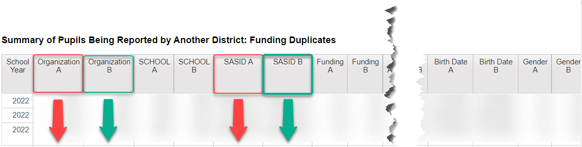
Audit Exception Report (under Student October Reports)
Summary of pupils being reported by another district: Funding Duplicates*
Summary of pupils being reported by another district: PAI Duplicates
Will not populate until after Cross LEA has been run
The information that your district is reporting is always Organization A (red) and will display students that are being submitted by at least one other district and whose total funding exceeds the state’s maximum allowable level.

Slide 20
Student October Submission to CDE (for the second time)

Slide 21
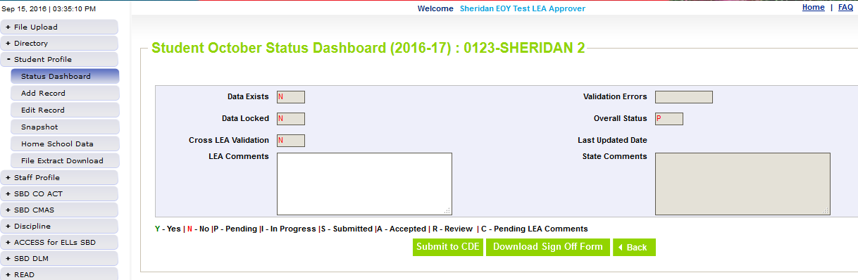
Update Data/Ready to Submit
Make changes to Student Interchange Files, Take a New Snapshot, Verify Data
Submit the snapshot to CDE
  Student Profile -> Status Dashboard and click ‘Submit to CDE’
    Must have OCT~LEAAPPROVER role in IDM to complete this step

Slide 22

Funding Allotments

Slide 23

Total Funding Allotment Acceptable Codes
Edit checks are in place to ensure that a given district does not submit an individual student for a funding level that is not allowed, per statute
Funding Level | Funding Codes
Full-time funding (1.0 FTE) | 80, 91 and 92
Part-time funding (0.5 FTE) | 82, 85, 94 and 95
No funding (0.0 FTE) | 86, 87, and 96

Slide 24

Total Funding Allotment
In general, the following rules apply:
Students in grades K-12 cannot exceed a total of 1.0 FTE
Home-school and private school students cannot exceed a total of 0.5 FTE

Slide 25
Edit Checks
The following criteria/edit checks will result in a student being included in the Duplicate Count process:​
Students in any grade level who are submitted for more than a total of 1.0 FTE​
Home-school and private school students who are submitted for more than a total of 0.5 FTE ​
  Home-Based Education Flag value of “1”, and/or Funding code of “85”​
  If a district submits a student with a funding code of "86" and home-based education flag of "1“:
    The district using funding code “86” does not have to upload documentation.
    However, the district submitting the student for funding does have to upload documentation.​

Slide 26

Edit Checks Continued
Students who are submitted for 0.5 FTE in more than one district​ will also be included in the Duplicate Count process.
This will allow the School Auditing Office to verify the students aren’t home-school or private school students.​
This may or may not result in funding changes.​

Slide 27

Using Syncplicity for Duplicate Count

Slide 28

Audit Syncplicity Folder
An audit Syncplicity folder has been created for each district and CSI
The naming convention for these Syncplicity folders is as follows:
  District Number_District Name_Audit_FAST
  For example: 0010_Mapleton 1_Audit_FAST

Slide 29
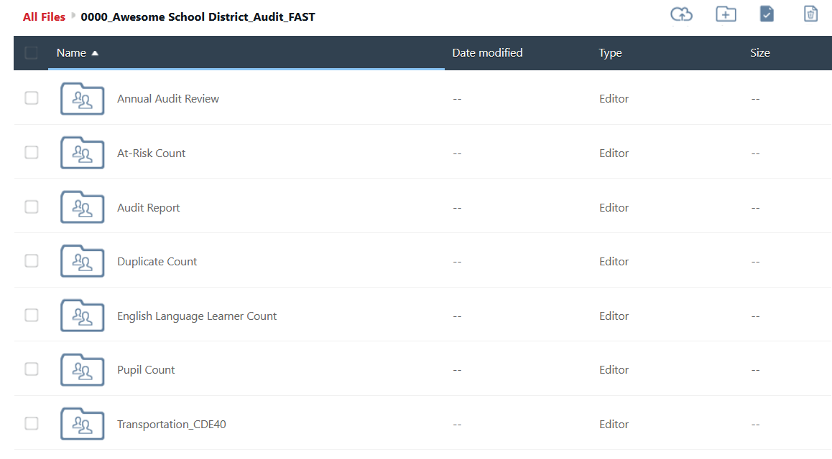
Audit Syncplicity Folder Structure
Do not change or delete these folders!

Slide 30
Audit Syncplicity Folder – Uploading Documents
All duplicate count audit documentation must be uploaded to the “Duplicate Count” subfolder found within the district’s audit Syncplicity folder.
  Document Upload Deadline: Thursday, November 13, 2025 at noon
  Uploading sooner benefits everyone!!!!!!!!!!!!!!!!!!
  Data Services will send out an email if this deadline is adjusted for any reason.
Check whether you have access to your district’s audit Syncplicity folder!​
  If not, email the School Auditing Office at audit@cde.state.co.us​
  In the subject line of the email, please include your district number, district name and “Duplicate Count Contact”​
    For example: “0010_Mapleton 1_Duplicate Count Contact”

Slide 31

Required Documentation

Slide 32


Duplicate Count Documentation
Districts must upload all required audit documentation to the “Duplicate Count” subfolder for all students included on the “Audit Exception Report” (except students with an “86” funding code).
This includes both:
School- or district-level documentation
Student-level documentation

Slide 33
Documentation: School- or District-level
These documents describe programs and services, provide context for interpreting student schedules and attendance, and allow for bell schedule calculations
District/school/program calendar
District/school/program bell schedule
District/school/program handbook & course catalog
  For secondary and district-run programs, including home school enrichment programs
  Link to Catalog of Courses using Alternative Instruction, if applicable
Online Schools and Programs
  Authorizer Assurances
  Instructional time equivalency statement

Slide 34
Documentation: Student-level
Upload documentation to the “Duplicate Count” subfolder for all students included on the “Audit Exception Report.” ​
The level of detail required for student-level documentation during Duplicate Count may exceed what is required for normal auditing purposes. ​
The School Auditing Office must sometimes make funding determinations between districts with very similar documentation and grounds for funding, so upload an expanded body of documents for contested students. ​
Whenever possible, include additional proof of attendance and participation in courses, especially for students receiving instruction off-site through digital means and/or students with sparse attendance

Slide 35
Documentation: Student-level Continued
Household demographic printout (from SIS)
Full enrollment history (with the district)
Student schedule (regardless of grade level) for all of Fall semester
  Semester 1, Quarters 1 & 2, Hexters 1, 2 & 3, etc.
  Identify which courses are alternative instruction courses, if applicable
Additional documentation as applicable
  i.e., corresponding unique student/course/school/program type documentation outlined in the 2025 Student October Count Audit Resource Guide
A short narrative may be useful to provide context regarding unique student circumstances not made clear by other documentation (optional)
Attendance verification (additional considerations on next slides)

Slide 36
Documentation: Student-Level Attendance Verification
Expanded Attendance verification ​
Include attendance for the entire months of September AND October.
Attendance reports generated out of student information systems (SIS) can be used to verify scheduled direct in-person or synchronous learning.​
SIS reports alone will not be sufficient to evidence attendance for off-site/alternative instruction courses
  Documentation must include course-level attendance.
  Documentation must evidence actual off-site participation/attendance.
  Online attendance must be documented per district, school, or program policies and/or Authorizer Assurances.

Slide 37
Documentation: Alternative Instruction Course Attendance
The only acceptable forms of documentation evidencing attendance for alternative instruction courses are:
  Evidence of attendance in direct instruction content
  Logins into course content for digitally-delivered instruction
  For work-based learning courses, documentation from an employer (e.g., timesheets, paystubs, etc.) that lists a student’s name and dates worked
For Independent Study courses, districts would have had to submit a request for alternative attendance documentation by September 15 (only 1 district made this request)
Note: Review the student's schedule before deciding what attendance documentation to provide.

Slide 38
Documentation: Online School and Program Attendance
For online school and program attendance, school or program policies and/or Authorizer Assurances determine appropriate documentation
Provide documentation evidencing actual off-site participation/attendance, generally at the course level
  For duplicate count purposes, evidence of participation in multiple courses is encouraged
Provide multiple types of documents, if available, to show the best possible evidence of student engagement during the semester
Include September AND October, but be especially thorough for the weeks before and after the count date
If policy or Authorizer Assurances allow, examples of attendance documentation may include, but are not limited to:
course log-ins
gradebooks showing dates assignments/ tests were submitted
dated progress reports
scanned assignments with name and date
etc.

Slide 39

Documentation: Labeling
For each student, please upload one assembled document.
Each assembled document should contain all required audit documents necessary to support funding.
Use the following naming convention:
  District Number_SASID_Student Last Name_Student First Name
    For example: 0010_9999999991_Smith_John.pdf
If necessary, a single folder or zip file for each student may be used.

Slide 40

Documentation for Conceded Students
If your district is conceding funding for a student (i.e., your district submitted the student for funding in error), you must still upload a document for the student
This document can be blank.
Use the following naming convention:
  District Number_SASID_Student Last Name_Student First Name_Concede
    For example: 0010_9999999991_Smith_Jane_Concede.pdf

Slide 41

Considerations and Scenarios

Slide 42
General Principles
Under most circumstances, the following general principles are considered in combination with the total picture provided by the supporting documentation:
A district using the official count date takes precedence over a district using an alternative count date
A district providing a full-time program of services to a student takes precedence over a district providing a part-time program of services
If a student meets the attendance criteria on the count date at multiple districts (which use the same count date), the receiving district generally takes precedence
Home-school and private school students can only be funded in a single district (funding cannot be split)
  For these students, the district of residence generally takes precedence over other districts

Slide 43

Scenarios and Considerations
The following slides cover some common scenarios that frequently arise during the duplicate count.
The specific circumstances surrounding a given student will determine funding decisions.
Whenever possible, districts should try to resolve duplicate count issues related to count date/enrollment prior to the duplicate count process.
Districts are encouraged to upload an expanded body of documents for contested students.

Slide 44

Alternate Count Date
Scenarios

Slide 45
Alternate Count Dates
In the event a student meets the funding criteria at multiple districts, and each district is using a different count date, the following is the general count date “hierarchy” that is used to determine which district is eligible to submit the student for funding.
Scenarios higher on the list take precedence:
Student who meets the funding requirements on count day:
  At a district using the official pupil enrollment count date (10/1)
  At a district using an approved alternative count date (either before or after the official pupil enrollment count date)
  At a district using the latest approved alternate count date

Slide 46
Official Count Date Takes Precedence
Districts using the pupil enrollment count date (10/1) will always have precedence over those that are using an alternative count date.
This is true whether the alternative count date comes before or after the pupil enrollment count date.
Example:
District A used the pupil enrollment count date of 10/1
District B used an alternative count date of 10/6
The student met the funding requirement at District A before transferring to District B on 10/3 and meeting requirements there.
District A can submit the student for funding.

Slide 47
Two Districts with Approved Alternative Count Dates
If a student meets all funding requirements at two different districts and both had an approved alternative count date:
The receiving district can submit the student for funding.
Example:
District A had an approved alternative count date of 9/22.
District B had an approved alternative count date of 10/6.
Student was enrolled at District A until 9/26, then the student transferred to District B and began attending on 10/2. The student met funding criteria at both districts.
District B (the receiving district) can submit the student for funding

Slide 48

Transfer Scenarios

Slide 49
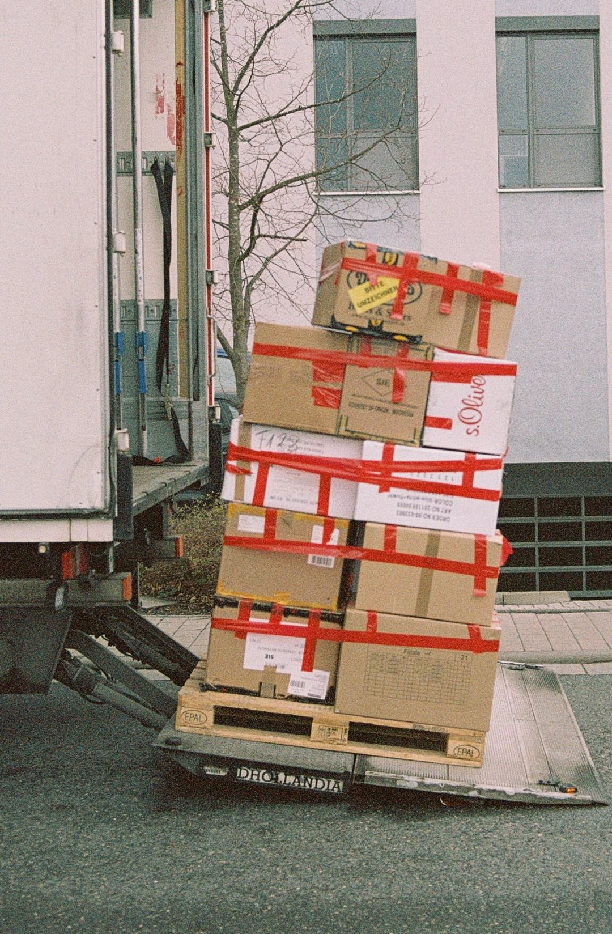
Transfer Enrollment Exceptions Eliminated!
Reminder: Starting with the 2025 Student October Count, the “transfer enrollment exception” is no longer available for out-of-state and within-state transfers
(In-district transfers are still permitted)
ONLY students who are enrolled in the district as of the count date can be submitted for funding.

Slide 50
Students Transferring Within-State into a District After the Pupil Enrollment Count Date
If a student transfers from one Colorado public school district to another after the pupil enrollment count date:
If the student met the funding criteria at the sending district:
The sending school district can submit the student for funding
Otherwise:
No district receives funding for this student.

Slide 51

Simultaneous Enrollment Scenarios

Slide 52
Students Enrolled in both a Full-Time and a Part-Time School/Program
If a student is enrolled in both a full-time Colorado public school or program and a part-time school or program in another Colorado district
AND the student meets schedule and attendance requirements in both districts
The full-time school or program can submit the student for full-time funding.
The part-time enrollment will not receive any funding.
When in doubt, both districts are encouraged to submit audit documentation during the duplicate count.

Slide 53
Students Enrolled Full-Time at a Colorado public Online School or Program and Part-Time at a Brick-and-Mortar School
If an online school or program is providing a full-time educational program and a brick-and-mortar school is providing a part-time program:
The full-time (online) school or program is eligible to submit the student for full-time funding.
The part-time (brick-and-mortar) enrollment will not receive any funding.
Note: The district of residence is not obligated to provide supplemental educational opportunities to a student enrolled full-time in a Colorado public online school or program
Brick-and-mortar schools may consider requiring the online school or program to pay tuition for these students
These decisions are left up to each individual district
When in doubt, both districts are encouraged to submit audit documentation during the duplicate count.

Slide 54
Student Reported as Part-time at Two Different Districts but Not Reported as Home-school
If two districts are reporting a student for part-time funding and neither district has indicated the student is a home-based education student, the documents will be reviewed to determine whether the student is a home-school (or private school) student:
If the duplicate count document review shows the student IS a home-based education (or private school) student: | If the duplicate count document review shows the student IS NOT a home-based education (or private school) student:
The student will be treated as a home-based education student enrolled in two districts (as discussed later in the presentation) | Neither district will be asked to change the reported funding code.
Generally, if a student is receiving educational services by multiple districts, one district has taken on the primary responsibility for the student’s education (i.e., the district from which the student will graduate)
The district primarily responsible for the student’s education usually has a contractual agreement with the secondary district to provide services

Slide 55
Ending Attendance On the Pupil Enrollment Count Date
If a student meets the attendance criteria ON the count date:
At multiple districts
Who are all using the same count date
And the student’s last date of attendance at the sending district is ON the count date
And student attends at the receiving district at least 1 additional day in October
The receiving district can generally submit the student for funding.
Example:
Student was enrolled at District A and attended for the last time in the morning of the pupil enrollment count date (10/1)
The student then attended District B in the afternoon on the pupil enrollment count date (10/1) and continues to attend there during the month of October
Even though the student met all funding criteria at both districts on the pupil enrollment count date, District B can submit the student for funding.

Slide 56
Double Attendance Beyond the Pupil Enrollment Count Date
If a student meets the attendance criteria ON the count date:
At multiple districts
Who are using the same count date
With a full-time schedule at both districts
And the student attends at both districts at least 1 additional day in October
Upload all documents for consideration!
Example:
Student was enrolled at District A from the beginning of the year and attends for the last time on 10/15, after the pupil enrollment count date (10/1)
The attended in the afternoon District B on the pupil enrollment count date (10/1) and continues attending there through October and into November
The specifics of the situation will be evaluated on a case-by-case basis.

Slide 57

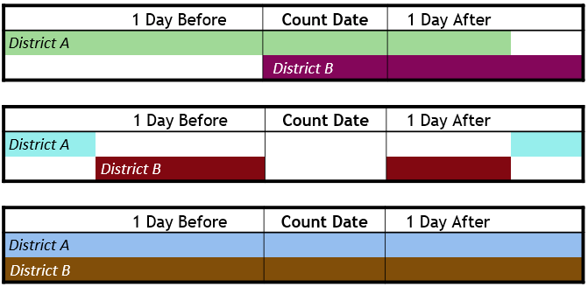


Simplified Timeline Diagrams
If a student is submitted for full-time funding at two districts, consider the attendance timeline:
If last date of attendance at A is before count, and student did not begin attending B until after count, the student is not eligible for funding at either district.
If student continued attending both districts after count, both districts should submit documents for consideration!
These will be evaluated on a case-by-case basis.
If last date of attendance at A is on count, and student continues at B at least 1 day after count, funding goes to B.
If last date of attendance at both districts is on count, funding is likely split.

Slide 58


Home-school & Private School
Scenarios

Slide 59
Home-school (and Private School) Students Enrolled Simultaneously in Multiple Districts
Home-school (and private school) students are eligible for a maximum of 0.5 FTE, meaning funding cannot be split for these students.
If a home-school student is participating in two part-time programs simultaneously at two different districts, and both districts are using the same count date:
The district of primary residence can submit the student for (part-time) funding
If neither district is the district of residence, or if it is not clear which district is the district of residence:
Both districts should upload documentation for consideration during the duplicate count process, as additional information (such as history of enrollment with each district) will be considered

Slide 60
Non-Funded Home-school Students Enrolled Full-Time at Another District
If a student is participating in a full-time program at one district, and another district has reported them as a non-funded (i.e., funding code '86') home-school student:
The district claiming the student for funding must upload documentation showing the student is eligible for full-time funding
The district who flagged the student as home-school (funding code '86') is not required to upload anything
  Depending on the results of the full-time district’s documentation, may be required to remove the home-based education flag from their snapshot
The specifics of the situation will be evaluated on a case-by-case basis.

Slide 61

Districts are strongly encouraged to work collaboratively to determine which district should submit each student for funding before the deadline for submitting duplicate count documents.
If districts cannot come to a resolution regarding who is eligible to submit the student for funding, then both districts should submit their expanded body of documentation.

Slide 62
Contact Information & Resources
School Auditing Office
audit@cde.state.co.us
Rebecca McRee
mcree_r@cde.state.co.us
303-482-6286
Data Services
Collin Slutzky
StudentOctober@cde.state.co.us
720-760-3569
Resources
Auditing Office Training Schedule
Auditing Office’s Pupil Count Website
Data Pipeline Town Halls
Identity Management/Data Pipeline
Student Interchange Website
Student October Data Collection Website
Syncplicity

