Slide 1
Special Education End-of-Year
Collection Training 1 2024-2025
May 13, 2025
Lindsey Heitman
SpedEndofYear@cde.state.co.us

Slide 2
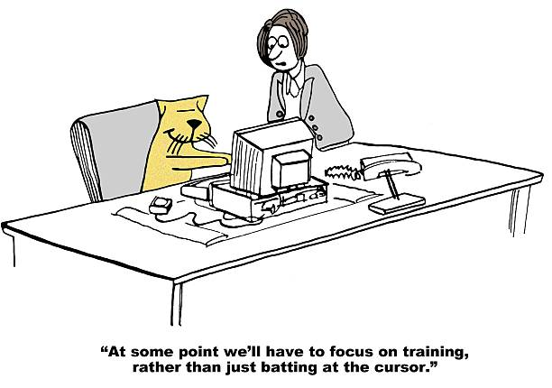
Welcome and Contact Information
  Welcome and thank you for joining the training!
Data Services Contact:
Lindsey Heitman – SpedEndofYear@cde.state.co.us
  heitman_l@cde.state.co.us 720-456-2033
  Collection manager
  Data Pipeline submission
Business Unit – Exceptional Student Services Unit Contacts:
Orla Bolger – bolger_o@cde.state.co.us ESSU Contact – data content clarification/data requests
Josh Fails – fails_J@cde.state.co.us ESSU Contact – Data Management System/questions on uploading final reports to the DMS
Please include in emails:
  AU #
  error code # (if applicable)
  any school code #’s referenced

Slide 3
Agenda
Purpose/Content/Timeline – slides 4-11
Special Ed IEP Interchange – slides 12-19
Special Ed EOY Snapshot/Resources– slides 20-23
Who to Report- Content Details slides 24-32

Slide 4
Collection Overview and Purpose

Slide 5
Frequently Used Terms and Acronyms
Term | Definition
LEA | Local Education Agency
AU | AU stands for Administrative Unit and means a school district, board of cooperative services, multi-district administrative unit, a charter school network, a charter school collaborative, or the State Charter School Institute, that is providing educational services to exceptional children and that is responsible for the local administration of services.
IdM | Identity Management. A single sign on system, allowing users to navigate between most CDE applications with the same login.
LAM | Local Access Manager. The individual with your LEA that is responsible for assigning the appropriate access to CDE applications.
Interchange | The data holding place within the Data Pipeline. A method of providing data to CDE in which LEA’s may choose from multiple file formats to submit data throughout the year.
Snapshot | A date in time when data is pulled from the appropriate interchanges, validated by additional business rules, and approval given that signifies it was accurately reported for a specific point in time by an LEA.
Cognos Reports/Cedar | Colorado Education Data Analysis and Reporting System (CEDAR). A type of report in which the user can view applicable reports that are formatted in a user-friendly environment.
DMS | The ESSU Data Management System (DMS) is a single sign on system that assists AUs in meeting accountability requirements for Special Education and Gifted Education.

Slide 6


Collection Process Overview
Schools
Track data throughout school year
Admin Unit/SOP
Combines data from schools. Determines the appropriate coding for each record.
Reports data to CDE
CDE via Data Pipeline
Provide data to Admin Unit/SOP
Verifies accuracy, corrects and approves data.
Checks data for accuracy
Collects data from Admin Unit/SOP
Edits data, all errors must be corrected
Federal Government
CDE Reviews and validates data and submits to U.S. Department of Education
Allows approval once passed all edit validations
Notes:
Admin Unit/SOPs collect data from schools and/or member districts. Data is compiled at the AU level and submitted to the CDE via the Data Pipeline.

Slide 7
Purpose and Content
FS009 File: Children with Disabilities Exiting Special Education
  The unduplicated number of students with disabilities (IDEA) who are ages 14 through 21, were in special education at the start of the reporting period and were not in special education at the end of the reporting period.
    The data collected using this file specification are collected under the authority of the Individuals with Disabilities Education Act (IDEA), Section 618.
    OSERS/OSEP – Office of Special Education and Rehabilitative Services/Office of Special Education Programs
State Performance Plan Indicators
  Indicator 1: Graduation - percent of youth with IEPs graduating w/ regular diploma
  Indicator 2: Dropout – percent of youth w/ IEPs dropping out
  Indicator 11: Timely Initial Evaluation - percent of children evaluated for Part B Services within 60 days
  Indicator 12: Part C to B Transition -percent of children with IEP by 3rd birthday
Exceptional Student Services Unit – CDE Office of Special Education home page
  Click General Supervision and Monitoring, then Results Driven Accountability
    Find published Special Education data reports for Colorado
    Find descriptions of each of the State Performance Plan Indicators as well as the Annual Performance Reports for Colorado
Note: there is no funding associated with your Special Education EOY Snapshot!

Slide 8
Identity Management:
Access to the Data Pipeline
INTERCHANGE ROLES *1 per account | ENABLES USER TO:
SPE~LEAVIEWER | read-only access
SPE~LEAUSER | upload files, view interchange level errors
SNAPSHOT ROLES *1 per account | ENABLES USER TO:
EOY~LEAVIEWER | read-only access
EOY~LEAUSER | create snapshots and view snapshot level errors
EOY~LEAAPPROVER *Need at least 1 | create snapshots, view snapshot level errors, AND can approve data (Submit final snapshot to CDE)
Special Education IEP group is: SPE
Special Education EOY Snapshot group is: EOY
Assigned by LAM (Local Access Manager)
LAMs click here to get to the IdM Home page
Only 1 role per group/account
LEAs may have as many Viewers, Users, and Approvers as needed

Slide 9
Reporting Period
The Special Education End of Year reporting period is July 1, 2024 through June 30, 2025.
  The purpose of this snapshot is to obtain data on students who were referred, evaluated, and/or received special education services in your AU at any point during the reporting period.
All Users:
Please update your Child and Participation files with a SPED EOY reporting focus now
Enrich Users:
Be sure you are selecting the EOY 24-25 option for your Child and Participation files.
Check collection parameters under collection settings to be sure it shows the full collection period of 07/01/24 – 06/30/2025.

Slide 10
Errors and Warnings
Business Rules, Errors, Warnings, Checks, Edits, Validations
  These terms can be used interchangeably and mean the same thing!
  A set of rules (logic) that your data is checked against in the Data Pipeline System
  Checks that help to ensure you are reporting accurate, valid, and reliable data
  This is accomplished by the Interchange (level 1) checks and the snapshot (level 2) checks
  You cannot finalize and submit the final snapshot to CDE without clearing all of the error checks at the interchange and snapshot levels
  Errors – must be fixed
  Warnings – need to be reviewed, but the data may be valid as is OR it may need adjusting

Slide 11
Special Education EOY 24-25 Timeline
May 1, 2025 - SPED EOY Snapshot official open
June 26, 2025 – IEP Interchange files error-free
September 4, 2025 - All Exception requests submitted to CDE
September 11, 2025 – All errors resolved at snapshot/interchange
September 11 -19, 2025 - Initial Report Review
September 22 - 26, 2025 – Resolving duplicates
September 20 - 27, 2025 – Final Report Review
September 26, 2025 – All error resolved and snapshot complete
September 29 – Oct. 1, 2025 - Final approval in Data Pipeline and reports uploaded to DMS
Please download full Timeline from the Special Education End of Year Snapshot webpage

Slide 12
Special Education IEP Interchange

Slide 13

Special Education End of Year Snapshot
Data pulls from these interchanges to make up the snapshot:
Special Education EOY Snapshot
Student Interchange:
Student Demographic File
Student School Association File
Special Education IEP Interchange:
Child File
Participation File
AU Responsibility
District(s) Responsibility
An interchange is the data holding place where your data files may be uploaded and validated throughout the school year
Records run through level 1 (interchange) checks and level 2 (snapshot) checks.
REMEMBER: records with errors at the level 1 interchange level will not pull into your level 2 snapshot checks
A snapshot is a point in time “picture” of your data extracted from the interchange files. It has specific logic that pulls the correct data from the interchange files.

Slide 14
Overview of all Data Submitted in the
Special Education IEP Interchange
Participation File
Medically Necessary Services Input Screen
Data Collected in the Special Education IEP Interchange
Special Education Child File
  student demographic information
  file required by every AU
Special Education Participation File
  special education services and referral information
  file required by every AU
Medically Necessary Services Screen
  Input screen to manually add counts related to medically necessary services
  required by every AU
Coordinated Early Intervening Services File
  * Only required if your AU funded CEIS or CCEIS using federal dollars (generally only 5-6 AUs)
  You will be contacted by CDE if you need to upload this file
CEIS File*

Slide 15
Special Education IEP Interchange
Files Record Expectation
Child File
Participation File
Demographic information
1 record per student
The primary source of this information is the Student Interchange Student Demographic File -Untagged File IF LASIDS match between district and AU
If student is not required to be submitted in the Student Interchange (private school or facility students) the demographic data is pulled from this file into the snapshot
Special Education services and referral information
1 record per student
Record should reflect a student’s latest Sped status within the reporting period
The primary source of the Entry Grade Level field is the Student Interchange Student School Association File- Untagged File
If student is not required to be submitted in the Student Interchange (private school or facility students) the Grade Level is pulled from this file
Each record must have a valid SASID and/or a LASID combination on each file before it will pull into the snapshot
LASIDs must match district uploaded Student Interchange files for the demographic data (i.e. race) to pull from the district files

Slide 16
Snapshot Fields in which the data should pull from the Student Interchange district files
Student Interchange- Authoritative Source Fields
Student Demographic File- Untagged
SASID
LASID
Student First Name
Student Middle Name
Student Last Name
Student Gender
Student Date of birth
Student Ethnicity
Student Race
Student School Association File-Untagged
Grade Level
Please be aware the fields above pull into your Sped EOY Snapshot from these files in most cases.
  If the student is not submitted by a district (Facility School and Private School records) the data will be pulled from the IEP Interchange files instead
  *remember this when troubleshooting your errors around these fields!

Slide 17
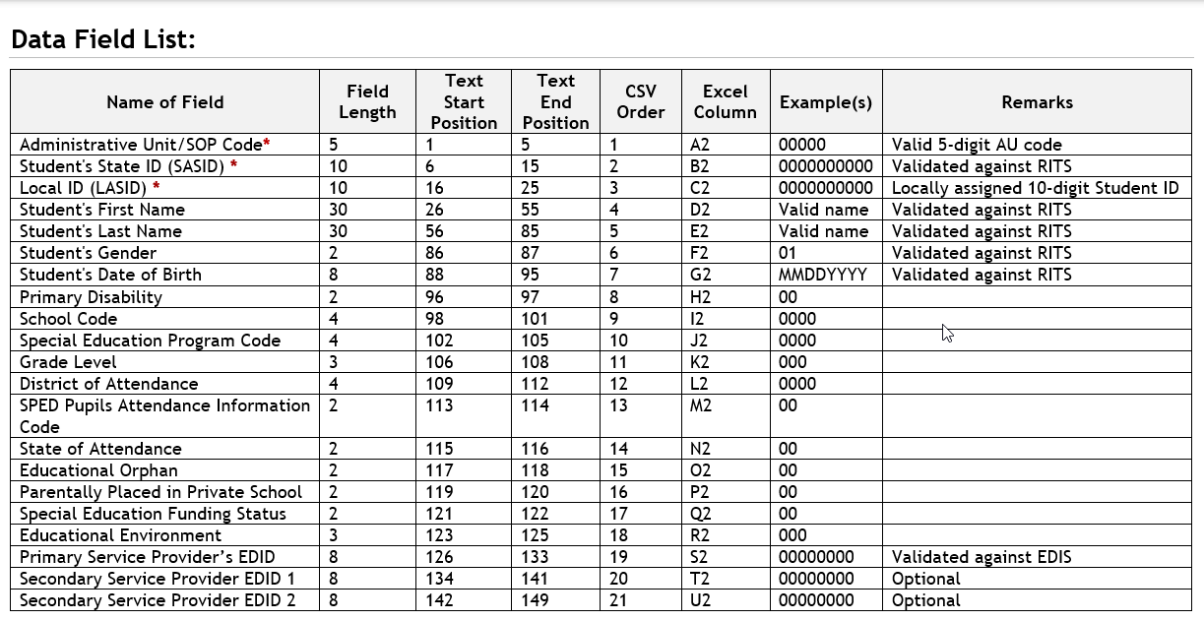
File Layout and Definitions Document:
Helpful to refer to for reporting questions
What’s included in the file layout?
Dependencies and record expectation
Name and Order (format) of the fields
Number of characters in each field
Examples and remarks that help clarify
Data field name, definition, and applicable codes for each field provided below the ordered format
Changes listed at bottom of layout and highlighted in yellow, items removed listed in red font and strikethrough.

Slide 18
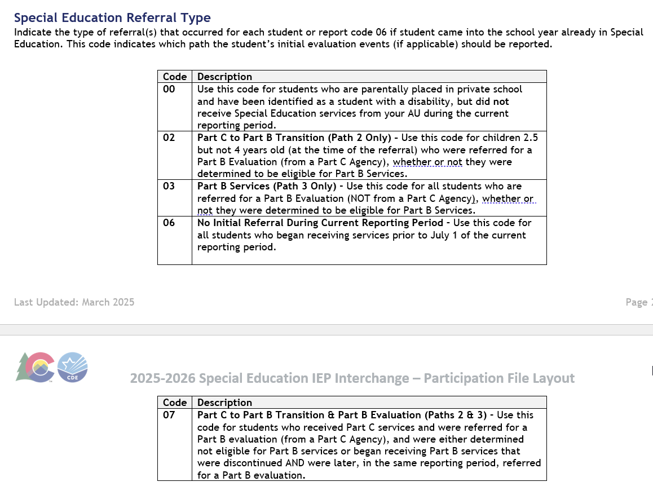
Special Education Participation File Layout
Field name and definition of what is being collected
All code options and definitions

Slide 19
File Tips
Excel, CSV, or Text formats are accepted
Excel templates for Child and Participation Files posted on the IEP Interchange page under Templates (if needed)
No blank fields (it likely won’t upload if there are blanks)
Be sure the file is not open when uploading it
Be sure each field has the correct number of bytes
PLEASE BE AWARE OF THIS ISSUE WITH CSV Files
  CSV files lose leading zeros within a data field after opening.
  A file will not process successfully unless the field has the correct # of bytes.
  Any field that could start with a zero will not have the correct number of bytes unless you format it to retain those leading zeros (custom or text)
  Find steps for converting it to text posted here.
If your file won’t upload, add the filter to each column and scan the column filter box for those that have incorrect characters (i.e. letters instead of numbers or incorrect number of characters)
  Use a version process that makes sense to you to keep track of files uploaded.
  Create a folder to save your files in as you work on each snapshot.
  Create an email folder for handling the Data Pipeline System Generated Emails as you will need to refer to them throughout the Data Pipeline Process.
  Be sure to save your final set of files for each snapshot.

Slide 20
Special Education End of Year Snapshot Overview

Slide 21
SPED EOY Snapshot Criteria
For a record to be added to the Special Education EOY Snapshot it must:
  be included in both the Child and Participation Files
  contain a matching SASID and/or LASID in both the Child and Participation Files
  be error free in both the Child and Participation Files
  All records that meet the above criteria will be pulled into the snapshot EXCEPT those with a PAI code of 23, 24, 31, or 32 or a Special Education Part C Referral code of 00.
  Data pulled from the Student Profile Interchange will be the untagged data
Note: if records are missing from your snapshot, it is likely they have one of the following:
  errors at the Interchange level
  contain one of the excluded PAI codes above (which may be correct if student has already been exited)
  an incorrect SASID or LASID on one file
  missing a record altogether from one file

Slide 22
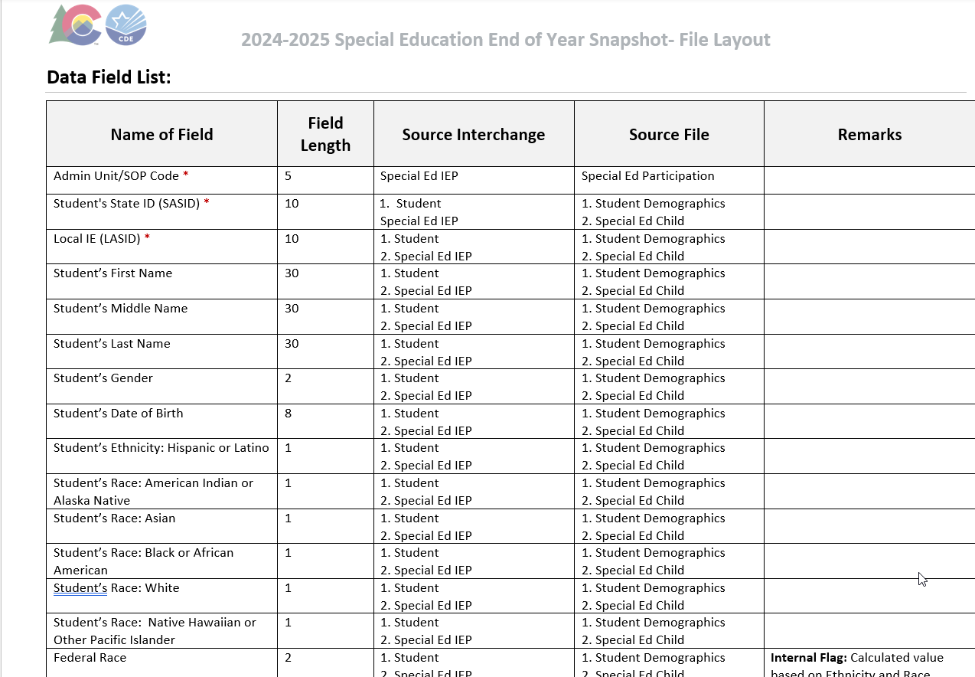
Special Education End of Year
Snapshot File Layout
Snapshot File Layout found on the Special Education EOY Snapshot Webpage
Find which data fields are pulled into this snapshot
Find which Interchange file each field is pulled from

Slide 23
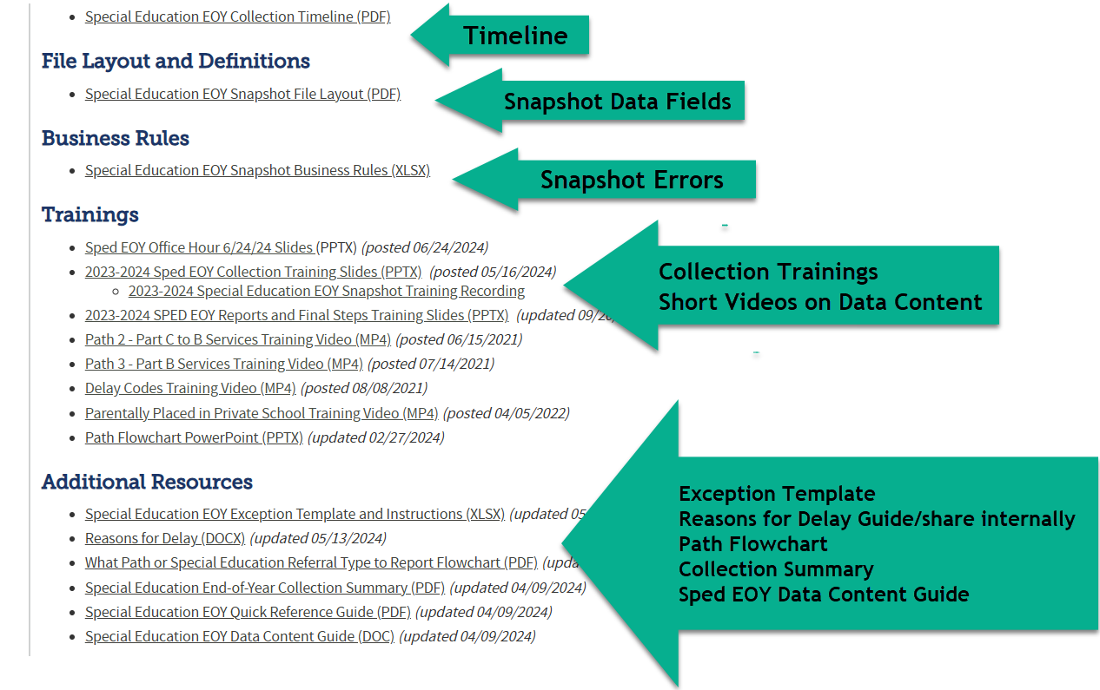
Special Education EOY Snapshot Webpage Resources

Slide 24
Who to Report

Slide 25
Please Report All Students Who:
Had an initial evaluation for Part B services:
  Were 2.5 but not 4 years old when they were referred from Part C to Part B (path 2 - C to B)
  Were 2.5 – 21 and referred for a Part B special education Initial Evaluation (path 3)
    Were evaluated, even if they were found not eligible. Check your data extracts to make sure students found not eligible are being reported too! Eligibility and Services = 04
Received services in your Administrative Unit at any point during this reporting period (July 1-June 30)
  Were placed in a CDE Approved Facility School and you are the Administrative Unit of residence
  Were detained at a Detention Center located within your AU boundaries and your AU is providing services
  Were in a county jail within your AU boundaries and your AU is providing services
  Were on an IEP and received services at a private school on a tuition basis or parentally placed in a private school, have an ISP and receive Sped services from the AU
  Were in a Special Education Transition Program in your AU
  Received services outside of the State of Colorado and are the responsibility of your Administrative Unit (these students are placed out of state per their IEP and should be reported by the AU of Residence).

Slide 26
Definition of Initial Evaluation for State Reporting:
  who were not eligible at the time of evaluation* – student may have received Special Education Services in the past but had returned to regular education prior to this evaluation
    *exception to this are transfer students in which your AU decides to do their own initial evaluation
    for whom parents revoked consent for services – student received Special Education Services for a period of time prior to parent deciding to cease services. When child is again referred/re-evaluated, please report them as an initial evaluation.
    who have never been evaluated for Part B Services - these students have never had an evaluation in your Administrative Unit/State Operated Program , another Administrative Unit/State Operated Program, or an Eligible Facility in Colorado.
    who received Special Education Services in another state, for whom it was determined that an initial evaluation was needed.
    who are parentally placed in a private school and had a Part B Initial Evaluation during the current reporting period (these students are reported by the Administrative Unit in which the private school is located).
    who were educated in a non-public home-based educational program (i.e., homeschooled) and had a Part B initial evaluation during the reporting period.
    Everything else is considered a re-evaluation and those dates/events do not need to be reported to CDE!

Slide 27
Access to Students for Medically Necessary Services:
Additional Reporting Requirement
Access to Students for Medically Necessary Services
NEW reporting requirement started in 2023-2024 school year – House Bill 22-1260
AUs must report # of requests for access to students for medically necessary services
  AU must report to CDE the number of requests during the 23-24 school year for access to a student by a private healthcare specialist and whether the access was authorized or denied.
  Each AU must report to CDE the total counts for the following (no student level information is needed):
    # of requests for access to a student for medically necessary services
    # of those requests authorized
    # of those requests denied
  The counts are collected in an input screen within the Data Pipeline under the IEP Interchange. ‘SPE User Role’ access. (see Pipeline Process section slide (?) for steps)
  AU will not be able to approve final SPED EOY Snapshot until counts have been entered and saved in the Data Pipeline
    Counts will not be included in your SPED EOY Snapshot though
  Each January, CDE must make this information available online.

Slide 28
Special Education EOY: Facility Schools, Detention Centers, SOPs, and SPED Programs
The term “Facility” is used throughout the state for different types of schools/entities. In Colorado we have:
  1. CDE Approved Facility Schools (“facility” students for state reporting purposes means this one)
  2. Special Education Programs - programs run by a district or AU – usually located in a different building than the school
  3. Detention Centers – student is detained – there are 8 detention centers currently in Colorado
  4. State Operated Programs – there are 4 in Colorado DYS-66080, DOC-66070, CMHI-66060, CSDB-66050 - student is “committed” if reported by DYS or DOC
How to Code for Sped EOY:
  Report the student’s latest/last attendance during the school year
  Report an exit if student transfers out of your AU at any point (even if you report them for December Count).
  Reporting for Sped EOY is different than December Count for these types of records! There are different reporting requirements for each snapshot. Sped EOY should include all students that your AU physically serves, along with resident students in a CDE Facility School.
Helpful codes document with a tab for each type found under Frequently Requested Codes http://www.cde.state.co.us/datapipeline/org_orgcodes. Allowable Approved Facility Schools and Other Agency Codes

Slide 29
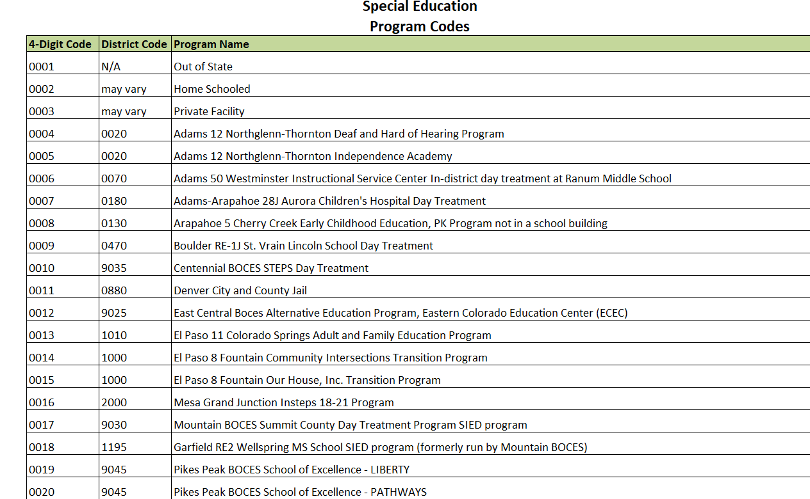
Special Education Program Codes List

Slide 30
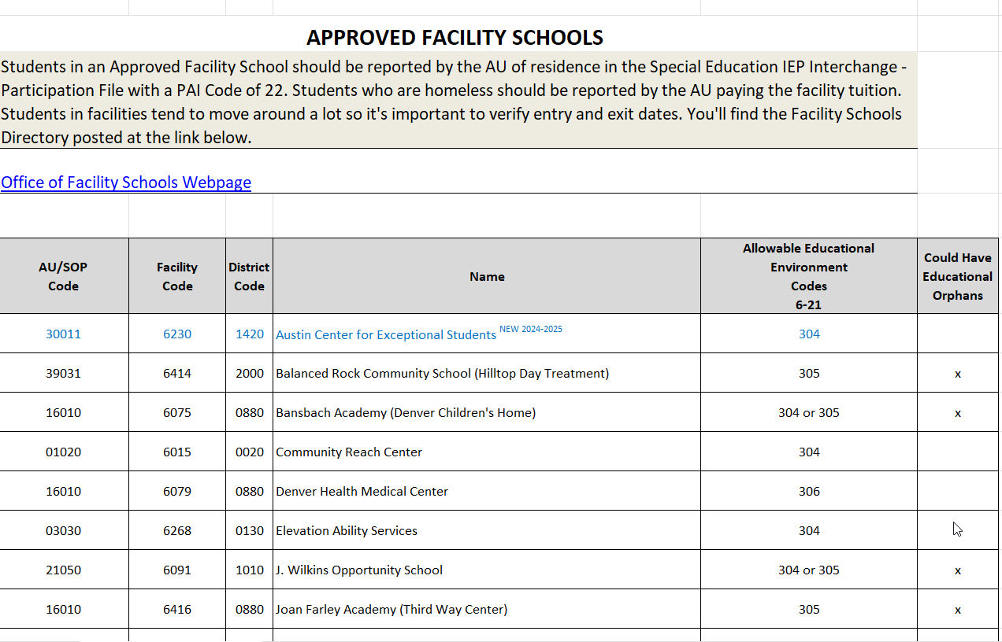
Approved Facility Schools List

Slide 31
Detention Centers
The AUs where these detention centers are located should report any detained students if this was the latest status in your AU in the school year.
Detention Centers | District Code | Name | Allowable Setting Codes 6-21
9801 | 0040 | Prairie Vista Youth Services Center | 307
9802 | 0130 | Marvin W Foote Youth Services | 307
9803 | 0880 | Gilliam Youth Services Center | 307
9804 | 1020 | Zebulon Pike Youth Services Center | 307
9805 | 1420 | Mountview Youth Service Center | 307
9807 | 2000 | Grand Mesa Youth Services Center | 307
9808 | 2690 | Pueblo Youth Service Center | 307
9809 | 3120 | Platte Valley Youth Services Center | 307

Slide 32
State Operated Programs
Division of Youth Services and Department Of Corrections report committed students.
  AU 66070 or AU 66080 would report these students
SOP Code | School Code | District Code | Name | Allowable Setting Codes 3-5 | Allowable Setting Codes 6-21
66060 | 6178 | 8102 | Colorado Mental Health Institute at Pueblo | 206 | 306
66050 | 1924 | 9000 | Colorado School for the Deaf and Blind | 205 or 206 | 304 or 305
66070 | 2759 | 8103 | Department of Corrections |  | 307
66080 |  | 8104 | Division of Youth Services |  | 307
66080 | 2688 | 8104 | Lookout Mountain (Division of Yourth Services) |  | 307
66080 | 2689 | 8104 | Spring Creek (Division of Youth Services) |  | 307
66080 | 2690 | 8104 | Grand Mesa Youth Services Center (Division of Youth Services) |  | 307
66080 | 2691 | 8104 | Mount View Youth Services Center (Division of Youth Services) |  | 307
66080 | 2692 | 8104 | Platte Valley Youth Services Center (Division of Youth Services) |  | 307
66080 | 2694 | 8104 | Betty K. Marler Youth Services Center (Division of Youth Services) |  | 307

Slide 33

Your participation is appreciated!

