Slide 1
2025-2026
Special Education December Count
December Staff Snapshot and
Staff Approval Matrix (SAM)
^{December 3, 2025}
^{Lindsey Heitman}

Slide 2
Special Education December Count
Contact Information and Resource Links
Contact Information:
Lindsey Heitman – SpedDecCount@cde.state.co.us 720-456-2033
  Special Education December Count Snapshot submission
  Includes IEP Interchange and December Count SPED staff/SAM questions
Hannah Prokop – Prokop_H@cde.state.co.us 720-284-8144
  Special Education staff qualifications
  Special Education monitoring and compliance
Please include your AU #, District # and error code # or cognos report name (if applicable) in emails
Resource Webpages
  Special Education IEP Interchange
  Staff Interchange
  Special Ed December Count Snapshot
  ESSU Data Management System

Slide 3
Agenda
Purpose and Resources – slides 4–6
Special Education December Staff Records – slides 7-12
Staff Assignment File breakdown – slides 13-14
Staff Approval Matrix (SAM) – slides 15–33
December Staff Data Pipeline Notes and Tips – slides 34-39

Slide 4
Regulations: IDEA/ECEA
Federal Law IDEA (The Individuals with Disabilities Education Act)
Requires staff who serve students with disabilities to be appropriately licensed and endorsed.
State Rules ECEA (Exceptional Children’s Educational Act-section 3.04 Personnel Qualifications)
All personnel providing special education services to children with disabilities shall be qualified.
Each special education teacher will serve, at a minimum, a majority of special education students with the same identified area of need as that teacher’s special education license endorsement. The endorsement level must be appropriate for the age being taught.

Slide 5
Purpose of Special Education Staff Data
Staff data in the December Count:
provides CDE the ability to verify licensing qualifications ensuring special education staff are qualified for the assignment and student caseload
  Identifies staff who are not appropriately licensed, which gives AUs the ability to rectify as soon as possible to mitigate potential harm to students with disabilities
populates mandatory federal reporting to the US Department of Education, summarized by:
    job classification
    age level of assignment/students served (age groups 3-5 and 6-21)
    qualified and non-qualified status

Slide 6
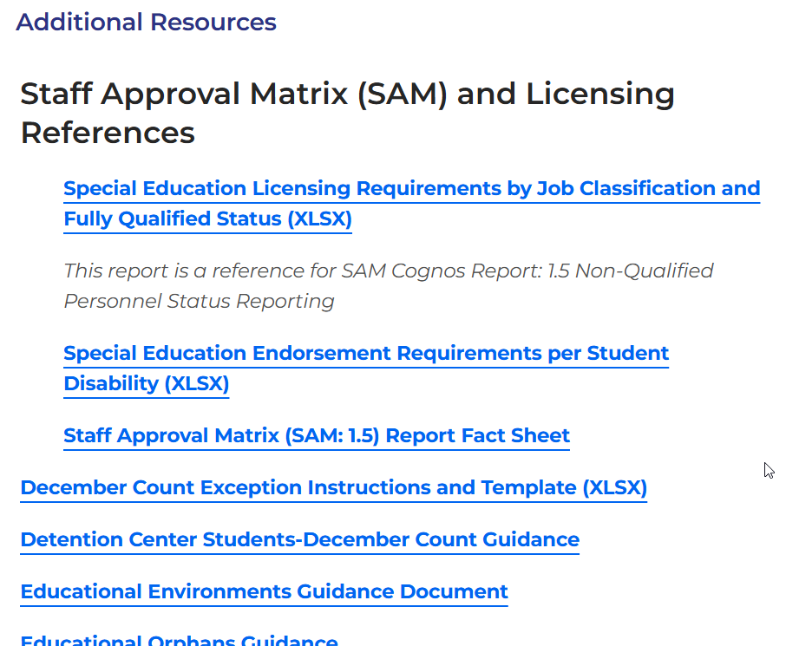
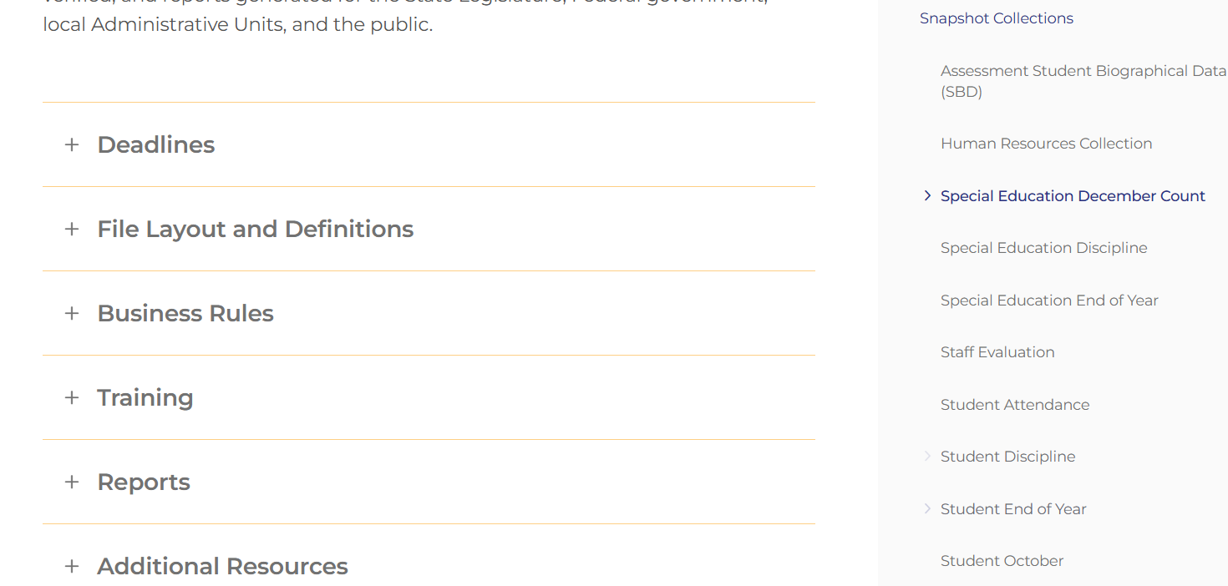
December Count
Snapshot Resources Webpage
Special Education December Count Snapshot Webpage

Slide 7
Staff Records to Include in
Special Education December Staff Snapshot
Include:
  all Special Education staff employed by the district(s) or BOCES
  full or part-time including teachers, paraprofessionals, special service providers
  Administrators, support staff, IT, office/clerical
  Contracted staff
Staff Assignment file records are included in the SPED Dec Staff Snapshot when ‘Special Education Assignment Flag’ = 1
Exclude:
  staff that do not support the education of students with disabilities, such as regular education teachers (they pull into the Human Resources snapshot)
  substitutes unless they are long term (90 days or more in the same classroom)
  temporary workers, such as after school coaches
Staff Assignment file records are NOT included in the SPED December Staff Snapshot when ‘Special Education Assignment Flag’ = 0

Slide 8
Contracted Staff (Purchased Service)
Contracted staff are:
employed on a contractual basis, typically an annual contract for services
not exempt from state licensing requirements
required to hold a valid and appropriate special education license and endorsement for the assignment and grade range of students served
reported with Employment Status Code = 23 Purchased Services
Note: If the contractual agreement is valid for the period including December 1st, the position is reported regardless of whether the contracted staff was “working” on December 1st.
  For more information, see ‘Purchase Service Staff Information Sheet’ on Staff Interchange page under Additional Resources section

Slide 9
Long Term Substitute Teacher
Long Term Sub Requirements (serving in job role for 90 days or more) in December Count:
Job code 204 (substitute teacher) does not pull into the December Count snapshot
If they are the primary provider for a SPED student, they should be reported with a job code of 202 or 238
A long-term sub for special education reporting purposes is held to the same licensing requirements as a regular SPED teacher or SLP. If the Special Ed license has expired or is not renewed by 12/01 and they are reported with job code 202 or 238, they will trigger a SAM (Staff Approval Matrix) warning.

Slide 10
Required Staff
Director of Special Education
Each administrative unit is required to employ and report an appropriately licensed and endorsed special education director.
  ECEA Rules 3.01(1)(c) Employment of a properly licensed and endorsed professional who will function at least half time as director of special education and who has the authority and responsibility to assure that all the duties and responsibilities of the AU as specified in these Rules are carried out.
  Appropriate license type = ADM (administrator)
  Appropriate endorsement = Director of Special Education
  Job Code = 102 Special Education Director

Slide 11
Required Staff
Child Find Coordinator
Each administrative unit is required to employ and report an appropriately licensed and endorsed child find coordinator.
  ECEA Rules 4.02(2)(b) Each administrative unit and state-operated program shall have one person designated as the child find coordinator who shall be responsible for an ongoing child identification process.
  Appropriate license types =
    TCH (teacher)
    SSP (special service provider)
    ADM (administrator - Director of Special Education)
  Appropriate endorsement = any special education endorsement (teacher, special service provider or administrator)
  Job Code = 330 Child Find Coordinator

Slide 12
Staff Interchange Files
Record Expectation
    Staff Profile
  General information per staff
  Only 1 record per staff
  Must be uploaded first
  District Code field - report district code or BOCES code that issue the paycheck
    *IMPORTANT for how data is pulled and displayed for the Staff Evaluation Snapshot
    Staff Assignment
  Provides specifics to actual duties and locations
  multiple records allowed per staff member
  District Code field - report district code or BOCES code that issue the paycheck
    *IMPORTANT for how data is pulled and displayed for the Staff Evaluation Snapshot
District status report found under Cognos Reports/Special Education December Count (DEC role)
Staff: District/AU Activity Report
Lists the status of all Staff Profile and Staff Assignment file uploads
Breaks it out by district and AU

Slide 13
Staff Assignment File Overview
Multiple records are allowed per person based on
  Special Education Status (if serving both SPED and non-SPED students)
  Job Class Code (report a record for each job role staff are fulfilling)
  School Code – teachers (202 job coded staff)
    Break out separate Staff Assignment records for teachers (202s) serving 3 or less schools
    SSPs may be reported with school code 9980- district wide (238, 236, 237)
  Administrator Instructional Area (AIA Code)
  Funding Source Code if more than one funding sources applies to a staff member
When reporting 2 or more records for a staff member…
  Base Salary would be split accordingly
  Hours per day would be split accordingly
  Contract days would not be split

Slide 14
Staff Assignment File and
Admin Instructional Area Codes
Separate assignment records are required in these cases:
  Pre-K grade - AIA 0035 Early Childhood/Prekindergarten
    Must break out a separate assignment record for staff serving Pre-k
  Grade K only - AIA 0036 Kindergarten
    AIA code 0036 should be reported for a staff that is only serving grade K
  Grades K, 1, 2 - AIA 0041 Early Childhood/Elementary) (see below)
    AIA code 0041 should only be reported for staff with early childhood Sped endorsement
  Grades 3-12 or K-12 (depending on the staff’s endorsement type) - 0002 Special Education
Note: Early Childhood Special Education (age level 0-8) endorsement is appropriate for services to students in grades PreK through 2 only. For SAM to determine qualified status, a separate assignment record for elementary grades K, 1, 2 (any combination of these grades) is reported with AIA 0041.

Slide 15
SAM – Staff Approval Matrix

Slide 16
Staff Approval Matrix
(SAM)
The Staff Approval Matrix (SAM):
is an automated process in the December Count
warnings that trigger when a Sp Ed Dec Count Snapshot is created
found under your Sp Ed Dec Count Staff Snapshot warnings report
pulls in data from the Staff Assignment and IEP Interchange files
connects staff data with Educator Licensing and EDIS records via the reported SSN
determines qualified/non-qualified status for positions requiring a CDE license
Triggers DEC Staff snapshot warnings DC208, DC209, DC210, and DC211

Slide 17
Staff to Student
Caseload Matches
Every IEP Student Participation File record must have a Primary Provider EDID of a 202 or a 238
All staff reported with Job Code 202 or 238 must be associated with at least one student record (either as a primary or secondary provider) in the Participation file or an error will trigger
Two caseload match checks exist for Special Education Teachers (202) and Speech-Language Pathologists (238):
1. Grade Caseload Match in the Data Pipeline (staff grades to student grades)
  grades marked “Yes” in the staff assignment record must match the grades of students in the IEP Participation file
  validates this on all 5 provider fields in student records for job codes 202 and 238 only
2. Disability/50% Caseload Match in SAM (staff endorsement to student disability)
  Primary provider staff must hold an appropriate special education endorsement for the majority of student disabilities in the IEP Participation file
    based on the staff EDID reported in the Primary Provider field in the IEP Participation file
    Staff EDID reported in any one of the four Secondary Provider fields do not generate a student disability caseload
    SAM warnings DC209/DC210

Slide 18
Qualified vs. Nonqualified Status
SAM warning validations check job code, AIA code, license type, endorsement, and student caseload to determine
if staff are qualified for the job assignment
Qualified staff:
Non-qualified staff:
Hold a valid and appropriate CDE license for the assignment
Hold an age level endorsement appropriate for the age range of students served
Job codes 202 and 238 serve a majority of special education students (50% disability caseload match-special education teachers and speech-language pathologists) with the same identified area of need (primary disability) as the staff’s special education endorsement.
Do not hold a CDE license effective as of December 1st
Do not hold a valid and appropriate CDE license for the assignment
Do not hold an age level endorsement appropriate for the age range of students served
Do not serve a majority of special education students (50% caseload match-special education teachers and speech-language pathologists) with the same identified area of need (primary disability) as the staff’s special education endorsement

Slide 19
December 1st License Requirement
Special Education staff must hold a valid and appropriate CDE license on the official count date of December 1^{st.}
Licenses issued with an effective date of December 1st or prior are validated when a snapshot is created in the Data Pipeline. The snapshot generates the Staff Approval Matrix (SAM) process.
Staff who do not hold a valid or appropriate license on December 1st:
will generate SAM Warning DC208, even if the license is renewed after 12/01, but before the collection closes
are determined to be non-qualified
display in the SAM: 1.5 Non-Qualified Personnel Status report

Slide 20
SAM Warnings
SAM Warning DC208 – Staff did not hold a valid license on 12/01
Remind staff to renew their license
SAM Warning DC209 – Staff does not hold an appropriate endorsement for the assignment
Check to be sure you are reporting the correct job code
Remind staff to apply for the correct license for their job role
SAM Warning DC210 – Staff does not hold an appropriate endorsement for the caseload
Check to be sure the primary providers/job codes are correct (i.e. students with disability type 08 or 11 must have a primary provider with a 238 job code)
SAM Warning DC211 – Staff does not hold a valid license
Check to be sure SSN is correct in COOL system and on your Staff Assignment file and in EDIS system

Slide 21
SAM Warning Notes
DC208, DC209, DC210, DC211
SAM Warnings are found in your Special Education December Staff Warning Reports (view in either Pipeline error reports or Cognos error reports)
SAM Warnings should be investigated - some may be resolved by correction of data, i.e., incorrect SSN, job code miscoding, student disability caseload discrepancy
Snapshot errors should be resolved before you review SAM Warnings DC209/DC210
Both DC209/DC210 generate for special education teachers (202) and speech-language pathologists (238) who do not satisfy SAM approval criteria

Slide 22
Student Disability and
Grade Caseload Match
A special education teacher’s caseload match is satisfied if:
Staff is reported as the Primary Provider (EDID reported in Primary Provider field) on at least 50% of the students identified in the same area of need as the teacher’s special education endorsement. Staff’s endorsement is a 100% match for the grade range of students served.
Notes:
The 50% student disability caseload match does NOT check the EDIDs placed in any of the four secondary provider fields.
The 100% grade caseload match checks all five provider fields (both primary and secondary) for the 202 and 238 records.

Slide 23
SAM Caseload Match
Speech-Language Pathologist
A speech-language pathologist’s caseload match is satisfied if:
Staff is reported as the Primary Provider (EDID reported in Primary Provider field) to a majority of students identified:
disability 08-Speech or Language Impairment (SLI)
disability 11-Developmental Delay (DD)
Staff is reported as a Secondary Service Provider (EDID reported in one of the Secondary Provider fields) to students identified in other disabilities who receive supplemental speech-language services, but SLI (08) or DD (11) is not the primary disability.

Slide 24
Special Service Provider Job Codes and SAM Warning DC209
Occupational Therapist = JCC 234
Physical Therapist = JCC 235
** these positions are often classified as “motor services” at the AU level with job codes interchanged during data reporting
Counselor = JCC 211
Psychologist = JCC 236
Social Worker = JCC 237
** these positions are often classified as “mental health services” at the AU level with job codes interchanged during data reporting
Verify staff license type and endorsement prior to coding
Ensure that staff positions are coded correctly in your Human Resources systems and are in alignment with job codes posted in the CDE Staff Interchange – Staff Assignment document and CDE Chart of Accounts
Job code miscoding results in SAM Warning (DC209)

Slide 25
SAM/Staff Qualifications
Online Reference Documents
Refer to documents posted in the Additional Resources section of the
Special Education December Count Snapshot webpage
Use Staff Approval Matrix (SAM) and Licensing Reference documents to assist in proper job coding, allowable license types and appropriate special education endorsements
  Special Education Licensing Requirements by Job Classification and Fully Qualified Status
    displays allowable license/endorsement types for job codes requiring a CDE license
  Special Education Endorsement Requirements per Student Disability
    displays allowable endorsements for the placement of special education teachers (202) for the 50% student disability caseload match

Slide 26
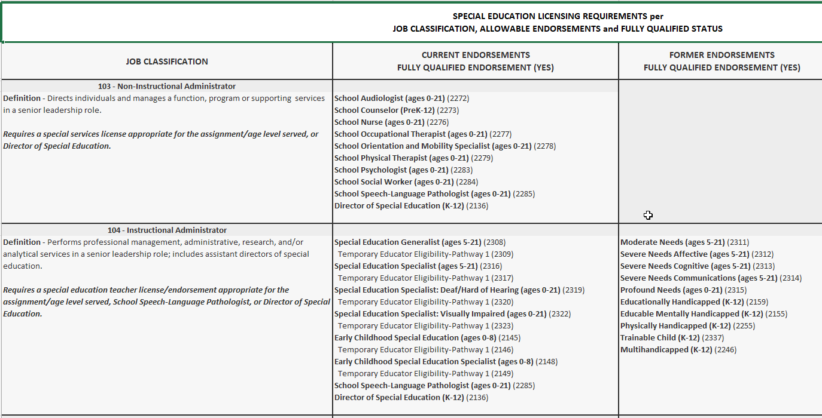
Special Education Licensing Requirements
Per Job Classification Spreadsheet –
Instructional vs. Non-instructional 103 and 104

Slide 27
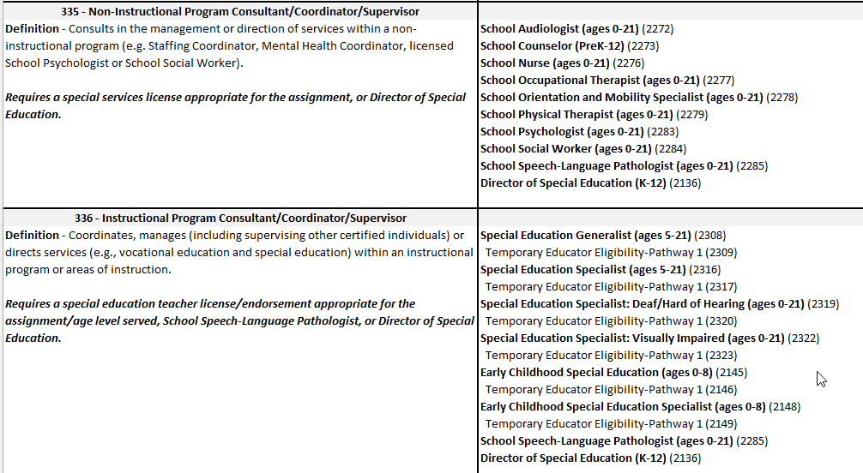
Special Education Licensing Requirements
Per Job Classification Spreadsheet –
Instructional vs. Non-instructional 335 and 336

Slide 28
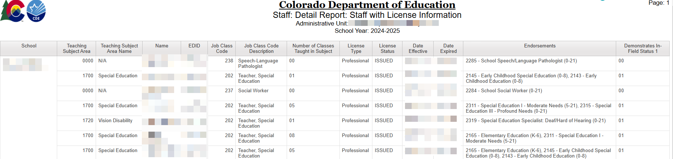
Special Education December Cognos Report
Staff: Detail Report: Staff with License Information
Cognos Reports -> Special Education December -> Staff: Detail Report: Staff with License Information
Find license types, endorsements, date effective, date expired, in-field status

Slide 29
SAM Cognos Reports
SAM cognos reports are available to help you validate your data/find coding issues
  SAM: 1.5 Non-Qualified Personnel Status
    displays staff by job code with each generated SAM Warning type
  SAM: ALL Certified Staff Report
    displays staff in assignments that require a CDE license
  SAM: Caseload Student Detail (DC210 Detail)
    displays special education teachers and SLPs with individual primary and secondary students
  SAM: Caseload Summary (DC210 Summary)
    displays special education teachers and SLPs with the number of primary students in each disability category

Slide 30
Cognos Report
SAM: Caseload Summary or Detail Report (DC210)
Displays the number of primary provider students in each disability category for special education teachers (202) and SLPs (238).
Displays the total number of primary caseload students in approved and non-approved disability categories per the staff’s special education endorsement.
Displays the caseload percentage of approved disability categories per the staff’s special education endorsement. (percentage must = at least 50% to satisfy the caseload match requirement)
Displays students in the secondary caseload (students that have these staff listed as secondary providers)
NOTE: Select ‘Approved and Non-Approved Staff’ and ‘Caseload Approved and Non-Approved’ when running this report
If no license is found with a validity date of December 1st, the staff approval matrix (SAM) cannot calculate caseload summary data. These records display with zero number of approved/non-approved students and disability percentage totals.

Slide 31
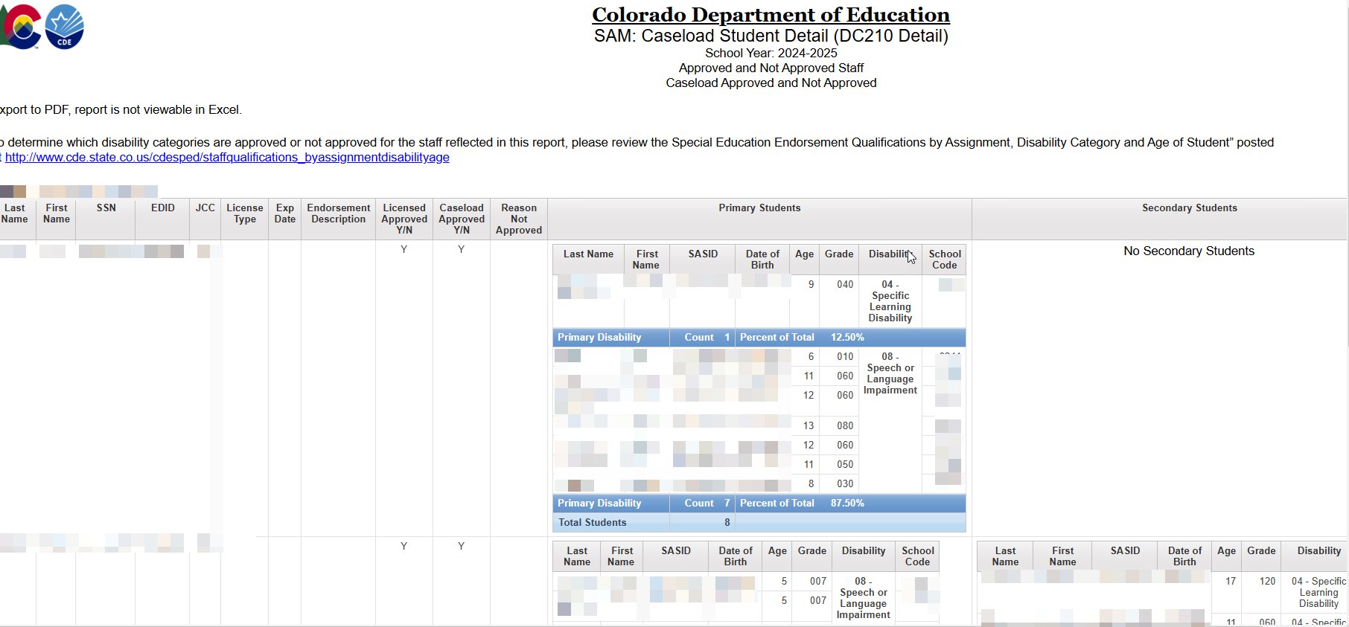
SAM: Caseload Student Detail (DC210 Detail) Report

Slide 32
Special Education December Count:
Unresolved SAM Warnings
December Staff Snapshot Warnings DC208, DC209, DC210, DC211
SAM Warnings will NOT prevent you from finalizing your December Count staff data.
If SAM Warnings remain unresolved at collection close, staff will display in the final SAM: 1.5 Non-Qualified Personnel Status report.
All non-qualified staff are included in the post December Count Correction Tracker accountability process.

Slide 33
Post December Count Collection
Staff Tracker Process
If SAM Warnings remain unresolved at collection close, staff will display in the final SAM:1.5 Non-Qualified Personnel Status report. These staff are considered non-qualified for one of the reasons we talked about today.
The Tracker is an accountability process between CDE and the AU documenting how the non-compliant issue is either resolved, or how it will be resolved.
AU Responsibility:
During December Count collection and post collection
Upon review of the SAM: 1.5 Non-Qualified Personnel Status report, the AU Special Education Director signs the report verifying the contained data is valid and accurate. Report is uploaded to the DMS.
CDE Responsibility:
SAM: 1.5 report data for each administrative unit is reviewed to validate SAM results.
If clarification is needed, Special Education Directors will be contacted by the ESSU’s General Supervision and Monitoring team.
Post collection Process:
A Personnel Status Correction Tracker form is completed for each administrative unit listing all staff contained in the SAM: 1.5 report. Director documents how the non-compliant issue will be resolved.
AU must work within CDE timelines to resolve the issue, and the AU remains in noncompliance status until the issue is fully resolved. If the issue is not timely resolved, the AU may be subject to corrective actions.

Slide 34
SPED December Staff
Data Pipeline Notes and Tips

Slide 35
Special Education December Count:
Staff and Student Snapshot Timeline
Date | Event | Event Description
10/31/2025 | Interim Deadline | IEP and Staff Files have been uploaded at least once by this date
11/03/2025 | Open | Special Education December Count Snapshot Open – AUs may begin creating snapshots in Data Pipeline.
12/01/2025 | Other Date | Official December Count Date
12/19/2025 | Interim Deadline | IEP and Staff Interchange files error free and at least 1 December Count Snapshot created by this date
01/30/2026 | Interim Deadline | Date for AUs to have a complete and error-free December Count Snapshot
02/02/2026 to 02/06/2026 | Report Review | Report Review – Review Student, Staff, and SAM reports found in cognos
02/06/2026 | Deadline | Date for AUs to have a complete and error-free December Count Snapshot
02/10/2026 to 02/17/2026 | Other Date | AUs work together to resolve duplicates
02/18/2026 | Deadline | All duplicates resolved and complete error-free snapshot
02/18/2026 to 02/20/2026 | Final Report Review | Final opportunity to review reports and make any last-minute changes needed
02/20/2026 | Final Deadline | Final submission due to CDE
The interchange files must be uploaded AND records error-free before they will pull into your December Count Snapshot.
The “missing” staff records will triggers errors DC114-DC115, DC225 – DC229 until they are included.

Slide 36
AU Respondent – Confirm SPED Staff Data Status
1. AU respondents please verify your district(s) staff files are uploaded
2. Check error status –
  Remember staff records must be error-free in both staff Profile and Staff Assignment files before they will pull into the snapshot
  Use ‘District/AU Activity Report’ from Cognos to verify staff files’ status and error counts
3. Check in with your district(s) staff data respondents on progress
  NOTE: December 19th is the Staff Profile and Staff Assignment files all errors resolved date
4. AUs begin creating Sped Dec Count Snapshots and checking December Staff Snapshot errors
IMPORTANT NOTE:
AU respondents cannot proceed with December Count Snapshot error validation until staff records are included in the snapshot
  They must be error free in the Staff Interchange files before they will pull into either the December Count or the Human Resources snapshot

Slide 37
Troubleshooting December Count Student Errors
If you receive grade caseload match errors such as:
Student errors: DC114, DC115, DC225, DC226, DC227, DC228, DC229
Staff errors: DC019 and DC020
  Fixing DC225 first may result in resolving DC114 and DC115 errors
  Consider fixing them in this order: DC225, DC114, and then any remaining DC115
  DC225– The following students have a Primary Service Provider EDID reported that is not included in the Staff Snapshot. Please verify if the staff has an error free record at the Interchange.
To determine why records are missing from the December Snapshot, check:
Pipeline Reports/Records Not in Snapshot report
  filter on December Staff and either Staff Assignment or Staff Profile
  Often-times caseload errors are caused because not all records have made it to snapshot

Slide 38
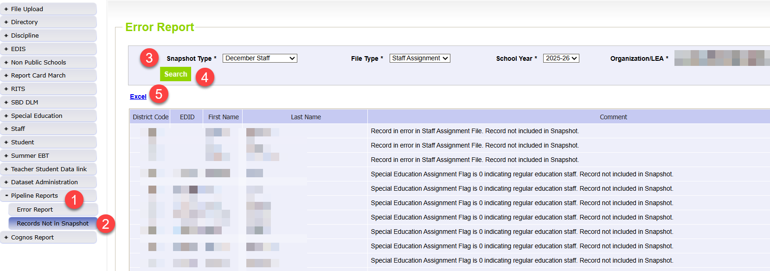
Records Not in Snapshot Report
Determine Why Staff Records are Missing
Helpful report for researching why SPED staff records are missing from your December Staff Snapshot
Keep in mind all staff records in the district staff files will display in this report if they are missing

Slide 39
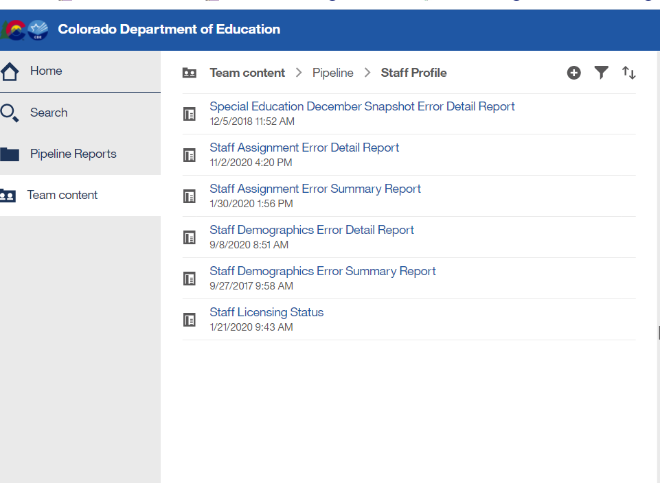
Special Education December Count – report available for Staff Interchange user to see Dec snapshot errors
Staff Interchange Users and Viewers are able to see their district’s December Count snapshot errors by downloading this report under:
  Cognos Reports- Staff Profile- Special Education December Snapshot Error Detail Report
Those with the STF role have access to this error report

Slide 40
Thank you for listening today!
Upcoming Training: Special Education December Count Office Hours
  Wednesdays - December 10, 17 and January 14, 21, and 28
  From 10:00- 11:00
  Common questions, reporting reminders, Q&A
  Microsoft Teams Meeting Join the meeting now

