Slide 1
2025-2026
Special Education December Count
Office Hours
^{December 10, 2025}
^{Lindsey Heitman}

Slide 2
Special Education December Count
Contact Information and Resource Links
Contact Information:
Lindsey Heitman – SpedDecCount@cde.state.co.us 720-456-2033
  Special Education December Count Snapshot submission
  Includes IEP Interchange and December Count SPED staff/SAM questions
Hannah Prokop – Prokop_H@cde.state.co.us 720-284-8144
  Special Education staff qualifications
  Special Education monitoring and compliance
Please include your AU #, District # and error code # or cognos report name (if applicable) in emails
Resource Webpages
  Special Education IEP Interchange
  Staff Interchange
  Special Ed December Count Snapshot
  ESSU Data Management System

Slide 3
Special Education December Count:
Staff and Student Snapshot Timeline
Date | Event | Event Description
10/31/2025 | Interim Deadline | IEP and Staff Files have been uploaded at least once by this date
11/03/2025 | Open | Special Education December Count Snapshot Open – AUs may begin creating snapshots in Data Pipeline.
12/01/2025 | Other Date | Official December Count Date
12/19/2025 | Interim Deadline | IEP and Staff Interchange files error free and at least 1 December Count Snapshot created by this date
01/30/2026 | Interim Deadline | Date for AUs to have a complete and error-free December Count Snapshot
02/02/2026 to 02/06/2026 | Report Review | Report Review – Review Student, Staff, and SAM reports found in cognos
02/06/2026 | Deadline | Date for AUs to have a complete and error-free December Count Snapshot
02/10/2026 to 02/17/2026 | Other Date | AUs work together to resolve duplicates
02/18/2026 | Deadline | All duplicates resolved and complete error-free snapshot
02/18/2026 to 02/20/2026 | Final Report Review | Final opportunity to review reports and make any last-minute changes needed
02/20/2026 | Final Deadline | Final submission due to CDE
The interchange files must be uploaded AND records error-free before they will pull into your December Count Snapshot.
The “missing” staff records will triggers errors DC114-DC115, DC225 – DC229 until they are included.

Slide 4
Special Education December Count
Timing Issues
Reminder
Timing is a key factor while working on this collection!
This snapshot pulls data from 3 Interchanges and 6 different files.
  IEP Interchange – Child File and Participation File
  Staff Interchange – Staff Profile File and Staff Assignment File
  Student Interchange – Student Demographic File and Student School Association File
    Any changes in your snapshot may be the result of changes in the Staff files or the Student Interchange Files or your Participation File. Use District Activity Report to research district file status:
AUs will find a District status report found under Cognos Reports/Special Education December folder (DEC role)
District/AU Activity Report
Lists the status of all Staff Profile and Staff Assignment file uploads and # of errors
Breaks it out by district and AU

Slide 5
Special Education December Count
Grade Level Pulls from Student Interchange
Reminder
    Grade field pulls from the district’s Student Interchange SSA file for most records
      This is regardless of what grade is reported in your Participation file
        - Unless it’s a private or facility school student (generally not included in Student Interchange Files)
    Dec Snapshot pulls grade from the district’s SSA record with latest ‘School Entry Date’
    AU respondent will need to work with their district respondent on the issue
      Error DC132
    **Any changes in your snapshot may be the result of changes in the files in the Student Interchange or Staff Interchange. Use District Activity Report to research issue:
AUs will find a District status report found under Cognos Reports/Special Education December folder (DEC role)
District/AU Activity Report
Lists the status of all Staff Profile and Staff Assignment file uploads and # of errors
Breaks it out by district and AU

Slide 6
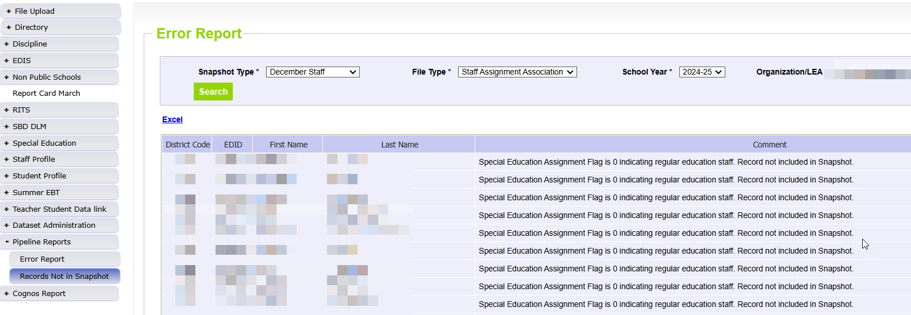
Special Education December Count:
Helpful Report to find why staff EDIDS are missing from your Dec Count Snapshot
Records potentially missing from your snapshot may be found in this report.
Pipeline Reports → Records Not in Snapshot
Filter on Snapshot Type ‘December Staff’ and each file type
Records listed in this report do not meet the snapshot criteria (see reasons below right) but they are not errors
Use this report to find why a staff or student interchange record is missing from your snapshot
AUs please use this report to locate why a Staff record is missing (to help your staff respondent)
Record may have error in the Staff Interchange files
Record may not be included in one of the Staff Interchange files
Record may not be marked with Sped Assignment Flag = 1
Record may have an End Date of Assignment prior to 12/01/24

Slide 7
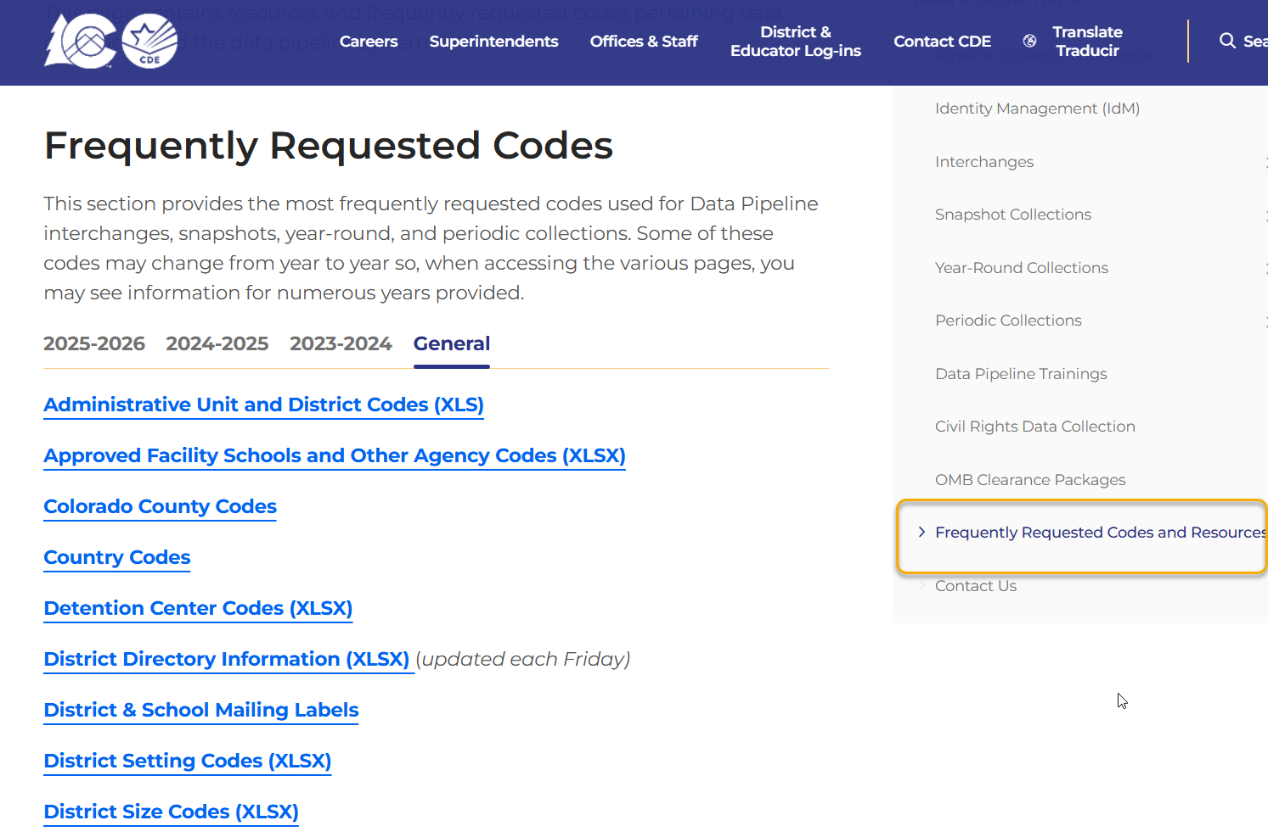
Frequently Requested Codes Webpage
Frequently Requested Codes and Resources
This is where you will find:
AU codes and their member district codes
Special Education Program codes
Facility School codes
Detention Center codes
Head Start codes
Non-public school codes
All school codes list – includes facility schools, but not SPED Programs

Slide 8
PAI Codes:
A-Side and B-Side Codes
PAI Codes A-Side | A – Side District of Attendance PAI Code Descriptions | PAI Codes B –Side | B-Side District of Residence PAI Code Descriptions
01 | Resident, Designated School | n/a | n/a
02 | Resident, Open Enrollment | n/a | n/a
03 | Resident, Non-District Site | n/a | n/a
08 | Resident, Non-Choice | n/a | n/a
04 | Non-Resident, Choice | n/a | n/a
n/a |  | 22 | Licensed Eligible Facility Attending On-Grounds School (Approved Facility School)
05 | Non-Resident, Non-Choice | 23 | Licensed Facility, Attending Public School
11 | Non-Resident, Detention Center | 24 | Court-Mandated Juvenile Detention
n/a | n/a | 27 | Non-Public School (Contractual Agreement)
n/a | n/a | 28 | Outside of CO, Public Education Agency
n/a | n/a | 29 | Outside of CO, Non-Public School
n/a | n/a | 30 | CO Public Agency (Contractual Agreement)
12 | Non-Resident Administrative Unit Placement | 31 | Administrative Unit (Contractual Agreement)
14 | Resident, Served at District Site | n/a
15 | Non-Resident, Served at District Site | n/a
16 | Resident, Non-District Site | n/a
17 | Non-Resident, Non-District Site | n/a
19 | State Operated Program | 32 | State Operated Program (AU of residence reporting is optional)
These codes differ from the Student Interchange PAI Code options!

Slide 9
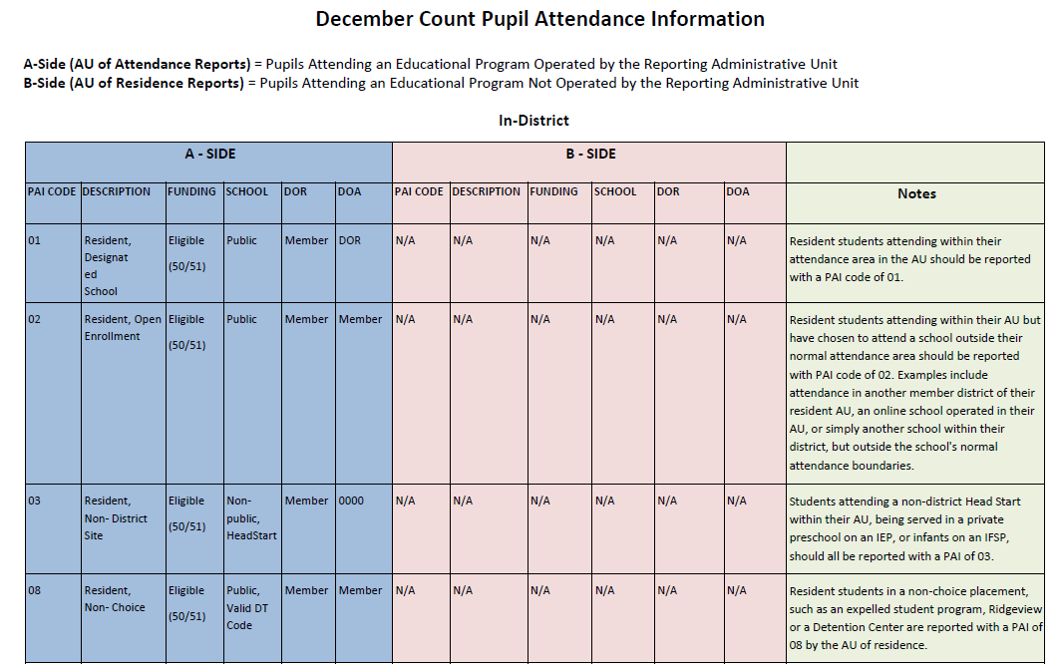
SPED PAI Codes Document– Please Print for PAI Coding Help
Special Education December Count Snapshot
SPED PAI coding chart with notes about each code found under Additional Resources section
Information on how to report these fields so they all align with the student’s placement:
  School Code
  PAI Code
  Funding Status
  District of Attendance
  District of Residence

Slide 10
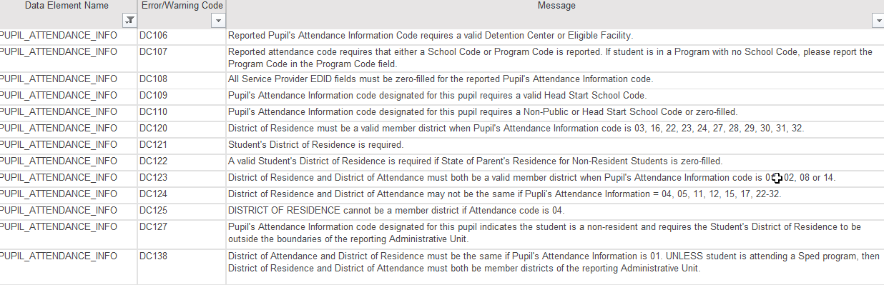
PAI Code Snapshot Errors:
Coding Student Records
What type of school is it? Check for correct school code and school type
Is student attending a Special Education Program located in another AU on a tuition contract?
How did student come to attend that school? parentally placed, choiced in, etc.
Determine the student’s District of Attendance Code
Determine the student’s District of Residence Code
Use school, DOA, and DOR codes to determine applicable PAI Code
Use PAI Coding Chart to determine Funding Status Code

Slide 11
Special Education December Count
Error DC234
DC234: A matching endorsement for the teaching subject area code reported was not found for this teacher in the license database. Please update the field 'Demonstrates In-Field Status 1' to another code (02= Degree; 03=36 Semester Hours; 04=Passed Exam; 05=Out of Field.
  A staff member with either a TEE or an interim authorization is technically not "in-field," as they have not yet demonstrated content knowledge to obtain a full initial or professional license.
  They do not hold a license (key word) with the endorsement.
    Examples - staff with a Temporary Educator Eligibility or Alternative Interim Authorization: Special Education Generalist endorsements cannot be marked with code 01 for Demonstrates In-Field Status.
    To clear error DC234, you will want to adjust it to a code other than 01 and it is common to have to report 05 – Out of Field.
SAM Note:
staff is on the path toward meeting full requirements so he/she should pass the Staff Approval Matrix warnings
SAM warnings are a separate validation from the Demonstrates In-Field Status check

Slide 12
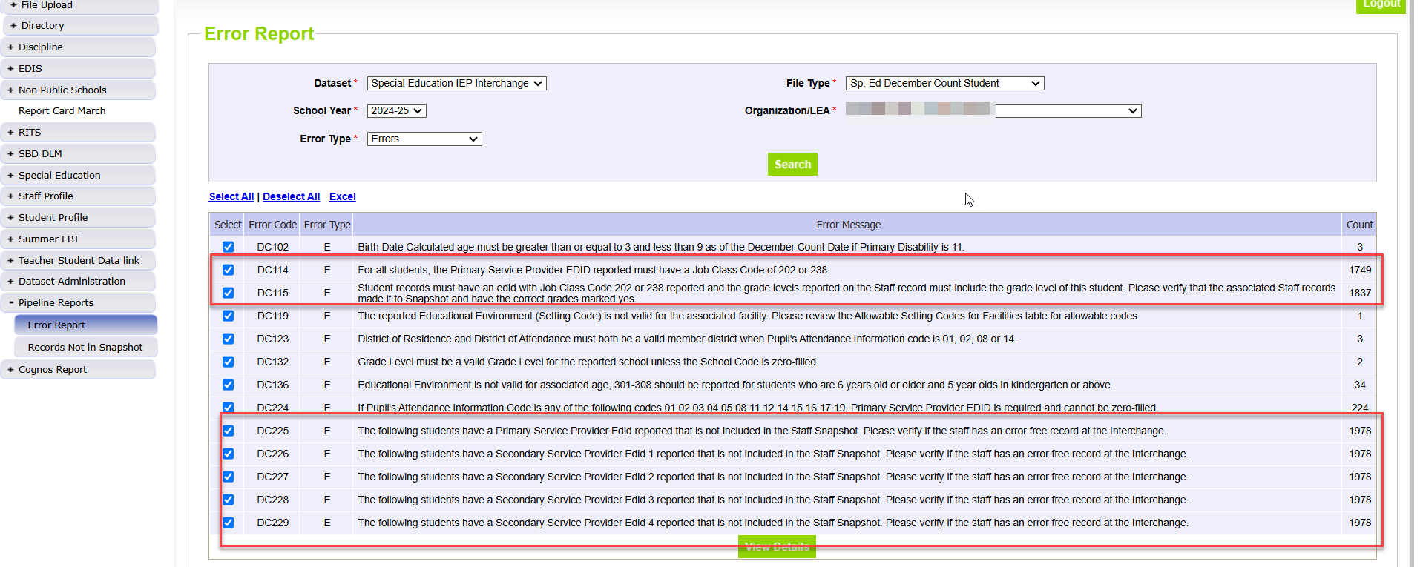
Sped December Count Student:
Errors Related to Missing Staff Records

Slide 13
Troubleshooting Grade Case Load Match- Dec Student Errors
DC114 – The Primary Provider reported on a student record must have a JCC of 202 or 238.
Every Special Education student record must contain the EDID of a staff member with a job class code of 202 or 238 in the Primary Provider field.
What to check:
  Did the Primary Provider EDID appearing on this student’s record pull into the Dec Staff Snapshot?
    First check for error DC225 for this record.
    This error indicates this staff’s record did not pull into the snapshot.
  If you don’t also have a DC225 triggering, then check to see if the Primary EDID of the providers on this student’s record is a JCC 202 or 238.
DC115 – Student records must have an EDID with Job Class Code 202 or 238 reported and the grade levels reported on the Staff record must include the grade level of this student. Please verify that the associated Staff records made it to Snapshot and have the correct grades marked yes.
What to check:
Did all the EDIDs appearing on this student’s record pull into your Dec Staff Snapshot?
Did all staff assignment records for these EDIDs pull into Snapshot?
  Verify in the Included Snapshot Records: Staff Interchange report.
Ensure the grade level of this student is marked ‘1’ yes on the staff assignment record for the EDIDs associated with this student.

Slide 14
Troubleshooting Grade Case Load Match-
Dec Staff Errors
DC019 – JOBCLASS CODES 202 (Teachers) and 238 (Speech Language Pathologists) must have a student caseload.
All Participation file student records must have an EDID of a Special Education Teacher (202) or a Speech-Language Pathologist (238) in the Primary Provider field.
What to check:
This error will trigger if you have reported a 202 or 238 staff member and their EDID does NOT appear on any IEP student records in the Snapshot.
  First make sure that all student records have made it to Snapshot.
  Check the December Count: Included Snapshot Records Report: IEP Interchange.
DC020 – Teaching grade level must be an exact match to the grades of the students reported on the caseload.
Grade levels reported on the 202 or 238 provider record should match the grade levels of the students where the EDID is reported.
What to check:
Did this EDID pull into Snapshot? Did all staff assignment records for this EDID pull into Snapshot?
Verify the grade levels of the students where this EDID is reported are accounted for on the staff assignment records for this EDID. Download the IEP included records report and filter the provider EDID columns to see all the students and grades where this EDID appears. Then compare the grades to the grades marked yes on the staff assignment file records.

Slide 15
Special Education December Count: Troubleshooting Dec Staff Errors DC191 – DC205 (grades of staff and students served for 202 and 238 job codes must match)
DC191 thru DC205 – these errors compare the student’s grades that are reporting that EDID in one of the 5 provider positions to the grades marked on the staff assignment record for that staff.
What to check:
Cognos Reports/Special Education December → Included Snapshot Records: Staff Interchange
Cognos Reports/Special Education December → Included Snapshot Records: IEP Interchange
  Use reports to compare grades between the student and staff snapshot records
    Download snapshot records report and export to Excel
    Highlight the Grade level field and the 5 Primary/Secondary Provider fields
    Click Data/Filter and search all 5 primary/secondary provider fields for the EDIDs triggering errors DC191- DC205
    For each EDID search results scroll to the left to find which grades levels the students are in
      You should eventually locate the student(s) whose grade levels are missing from the Staff Assignment record.
      If you have verified that provider EDID is correct for that student, the change will need to be in the Staff Assignment file – mark a ‘1’ by the missing grades
      If you have verified that provider EDID is incorrect for that student’s record, the change will be in the IEP Participation file and that EDID should be removed from one of the provider fields.

Slide 16
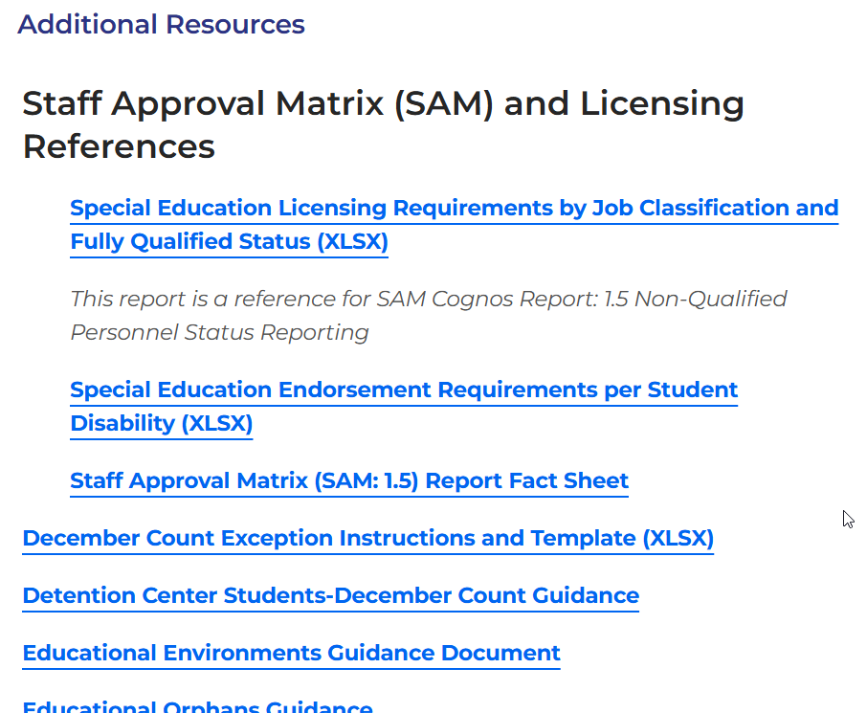
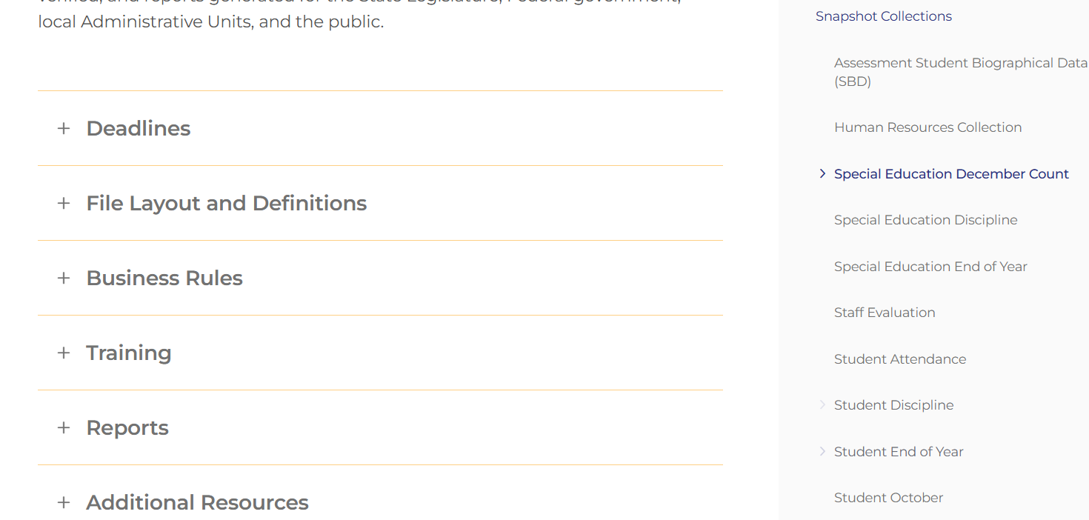
December Count
Snapshot Resources Webpage
Special Education December Count Snapshot Webpage

Slide 17
Thank you for listening today!

